Slide 1
Loops

Slide 2
Review: Last Session
Write the code to complete the following task
Design a change-counting game that gets the user to enter the number of coins required to make exactly one dollar.
The program should ask the user to enter the number of pennies, nickels, dimes, and quarters.
If the total value of the coins entered is equal to one dollar, the program should congratulate the user for winning the game.
Otherwise, the program should display a message indicating whether the amount entered was more than or less than one dollar.

Slide 3
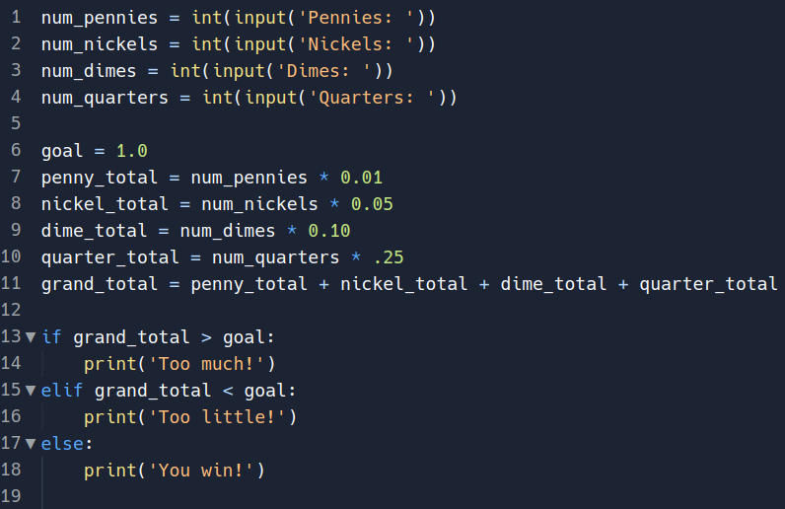
Review: Sample Solution

Slide 4
Loops
Loops allow us to repeat logic
There are 2 looping mechanisms in Python
while – loop logic as long as a condition is met
for – loop logic for a set number of times

Slide 5
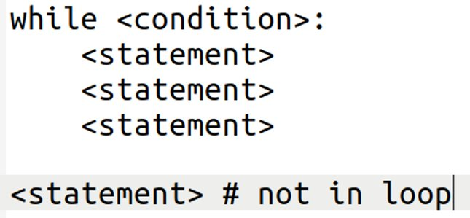
Loops: While
While loops are pre-condition loops, meaning they check the condition before they run
The general syntax of a "while" loop

Slide 6
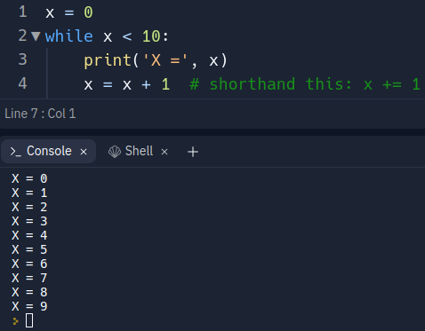
Loops: While

Slide 7
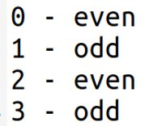
Review
Write the code to complete the following task
Develop a program that asks for a user to enter an integer, then print the numbers zero through that input and display whether they are even or odd
Example output:

Slide 8
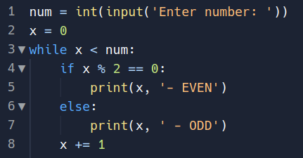
Review: Sample Solution

Slide 9
Review
Write the code to complete the following task
Create a list of names
Using a while loop, iterate through the names and display them

Slide 10
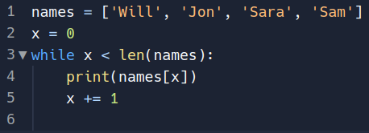
Review: Sample Solution

Slide 11
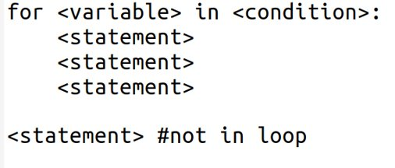
Loops: For
For loops are pre-condition loops too
General syntax for a for loop:

Slide 12
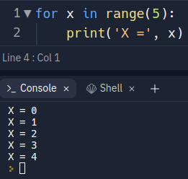
Loops: For
range() - is a function that yields a series of numbers
Default starting number is 0
Default iteration is by 1
Can pass 2 arguments to change start number
Ex: range(1, 6) # start at 1
Can pass a 3rd argument to iterate by a different number
Ex: range(1, 20, 2) # start at 1, count by 2
Output would be 1, 3, 5, 7, etc.

Slide 13
Review
Write the code to complete the following task:
Given an integer input, print all numbers from zero to input
For multiples of 3, display 'fizz'
For multiples of 5, display 'buzz'
For multiples of 5 and 3, display 'fizzbuzz'
All other numbers, print their value (0, 1, 2...)

Slide 14
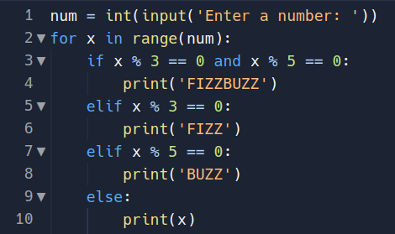
Review: Sample Solution

Slide 15

Loops: For
For loops have some helpful functionality that aren't available in while loops
Let's loop through the name list again, this time with a for loop
Rather than give us the index, the above will give the element as "n"
This applies to tuples as well in the same way
This applies to strings as well: iterating through characters

Slide 16
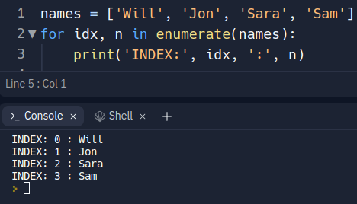
Loops: For
Another helpful function for iterating on lists and tuples is enumerate()
enumerate() - returns the index and element (need 2 variables)

Slide 17
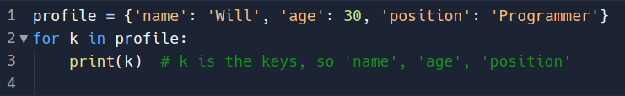
Loops: For
For loops are also helpful for dictionaries
By default, iterating on a dictionary like we did lists will iterate through the keys
Dictionaries also provide a couple of helpful functions to loop
.values() - iterate through the values of the dictionary
.items() - will iterate through the entries of the dictionary (note, 2 variables needed)

Slide 18

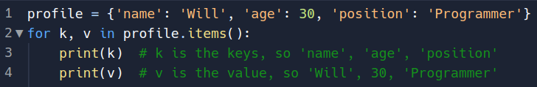
Loops: For

Slide 19
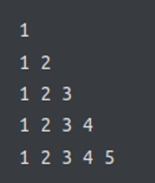
Review
Make a program that outputs the following:
Make a program that accepts a string input and outputs the reverse without using any reverse built-in functions
Ex:
Input: WILLIAM
Output: MAILLIW

Slide 20
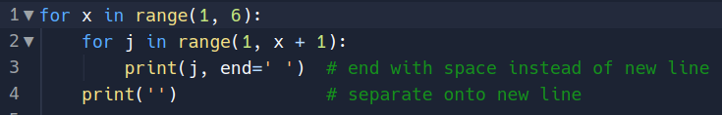
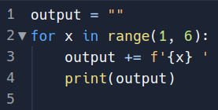
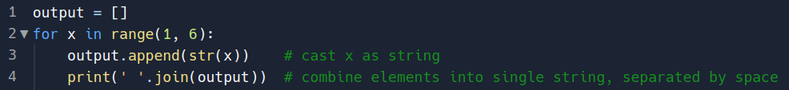
Review: Sample Solutions Task 1

Slide 21
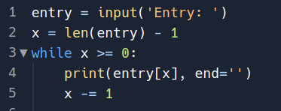
Review: Sample Solutions Task 2

Slide 22
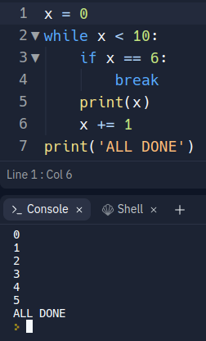
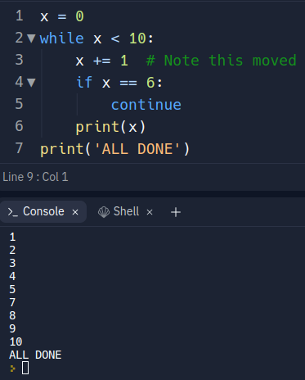
Loops: Flow Control
We are able to manipulate the flow of a loop using specific keywords
break – stop logic immediately and "break" out of the loop
continue – skip to the next iteration without completing the logic for the current one

