Slide 1
Functions

Slide 2
Functions
Functions are pieces of logic that are broken out into named bodies of work
We've been using functions since the beginning of our sessions
print() : Python built-in function that outputs to the std output and accepts
value(s)
The things to show
a separator (sep=)
Default separator is a space
an end (end=)
Default end is a newline (\n)
And some other things that aren't important right now

Slide 3
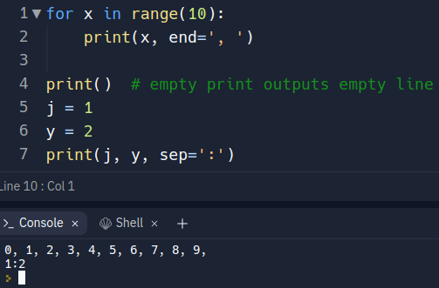
Functions: print()

Slide 4
Functions: Terms
Terms you need to know:
Argument – data given to a function from the caller of the function
Parameter – data received into the function and used in the function
return – keyword used to indicate data is given back to the caller
function signature – the definition of your function
Scope – variable visibility

Slide 5
Functions: Named Body of Work
As the programmer, you can make your own functions by creating a function signature and adding the associated logic
Function signature in Python:
def – keyword indicating "define function"
function name – your name for your function
parenthesis – empty or comma-separated parameters (inputs) to your function

Slide 6
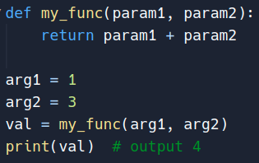

Slide 7
Functions: Conventions
In Python, there is a style guide named "PEP 8"
Per the guide, function names should be similar to variable names
Snake case: my_func, add_nums, calc_sales
There's no enforcement of this rule

Slide 8
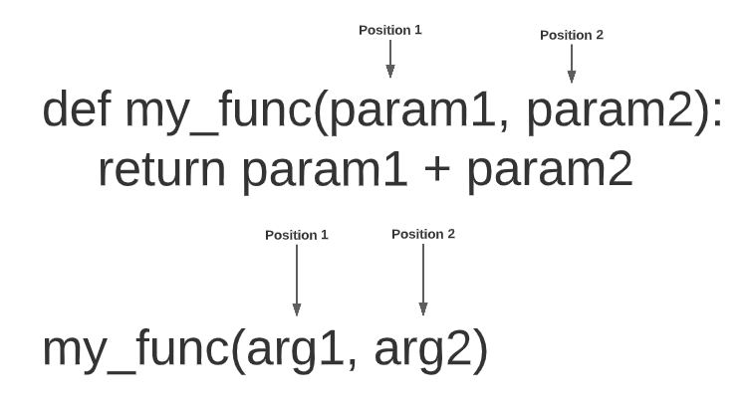
Functions: Args/Params
How did Python know that the variables arg1 & arg2 mapped to param1 and param2 respectively?
Positional Arguments: The order in which you pass args is how they map to parameters

Slide 9
Functions: Args/Params
But wait, why did print() have things like sep=' ' and end='\n' ?
These are keyword args (named)
They have to be after your positional args

Slide 10
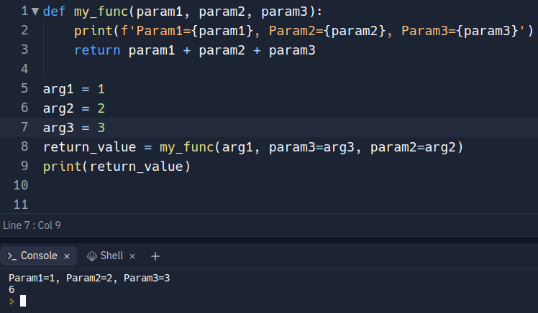
Functions: Keyword args

Slide 11
Review
Write a function called make_shirt() that accepts a size and the text of a message that should be printed on a shirt. The function should print or return a sentence summarizing the size of the shirt and the message printed on it
Call the function once using positional args
Call the function again using keyword args

Slide 12
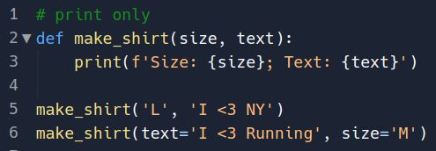
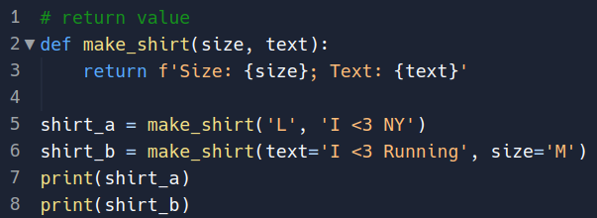
Review: Solutions

Slide 13
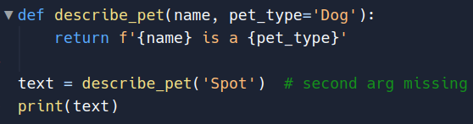
Functions: Args/Params
Parameters can use a similar syntax to keyword args to create default (optional) parameters
Similarly, they have to be used after the positional params

Slide 14
Python Quirks
*args and **kwargs : these are special parameters that allow you to accept a changeable number of arguments
Real Python : Link to an article describing what they are and how to use them
Pass by reference/value?
Reference: pass a "reference" to the argument location in memory
Value: pass a copy value of the argument to the parameter
Which is it? Neither... Python is pass by assignment
Immutable parameters: Will receive what looks like a copy that can't impact the outside variables.
Mutable parameters: The parameter that accepts a mutable parameter will be assigned a reference and changes can impact the outside variables

Slide 15
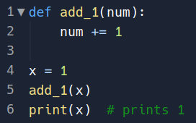
Python Quirks: Immutable Params
Immutable parameters are going to be all of your primitive data types and tuples

Slide 16
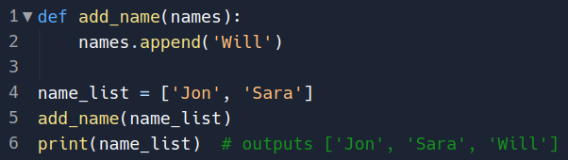
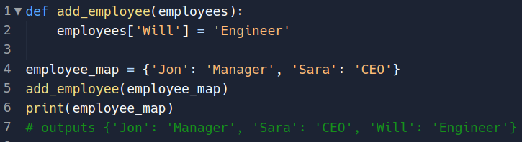
Python Quirks: Mutable Params
The mutable params are lists and dictionaries

Slide 17
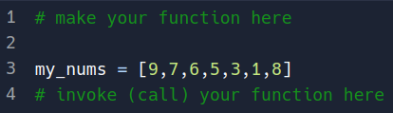
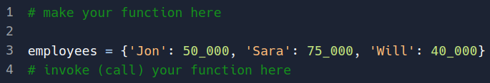
Review
Write a function that given a list of integers, it will return the largest number
Write a function that given a dictionary, it will return the value with the lowest integer
Starting code:

Slide 18
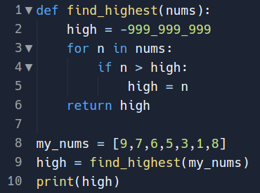
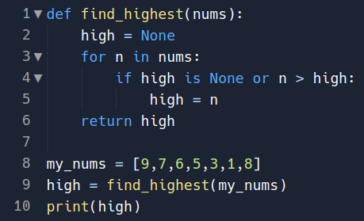
Review Solution 1
Good
Better

Slide 19
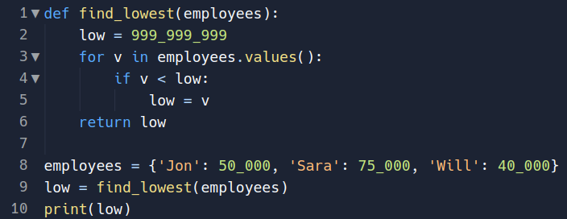
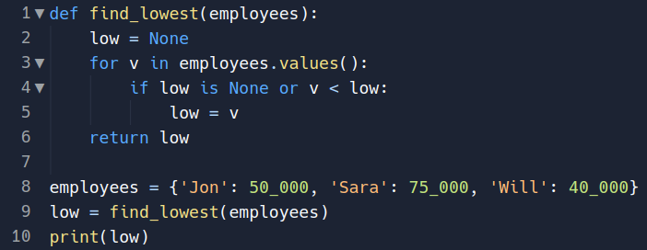
Review: Solution 2
Good =>
Better =>

Slide 20
Review
Program containing 2 functions
A function to calculate bonus percentage given the following salary info:
> 75_000 : 5%
> 50_000 : 3%
<= 50_000 : 2%
A function that, given the salary + bonus, will calculate the benefits given the following info:
>= 100_000 : 10_000
< 100_000 : 7_500
After the above calculations, display the total compensation package
(salary + bonus + benefits)

Slide 21
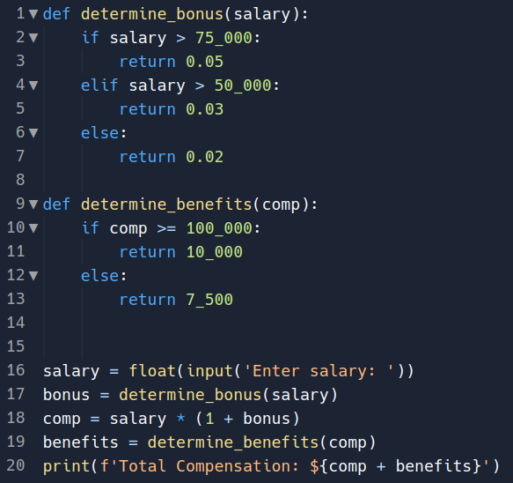
Review: Sample Solution

