Slide 1

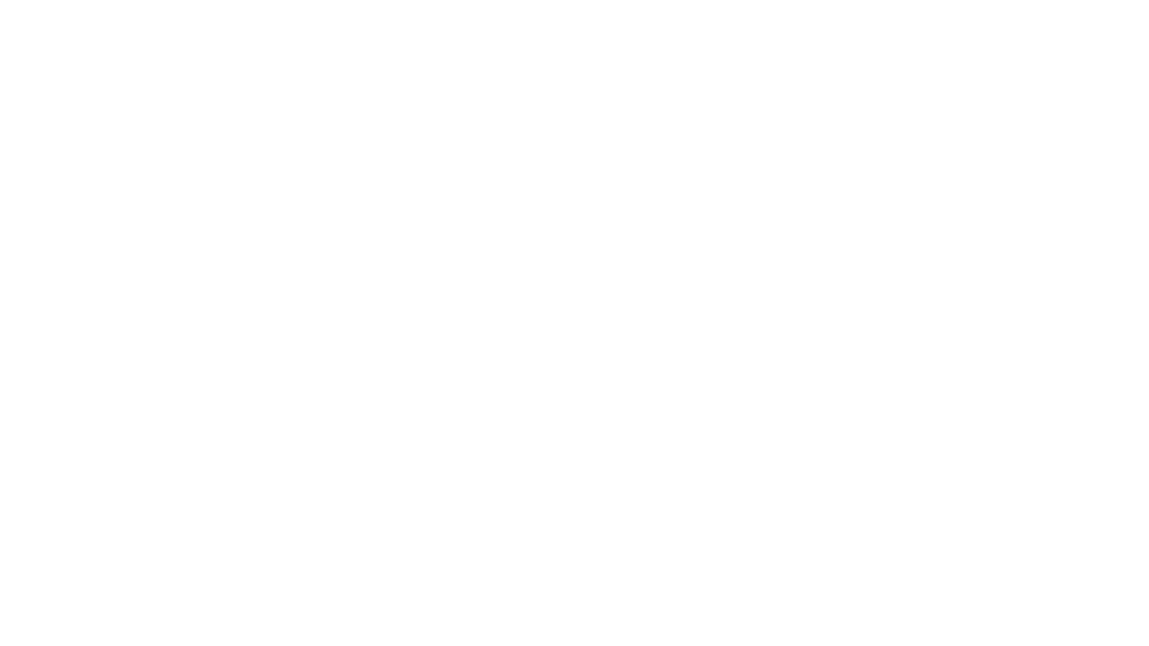

CSC 119:Intro to Programming Lecture 1

Slide 2
What this class is and is not
IS
Introductory
No programming experience required
Similar to my 75 minute in-class lectures
Some content has been modified for the YouTube medium though
IS NOT
Going to make you an expert programmer
A Python mastery course

Slide 3
About Me
Programming professionally since 2015
First job was RPG on an IBM Mainframe (AS400/I-Series)
Then moved to Java with the Spring ecosystem
I have a B.B.A. in Accounting (super useful) and a M.S. in Software Engineering

Slide 4
Tools – What you’ll need to be successful
Access to a computer
Getting the following setup is part of your HW
Python 3.x
Text editor/IDE
Notepad++
Visual Studio Code – Free
PyCharm – Free (Community Edition) and Paid
Terminal/Command Line
Online editors (ex: Repl.it)

Slide 5
Let’s Jump In
What is programming?
“The action or process of writing computer programs” – Oxford Languages
“The process of preparing an instructional program for a device” – Merriam-Webster
These definitions are not super clear, so I prefer to define it as “attempting to get a computer to complete a specific task correctly by giving it commands/instructions”
What is the role of programming languages?

Slide 6
Programming Languages
They’re a way of providing a computer with instructions
They can serve as a middle-man to the computer’s language
Computers understand machine code. Without programming languages you’d have to program using 0s and 1s
Programming languages make it easier by allowing us to write code using more familiar syntax
Not all programming languages are the same, some are “higher level” and others are “low level”
High Level: Python, Java, C#
Low Level: Assembly, Machine
Middle: C, C++

Slide 7

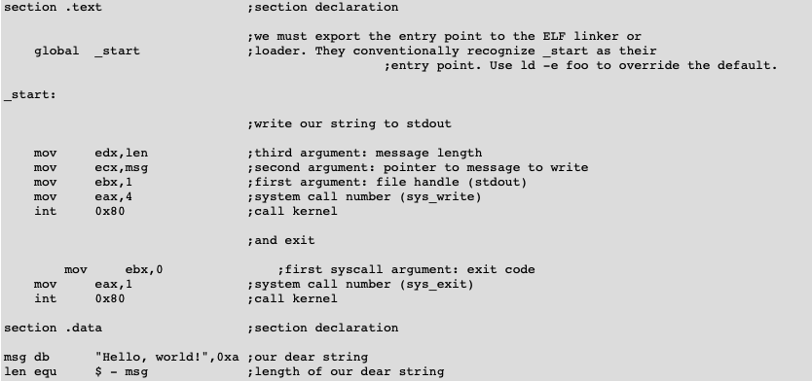
Programming Languages – Examples
Python “Hello World”
Assembly “Hello World”

Slide 8
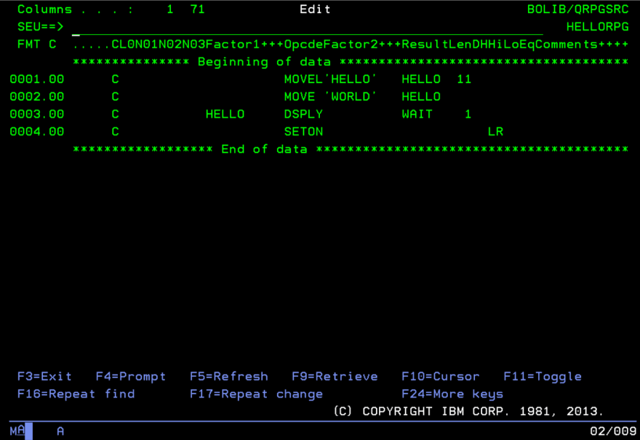
My First Programming Job

Slide 9
Python
For this class, we will be using the Python programming language (v3.x).
v2.x is for legacy support, try to avoid programming in v2.x unless you have to
If you’re on a Windows machine, you likely don’t have v2 or v3 installed
If you’re on a Mac or Linux, you may have v2 installed
Python is a popular beginner language
Easier syntax for beginners to learn
As of 2014, it was the most popular intro language at the top computer universities

Slide 10
Syntax
All programming languages have a specific syntax
These are rules you must follow in order for your program to run properly
Ex: Declaring variables or functions
Breaking the rules will result in errors
“Let’s eat, Grandma!” vs ”Let’s eat Grandma!”

Slide 11
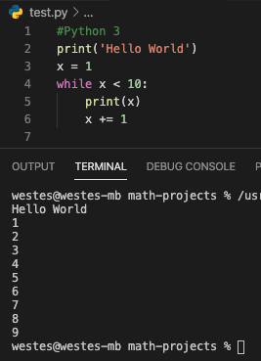
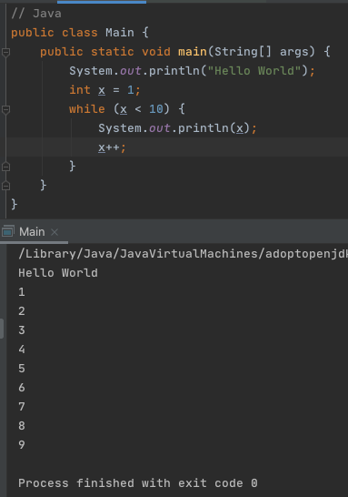
Syntax Examples

Slide 12
Variables
What is a variable?
Something that can store information, which can be referenced and manipulated
Think of a box with the label “score” with the number 2 in it. The box is the variable named “score” and number 2 is its value
score = 2
Each variable has a type, name, and piece of information stored inside of it
In Python (and many languages) variables can be of two types, primitive and non-primitive (complex)
Why are they important?
Helpful for getting input from the user
Allows a program to be more flexible and reusable
Manipulating variables is necessary for ton of things in programming
Ex: adding points to a score, totaling an online web order total

Slide 13
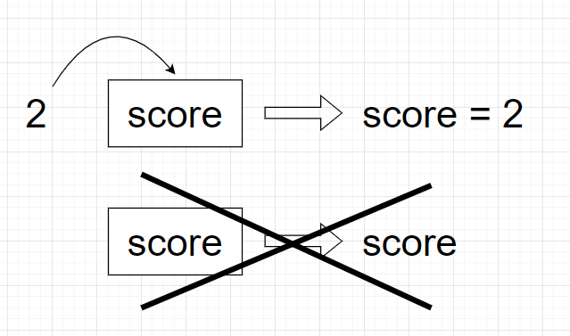
Python note

Slide 14
Python Primitive vs Non-Primitive Variables
Primitive/Simple
Integers – represent whole numbers
Float – represents numbers with decimals
Strings – for storing characters or collection of characters (ex: words)
Boolean – can store only True or False
Non-Primitive/Complex
Lists – mutable (changeable) sequences, used to store collections of data
Tuples – immutable (non-changeable) sequences, used to store collections of data
Range – immutable sequence of numbers, commonly used for looping
Dictionary – mutable map of hashable values to arbitrary objects (key, value pair)
Sets – unordered collection of distinct hashable objects

Slide 15
Some Syntax Around Variables - Python
Names can contain only letters, numbers, and underscores.
They can start with a letter or underscore, but not a number
Spaces are not allowed
Ex “user_name” vs “user name”
Avoid using Python keywords and function names as variable names
Keywords, Built-In Functions
Not syntax, but try to keep your variable names short but descriptive
Ex “total_score” vs “ts” vs “the_players_cummulative_score_so_far”
Not syntax, but Python programmers generally prefer the underscore vs camelCase
Ex “user_name” vs “userName”

Slide 16
Check Understanding
Which of the following pieces of code have an error?
Score = 12
my_score = 25.0
player 2 = ‘Will’
_total = 124.99
1_player = ‘Sam’

Slide 17
Check Understanding - Answers
Which of the following pieces of code have an error?
Score = 12
OK – but generally bad practice to use capital letter
my_score = 25.0
OK
player 2 = ‘Will’
NOT OK – cannot have spaces in variable name
_total = 124.99
OK
1_player = ‘Sam’
NOT OK – cannot start with number

Slide 18
Integers
You can do basic arithmetic like add (+), subtract (-), multiply (*), and divide (/)
Python uses two multiplication symbols (**) to represent exponents
3**2 outputs 9
Python follows order of operations
2 + 3*4 outputs 14
(2+3)*4 outputs 20
Quirk – When you divide two integers, Python will give the answer as a float
4/2 outputs 2.0
Large numbers can be written using underscores for readability
1_000_000 vs 1000000

Slide 19

Floats
Any number with a decimal is called a float
Similar operations to integers (+, -, *, /, **, etc)
Quirk – sometimes floats get arbitrary numbers, we will ignore this for now

Slide 20
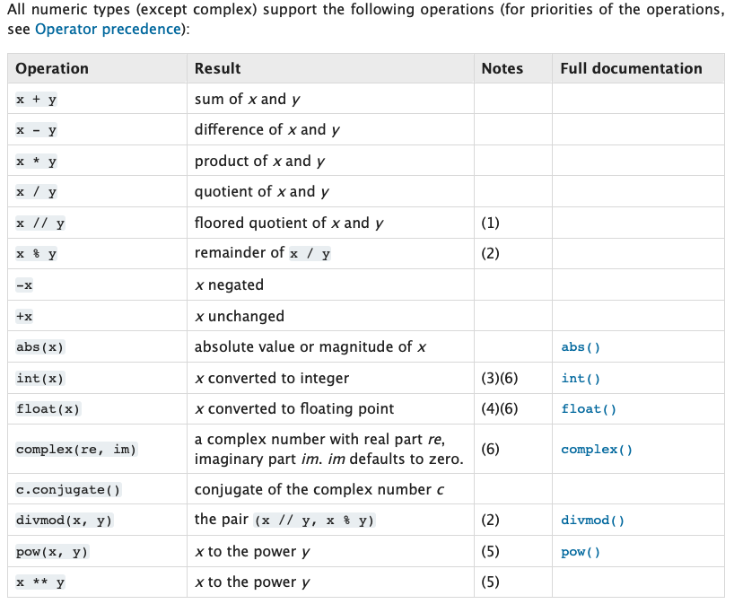
Python Standard Types

Slide 21
Strings
Python allows strings to be surrounded by single or double quotes
Ex: ‘This is a string’ and “This is also a string”
This flexibility can be helpful when you need to have apostrophes or quotes in your string
Ex: ‘He said “I don’t like green eggs and ham!” when I asked him’
Ex: “The name ‘Python’ is actually from Monty Python”
Strings have built in functions that are very useful
Examples:
upper() – All uppercase letters
lower() – All lowercase letters
title() – The first letter of each word is capitalized
To use these, you use this notation: variable_name.function()
These specific functions do not take parameters – we’ll explore that in a later lecture, but for now that just means the parenthesis are empty ()
user_name = ‘will’
print(user_name.upper())
-----------------------------
Outputs “WILL”

Slide 22
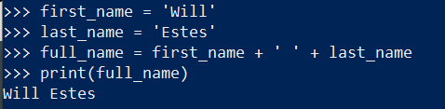
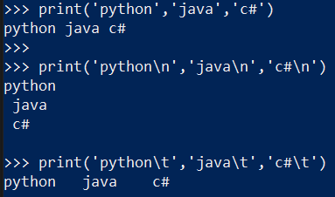
More strings
Variables in strings
Whitespace characters: \n & \t

Slide 23
Homework
Read chapters 1 & 2 in textbook
"Starting Out with Programming Logic and Design 5th Edition" (ISBN: 978-0134801155)
You can likely find a free PDF version if your “Google-Fu” is good
I haven’t looked at the older editions
Download and install Python 3 on your computer: Python Downloads
BIG NOTE: Make sure it's available on your PATH, otherwise you may have issues
Windows 10 install video: youtube (similar for Mac, but may have specific quirks)
Download and install a text editor/IDE of your choosing
My personal favorites are VSCode and Pycharm
Be sure to test that you can run a python program on it (simple print('hello world') )

Slide 24
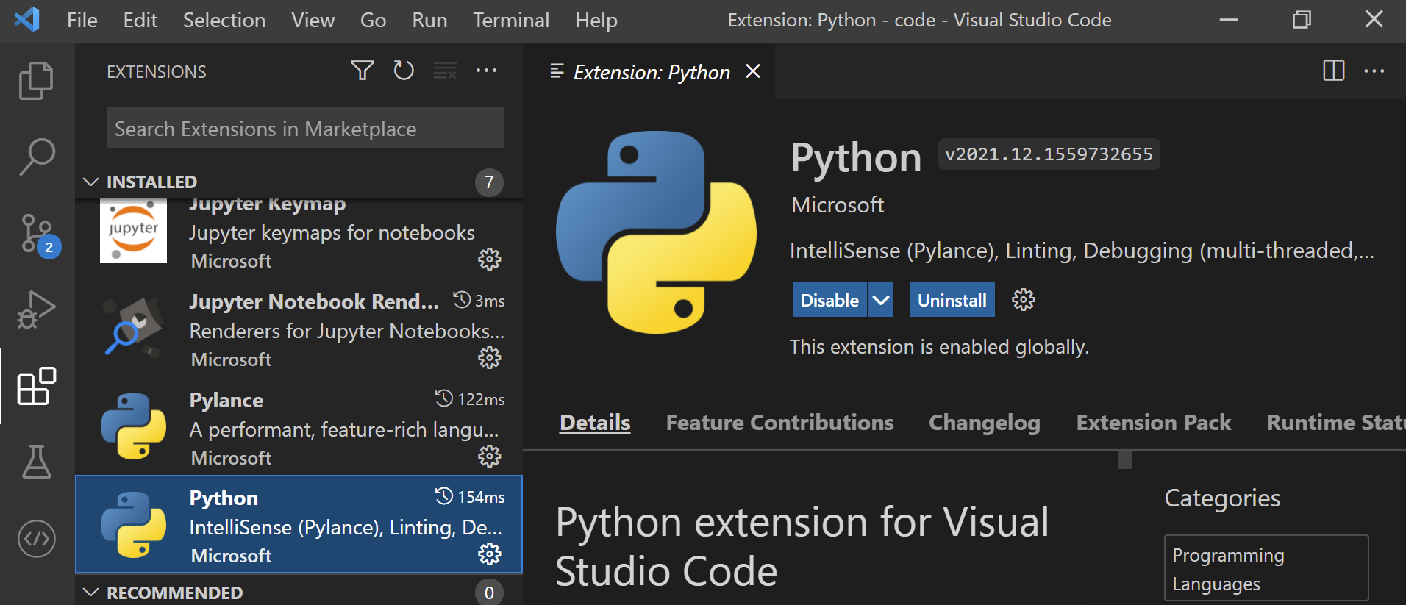
VS Code extensions

