Slide 1



CSC 119:Intro to Programming Lecture 2

Slide 2
Last Lecture
General programming intro
Python syntax & variables

Slide 3
Last Week – Assigned Reading
A set of well-defined logical steps that must be taken to perform a task is called... ?
Answer: Algorithm
An informal language that has no syntax rules, and is not meant to be compiled or executed is called... ?
Answer: Pseudocode
A _____ is a diagram that graphically depicts the steps that take place in a program.
Answer: Flow Chart
Flow Chart shapes and meanings:
Oval -> Terminal Symbols
Parallelogram -> Input/Output
Rectangle -> Processing Symbol
Diamond -> Decision Symbol

Slide 4
Last Week – Assigned Reading
A set of statements that execute in the order that they appear is called... ?
Answer: Sequence Structure
A ____, also called a _____, is a logical design that controls the order in which a set of statements executes
Answer: structure, control structure
When would a "constant" be appropriate in code?
Answer: anytime a value cannot be changed during a program's execution
How do you get user input in Python?
Answer: input() function *note, it always gives string

Slide 5
Last Week – Assigned Reading
Complete the IPO chart:
Input
Processing
Output
Multiply number of hours by hourly pay rate
Hourly Pay Rate
Gross Pay
Number of Hours Worked

Slide 6
Paired Programming
Tasks
Declare/Initialize an integer variable
Declare/Initialize a float variable
Declare/Initialize a string variable
Display the variables on the console
Display the variables on new lines in the console

Slide 7

Let’s Jump In
This lecture we will be focusing on Non-Primitive (Complex) types in Python
List – a mutable (changeable) collection of items in a particular order
Can hold letters, numbers, names, etc
Does not have to be of the same type
Good Practice: make the names of lists plural
In Python lists are indicated by square brackets: [ ]

Slide 8
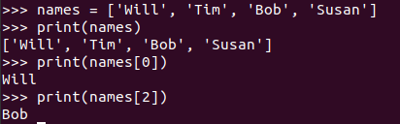
Lists
Accessing list elements
Lists start at index (think position) 0 – There's a history behind why 0 and not 1, but that's not for this class
To access specific elements, you can pass the index of that element
Python offers a unique way of getting the last element of a list
In the above example, you can get the last by either of the following:
print(names[3])
print(names[-1])

Slide 9
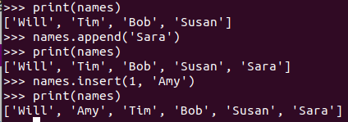
lists
Modifying Elements
To change an element in a list, assign the new element to the index of the element you want to change
names[0] = 'Amy' #used to be 'Will'
Adding Elements
.append(element) - Adds element to end of list
.insert(idx, element) - Adds element at desired index while moving elements after index to the right (think current index + 1)

Slide 10
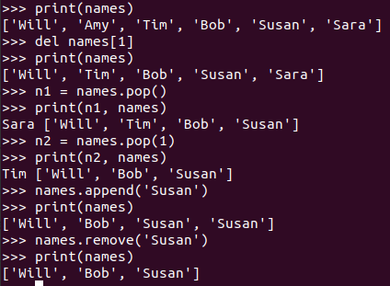
Lists
Removing Elements
del statement – removes an element at the index provided
.pop() - removes last element, but lets you work with it after it's removed (assign to variable)
.pop(idx) - removes element at index, but lets you work with it after it's removed
.remove(element) - removes element by the value (useful if you don't know index)
Note: only removes first occurrence of element

Slide 11
Paired Programming
Tasks
Create a list of car manufacturers (let's say 3)
Add a new car manufacturer to the end of the list
Add a new car manufacturer to index 2
Display the car manufacturer at index 3
Remove a car manufacturer
Remove a car manufacturer and save it to a variable

Slide 12
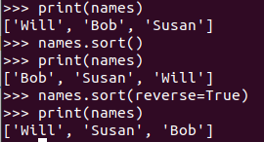
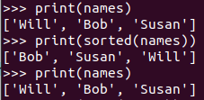
Lists
Organizing Lists
Sorting
.sort() - sort a list in natural (alphabetical) order. This is a permanent sort
sorted() - sort a list in natural (alphabetical) order. This will not affect actual order of list
.reverse() - reverses the order of the list permanently
This is not alphabetical, it's literally flipping the list as it is

Slide 13
Lists
Helpful built-in functions
len() - returns integer number of elements in an list
Unlike list indexes, this does not start at 0, it starts at 1
len( ['will', 'bob', 'susan’] ) will return 3
sum() – returns the cumulative total of integer or float list
min() – returns the minimum value of a list
max() – returns the maximum value of a list

Slide 14
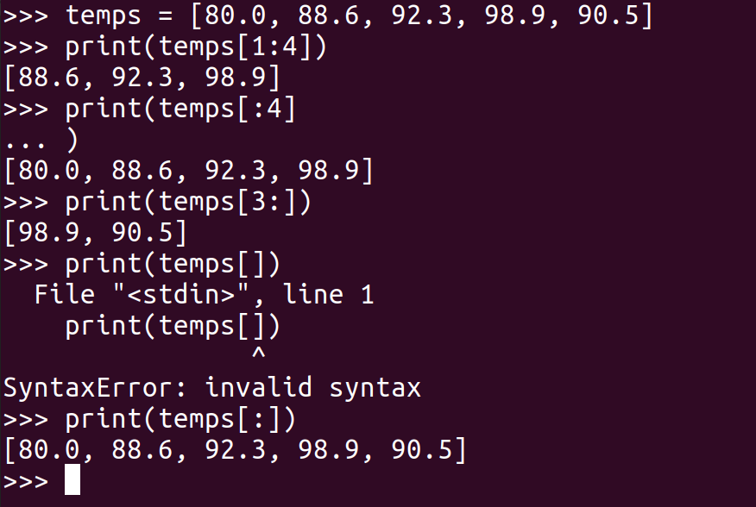
Lists
Slicing
Syntax uses square brackets, with the first value being the start index, and the second value being the end index (non-inclusive)
The start and/or end can be excluded and the interpreter will start from the beginning or end at the last index

Slide 15
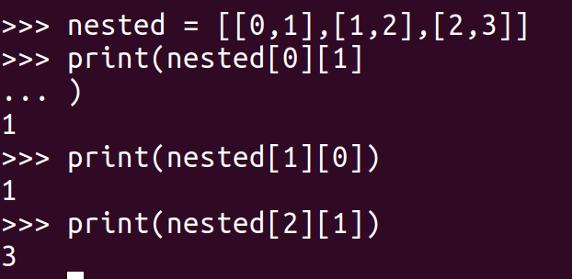
Lists
Lists can contain other lists
Access internal lists using the same square bracket notation

Slide 16
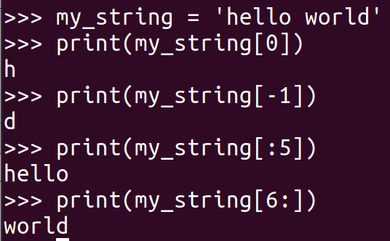
Lists
A “quirk” of Python, but strings have similar functionality to lists
You can traverse a string in the same way using the square bracket notation

Slide 17
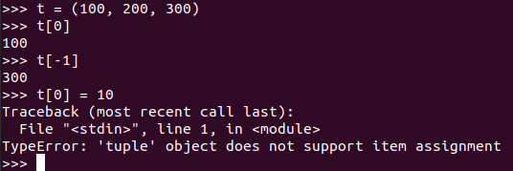
Tuples
Tuples are similar to lists, but they are 'immutable' (cannot change)
Declared using parenthesis ( )
Tuples with a single element need to have a trailing comma
Ex: t = (100,)

Slide 18
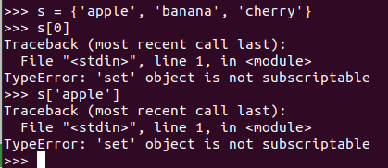
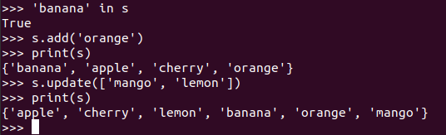
Sets
Sets are unordered, unindexed, and don't allow duplicates
Declared using curly brackets { } with initial data or set()
Cannot get elements like you would a list, you'll have to loop through it
We will discuss “loop” in a later lecture
You can verify an element exists: element in my_set -> returns True or False
Add elements using .add() or .update() -> update is for multiple elements
Remove elements using .remove() or .discard()
remove() will throw error if element doesn’t exist, discard() won't throw that error

Slide 19

Dictionaries
A dictionary in Python is a collection of key-value pairs
Each key is connected to a value, and you use this key to access the value associated with it
Dictionaries are wrapped in curly braces/brackets: { }
Notice that key/value pairs are separated by comma, and that the pair itself uses a colon to separate the key from the value
Dictionaries can be initialized with no data (so just empty curly brackets)

Slide 20


Dictionaries
How to access values
Put the key inside a set of brackets after the dictionary variable name
Can use variables in the brackets, if the variable value matches a key, it will return that key's value
.get(key, default) - gets the value if present, otherwise return default (if provided)
Adding new key/value pairs
Similar to access except for the initialize
NOTE: Since Python 3.7, dictionaries maintain the order in which they were defined

Slide 21
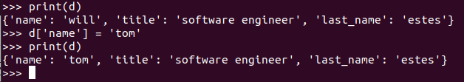
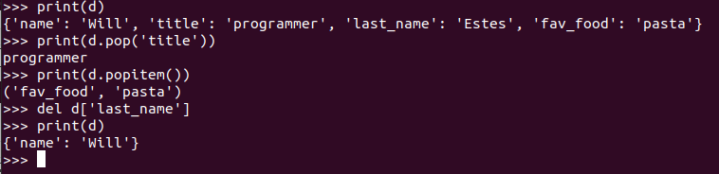
Dictionaries
Modifying dictionaries
Same as adding an element, except the key is going to be an existing key
Removing elements
.pop(key) - removes key/value pair from dictionary and returns value by specified key
.popitem() - removes last (LIFO) key/value pair and returns a tuple containing key, value
Prior to Python 3.7, this would remove a random key/value pair
del – removes key/value pair from dictionary *Note, this is a special case that not actually a built in for dictionaries
.clear() - empties dictionary

Slide 22
Paired Programming
Tasks
Create a dictionary that contains student information (name, s#, major)
Add an entry for age
Add an entry for credits earned
Remove age entry
Change credits earned

Slide 23
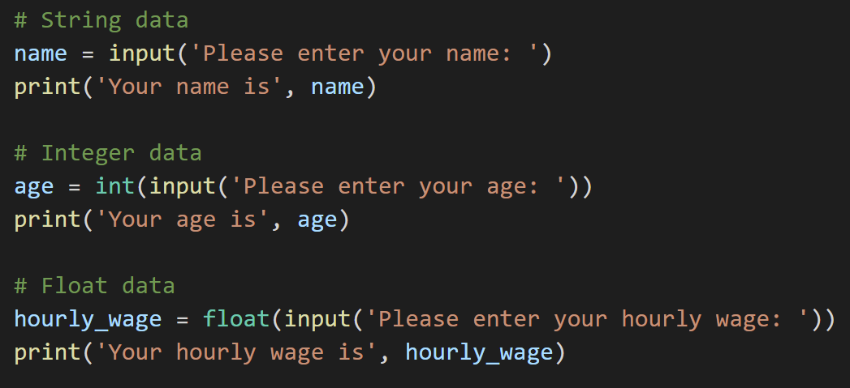
Getting user input
The simplest way to get user input is to use the input() built-in function
Depending on the type of data you’re asking for, you may need to “cast” the input to that data type – See L2_Input.py (below)

Slide 24
Homework
Read chapter 3
Programming Assignment

