Slide 1
CSC-119 Intro To Programming w/Python Lecture 4

Slide 2
Last Week
Reviewed chapter 3 material
Python conditionals

Slide 3
Paired Programming
Tasks
Design a change-counting game that gets the user to enter the number of coins required to make exactly one dollar.
The program should ask the user to enter the number of pennies, nickels, dimes, and quarters.
If the total value of the coins entered is equal to one dollar, the program should congratulate the user for winning the game.
Otherwise, the program should display a message indicating whether the amount entered was more than or less than one dollar.

Slide 4
Let's Jump In
Loops

Slide 5
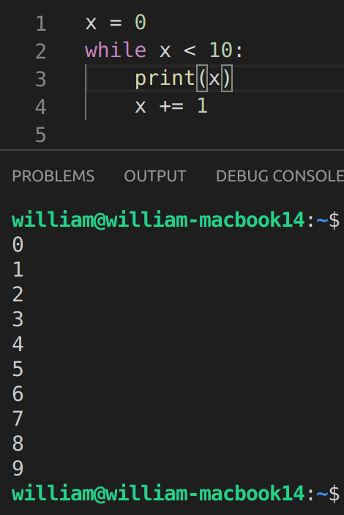
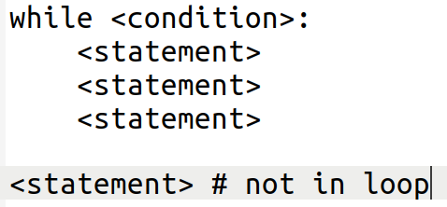
Let's Jump In - Loops
While loops
This repeats a block of code while a condition is true

Slide 6
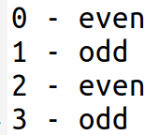
Let's Jump In - Loops
While loops - Pair Programming
Task: Develop a program that asks for a user to enter an integer, then print the numbers zero through the users’ input and display whether they are even or odd
Example output:

Slide 7
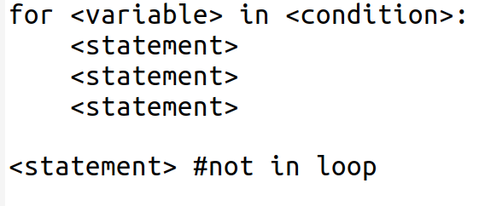
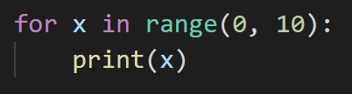
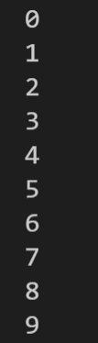
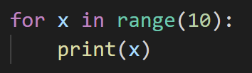
Let's Jump In - Loops
For Loops
Traditionally used to repeat a code block for a set number of times
The range() function returns a sequence of numbers that by default starts at zero

Slide 8
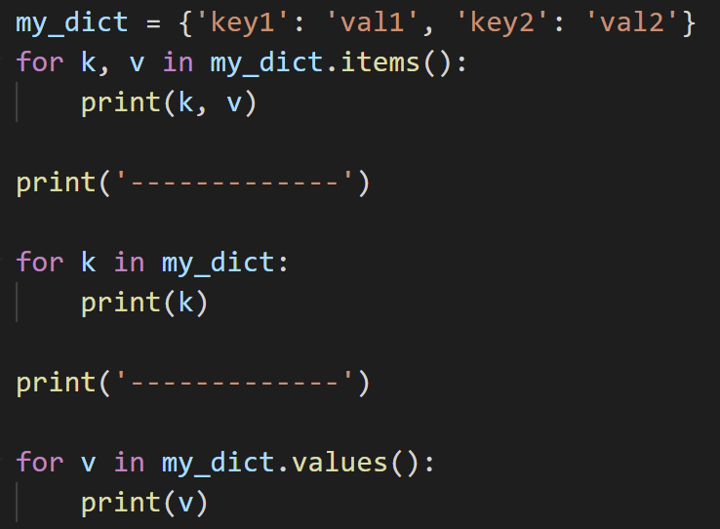
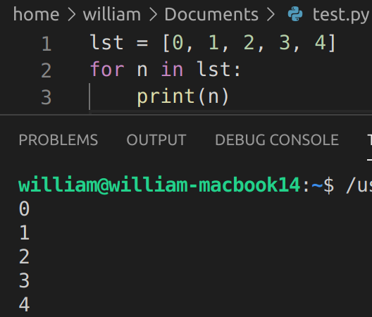
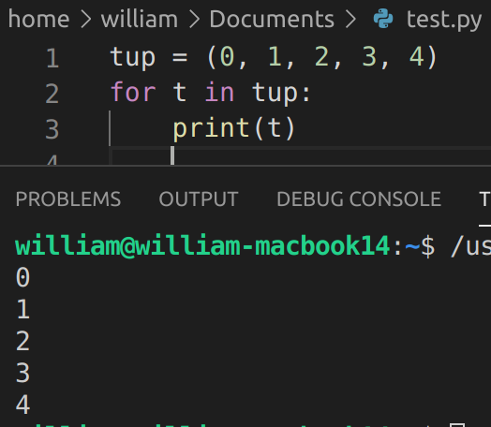
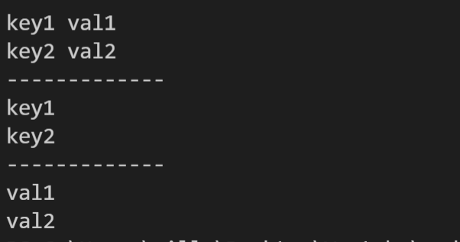
Let's Jump In - Loops
For Loops
Can also iterate through non-primitive/complex
^ This also works with strings

Slide 9
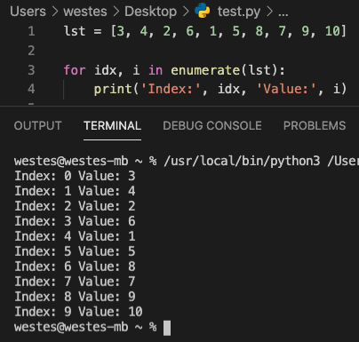
Let's Jump In - Loops
For Loops
What if you want to know what index you're on?
enumerate() - It allows us to loop over something and have an automatic counter

Slide 10
Let's Jump In - Loops
For Loops – Pair Programming
Task: Classic programming interview question FizzBuzz.
Given an integer input, print all numbers from zero to input
For multiples of 3, display 'fizz'
For multiples of 5, display 'buzz'
For multiples of 5 and 3, display 'fizzbuzz'
All other numbers, print their value (0, 1, 2...)

Slide 11
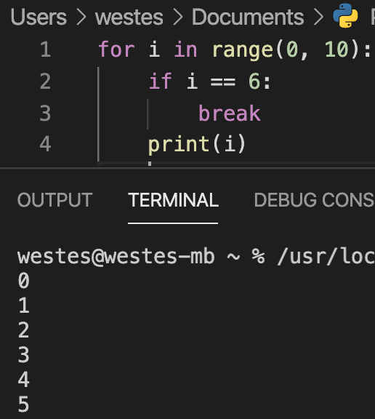
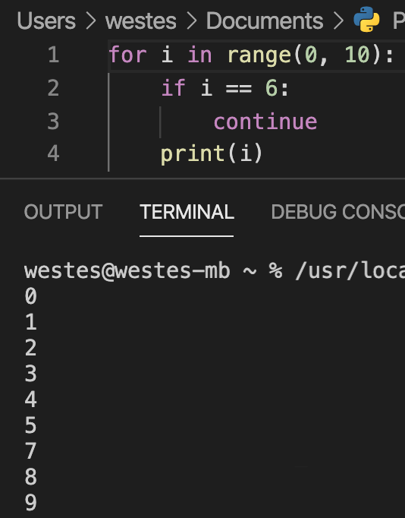
Let's Jump In - Loops
Break/Continue/Pass keywords
Break - "break" out of the current loop before processing is complete
Continue – jump to next iteration without completing any more logic from the current iteration
Pass – ignore this block, typically used for 'if' statements or empty functions (may be useful for testing)

Slide 12
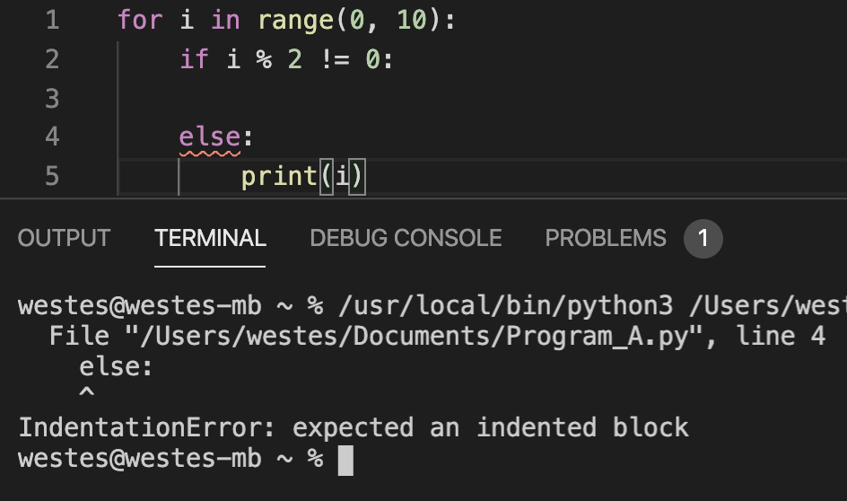
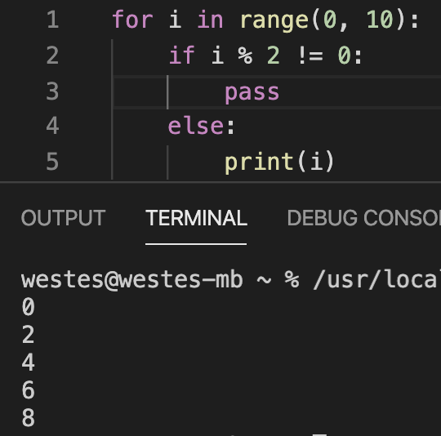
Let's Jump In - Loops
Break/Continue/Pass keywords

Slide 13
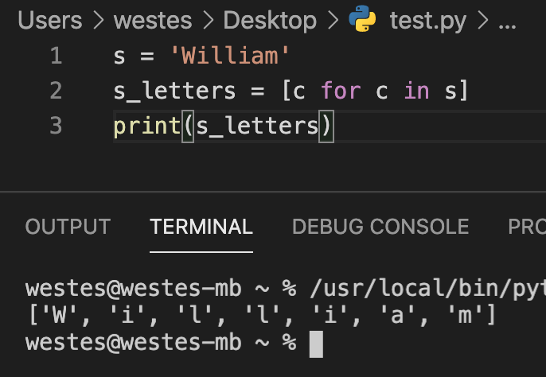
Let's Jump In - Loops
List Comprehension
Syntax: [ <expression> for <item> in <list> ]
Not all loops can be converted to list comprehension!
Avoid making long, single lines of list comprehension. It makes code harder to read.
To learn more: List Comprehensions Article

Slide 14
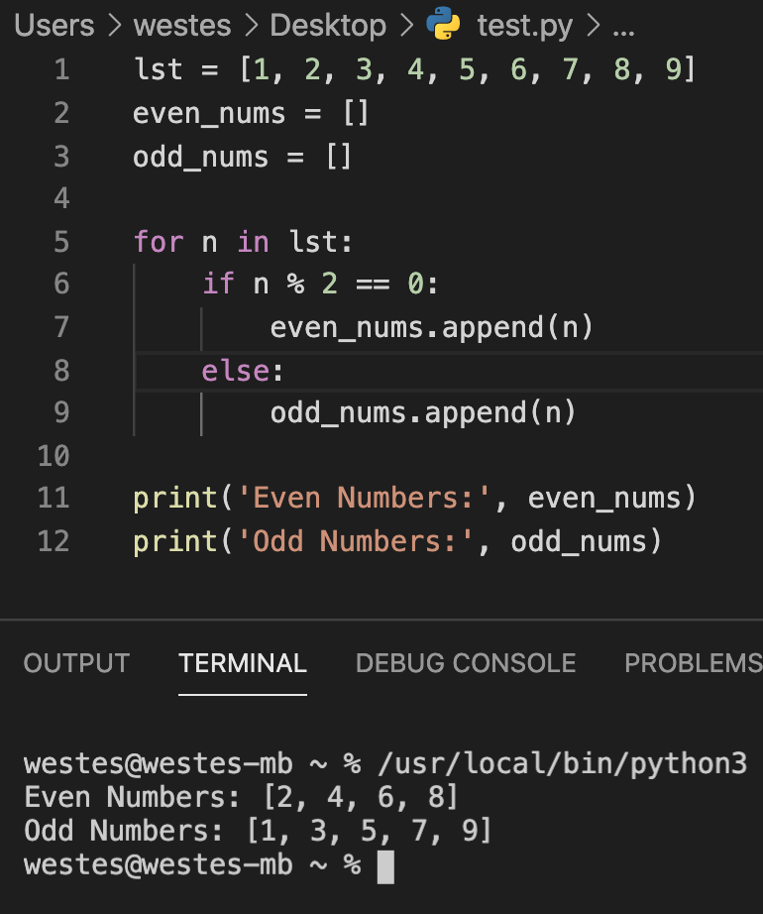
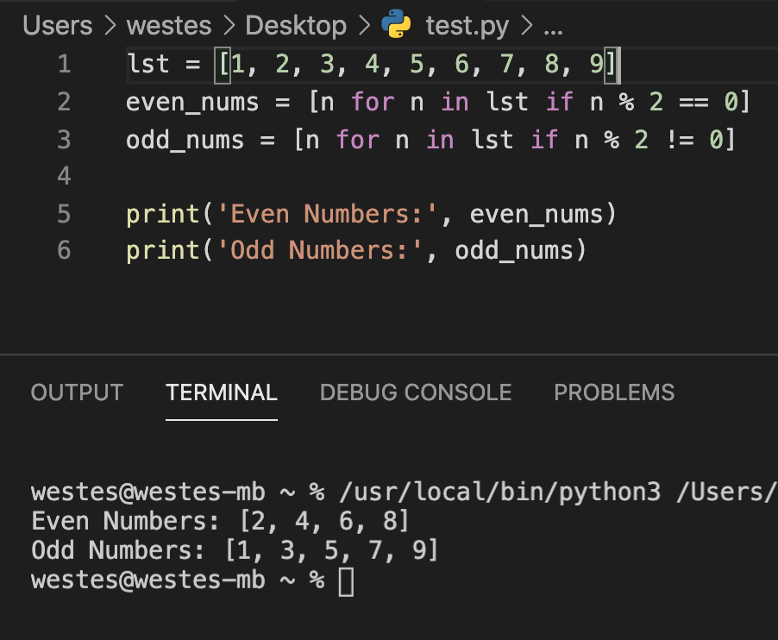
Let's Jump In - Loops
List Comprehension

Slide 15
Let's Jump In - Loops
Comprehensive – Pair Programming
Task
You and your team need to write a program that implements bubble sort
Bubble sort is one of the simpler sorting algorithms that works by swapping neighboring values in a list until they're all sorted
This will require you to use all the things we've learned in class so far
You may use Google or any other resource, but you need to be able to explain your code!

Slide 16
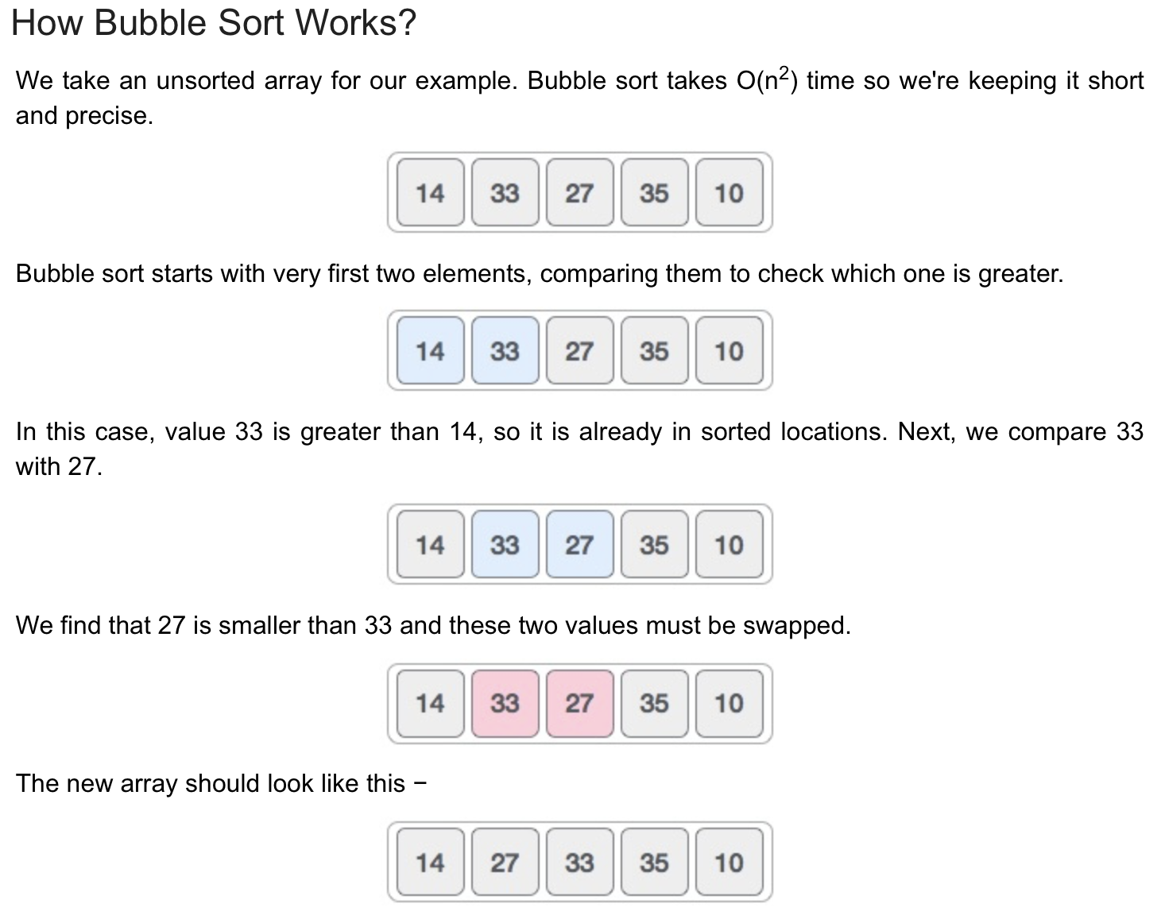
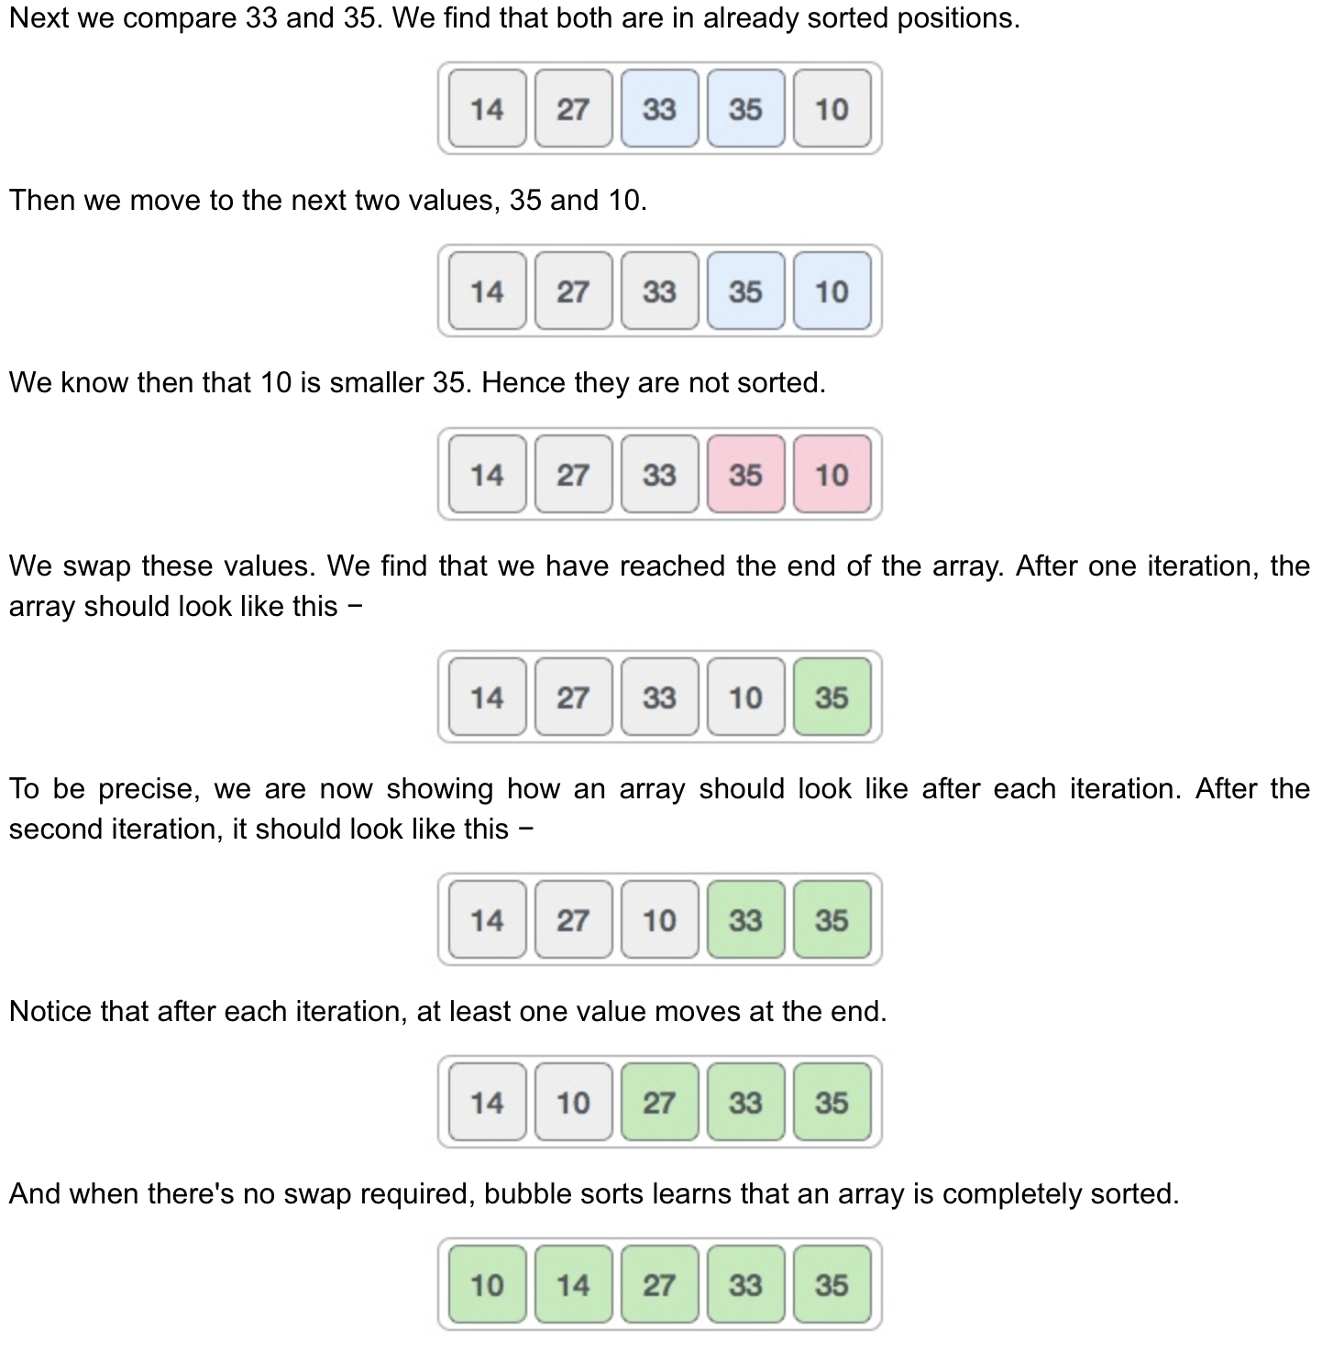

Slide 17
# HINT 1
Loop if list is not sorted
Loop through values of the list
If the current value is greater than the next value, swap them
End Loop
End Loop
# HINT 2
swapped = True
while swapped == True
swapped = False
Loop through values of the list
If the current value is greater than the next value
swap the values
swapped = True
End Loop
End Loop
# HINT 3
swapped = True
while swapped == True
swapped = False
count = 0
while count < len(list) - 1
If the current value is greater than the next value
swap the values
swapped = True count += 1
End Loop
End Loop

Slide 18
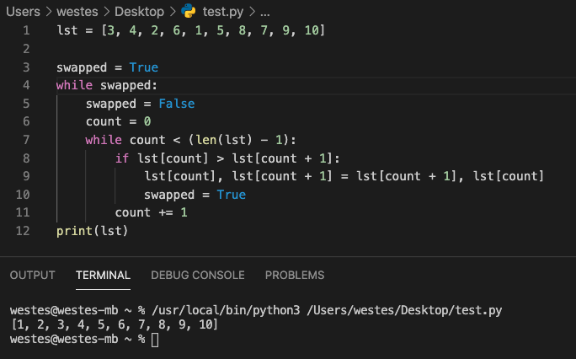
Let's Jump In - Loops
Comprehensive – Pair Programming – My Solution

Slide 19
Homework
Read Chapter 5
Programming Assignment

