Slide 1


CSC 119:Intro to Programming Lecture 5

Slide 2
Last Week
Looping

Slide 3
Review
Repetition Structures
What is a condition controlled loop?
Uses a true/false condition to control the number of times that it repeats
What is a count controlled loop?
Repeats a specific number of times
Last week we covered 'for' loops and 'while' loops
Both are pre-test loops, so the conditions are checked before iterating
Your reading introduced you to the 'do while' and 'do until' loops.
Both are Post-test loops, meaning it's run at least once before the condition is checked
These don’t exist in Python

Slide 4
Review
Repetition Structures
For loops – count controlled loops
Typically performs three actions:
Initialize – Declare a counter variable; what it's declared as is dependent on the situation
Test – Compare the counter to the max/min value. Break loop if meets condition
Increment – Increase value of counter during each iteration
Sentinel
A sentinel is a special value that marks the end of a list of values
Ex: Tell the user to enter a 0 when they are done entering values

Slide 5
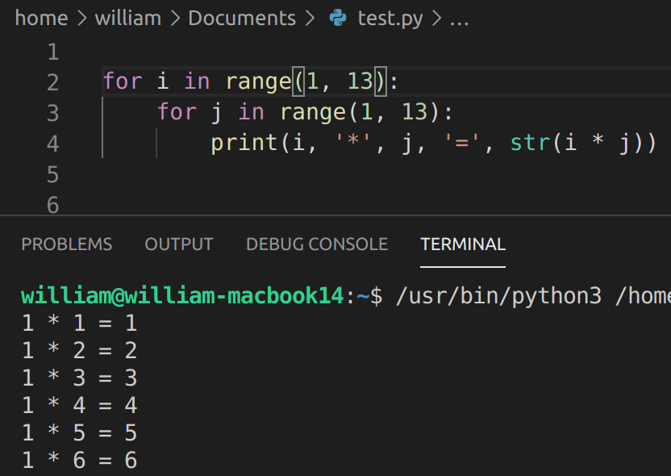
Review
Repetition Structures
Nested loops – A loop inside another loop

Slide 6
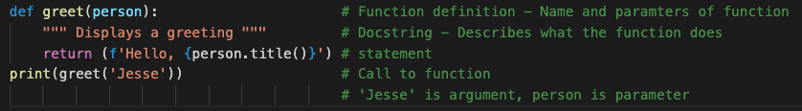
Let's Jump in - FUNCTIONS
Functions
Are modules that return a value back to the program that called it
The term “modules” is what the book called functions that don’t return a value – going forward, we’ll just call everything a “function” or “method”
Notice here in the return statement there is a new way to format strings
Adding the f before the start of the string allows us to use bracket notation to insert variables into strings
Another example: print(f‘Hello to you {user_name}.’)

Slide 7
Let's Jump in - FUNCTIONS
Function Names (for Python from PEP 8)
Function names should be lowercase, with words separated by underscores as necessary to improve readability.
Variable names follow the same convention as function names.
mixedCase is allowed only in contexts where that's already the prevailing style (e.g. threading.py), to retain backwards compatibility.
Examples:
print_check()
calculate_total()
PEP 8 - Style Guide

Slide 8

LET'S JUMP IN - Functions
Functions
Positional Arguments – when arguments are passed in order to match parameters
In the above example
Value 1 maps to the parameter x because it’s the first parameter in the function definition
Value 2 maps to the parameter y because it’s the second parameter in the function definition
The output would be 3 since we’re immediately printing the return value of add_numbers

Slide 9
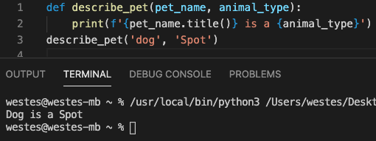
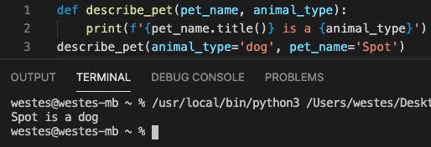
LET'S JUMP IN - FUNCTIONS
Functions
Keyword Arguments – when arguments are passed as a name-value pair that match the names of the parameters

Slide 10
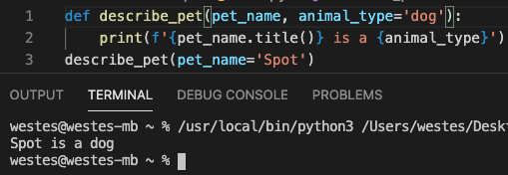
LET'S JUMP IN - FUNCTIONS
Functions
Default Values – when an argument is omitted, this will become the value of that parameter
When you use default values, any parameter with a default needs to be listed after all the parameters that don't have default values. Otherwise, positional arguments will have trouble being interpreted and cause a syntax error.

Slide 11
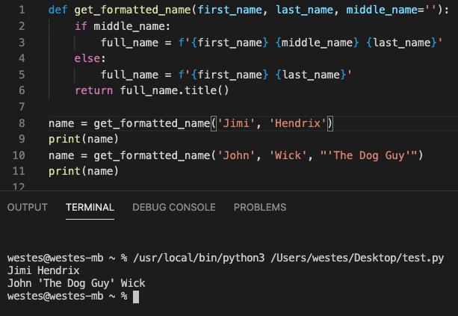
LET'S JUMP IN - FUNCTIONS
Functions
Default Values
Useful for making optional parameters

Slide 12
Paired Programming
Tasks
Write a function called make_shirt() that accepts a size and the text of a message that should be printed on a shirt. The function should print a sentence summarizing the size of the shirt and the message printed on it
Call the function once using positional args
Call the function again using keyword args
Write a function called describe_city() that accepts the name of a city and its country. The function should print a simple sentence such as 'Boston is in USA.'
Give the parameter for the country a default value
Call your function for three different cities, at least one of which is not in the default country

Slide 13
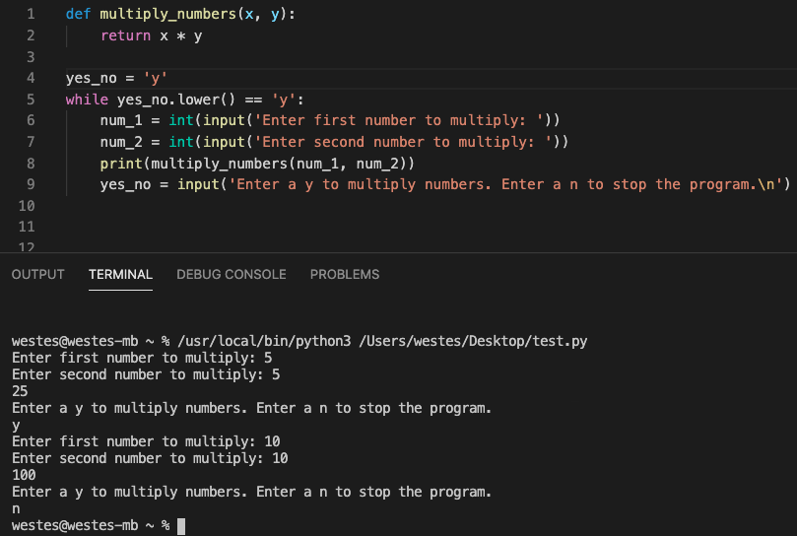
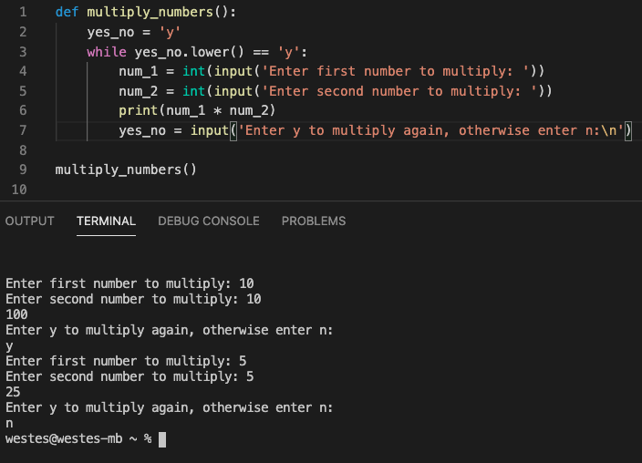
LET'S JUMP IN - FUNCTIONS
Functions
Combining ideas: Looping

Slide 14
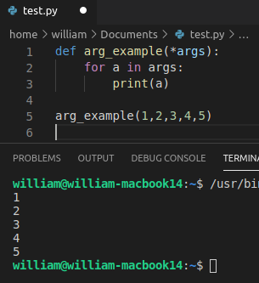
LET'S JUMP IN - FUNCTIONS
Python Quirks and "Good to Knows"
*args– used when unknown number of arguments passed
The asterisk tells Python to 'pack' values into a tuple
Even if only 1 arg passed, it's still a tuple
Must be after the other types of parameters
*args cannot be used as keyword (*args=…) argument

Slide 15
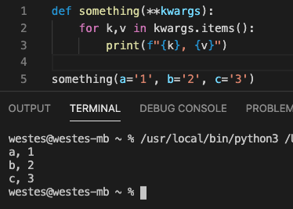
LET'S JUMP IN - FUNCTIONS
Python Quirks and "Good to Knows"
**kwargs– used when unknown number of named arguments passed (dictionary entries)
Other variable types and *args must come before **kwargs in the parameters

Slide 16
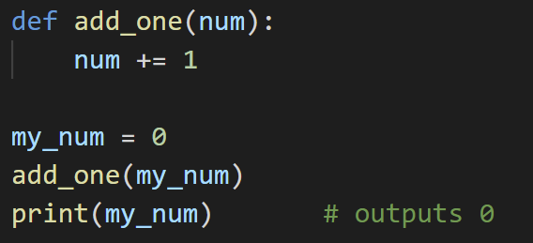
LET'S JUMP IN - FUNCTIONS
Python Quirks and "Good to Knows"
Changes to a parameter do not affect the argument for primitive data types

Slide 17
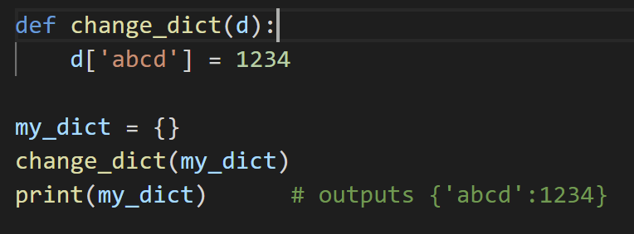
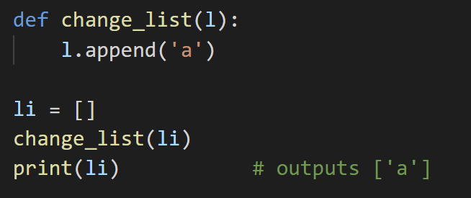
LET'S JUMP IN - FUNCTIONS
Python Quirks and "Good to Knows"
Changes to a parameter will affect the argument for non primitive (complex) data types (mutable) (excluding tuple)

Slide 18
LET'S JUMP IN - FUNCTIONS
Python Quirks and "Good to Knows"
This brings up a good interview question!
IS PYTHON PASS BY REFERENCE OR VALUE?
GeeksForGeeks: Python utilizes a system, which is known as “Call by Object Reference” or “Call by assignment”. In the event that you pass arguments like whole numbers, strings or tuples to a function, the passing is like call-by-value because you can not change the value of the immutable objects being passed to the function. Whereas passing mutable objects can be considered as call by reference because when their values are changed inside the function, then it will also be reflected outside the function.

Slide 19
Paired Programming
Tasks
Write a function that accepts a list of items a person wants on a sandwich. The function should have one parameter that collects as many items as the function call provides, and it should print a summary of the sandwich that's being ordered.
Call the function 3 times using a different number of arguments each time
Write a function that stores information about a car in a dictionary. The function should always receive the manufacturer and model name. It should then accept an arbitrary number of keyword arguments.
Call the function with the required information and 2 other name-value pairs (like color, or FWD/RWD/AWD)
Print the dictionary that's returned to make sure all the information was stored correctly.

Slide 20
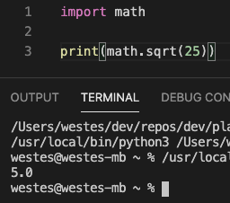
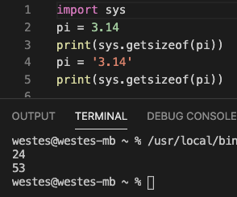
LET'S JUMP IN - FUNCTIONS
Imports
Python allows you to "import" modules that expand your program without having to type it all out yourself.
Some examples of modules that are commonly imported are math, time, and sys (there's lots though!)
These are all part of the python standard library so you'll always be able to import these

Slide 21
LET'S JUMP IN - FUNCTIONS
Imports
There are three ways to import...
import modulename – parses contents of module but any references must still be prepended with the module name
from modulename import name1, name2, … - parses specific names from modules, so no prepending is necessary
from modulename import *
This method makes your code harder to debug as it won't be obvious where things came from
How do you know which one to use? This is dependendent on what your sys.path lists as directories
The sys.path will list, in order, how the python interpreter will search for modules
Generally, your sys.path will look in the current directory first

Slide 22
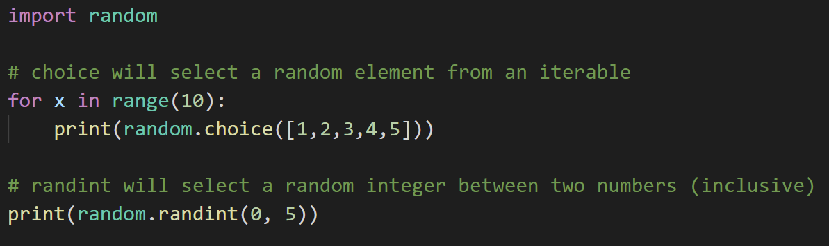
For your HW...
You will need to know how to randomly generate numbers

Slide 23
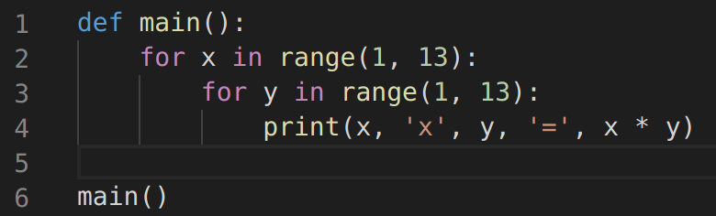
For your HW...
I want all programs going forward to have a main() function that initiates the program
See example below, this is from a previous HW assignment to print a multiplication table for numbers 1 - 12

Slide 24
Homework
Read chapters 6 & 7 (8 & 9 optional)
Programming Assignment
The next lecture would be dedicated to prepping for the midterm
Basically just go over some example problems and answer questions as needed
Since this is a YouTube series and not a “real” classroom, I’ll just post the example problems with solutions in the lecture_6 folder on Github
The midterm will be a single problem in the lecture_7 folder on Github
To make it more realistic to a classroom, try to complete it in one, 75 minute sitting

