Slide 1

Variables & Simple Data Types

Slide 2
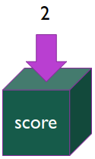
variables
Variables are containers for (or reference to) information
They have a name, data type, and value
Given the image to the right...
Name: score
Data Type: number (more specifically, integer)
Value: 2

Slide 3
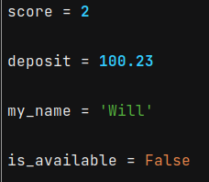
Variables: examples
Declaring a variable
variable name = variable value

Slide 4
Variables: syntax
Names can contain only letters, numbers, and underscores.
They can start with a letter or underscore, but not a number
Spaces are not allowed
Ex “user_name” vs “user name”
Avoid using Python keywords and function names as variable names
Not syntax, but try to keep your variable names short but descriptive
Ex “total_score” vs “ts” vs “the_players_cummulative_score_so_far”
Not syntax, but Python programmers generally prefer the underscore vs camelCase
Ex “user_name” vs “userName”

Slide 5
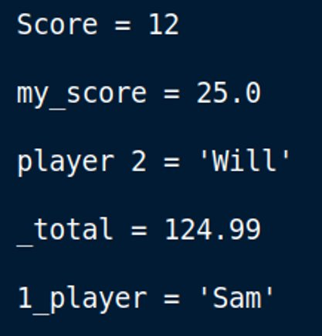
Variables: check understanding
Which of these variable names will produce an error?

Slide 6
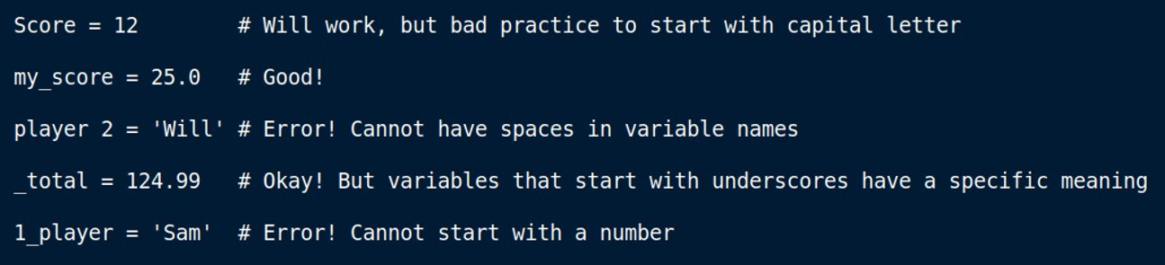
Variables: check understanding

Slide 7
Simple data types
Data types are used to categorize a piece of data
Python has a few simple/complex data types to work with
Here's the few we will focus on for this class:
Integer – Whole numbers
Float – Decimal numbers
Boolean – Can store only True or False
String – Text

Slide 8
Simple data types: Integers
You can do basic arithmetic like add (+), subtract (-), multiply (*), and divide (/)
Python uses two multiplication symbols (**) to represent exponents
3**2 # 9
Python follows order of operations
2 + 3*4 # 14
(2+3)*4 # 20
Quirk – When you divide two integers, Python will give the answer as a float
4/2 # 2.0
Large numbers can be written using underscores for readability
1_000_000 vs 1000000

Slide 9
Simple data types: floats
Similar operations to integers (+, –, *, /, **, etc)
Quirk – sometimes floats are imprecise, we will ignore this for now
Example: .2 + .1 = 0.3000000000000004

Slide 10
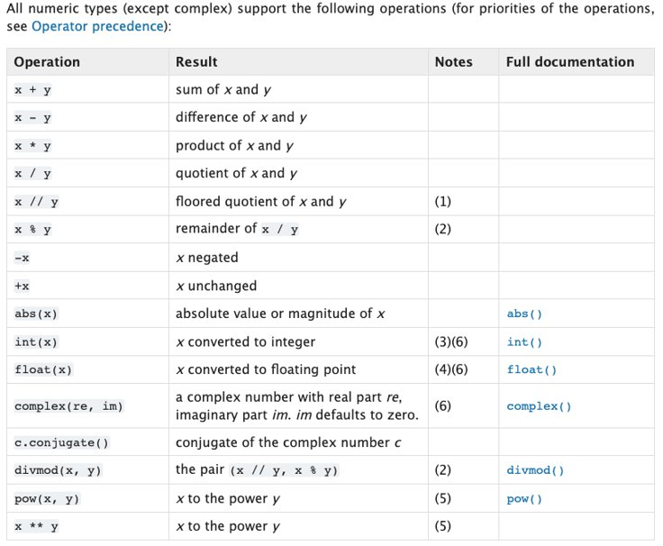
Simple data types: numbers
Python Standard Types

Slide 11
Simple data types: strings
Strings store text data
Strings are indicated with the double quote (") or single quote(')
Examples:
"Hello world"
'Hello world'
Unlike integers and floats, strings have helpful built-in methods

Slide 12
Simple data types: strings
Built-in functions:
.upper() - Convert the string to all uppercase letters
.lower() - Convert the string to all lowercase letters
.title() - Convert the first letter of each word to uppercase
.isalpha() - return True if all characters are in the alphabet, otherwise return False
There are many more: W3Schools
Examples of these on the next slide

Slide 13
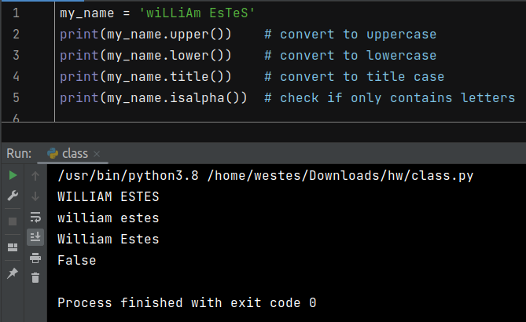
Simple data types: strings

Slide 14
Next time
Complex data types

