Slide 1


CSC 119:Intro to Programming Lecture 3

Slide 2
Last Lecture
Review of Chapter 2
Non Primitive (Complex) data types
User Input

Slide 3
Paired programming
Tasks
List
Create a new, empty list
Add 2 entries to the list
Change the second entry
Remove the second entry
Create a new list and initialize it with 3 entries
Modify the last entry in the new list
Access the first entry in the new list
Dictionaries
Create a new dictionary with initialized data, let’s make a phone book
Access an entry
Modify a phone number
Remove an entry
Add a new entry

Slide 4
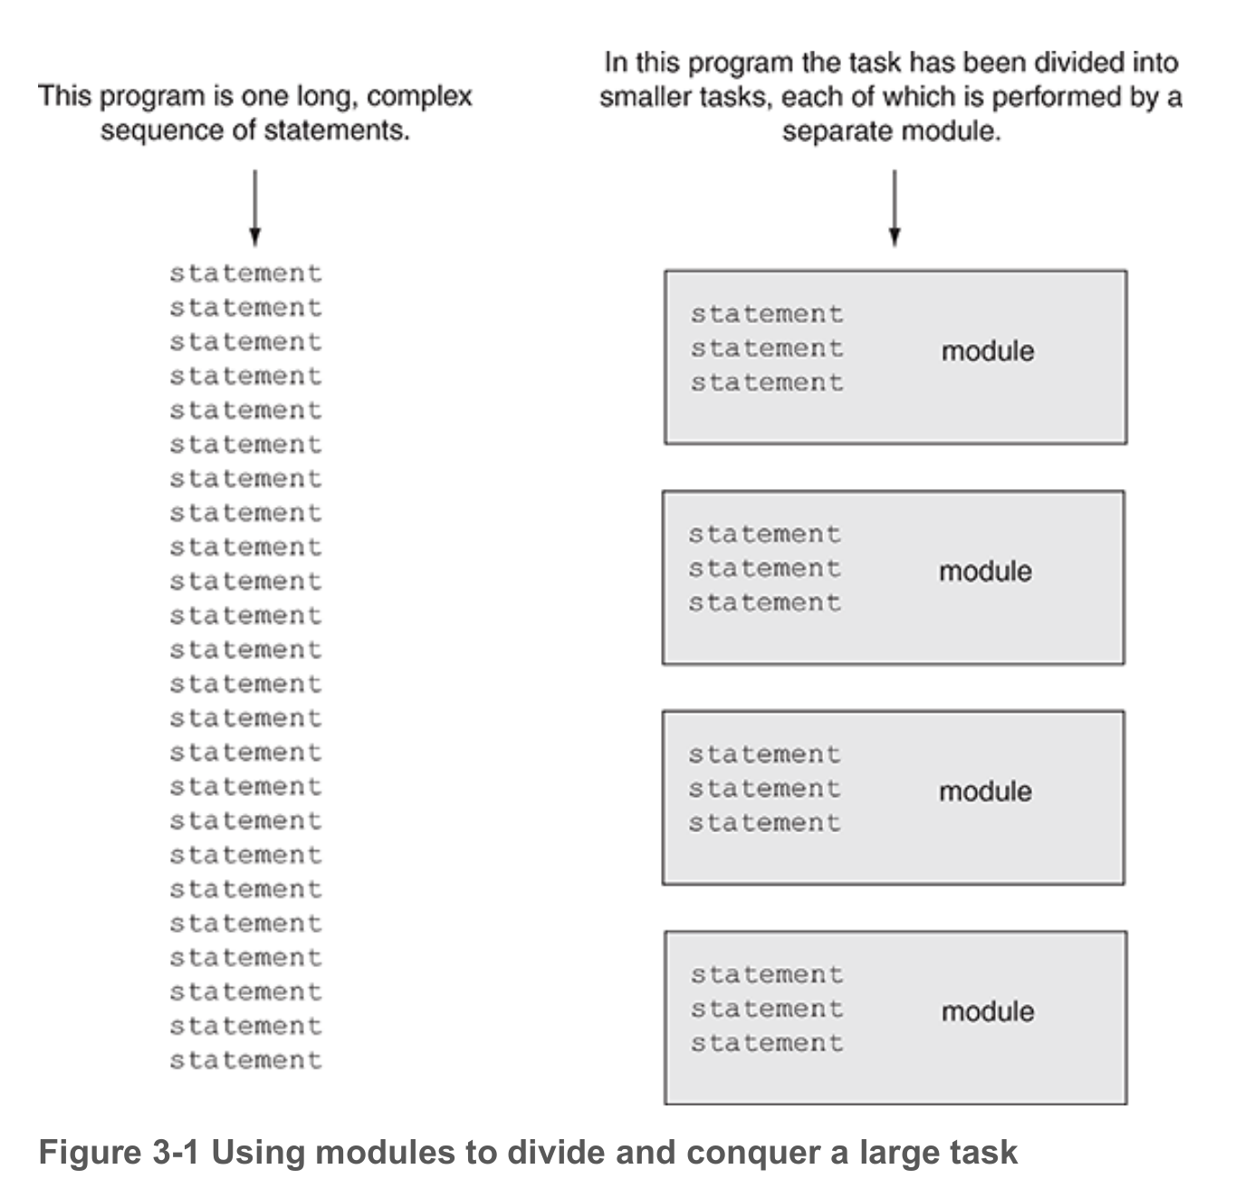
Last Week – Assigned Reading
Can anyone describe "divide and conquer?"
Can anyone describe why modules are important?

Slide 5
Last Week – Assigned Reading
Benefits of Modules
Simpler code
Code reuse
Easier testing
Easier maintenance
Faster development
Better teamwork

Slide 6
Last Week – Assigned Reading
Local Variables
A variable inside a module is called a local variable
Local variables can only be accessed inside the module they're declared in
Can anyone describe scope?
Answer: describes the part of a program in which a variable may be accessed

Slide 7
Last Week – Assigned Reading
Global Variables
A variable that's available to all modules in a program
Generally a bad practice to create global variables
Make programs hard to understand and hard to debug
Global Constants are okay!
Because a global constant’s value cannot be changed during the program’s execution, you do not have to worry about many of the potential hazards that are associated with the use of global variables
Example: the value of PI (3.14)

Slide 8
Last Week – Assigned Reading
Passing Data
Pieces of data that are sent into a module are known as arguments
A special variable that receives an argument when a module is called a parameter

Slide 9
Let’s Jump In
Conditionals
Testing equality
If/elif/else

Slide 10
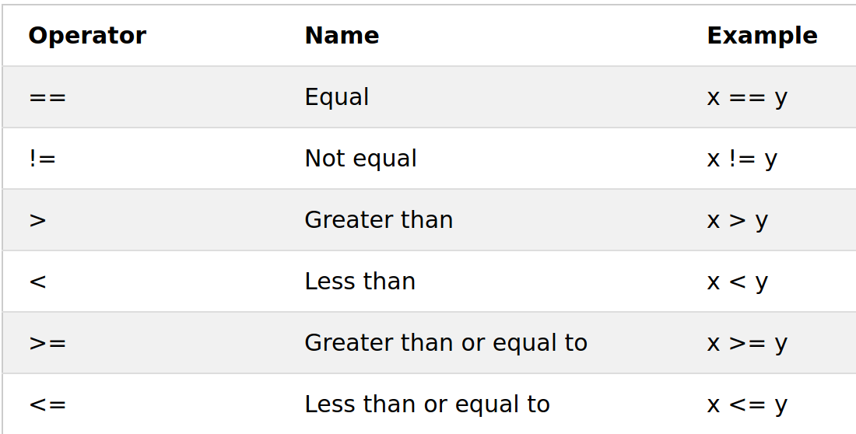
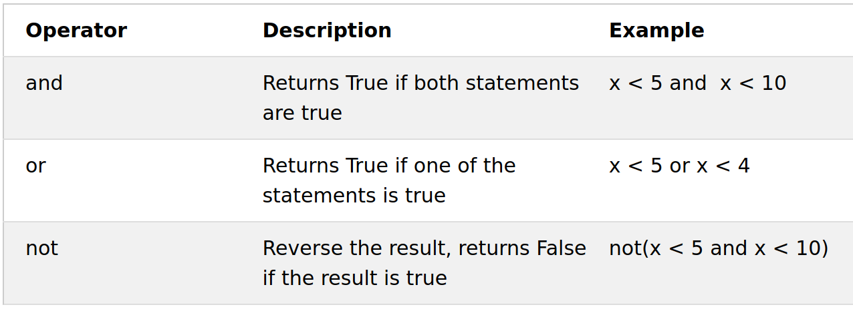
Let’s Jump In
https://www.w3schools.com/python/python_operators.asp

Slide 11
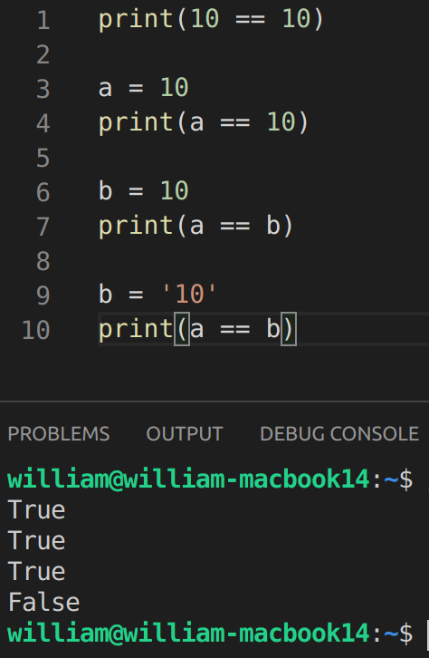
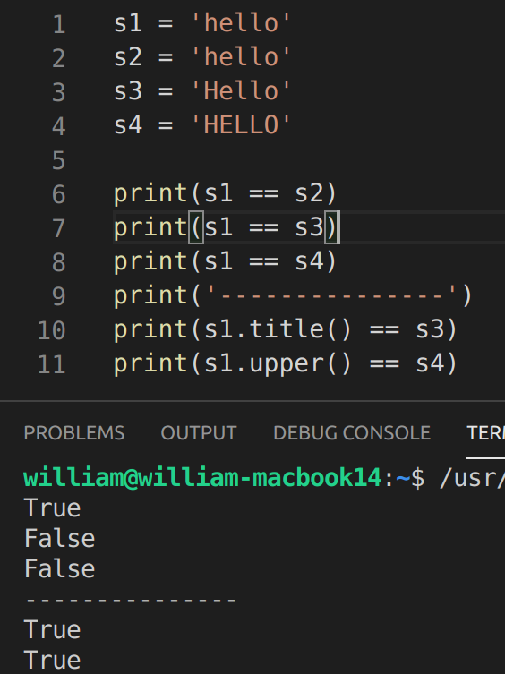
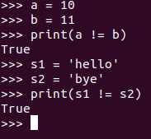
Let’s Jump In
Testing Equality/Inequality
Use the '==' notation to determine if something (value, variable) equals something else
Use the '!=' notation to determine if something is not equal

Slide 12
Paired Programming
Tasks
Define 2 integer variables of different value, then display if one is equal to the other
Using the previous variables, display if they are different
Using the previous variables, display if one is greater than the other
Using the previous variables, display if one is less than the other
Using the previous variables, display if one is greater than or equal to the other

Slide 13
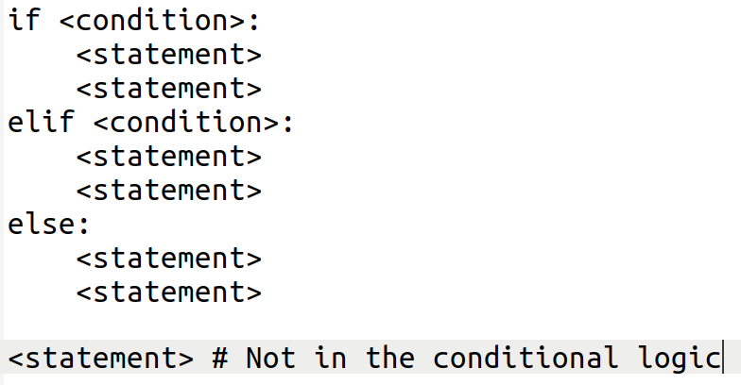
Let’s Jump In
If/elif/else statements
They are a control structure that allow the program to branch or implement conditional execution

Slide 14
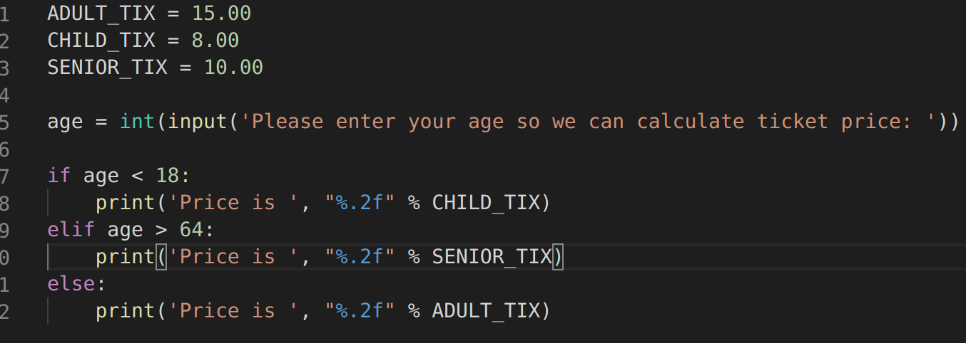
Let’s Jump In
If/elif/else statements
Ex: movie ticket prices have child, adult, and senior admission. You wouldn’t want to write a separate program for each of these. If statements allow you to do it in one program

Slide 15
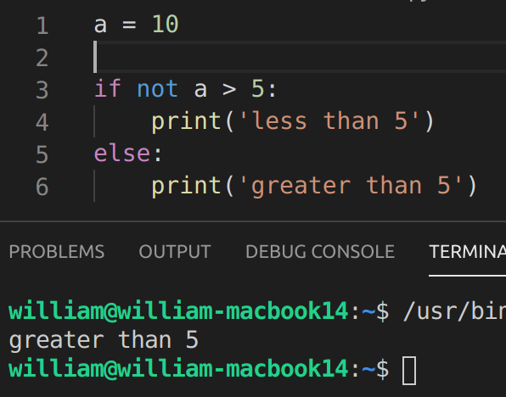
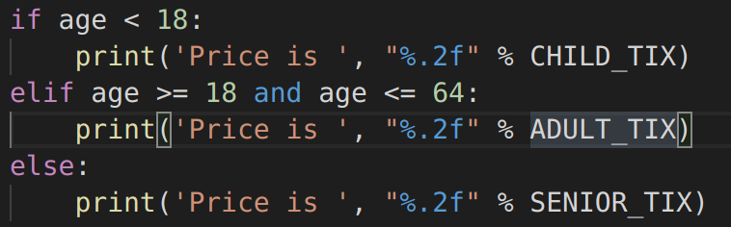
Let’s Jump In
If/elif/else statements
Combining conditionals
Use 'and' and 'or' to have multiple conditions
Use 'not' to reverse condition

Slide 16
Paired Programming
Tasks
We need to develop a program that determines letter grades based on numeric scores from 0 – 100
Test cases include inputs of 0:F, 100:A, 55:F, 65:D, 75:C, 85:B, 95:A
We need to develop a program that given the height & width of 2 rectangles, print the area of the larger rectangle
Test cases include inputs of (2x2, 2x4), (3x4, 1x5), (3x4, 4x3)

Slide 17
Homework
Read chapter 4
Programming Assignment
Hint – you will need to know how to use the % operator
The % operator provides the remainder after division
Ex: 9 % 3 will output 0
Ex: 10 % 3 will output 1

