Slide 1

Complex Data Types

Slide 2
Last Session
Learned about variables and simple data types
Let's take a minute to do a review activity
Write the code to complete the following tasks:
Declare/Initialize an integer variable
Declare/Initialize a float variable
Declare/Initialize a string variable
Display the variables in the console

Slide 3
Complex Types
Non-Primitive/Complex/Data Structures
Lists – mutable (changeable) sequences, used to store collections of data
Tuples – immutable (non-changeable) sequences, used to store collections of data
Dictionary – mutable map of key/value pairs
Sets – mutable, unordered collection of distinct objects

Slide 4
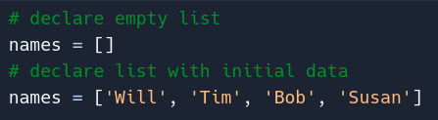
Lists
Can hold text, numbers, booleans, etc
Does not have to be of the same type
Good Practice: make the names of lists plural
Lists are indicated by square brackets [ ]

Slide 5
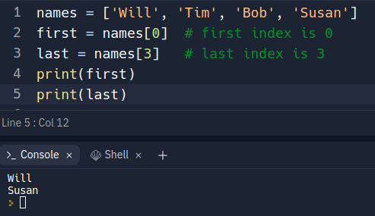
Lists: Read
To access list elements, you use the "index"
Index is the position of an element in the list
Index start count at 0
Accessing an element is done using square brackets containing the index

Slide 6
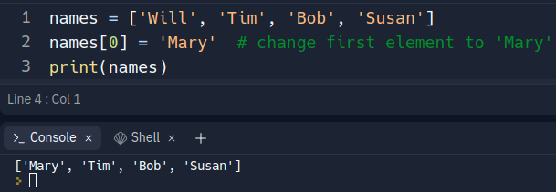
Lists: Modify
Modifying elements in a list is done using the bracket notation we saw previously
Difference is that we need to assign something to the index we're accessing
Think of it as overwriting what already exists at that index

Slide 7
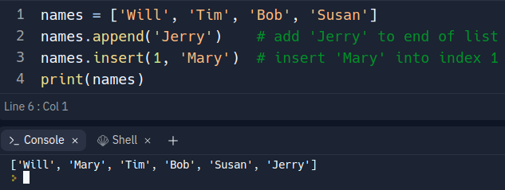
Lists: Add
Lists, like strings, have built-in methods
Adding elements:
.append() - Adds an element to the end of the list
.insert() - Adds an element at a desired index (shifts elements by +1 index)

Slide 8
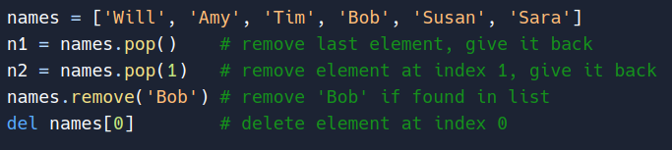

Lists: Remove
There are a few ways to remove elements in a list
Built-in methods:
.pop() - remove last element (or element at provided index) and return it
.remove() - remove element by value
Note – This only removes the first occurrence of the element
Python built-in
del – deletes the element by specified index

Slide 9
Lists: Review Activity
Write code to complete the below tasks:
Create a list of car manufacturers (let's say 3)
Add a new car manufacturer to the end of the list
Add a new car manufacturer to index 2
Display the car manufacturer at index 3
Remove a car manufacturer
Remove a car manufacturer and save it to a variable

Slide 10
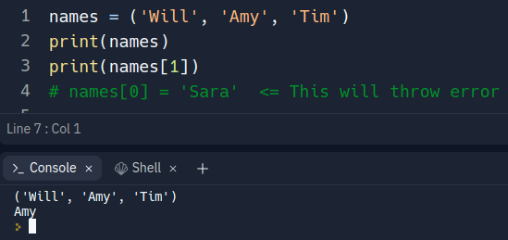
Tuples
Tuples are similar to lists in that you access elements by index using the same square bracket notation
Immutable! - Cannot change after initialized
Declared using parenthesis
Note: a single element tuple needs to have a trailing comma after it's element

Slide 11
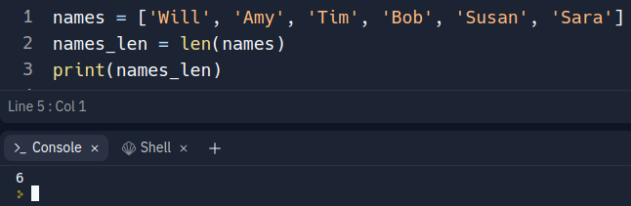
Lists & Tuples: Helpful Info
List built-in methods: W3Schools
Tuple built-in methods: W3Schools
Length of lists & tuples can be found using the Python built-in len() function

Slide 12

Dictionaries
Declared using the curly braces { }
Collection of key/value pairs
Keys cannot be duplicated, values can
A key/value pair is known as an "entry"
Entries are formatted as key:value
Entries are separated by commas

Slide 13
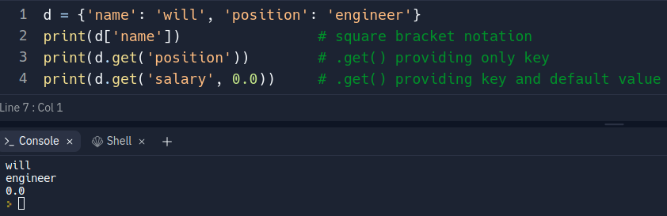
Dictionaries: Read
Using square bracket notation, we can use the key to get the associated value
We can also use the dictionary built-in method .get()

Slide 14
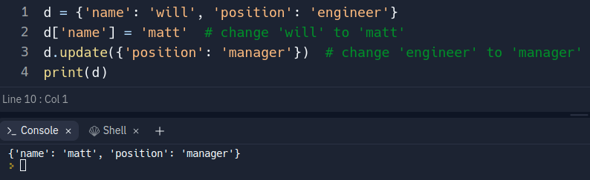
Dictionaries: Modify
Using square bracket notation, we can use the key to modify its value
We can also use the dictionary built-in method .update()
Note: If the entry passed to .update() doesn't exist, it will be created

Slide 15
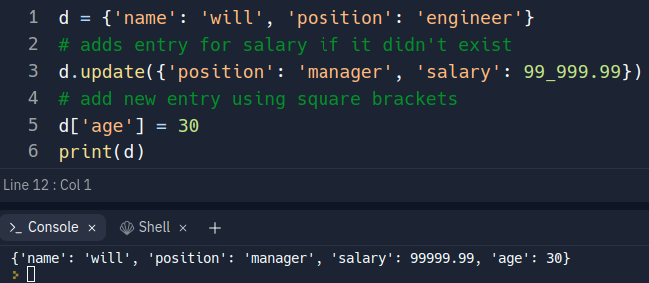
Dictionaries: Add
Using square bracket notation, we can use a key to add a new entry
We can also use .update() as mentioned on the previous slide

Slide 16
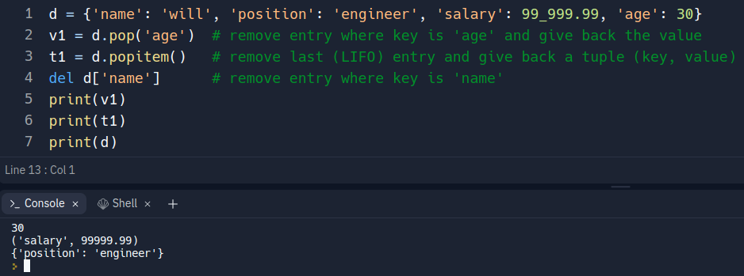
Dictionaries: Remove
A few options are available to remove entries from a dictionary
Dictionary built-in methods
.pop() - given a key, remove that entry and return the value
.popitem() removes last (LIFO) entry and returns a tuple of (key, value)
Python built-in
del – remove entry from dictionary

Slide 17
Dictionaries: Review Activity
Write the code to complete the following tasks
Create a dictionary that contains student information (name, id, major)
Add an entry for age
Add an entry for credits earned
Remove age entry
Change credits earned

Slide 18

Dictionaries: Helpful Info
Dictionary built-in methods: W3Schools
Can also use Python built-in len() function to get the number of entries
Determine if a key exists in the dictionary using the "in" syntax

Slide 19

Sets
Sets are unordered, unindexed, and don't allow duplicates
Declared with curly brackets and initial data, or with Python built-in set()
If using { } then initial data must be provided, otherwise Python thinks it's an empty dictionary

Slide 20
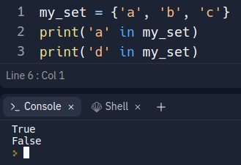
Sets: Read
Because sets are unindexed, we can't access elements using the square bracket notation
You have to "loop" through the set to get the element you want
We will cover "looping" later, so don't worry about this now
You can verify an element exists in the set using the "in" syntax

Slide 21
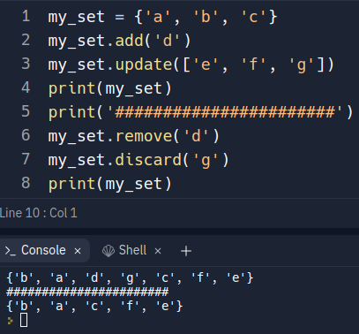
Sets: Add & Remove
Add
Set built-in methods
.add() - add a single element
.update() - add iterable containing elements
Remove
Set built-in methods
.remove() - remove element, but throw error if it doesn't exist
.discard() - remove element

Slide 22
Sets: Helpful Info
Set built-in methods: W3Schools
Can use Python built-in len() to get length of sets

Slide 23
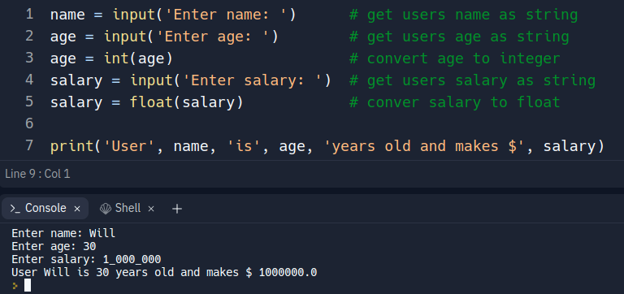
User Input
To get input from the user, use the Python built-in input()
The input() function allows you to pass a prompt to be shown to the user
The input() function will always return a string
Even if the user enters a number, the input() will return it as a string
This means that you must "cast" (convert) to your desired data type
Integers – int()
Floats – float()

