Slide 1
A brief introduction to machine learning-I
David Chien-Chang Yen
嚴健彰
yen@math.fju.edu.tw
Oct 2, 2026
Fu Jen Catholic University, Mathematics

Slide 2
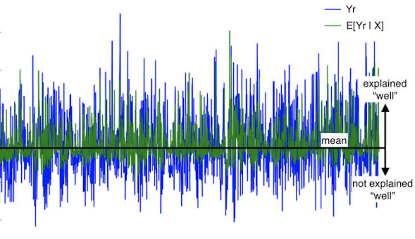
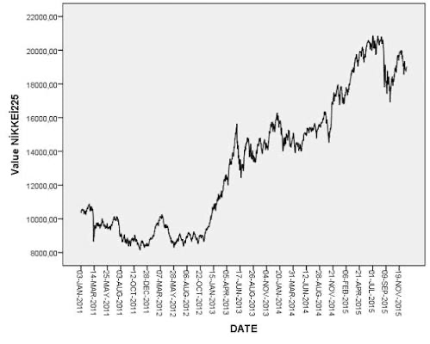
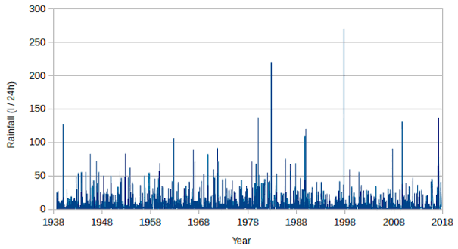
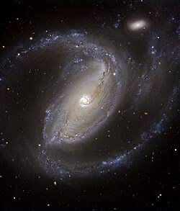
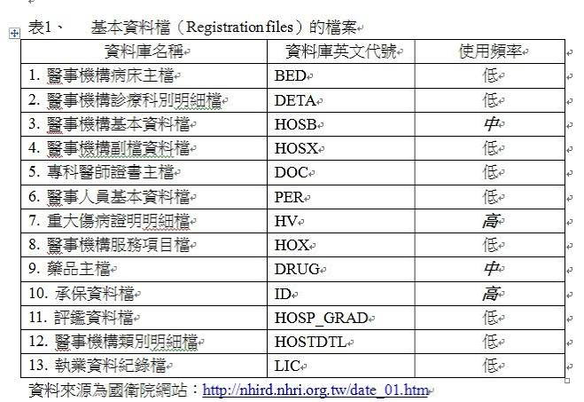

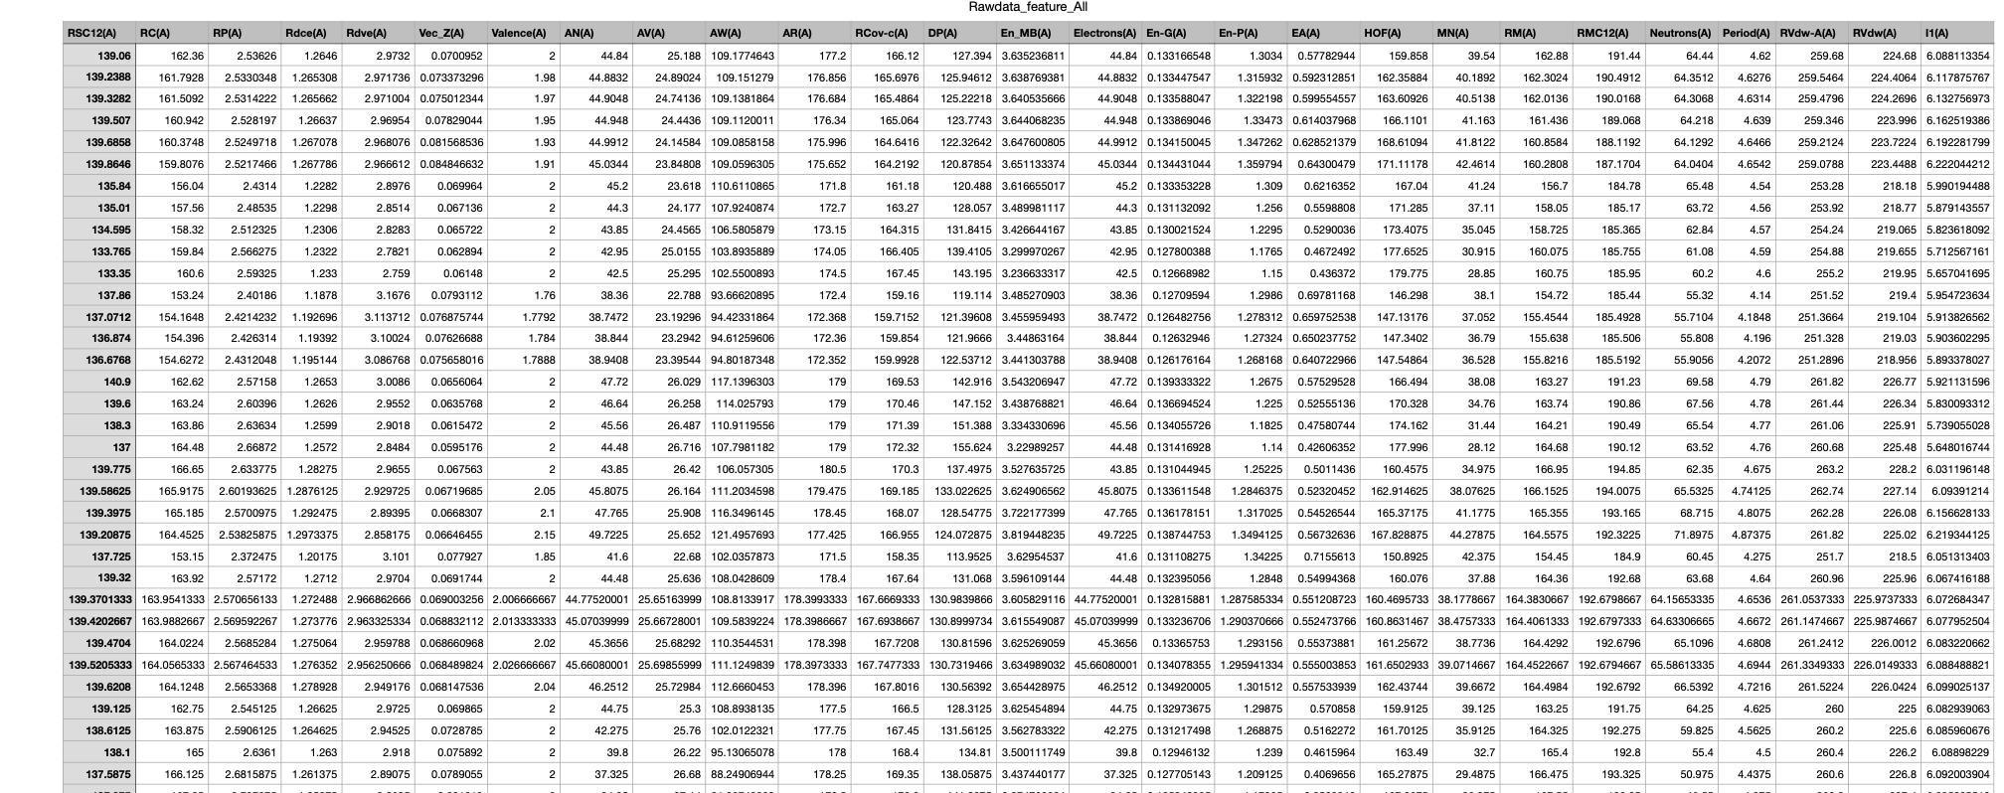
Data Sets
Time series: spikes, stocks, weather
Collection: astronomical images, HIRD, iris, Rawdata_feature_all.csv
https://codeocean.com/capsule/4347581/tree/v2

Slide 3
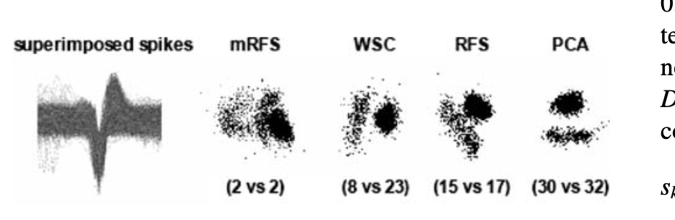
Non-Classification Data Sets
Methods for classification: PCA, RFS, WSC, min-max
Spike sorting by a minimax reduced feature set based on finite differences (DOI 10.1007/s12576-008-0010-x)

Slide 4
Classification Data Sets
iris, Rawdata_feature_all.csv
Find a rule for classification (machine learning) in order to next goal: DTR, RF, BR (Bayesian Ridge Regression), GBR (Gradient Boosting Regressor), SVR
https://www.slideshare.net/slideshow/decision-trees-97029144/97029144
https://www.youtube.com/watch?v=3U8N5sPdQPk
https://www.youtube.com/watch?v=bE2yMLKJFbk
https://www.youtube.com/watch?v=yfDLN82D6Gc

Slide 5
Goals
Spikes: de-code the biological information
Stocks: predict the next stock price
Weather: effect on evolution of asthmas
Astronomical image: probe the galactic center region
iris: Study the methods of machine learning
Rawdata_feature_all.csv: Find the significant A-sites and B-sites

Slide 6
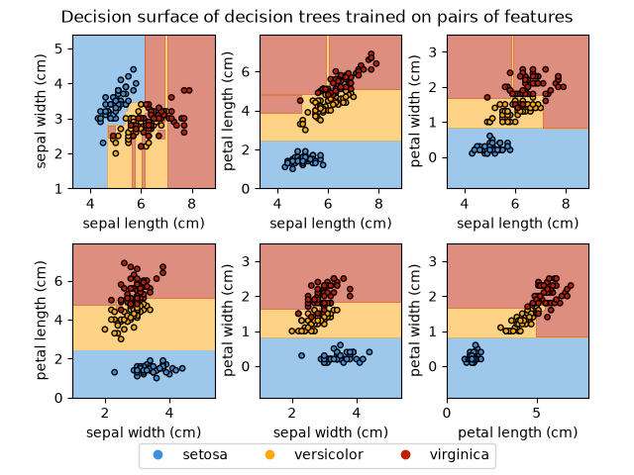
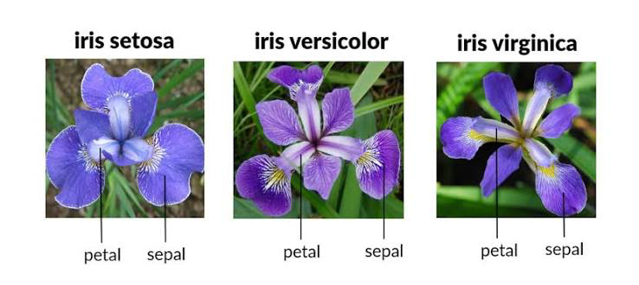
Decision Tree for iris data

Slide 7
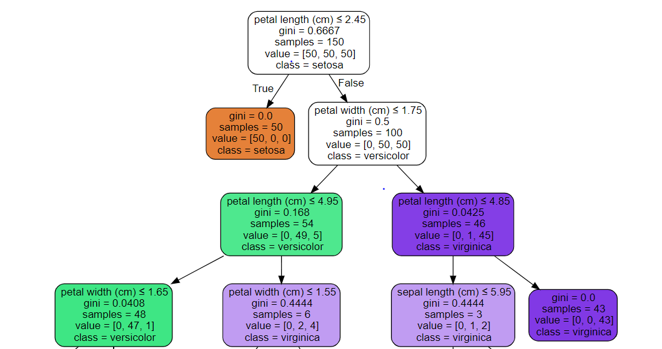
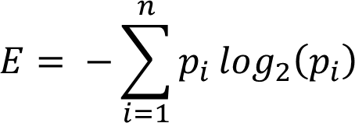

Decision Trees Explained - Entropy, Information Gain, Gini Index, CCP Pruning
https://towardsdatascience.com/decision-trees-explained-entropy-information-gain-gini-index-ccp-pruning-4d78070db36c/
Entropy is measured by the formula:
The formula for Gini Index:

Slide 8
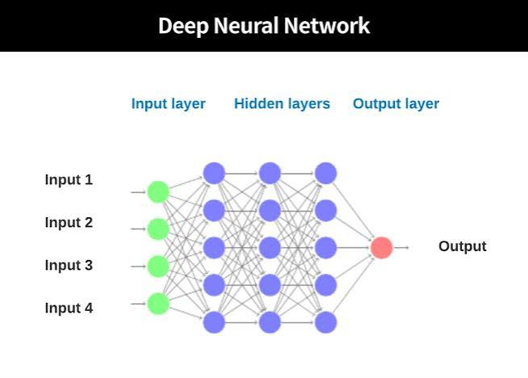
Deep learning
Use the classified data set to learn the rule
How to find the feature?

