Slide 1
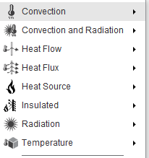
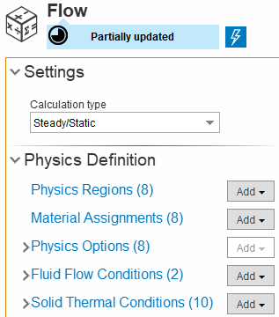

Checklist for simulation
Material Assignments
Materials of parts to be heated:
(k, ρ, and C_{p})?
Fluid to be heated:
Air
Others: specified (k, ρ, and C_{p})?
Solid Thermal Conditions
Ambient temperature/convection coefficient: ___°C / ____ W/m²-K
Boundary condition of area of jacket ends:
Insulated:___________
Constant temperature: _________°C
SO_____________
Heater setpoint / pass criteria:
____ /±____ °C
Physical Options
(For no flow)
Gravity orientation: ______
Notes for testing points/critical area
Fluid Flow Conditions
(For no flow)
Boundary condition of area of fluid ends:
(opening/wall)?
(For flow)
Inlet flow rate / temperature: ___ SLM / ___ °C
Filter included
Yes/No
Interface

