Slide 1

Noise2Music: Text-conditioned Music Generation with Diffusion Models
“A funk song with rhythmical guitars using wah pedals, a horn section, a strong bass line and husky vocals”
“Powerful tune with pop, rock influence with strong synthesizers for an introduction to a sporting event”
Notes:
Huang et al., google brain

Slide 2
Previous work
Autoregressive Approaches:
  Music LM: Generating Music From Text (Agostinelli et al. 2023)
  Next token prediction task
Variational Autoencoders
  Jukebox: A Generative Model for Music (Dhariwal et al. 2020)
  Sample from latent space
Can we use diffusion too?

Slide 3
AGENDA
Diffusion
Spectrograms vs Waveforms
MuLaMCap
Training
Model Evaluation

Slide 4


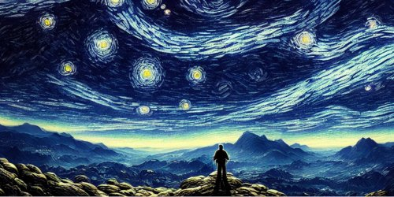
Diffusion

Slide 5
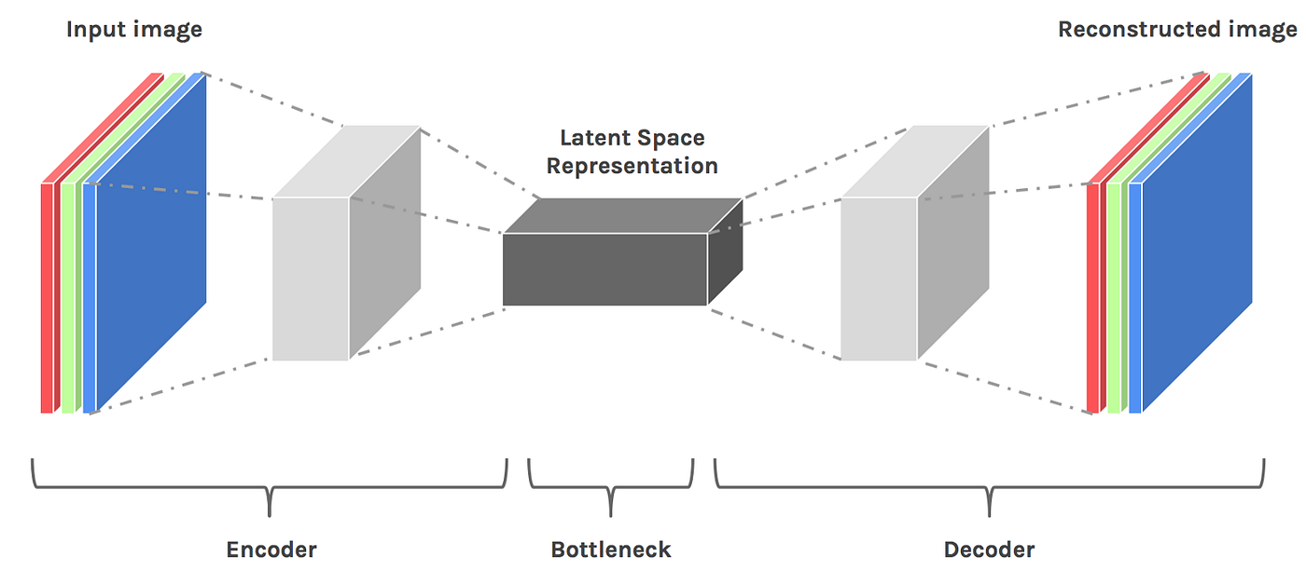
Autoencoders and latent space

Slide 6
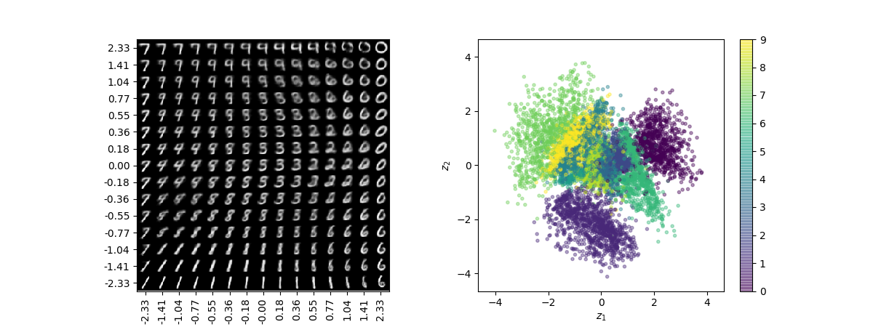
The latent space is meaningful!

Slide 7
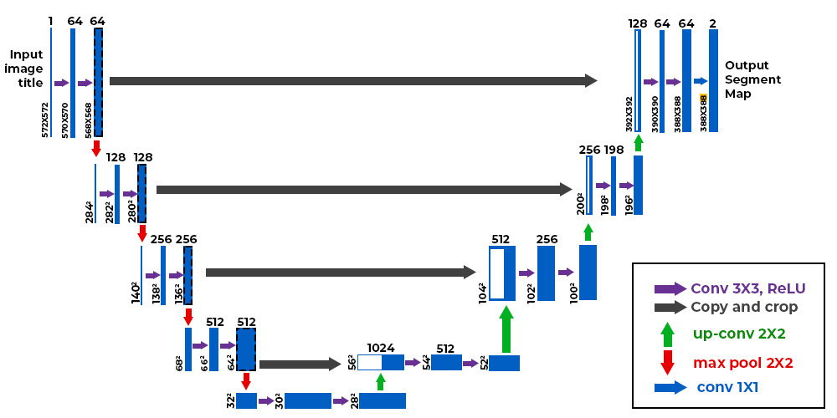
U-nets

Slide 8
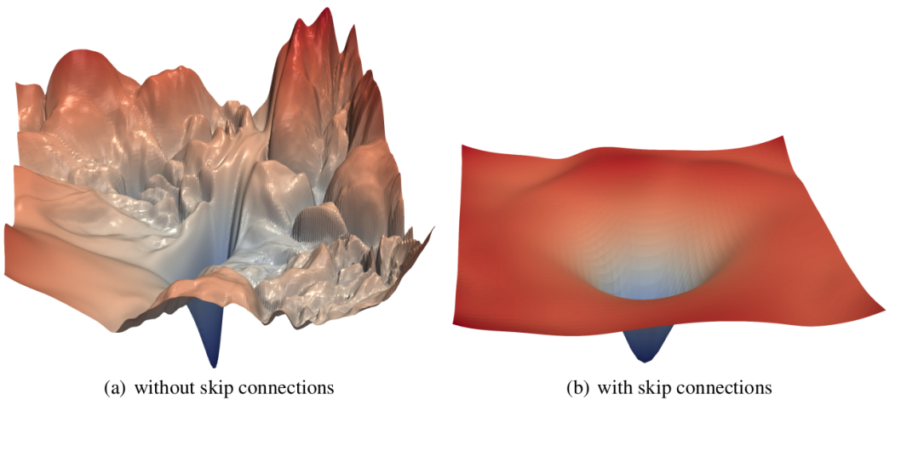
U-Nets

Slide 9
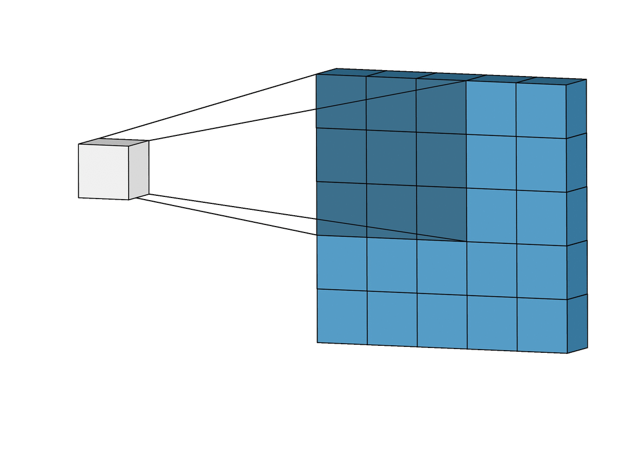
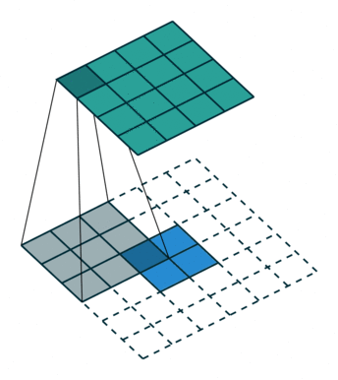
Deconvolution
Convolution
Deconvolution

Slide 10
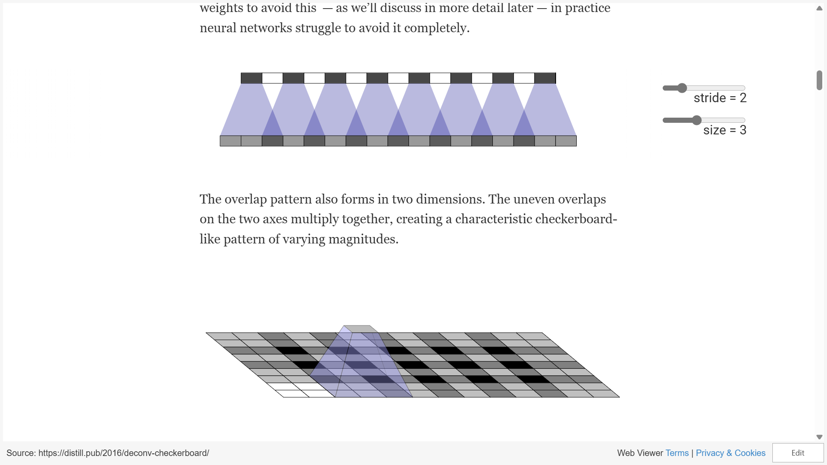
Deconvolution

Slide 11

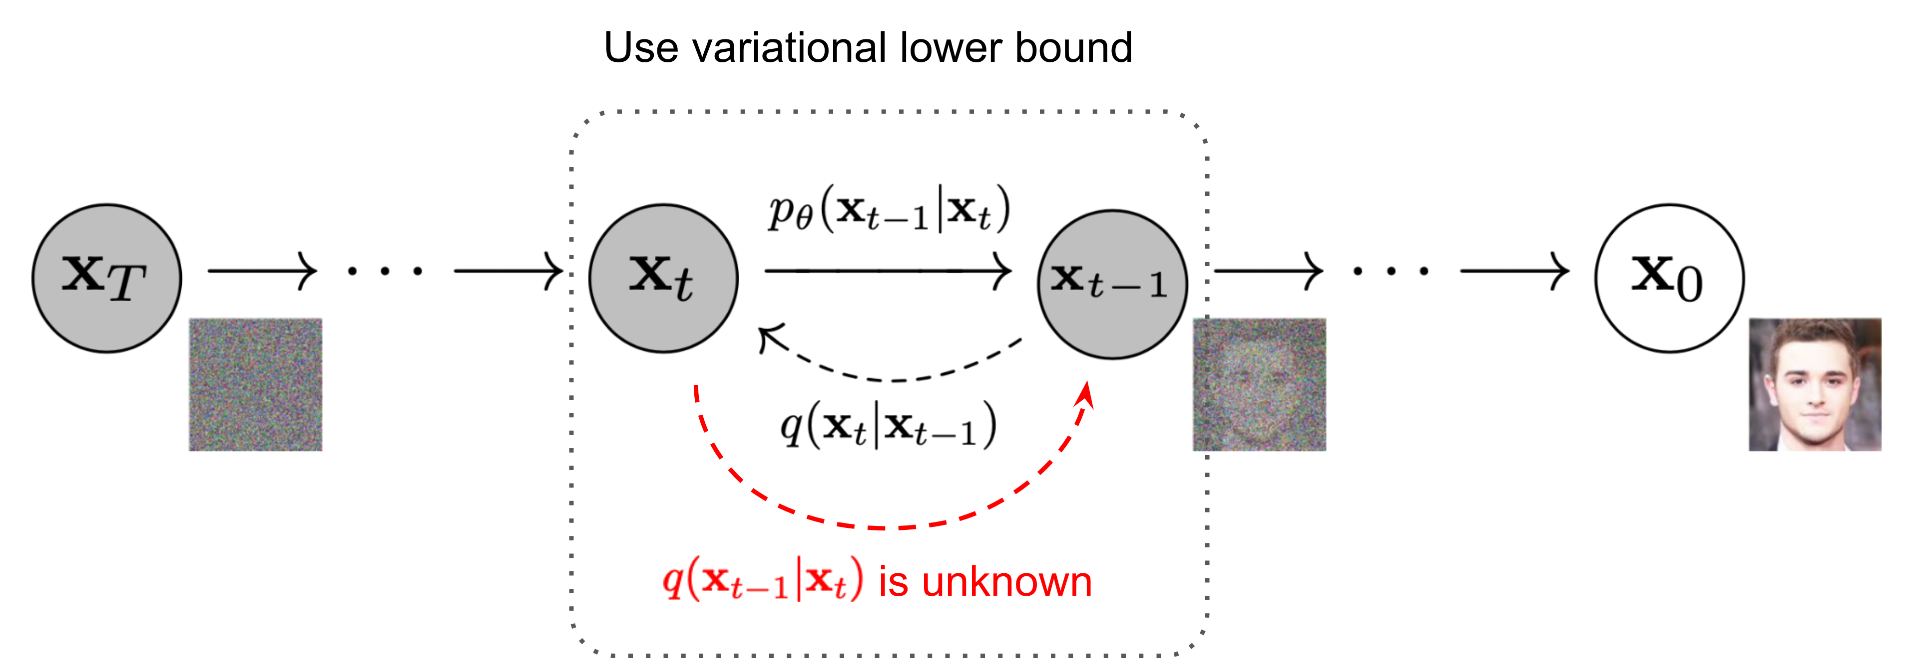
Diffusion
Current SOTA for image generation
  Inspired by Brownian motion in physics
  Obtain new images via repeated denoising
Can we turn back the clock?

Slide 12
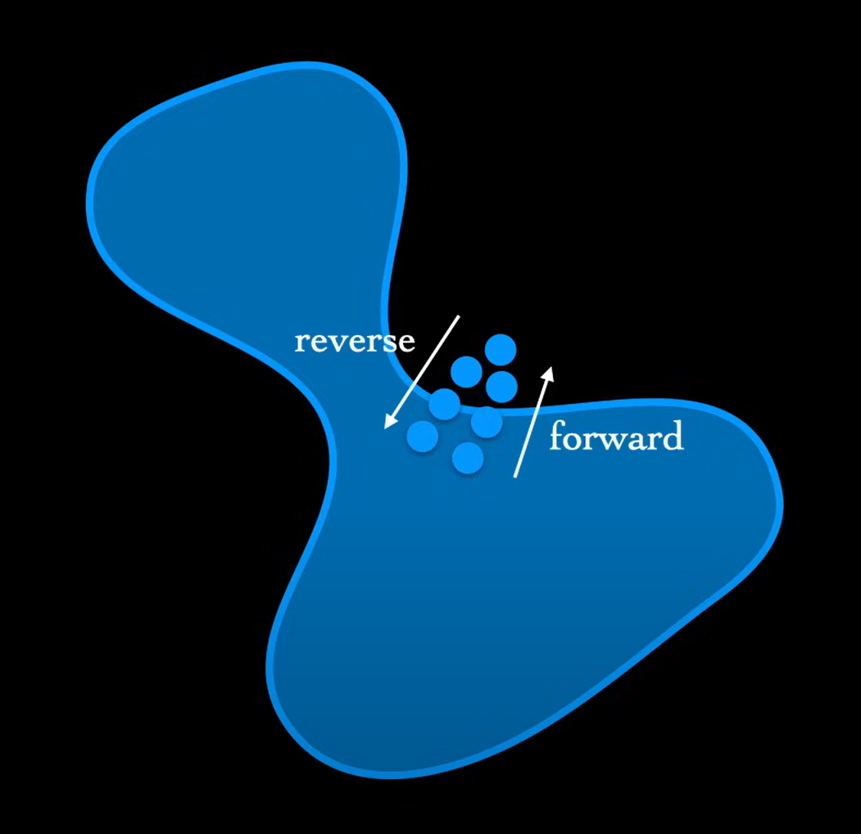
Data manifold
Most of state space is noise, only a low dimensional manifold contains valid data
We aim to undo small perturbations from the manifold

Slide 13
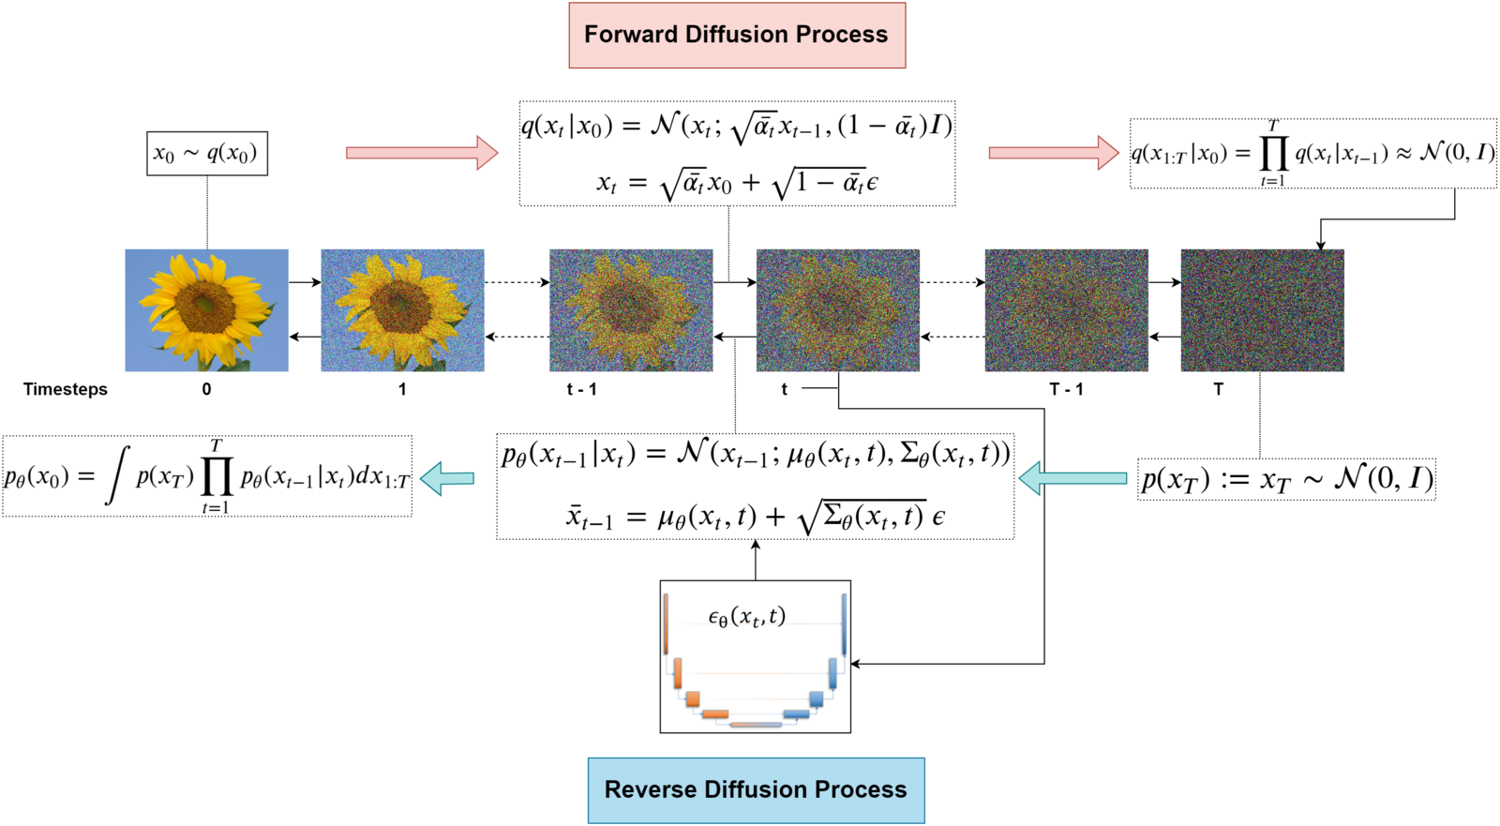
Follows a noise “schedule” (usually T~1000)
How do we guide generation with a prompt?

Slide 14
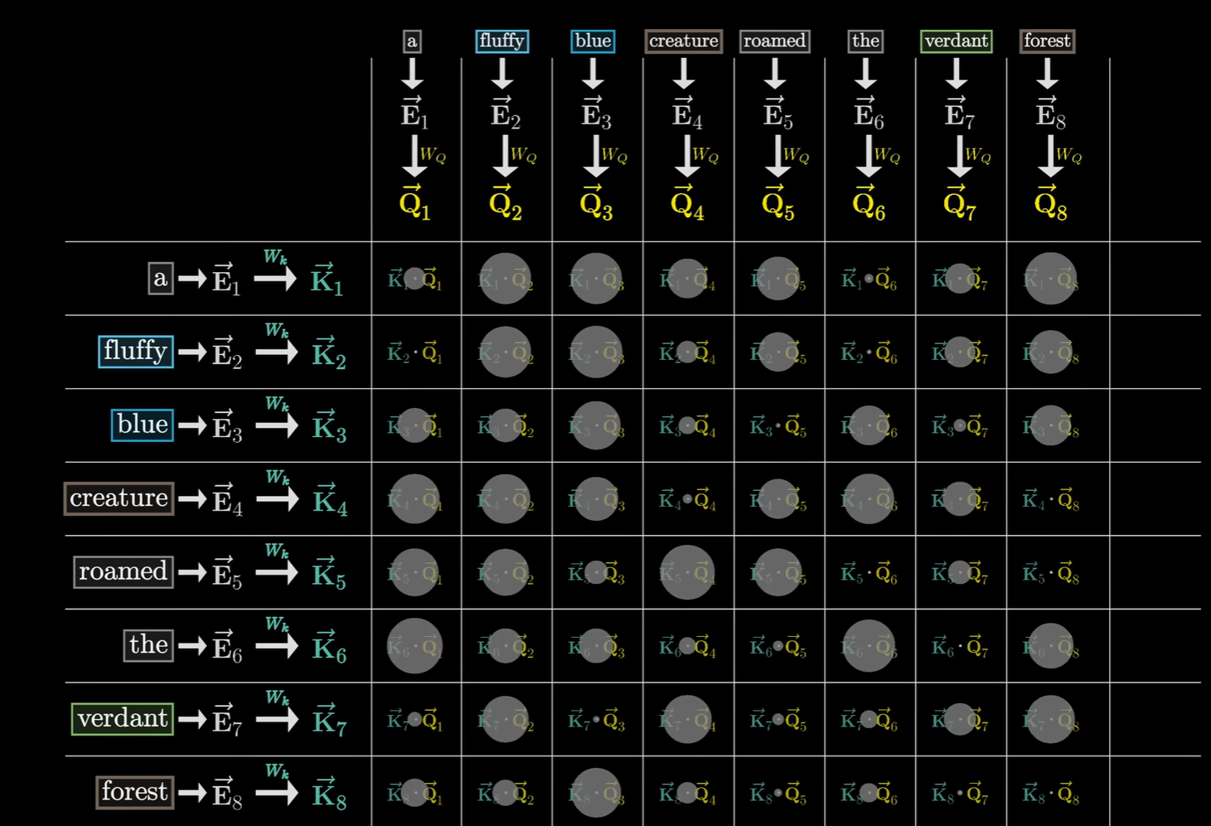
Self-Attention

Slide 15
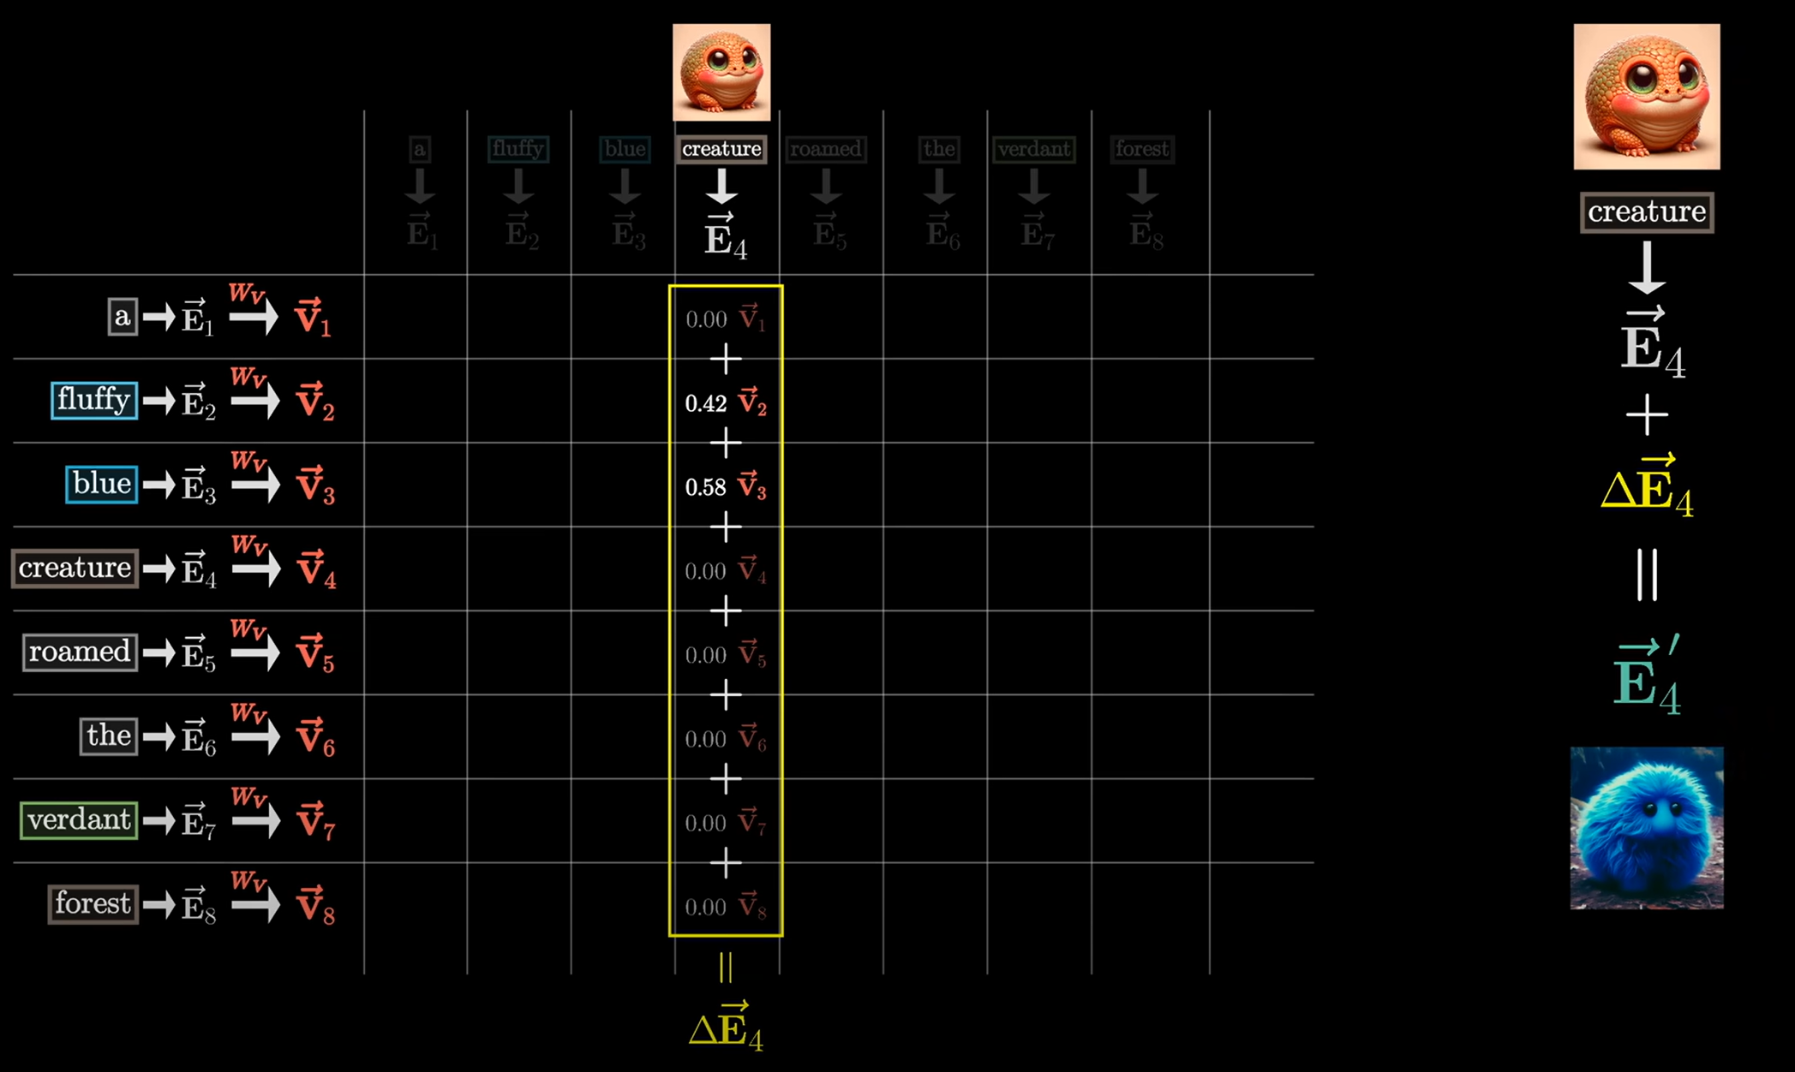
Self-Attention

Slide 16
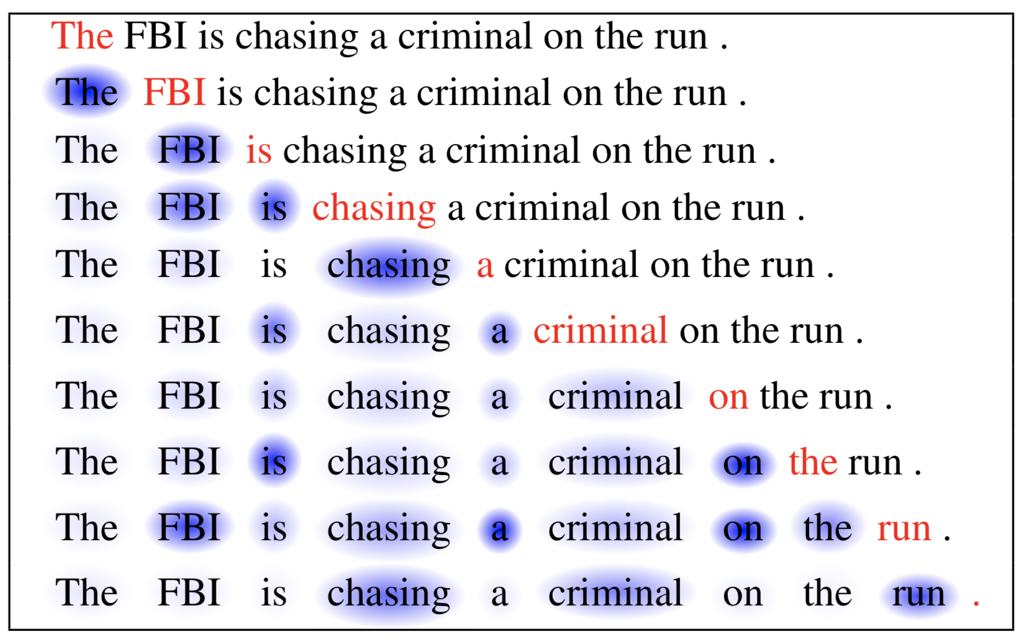
Self-Attention

Slide 17
Cross-Attention
Keys “attend to” queries
  Dot products are computed
  Vectors from value matrix used to update queried vectors
With cross-attention:
  Hidden layers of the U-net containing features of our music are “queried”
  Natural language prompt is “keyed”, attends to the hidden layers

Slide 18
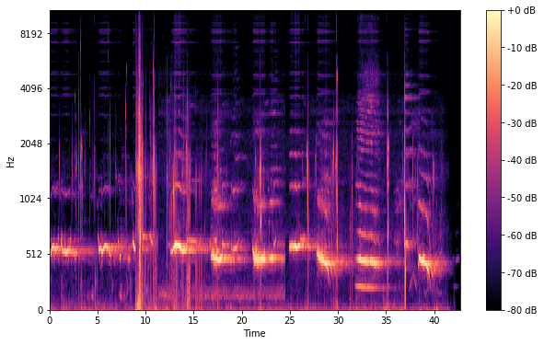
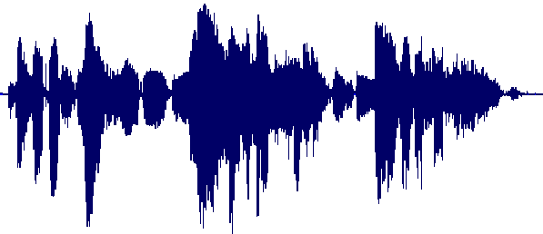
Intermediate Representation

Slide 19
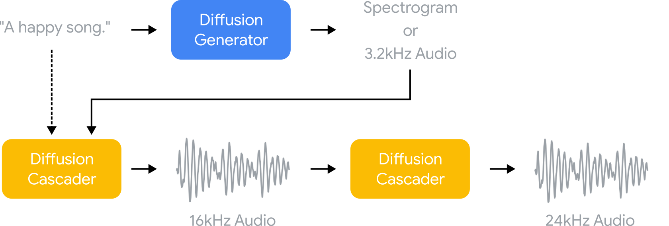
Intermediate representation
Notes:
Input ingested by cross attention
Generate an intermediate representation that is converted into 16 kHz: 3.2 KHz waveform (Cascader) or log-mel spectogram (Vocoder)
Output is transformed into 24 kHz audio via “super-resolution cascader” (decoder part of U-net)
Up-sampling done via FFT, zero-padding, and then inverse FFT

Slide 20
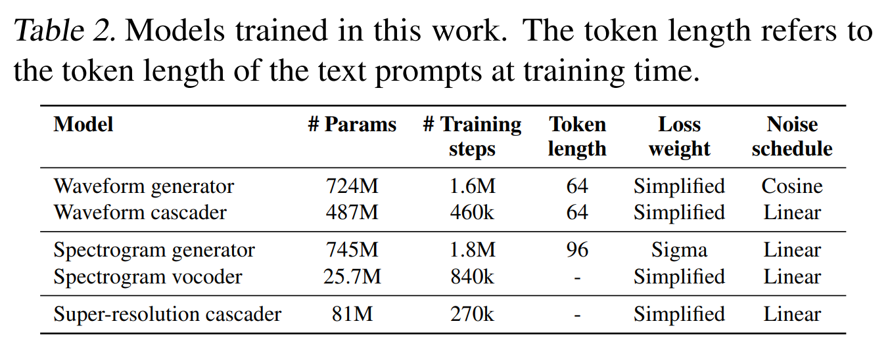
Intermediate representation

Slide 21
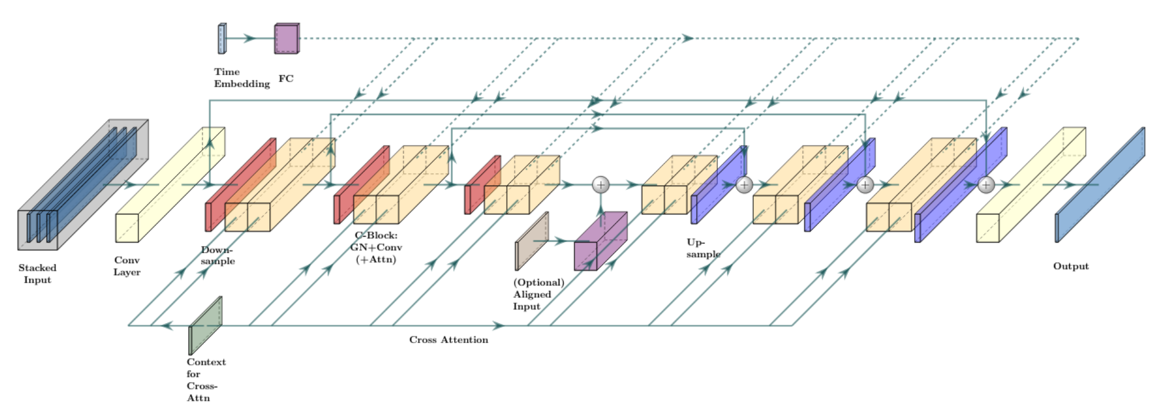
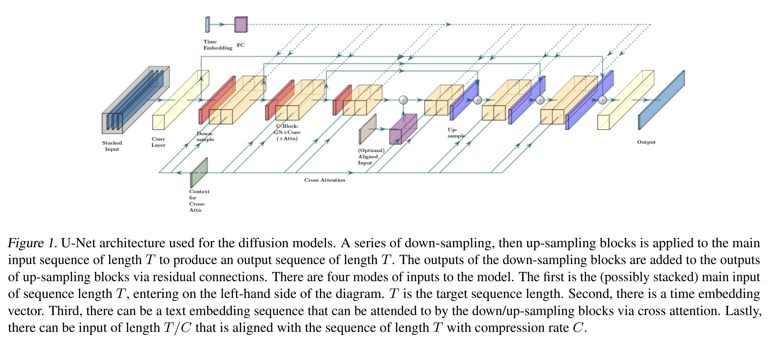
Log mel

Slide 22
MulamCap dataset

Slide 23

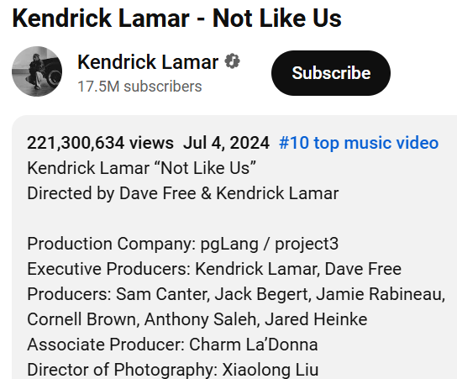
Pseudo-labeling
Scarcity of Data
Text-Music data scarce compared to Images
  Mostly metadata, no descriptions
  Imagen: O(1B)
6.8M music audio source files (~340k hours)
Noisy text labels: title, tags (genre, artist name, instrument

Slide 24
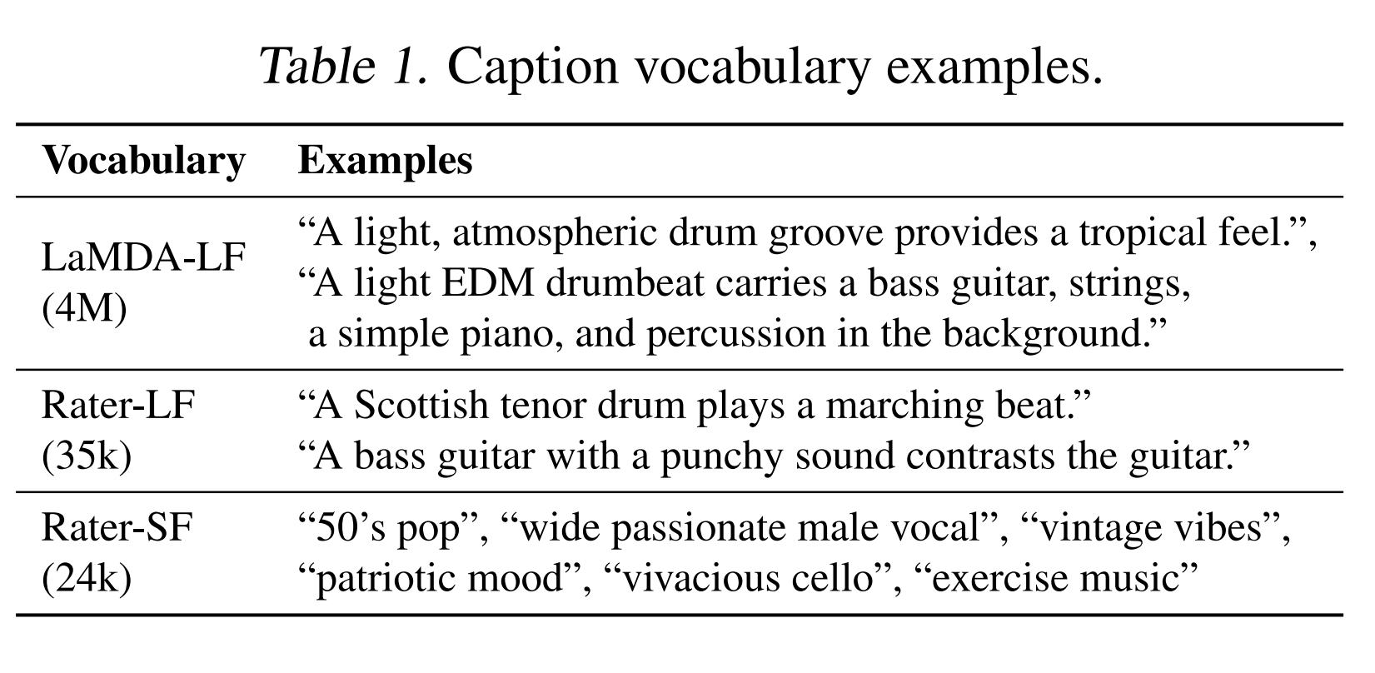
Pseudo-labeling
Where to get labels?
Large music-vocabulary datasets curated
LLM (LaMDA) used to generate 4M descriptions, primed on 150k popular song names/artists
RaterLF: rater written captions obtained from MusicCaps
Rater-SF: short-form music tags

Slide 25
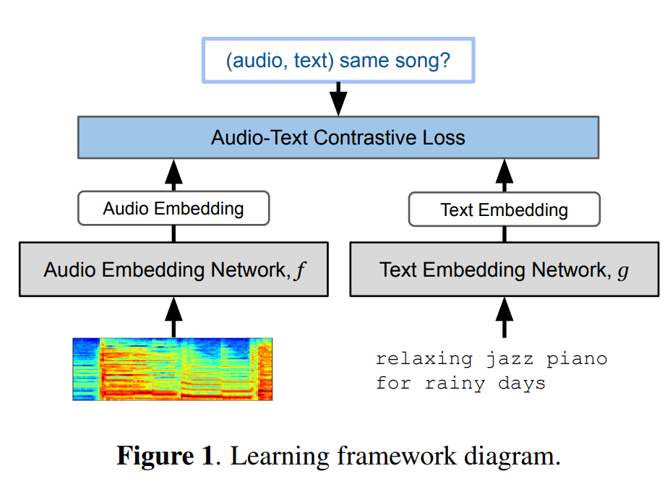
Pseudo-labeling
MuLan (Huang Et al. 2022)
Joint music-text embedding
Trained on a large number of music-text pairs gathered from 44 M internet music videos (comments, metadata, playlists)

Slide 26
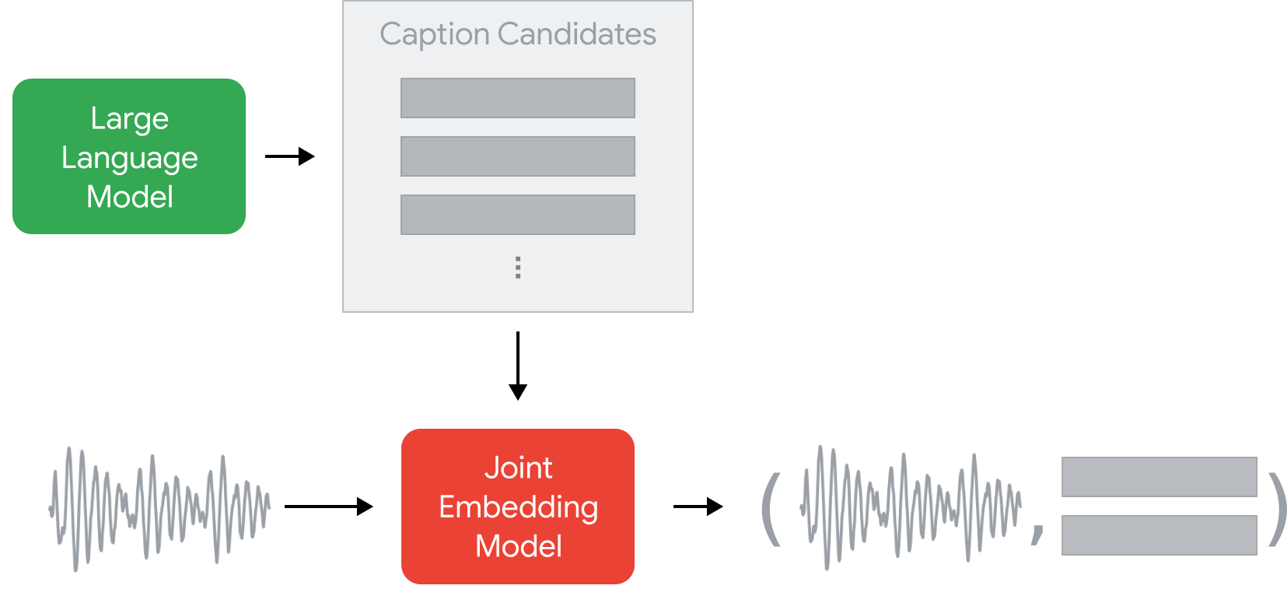
Pseudo-labeling
Top K captions closest in embedding space are sampled
Probabilities are inverse to frequency counts across all clips to avoid generic labels

Slide 27
Training
MuLaMCap
Data Mining
10 second audio clips
  3 captions from LAMBDA-LF
  3 captions from RATER-LF
  6 short-form captions from RATER-SF
Six 30 second clips extracted (340k hours)
Pseudo-labels + entity tags used as descriptions
O(300) hours of annotated audio
Trained with Adam + random corruptions and blurring during training

Slide 28
Evaluation

Slide 29
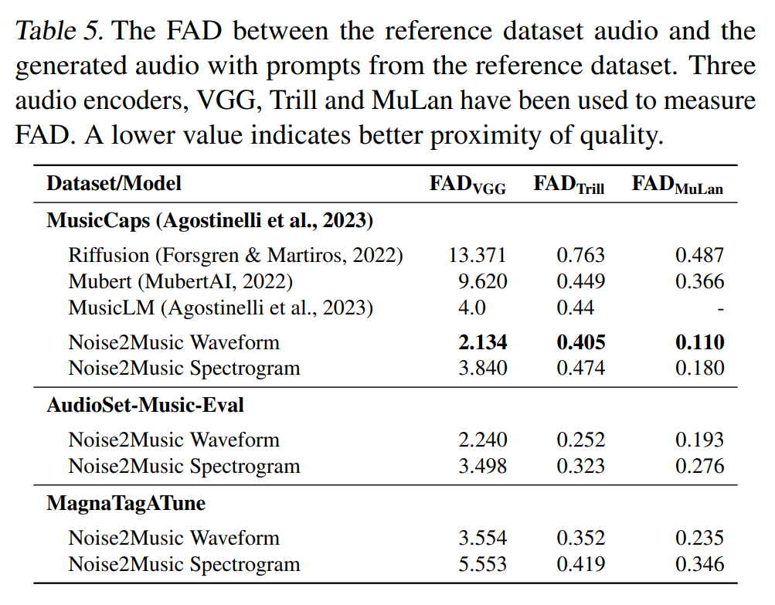
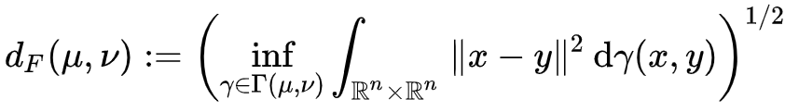
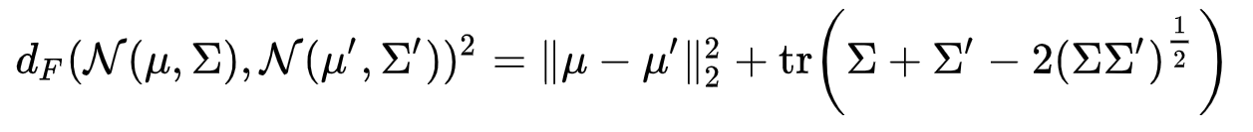
Frechet audio distance
Frechet Audio Distance (Kilgour et al. 19)
FID taken between embeddings distribution of generated samples and a set of reference audio clips
VGG = general, Trill = Vocals, MuLan = semantics
FID: Mathematical Formalism
Intuition: minimum average squared distance between samples given most generous possible joint distribution/coupling of marginals

Slide 30
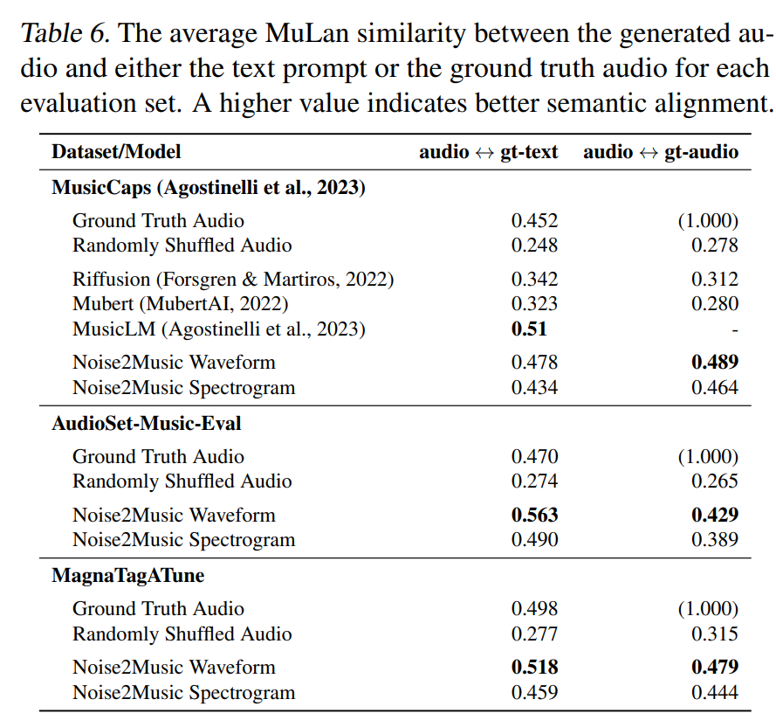
MuLan similarity
Cosine Similarity
Cosine similarity (can be computed via dot product)
Alignment in embedding space of MuLan
Possibly biased metric since MuLan used for training

Slide 31
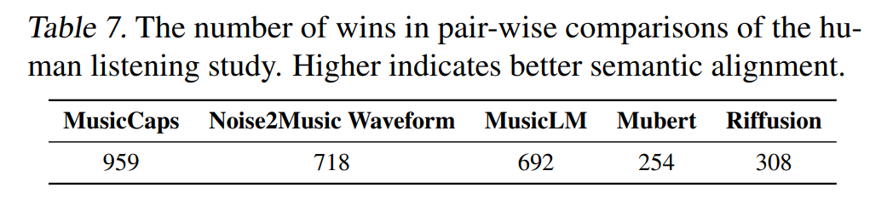
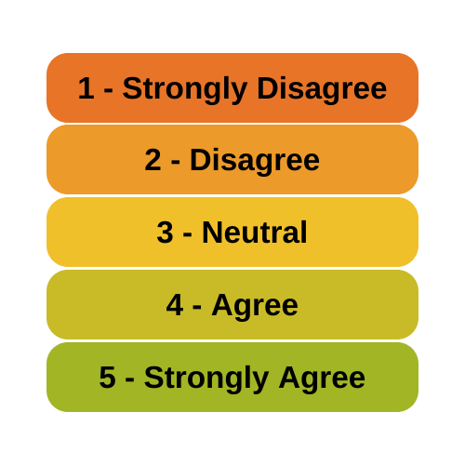
Human preference
Humans asked to rate how similar output is to caption on likert scale
Number of “head-to-head” victories recorded in Table 7
Noise2Music is the closest to the ground-truth

Slide 32
Discussion
Spectrogram vs Waveform
Qualitative analysis
Waveform performed better because of larger information content
  Shorter sequence length in spectrogram, with sound information “summarized” by fourier modes
  Spectrogram is more lightweight
  Waveform was easier to debug
Effectively conveys mood, instrument, genre, era etc. in music
Struggles with out-of-distribution prompts
Incoherent lyrics

Slide 33
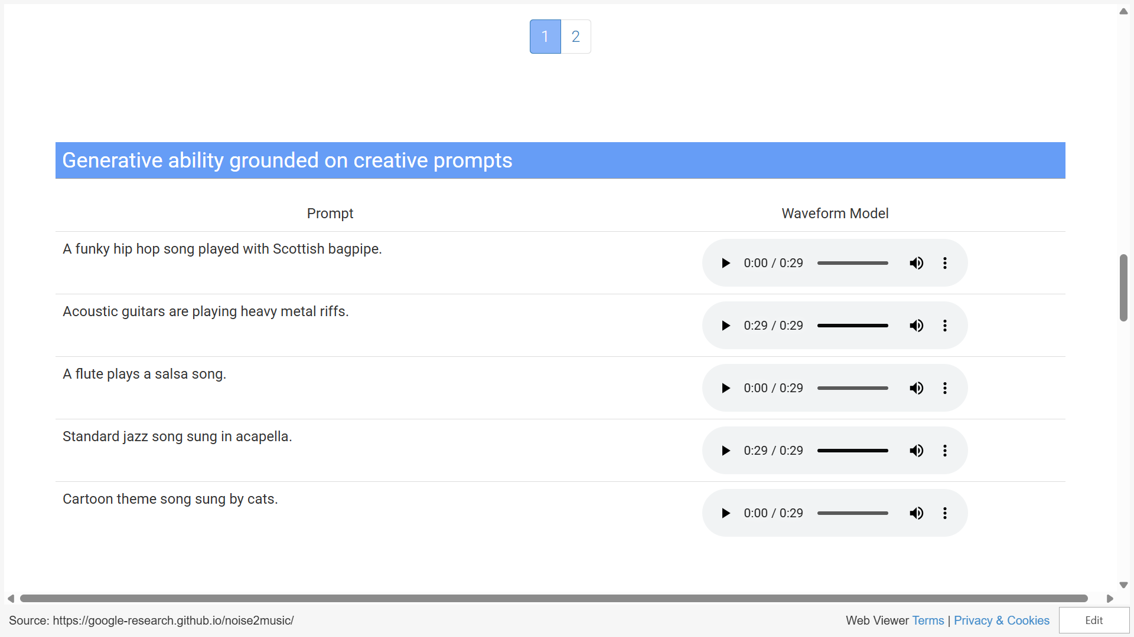

Slide 34
THANK YOU!

Slide 35
Thank yoU!
Questions?

