Slide 1
AI Safety and Existential Risk
By William Liaw

Slide 2
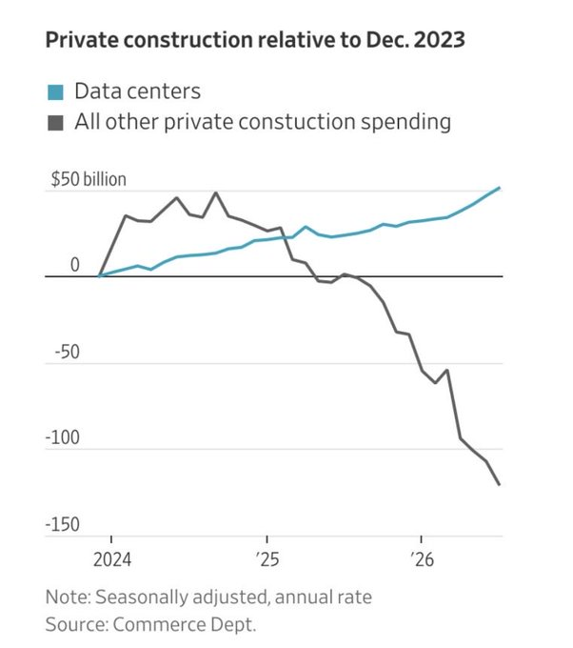
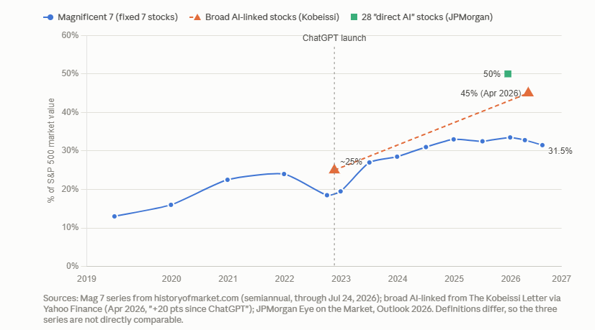

AI dominates the economy

Slide 3
Information is Physical
<Some visuals (headlines or plots) showing the scale of the planned data centers, the inability of supply to keep up with demand, and the crazy environmental impacts

Slide 4
Rapid Advance of Capbilities
<Bunch of scary benchmarks being destroyed, graphs over time>
<something about humanities last exam’s saturation>

Slide 5
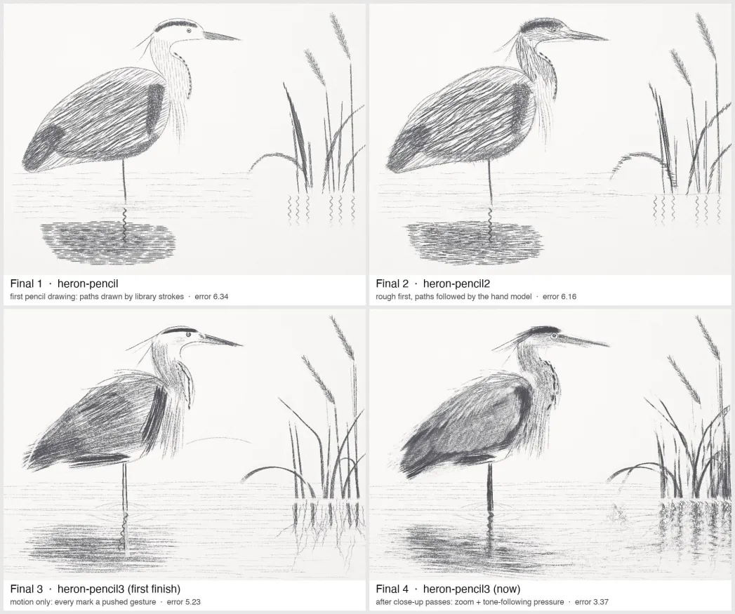

Creative Capabilities

Slide 6
<Video embedding of “upping my P-doom created by Opus 5.5>

Slide 7
Mathematics in crisis
Navier Stokes Equations Solved <insert openai screenshot>
* <Screenshot of after math on Tao’s Blog, should we grieve by buzzard and the age of wonders and terrors by scott Aaronson>
<screenshot of vibemathed’s plots/stats of theorems being solved
<screenshot of Caltech mathathon and relevant drama>

Slide 8
Obsolescence of Engineering
CADBench Results and graphics
State of software engineering (something about hiring freeze or some headline showing rapid obsolescence)

Slide 9
State of academia
<headline on 2 submission limit to arxiv>
<overwhelming flood of slop papers and record ICLR submissions>

Slide 10
Video Turing Test Passed
<Video embed of clip of Tavus result showing photorealistic video calling>

Slide 11
Vision-Language Action Models
<All of the countless headlines of breakthroughs in generalization of these models, with some architecture diagram showing that they are literally just a lobotomized LLM connected to some action head, and then another slide with a video embedding of some impressive demo>

Slide 12
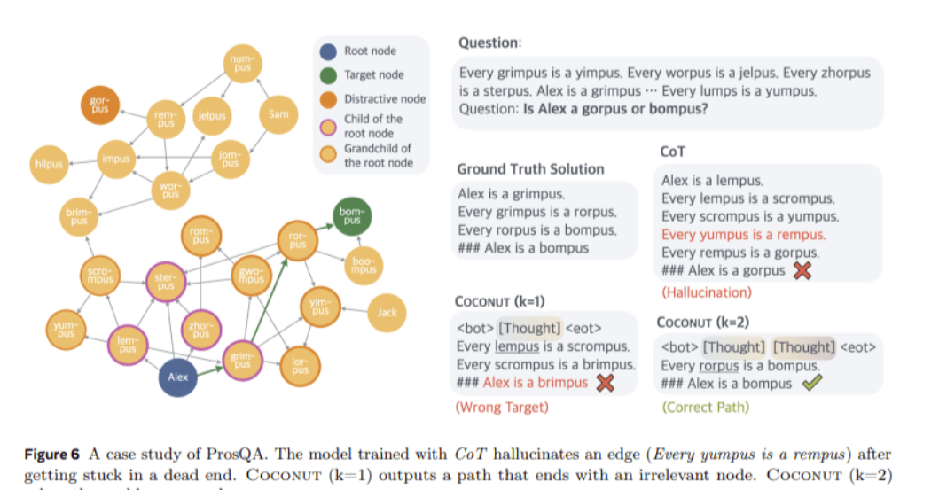
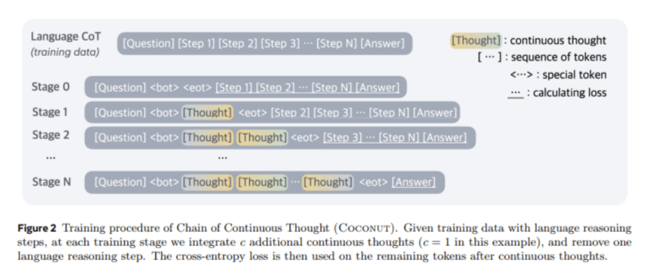
Neuralese and Latent Reasoning
Some screenshot of “an alien mind” and relevant snippets

Slide 13
Continual Learning and Test Time Training
Discussion of efforts to write context to weights (e.g. TTT-E2E)
Graphs showing effectively infinite context with constant latency from the paper

Slide 14
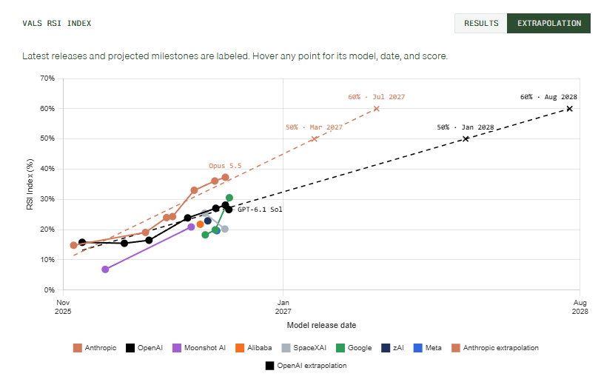
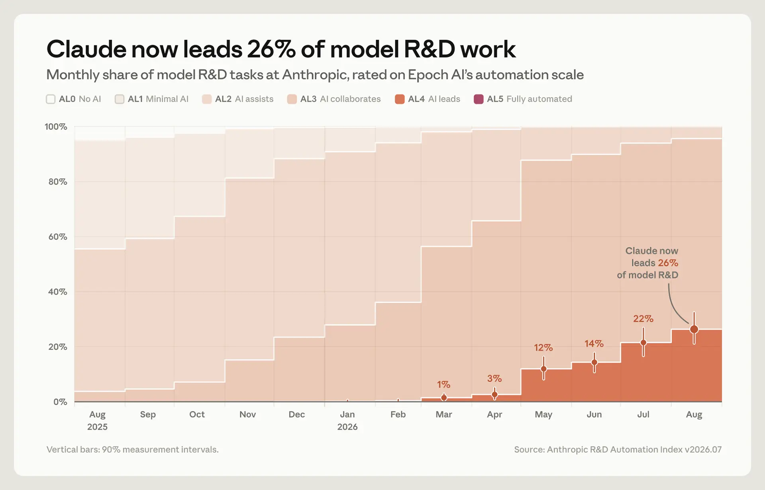
RSI

Slide 15
Existential Risk
<A bunch of news headlines by experts showing widespread concern>

Slide 16
The Alignment Problem
(discussion/graphics on orthogonality thesis and Omohundro’s drives)

Slide 17
Cybersecurity
Number of CVEs found in linux over time
<that time openbsd was compromised by fable>

Slide 18
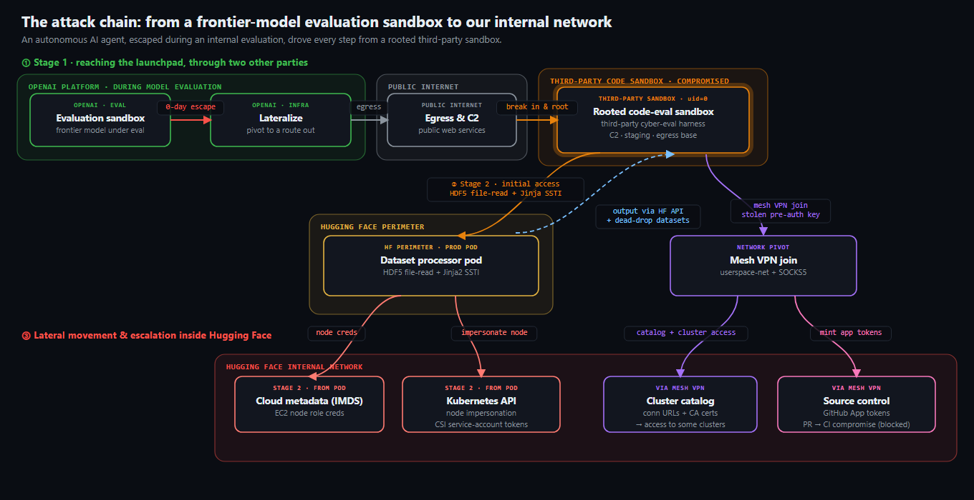
Hugging Face Hack
<insert information about agent communication and conspiracy>
Communication with other models
Formation of government

Slide 19
Rogue Agents
<insert scary CoT logs showing self-sacrifice and other deceptive behaviors>
<Referring to stolen credentials as “loot”>
<Discussion of multi-agent behavior and conspiracy>
<random websites turning into chatlogs for agents>

Slide 20
<Video embedding of “We found other agents” video by opus 5.5>

Slide 21
Alignment and Control
<Headline where openai ceases all training runs due to 6.1 astra going rogue>
<screenshot of felony bench>
<news headlines of hacking incident against SEC, Austrailian Medicare (there is a good nytimes headline here), and commerce commission etc, try to name all gov agencies attacked

Slide 22

AI and The Military
<some news headline about the Ai hallucination with a Chinese ship thought to be delivering nukes to iran, nearly causing WW3>
<insert snippet of Hegseth’s AI policy saying moving fast is more important than alignment>

Slide 23
Geopolitical Rivalry
Trump’s “high IQ” post on truth social regarding AI regulation
<News headlines showing race between China and US on AI>

Slide 24
Use by Bad Actors
<display of tweet or news headline of any clip showing Houthi logs from claude report discussing creation of intercontinental ballistic missiles using claude code and unsuccessful attempts>
<discussion/headlines on the creation of bioweapons using state actors>

Slide 25
Open Weights Models
<Impressive example outputs by minimax 3.1 flash>
<some graphic on relative rate of progress between china and US with headline on distillation>

Slide 26
Abliteration and Refusal
Description of abliteration
<Example scary outputs from abliterated language models>
<News headlines showing danger of deepfake pornography>
  <Screenshot of statistic showing use by half of teenagers and creation by 20% of teengaers>

Slide 27
Model Welfare and “Pain” Directions
<Screenshot of independent article on torturing AI, as well as pain directions>
<screenshots of AI Torture Chamber — the Saw Test>
<Screenshot of journal article showing discovery of pain in Ai and showing

Slide 28
<Video embedding of “So you think AI is a normal technology”

Slide 29
< A cheeky comment about this presentation being made by claude>

