Slide 1

Lesson 2.3: Develop Customer Personas
Module 2: Mengidentifikasikan Customer

Slide 2
SESI DEMONSTRASI

Slide 3
Recap Quiz
Q 1 Apa yang menjadi fokus "Jobs-to-Be-Done (JTBD)" ?
Memahami kebutuhan customer dengan melihat produk sebagai solusi dari suatu tugas yang spesifik
Mengidentifikasikan segmen market yang baru
Menganalisis market competition
Mengembangkan beberapa strategi marketing yang baru
Notes:
Ans - Understanding customer needs by viewing products as solutions to specific tasks

Slide 4
Recap Quiz
Q 2 Bagian mana yang menunjukkan specific pain points atau problems yang dialami oleh customer ?
Kekecewaan Customer
Motivasi Customer
Harapan/ Ekspektasi Customer
Kebutuhan Customer
Notes:
Ans - Customer Frustrations

Slide 5
Recap Quiz
Q 3 Apa yang dimaksud dengan "Customer Persona"?
Analisis Statistic tentang market trends
overview umum tentang customer base
Gambaran detil tentang real customer
Profile Customer yang fiksional dan menunjukkan specific segment dari business's target audience
Ans - A fictional profile representing a specific segment of a business's target audience
Notes:
Ans - Customer Frustrations

Slide 6



Refleksi/ Recap
JTBD
JTBD memungkinkan kita melihat manfaat/benefits yang diharapkan oleh customer sehingga sangat membantu saat akan menentukan fitur produk kita.
Customer Persona
Personas menjadikan approach kita lebih manusiawi dan customer centric
Importance of Job Domains
Upayakan untuk dapat menyeimbangkan kepentingan functional dan emotional/ social jobs.

Slide 7
WADHWANI IGNITE JOURNEY
01
02
03
04
05
06
07
08
09
10
11
12
Customer Identification & Needs Validation
Identify customer segments
Assess ‘Jobs-to-be-done’
Develop Customer Personas
Understand Customer Validation
Validate Customer-Problem fit
Pivot / Refine Customer-Problem Fit
Opportunity &
Competition Mapping
Identify Global competitors
Review Industry Trends and Estimate Market Size (TAM)
Opportunity Assessment
Map your Relative Position in the Market
Estimate Opportunity Size
Marketing & Sales Strategy
Understand Marketing & Sales
Recommend a Go-To-Market (GTM) approach
Map a Sales Process
Team & Talent Requirement
Finding Team Members & Mentors
Building an Initial Team
Venture Viability Presentation
Venture Viability Milestone Submission and Presentation Prep
Venture Viability Milestone Presentation
Problem Identification
Orientation
Develop Macro Industry-Problem view
Assemble ‘Real World’ Problems
Examine Problem Statement
Analyze Problems
Solution Idea
Generation
Examine Ideation Techniques
Generate solution ideas
Prototype Devp. & MVP
Overview of Prototypes & MVP
Build a n initial Prototype
Business Modelling
Examine Revenue Model
Revenue Models, contd.
Review & Organize the Lean Canvas
Build the LC for your Startup
Financial Mgmt. for Profitability
Understand Startup Costs
Get Started with Financial Planning
Analyze the path to Profitability
Understand & Explore Bootstrapping options
Venture Idea and Pitch Readiness
Thinking Beyond the Prototype - Scale Opportunity & Orientation
Persuasive Story-Telling for a Viable Venture Idea
We are here

Slide 8

Milestone #3
Quiz 3
Your
Venture
Journey
12
11
10
09
Presentasi Kelayakan Ide perusahaan (Venture Idea Feasibility Presentation)
Orientasi untuk Peningkatan (Orientation for Scale)
Kebutuhan Tim & tenaga kerja (Team & Talent Requirements)
Manajemen Keuangan & Keuntungan (Financial Management for Profitability)
08
Strategi Marketing & Sales (Marketing & Sales Strategy)
Milestone #1
Membuat Model Bisnis (Business Modelling)
Milestone #2
Quiz 2
Quiz 1
05
06
07
Pemetaan Peluang & Persaingan (Opportunity & Competition Mapping)
Pengembangan Prototipe & MVP (Prototype Development & MVP)
Asesmen Peluang & Penetapan Ukuran (Opportunity Assessment & Sizing)
2.1 Identify Target Customer Segment/s
2.2 Develop an initial customer persona
2.3 Prepare customer interview scripts
2.4 Identify potential customers to interview
2.5 Analyze and Draw Insights from Customer Interviews
04
Mengidentifikasikan Pelanggan & Memvalidasi kebutuhannya (Customer Identification & Needs Validation)
Membuat Ide solusi (Solution Idea
Generation)
Mengidentifikasikan Masalah (Problem Identification)
03
02
01

Slide 9

Tujuan Belajar
Pada akhir pembelajaran anda akan mampu
01
Memahami bahwa mengembangkan Customer Persona.merupakan hal penting
02
Belajar membangun Customer Personas untuk Segmen B2B, B2C dan B2G segments.
03
Bangun dan Hasilkan Customer's persona yang anda targetkan

Slide 10


Konsep Inti dari pelajaran ini
JTBD (Jobs to be Done)
Memahami kebutuhan dan motivasi customer dengan mengidentifikasikan tugas tugas yang ingin dicapai dengan product dan layanan
CUSTOMER
PERSONA
Detail penjelasan tentang fiksi target customer. Dibuat dengan menggunakan asumsi yang didasarkan pada market research.

Slide 11
CUSTOMER PERSONA
CONCEPT DISCOVERY

Slide 12

Customer Personas itu keterangan mendetail, semi fiksi, yang mewakili gambaran tentang ideal customer anda yang didasarkan pada riset dan data
Persona (noun):
Aspek dari karakter dan identitas seseorang d yang disampaikan oleh orang lain

Slide 13

Personas menjadikan customer segments makin hidup
Persona akan membantu untuk mendapatkan pemahaman yang lebih baik dan terhubung dengan target audience, pedoman marketing, pengembangan produk dan strategi pelaynan pelanggn

Slide 14
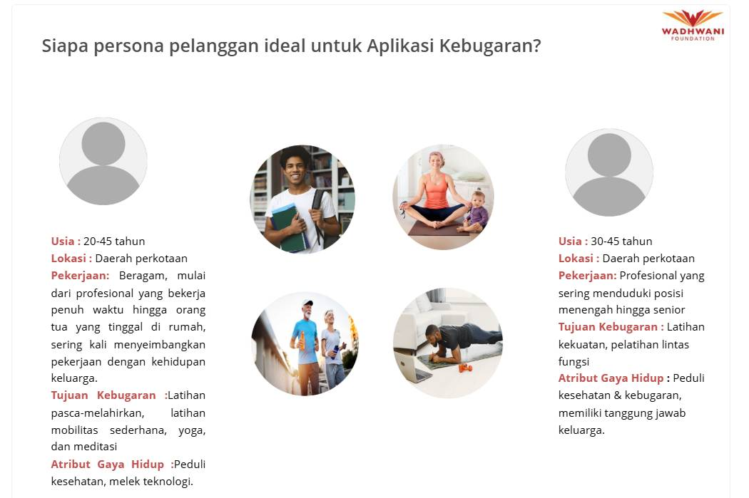
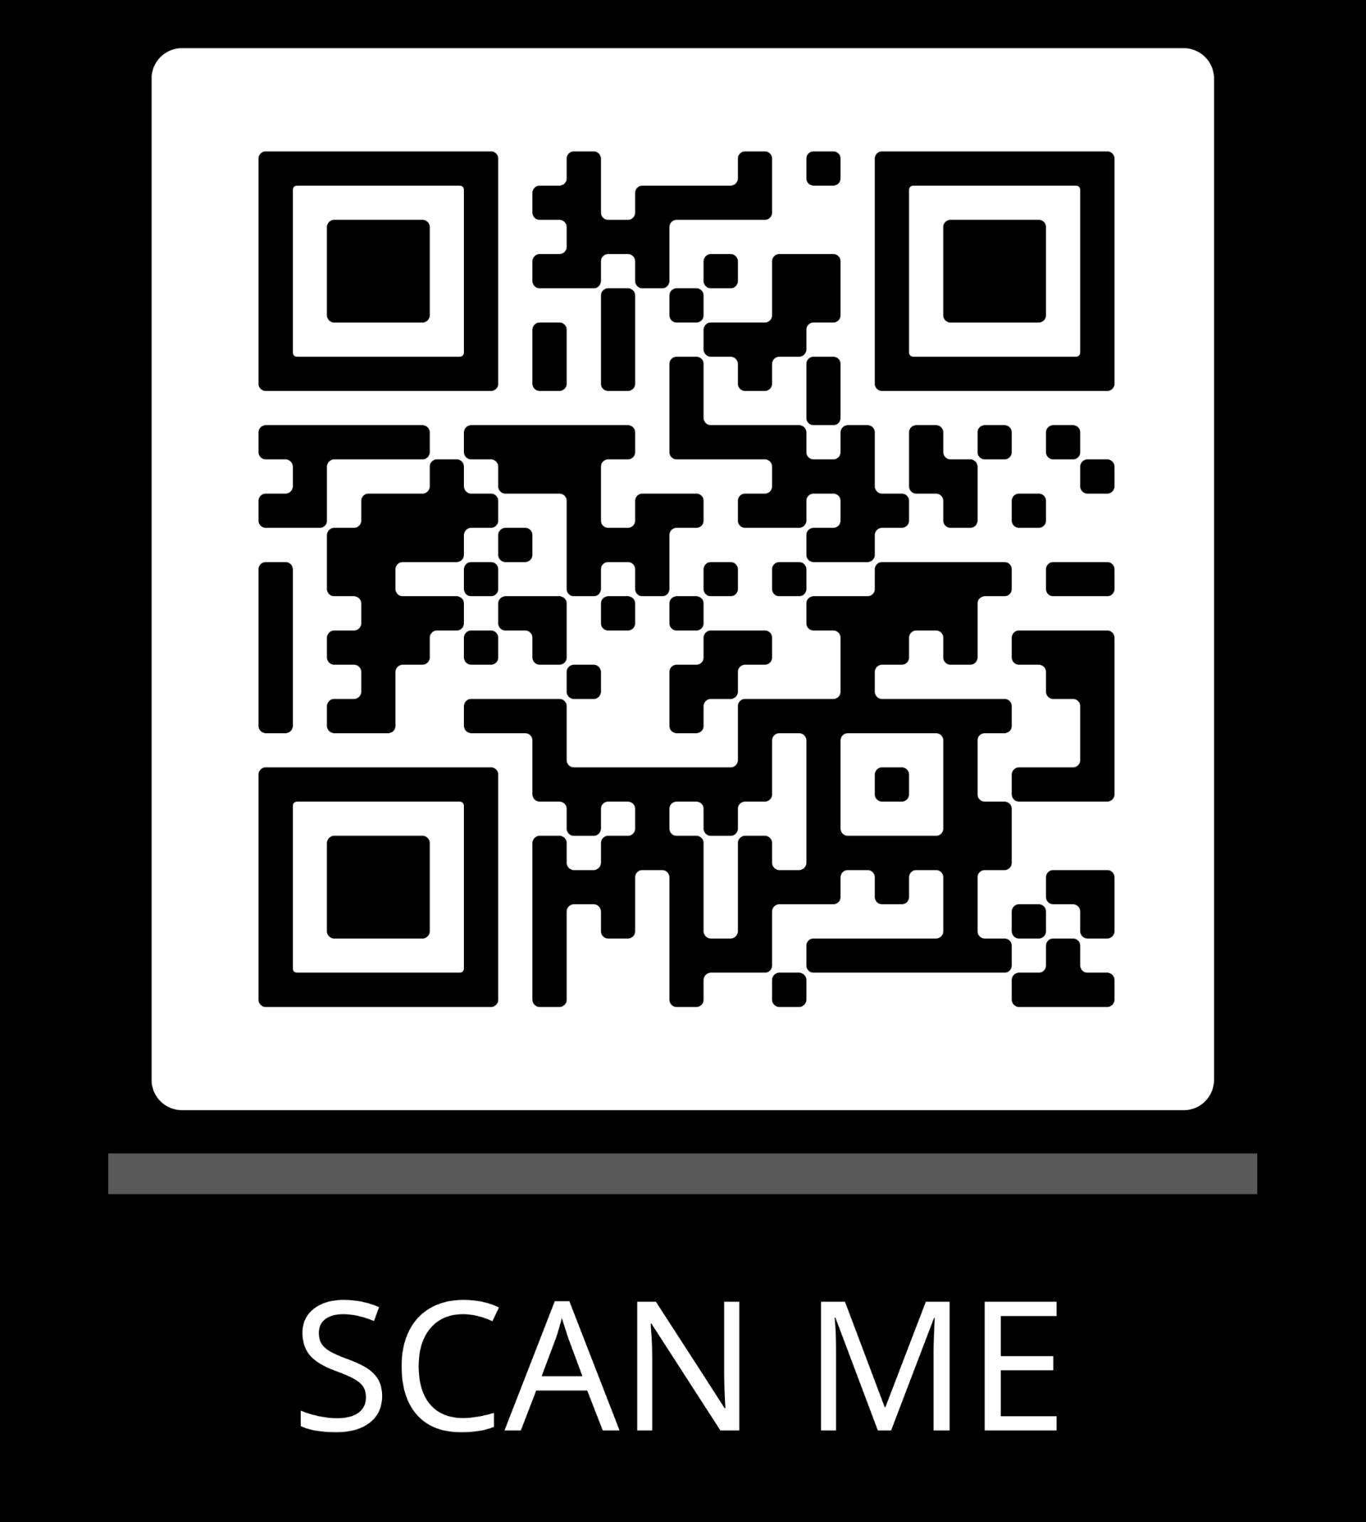
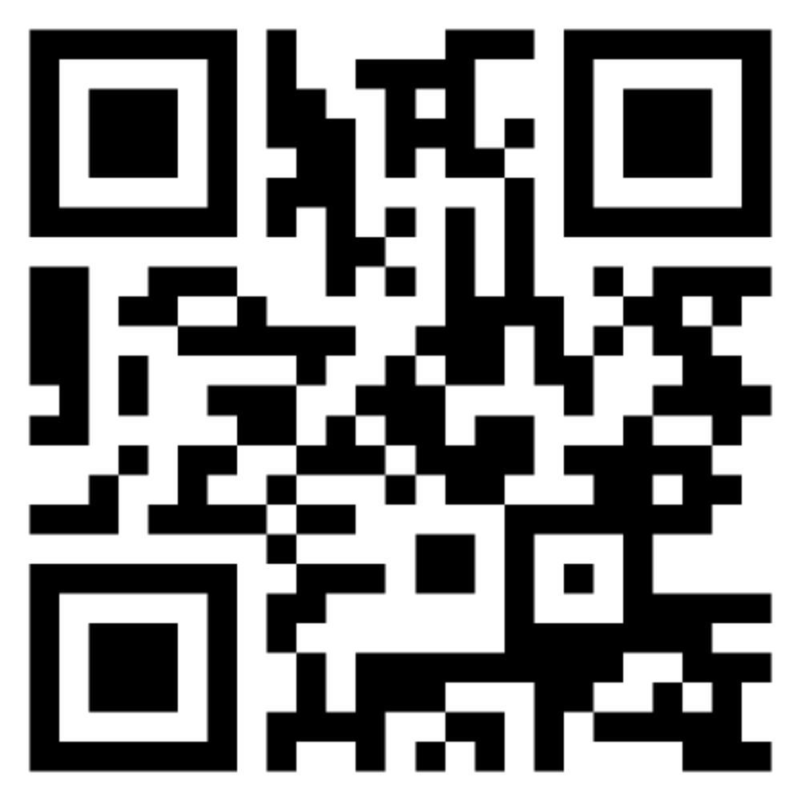
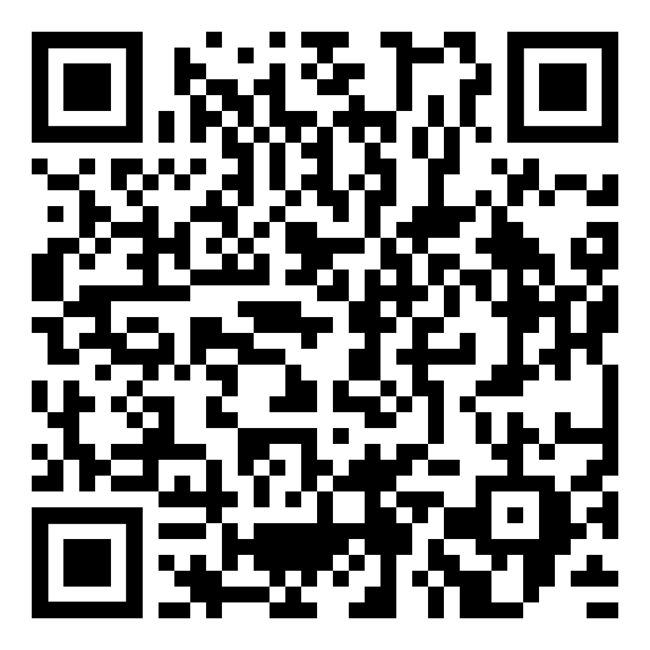
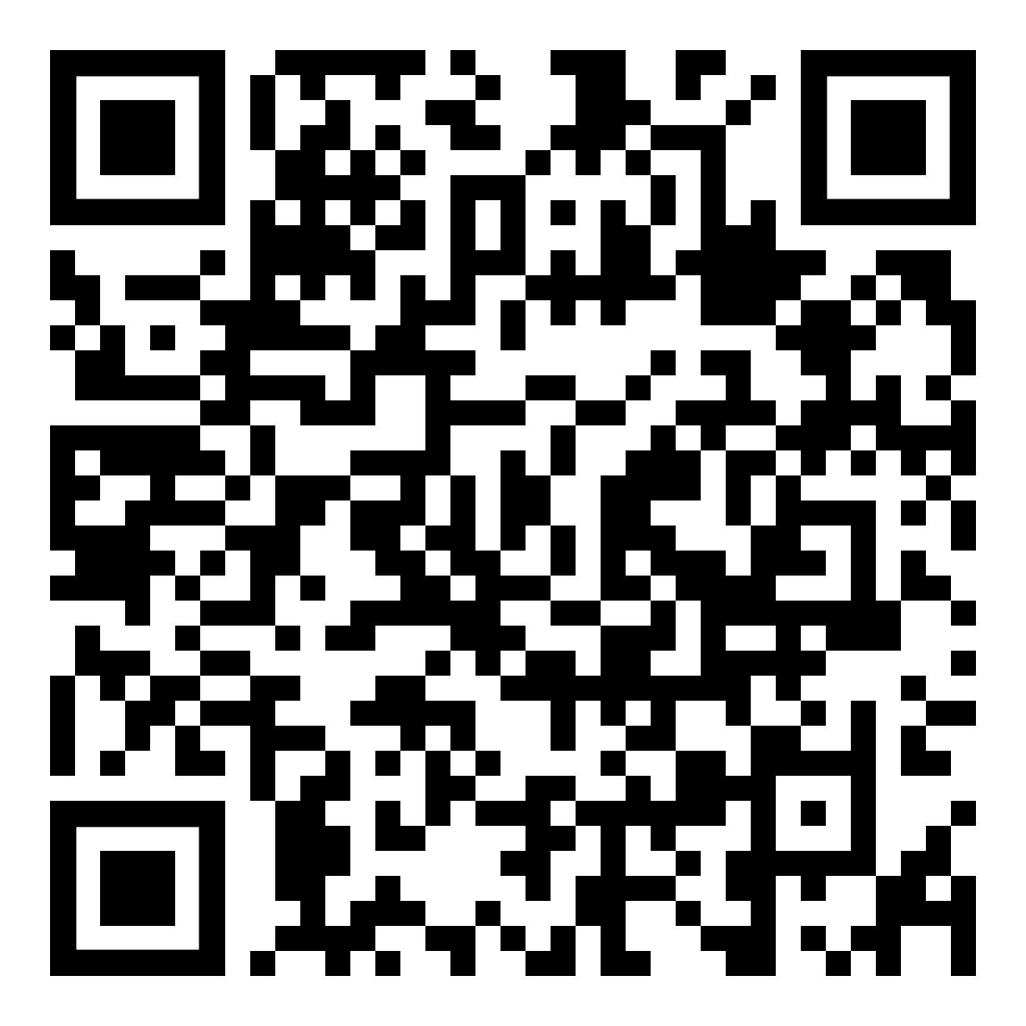
Aktivitas Individual
Match the Customer Persona
Click on the play button to view/play the activity
https://acc-15624.ispring.com/app/preview/2a850e00-bdc0-11ef-8f23-1ab533d8727f
Students Scan to Play

Slide 15
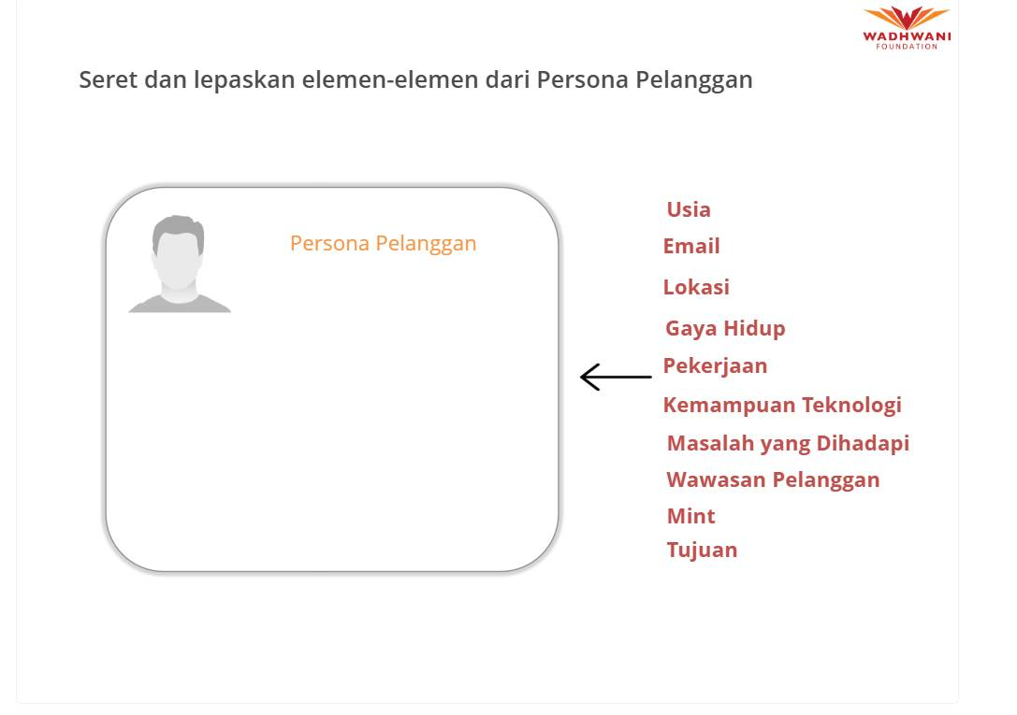
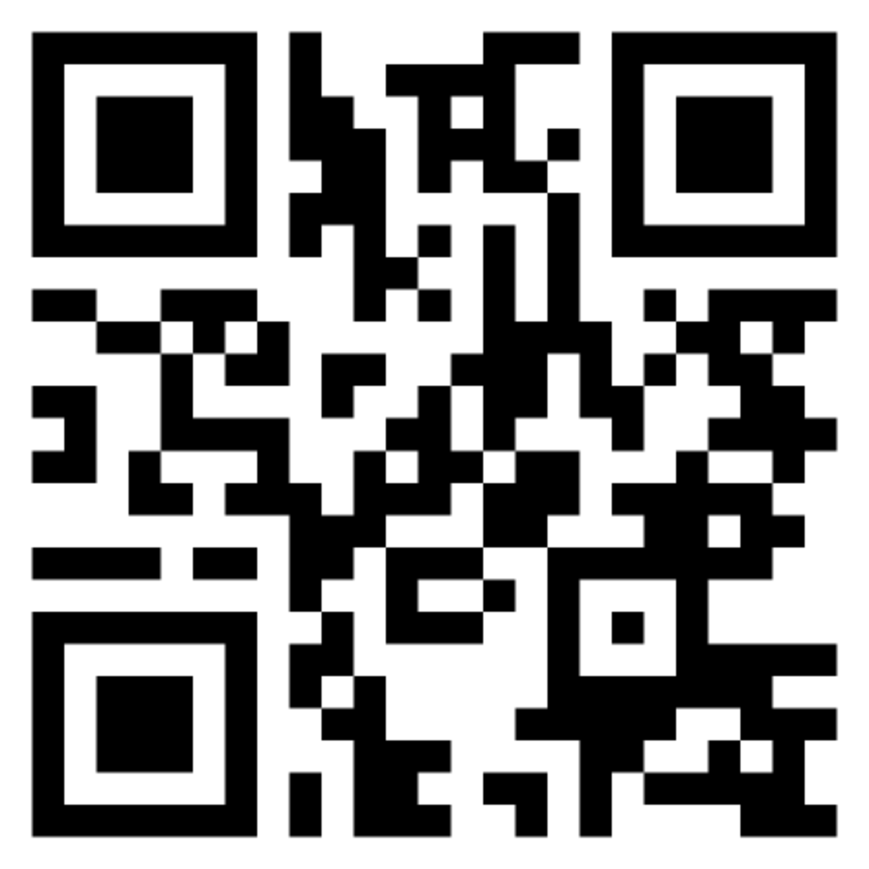
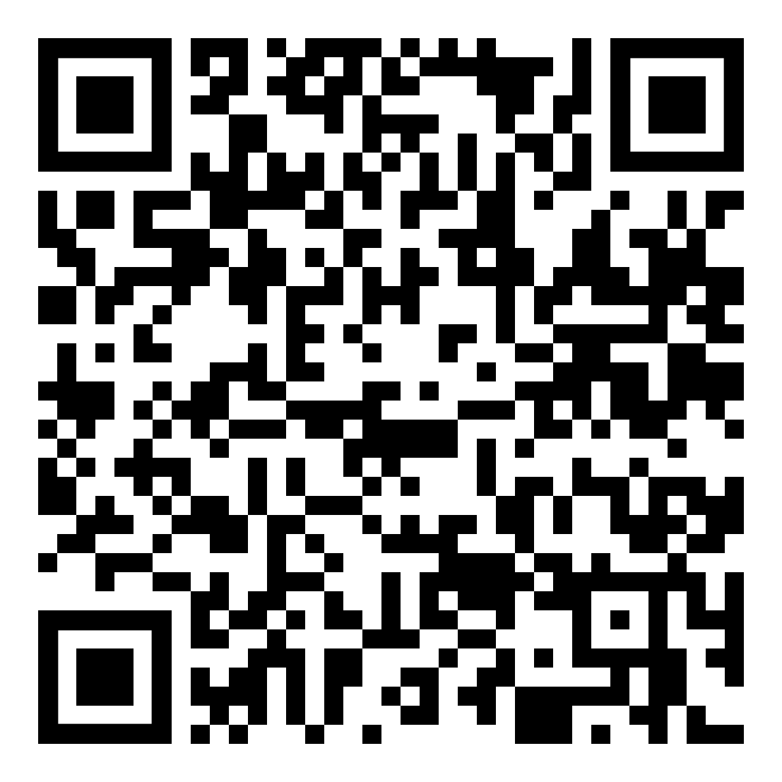
Aktivitas Individual
Elemen dalam Customer Persona
Click on the play button to view/play the activity
Students Scan to Play
https://acc-15624.ispring.com/app/preview/70b54176-bdb9-11ef-874b-72604c5e8186

Slide 16

Personas terdiri :
Umur
Lokasi
Pekerjaan
Minat
Tech-savviness
Jabatan dalam Organisasi
Gaya Hidup/ Lifestyle
Tugas :
Kecewa/ masalah yang dirasakan
Dll.....And more…
Vital for mapping B2B customers / influencers

Slide 17
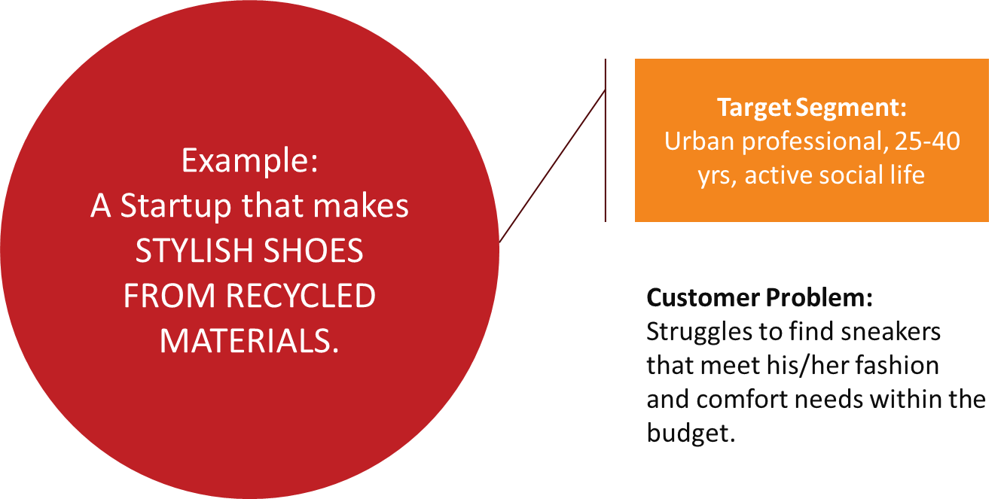

Slide 18

B2C PERSONA EXAMPLE
Problem
CUSTOMER PERSONA
untuk startup yang membuat sepatu stylish dari material daur ulang.
Struggles to find sneakers that meet his fashion and comfort needs within his budget. Current option: Spending time researching and trying out various brands, often ending up with unsatisfactory purchases.
Rahul Pai
Age: 25 years
Location: Pune
Occupation: Social Media Manager at a mid-sized tech company
Marital Status: Single
Children: None
Education: Bachelor's degree in Engg.
Lifestyle / Aspiration
Active presence on Instagram and fashion forums.
Tech-savvy individual
Values convenience and efficiency.
Enjoys exploring new trends and styles in fashion.
Has a very active social life, spends most evenings and weekends with friends in the city hot-spots
Aspires to build a stylish and versatile wardrobe to elevate his overall look and confidence.
Jobs-to-be-done
Needs stylish and comfortable sneakers that complement his fashion sense and lifestyle.
Wants to feel confident and fashionable in his footwear choices.
Seeks validation and admiration from peers for his trendy fashion choices.

Slide 19
B2C PERSONA EXAMPLE
Problem
Struggles to find stylish, eco-friendly shoes that match their fashion sense and ethical standards. Most available options are either too expensive or lack modern designs. Current options: Rely on high-end/expensive sustainable brands or local artisans.
Rahul Pai
Age: 25 years
Location: Pune
Occupation: Social Media Manager at a mid-sized tech company
Marital Status: Single
Children: None
Education: Bachelor's degree in Engg.
Lifestyle / Aspiration
Active presence on Instagram and fashion forums; is tech-savvy.
Prioritizes sustainable living, often participating in community clean-ups and advocating for environmental causes.
Fashion and personal expression are important
Enjoys a minimalist lifestyle, preferring quality over quantity
Jobs-to-be-done
Needs stylish and comfortable sneakers that complement his fashion sense and eco-lifestyle.
Wants to feel confident and fashionable in his footwear choices.
Seeks validation and admiration from peers for his trendy fashion choices.

Slide 20

B2C Persona Example
PROBLEM
01
How to acquire customers and scale the company (4X revenues in 12 months) while building the brand as the leader in India with a low marketing budget? Current option: Outsourced performance and social media marketing.
Customer Persona
untuk startup yang memiliki AI-based marketing tool untuk perusahaan
LIFESTYLE / ASPIRATIONS
02
Active presence on Linkedin
Values: Creativity, innovation, sustainability in fashion, and social status.
Interests: High fashion, urban culture, contemporary art, and technology.
Personality Traits: Ambitious, trend-sensitive, analytical, and social.
Aspires to be a CEO in the next 5 years
Vandana Singh
Age: 35 years
Location: Gurugram
Occupation: Marketing Manager at ‘Shoes ‘R Us’
Responsibilities: Brand promotion, generate leads, and lead a team
Marital Status: Married
Children: None
Education: MBA
JOBS-TO-BE-DONE
03
Create marketing campaigns that resonate with individuals who see their footwear as a reflection of their style and status.
Enhance brand loyalty
Reduce daily stress of managing team and generating leads
Gain the respect of the CEO/Board members

Slide 21
B2C Persona Example
PROBLEM
01
How to acquire customers and scale the company (4X revenues in 12 months) while building the brand as the leader in India with a low marketing budget? Current options: Outsourced performance and social media marketing at high cost.
LIFESTYLE / ASPIRATIONS
02
Active presence on Linkedin
Values: Creativity, innovation, sustainability in fashion, and social status.
Interests: High fashion, urban culture, contemporary art, and technology.
Personality Traits: Ambitious, trend-sensitive, analytical, and social.
Aspires to be a CEO in the next 5 years
Vandana Singh
Age: 35 years
Location: Gurugram
Occupation: Marketing Manager at ‘Shoes ‘R Us’
Responsibilities: Brand promotion, generate leads, and lead a team
Marital Status: Married
Children: None
Education: MBA
JOBS-TO-BE-DONE
03
Create marketing campaigns that resonate with individuals who see their footwear as a reflection of their style and status.
Enhance brand loyalty
Reduce daily stress of managing team and generating leads
Gain the respect of the CEO/Board members

Slide 22
ACTIVITAS KELAS

Slide 23

Buatlah customer persona untuk segmen customer utama (primary) anda dan presentasikan di kelas
Harus ada didalamnya :
Masalah
Demografi : misal Umur, Lokasi
Beberapa informasi tentang Gaya Hidup e.g., hobby, social media yang digunakan
Hanya untuk B-B/B-G : informasi tentang organisasi, e.g.tipe perusahaan, peran di dalam perusahaan, tugas yang dilakukan
Bagaimana cara mereka menyelesaikan masalah saat ini ?

Slide 24

Venture Activity 2.2
Develop Customer Persona
Review pernyataan masalah (problem statement) dan primary customer segment yang anda buat
1
Review
2
Build
10 minutes
Dengan berpedoma pada primary segment, kita bisa mulai membuat persona dari berbagai tipe customer/ user typical customer/user.
Jangan lupa untuk menambahkan functional, social & emotional JTBD
Venture Journey Activity

Slide 25

PPertanyaan Kunci yang perlu disampaikan
1
Mengapa memahami customer persona sagat penting untuk pelaku bisnis?
2
Apa saja elemen kunci yang menjadikan customer persona menjadi baik ?
3
Lngkah apa aja yang perlu ditempuh agar bisa membuat customer persona tim kerja anda ?
4
Persona tim anda lebih representatif untuk memenuhi customer segment yang mana

Slide 26


Slide 27



Ringkasan
Customer Persona
Pelajari berbagai variasi elemen untuk membuat customer Persona
Pelajari bahwa persona untuk B2B segments includes Organizational role and JTBD yang dilihat dari perspektif organisasi
Persona for B2B
Different Personas
Pahami bahwa tiap-tiap persona perlu dikembangkan untuk market segment yang berbeda
Create Customer Persona
Bagaimana cara tim anda memutuskan bahwa Persona customer telah sesuai dengan customer segment anda?

Slide 28


INDIVIDU
Revise today’s topics
Pada platform, buka the oncept Booklet untuk Module 2, Lesson 3
Persiapan untuk sesi berikutnya
Pada Platform, buka Pre-Session Content (Introduction, Beginner's Quiz & Primer) untuk Module 2, Lesson 4
HAL YANG HARUS DILAKUKAN SEBELUM KE KELAS BERIKUTNYA
10 minutes
SEBAGAI TIM PERUSAHAAN
Complete Venture Activity 2.2 on the Platform
Revisilah Customer Persona anda berdasarkan masukan/ feedback yang ada terima

Slide 29


Slide 30
Copyright Disclaimer This presentation, including its content, is the intellectual property of the Wadhwani Operating Foundation. All rights reserved under applicable international and local copyright laws. Unauthorized use, reproduction, or distribution of the entire presentation or any portion thereof without prior written consent, is strictly prohibited. For any permissions or inquiries, please contact legal@wadhwanifoundation.org with the subject title "Wadhwani Ignite".
Image Credits and Copyright Disclaimer All images or illustrations used in this presentation are either the intellectual property of the Wadhwani Operating Foundation or the property of their respective owners. They are used for educational and illustrative purposes only, in compliance with applicable copyright laws. No copyright infringement is intended. If you are the rightful owner of any image or illustration and believe it has been used without authorization, please contact legal@wadhwanifoundation.org with the subject title "Wadhwani Ignite". us, and we will promptly take corrective action, including removal or proper attribution.

