Slide 1

PRESENTATION BY :
William – Ellen – Sonia

Slide 2
Canvas
A two-dimensional touch-sensitive rectangular panel on which drawing can be done and sprites can be moved.
Note :
The Width and Height are measured in pixels and must be positive.
Any location on the Canvas can be specified as a pair of (X, Y) values, where
X is the number of pixels away from the left edge of the Canvas
Y is the number of pixels away from the top edge of the Canvas

Slide 3
Interval
The interval in milliseconds at which the sprite's position is updated. For example, if the interval is 50 and the speed is 10, then the sprite will move 10 pixels every 50 milliseconds.

Slide 4
X = The horizontal coordinate of the left edge of the sprite, increasing as the sprite moves to the right.
Y = The vertical coordinate of the top of the sprite, increasing as the sprite moves down.
Z = How the sprite should be layered relative to other sprits, with higher-numbered layers in front of lower-numbered layers.

Slide 5
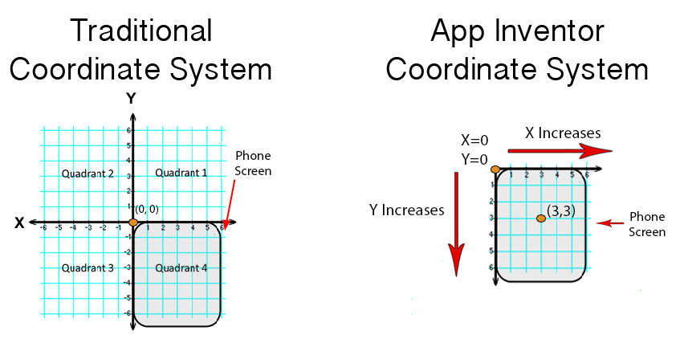

Slide 6
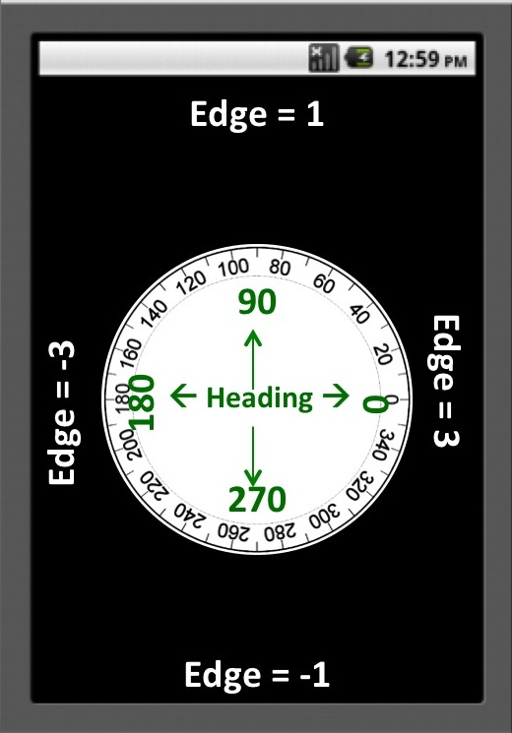
North(1),
Northeast(2),
East(3),
Southeast(4)
South (-1)
Southwest(-2)
West(-3)
Northwest(-4).
Edge = Tepi / Pinggir

Slide 7
SOURCE http://ai2.appinventor.mit.edu/reference/components/animation.html

