Slide 1

Acme procurement
Case study
Quote review, catalog guidance and approvals
William Bittner / 2 November 2026
Notes:
Introduce the customer and scope. The brief specifies a five-hour timebox and asks for prioritisation. Explain your actual approach and time honestly if asked. Source: FDE-Case-Study.pdf.

Slide 2

What I built
01
More dependable extraction
OCR, missing fields and safer quote totals.
ACME POLICY
Rules and approvals
02
Quote review and alternatives
Apply Acme’s category rules and auto-approve requests below €2,000.
Compare the PDF, edit items and swap options.
03
Negotiated catalog suggestions
Recheck approval when request details change.
Show and inspect relevant supplier prices.
02
Notes:
Introduce the implemented work rather than repeat the assignment. I improved extraction and OCR, added side-by-side quote review and alternative selection, built negotiated-article suggestions, and implemented Acme category and approval rules. Requests below 2,000 euros are automatically approved; edits re-evaluate the decision. Sources: handover.md, SOLUTION_NOTES.md.

Slide 3
PDF extraction: what changed
1
2
3
4
Image text via OCR
Missing fields
Alternative items
Quote totals
Read image-based supplier details locally.
Keep useful results when the VAT ID is missing.
Keep options separate from base order lines.
Preserve quoted totals and discounted prices.
Examples: styleGREEN image text and Gärtner Gregg alternatives.
03
Notes:
Explain each change and why: styleGREEN supplier details were in an image, so local OCR supplements selectable text. Missing VAT IDs previously caused schema validation to discard all extraction data. Alternative positions are kept apart from base lines. The backend uses a clearly labelled quote total when unambiguous, and the form preserves discounts and asks for manual review when it cannot safely recalculate. Source: SOLUTION_NOTES.md, pdf-benchmark.md.

Slide 4
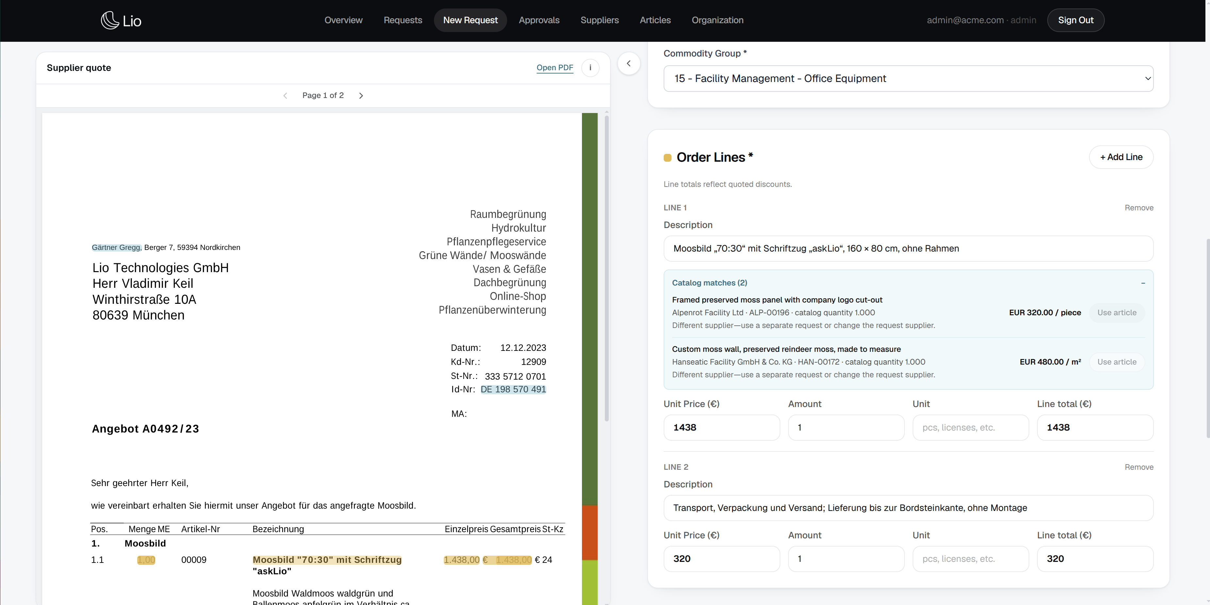
Quote review: what I added
A hideable PDF view sits beside the request form.
Users can add or swap alternatives and review the total and VAT.
Highlights link likely PDF matches to the form for review.
04
Notes:
Show the hideable split view and continuous PDF scrolling in the current app. Selecting a field highlights possible matches on the source; the link is inferred, not a model-provided citation. Demonstrate adding or swapping an alternative and the VAT breakdown when totals reconcile. The screenshot is from an earlier development view; the live app shows the current interface. Sources: handover.md and Gärtner Gregg quote.

Slide 5
Catalog guidance and Acme categories
Catalog suggestions
Customer-specific categories
I added organization-scoped matches showing supplier, unit and negotiated price.
Cable ties
Electrical Engineering
Printer toner
IT Hardware
Requesters can open an article and apply a compatible supplier’s price.
Monthly software
subscription ≤ €20
Office Supplies
The €20 limit and tax basis need Acme’s confirmation.
05
Notes:
Describe the implementation: lexical catalog suggestions are limited to the current organization. Requesters can open the article; they explicitly apply a compatible same-supplier price. The category rules are enforced on the backend and visible in settings. The 20-euro monthly subscription threshold and tax treatment are assumptions to validate with Acme. Sources: handover.md, backend/app/services/acme_categories.py.

Slide 6
Access and approval changes
Requester
Creates and sees their own requests
ACME THRESHOLD
Buyer
Reviews requests and can approve their own
< €2,000
Automatically approved
Admin
Buyer capabilities plus member, data and settings management
€2,000 and above: manual approval.
Changes to request content trigger the approval check again.
06
Notes:
Explain the added role controls and threshold: requesters see their own requests, buyers and admins can review organization requests and approve their own, and admins retain additional management rights. Acme requests below 2,000 euros are auto-approved; larger requests need a buyer or admin. Content or document edits re-evaluate approval. Amounts are user-editable, so trusted financial controls and the gross/net policy need further review. Sources: handover.md, backend/app/services/approval_policy.py.

Slide 7
How I checked the changes
01
15 quote extractions
Still needs review
Five PDFs, three runs each. Gross totals and line price patterns matched.
Five PDFs are a small sample. VAT breakdowns and source matches still need review.
02
styleGREEN OCR
All three runs recovered the supplier and VAT ID.
03
Automated tests
72 backend tests passed, alongside frontend and type checks.
07
Notes:
This slide answers how I checked the work, not whether the product is guaranteed correct. Five PDFs were each parsed once and extracted three times: all 15 responses returned the expected gross totals and base/alternative price patterns. All three styleGREEN results returned its supplier and VAT ID after OCR supplementation. The backend suite passed 72 tests; frontend tests and type checking passed. This is a small sample, not proof for unseen PDFs, and it does not test OCR variation or every field. The exact running Docker image and effective model were not independently verified. Some VAT breakdowns and inferred source matches require user review. Source: pdf-benchmark.md.

Slide 8
What I would do with more time
01
Evaluate extraction quality
Score real quotes, including scans and difficult cases.
02
Rejection reasons and resubmission
Show requesters why a buyer rejected a request.
03
Better article suggestions
Check product, unit and agreement terms across languages.
04
Configurable customer rules
Set approval and category policies for each organization.
Questions and discussion
08
Notes:
Four proposals for further work, not completed features. Evaluate extraction using labelled quotes and field-level errors, especially totals, VAT, alternatives and scans. Capture rejection reasons in the activity history and support correction and resubmission. Improve multilingual catalog matches, supplier and contract information, and unit and product comparability; measure acceptance. Let each organization configure category and approval policies after confirming tax treatment, gross versus net, and the assumed 20 euro threshold. Sources: handover.md and INTERVIEW_PREP.md.

