Slide 1

Acme procurement
Case study
Quote review, catalog guidance and approvals
William Bittner / 2 November 2026
Notes:
Introduce the customer and scope. The brief specifies a five-hour timebox and asks for prioritisation. Explain your actual approach and time honestly if asked. Source: FDE-Case-Study.pdf.

Slide 2

Customer priorities
01
Reliable quote extraction
Prevent upload failures and make errors easier to review.
Bonus
Less manual approval
02
Negotiated articles
Auto-approve qualifying Acme requests below €2,000.
Surface relevant catalog prices while a request is created.
03
Acme accounting rules
Brief: prioritize value and document what needs more time.
Apply the customer’s category exceptions consistently.
02
Notes:
The case asks for three areas and an optional approval bonus. It explicitly says completion of every item is not expected. The implementation should be discussed as prioritised work, with tradeoffs. Source: FDE-Case-Study.pdf, assignment.

Slide 3
Quote extraction flow
1
2
3
4
PDF text + OCR
Structured extraction
Review
Save + approval
Read the PDF; use local OCR for image-based text.
The backend sends extracted text to the configured model.
Compare fields with the quote; choose alternatives.
Store the request and apply the Acme approval rule.
OCR and matching are local. Model output is reviewed before a request is created.
03
Notes:
The frontend uploads a PDF to POST /pdf/parse. The backend extracts text and selectively uses Tesseract OCR. POST /extraction sends text to the configured OpenAI model for structured fields. The review screen allows corrections; POST /requests saves the result. Highlighting is a separate local text-matching step. Sources: backend/app/routers/pdf.py, backend/app/services/pdf.py, backend/app/services/extraction.py, frontend/src/app/dashboard/new-request/page.tsx.

Slide 4
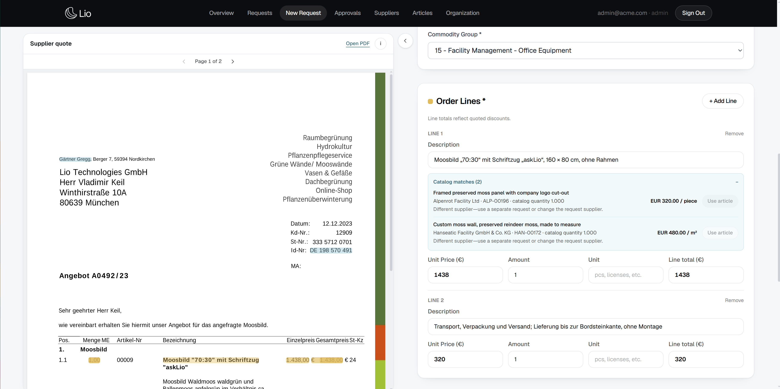
Reviewing a supplier quote
The requester can compare the document and request side by side.
Alternative positions can be added or swapped. Totals and VAT remain reviewable.
Highlights show possible text matches and are not proof of source.
04
Notes:
Demonstrate the Gärtner Gregg quote live. The sample has alternatives which should not automatically become ordinary order lines. The screenshot is from an earlier development view; use the live app to show the current continuous scrolling viewer. Highlights are inferred text matches, not trusted provenance. Source: handover.md and the supplied Gärtner Gregg quote.

Slide 5
Negotiated prices and Acme rules
Catalog suggestions
Customer-specific categories
Find candidate articles in the customer’s own catalog and show supplier, unit and negotiated price.
Cable ties
Electrical Engineering
Printer toner
IT Hardware
The requester can inspect an article and explicitly apply a compatible supplier’s price.
Monthly software
subscription ≤ €20
Office Supplies
The €20 limit and tax basis need Acme’s confirmation.
05
Notes:
Suggestions use lexical matching on the current organisation’s catalog. The requester can open the article record. One request supports one supplier; other-supplier suggestions are visible but cannot be applied. Explain that matching is approximate and catalog terms must be reviewed. The €20 monthly limit is an explicit assumption, not a value stated in the brief. Sources: handover.md, backend/app/services/acme_categories.py.

Slide 6
Roles and approval
Requester
Creates and sees their own requests
ACME THRESHOLD
Buyer
Reviews requests and can approve their own
< €2,000
Automatically approved
Admin
Buyer capabilities plus member, data and settings management
€2,000 and above: manual approval.
Changes to request content trigger the approval check again.
06
Notes:
The user confirmed that both buyers and admins may approve their own pending requests. Requesters only see their own. Rejection of one’s own request remains restricted. Acme requests below 2,000 euros are automatically approved; other tenants retain manual approval. Content edits or document changes rerun the policy; workflow status is separate. Amounts are based on the recorded total, so independent financial controls would be needed in production. Sources: backend/app/routers/requests.py, backend/app/services/approval_policy.py.

Slide 7
Verification and limits
01
Five supplied quotes
Known limits
15/15 live responses returned the expected gross totals and price patterns.
AI and OCR can be wrong. Source highlights are approximate. Recorded totals are editable.
02
Automated tests
Backend and frontend tests cover extraction, matching, pricing, roles and approval rules.
03
OCR-supplemented extraction
styleGREEN supplier and VAT ID were recovered in all three API runs.
07
Notes:
The initial baseline covered five PDFs once. A later 15-call live API benchmark used one parse per quote and three model extractions, with expected gross totals and base/alternative price patterns in all responses. StyleGREEN OCR-supplemented results included the supplier and VAT ID in all three runs. These checks did not cover every field, frontend interaction, or OCR variability; Docker image and effective model were not independently verified. A larger dataset is needed. Sources: pdf-benchmark.md, handover.md.

Slide 8
What I would do with more time
01
Evaluate extraction quality
Score real quotes, including scans and difficult cases.
02
Rejection reasons and resubmission
Show requesters why a buyer rejected a request.
03
Better article suggestions
Check product, unit and agreement terms across languages.
04
Configurable customer rules
Set approval and category policies for each organization.
Questions and discussion
08
Notes:
Four proposals for further work, not completed features. Evaluate extraction using labelled quotes and field-level errors, especially totals, VAT, alternatives and scans. Capture rejection reasons in the activity history and support correction and resubmission. Improve multilingual catalog matches, supplier and contract information, and unit and product comparability; measure acceptance. Let each organization configure category and approval policies after confirming tax treatment, gross versus net, and the assumed 20 euro threshold. Sources: handover.md and INTERVIEW_PREP.md.

