Slide 1
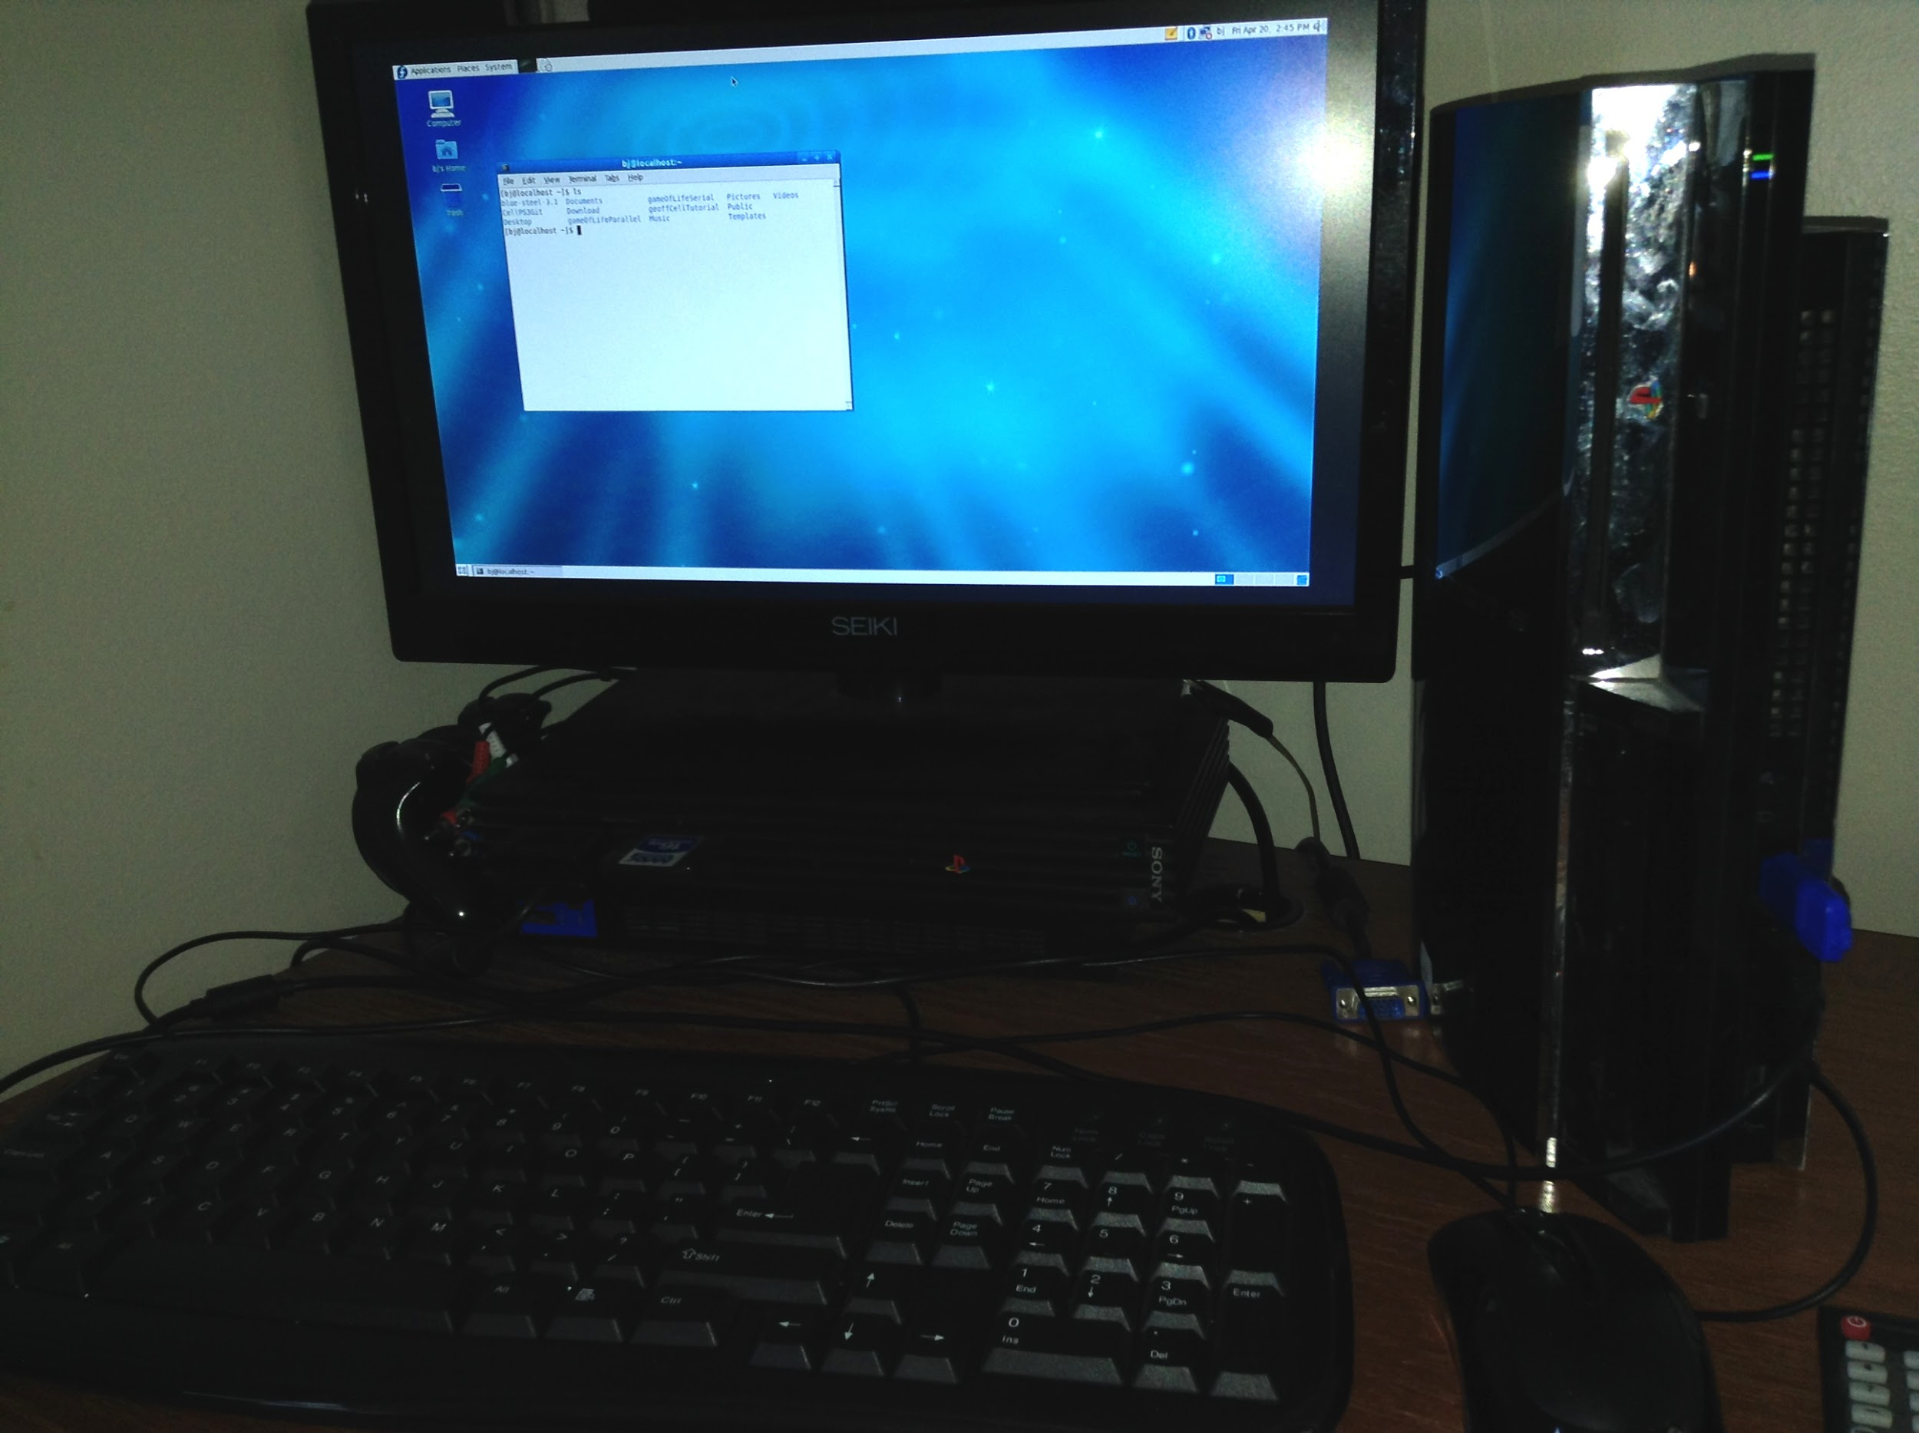
Parallel Programming on the Sony PlayStation® 3
William Blair
CS 518/523: Parallel Programming
The IBM Cell B.E. Processor

Slide 2
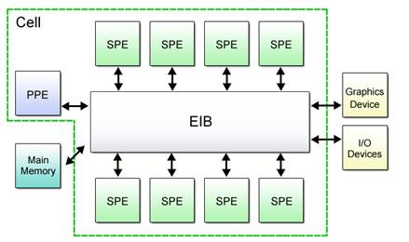
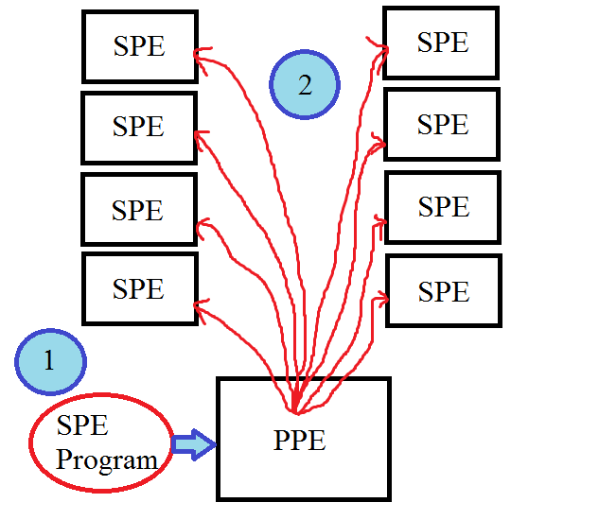
The Cell Broadband PowerPC Engine
Basic structure of a Cell program
Cell internal hardware layout [1]
Notes:
The PPE (PowerPC Processor Element) Is the main central chip, like the PC’s CPU. The SPEs (Synergistic Processing Elements) are the specialized processing cores you run your threads on. A program works by running the main program on the ppe, which loads the SPE program and sends it to each SPE.

Slide 3
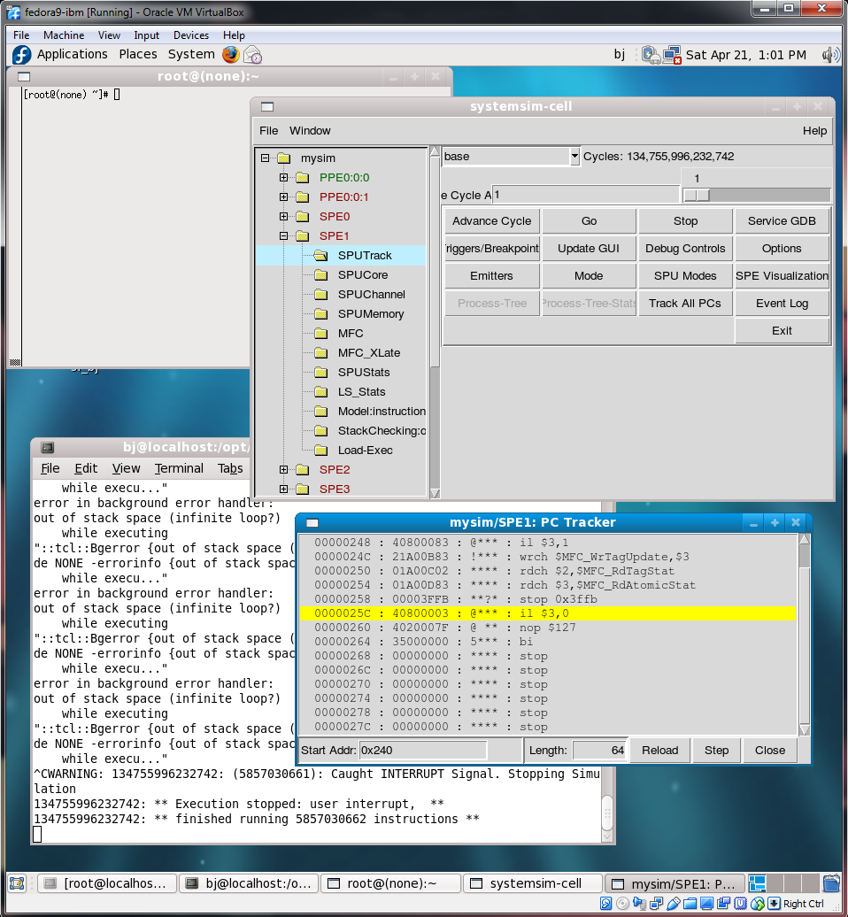
IBM Cell SDK 3.1
IBM’s Official SDK to program the Cell Processor
ppu-gcc, ppu-g++ to compile PPE programs (main)
spu-gcc, spu-g++ to compile SPU programs
Optional Fortran support
Also includes a Cell simulator to work on your programs locally and analyze the program (i.e. monitor states, bottlenecks, load) (image right)
Runs on Fedora 9 or YellowDog linux 5.0 and above, which run on both PowerPC (PS3) and PC
Linux support dropped by Sony after PS3 firmware 3.21 on April 1st, 2010 [2]
Notes:
Pain in the tookus to find! Honestly the hardest/longest part of the project along with installing linux. Since linux support was dropped had to install custom firmware

Slide 4
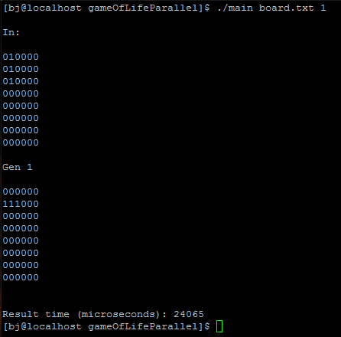
Conway’s Game of Life
Not really a ‘game’ but a simulation of living, biological cells
Set of rules that runs for a number of generations [3]:
Any live cell with fewer than two live neighbours dies, as if caused by underpopulation.
Any live cell with two or three live neighbours lives on to the next generation.
Any live cell with more than three live neighbours dies, as if by overpopulation.
Any dead cell with exactly three live neighbours becomes a live cell, as if by reproduction.
Written in C++, parallelized for the Cell B.E. Processor, and a serial version for comparison

Slide 5
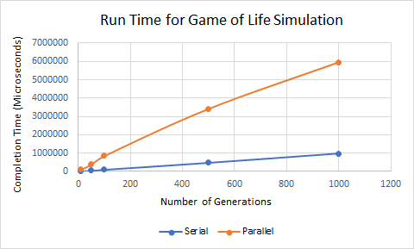
Results
# Generations | Serial Time | Parallel Time
10 | 10,957 µs | 89,483 µs
50 | 47,457 µs | 375,271 µs
100 | 101,292 µs | 841,760 µs
500 | 468,587 µs | 3,406,050 µs
1000 | 957,655 µs | 5,948,228 µs
Run time comparison of the Serial and Parallel implementations of Game Of Life. Calculations were performed on a grid of size 8x30 (so 1 row for each SPE thread in the parallel version) with the same layout each time.
Notes:
The serial version, as expected, is increasing linearly while the parallel version almost seems to be taking a logarithmic curve - so in theory, with enough generations (and more data) the parallel version would outperform the serial version.

Slide 6
Analysis/Future Work
Bottlenecks:
Need bigger board for an improved compute/io ratio
Synchronization: each generation relies on the results of the previous generation, so each thread has to wait for each other thread to finish before computing the next generation
Each row requires the previous and next row to check for live neighbors -> sending 3x amount of data per thread
Future work:
Use different method of data communication between PPE/SPEs
Max size to the amount of data you can send over the bus
The previous chart used the largest board size possible for the given amount of threads -> not big enough
Technique called ‘Mailbox’

Slide 7
References
https://mirrors.edge.kernel.org/pub/linux/kernel/people/geoff/cell/ps3-linux-docs/CellProgrammingTutorial/BasicsOfCellArchitecture.html
https://en.wikipedia.org/wiki/OtherOS
https://en.wikipedia.org/wiki/Conway%27s_Game_of_Life
Project Web Page
https://web.cs.sunyit.edu/~blairw/CS518/final_proj/index.html

