Slide 1
Credit Card Fraud Detection
William Barker
DSC680 - Project 3

Slide 2
Business Problem
Credit card fraud is major problem and can cause a great amount of stress on those who fall victim to it.
It affects businesses just as much as consumers however, if not more.
This project would allow credit card companies to hopefully detect fraud as quickly as possible so cards can be cancelled before more purchases are made.

Slide 3
Data Exploration
The dataset I’m using for this project is one from Kaggle.com titled creditcard_2023.
It’s one of the largest datasets I’ve ever worked with, having 568,631 rows and 31 columns.
28 of the columns are anonymized features representing various transaction attributes like time and location.
The others are “id”, “Amount” and “Class”. “Amount” being the transaction amount and “Class” being a binary label indicating whether the transaction is fraudulent (1) or not (0).
I used “describe” to get summary statistics of my dataset, then checked for any missing values, and didn’t find any.

Slide 4
Data Exploration
Visualizations
I checked the distribution of the “Class” column and found a perfectly even amount of fraudulent and non-fraudulent transactions.
I then visualized a correlation matrix to check for possible correlations between features.
Finally, I dropped the “id” column since it serves no purpose for me and split my data into a training and test set, and scaled the features.

Slide 5
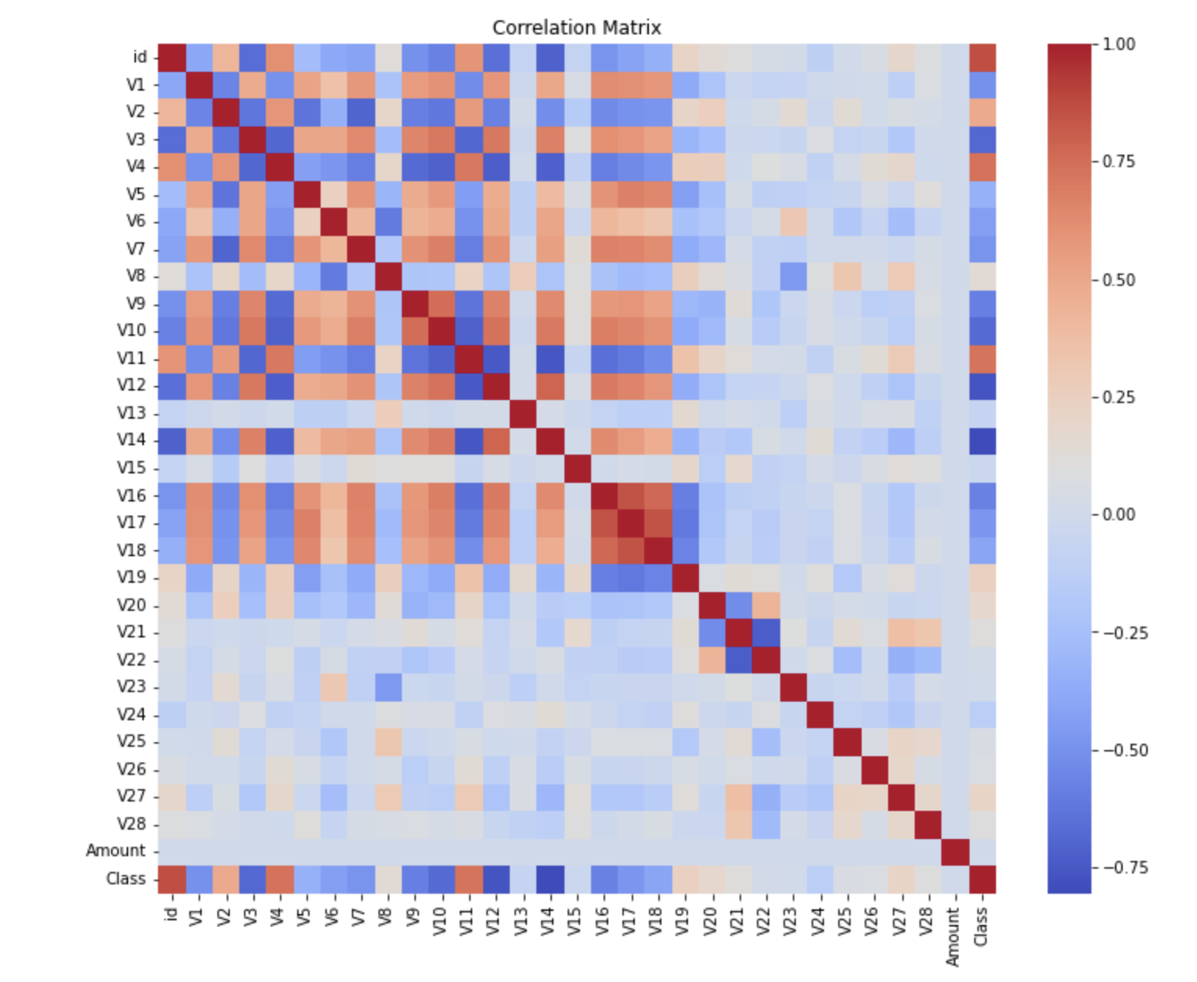
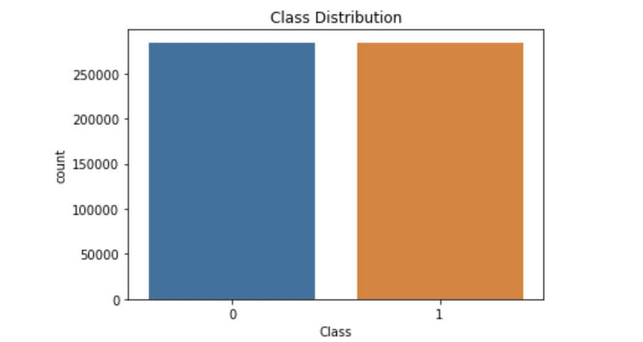
Data Exploration
Visualizations

Slide 6
Methods
For this project, I implemented the simple yet powerful linear regression model to try and predict whether a transaction is fraudulent or not.
I also branched out and tried something new for me, an isolation forest model which is used to detect anomalies.

Slide 7
Analysis
I started with training my linear regression model.
I then made predictions with the scaled data and used a classification report to evaluate the results.
I got a precision score of 0.95 for non-fraudulent transactions and 0.98 for fraudulent ones, a recall score of 0.98 for non-fraudulent transactions and 0.95 for fraudulent ones, and an f1-score of 0.97 for non-fraudulent transactions and 0.96 for fraudulent ones.
I also got an accuracy score of 0.96.

Slide 8
Analysis
High precision ensures that most transactions identified as fraudulent are indeed frauds, reducing the cost of false positives.
High recall ensures that most actual frauds are detected, reducing the risk of missed frauds.
The F1-Score is the weighted average of Precision and Recall. A high F1-Score means that the model has a good balance between precision and recall, making it more reliable in the context of fraud detection where both metrics are important.
Accuracy is the ratio of correctly predicted observations to the total observations, it gives an overall performance measure.

Slide 9
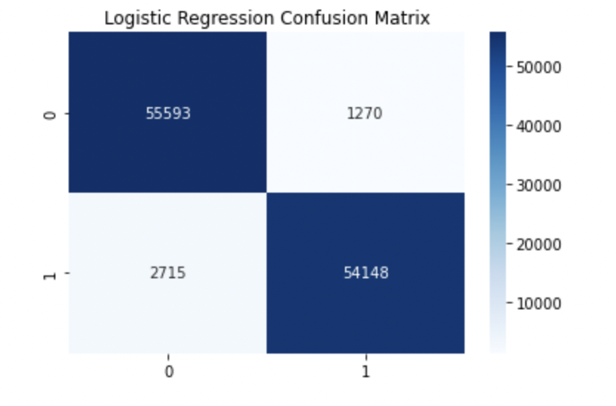
Analysis
My scores with my linear regression model are incredible!
With an f1-score of 0.97 and 0.96 and an accuracy score of 0.96, my model is almost always correct in its predictions.
I built a confusion matrix which helps to visualize just how accurate the model was.

Slide 10
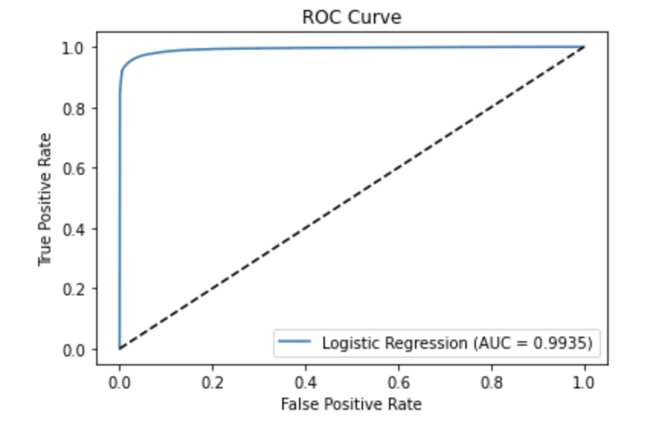
Analysis
I also got an ROC-AUC score of 0.9935, which is very high and indicates my model is very effective!

Slide 11
Analysis
Next I initialized and trained my isolation forest model.
I predicted the anomalies of my data and then converted the predictions to match the binary classification system of my dataset.
I once again used a classification report to evaluate my model.
I got a precision score of 0.50 for non-fraudulent transactions and 0.97 for fraudulent ones, a recall score of 1.00 for non-fraudulent transactions and 0.02 for fraudulent ones, and an f1-score of 0.67 for non-fraudulent transactions and 0.04 for fraudulent ones.
I also got an accuracy score of 0.51.

Slide 12
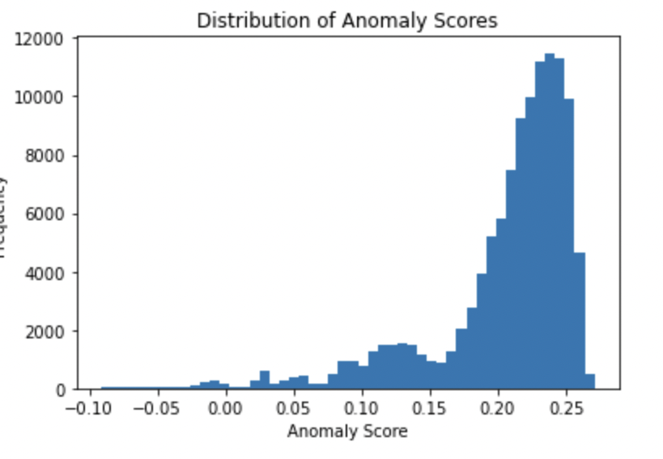
Analysis
The only score that is good is the precision score for fraudulent transactions, which makes sense because the isolation forest model is an anomaly detection algorithm.
This score means that the majority of the time my model detected an anomaly (fraudulent activity), it was correct!
I also got the anomaly scores for my test set and visualized the distribution.

Slide 13
Conclusion
In conclusion, I believe both of my models to be extremely effective at what they do!
My linear regression is able to very accurately make predictions on the data and my isolation forest model did a good job and accurately detecting fraud.

Slide 14
Limitations
I only trained two models for this project, but if I had tried some more powerful models I may have possibly gotten even more accurate predictions.

Slide 15
Future Uses
By integrating this model with a live transaction processing system, it could help in identifying potentially fraudulent transactions in real-time.
With further refinement and testing, it could reduce the incidence of fraud and save businesses and consumers from significant financial losses.

Slide 16
Ethical Assessment
Being able to look at someones transaction data could be considered an invasion of privacy, since the data could be used to track someones location at any given time, what they are buying etc.
Luckily, the dataset I am using completely anonymizes all transaction attributes and does not include anyone’s name, so I think ethically I’m ok.

Slide 17
References
https://fraud.net/n/how-does-credit-card-fraud-affect-businesses/
https://www.kaggle.com/datasets/nelgiriyewithana/credit-card-fraud-detection-dataset-2023?resource=download
https://www.ellipse.la/post/a-brief-history-of-credit-card-fraud#:~:text=The%20very%20first%20instance%20of,%2425%20worth%20of%20train%20travel.

