Slide 1
Predicting Health Insurance Charges
William Barker
DSC 630

Slide 2
Health Insurance
Of the expenses adults are most concerned about affording, medical bills ranked second to gasoline and/or transportation expenses.
Cost is preventing people from getting care—8.7% of adults reported not seeing a doctor in 2021 because of the expense.
Total national healthcare expenditures reached $4.3 trillion in 2021.
Private health insurance was more prevalent than public health insurance in 2022, with 65.6% of insured adults having a private healthcare plan compared to 36.1% having a public healthcare plan.

Slide 3
Project Goal
Health Insurance companies take several different factors into considerations when pricing their insurance plans to individuals.
The aim of this project is to see if I could build a machine learning model that could accurately predict a persons medical insurance charges based on several different columns of data about them.

Slide 4
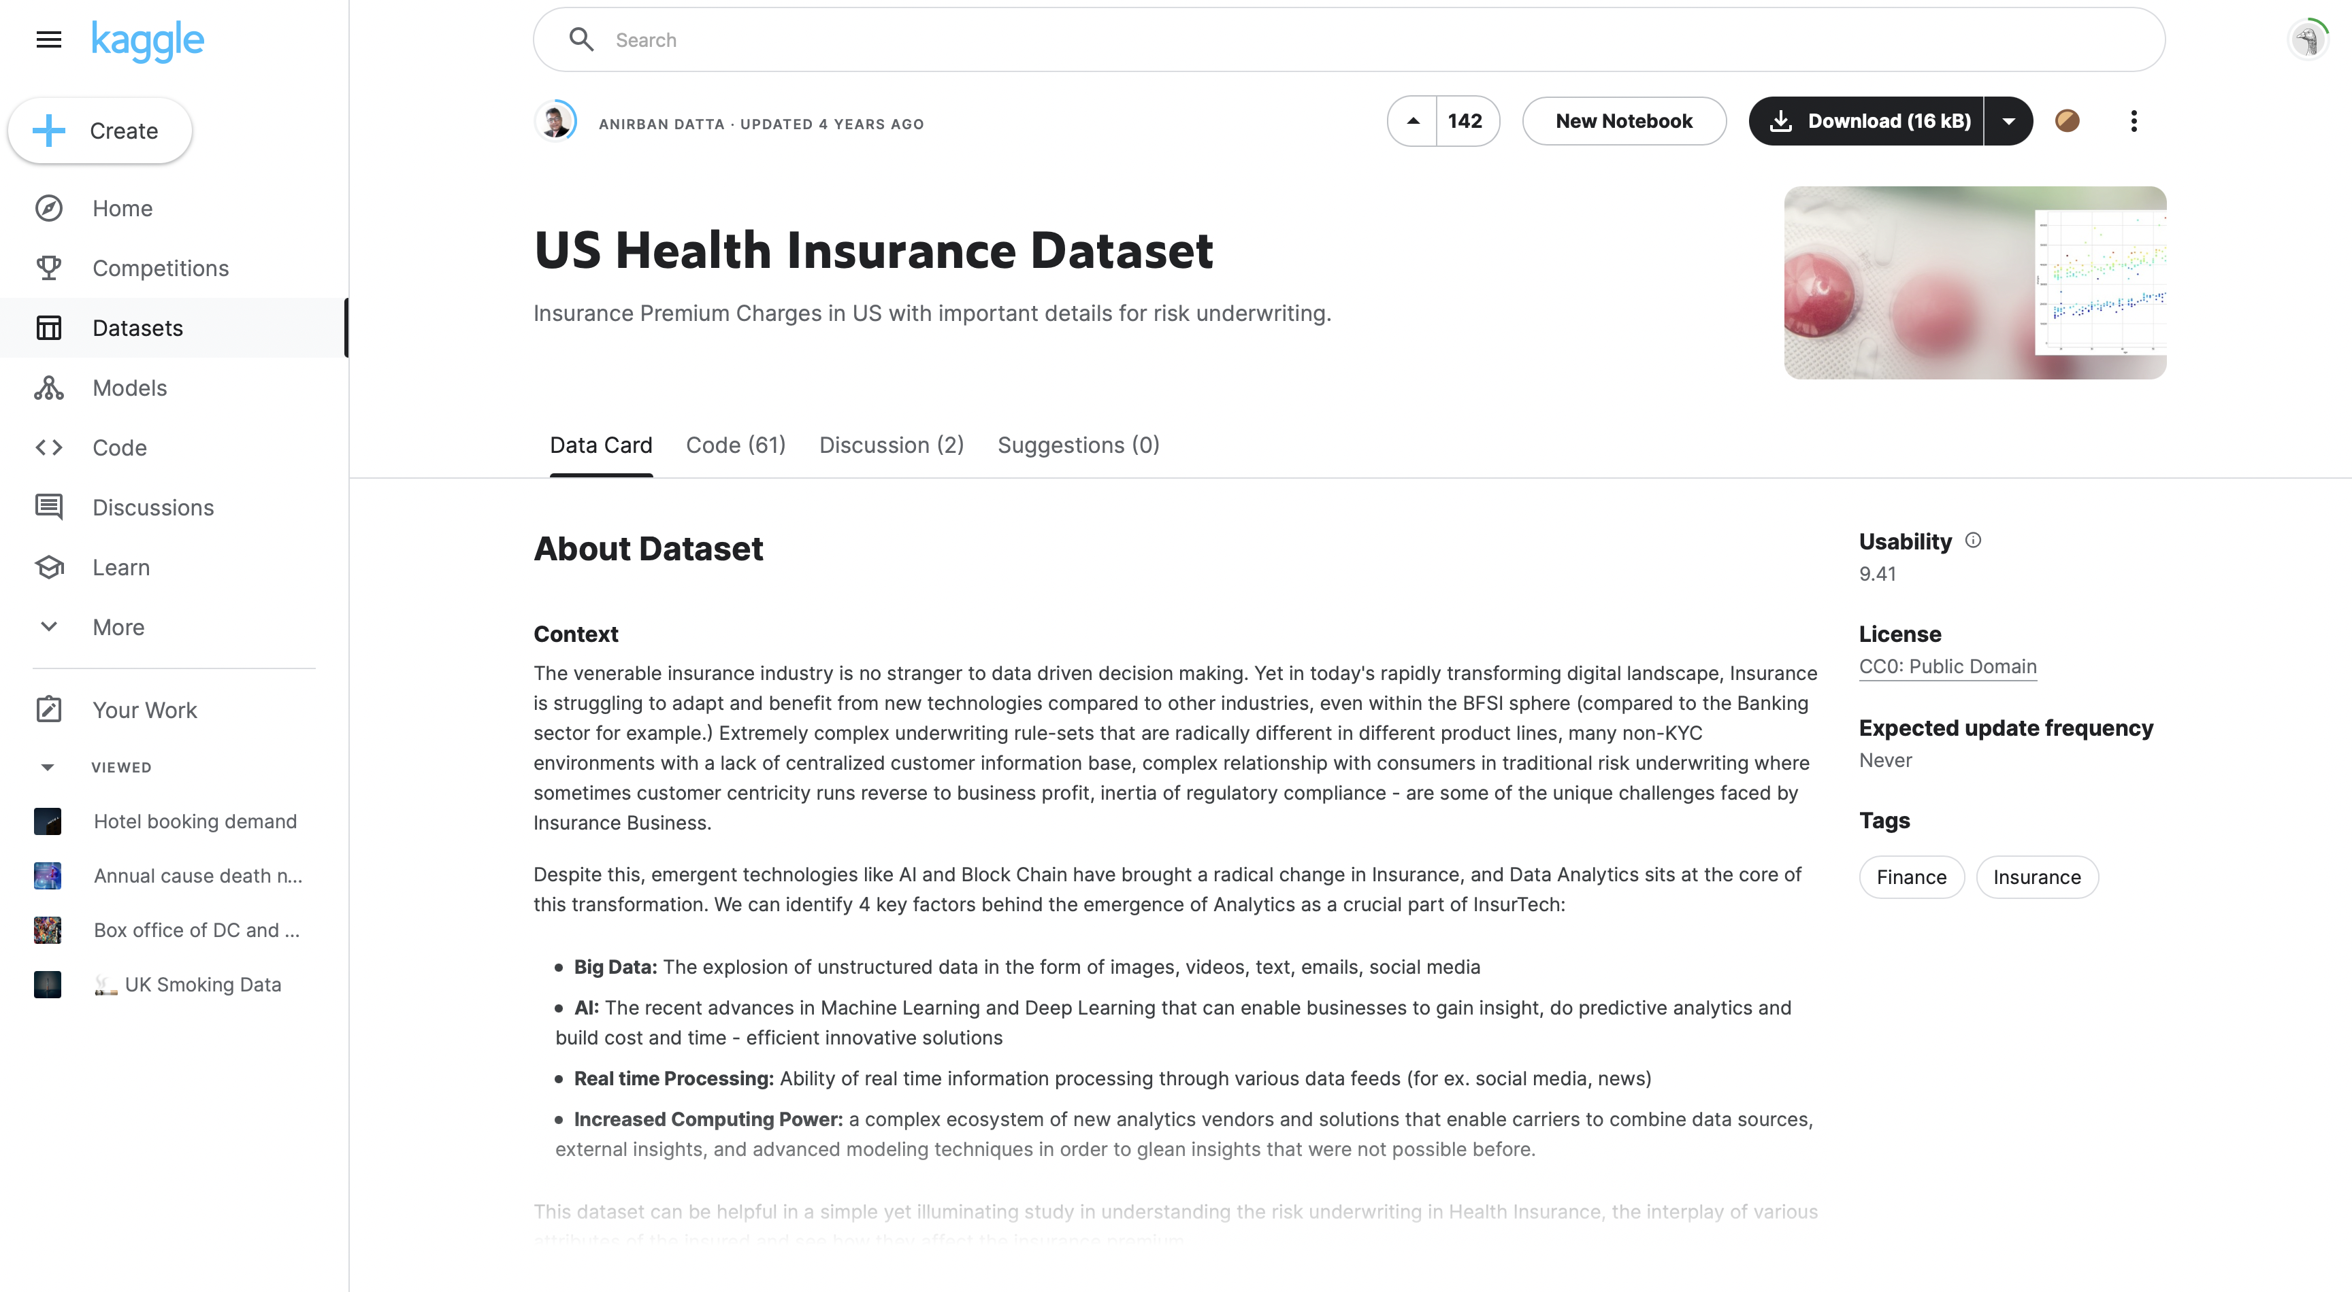
Dataset
I used a dataset on US Health Insurance from kaggle.com for this project.
The dataset has 2,700 rows and seven columns.
The columns are age, sex, BMI (body mass index), children, smoker, region, and charges.

Slide 5
Dataset
Numerical Features
Age (in years)
BMI
Children (how many)
Charges (in USD)

Slide 6
Dataset
Categorical Features
Sex (Male or Female)
Smoker (Yes or No)
Region (Southeast, Southwest, or Northwest)
I converted these categorical features to numeric ones for the model to work with by mapping their values to numbers
Sex and Smoker values became either a 1 or a 2, while region values became a 1, 2 or 3.

Slide 7
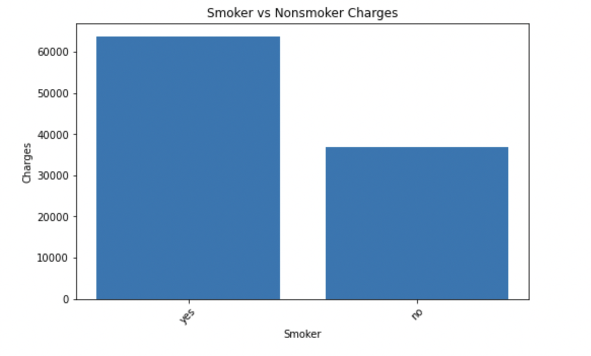
Data Exploration
I decided to calculate the average of the charges column so that so I would have a figure to compare the results of my models to and found the average charge to be $13,261.38
A simple visualization gave me an early sign that being a smoker has a decent impact on health insurance charges

Slide 8
Data Cleaning
I found that the dataset was already well put together and mostly clean.
Other than the conversion of categorical values to numeric ones I mentioned previously, I only had to drop some rows with NaN values before I was able to proceed.

Slide 9
Model Deployment
I chose to test three different models on my dataset.
The simple but powerful linear regression model.
The versatile random forest model.
The K-means algorithm which is good for identifying patterns.

Slide 10
Linear Regression Results
For my linear regression model I looked at three things to evaluate its performance; Mean Absolute Error (MAE), Root Mean Squared Error (RMSE), and its R-Squared Score (R2).
I got an MAE of 3950.60, which means my models predictions were off by $3,950.60 when compared to the actual values.
The RMSE score was 6154.54 which is a worse result.
The R2 score was 0.765 which means about 76.5% of the variability can be explained by the features in the dataset.
With an average charges cost of $13,261.38 these results aren’t terrible but could be better.

Slide 11
K-Means Algorithm
I checked the same metrics to evaluate my K-Means Algorithm that I did for the linear regression but also looked at the Mean Squared Error (MSE).
For the MAE I got a result of 5825.06.
For the MSE I got a result of 94123020.0
For the RMSE I got a result of 9701.7
For the R2 Score I got a result of 0.42.
These results are a lot worse than what I got from the linear regression, showing that a K-Means Algorithm was not a good choice for this project.

Slide 12
Random Forest Model
The Ideal Model
I tested the same metrics I did for the K-Means Algorithm.
I got an MAE of 1256.58
An MSE of 7243418.85
An RMSE of 2691.36
An R2 Score of 0.955
These result are without a doubt the best so far and show that my model fits the data very well and has strong predictive power!

Slide 13
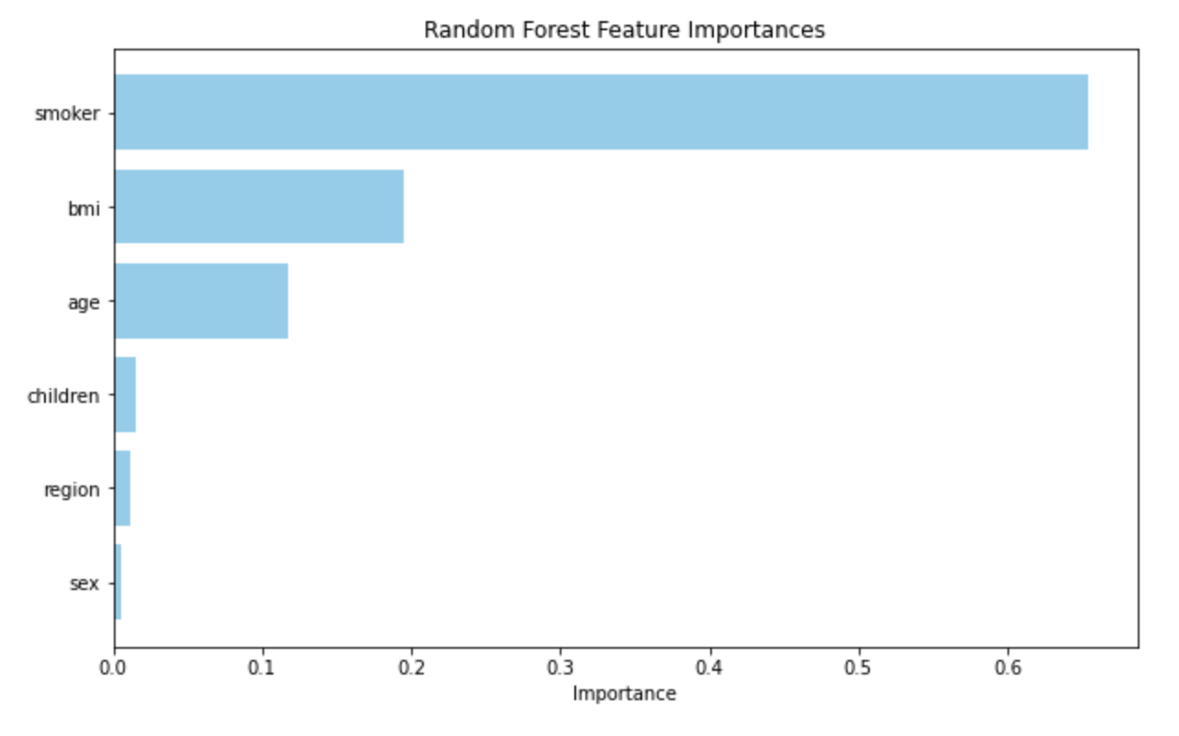
Feature Importance
After the success of my random forest model I chose to evaluate the importance of each feature against the charges column using that model.
Unsurprisingly, the most important feature by far was whether someone was a smoker or not, followed by a persons BMI and their age.

Slide 14
Conclusion
We discovered with this project that with the help of the appropriate machine learning model (in this case the random forest model) it is in fact possible for health insurance companies to predict a persons future medical charges and adjust their health care coverage costs accordingly.
There are obvious ethical dilemmas involved around this topic however, as some may find charging someone with a higher BMI or for being a smoker more than others to be unethical.

Slide 15
References
https://www.forbes.com/advisor/health-insurance/health-insurance-statistics-and-facts/
https://www.kaggle.com/datasets/teertha/ushealthinsurancedataset

