Slide 1
Spotify Recommender System
William Barker
DSC680 - Project 2

Slide 2
Business Problem
Music apps all have features that try to recommend new music to users.
Spotify even has an AI dj now that tries to play songs for you it thinks you will like. This project makes an attempt at tackling this process.

Slide 3
Data Explanation
The dataset I’m using is from kaggle.com called “top 100 streamed_songs”
The columns in this dataset are “id”, “name”, “duration”, “energy”, “key”, “loudness”, “mode”, “speechless”, “acousticness”, “instrumentalness”, “liveness”, “valence”, “tempo”, and “danceability”
To prepare the data, I first dropped the “id” column since it’s not needed for this project. Then I checked for any missing values and dropped them if they existed.
I also selected my features I wanted to use for my recommender system and scaled them.

Slide 4
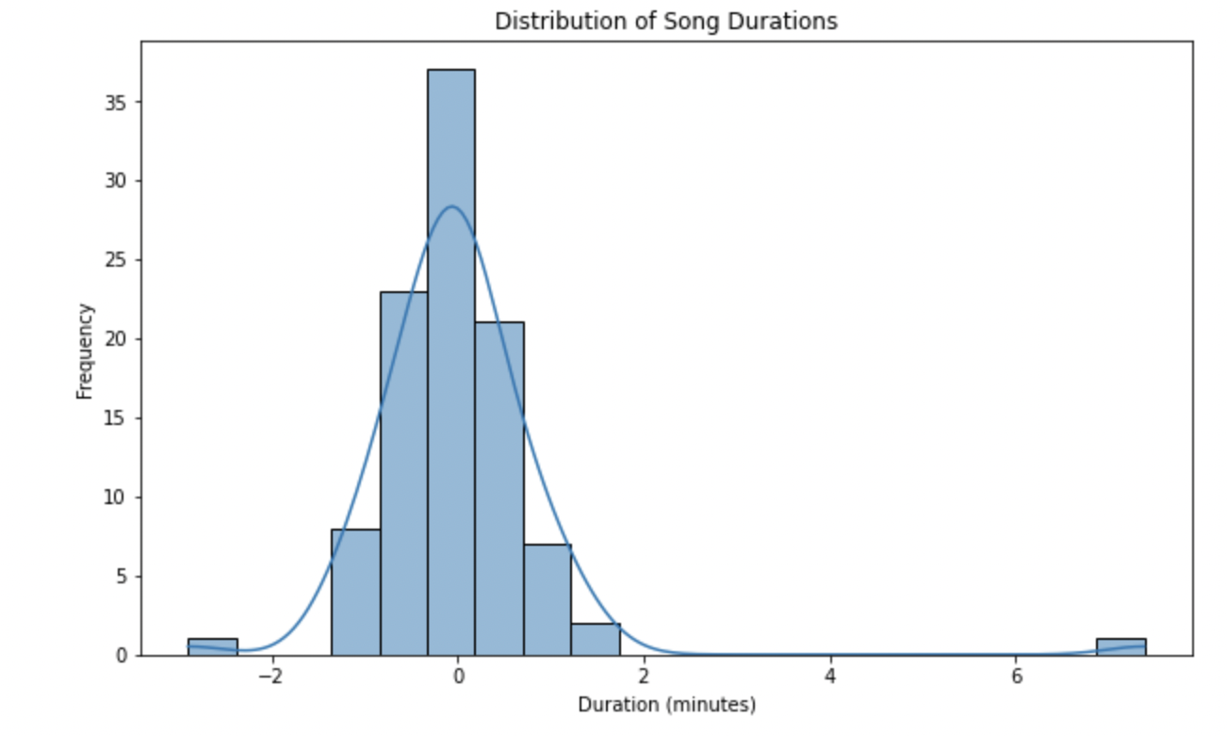
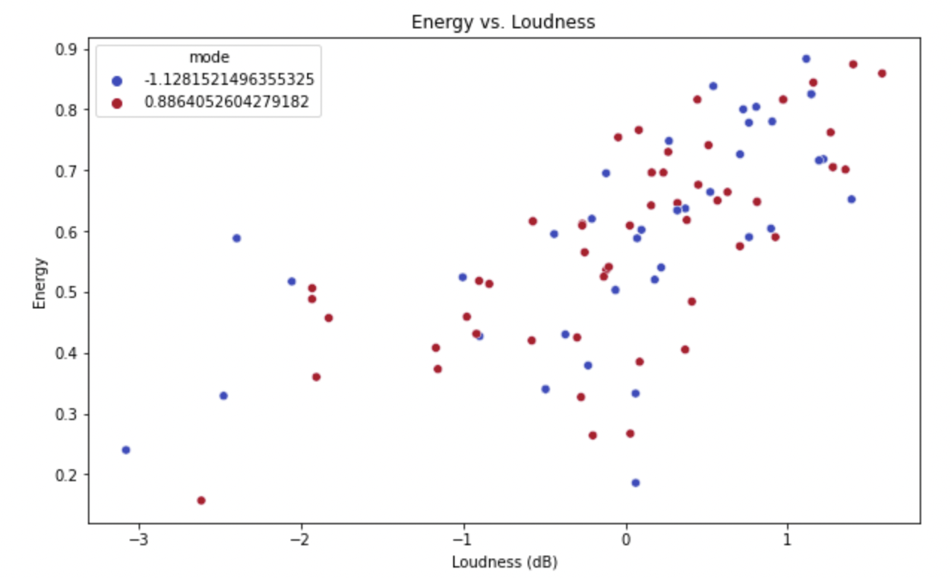
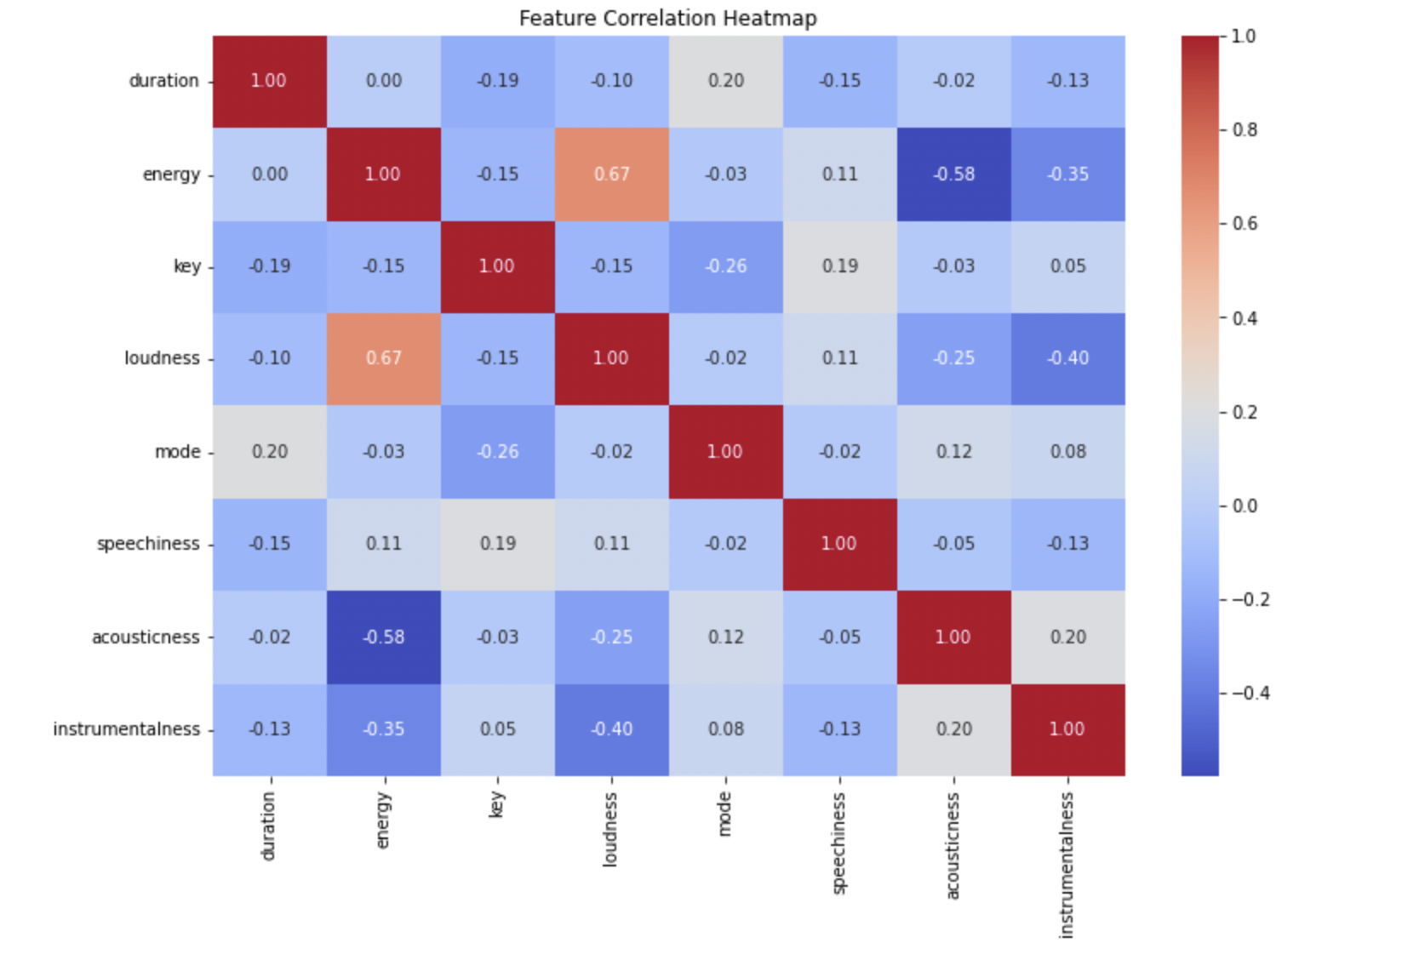
Data Exploration
Visualizations

Slide 5
Methods
I will be defining a function that takes a song name and uses the various variables the dataset provides to recommend other songs you might like.
It will use a cosine similarity matrix to find similar songs.

Slide 6
Analysis
The analysis of this project takes in the chosen features to build a similarity matrix using cosine similarity.
Then I convert the matrix into a data frame to make it easier to work with.
Then I defined a function that uses the similarity matrix to get a similarity score from the song that is entered and find the most similar songs from the top 100 it looks at.

Slide 7
Conclusion
I tested out this project by checking the results of entering in “Good 4 U” by Olivia Rodrigo and “Stitches” by Shawn Mendes.
I checked the top five most similar songs and found that for Olivia’s song, music by Polo G, J Balvin and Bad Bunny, Karol G and Nicki Minaj, Joel Corry, and a Diplo remix of a Glass Animals song.
For the Shawn Mendes song it recommended two The Weeknd songs, and songs by Pop Smoke, Mark Ronson with Bruno Mars, and Gotye with Kimbra.
I don’t know most of the songs it recommended with Olivia but as someone who likes “Stitches”, I also really like most of the songs my system recommended! This leads me to believe its doing a good job at making recommendations.

Slide 8
Limitations
This recommender system is limited to the data provided.
It only has 100 songs to work with and is limited to the variables about each song that was given.

Slide 9
Challenges/Issues
Figuring out what specifically someone likes about a song is difficult, so it can be hard to decide what to look at to find other songs they will like.
I feel like the dataset I'm using has a good variety of variables to compare that will allow it to accurately recommend new music.

Slide 10
Future Uses
The model could be deployed as a micro-service, where it receives input (a song) and returns recommendations.
The system would need to be continually updated with new songs and user feedback to improve the quality of recommendations over time.

Slide 11
Ethical Assessment
This project simply recommends music based on a song you type in, so I don’t think theres anything unethical to really worry about.

Slide 12
References
https://www.kaggle.com/datasets/amaanansari09/top-100-songs/data
https://arxiv.org/abs/2209.01860

