Slide 2
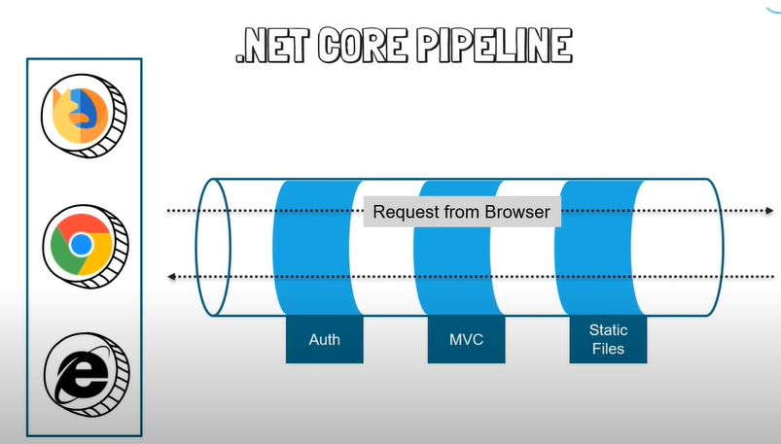
.NET CORE PIPLINE

Slide 3
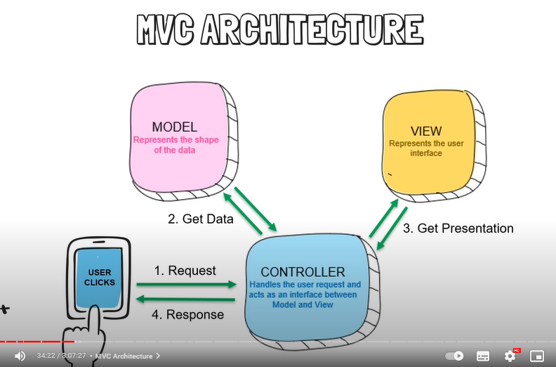
MVC design

Slide 4
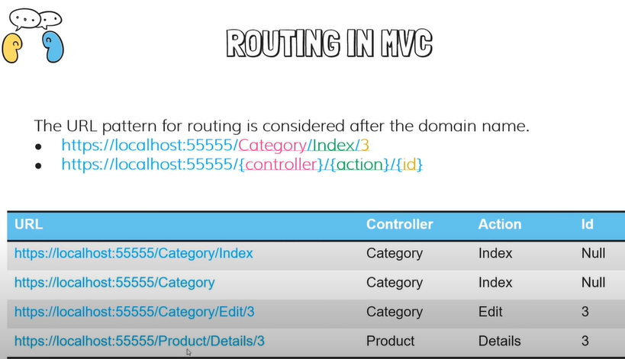
ROUTING IN MVC

Slide 5
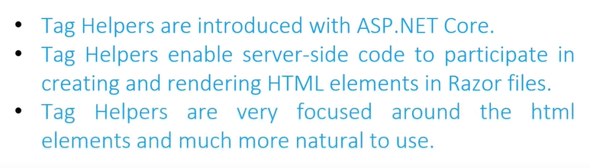
Tag Helpers

Slide 6
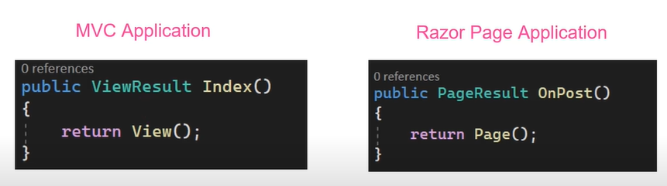
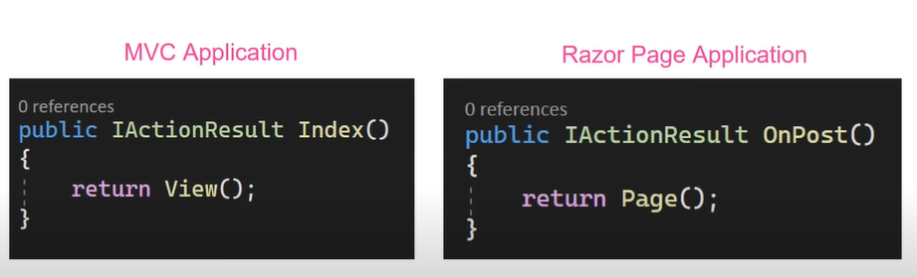
ACTION RESULT

Slide 7
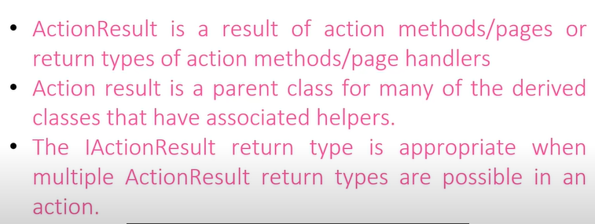
ACTION RESULT

Slide 8
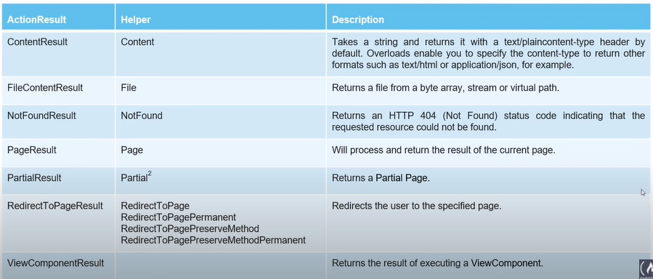
Action Result in Rasor Pages

Slide 9
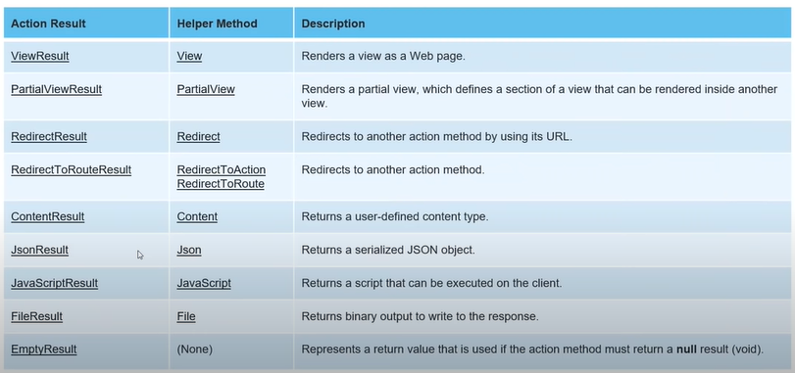
Action Result in MVC

Slide 10

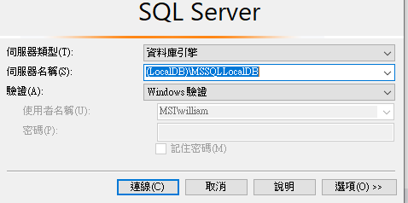
Connect to LocalDB of SSMS
Download ssms
Run “sqllocaldb” or “sqllocaldb info” in cmd.exe to check your lacalDB’s name
Try connect to SSMS with servername : (LocalDB)\MSSQLLocalDB

Slide 11
Build DBContext with Migration
Open 工具->NuGet套件管理員->套件管理主控台
Run “add-migration AddCategoryToDatabase”
Run “add-migration AddCategoryToDatabase”

