Slide 1
Week 10
Project 4C
06/05/2020

Slide 2
Project 4C - Overview
Extension of Project 4b
Temperature sensing program receives commands from a server over the network
Connection to server implemented via :-
TCP - Unencrypted connection (insecure)
TLS - Encrypted connection (secure)

Slide 3
Project 4b - Recap
Lab4b.c
Temperature Sensor
STDIN
COMMANDS
MRAA Library
STDOUT
REPORT
LOG
FILE
Beaglebone

Slide 4
Project Objectives
Demonstrate the ability to design, build and debug an embedded application that interacts with a central control server with the aid of server-side logs.
Demonstrate the ability to implement a secure channel using standard tools.
Demonstrate the ability to research and exploit a complex API, and to debug an application involving encrypted communication.

Slide 5
Project 4c - High Level
Logging Server
Lab4b.c
Temperature Sensor
STDIN
COMMANDS
MRAA Library
STDOUT
REPORT
LOG
FILE
Network Connection
Beaglebone

Slide 6
Logging Server
A remote logging server will send commands to your beaglebone.
These commands will be similar to what you implemented for Project 4b.
In 4b, you read from STDIN and wrote to STDOUT
In 4c, you will read from SOCKET and write to SOCKET
In 4b, you took input from button to SHUTDOWN the sampling, You don’t need to take input from button in 4c
Logging server has already been implemented and available for your use.

Slide 7
Logging Server Details
Logging Server is available at lever.cs.ucla.edu
You can connect to the server on two ports:
PORT 18000 - TCP
PORT 19000 - TLS

Slide 8
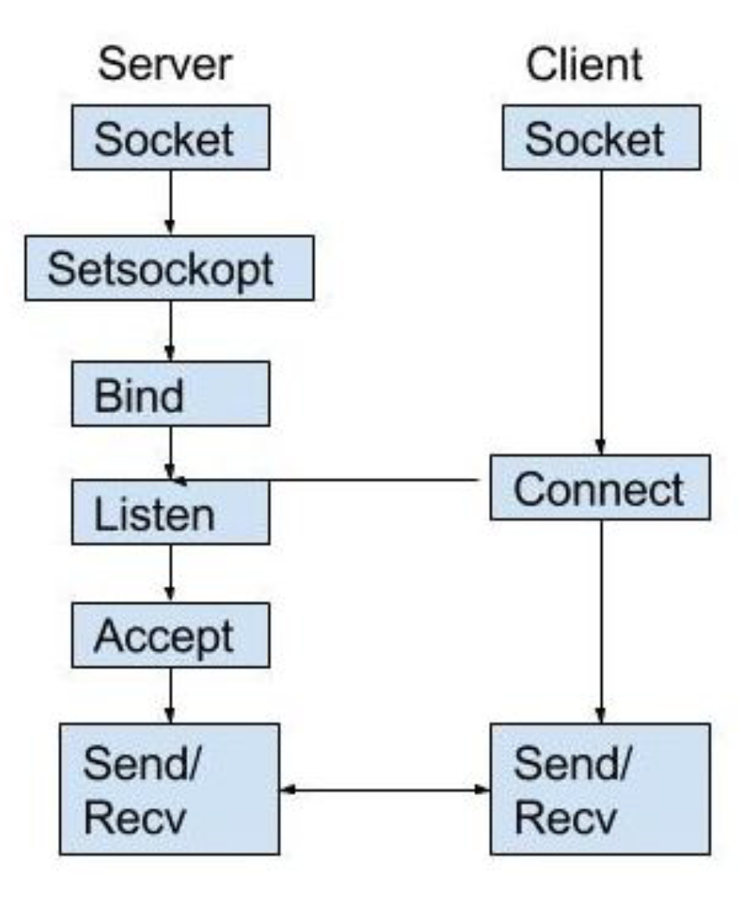
Socket Programming Recap from 1B
Server
Create a socket with the socket() system call
Bind the socket to an address using the bind() system call. For a server socket on the Internet, an address consists of a port number on the host machine.
Listen for connections with the listen() system call
Accept a connection with the accept() system call. This call typically blocks until a client connects with the server.
Send and receive data
Client
Create a socket with the socket() system call
Connect the socket to the address of the server using the connect() system call
Send and receive data. There are a number of ways to do this, but the simplest is to use the read() and write() system calls.

Slide 9
Socket Programming Demo
Create server.c client.c
Compile server : gcc -o server server.c
Compile client : gcc -o client client.c
Run server : ./server 8080
Run client : ./client localhost 8080
Explain - Sockets Tutorial

Slide 10
socket(2)
Implemented for you
Create a bidirectional channel of communication using the socket function
#include <sys/types.h>
#include <sys/socket.h>
int socket(int domain, int type, int protocol);
Use the below values to create a TCP socket
int sockFd = socket(AF_INET, SOCK_STREAM, 0);
What this means?
AF_INET => IPv4 protocol family
SOCK_STREAM => TCP socket type, abstract away network reliability issues
0 => Choose the default protocol supporting the domain and the protocol type

Slide 11
connect(2)
You need to know two pieces of information before you can connect a client program to a server program.
The address of the server
struct hostent *gethostbyname(const char *name);
The port on which the server is listening for connections.
Port 18000 for TCP
Port 19000 for TLS

Slide 12
connect(2) - putting it all together
int connect(int sockfd, const struct sockaddr *addr, socklen_t addrlen);
sockfd - created with socket function
addr -
struct sockaddr_in {
sa_family_t sin_family; /* address family: AF_INET */
in_port_t sin_port; /* port in network byte order */
struct in_addr sin_addr; /* internet address */
};
addrlen - sizeof(struct sockaddr)
Network byte order - convert host byte order to network byte order (htons)
/* Internet address. */ struct in_addr {
uint32_t s_addr;
/* address in network byte order */
};
Notes:
https://www.tutorialspoint.com/unix_sockets/network_byte_orders.htm

Slide 13
connect(2)
It is mostly copy paste from the example program.
Main changes required are
Changing port value
Changing host value

Slide 14
send/rcv
Use read / write system calls on the sockfd you get after creating the socket
Poll on sockfd to see if there are any new commands.
Read commands and process individually (separated by ‘\n’)

Slide 15
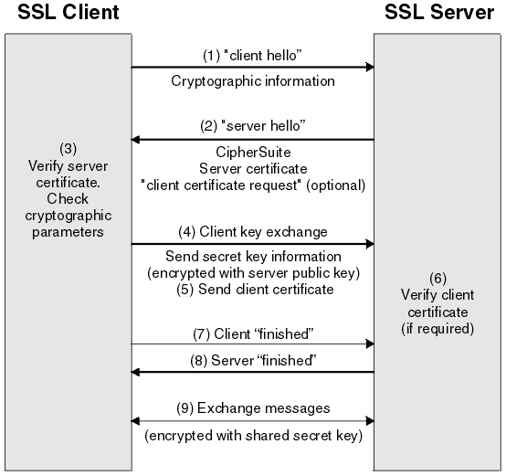
TLS - Transport Layer Security
SSL - Secure sockets layer - used interchangeably with TLS
Secure way of communicating over the network.
Authentication
Integrity
Confidentiality
Uses a TLS handshake to initialize and exchange keys that are to be used for the session.

Slide 16
Install SSL Library
We will use the header files
<openssl/ssl.h>
Install the libraries :
sudo apt-get update
sudo apt-get install libssl-dev
Notes:
src - https://piazza.com/class/k4x6oonkcge2mj?cid=868

Slide 17
SSL Usage
SSL Basic Setup
SSL Initialization
SSL Connection
SSL Send / Rcv
SSL Shutdown
Reference : https://www.ibm.com/support/knowledgecenter/SSB23S_1.1.0.13/gtps7/s5appl.html

Slide 18
SSL Basic Setup
Call below functions to setup
SSL_library_init(); -
registers the available SSL/TLS ciphers and digests. Used in TLS handshake
SSL_load_error_strings();
registers the error strings for all libcrypto functions and libssl error strings
OpenSSL_add_all_algorithms();
OpenSSL keeps an internal table of digest algorithms and ciphers. It uses this table to lookup ciphers via functions. This function adds all algorithms to the lookup table

Slide 19
SSL Initialization
Create an object that has configuration information about the SSL connection
SSL_CTX
Create a SSL client using this configuration object
SSL_new
SSL_CTX *newContext = SSL_CTX_new(TLSv1_client_method());
if (newContext == NULL) {
fprintf(stderr, "Unable to get SSL context\n");
exit(EXIT_FAIL);
}
sslClient = SSL_new(newContext);
if (sslClient == NULL) {
fprintf(stderr, "Unable to complete SSL setup\n");
exit(EXIT_FAIL);
}

Slide 20
SSL Initialization - Configuration
Need to create an object that has all the state required to implement the SSL protocol.
This function is served by a context object - SSL_CTX
Use the SSL_CTX_new function to create a new CTX structure based on the SSL or TLS version (We will use TLSv1_client_method() as that is what the logging server supports.)
Function signature
SSL_CTX *SSL_CTX_new(const SSL_METHOD *method);

Slide 21
SSL Initialization - Client
We need a client that uses the context object to create the SSL session
SSL *SSL_new(SSL_CTX *ctx);
SSL_new() creates a new SSL structure which is needed to hold the data for a TLS/SSL connection. The new structure inherits the settings of the underlying context ctx: connection method, options, verification settings, timeout settings.
An SSL structure is reference counted. Creating an SSL structure for the first time increments the reference count.

Slide 22
SSL Connection
Using the configured SSL client and an existing TCP socket, we can create an SSL connection in 2 steps:
Associate the created TCP socket with the SSL client using
SSL_set_fd(ssl, socketfd)
ssl is what we created in the previous step using SSL_new method.
Make the actual SSL connection using the ssl_client
int SSL_connect(SSL *ssl);

Slide 23
SSL Send / Rcv
Now that we have created the SSL connection, we can send and receive data on this connection.
int SSL_read(SSL *ssl, void *buf, int num);
int SSL_write(SSL *ssl, const void *buf, int num);

Slide 24
SSL Shutdown
int SSL_shutdown(SSL *ssl);
shuts down an active TLS/SSL connection
void SSL_free(SSL *ssl);
SSL_free() decrements the reference count of ssl, and removes the SSL structure pointed to by ssl and frees up the allocated memory if the reference count has reached 0.
Please ensure that you do a shutdown and free.

Slide 25
SSL - Putting it all together
SSL Basic Setup
SSL_library_init();
SSL_load_error_strings();
OpenSSL_add_all_algorithms();
SSL Initialization
SSL_CTX *SSL_CTX_new(TLS v1);
SSL *SSL_new(SSL_CTX *ctx);
SSL Connection
SSL_set_fd(ssl, socketfd)
int SSL_connect(SSL *ssl);
Reference : https://www.ibm.com/support/knowledgecenter/SSB23S_1.1.0.13/gtps7/s5appl.html
SSL Send / Rcv
int SSL_read(SSL *ssl, void *buf, int num);
int SSL_write(SSL *ssl, const void *buf, int num);
SSL Shutdown
int SSL_shutdown(SSL *ssl);
void SSL_free(SSL *ssl);
If you are interested in exactly what SSL is in detail:
https://aticleworld.com/ssl-server-client-using-openssl-in-c/
After function calls, handle errors while setting up / initialization / connection

Slide 26
4c - Putting it all together
Extend 4b to accept host , port values
Create 2 executables - one for TCP, one for TLS
The TCP executable should
create a socket to the provided host and port
it should then poll on this socket waiting for commands.
As commands are received, read and parse them
The output of the commands should be written to the socket
Once shutdown command is received, it should stop sampling and close the socket
The TLS executable should
create a socket to the provided host and port
Use the socket and create a SSL connection to the server
it should then poll on this socket waiting for commands.
As commands are received, read and parse them using SSL_read
The output of the commands should be written to the socket using SSL_write
Once shutdown command is received, it should stop sampling and close the ssl connection and the socket

