Slide 1
Week 8 CS111
Project 3A
05/22/2020

Slide 2
Project 3A
In this project we will design and implement a program to read the on-disk representation of a file system, analyze it, and summarize its contents. In the next project, we will write a program to analyze this summary for evidence of corruption.
This project can be broken into two major steps:
Understand the on-disk data format of the EXT2 file system. We will mount a provided image file on your own Linux system and explore it with familiar file navigation commands and debugfs(8).
Write a program to analyze the file system in that image file and output a summary to standard out (describing the super block, groups, free-lists, inodes, indirect blocks, and directories).

Slide 3
Project Objectives
Primary: reinforce the basic file system concepts of directory objects, file objects, and free space.
Primary: reinforce the implementation descriptions provided in the text and lectures.
Primary: gain experience researching, examining, interpreting and processing information in complex binary data structures.
Primary: gain experience with examining interpreted and raw hex dumps of complex data structures as a means of developing an understanding of those data structures.
Secondary: gain practical experience with typical on-disk file system data formats.

Slide 4
File Systems and the OS
App 1
App 2
App 3
App 4
system calls
The file system API
file container
operations
directory
operations
file
I/O
A common internal interface for file systems
virtual file system integration layer
device
I/O
socket
I/O
CD FS
DOS FS
UNIX FS
EXT3 FS
…
…
Some example file systems
Non-file system services that use the same API
Device independent block I/O
device driver interfaces (disk-ddi)
CD
drivers
disk
drivers
diskette
drivers
flash
drivers

Slide 5
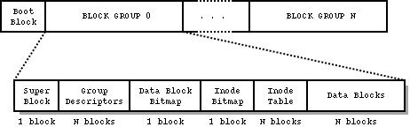
EXT2 Filesystem
Easy to extend without modifying internal data structures.
Details:
Blocks - the basic unit of storage (building block)
inodes as the mean of keeping track of files and system objects (metadata)
block groups - to logically split the disk into more manageable sections (combine building blocks)
Directories - to provide a hierarchical organization of files (organize files)
block and inode bitmaps - to keep track of allocated blocks and inodes
Superblocks - to define the parameters of the file system and its overall state (overall metadata)

Slide 6
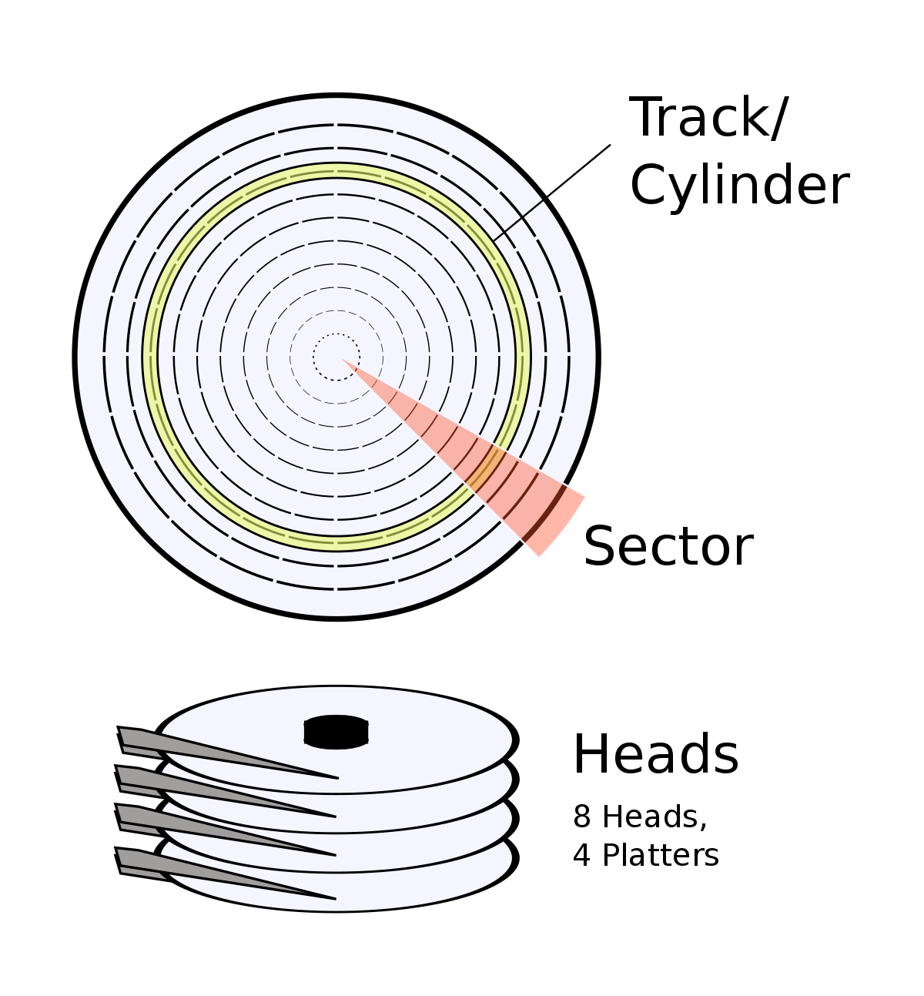
Blocks
A partition, disk, file or block device formatted with a Second Extended Filesystem is divided into small groups of sectors called “blocks”.
These blocks are then grouped into larger units called block groups.
Identify the block size of the ext2 file system provided to you.

Slide 7
Block Groups
Blocks are clustered into block groups
to reduce fragmentation
minimise the amount of head seeking when reading a large amount of consecutive data.
Two blocks near the start of each group are reserved for the block usage bitmap and the inode usage bitmap which show which blocks and inodes are in use.

Slide 8
Block Bitmap
1 block in every block group reserved for the block bitmap
Each bit represent the current state of a block within that block group, where 1 means “used” and 0 “free/available”.
1 1 1 1 1 1 1 1
1 1 1 1 1 0 0 0
…....
No. of bytes = block size
Each bit represent the current state of a block within that block group, where 1 means “used” and 0 “free/available”.
The first block of this block group is represented by bit 0 of byte 0, the second by bit 1 of byte 0. The 8th block is represented by bit 7 (most significant bit) of byte 0 while the 9th block is represented by bit 0 (least significant bit) of byte 1.
Max block size = No. of bits in block bitmap = block size * 8

Slide 9
i-node
Each object in the filesystem is represented by an inode.
An inode is a data structure on a filesystem on Linux and other Unix-like operating systems that store all the information about a file except its name and its actual data.
The inode structure contains pointers to the filesystem blocks which contain the data held in the object .
The metadata about an object includes the permissions, owner, group, flags, size, number of blocks used, access time, change time, modification time, deletion time, number of links, fragments.

Slide 10
Unix Inodes and Block Pointers
Block pointers
(in I-node)
Triple-indirect
Double-indirect
Indirect blocks
Data blocks
1st
1st
2nd
...
3rd
2nd
4th
5th
...
10th
6th
...
7th
11th
8th
9th
...
10th
...
1034th
...
11th
1035th
12th
13th
...
...
2058th
2059th

Slide 11
Structure of an inode on the disk
struct ext2_inode {
__u16 i_mode; /* File mode */
__u16 i_uid; /* Owner Uid */
__u32 i_size; /* Size in bytes */
__u32 i_atime; /* Access time */
__u32 i_ctime; /* Creation time */
__u32 i_mtime; /* Modification time */
__u32 i_dtime; /* Deletion Time */
__u16 i_gid; /* Group Id */
__u16 i_links_count; /* Links count */
__u32 i_blocks; /* Blocks count */
__u32 i_flags; /* File flags */
__u32 i_reserved1;
__u32 i_block[EXT2_N_BLOCKS];/* Pointers to blocks */
...
};

Slide 12
inode table
inode Table, contains inodes (inode structures).
It is one or typically more blocks.
Its location is not fixed, it is indicated in the Group Descriptor.
There is one inode table per block group and it can be located by reading the bg_inode_table in its associated group descriptor. There are s_inodes_per_group inodes per table.

Slide 13
inode bitmap
The “Inode Bitmap” works in a similar way as the “Block Bitmap”, difference being in each bit representing an inode in the “Inode Table” rather than a block.
Since inode numbers start from 1 rather than 0, the first bit in the first block group's inode bitmap represent inode number 1.
There is one inode bitmap per group and its location may be determined by reading the “bg_inode_bitmap” in its associated group descriptor.
When the inode table is created, all the reserved inodes are marked as used. In revision 0 this is the first 11 inodes.

Slide 14
Block group descriptor
used to define parameters of all the block groups. It provides the location of the inode bitmap and inode table, block bitmap, number of free blocks and inodes, and some other useful information.
struct ext2_group_desc
{
__u32 bg_block_bitmap; /* Blocks bitmap block */
__u32 bg_inode_bitmap; /* Inodes bitmap block */
__u32 bg_inode_table; /* Inodes table block */
__u16 bg_free_blocks_count; /* Free blocks count */
__u16 bg_free_inodes_count; /* Free inodes count */
__u16 bg_used_dirs_count; /* Directories count */
__u16 bg_pad;
__u32 bg_reserved[3];
};

Slide 15
superblock
The superblock contains all the information about the configuration of the filesystem.
the total number of inodes and blocks in the filesystem and how many are free, how many inodes and blocks are in each block group,
when the filesystem was mounted (and if it was cleanly unmounted),
when it was modified,
what version of the filesystem it is and which OS created it.
The primary copy of the superblock is stored at an offset of 1024 bytes from the start of the device, and it is essential to mounting the filesystem. Since it is so important, backup copies of the superblock are stored in block groups throughout the filesystem.

Slide 16
Summarizing

Slide 17
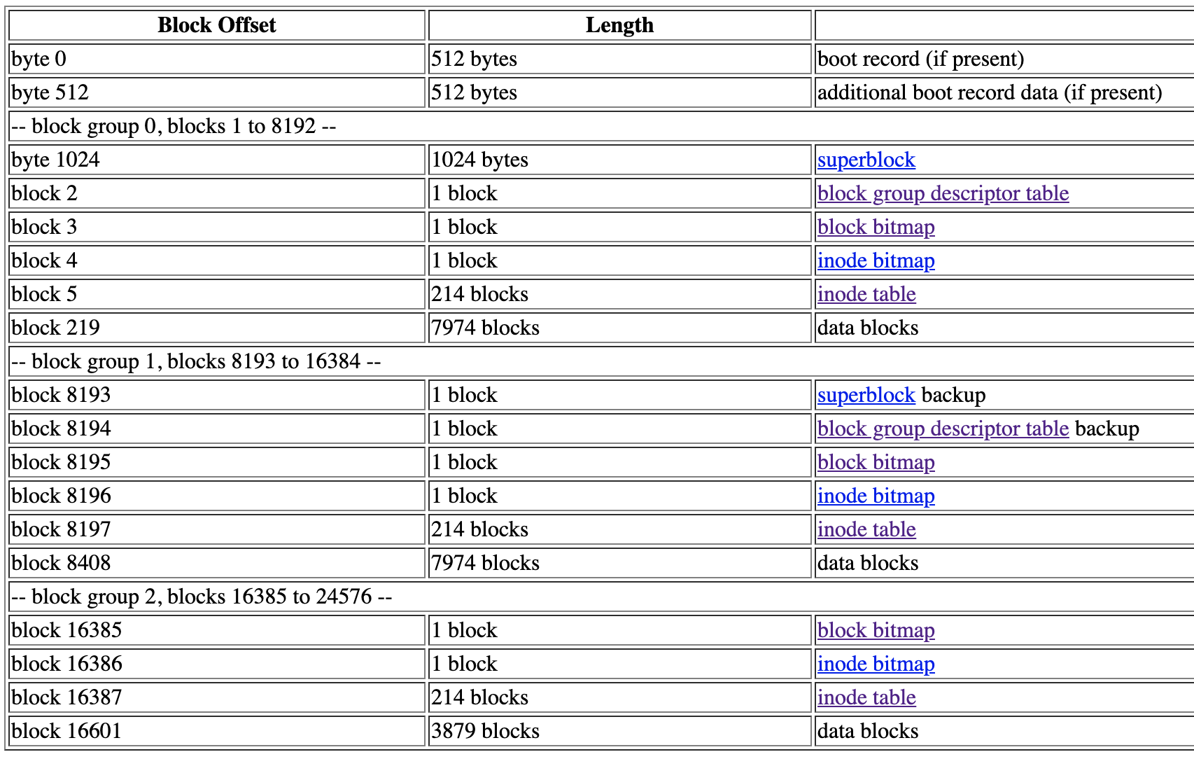
Example layout - block size 1 KiB
No. of blocks / group =
8 * 1024 = 8192
Notice how block 0 is not part of the block group 0 in 1KiB block size file systems. The reason for this is block group 0 always starts with the block containing the superblock. Hence, on 1KiB block systems, block group 0 starts at block 1, but on larger block sizes it starts on block 0. For more information, see the s_first_data_block superblock entry.

Slide 18
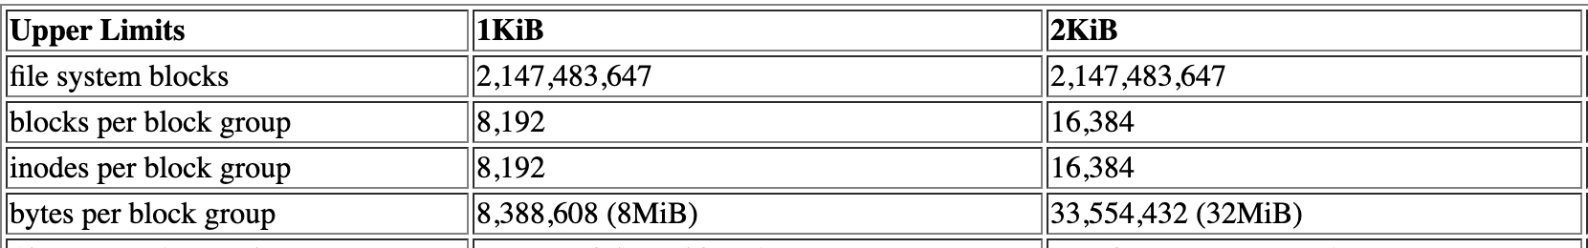
Block Size Calculation
Block count = 1KiB * 8 = 8 * 1024 = 8192
Bytes per block group = 1KiB * 8192 = 1024 * 8192 = 8388608 bytes

Slide 19
Navigating Ext2fs - Superblock
The superblock is always located at byte offset 1024 from the start of the disk or partition.
In a 1KiB block-size formatted file system, this is block 1
In larger block size file systems - it will always be block 0 (at 1024 bytes within block 0)
The layout on disk is very predictable as long as you know a few basic information; block size, blocks per group, inodes per group.
This information is all located in, or can be computed from, the superblock structure.

Slide 20
How to read superblock?
Reading superblock - (ext2_super_block)
Read how many bytes starting from byte_offset of 1024 (fixed for superblock)?
how to verify if it is superblock?
Hint: EXT2_SUPER_MAGIC variable
After finding superblock, report the stats mentioned in the spec.

Slide 21
How to find block size from superblock?
Source : ext2_fs.h
__u32 s_log_block_size; /* log2(Block size) */
The block size is computed using this 32bit value as the number of bits to shift left the value 1024. This value may only be non-negative.
/* bsize = EXT2_MIN_BLOCK_SIZE << s_log_block_size */

Slide 22
Where are we?
Successfully able to report superblock

Slide 23
Navigating Ext2fs - Group Descriptor table
What is the group descriptor table?
This list contains a descriptor for each block group on the disk.
Where is the group descriptor table?
In the blocks immediately following the super-block reside the list of block-group descriptors.
Remember: Super block location depends on block size

Slide 24
Navigating Ext2fs - Group Descriptor table
How many bytes to read for the group descriptor table?
How many entries are there?
What is size of one entry?
=> No. of bytes = no. of entries * size of one entry
How many block groups are present on the filesystem?
Use the values of these variables from ext2_super_block
s_blocks_count - total no. of blocks in the file system
s_blocks_per_group - blocks in every group

Slide 25
Navigating Ext2fs - Group Descriptor table
You’ve successfully read the group descriptor table into a buffer.
Iterate through this table and report group statistics for all the group entries.

Slide 26
Where are we?
Successfully able to report superblock
Successfully able to report groups

Slide 27
Navigating Ext2fs - Using Group Descriptor
The group descriptor tells us the location of the block/inode bitmaps and of the inode table through the bg_block_bitmap, bg_inode_bitmap and bg_inode_table fields.
bg_block_bitmap
32bit block id of the first block of the “block bitmap” for the group represented.
The actual block bitmap is located within its own allocated blocks starting at the block ID specified by this value.
bg_inode_bitmap
32bit block id of the first block of the “inode bitmap” for the group represented.
bg_inode_table
32bit block id of the first block of the “inode table” for the group represented.
use block no and block_size to find actual physical location of block

Slide 28
Reading block bitmap
In every block group:
Block bitmap is located at block no. bg_block_bitmap in the group descriptor structure
Use the block no. (from 1) and the block size to calculate the byte offset
Read 1 block of data into a buffer starting from the correct offset,
this is your block bitmap - report it

Slide 29
Where are we?
Successfully able to report superblock
Successfully able to report groups
Successfully able to report block bitmaps

Slide 30
Reading inode bitmap
In every block group:
Inode bitmap is located at block no. bg_inode_bitmap in the group descriptor structure
Use the block no. (from 1) and the block size to calculate the byte offset
Read 1 block of data into a buffer starting from the correct offset,
this is your inode bitmap - report it

Slide 31
Where are we?
Successfully able to report superblock
Successfully able to report groups
Successfully able to report block bitmaps
Successfully able to report inode bitmaps

Slide 32
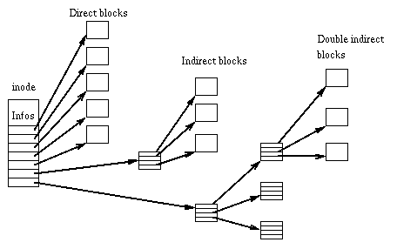
Stepping back
2 questions to answer about i-node:
What does it contain and what is its structure?
Has metadata and pointers to actual file content. We will use these pointers to navigate contents of a specific i-node.
Where is inode stored?
i-node table has pointer to every i-node in the group. Think of this like a container of all i-nodes

Slide 33
Navigating ext2fs - inode table
iNode table can be multiple blocks and stores all information about the inodes in the current block group.
Where is the inode table?
bg_inode_table field of the ext2_group_desc gives us the block no. of the inode table
How big is the inode table?
How many inodes per group?
How many inodes in one block? Hint: You know block size, inode size
How many blocks for inode table - no. of inodes per group / no. of inodes per block

Slide 34
Navigating ext2fs - inode table
For every group we know:
Starting block no. of inode table? Bg_inode_table
How many blocks of inode table are present? Calculated in prev. Slide
Using this information:
Iterate through blocks belonging to the inode table
Process all i-nodes belonging to the current block

Slide 35
Navigating ext2fs - inode
you can navigate to the inode you want to read by offsetting the inode table beginning by the required number of inodes
Ex: To navigate to the root directory(inode no. 2), you can offset the start address of bg_inode_table by (2-1) times size of every inode.
Why -1?
Start of inode n will be at (n-1)* size of inode
Once you read in the inode - report metadata of inode

Slide 36
inode - i_mode
i_mode has information about
file format
process execution user/group override
access rights
<sys/stat.h> defines macros to identify file type, permissions
Ex: To check if the inode you are currently reading
is a link - inode.i_mode & S_IFLNK
is a directory - inode.i_mode & S_DIR
….

Slide 37
Navigating the inode
__u32 i_size; /* Size in bytes */
Use the i_size variable along with block_size to identify the number of blocks that the data of this file occupies.
Use the direct, indirect, double-indirect pointer to identify the actual data blocks that belong to this file.

Slide 38
Reporting metadata - inode
INODE
inode number (decimal)
file type ('f' for file, 'd' for directory, 's' for symbolic link, '?" for anything else)
mode (low order 12-bits, octal ... suggested format "%o")
owner (decimal)
group (decimal)
link count (decimal)
time of last I-node change (mm/dd/yy hh:mm:ss, GMT)
modification time (mm/dd/yy hh:mm:ss, GMT)
time of last access (mm/dd/yy hh:mm:ss, GMT)
file size (decimal)
number of (1024 byte) blocks of disk space (decimal) taken up by this file

Slide 39
Reporting metadata - inode
For ordinary files (type 'f') and directories (type 'd') the next fifteen fields are block addresses (decimal, 12 direct, one indirect, one double indirect, one triple indirect).
Symbolic links are a little more complicated. If the file length is less than the size of the block pointers (60 bytes) the file will contain zero data blocks, and the name is stored in the space normally occupied by the block pointers. If this is the case, the fifteen block pointers need not be printed.

Slide 40
Logical Block Offset
Logical block is a commonly used term. It ignores physical file structure (where data is actulally stored, indirect blocks, sparseness, etc) and views the data in the file as a (logical) stream of bytes. If the block size was 1K (1024 bytes):
bytes 0-1023 would be in logical block 0
bytes 1024-2047 would be in logical block 1
bytes 2048-3071 would be in logical block 2
...

Slide 41
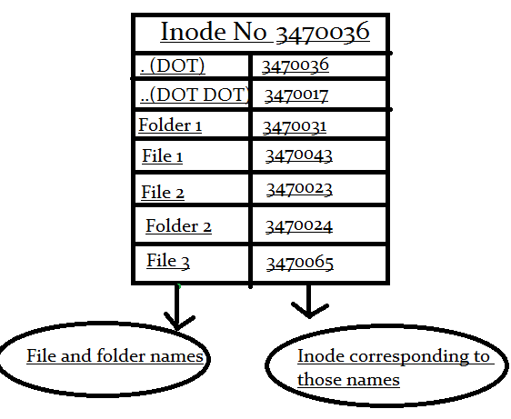
Directory
When you read the inode data, you can use the i_mode field to identify if the inode under consideration is a directory.
Use the ext2_dir_entry struct to get details of the files in the directory.
The directory structure is a linkedlist like structure.
To navigate to the next entry, rec_len gives the offset needed from the start of the current record to identify the next record.

Slide 42
Reporting directory entry
For each directory I-node, scan every data block. For each valid (non-zero I-node number) directory entry, produce a new-line terminated line, with seven comma-separated fields (no white space).
DIRENT
parent inode number (decimal) ... the I-node number of the directory that contains this entry
logical byte offset (decimal) of this entry within the directory
inode number of the referenced file (decimal)
entry length (decimal)
name length (decimal)
name (string, surrounded by single-quotes). Don't worry about escaping, we promise there will be no single-quotes or commas in any of the file names.

Slide 43
Reporting indirect blocks
The I-node summary contains a list of all 12 blocks, and the primary single, double, and triple indirect blocks. We also need to know about the blocks that are pointed to by those indirect blocks. For each file or directory I-node, scan the single indirect blocks and (recursively) the double and triple indirect blocks. For each non-zero block pointer you find, produce a new-line terminated line with six comma-separated fields (no white space).
INDIRECT
I-node number of the owning file (decimal)
(decimal) level of indirection for the block being scanned ... 1 for single indirect, 2 for double indirect, 3 for triple
logical block offset (decimal) represented by the referenced block. If the referenced block is a data block, this is the logical block offset of that block within the file. If the referenced block is a single- or double-indirect block, this is the same as the logical offset of the first data block to which it refers.
block number of the (1, 2, 3) indirect block being scanned (decimal) . . . not the highest level block (in the recursive scan), but the lower level block that contains the block reference reported by this entry.
block number of the referenced block (decimal)

Slide 44
Reporting triple indirect block
If an I-node contains a triple indirect block:
the triple indirect block number would be included in the INODE summary.
INDIRECT entries (with level 3) would be produced for each double indirect block pointed to by that triple indirect block.
INDIRECT entries (with level 2) would be produced for each indirect block pointed to by one of those double indirect blocks.
INDIRECT entries (with level 1) would be produced for each data block pointed to by one of those indirect blocks.

Slide 45
Where are we?
Successfully able to report superblock
Successfully able to report groups
Successfully able to report block bitmaps
Successfully able to report inode bitmaps
Successfully able to report inode entries

Slide 46
Random read
ssize_t pread(int fd, void *buf, size_t count, off_t offset);
Read count no. of bytes from fd into buf, starting at offset in the file.
Use pread to read from specific offsets throughout your program

Slide 47
debugfs
stat
block_dump
testi

Slide 48
Summarizing Navigation
Identify superblock
Use info to find group descriptor table
For all groups:
Use info in group descriptor to find block and inode bitmaps
Use info in group descriptor to find inode table
Use info in inode table to report inodes

