Slide 1
GraphBlas for SynthPlanning
William (Liam) Cole
UGSP Postbac IRTA
Dr. Gergely Zahoránszky-Kohalmi
ASPIRE INFORMATICS, NCATS, NIH

Slide 2
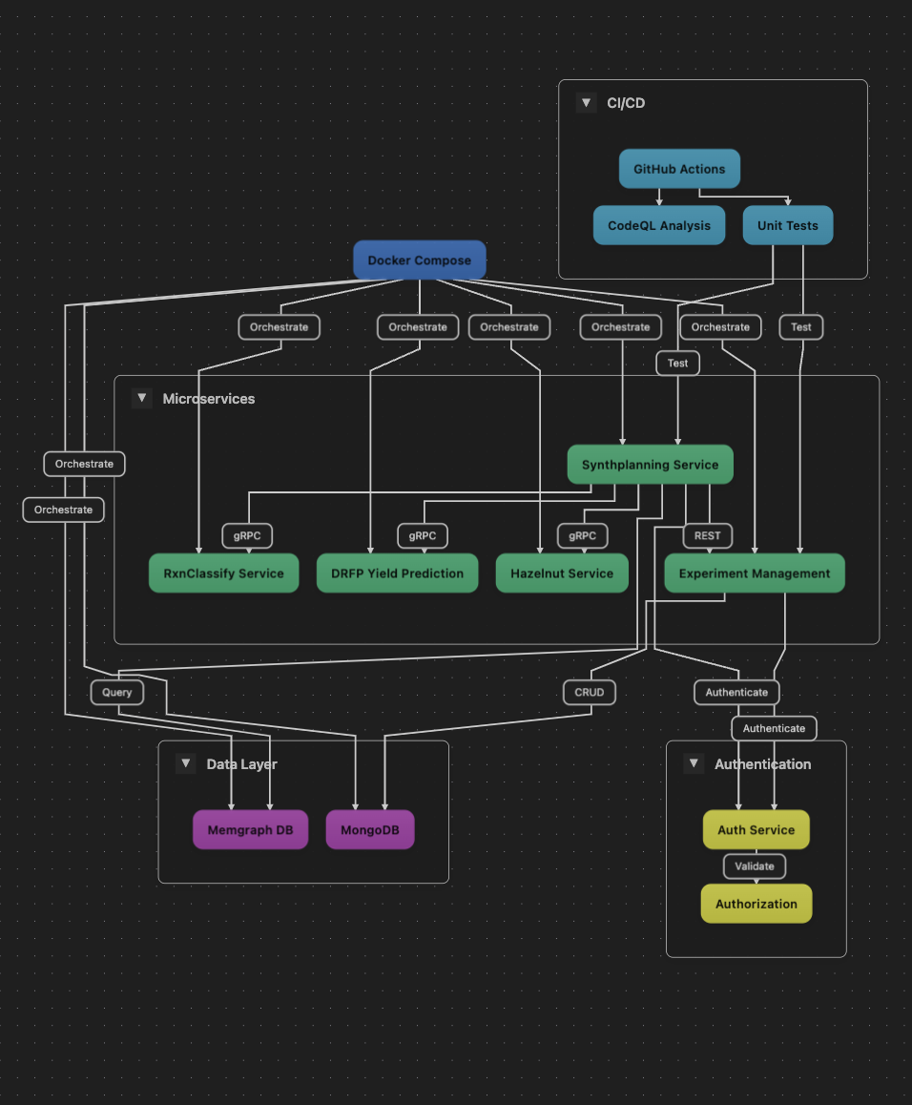
This work is relevant to SynthPlanning Service
Route planning
AICP Architecture

Slide 3
Trainee Developmental | AICP Development Goal
Applying Advanced Mathematics to Informatics from the Ground Up | fast and efficient and low constraint search
Requires accessing prior linear algebra knowledge and converting this into python code. Requires understanding some C++ and accelerated computing concepts. | Open Source, no lock in, no gpu needed for end user

Slide 4
Dr. Tim Davis out of Texas A&M : https://engineering.tamu.edu/cse/profiles/davis-tim.html
GraphBlas: Linear Algebra for Graphs
https://graphblas.org/
Graphs as matrices, edges as entries
Sparse matrix operations for efficiency
Standardizes graph algorithms mathematically
Supports diverse applications: AI, networks
High-performance computing on graphs
Portable across platforms, languages
Accelerates graph analytics, big data

Slide 5
Origin
GraphBlas: From GPU Insights to Linear Algebra
Started with GPU work via RAPIDS
Explored GPU potential for graph problems
Considered matrix representations of graphs
Investigated linear algebra for graph computations
Experimented with approximate solutions initially
Discovered GraphBlas: exact solutions, linear algebra
Noted GraphBlas runs on CPU currently

Slide 6
Where this work is stored
https://github.com/williamcolegithub/graphsearch
I have made this into a submodule on a branch inside of AICP:
https://github.com/williamcolegithub/aspire-aicp-services/tree/liam-dev

Slide 7
Primary Experiment
GraphBLAS on Memgraph: ASP Performance Test I
Implemented GraphBLAS for ASP on Memgraph
Compared to Memgraph’s native ASP search
GraphBLAS used sparse matrix operations
Measured disk space: GraphBLAS more efficient
Measured time: GraphBLAS faster for large graphs
Memgraph’s in-memory approach increased RAM usage
GraphBLAS on CPU, Memgraph traversal-based

Slide 8
Results so Far

Slide 9
A PAUSE FOR QUESTIONS

