Slide 1
Talos CleanRoom
An Infrastructure-as-Code Security Platform on Kubernetes
William de Marigny | St. Mary's University | Spring 2026
Notes:
Welcome. I'm William de Marigny and today I'll present Talos CleanRoom -- a platform I built that deploys a full Kubernetes cluster and integrated security toolchain with a single click, then lets you scan your network for vulnerabilities and malware. I'll alternate between slides and live demos so you can see the real system in action. Total time: about 25 minutes.

Slide 2
The Problem
Setting up a security scanning environment is complex and time-consuming
OpenVAS, Metasploit, Faraday, and LOKI each need separate installation, configuration, networking, and maintenance
Manual Kubernetes deployment is error-prone and not reproducible
No single interface to orchestrate scanning across multiple tools
Results are siloed -- no unified reporting, no comparison over time, no remediation tracking
Security teams spend more time fighting infrastructure than finding vulnerabilities
Notes:
If you wanted to stand up a professional vulnerability management environment from scratch, you'd need to install and configure at least 4 separate security tools, deploy a Kubernetes cluster, set up ingress, TLS, storage, GitOps -- and then build a way to use all of it together.
There is no turnkey solution that does all of this as Infrastructure-as-Code with a web interface. That's the gap this project fills.

Slide 3
Talos CleanRoom -- The Solution
What It Does
One-click Kubernetes cluster deployment on Proxmox via Terraform + Talos Linux
Integrated security toolchain: Nmap, OpenVAS, Metasploit, LOKI-RS
3 web applications with single sign-on (Portal, Deployment Console, Scanning Console)
GitOps via ArgoCD -- entire platform state managed in Git
Real-time WebSocket progress for all operations
Key Numbers
434 commits over ~3.5 months
23-step automated deployment pipeline
4 scanning tools unified in one interface
3 scan profiles + fully customizable
Zero-trust network policies per namespace
PostgreSQL persistence with daily backups
30+ page documentation site with videos
Notes:
The platform does two major things. First, it deploys your entire infrastructure with one click -- Terraform creates VMs, Talos Linux bootstraps Kubernetes, and ArgoCD deploys all the security tools automatically.
Second, it gives you a unified interface to scan, analyze, and track vulnerabilities across Nmap, OpenVAS, Metasploit, and LOKI-RS.
434 commits in about 3 and a half months. The deployment pipeline has 23 automated steps. Let me show you the architecture.

Slide 4
Platform Architecture
Proxmox Cluster (4 nodes: pve01-04, 10.83.2.20-23)
Talos Kubernetes Cluster (VLAN 3: 10.83.3.0/24)
Control Plane (master-01)
Workers x3 (worker-01..03)
Ceph RBD Storage
Pod/Svc CIDRs
Infrastructure Layer
MetalLB
cert-manager
Traefik
Ceph CSI
ArgoCD
Security Tools Layer
OpenVAS / Greenbone
Metasploit
Faraday
Harbor Registry
Application Layer
Deployment Console (LXC, 10.83.3.190)
Build VM -- Docker Image Builds (LXC, 10.83.3.191)
Scanning Console
Portal (SSO)
CleanRoom DB (PostgreSQL)
Ingress: Internet → MetalLB (10.83.3.200) → Traefik → K8s Services | DNS: *.knowledgeondemand.net | TLS: Wildcard cert (Cloudflare DNS-01)
Notes:
The foundation is a 4-node Proxmox cluster. Terraform creates 4 VMs that become a Talos Linux Kubernetes cluster -- one control plane and three workers.
Inside the cluster, ArgoCD manages everything via GitOps. The infrastructure layer handles load balancing (MetalLB), TLS certificates (cert-manager), and ingress (Traefik). The security layer runs OpenVAS, Metasploit, Faraday, and Harbor as containerized workloads.
The Scanning Console and Portal run inside the cluster. The Deployment Console runs in a separate LXC container because it needs to manage the cluster from outside.
Every namespace has default-deny network policies -- zero-trust networking.

Slide 5
Technology Stack
Backend & Infrastructure
Frontend & Security Tools
Python / FastAPI + Uvicorn (async)
PostgreSQL 17 (SQLAlchemy + Alembic)
Terraform (Proxmox VM provisioning)
Talos Linux (immutable Kubernetes OS)
ArgoCD (GitOps, self-healing, auto-sync)
SOPS + Age (secret encryption in Git)
Ceph RBD (persistent block storage)
Jinja2 + Alpine.js + Tailwind CSS
WebSocket + REST polling fallback
JWT SSO with HMAC one-time codes
Nmap (port & service discovery)
OpenVAS / Greenbone (70k+ vuln tests)
Metasploit (exploit verification)
LOKI-RS (IOC / malware scanning)
Faraday (vuln management aggregation)
Notes:
On the backend, all three web apps use FastAPI, a modern async Python framework. The frontend uses server-rendered Jinja2 templates with Alpine.js for interactivity and Tailwind CSS for styling.
I chose Talos Linux because it's an immutable, API-driven OS designed for Kubernetes -- no SSH, no shell, no package manager. Inherently more secure.
Cross-app authentication uses HMAC-signed one-time codes so the user logs in once at the Portal and is seamlessly authenticated across all three apps.
TRANSITION: Let me switch to the live system and show you how this works in practice.

Slide 6
Live Demo
Portal Login → SSO Navigation → Deployment Console → Dashboard → Configuration
Notes:
TRANSITION TO LIVE DEMO.
Switch to browser. Tabs should be pre-loaded.
Demo flow (5 minutes):
1. Portal login (30s): Open cleanroom.knowledgeondemand.net, log in admin/admin, show landing page with two console cards
2. SSO navigation (30s): Click Deployment Console card, point out no second login needed
3. Dashboard (1m): Show completed deployment, scroll through 23 steps, show service links
4. Configuration (1m): Show Terraform config, Talos config, trigger validation error
5. Logs (1m): Show log filtering, historical logs, failed/resume/skip capability
6. Cleanup (30s): Show cleanup dialog but do NOT click confirm
FALLBACK: If demo fails, play 01-getting-started.mp4 (37s) and narrate over screenshots.

Slide 7
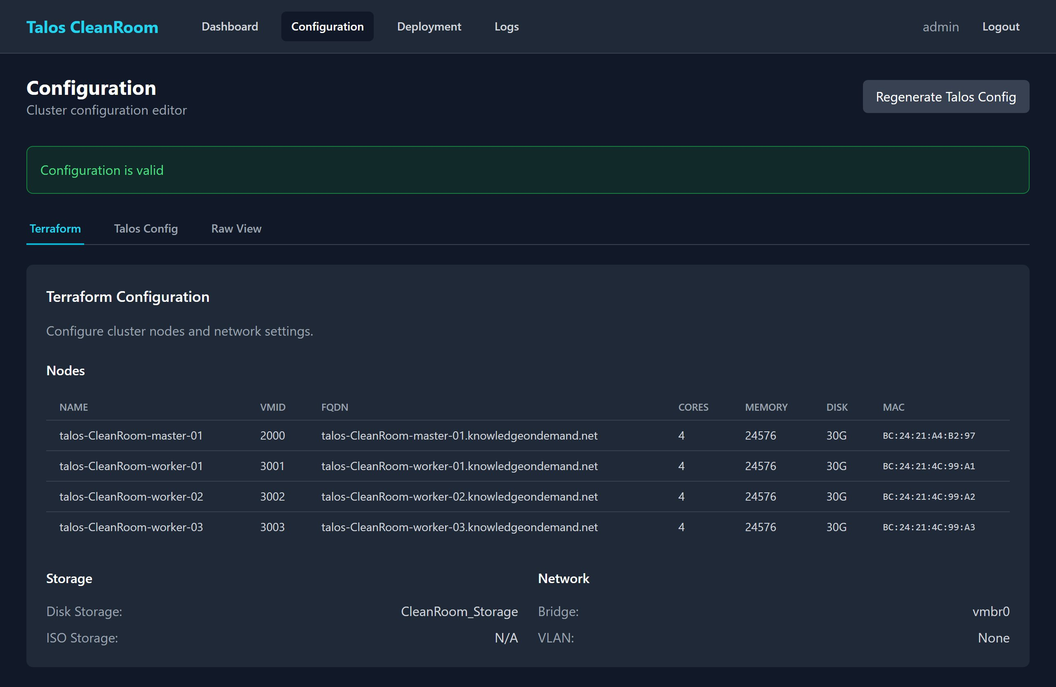
23-Step Automated Deployment
Steps 0-2: Terraform VM creation on Proxmox (4 VMs)
Steps 3-5: Talos config generation, application, cluster bootstrap
Steps 6-8: Health verification, kubeconfig retrieval, ArgoCD installation
Steps 9-11: Infrastructure stack (MetalLB, cert-manager, Traefik, Ceph)
Steps 12-16: ArgoCD self-management, security tools (OpenVAS, Faraday, Metasploit, Harbor)
Steps 17-22: Secrets, Build VM, container image builds, app deployment, network policies
Every step is checkpointed to an encrypted state file
If step 14 fails, resume from step 14 -- all previous work is preserved
Real-time WebSocket progress; automatic REST polling fallback
Notes:
What you just saw in the demo was the end state. Here's what actually happens during a deployment.
The 23 steps cover everything from VM creation through network policy enforcement. Every step is checkpointed to a Fernet-encrypted state file. If any step fails, you can fix the issue and resume from that exact step.
The deployment page uses WebSockets to stream progress in real time. If the WebSocket connection drops, it automatically falls back to REST polling.

Slide 8
Scanning Console -- Unified Vulnerability Management
Vulnerability Scanning
Nmap: port discovery & service fingerprinting
OpenVAS: 70,000+ vulnerability tests (NVTs)
Metasploit: exploit-based verification (11-39 modules)
Results auto-enriched with CVSS + EPSS scores
All findings aggregated in Faraday
3 profiles: Quick (5-15m), Standard (15-45m), Thorough (1-3h)
IOC Scanning
LOKI-RS: file-based indicator of compromise scanner
Mounts remote filesystems via SSH or SMB/CIFS
Scans against YARA rules, malicious hashes, threat signatures
Severity levels: Alert (80+), Warning (60-79), Notice (<60)
Runs as ephemeral privileged K8s pods
Findings persisted to PostgreSQL + uploaded to Faraday
Notes:
The Scanning Console provides a unified interface across four vulnerability scanning tools and one IOC scanner.
You pick a target, select tools, choose a scan profile, and click Start. The system orchestrates tools in parallel, streams progress via WebSocket, enriches results with CVSS severity and EPSS exploit probability scores, and uploads everything to Faraday.
The IOC scanner checks individual servers for malware by mounting their filesystem and running LOKI-RS against known threat signatures. Useful for incident response.
TRANSITION: Let me demonstrate the scanning workflow live.

Slide 9
Live Demo
Vulnerability Scan → IOC Scan → Reports Dashboard → Scan Comparison
Notes:
TRANSITION TO LIVE DEMO 2.
Demo flow (8 minutes):
1. SSO into Scanning Console (15s): Click card from Portal
2. Target Lab (1.5m): Show Vulhub catalog, active targets
3. Vulnerability scan config (1m): Enter target, select Nmap+OpenVAS, Quick profile, show Custom module picker, start scan
4. Scan progress (1.5m): Show real-time tool progress cards, log filtering by tool. If Nmap finishes, show completion. If OpenVAS still running, explain and move on.
5. IOC Scanning (1.5m): Show SSH/SMB config, start scan if target available, show findings
6. Reports (2m): Dashboard summary, drill into scan detail, hosts view, vulnerability filters, scan comparison, audit log, remediation tracking
FALLBACK: Play 05-reports-tour.mp4 (35s) for reports. Show screenshots in sequence.

Slide 10
Security Architecture & Design Decisions
Immutable OS: Talos Linux -- no SSH, no shell, no package manager; API-only management
Zero-trust networking: Default-deny network policies per namespace; explicit allow-lists
Secret management: SOPS + Age encryption; secrets never stored in plaintext in Git
Cross-domain SSO: HMAC-signed one-time codes (no JWT in URLs, single-use, rate-limited)
Container security: Private Harbor registry with Trivy vulnerability scanning on push
Database security: Alembic migrations via hardened init container (non-root, read-only FS)
Fault tolerance: Deployment checkpointed per step; WebSocket with REST fallback
Key derivation: Single SECRET_KEY derives separate keys for JWT, HMAC, and Fernet
Notes:
Security was a primary concern throughout the design.
Starting at the OS level, Talos Linux is immutable -- you literally cannot SSH into the nodes. The only way to manage them is through the Talos API.
At the network level, every namespace starts with default-deny for both ingress and egress. I had to explicitly define what each service is allowed to talk to.
Secrets are encrypted at rest in the Git repository using SOPS with Age keys. ArgoCD decrypts them on deploy via the KSOPS plugin.
The SSO mechanism avoids putting JWTs in URLs (a common security anti-pattern). Instead, the Portal generates a short-lived HMAC-signed one-time code that the target app exchanges for a local JWT.

Slide 11
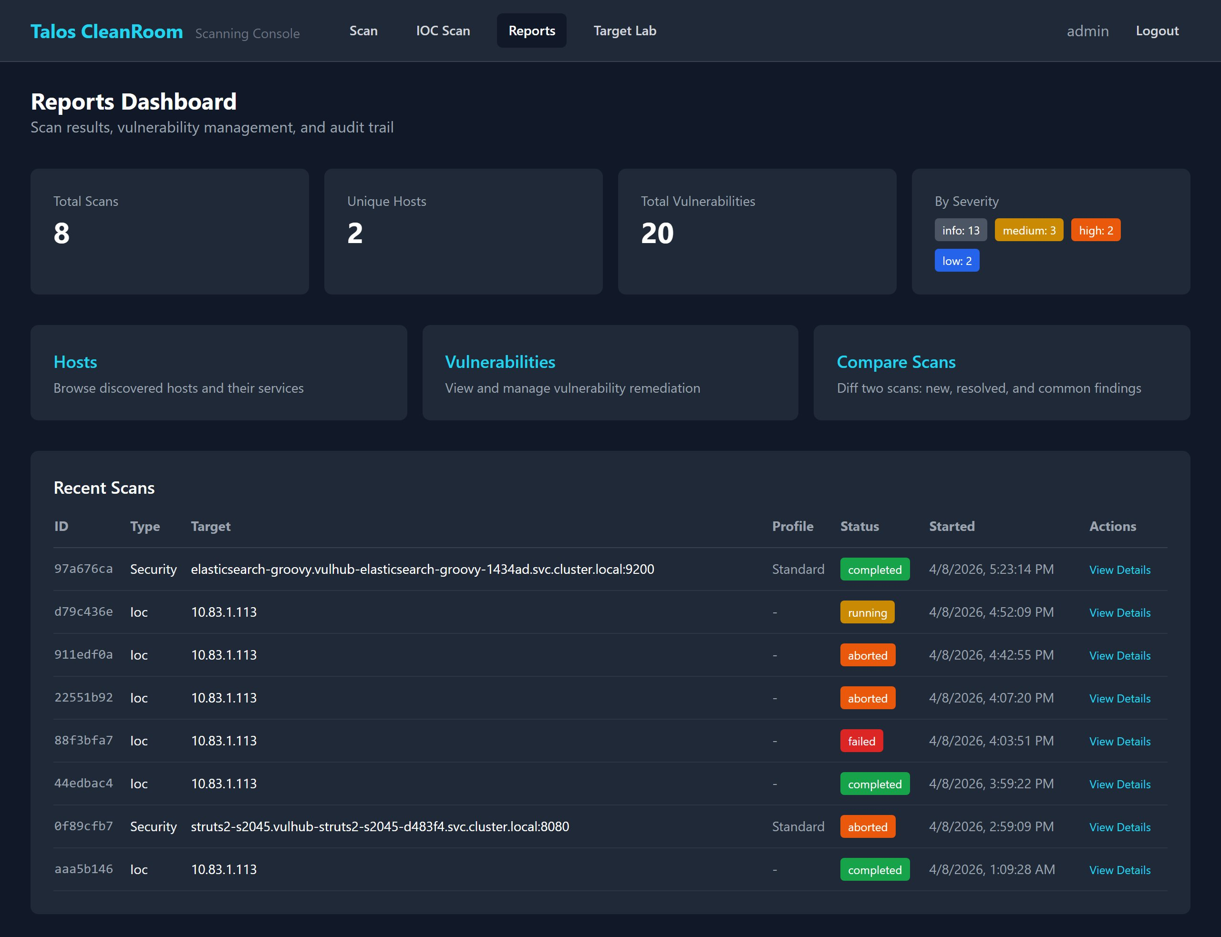
Results & Achievements
Fully automated: bare Proxmox nodes to running security platform in ~45 minutes
3 production-quality web applications with shared authentication library
Comprehensive documentation: 30+ page MkDocs site with screenshots and video walkthroughs
434 commits across 3.5 months of development
Technology breadth: Python, JavaScript, Bash, Terraform HCL, Kubernetes YAML, Helm, SQL
Successfully scanned targets and detected known CVEs with all four scanning tools
Demonstrated IOC detection capability against simulated threat indicators
All infrastructure reproducible from Git -- true Infrastructure-as-Code
Notes:
The end result is a platform that takes bare Proxmox nodes and, with one click, produces a fully operational Kubernetes cluster running a complete security toolchain.
I wrote over 430 commits of code across Python, JavaScript, Bash, Terraform, and Kubernetes manifests. The three web applications share a common library.
The documentation site has over 30 pages with screenshots and video walkthroughs.

Slide 12
Lessons Learned & Future Work
Lessons Learned
Future Work
OpenVAS resource tuning: OOMKill at 1Gi, needed 4Gi (trial and error)
Faraday Community Edition: no bulk API; had to create findings individually
LOKI-RS in K8s: needed privileged pods + FUSE for filesystem mounting
kubectl output truncation: SPDY ~200KB limit; temp files + base64 workaround
Cross-app auth: built 3 iterations before one-time code exchange
Scheduled / recurring scans (cron-based)
LDAP / Active Directory authentication
Multi-cluster support
Dashboard analytics with trend graphs
SecureCodeBox integration for CI/CD scanning
Automated remediation workflows
Notes:
Some highlights from lessons learned:
OpenVAS kept getting killed by Kubernetes because it exceeded its memory limit. The default 1Gi was not enough; I had to bump it to 4Gi and enable shared process namespaces for zombie process reaping.
Faraday's Community Edition doesn't have a bulk API -- the Celery worker that processes bulk imports doesn't run. I had to write code to create hosts, services, and vulnerabilities individually via the REST API.
For future work, the most impactful addition would be scheduled scans so security teams don't have to manually trigger scans.

Slide 13
Questions?
William de Marigny
github.com/williamdemarigny/Talos-CleanRoom
Notes:
Thank you for your attention. Happy to take questions.
Have the live system still open in the browser in case someone asks to see a feature.
Anticipated questions:
- Why Talos Linux? Immutable, API-only, no attack surface from SSH/shell.
- Why not managed K8s? Runs on-premises on Proxmox for full control.
- How long does deployment take? About 45 minutes from bare nodes.
- Could this scale to production? Yes -- Talos and ArgoCD are production-grade.

