Slide 1
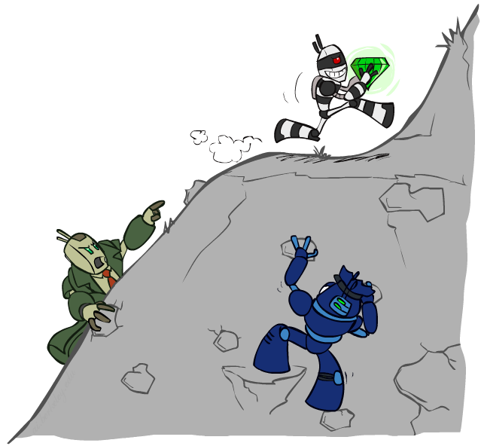
CS 370: Artificial Intelligence
Constraint Satisfaction Problems II
Instructor: William DeMeo
[slides created by Dan Klein and Pieter Abbeel; provided courtesy of http://ai.berkeley.edu.]
Notes:
Please retain proper attribution, including the reference to ai.berkeley.edu. Thanks!

Slide 2

Today
Efficient Solution of CSPs
Local Search

Slide 3


Reminder: CSPs
CSPs:
Variables
Domains
Constraints
Implicit (provide code to compute)
Explicit (provide a list of the legal tuples)
Unary / Binary / N-ary
Goals:
Here: find any solution
Also: find all, find best, etc.
Notes:
A unary constraint restricts possible values of a single variable.
A binary... two variables...

Slide 4
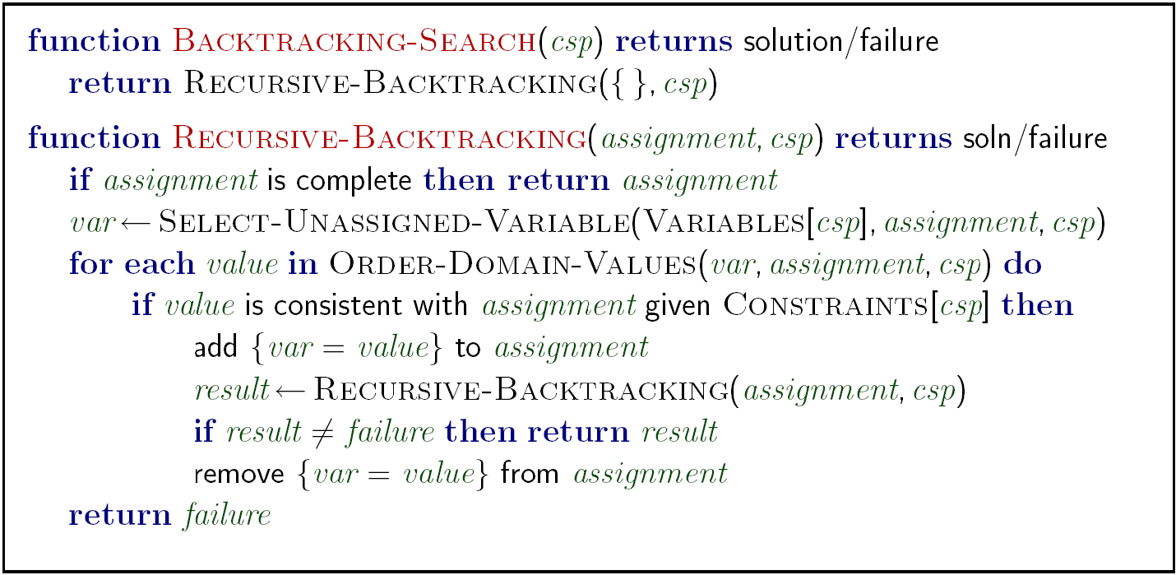
Backtracking Search

Slide 5
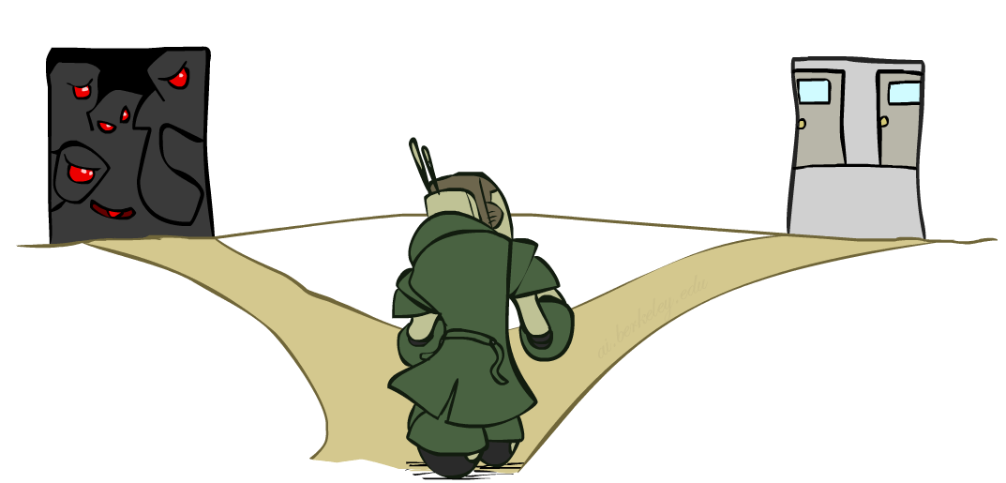

Improving Backtracking
General-purpose ideas give huge gains in speed
… but it’s all still NP-hard
Filtering: Can we detect inevitable failure early?
Ordering:
Which variable should be assigned next? (MRV)
In what order should its values be tried? (LCV)
Structure: Can we exploit the problem structure?

Slide 6

Arc Consistency and Beyond

Slide 7
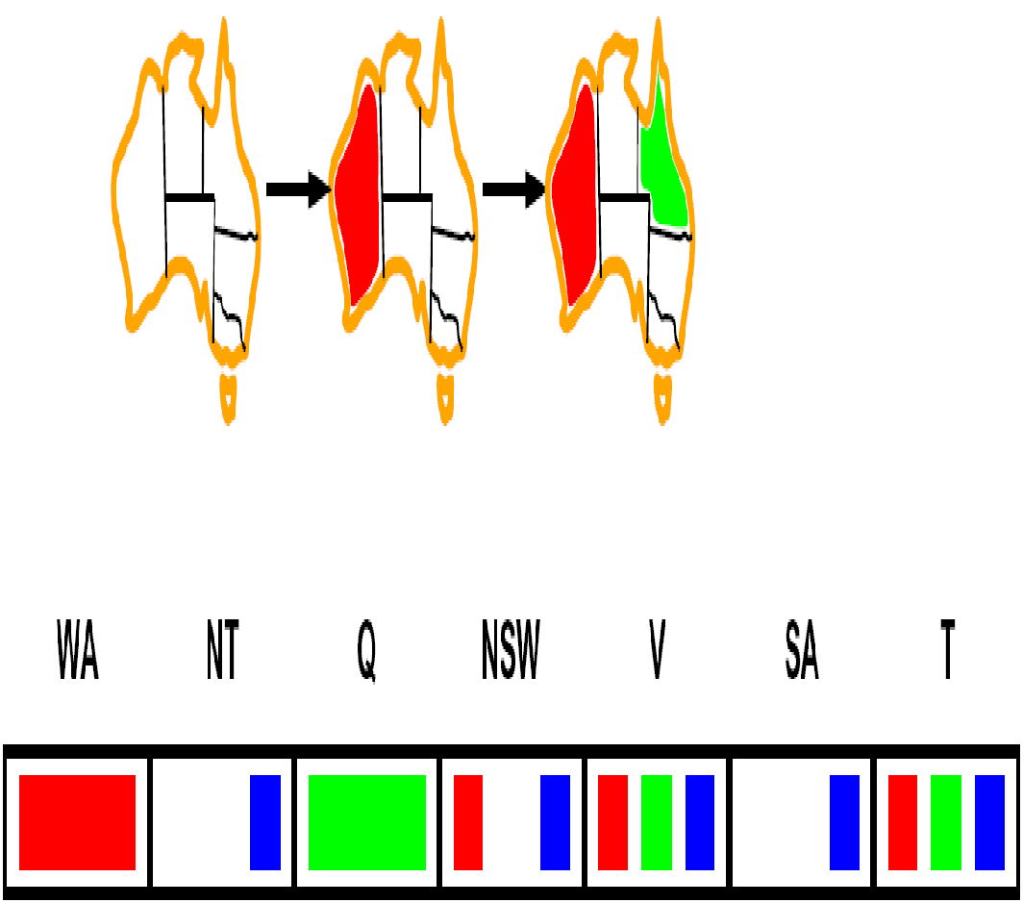
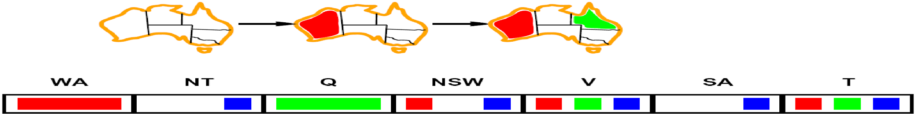
Arc Consistency of an Entire CSP
A simple form of propagation makes sure all arcs are simultaneously consistent:
Arc consistency detects failure earlier than forward checking
Important: If X loses a value, neighbors of X need to be rechecked!
Must rerun after each assignment!
NT
Q
WA
SA
NSW
V
Remember: Delete from the tail!

Slide 8
Limitations of Arc Consistency
After enforcing arc consistency:
Can have one solution left
Can have multiple solutions left
Can have no solutions left (and not know it)
Arc consistency still runs inside a backtracking search!
What went wrong here?

Slide 9
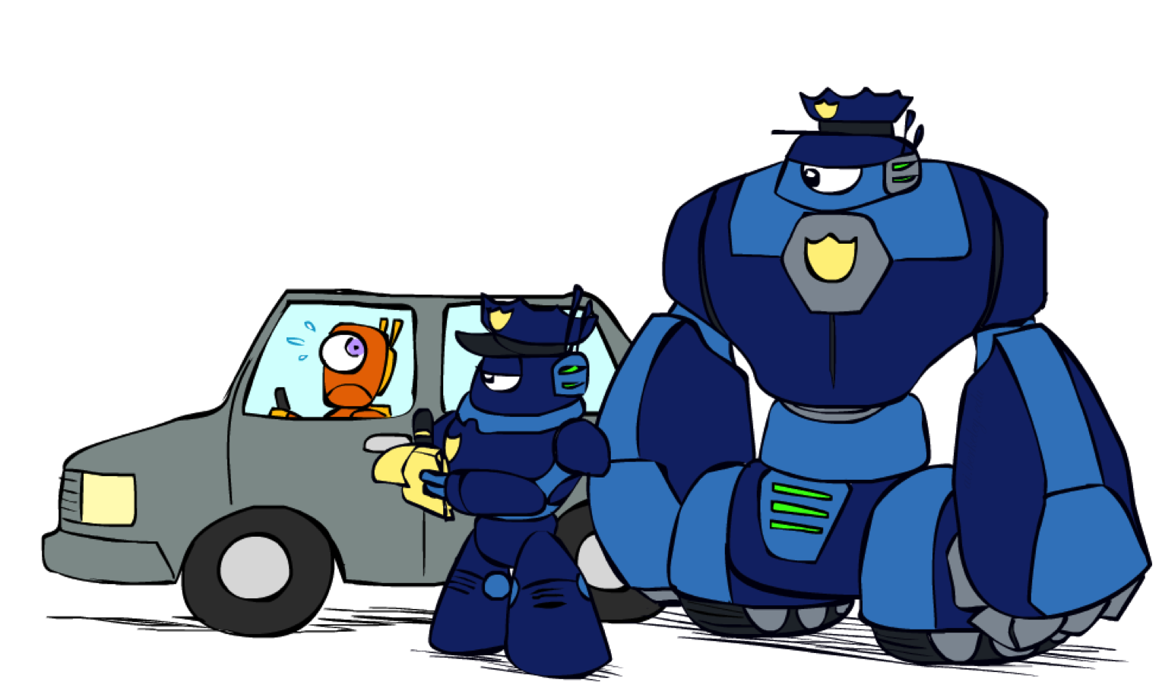
K-Consistency
Notes:
Instead of limiting to pairs as in arc consistency, we now want triples or quadruples or, more generally, k-tuples, to be consistent.
This will be more expensive to check, but it will result in less back tracking.
In general, it's hard to know how much consistency to enforce... how much will end up saving compute time.

Slide 10
K-Consistency
Increasing degrees of consistency
1-Consistency (Node Consistency): Each single node’s domain has a value which meets that node’s unary constraints
2-Consistency (Arc Consistency): For each pair of nodes, any consistent assignment to one can be extended to the other
K-Consistency: For each k nodes, any consistent assignment to k-1 can be extended to the k^{th} node.
Higher k more expensive to compute
(For us, we will only really need the k=2 case: arc consistency)

Slide 11
Strong K-Consistency
Strong k-consistency: also k-1, k-2, … 1 consistent
Claim: strong n-consistency means we can solve without backtracking!
Why?
Choose any assignment to any variable
Choose a new variable
By 2-consistency, there is a choice consistent with the first
Choose a new variable
By 3-consistency, there is a choice consistent with the first 2
…
Lots of middle ground between arc consistency and n-consistency! (e.g. k=3, called path consistency)

Slide 12
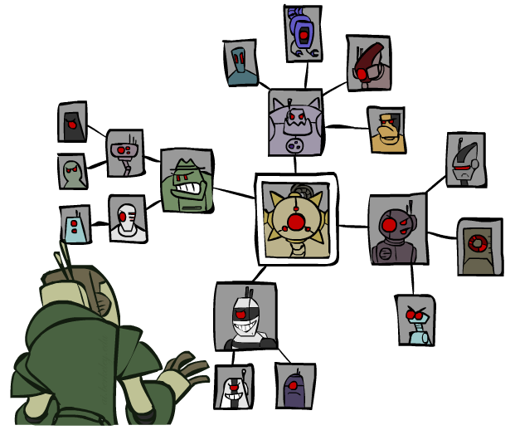
Structure

Slide 13
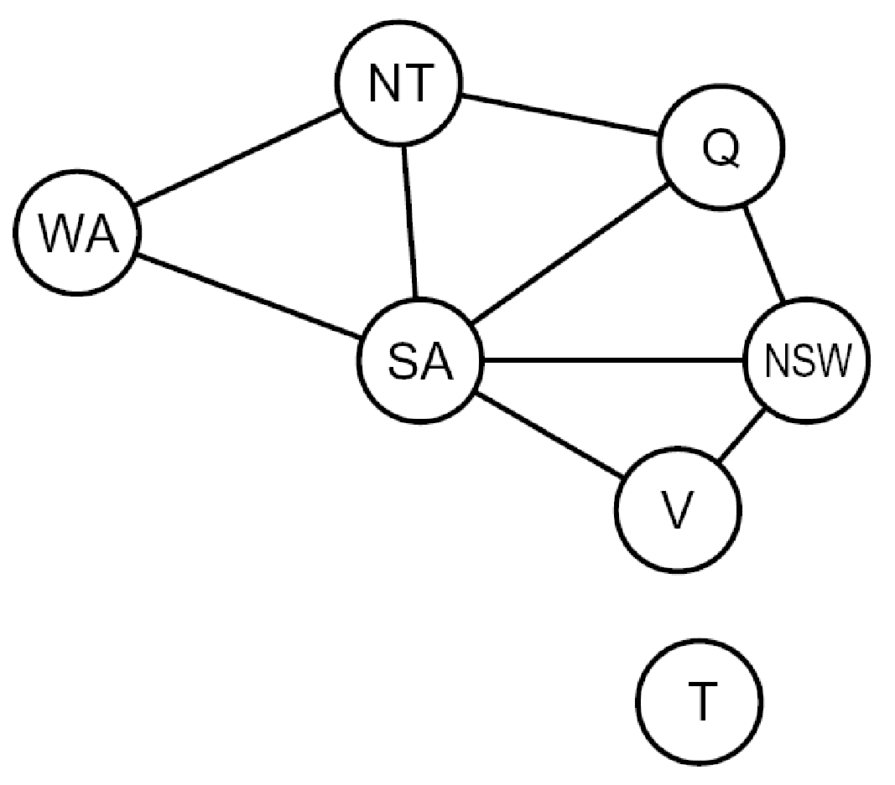
Problem Structure
Extreme case: independent subproblems
Example: Tasmania and mainland do not interact
Independent subproblems are identifiable as connected components of constraint graph
Suppose a graph of n variables can be broken into subproblems of only c variables:
Worst-case solution cost is O((n/c)(d^{c})), linear in n
E.g., n = 80, d = 2, c =20
2⁸⁰ = 4 billion years at 10 million nodes/sec
(4)(2²⁰) = 0.4 seconds at 10 million nodes/sec

Slide 14
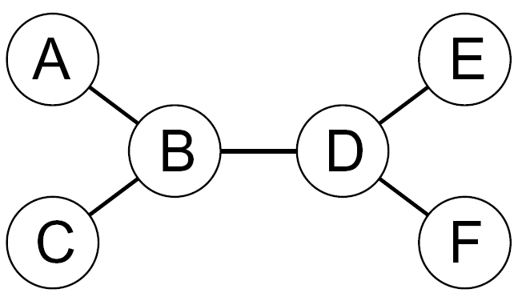
Tree-Structured CSPs
Theorem: if the constraint graph has no loops, the CSP can be solved in O(n d²) time
Compare to general CSPs, where worst-case time is O(d^{n})
This property also applies to probabilistic reasoning (later): an example of the relation between syntactic restrictions and the complexity of reasoning

Slide 15
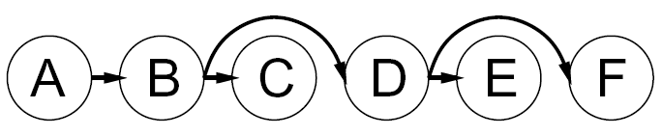
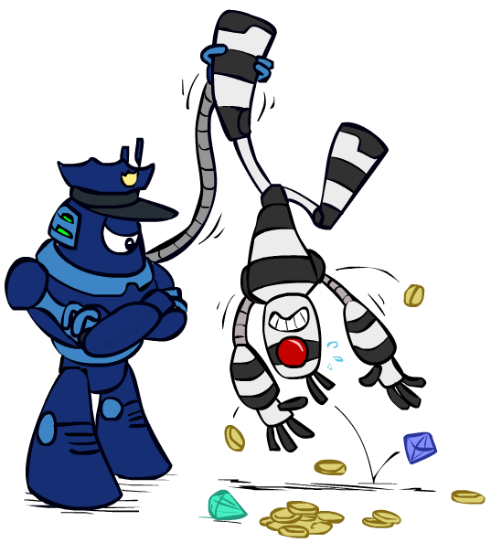

Tree-Structured CSPs
Algorithm for tree-structured CSPs:
Order: Choose a root variable, order variables so that parents precede children
Remove backward: For i = n : 2, apply RemoveInconsistent(Parent(X_{i}),X_{i})
Assign forward: For i = 1 : n, assign X_{i} consistently with Parent(X_{i})
Runtime: O(n d²) (why?)

Slide 16
Tree-Structured CSPs
Claim 1: After backward pass, all root-to-leaf arcs are consistent
Proof: Each X→Y was made consistent at one point and Y’s domain could not have been reduced thereafter (because Y’s children were processed before Y)
Claim 2: If root-to-leaf arcs are consistent, forward assignment will not backtrack
Proof: Induction on position
Why doesn’t this algorithm work with cycles in the constraint graph?
Note: we’ll see this basic idea again with Bayes’ nets

Slide 17
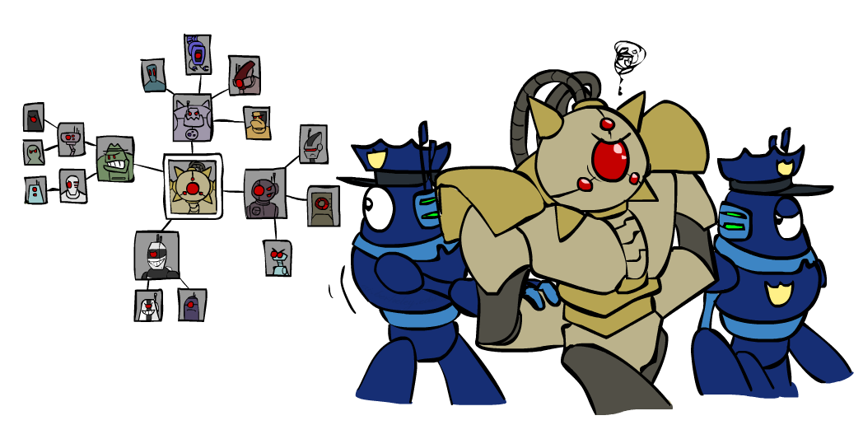
Improving Structure

Slide 18
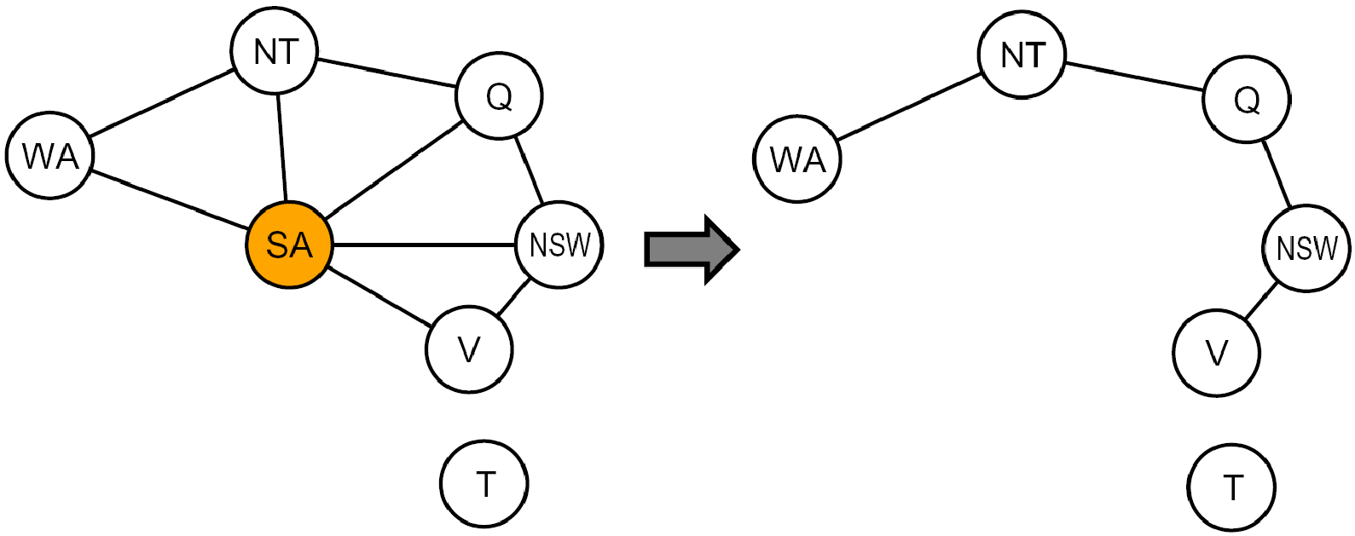
Nearly Tree-Structured CSPs
Conditioning: instantiate a variable, prune its neighbors' domains
Cutset conditioning: instantiate (in all ways) a set of variables such that the remaining constraint graph is a tree
Cutset size c gives runtime O( (d^{c}) (n-c) d² ), very fast for small c

Slide 19







Cutset Conditioning
Choose a cutset
SA
Instantiate the cutset (all possible ways)
SA
SA
SA
Compute residual CSP for each assignment
Solve the residual CSPs (tree structured)

Slide 20
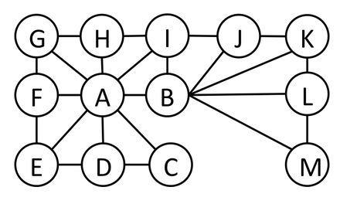
Cutset Quiz
Find the smallest cutset for the graph below.

Slide 21
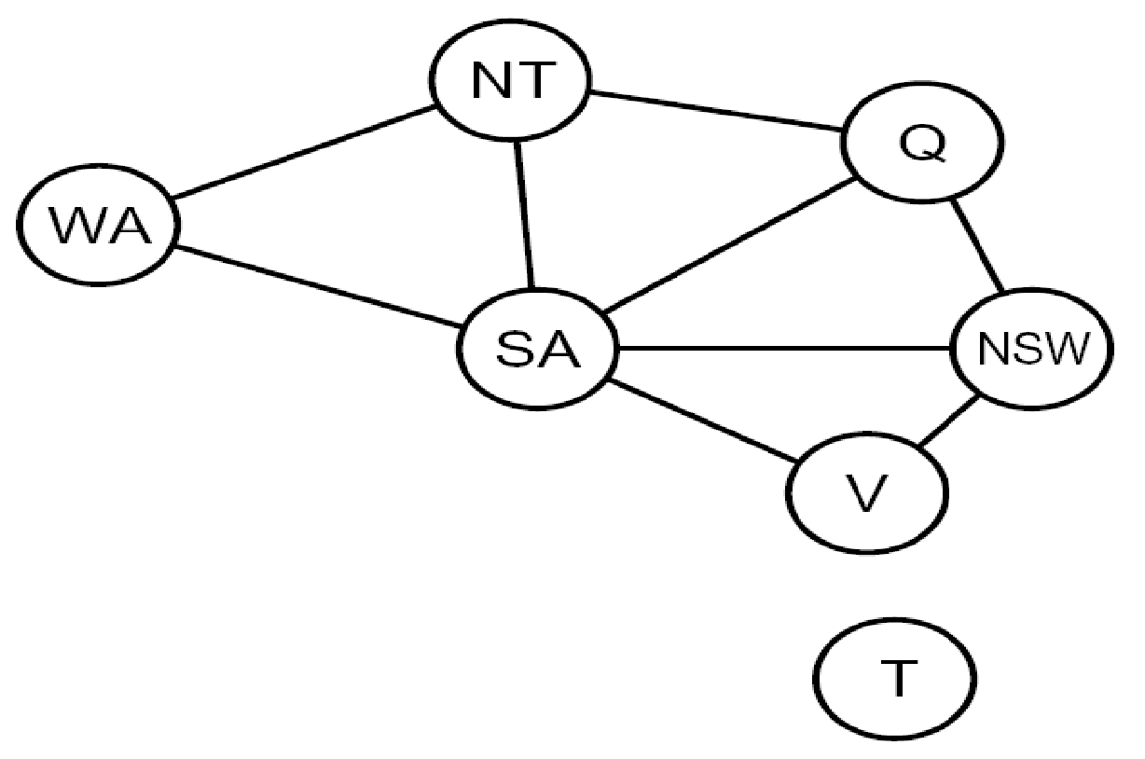
Tree Decomposition*
Idea: create a tree-structured graph of mega-variables
Each mega-variable encodes part of the original CSP
Subproblems overlap to ensure consistent solutions
M1
M2
M3
M4
WA
≠
NT
NT
≠
Q
Q
≠
NSW
NSW
≠
V
≠
≠
≠
≠
≠
≠
≠
≠
SA
SA
SA
SA
Agree on shared vars
Agree on shared vars
Agree on shared vars
{(WA=r,SA=g,NT=b),
(WA=b,SA=r,NT=g),
…}
{(NT=r,SA=g,Q=b),
(NT=b,SA=g,Q=r),
…}
Agree: (M1,M2) ∈
{((WA=g,SA=g,NT=g), (NT=g,SA=g,Q=g)), …}

Slide 22
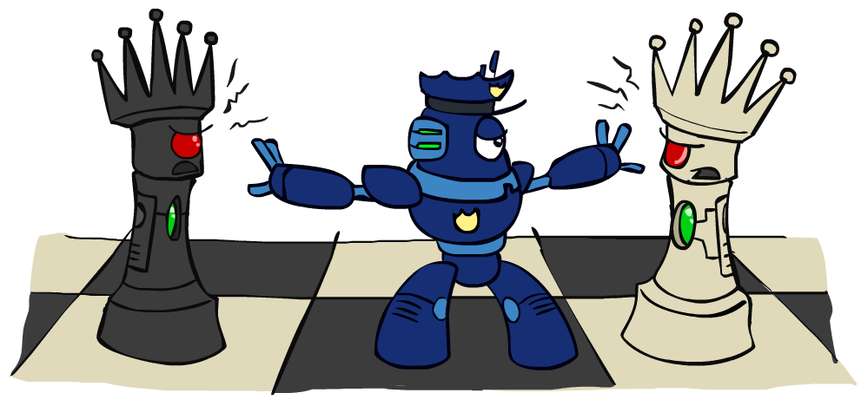
Iterative Improvement

Slide 23
Iterative Algorithms for CSPs
Local search methods typically work with “complete” states, i.e., all variables assigned
To apply to CSPs:
Take an assignment with unsatisfied constraints
Operators reassign variable values
No fringe! Live on the edge.
Algorithm: While not solved,
Variable selection: randomly select any conflicted variable
Value selection: min-conflicts heuristic:
Choose a value that violates the fewest constraints
I.e., hill climb with h(n) = total number of violated constraints

Slide 24
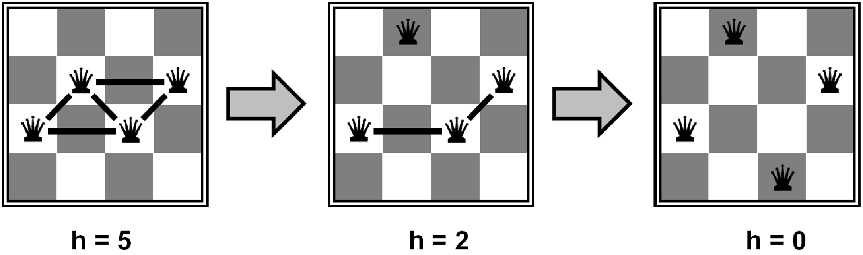
Example: 4-Queens
States: 4 queens in 4 columns (4⁴ = 256 states)
Operators: move queen in column
Goal test: no attacks
Evaluation: c(n) = number of attacks
[Demo: n-queens – iterative improvement (L5D1)]
[Demo: coloring – iterative improvement]
Notes:
L5D1 – python demos
Coloring – javascript demos

Slide 25
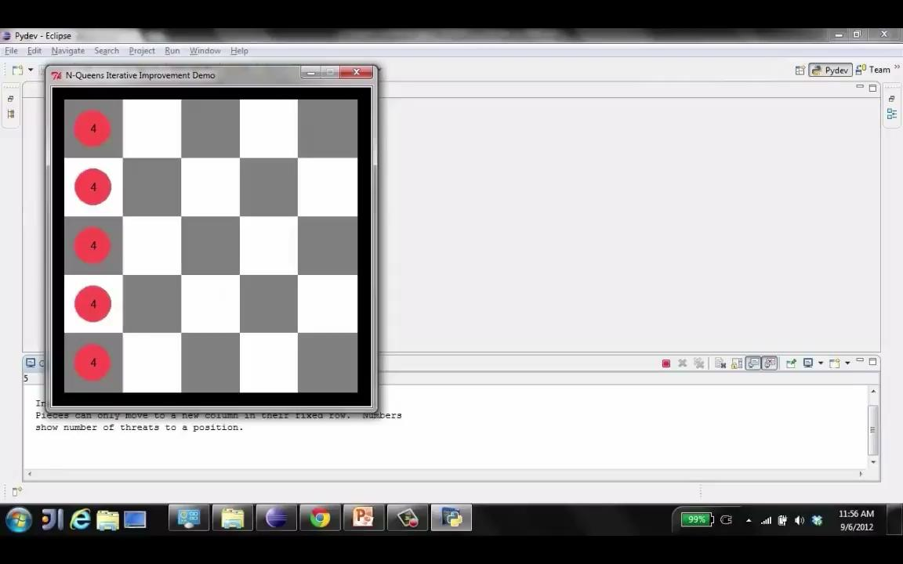
Video of Demo Iterative Improvement – n Queens

Slide 26
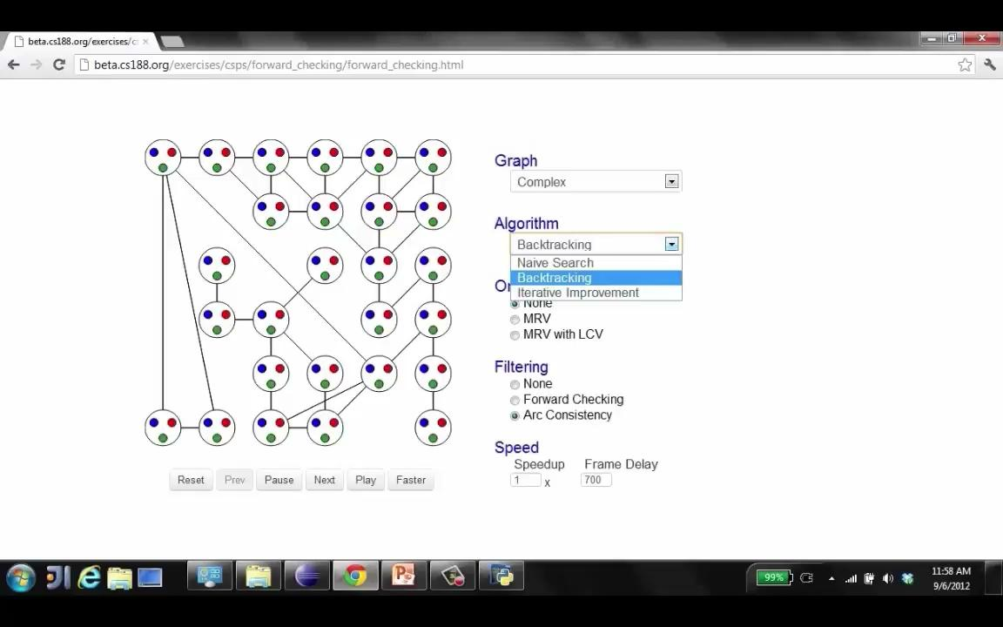
Video of Demo Iterative Improvement – Coloring

Slide 27
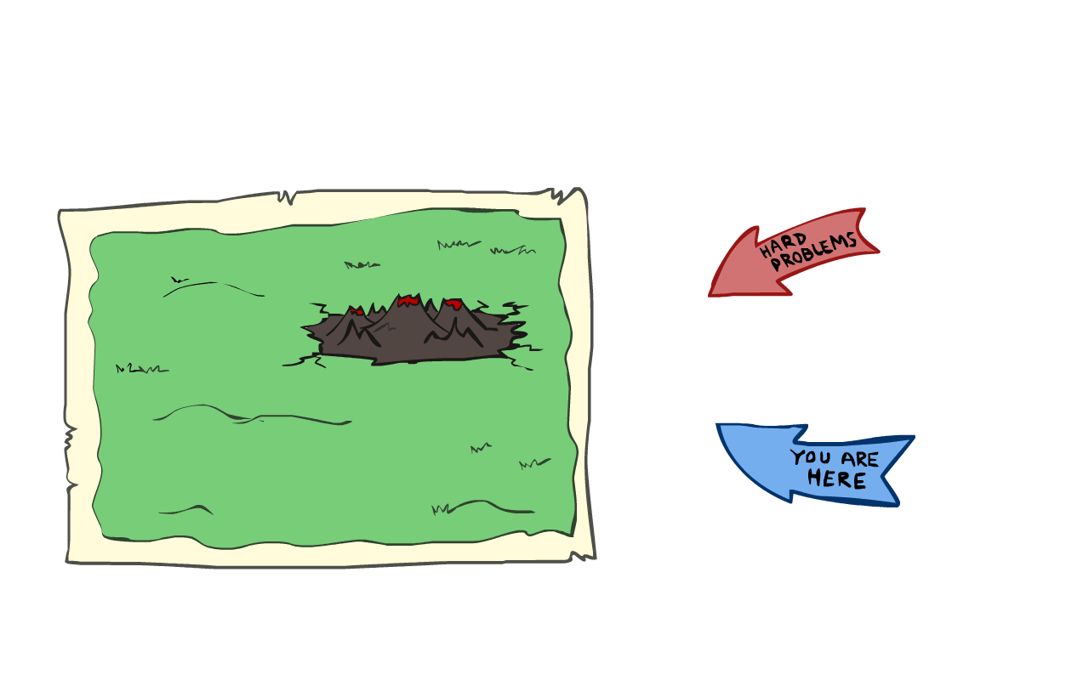
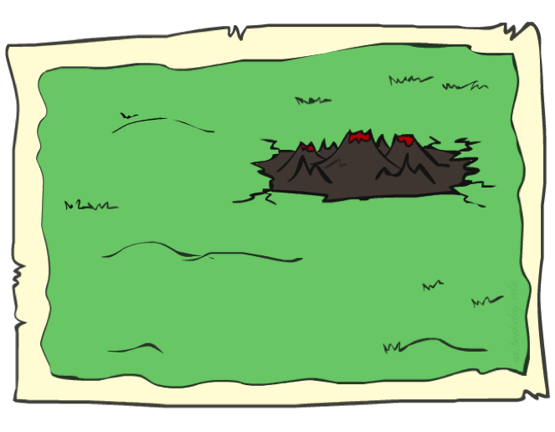
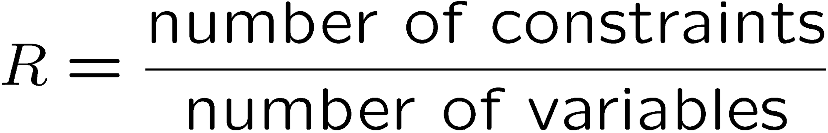
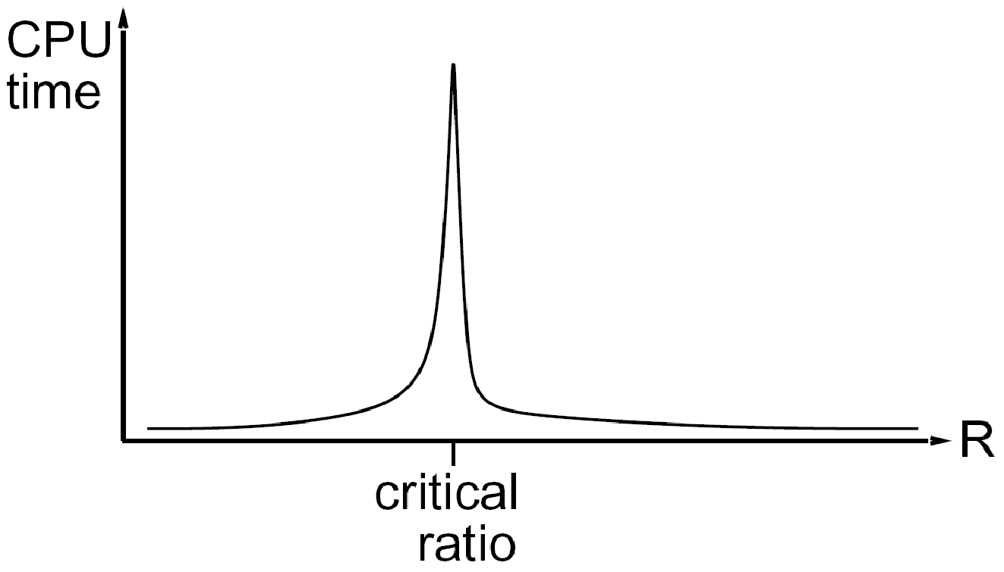
Performance of Min-Conflicts
Given random initial state, can solve n-queens in almost constant time for arbitrary n with high probability (e.g., n = 10,000,000)!
The same appears to be true for any randomly-generated CSP except in a narrow range of the ratio

Slide 28
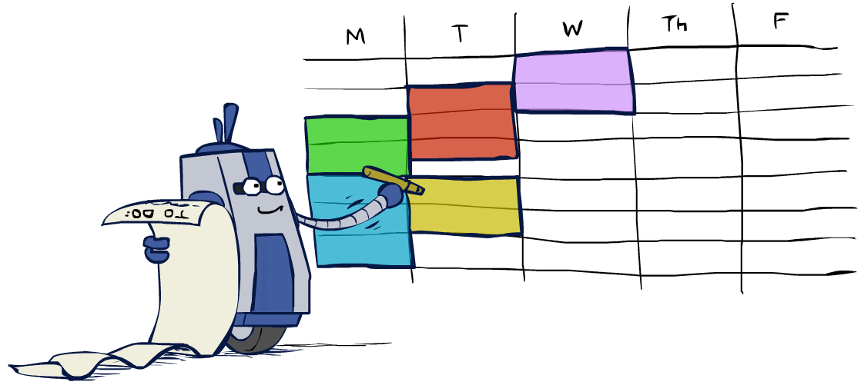
Summary: CSPs
CSPs are a special kind of search problem:
States are partial assignments
Goal test defined by constraints
Basic solution: backtracking search
Speed-ups:
Ordering
Filtering
Structure
Iterative min-conflicts is often effective in practice

Slide 29
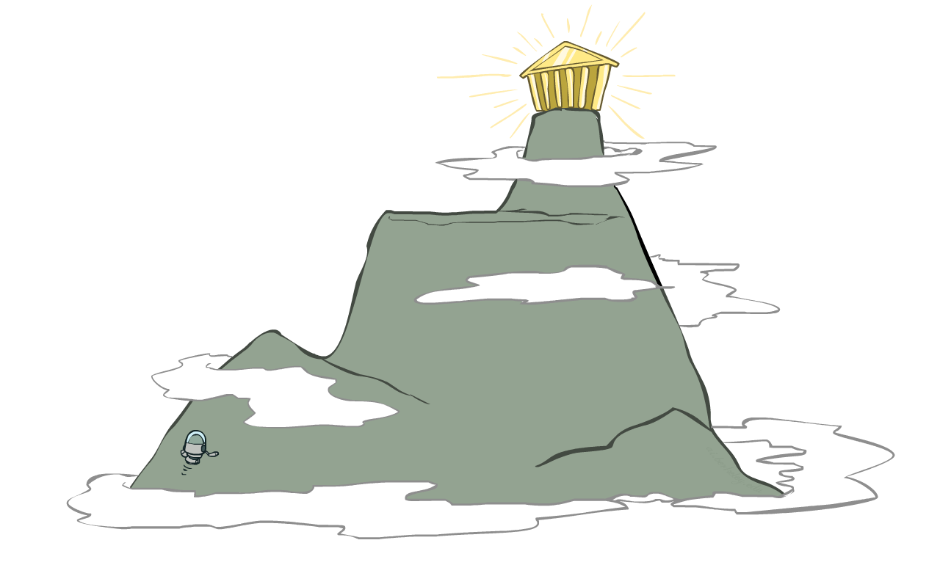
Local Search

Slide 30
Local Search
Tree search keeps unexplored alternatives on the fringe (ensures completeness)
Local search: improve a single option until you can’t make it better (no fringe!)
New successor function: local changes
Generally much faster and more memory efficient (but incomplete and suboptimal)

Slide 31
Hill Climbing
Simple, general idea:
Start wherever
Repeat: move to the best neighboring state
If no neighbors better than current, quit
What’s bad about this approach?
Complete?
Optimal?
What’s good about it?

Slide 32
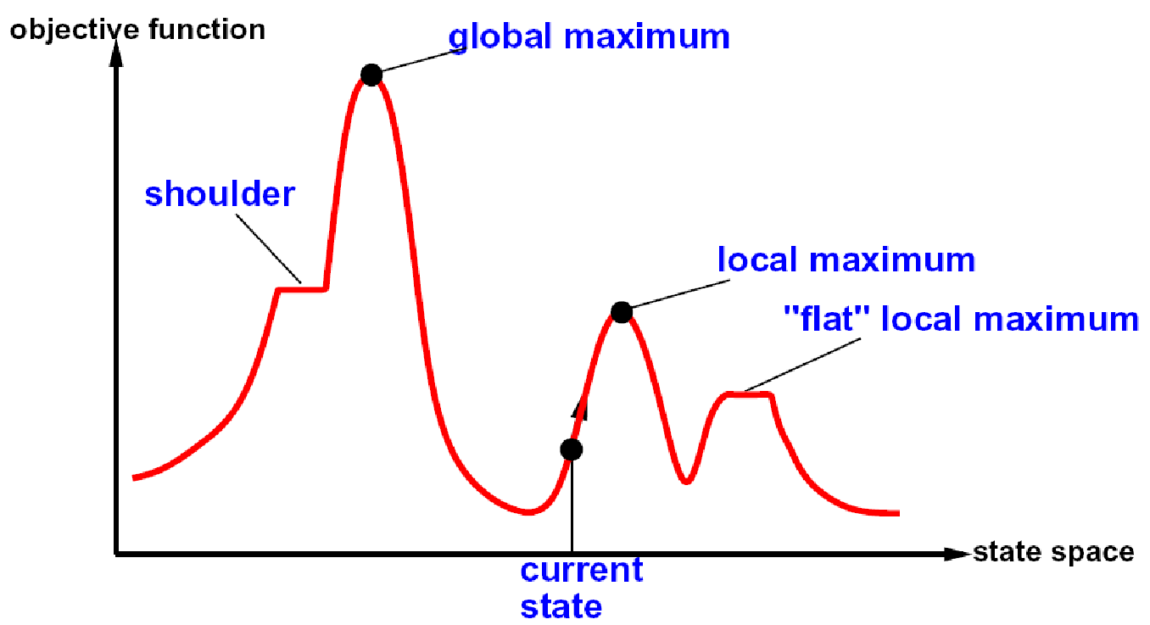
Hill Climbing Diagram

Slide 33
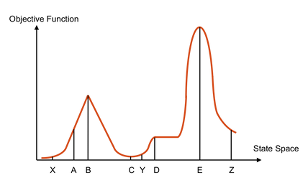
Hill Climbing Quiz
Starting from X, where do you end up ?
Starting from Y, where do you end up ?
Starting from Z, where do you end up ?

Slide 34

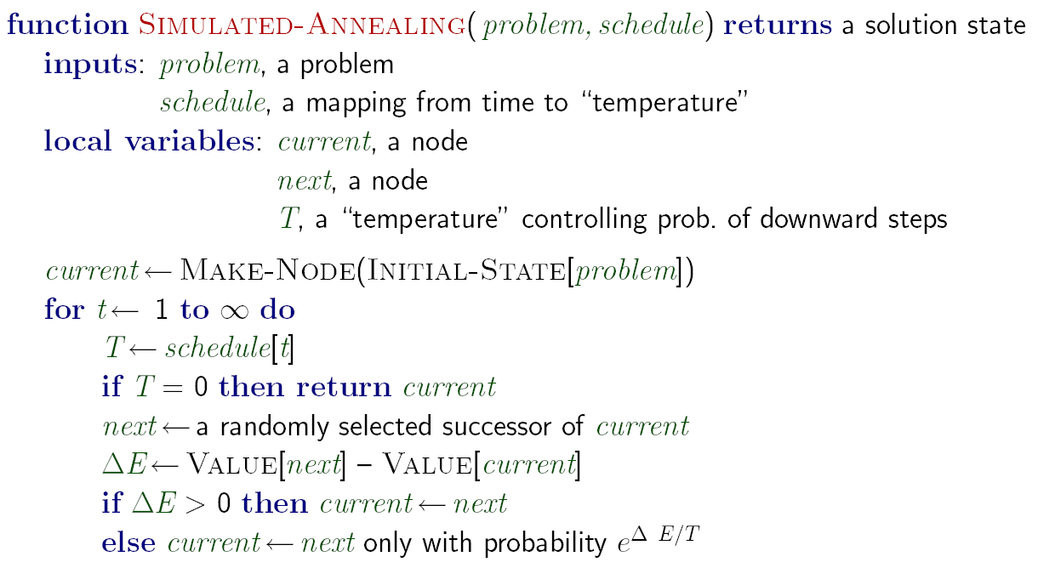
Simulated Annealing
Idea: Escape local maxima by allowing downhill moves
But make them rarer as time goes on

Slide 35
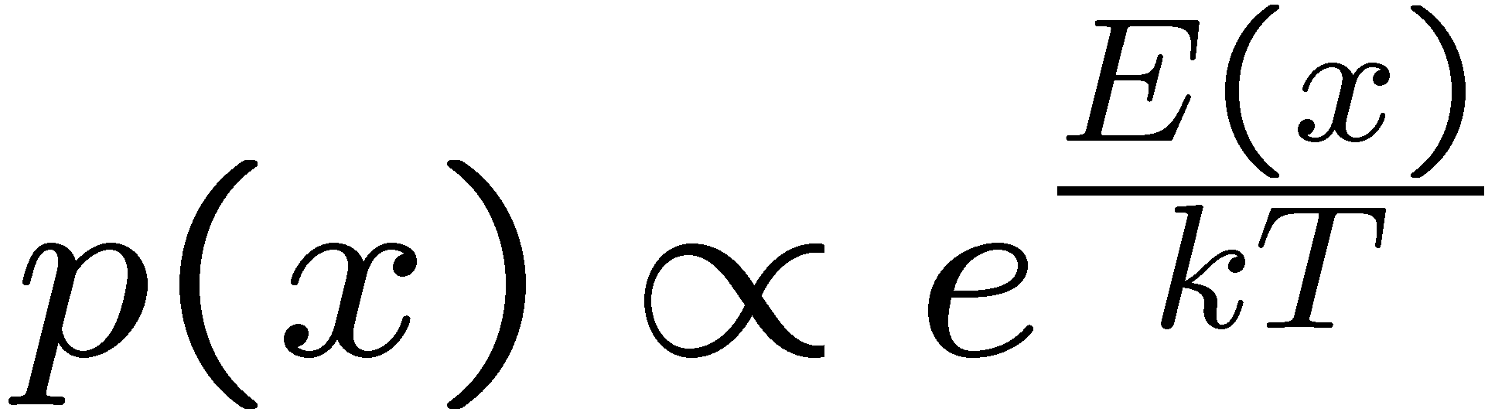
Simulated Annealing
Theoretical guarantee:
Stationary distribution:
If T decreased slowly enough,
will converge to optimal state!
Is this an interesting guarantee?
Sounds like magic, but reality is reality:
The more downhill steps you need to escape a local optimum, the less likely you are to ever make them all in a row
People think hard about ridge operators which let you jump around the space in better ways

Slide 36
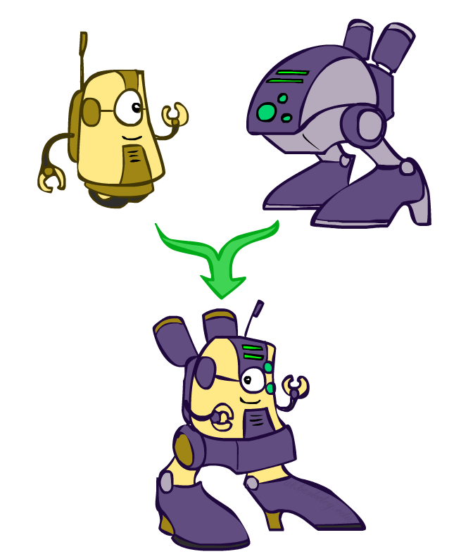
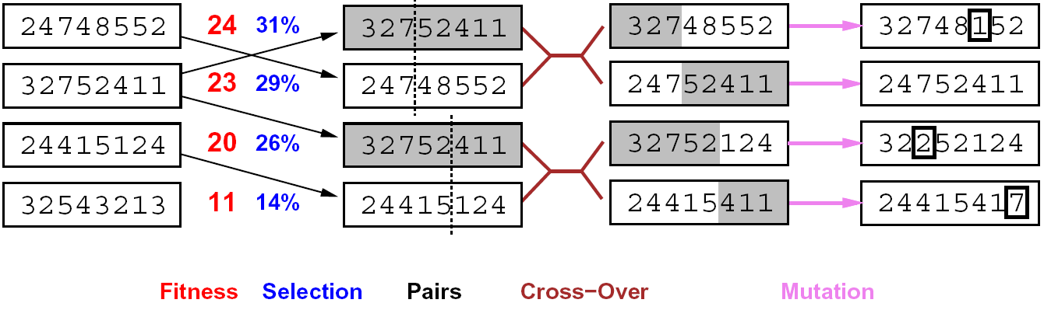
Genetic Algorithms
Genetic algorithms use a natural selection metaphor
Keep best N hypotheses at each step (selection) based on a fitness function
Also have pairwise crossover operators, with optional mutation to give variety
Possibly the most misunderstood, misapplied (and even maligned) technique around

Slide 37
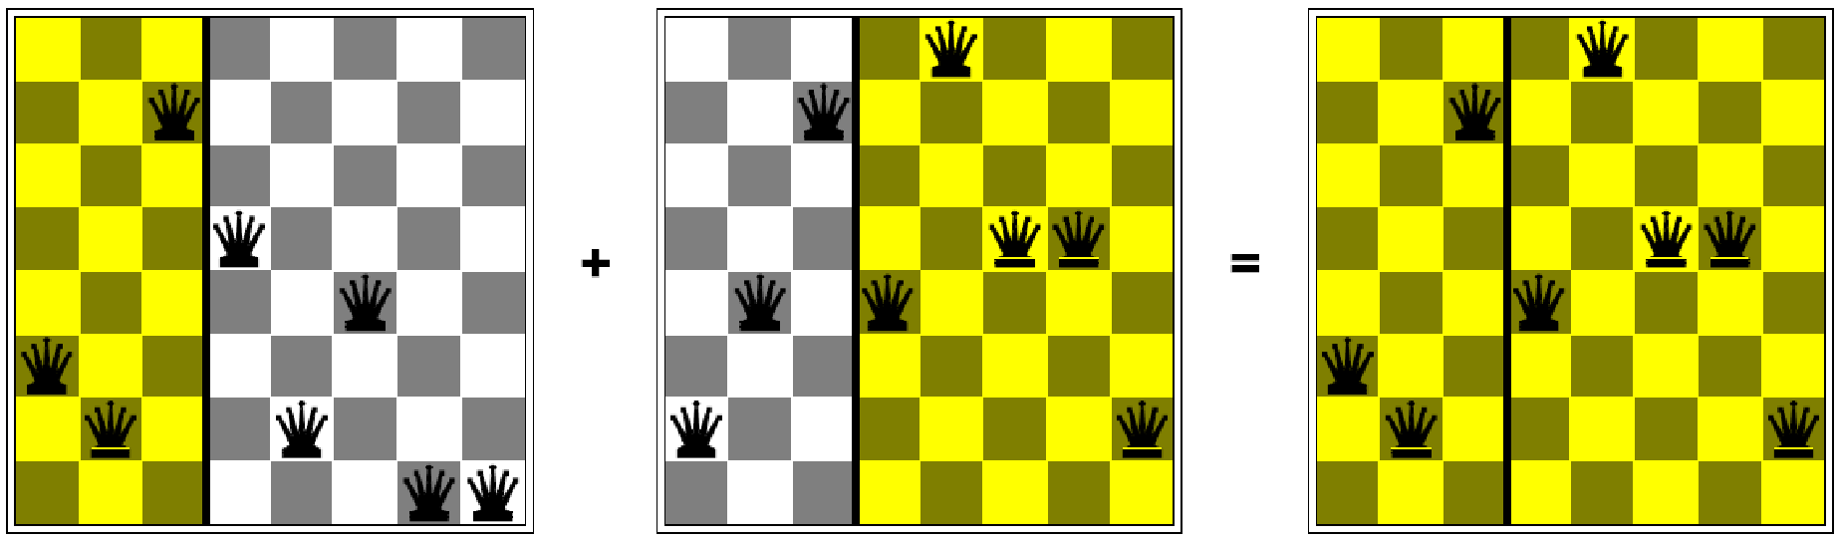
Example: N-Queens
Why does crossover make sense here?
When wouldn’t it make sense?
What would mutation be?
What would a good fitness function be?

Slide 38
Next Time: Adversarial Search!

Slide 39
Example: Fault Diagnosis
Causes
Symptoms
Fault networks:
Variables?
Domains?
Constraints?
Various ways to query,
given symptoms
Some cause (abduction)
Simplest cause
All possible causes
What test is most useful?
Prediction: cause to effect
We’ll see this idea again with Bayes’ nets
SMTP down
Can’t email
DNS down
Can’t IM
Firewall blocking
Can’t print
Printer jam

Slide 40
Beam Search
Like greedy hillclimbing search, but keep K states at all times:
Variables: beam size, encourage diversity?
The best choice in MANY practical settings
Complete? Optimal?
Why do we still need optimal methods?
Greedy Search
Beam Search

