Slide 1
Announcements
Homework 6
Due Wednesday 3/9 by 11:59pm
Project 3 MDPs/RL
About to be released
Due Wednesday 3/23 by 11:59pm

Slide 2
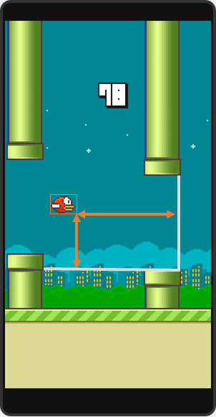
AI in the News – Flappy Bird RL
State space
Discretized vertical distance from lower pipe
Discretized horizontal distance from next pair of pipes
Life: Dead or Living
Actions
Click
Do nothing
Rewards
+1 if Flappy Bird still alive
-1000 if Flappy Bird is dead
6-7 hours of Q-learning

Slide 3
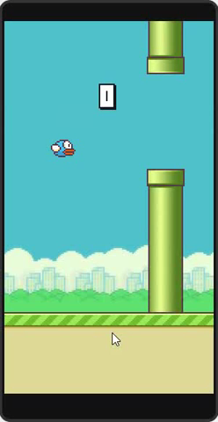
AI in the News – Flappy Bird RL
State space
Discretized vertical distance from lower pipe
Discretized horizontal distance from next pair of pipes
Life: Dead or Living
Actions
Click
Do nothing
Rewards
+1 if Flappy Bird still alive
-1000 if Flappy Bird is dead
6-7 hours of Q-learning

Slide 4
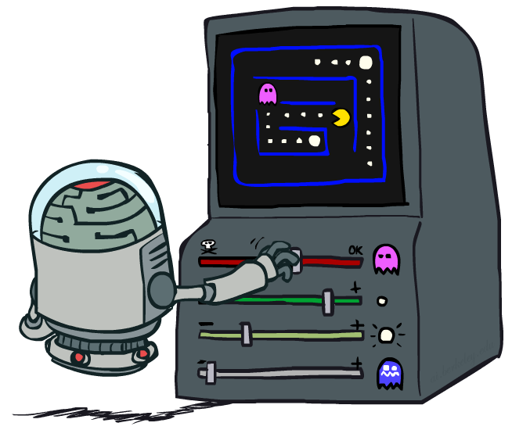
CS 370: Artificial Intelligence
Reinforcement Learning II
Instructor: William DeMeo, NJIT
[slides created by Dan Klein and Pieter Abbeel for CS188 at UC Berkeley; provided courtesy of ai.berkeley.edu]
Notes:
Please retain proper attribution and the reference to ai.berkeley.edu. Thanks!

Slide 5

Reinforcement Learning
We still assume an MDP:
A set of states s ∈ S
A set of actions (per state) A
A model T(s,a,s’)
A reward function R(s,a,s’)
Still looking for a policy π(s)
New twist: don’t know T or R, so must try out actions
Big idea: Compute all averages over T using sample outcomes

Slide 6
The Story So Far: MDPs and RL
Known MDP: Offline Solution
Goal Technique
Compute V*, Q*, π* Value / policy iteration
Evaluate a fixed policy π Policy evaluation
Unknown MDP: Model-Based
Unknown MDP: Model-Free
Goal Technique
Compute V*, Q*, π* VI/PI on approx. MDP
Evaluate a fixed policy π PE on approx. MDP
Goal Technique
Compute V*, Q*, π* Q-learning
Evaluate a fixed policy π Value Learning

Slide 7
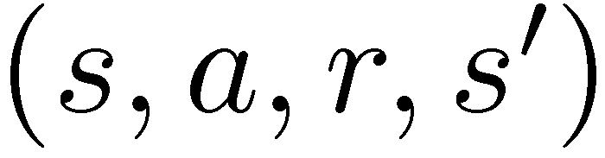
Model-Free Learning
s
Model-free (temporal difference) learning
Experience world through episodes
Update estimates each transition
Over time, updates will mimic Bellman updates
a
s, a
r
s’
a’
s’, a’
s’’

Slide 8
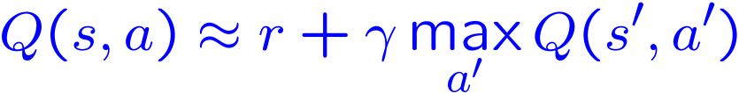
Q-Learning
We’d like to do Q-value updates to each Q-state:
But can’t compute this update without knowing T, R
Instead, compute average as we go
Receive a sample transition (s,a,r,s’)
This sample suggests
But we want to average over results from (s,a) (Why?)
So keep a running average

Slide 9

Q-Learning Properties
Amazing result: Q-learning converges to optimal policy -- even if you’re acting suboptimally!
This is called off-policy learning
Caveats:
You have to explore enough
You have to eventually make the learning rate
small enough
… but not decrease it too quickly
Basically, in the limit, it doesn’t matter how you select actions (!)
[Demo: Q-learning – auto – cliff grid (L11D1)]

Slide 10
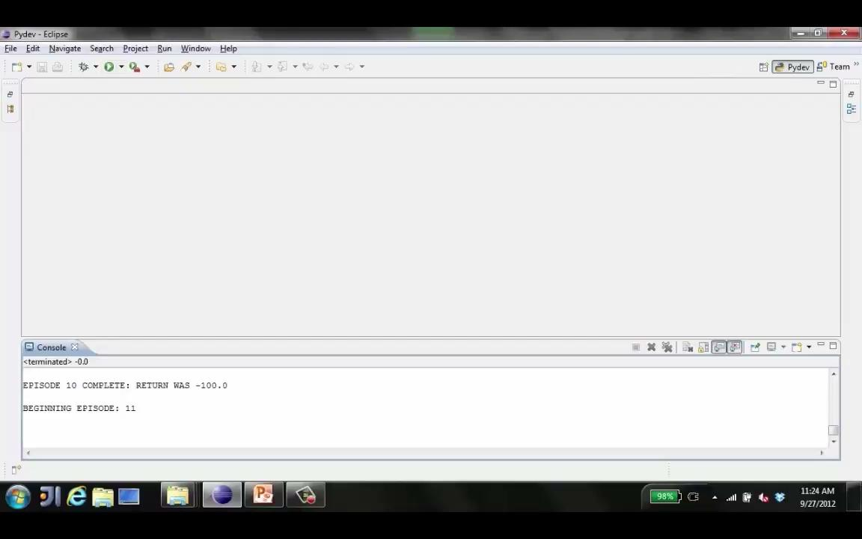
Video of Demo Q-Learning Auto Cliff Grid

Slide 11
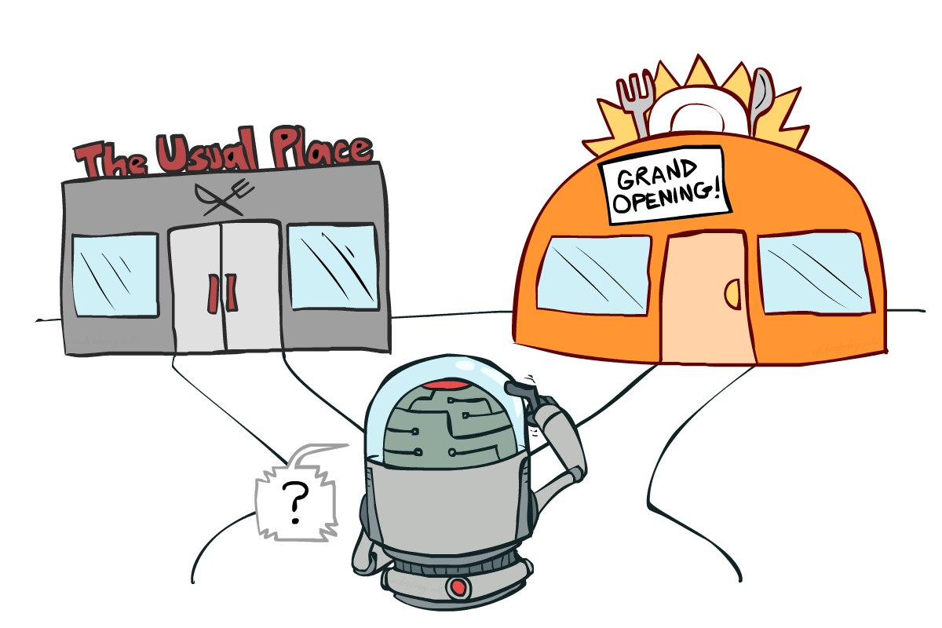
Exploration vs. Exploitation

Slide 12

How to Explore?
Several schemes for forcing exploration
Simplest: random actions (ε-greedy)
Every time step, flip a coin
With (small) probability ε, act randomly
With (large) probability 1-ε, act on current policy
Problems with random actions?
You do eventually explore the space, but keep thrashing around once learning is done
One solution: lower ε over time
Another solution: exploration functions
[Demo: Q-learning – manual exploration – bridge grid (L11D2)] [Demo: Q-learning – epsilon-greedy -- crawler (L11D3)]

Slide 13
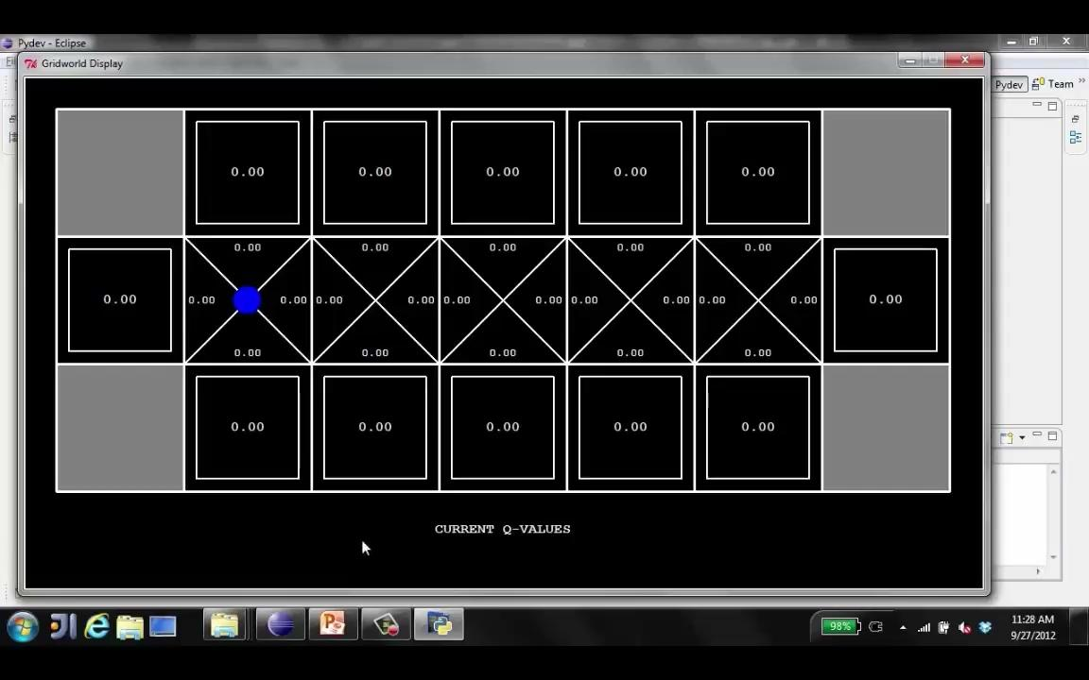
Video of Demo Q-learning – Manual Exploration – Bridge Grid

Slide 14
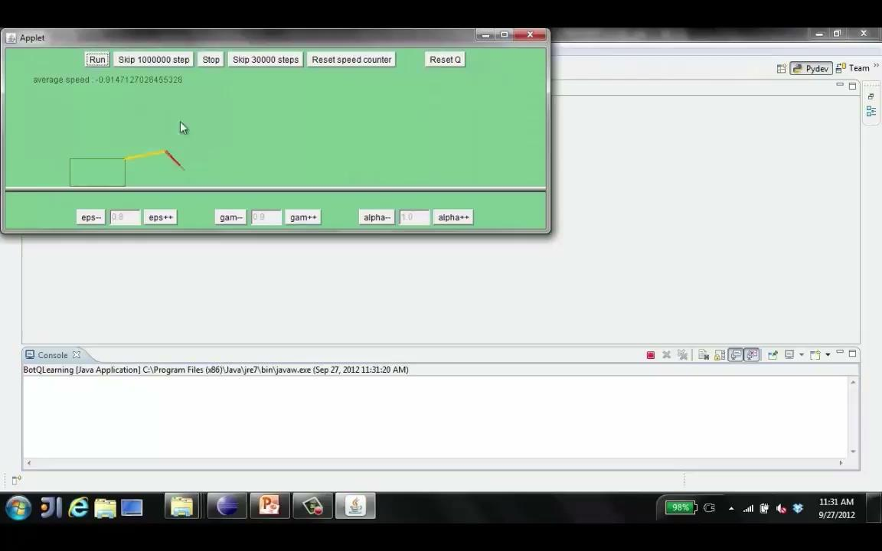
Video of Demo Q-learning – Epsilon-Greedy – Crawler

Slide 15
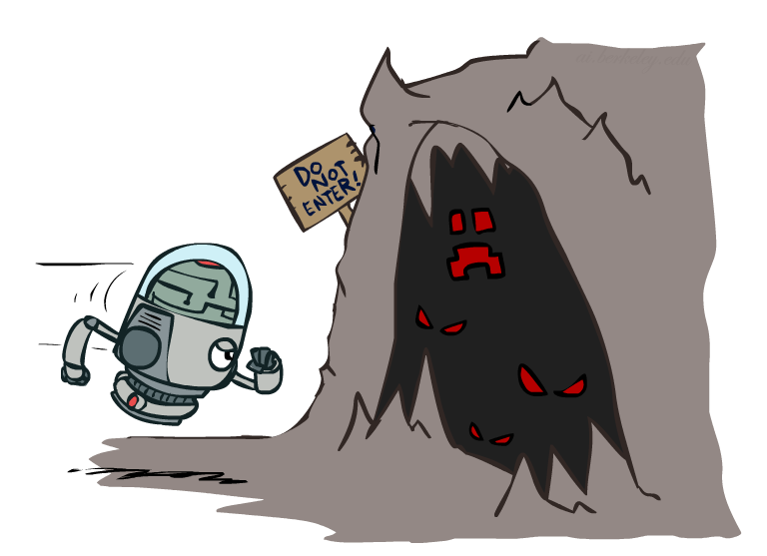

Exploration Functions
When to explore?
Random actions: explore a fixed amount
Better idea: explore areas whose badness is not
(yet) established, eventually stop exploring
Exploration function
Takes a value estimate u and a visit count n, and
returns an optimistic utility, e.g.
Note: this propagates the “bonus” back to states that lead to unknown states as well!
Regular Q-Update:
Modified Q-Update:
[Demo: exploration – Q-learning – crawler – exploration function (L11D4)]

Slide 16
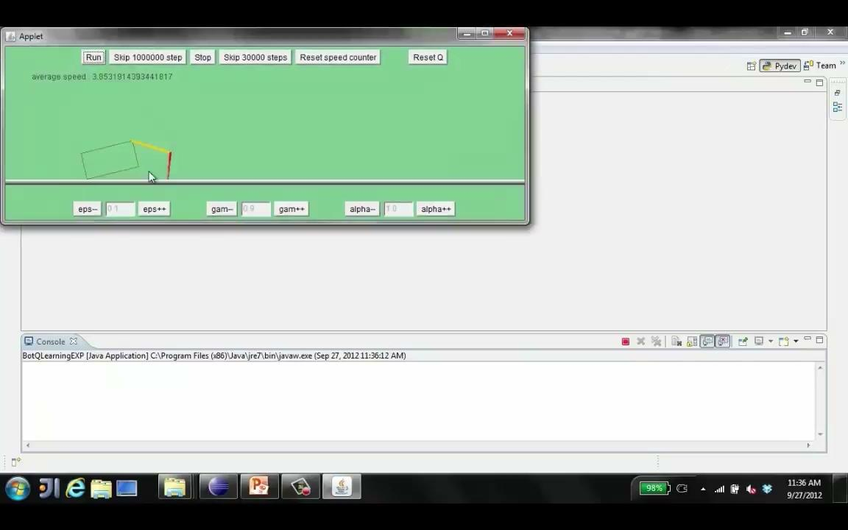
Video of Demo Q-learning – Exploration Function – Crawler

Slide 17
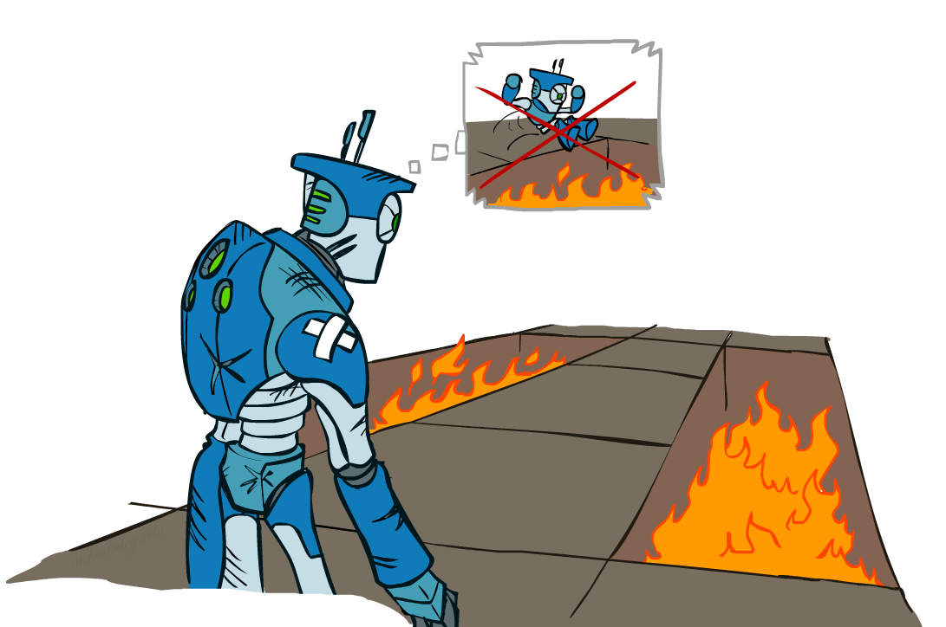
Regret
Even if you learn the optimal policy, you still make mistakes along the way!
Regret is a measure of your total mistake cost: the difference between your (expected) rewards, including youthful suboptimality, and optimal (expected) rewards
Minimizing regret goes beyond learning to be optimal – it requires optimally learning to be optimal
Example: random exploration and exploration functions both end up optimal, but random exploration has higher regret

Slide 18
Approximate Q-Learning

Slide 19
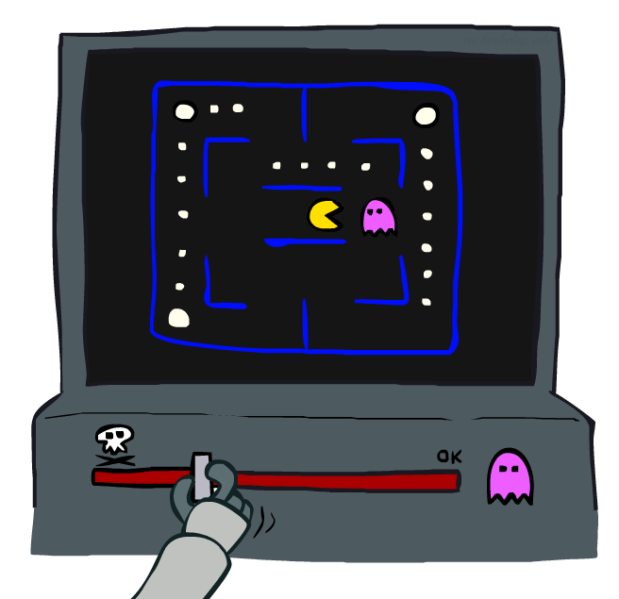
Approximate Q-Learning

Slide 20

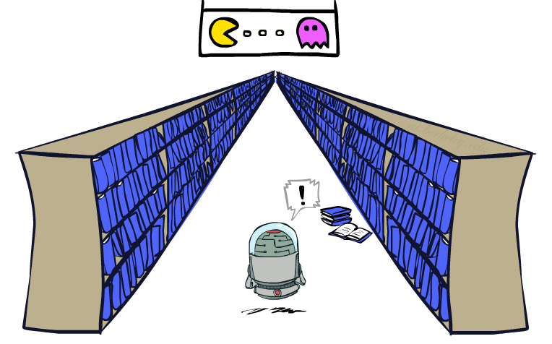
Generalizing Across States
Basic Q-Learning keeps a table of all q-values
In realistic situations, we cannot possibly learn about every single state!
Too many states to visit them all in training
Too many states to hold the q-tables in memory
Instead, we want to generalize:
Learn about some small number of training states from experience
Generalize that experience to new, similar situations
This is a fundamental idea in machine learning, and we’ll see it over and over again
[demo – RL pacman]

Slide 21
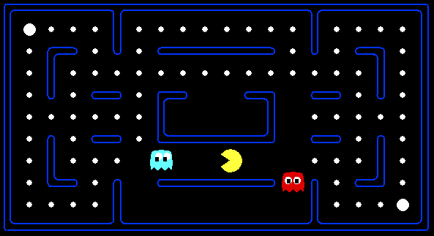



Example: Pacman
Let’s say we discover through experience that this state is bad:
In naïve q-learning, we know nothing about this state:
Or even this one!
[Demo: Q-learning – pacman – tiny – watch all (L11D5)]
[Demo: Q-learning – pacman – tiny – silent train (L11D6)]
[Demo: Q-learning – pacman – tricky – watch all (L11D7)]

Slide 22
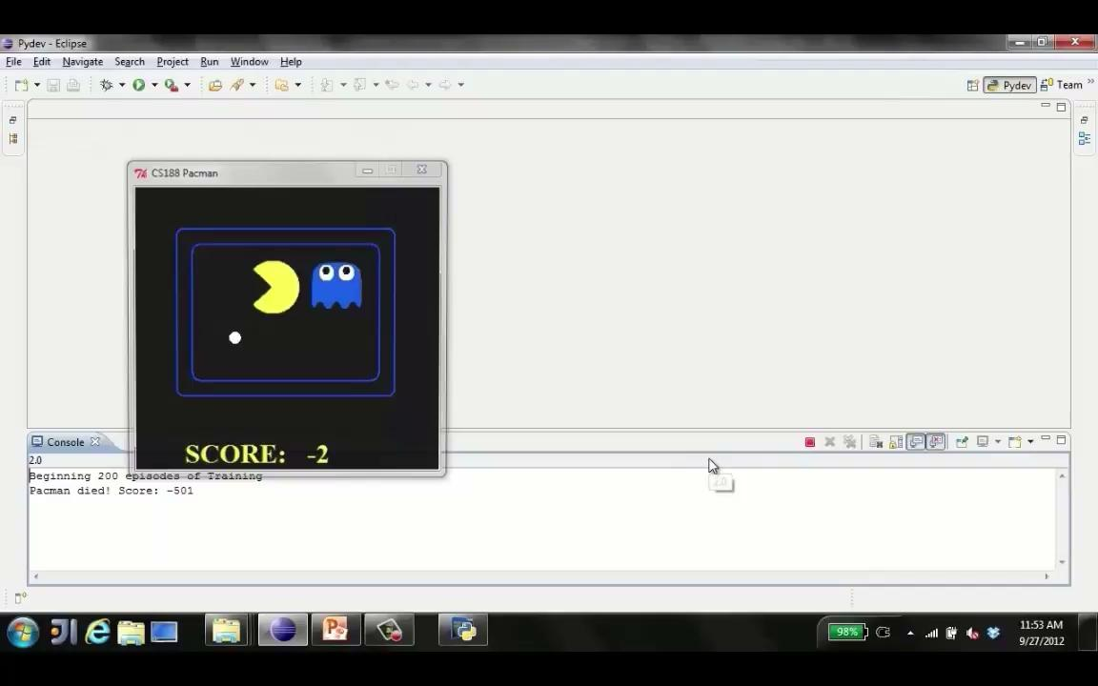
Video of Demo Q-Learning Pacman – Tiny – Watch All

Slide 23
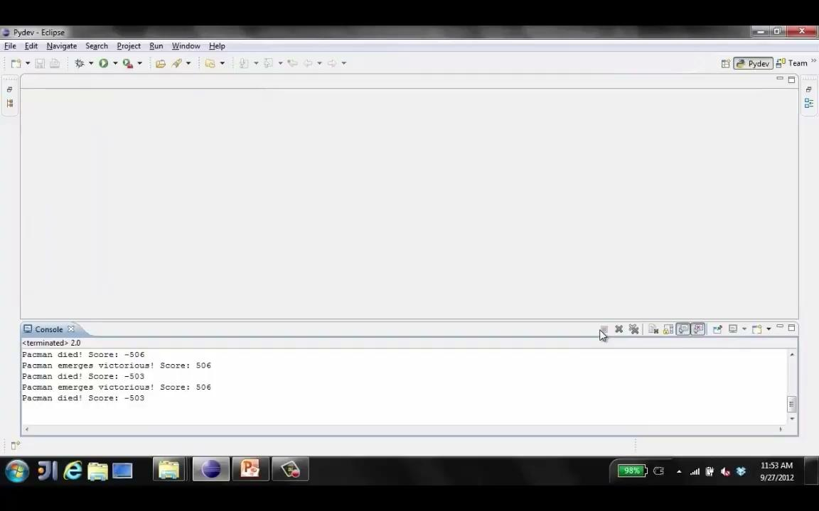
Video of Demo Q-Learning Pacman – Tiny – Silent Train

Slide 24
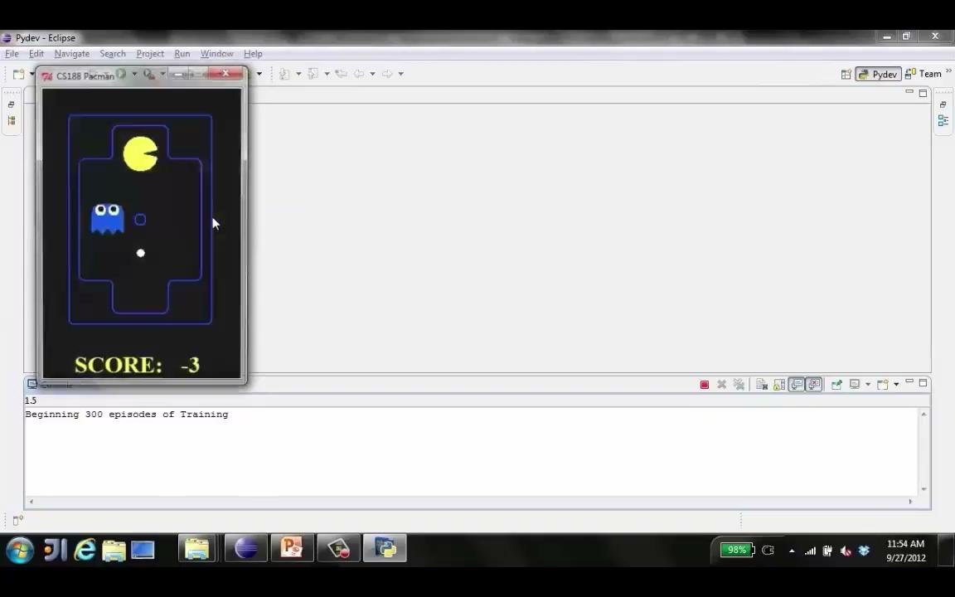
Video of Demo Q-Learning Pacman – Tricky – Watch All

Slide 25
Feature-Based Representations
Solution: describe a state using a vector of features (properties)
Features are functions from states to real numbers (often 0/1) that capture important properties of the state
Example features:
Distance to closest ghost
Distance to closest dot
Number of ghosts
1 / (dist to dot)²
Is Pacman in a tunnel? (0/1)
…… etc.
Is it the exact state on this slide?
Can also describe a q-state (s, a) with features (e.g. action moves closer to food)

Slide 26
Linear Value Functions
Using a feature representation, we can write a q function (or value function) for any state using a few weights:
Advantage: our experience is summed up in a few powerful numbers
Disadvantage: states may share features but actually be very different in value!

Slide 27

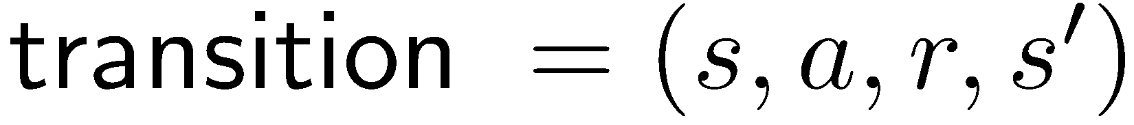
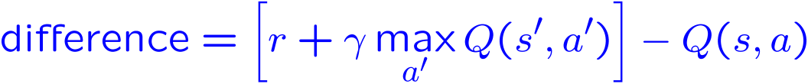
Approximate Q-Learning
Q-learning with linear Q-functions:
Intuitive interpretation:
Adjust weights of active features
E.g., if something unexpectedly bad happens, blame the features that were on: disprefer all states with that state’s features
Formal justification: online least squares
Exact Q’s
Approximate Q’s

Slide 28

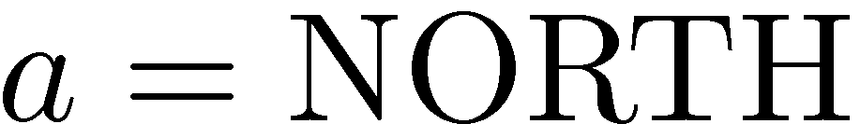
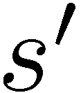
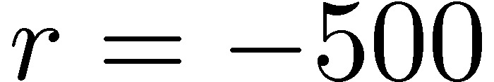


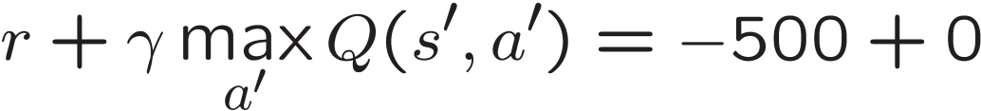
Example: Q-Pacman
[Demo: approximate Q-learning pacman (L11D10)]

Slide 29
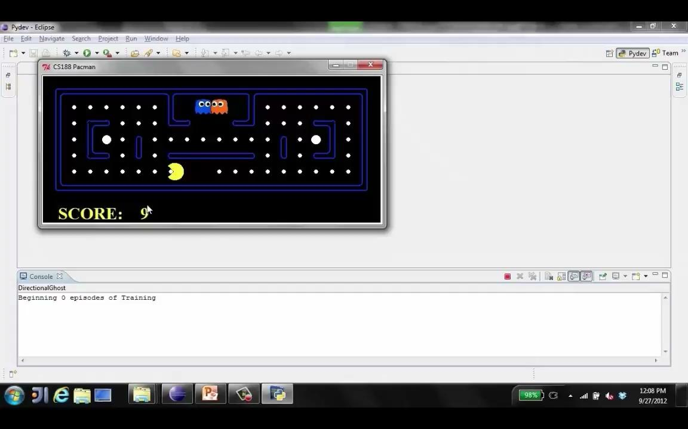
Video of Demo Approximate Q-Learning -- Pacman

Slide 30
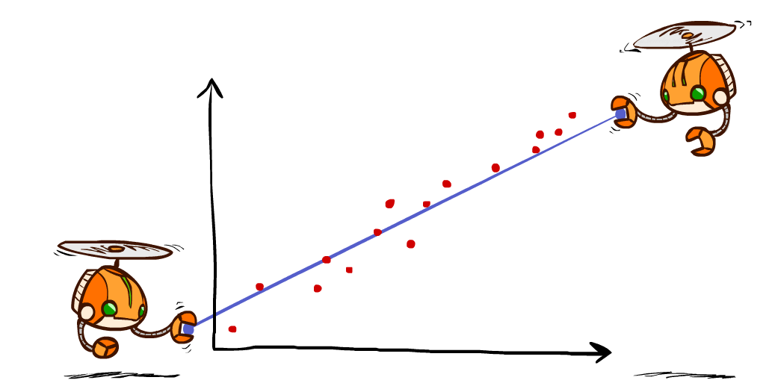
Q-Learning and Least Squares

Slide 31
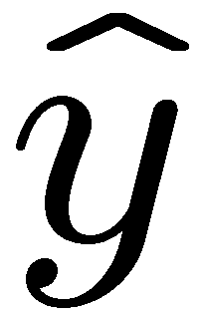
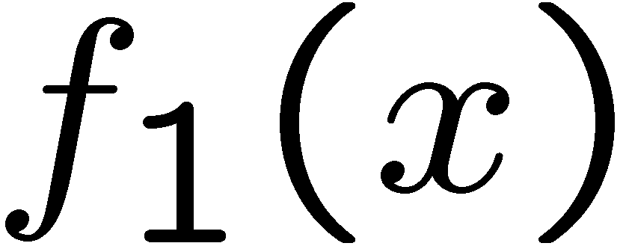
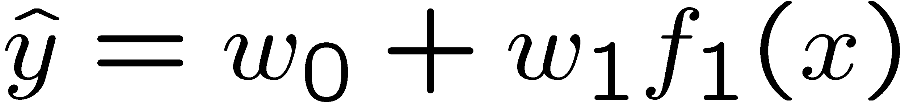
Linear Approximation: Regression*
40
26
24
20
22
20
30
20
40
0
0
20
30
10
20
0
10
0
Prediction:
Prediction:
Notes:
Figure 1: scatter(1:20,10+(1:20)+2*randn(1,20),'k','filled'); a=axis; a(3)=0; axis(a);

Slide 32
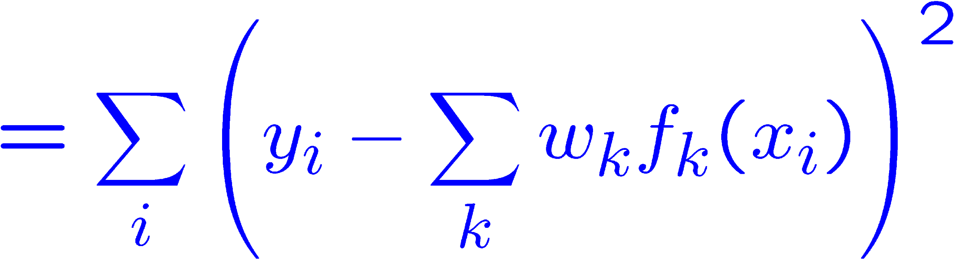
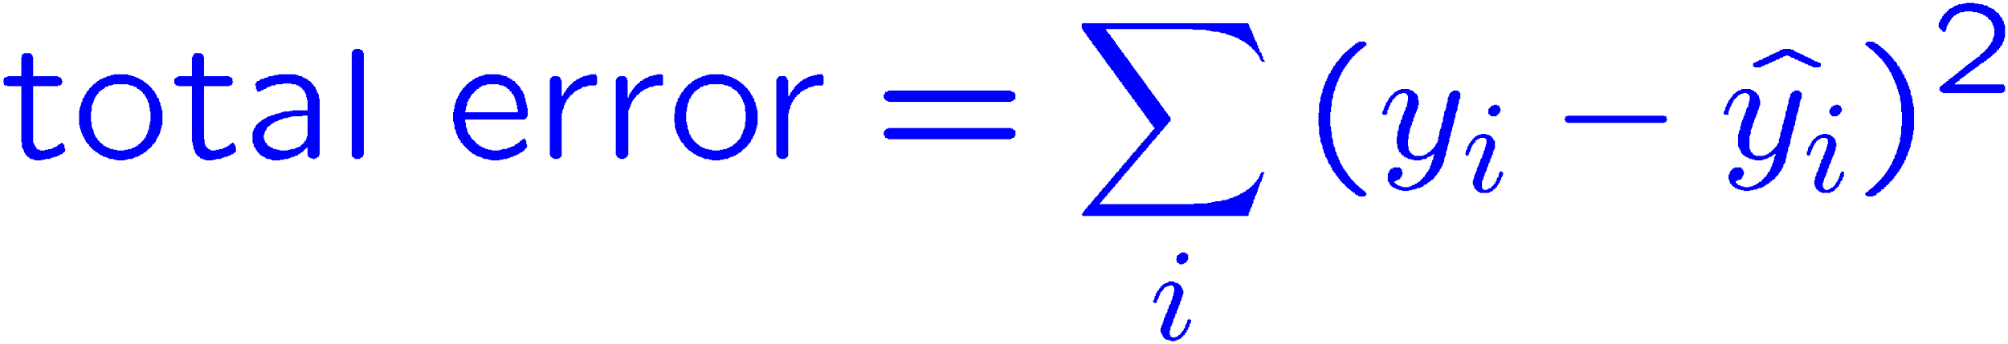
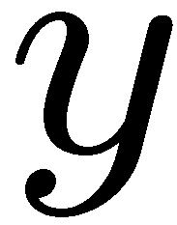
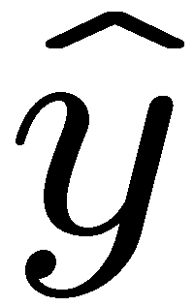

Optimization: Least Squares*
Error or “residual”
Observation
Prediction
0
0
20
Notes:
Figure 1: scatter(1:20,10+(1:20)+2*randn(1,20),'k','filled'); a=axis; a(3)=0; axis(a);

Slide 33
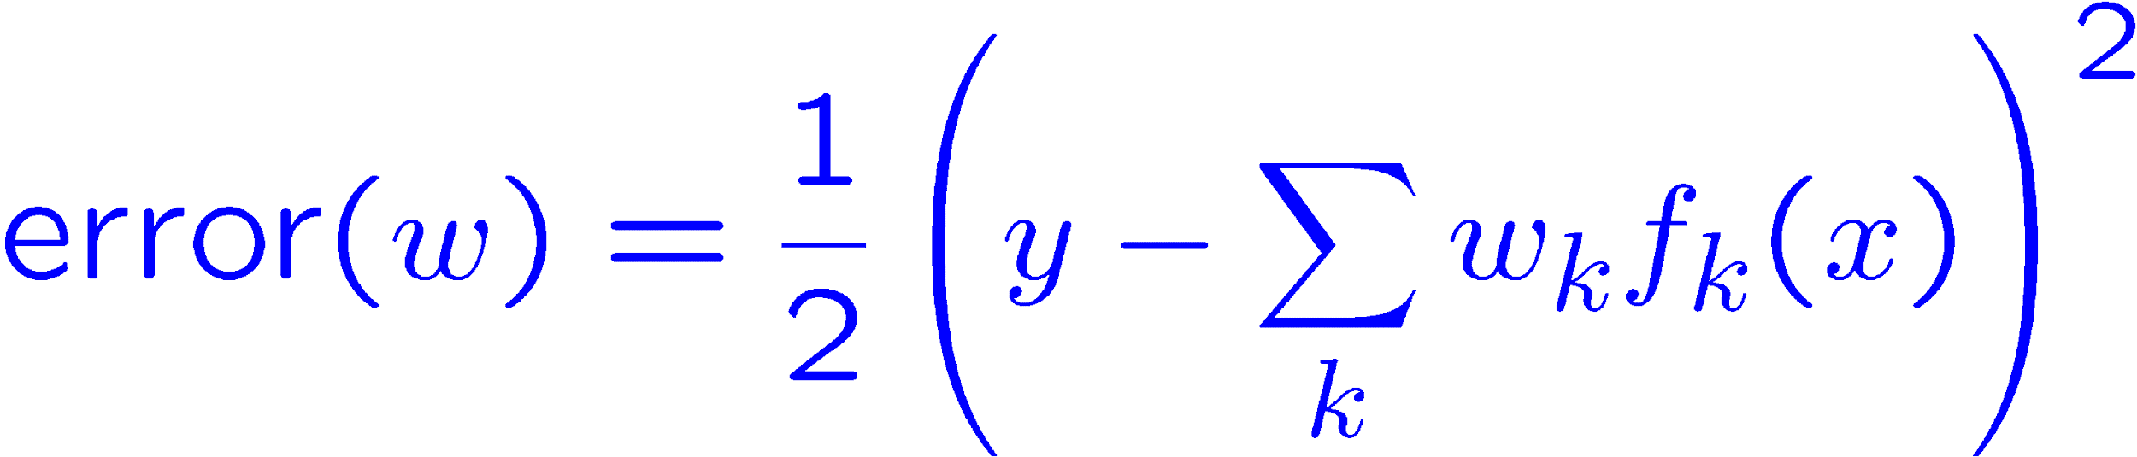
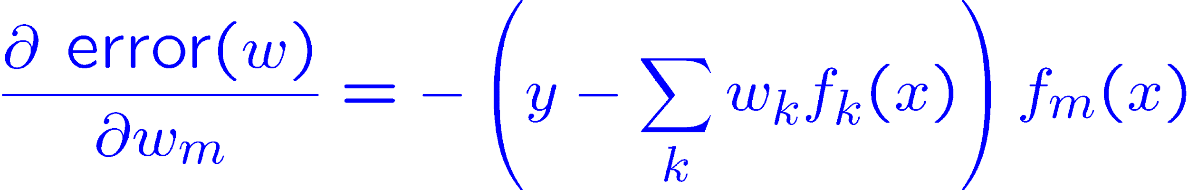
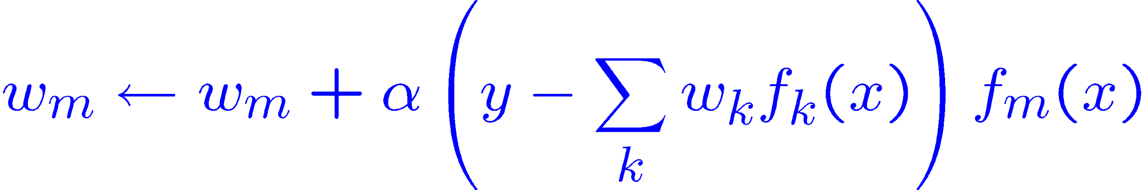
Minimizing Error*
Imagine we had only one point x, with features f(x), target value y, and weights w:
Approximate q update explained:
“target”
“prediction”

Slide 34
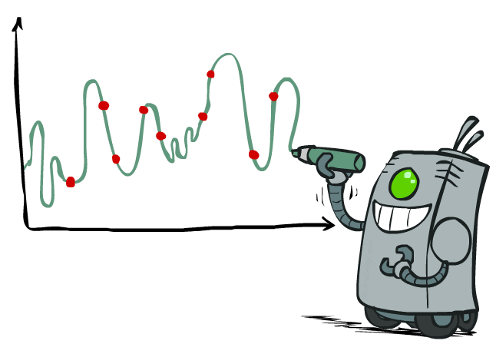
Overfitting: Why Limiting Capacity Can Help*
30
25
20
Degree 15 polynomial
15
10
5
0
-5
-10
-15
0
2
4
6
8
10
12
14
16
18
20

Slide 35

Policy Search

Slide 36
Policy Search
Problem: often the feature-based policies that work well (win games, maximize utilities) aren’t the ones that approximate V / Q best
E.g. your value functions from project 2 were probably horrible estimates of future rewards, but they still produced good decisions
Q-learning’s priority: get Q-values close (modeling)
Action selection priority: get ordering of Q-values right (prediction)
We’ll see this distinction between modeling and prediction again later in the course
Solution: learn policies that maximize rewards, not the values that predict them
Policy search: start with an ok solution (e.g. Q-learning) then fine-tune by hill climbing on feature weights

Slide 37
Policy Search
Simplest policy search:
Start with an initial linear value function or Q-function
Nudge each feature weight up and down and see if your policy is better than before
Problems:
How do we tell the policy got better?
Need to run many sample episodes!
If there are a lot of features, this can be impractical
Better methods exploit lookahead structure, sample wisely, change multiple parameters…

Slide 38

Policy Search
[Andrew Ng]
[Video: HELICOPTER]

Slide 39

Conclusion
We’re done with Part I: Search and Planning!
We’ve seen how AI methods can solve problems in:
Search
Constraint Satisfaction Problems
Games
Markov Decision Problems
Reinforcement Learning
Next up: Part II: Uncertainty and Learning!

