Slide 1
Announcements
Midterm 2 prep page is up

Slide 2
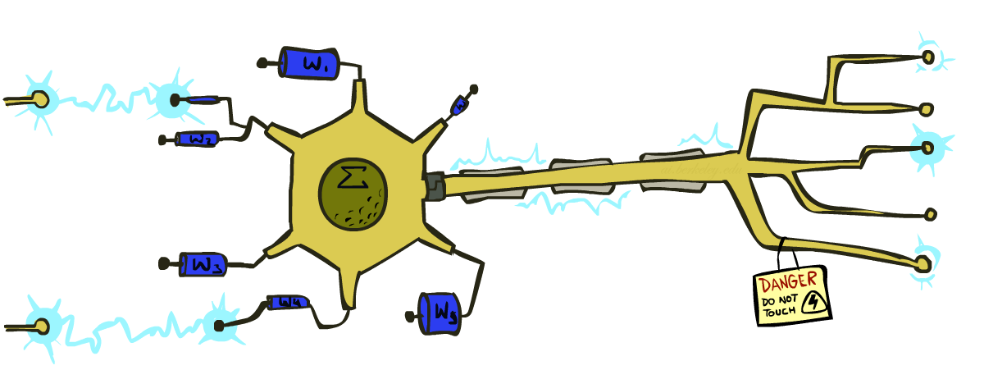
CS 370: Artificial Intelligence
Perceptrons
Instructor: William DeMeo, NJIT
[slides created by Dan Klein and Pieter Abbeel for CS188 at UC Berkeley; provided courtesy of ai.berkeley.edu.]

Slide 3
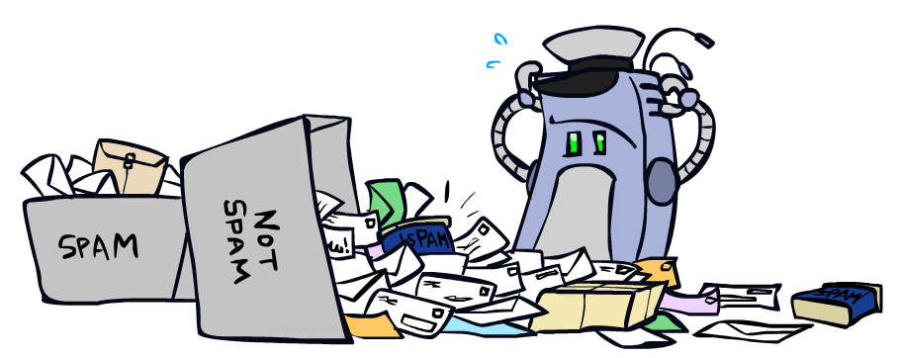
Error-Driven Classification

Slide 4
Errors, and What to Do
Examples of errors
Dear GlobalSCAPE Customer,
GlobalSCAPE has partnered with ScanSoft to offer you the latest version of OmniPage Pro, for just $99.99* - the regular list price is $499! The most common question we've received about this offer is - Is this genuine? We would like to assure you that this offer is authorized by ScanSoft, is genuine and valid. You can get the . . .
. . . To receive your $30 Amazon.com promotional certificate, click through to
http://www.amazon.com/apparel
and see the prominent link for the $30 offer. All details are there. We hope you enjoyed receiving this message. However, if you'd rather not receive future e-mails announcing new store launches, please click . . .

Slide 5
What to Do About Errors
Problem: there’s still spam in your inbox
Need more features – words aren’t enough!
Have you emailed the sender before?
Have 1M other people just gotten the same email?
Is the sending information consistent?
Is the email in ALL CAPS?
Do inline URLs point where they say they point?
Does the email address you by (your) name?
Naïve Bayes models can incorporate a variety of features, but tend to do best in homogeneous cases (e.g. all features are word occurrences)

Slide 6
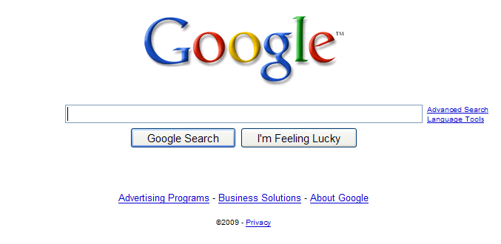
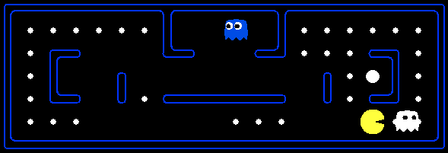
Later On…
Web Search
Decision Problems

Slide 7
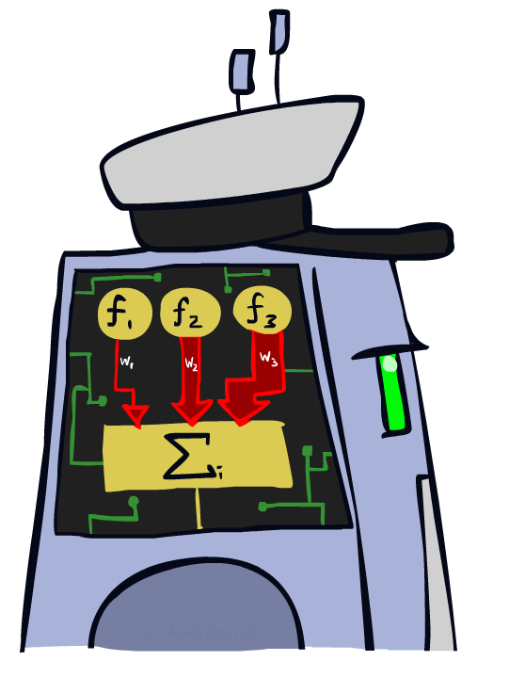
Linear Classifiers

Slide 8
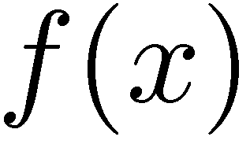

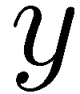

Feature Vectors
Hello,
Do you want free printr cartriges? Why pay more when you can get them ABSOLUTELY FREE! Just
# free : 2
YOUR_NAME : 0
MISSPELLED : 2
FROM_FRIEND : 0
...
SPAM
or
+
PIXEL-7,12 : 1
PIXEL-7,13 : 0
...
NUM_LOOPS : 1
...
“2”

Slide 9
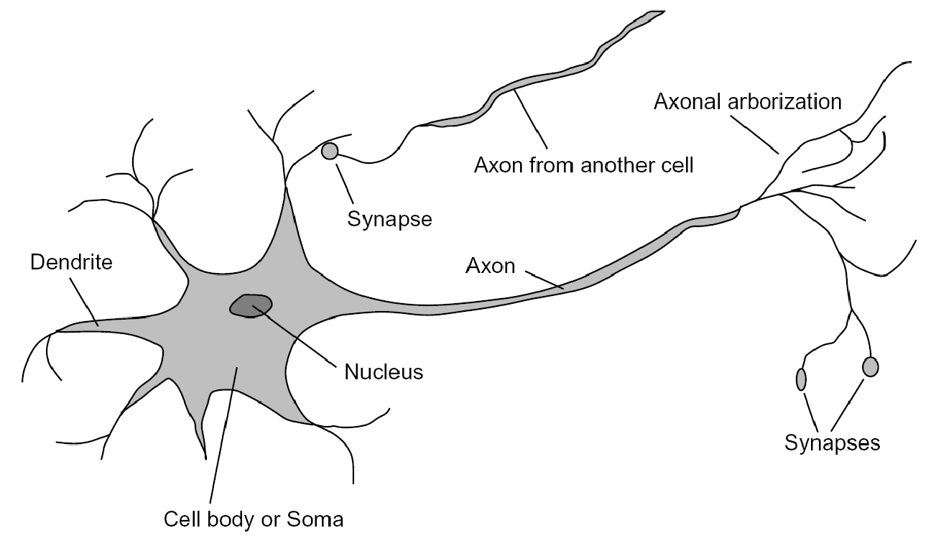

Some (Simplified) Biology
Very loose inspiration: human neurons

Slide 10
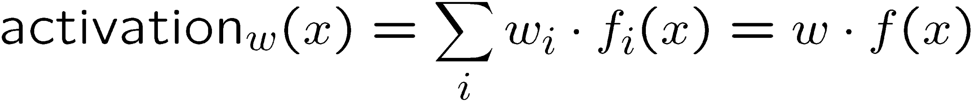
Linear Classifiers
Inputs are feature values
Each feature has a weight
Sum is the activation
If the activation is:
Positive, output +1
Negative, output -1
w₁
f₁
Σ
w₂
>0?
f₂
w₃
f₃

Slide 11

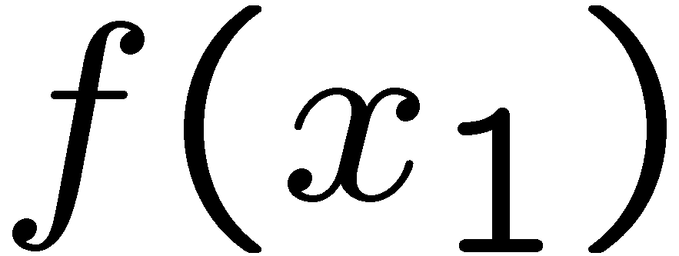
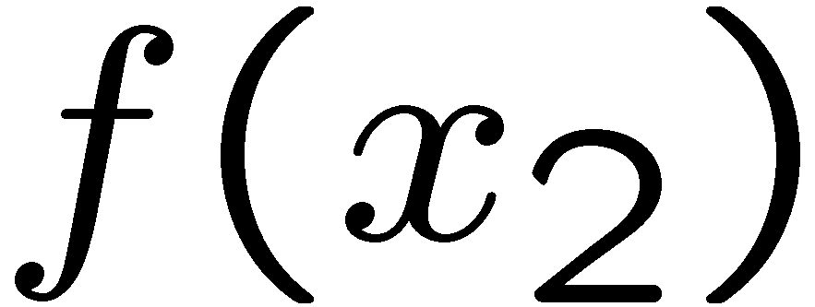
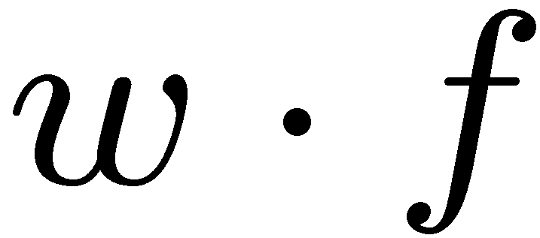
Weights
Binary case: compare features to a weight vector
Learning: figure out the weight vector from examples
# free : 4
YOUR_NAME :-1
MISSPELLED : 1
FROM_FRIEND :-3
...
# free : 2
YOUR_NAME : 0
MISSPELLED : 2
FROM_FRIEND : 0
...
# free : 0
YOUR_NAME : 1
MISSPELLED : 1
FROM_FRIEND : 1
...
Dot product positive means the positive class

Slide 12
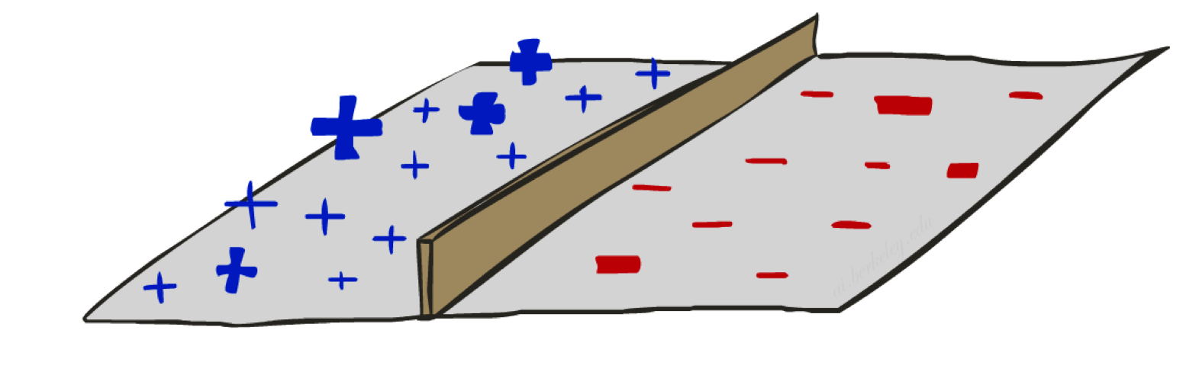
Decision Rules

Slide 13


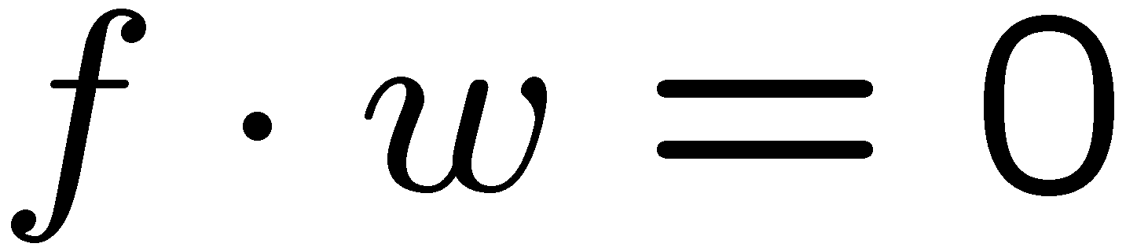
Binary Decision Rule
In the space of feature vectors
Examples are points
Any weight vector is a hyperplane
One side corresponds to Y=+1
Other corresponds to Y=-1
money
2
+1 = SPAM
1
BIAS : -3
free : 4
money : 2
...
0
-1 = HAM
0
1
free

Slide 14
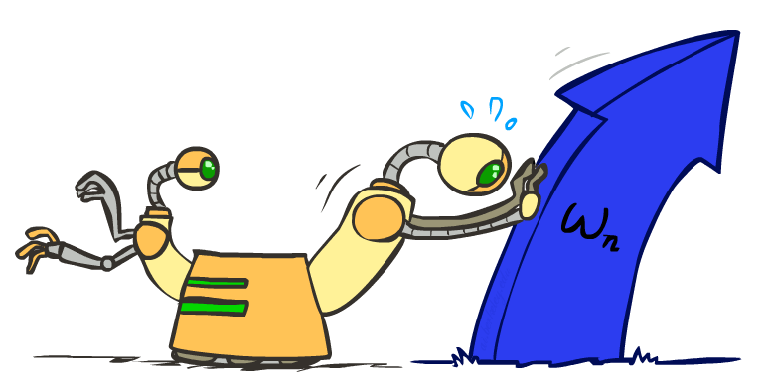
Weight Updates

Slide 15
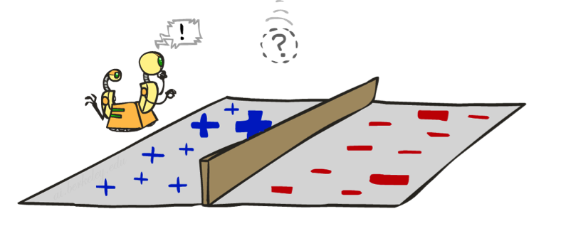
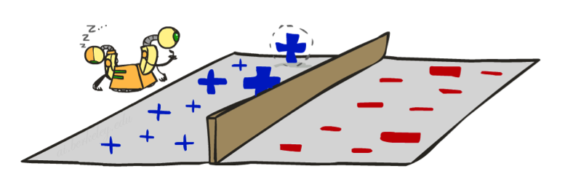
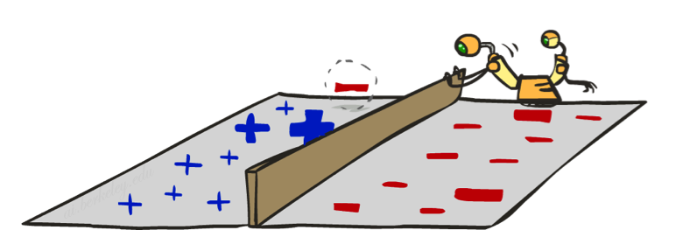
Learning: Binary Perceptron
Start with weights = 0
For each training instance:
Classify with current weights
If correct (i.e., y=y*), no change!
If wrong: adjust the weight vector
Notes:
http://isl.ira.uka.de/neuralNetCourse/2004/VL_11_5/Perceptron.html

Slide 16
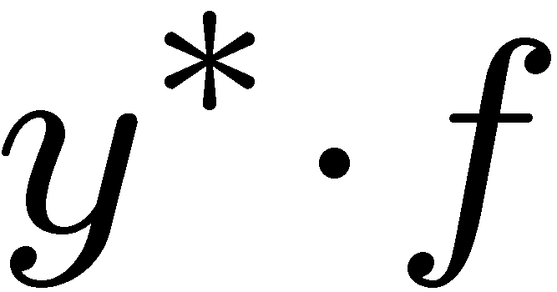
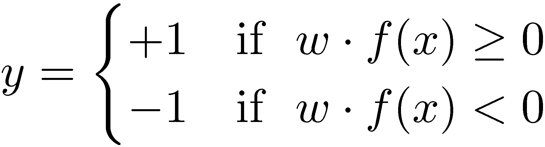

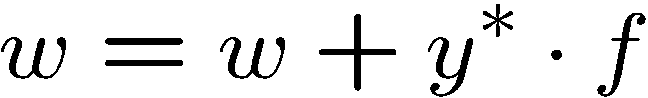
Learning: Binary Perceptron
Start with weights = 0
For each training instance:
Classify with current weights
If correct (i.e., y=y*), no change!
If wrong: adjust the weight vector by adding or subtracting the feature vector. Subtract if y* is -1.
Notes:
http://isl.ira.uka.de/neuralNetCourse/2004/VL_11_5/Perceptron.html

Slide 17
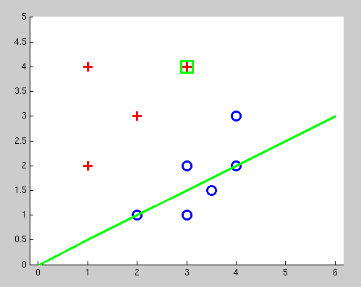
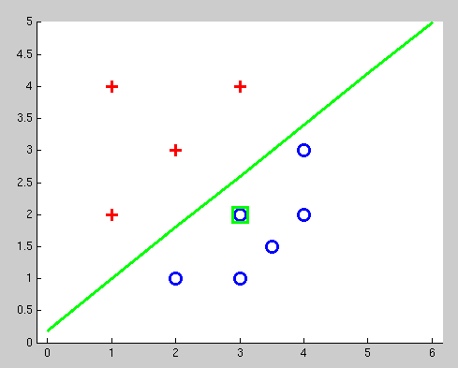
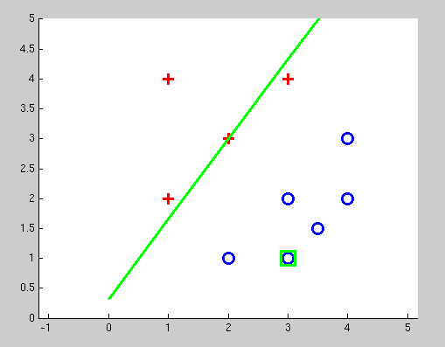
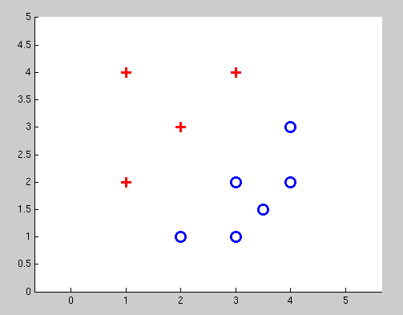
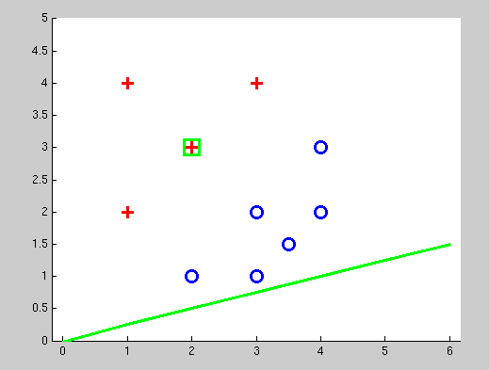
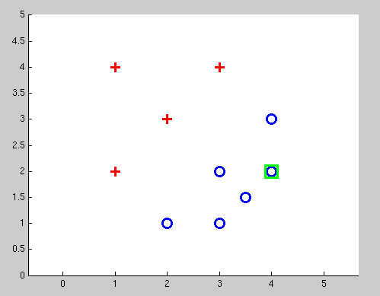
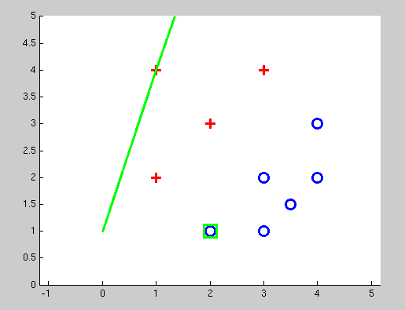
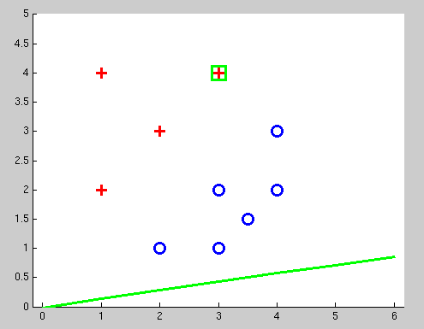
Examples: Perceptron
Separable Case

Slide 18
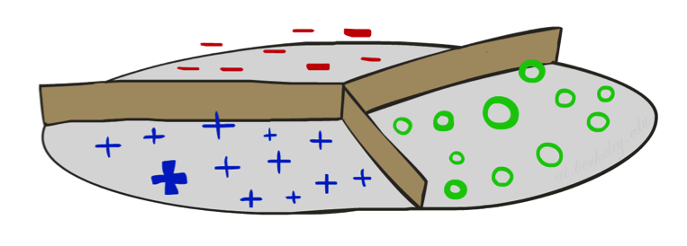


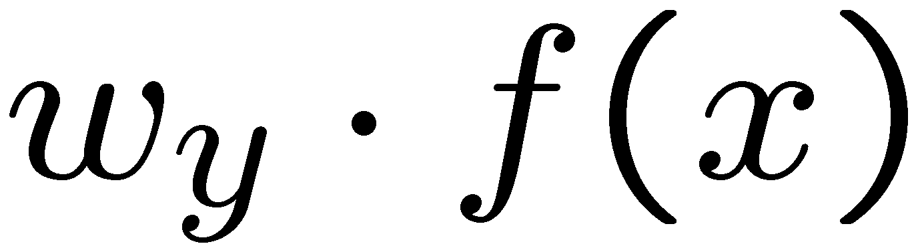


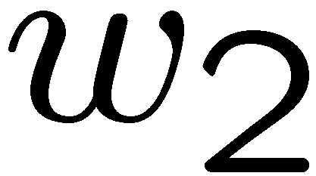
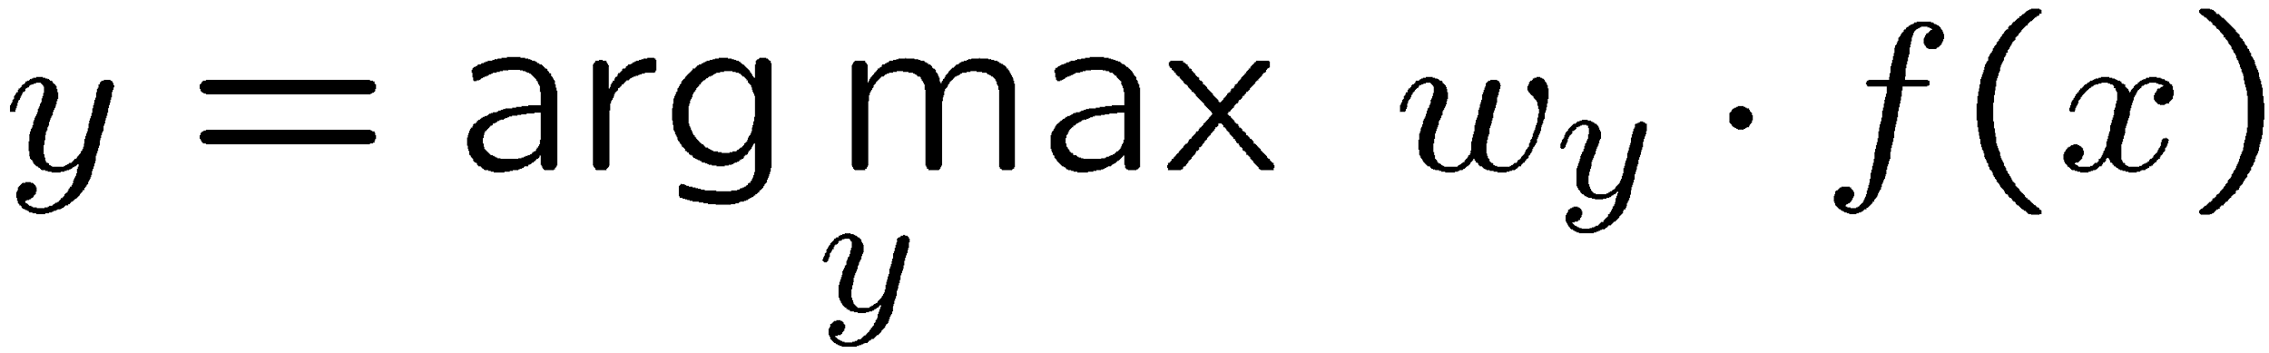
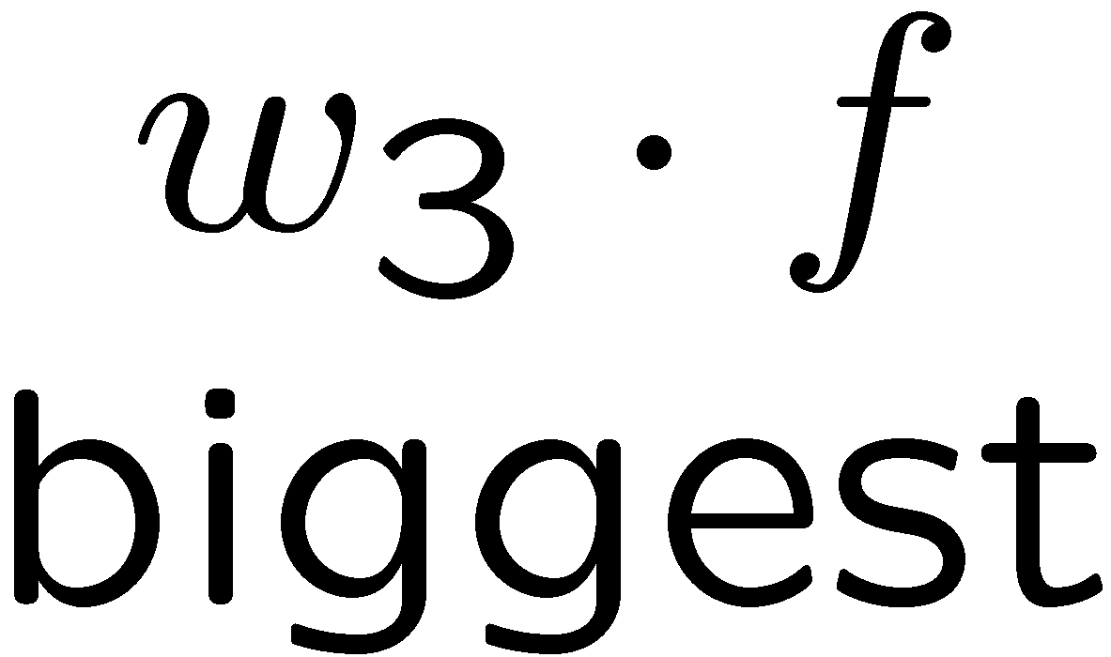
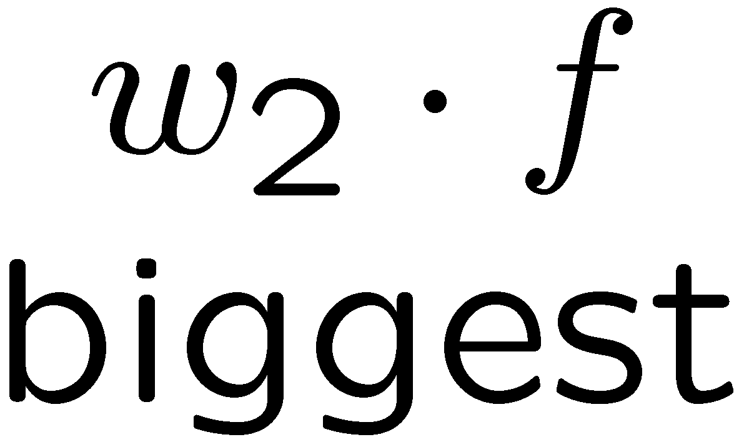
Multiclass Decision Rule
If we have multiple classes:
A weight vector for each class:
Score (activation) of a class y:
Prediction highest score wins
Binary = multiclass where the negative class has weight zero

Slide 19

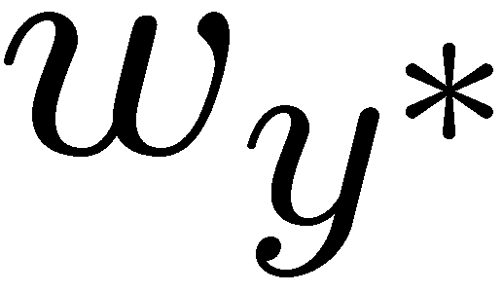

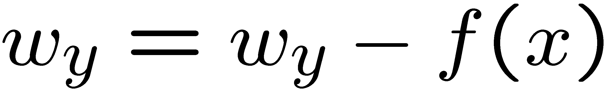
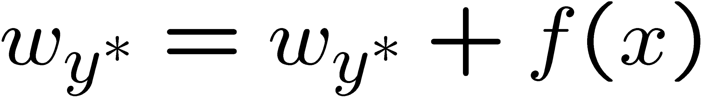
Learning: Multiclass Perceptron
Start with all weights = 0
Pick up training examples one by one
Predict with current weights
If correct, no change!
If wrong: lower score of wrong answer, raise score of right answer

Slide 20



Example: Multiclass Perceptron
“win the vote”
“win the election”
“win the game”
BIAS : 1
win : 0
game : 0
vote : 0
the : 0
...
BIAS : 0
win : 0
game : 0
vote : 0
the : 0
...
BIAS : 0
win : 0
game : 0
vote : 0
the : 0
...

Slide 21
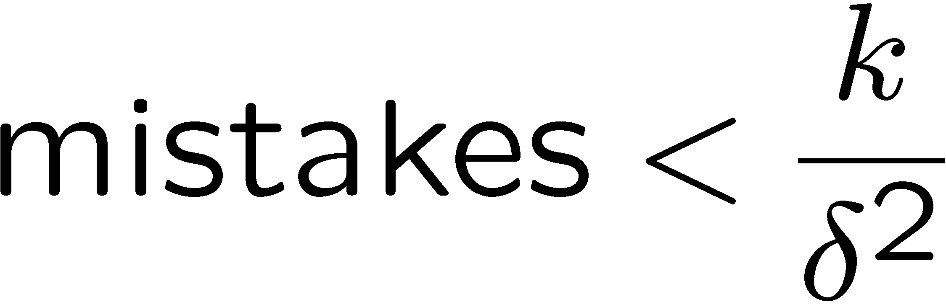
Properties of Perceptrons
Separable
Separability: true if some parameters get the training set perfectly correct
Convergence: if the training is separable, perceptron will eventually converge (binary case)
Mistake Bound: the maximum number of mistakes (binary case) related to the margin or degree of separability
Non-Separable

Slide 22
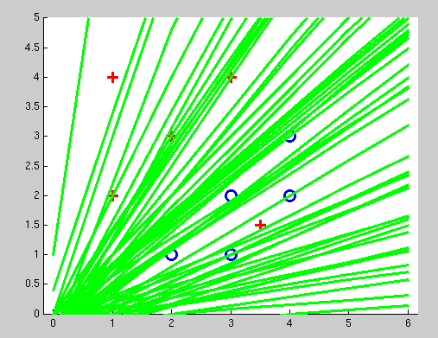
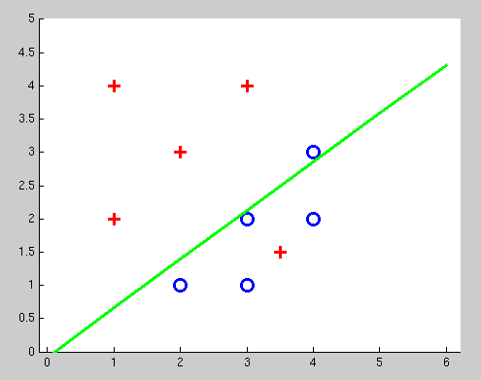
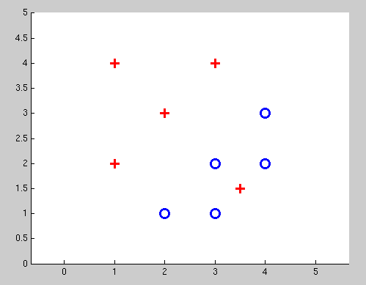
Examples: Perceptron
Non-Separable Case

Slide 23
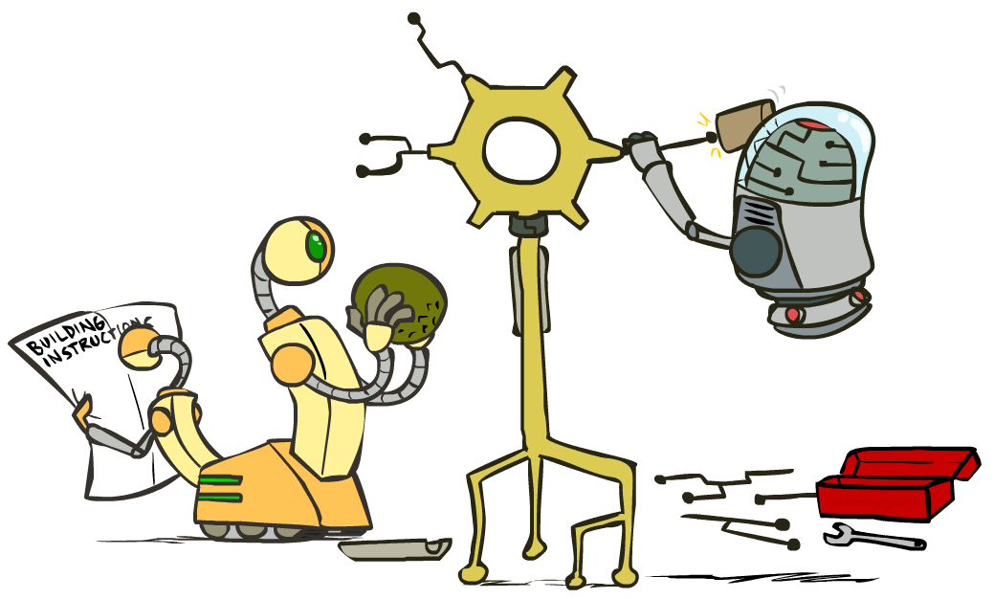
Improving the Perceptron

Slide 24
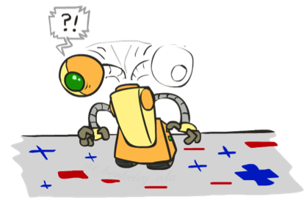
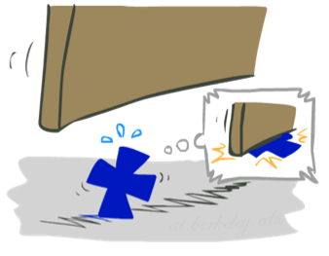

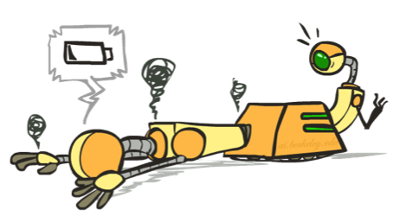




Problems with the Perceptron
Noise: if the data isn’t separable, weights might thrash
Averaging weight vectors over time can help (averaged perceptron)
Mediocre generalization: finds a “barely” separating solution
Overtraining: test / held-out accuracy usually rises, then falls
Overtraining is a kind of overfitting

Slide 25
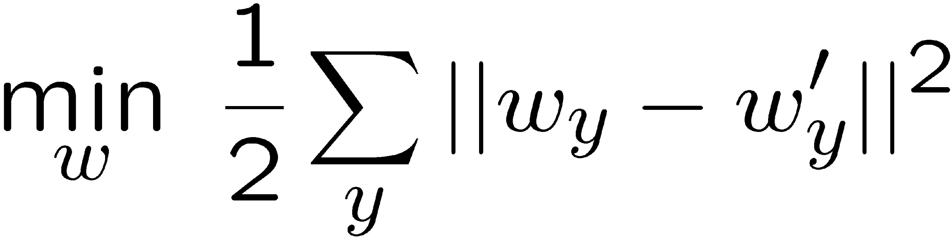
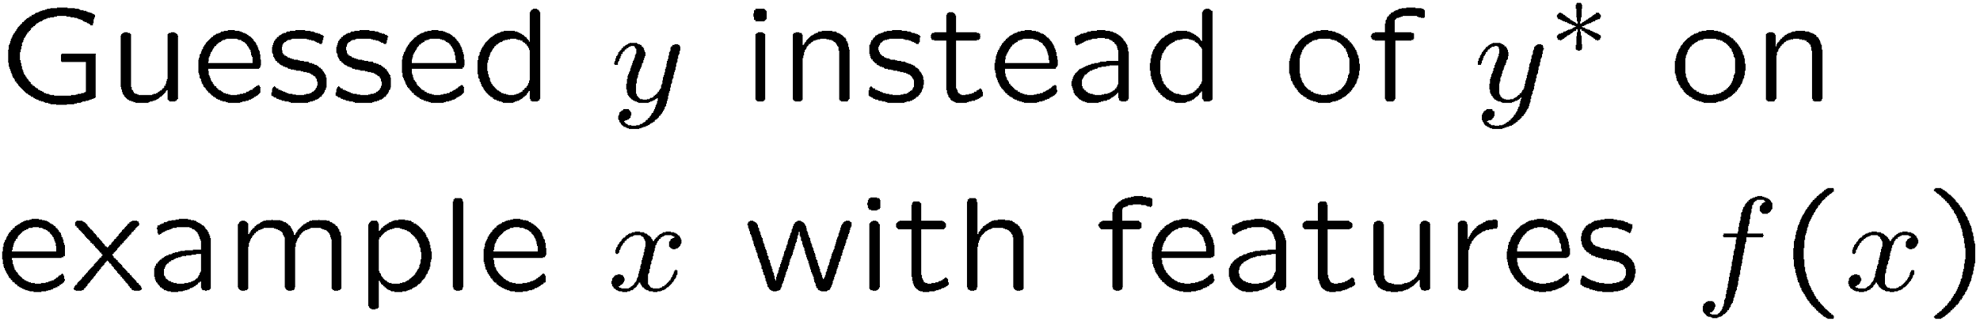
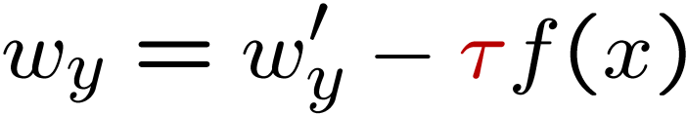
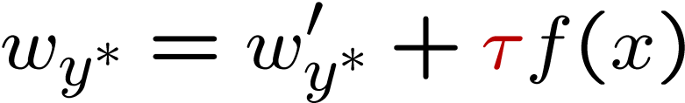
Fixing the Perceptron
Idea: adjust the weight update to mitigate these effects
MIRA*: choose an update size that fixes the current mistake…
… but, minimizes the change to w
The +1 helps to generalize
* Margin Infused Relaxed Algorithm

Slide 26





Minimum Correcting Update
min not τ=0, or would not have made an error, so min will be where equality holds

Slide 27




Maximum Step Size
In practice, it’s also bad to make updates that are too large
Example may be labeled incorrectly
You may not have enough features
Solution: cap the maximum possible value of τ with some constant C
Corresponds to an optimization that assumes non-separable data
Usually converges faster than perceptron
Usually better, especially on noisy data

Slide 28
Linear Separators
Which of these linear separators is optimal?

Slide 29


Support Vector Machines
Maximizing the margin: good according to intuition, theory, practice
Only support vectors matter; other training examples are ignorable
Support vector machines (SVMs) find the separator with max margin
Basically, SVMs are MIRA where you optimize over all examples at once
MIRA
SVM

Slide 30
Classification: Comparison
Naïve Bayes
Builds a model training data
Gives prediction probabilities
Strong assumptions about feature independence
One pass through data (counting)
Perceptrons / MIRA:
Makes less assumptions about data
Mistake-driven learning
Multiple passes through data (prediction)
Often more accurate

Slide 31

Web Search

Slide 32


Extension: Web Search
Information retrieval:
Given information needs, produce information
Includes, e.g. web search, question answering, and classic IR
Web search: not exactly classification, but rather ranking
x = “Apple Computers”

Slide 33
Feature-Based Ranking
x = “Apple Computer”
x,
x,

Slide 34








Perceptron for Ranking
Inputs
Candidates
Many feature vectors:
One weight vector:
Prediction:
Update (if wrong):

Slide 35

Apprenticeship

Slide 36


Pacman Apprenticeship!
Examples are states s
Candidates are pairs (s,a)
“Correct” actions: those taken by expert
Features defined over (s,a) pairs: f(s,a)
Score of a q-state (s,a) given by:
How is this VERY different from reinforcement learning?
“correct” action a*
[Demo: Pacman Apprentice (L22D1,2,3)]

Slide 37

Video of Demo Pacman Apprentice

Slide 38
Next: Kernels and Clustering

