Slide 1
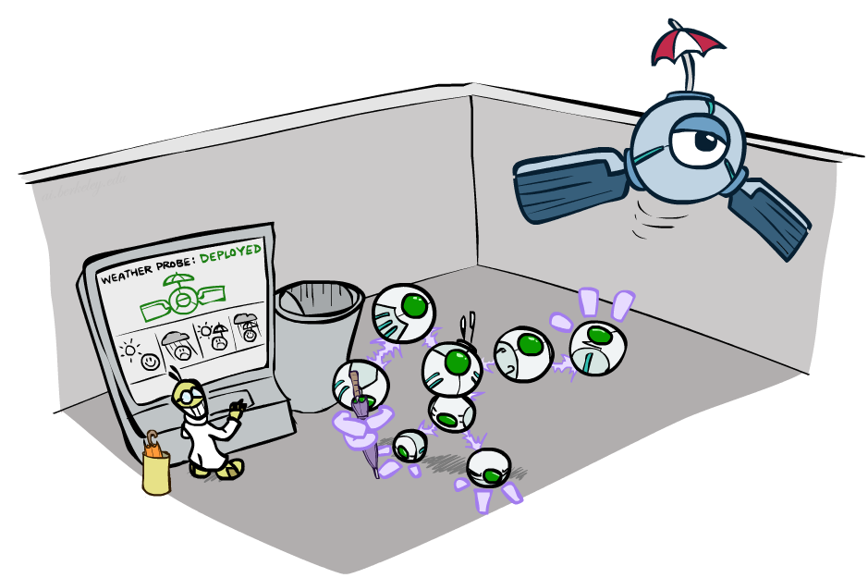
CS 370: Artificial Intelligence
Decision Networks and Value of Information
Instructor: William DeMeo
New Jersey Institute of Technology
[slides created by Dan Klein and Pieter Abbeel for CS188 at UC Berkeley; provided courtesy of ai.berkeley.edu]
Notes:
Please retain proper attribution, including the reference to ai.berkeley.edu. Thanks!

Slide 2
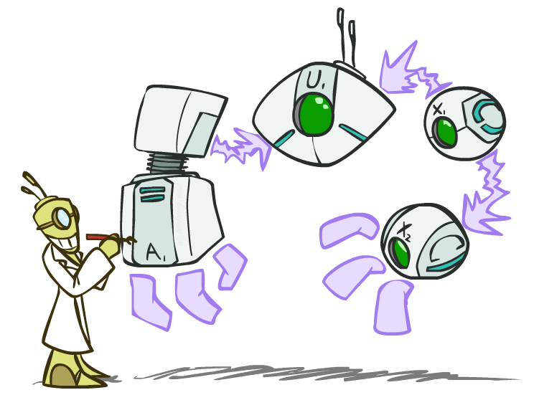
Decision Networks

Slide 3

Unused art

Slide 4
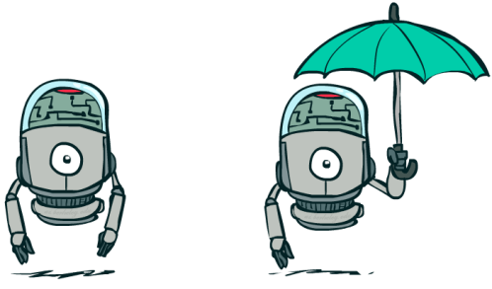
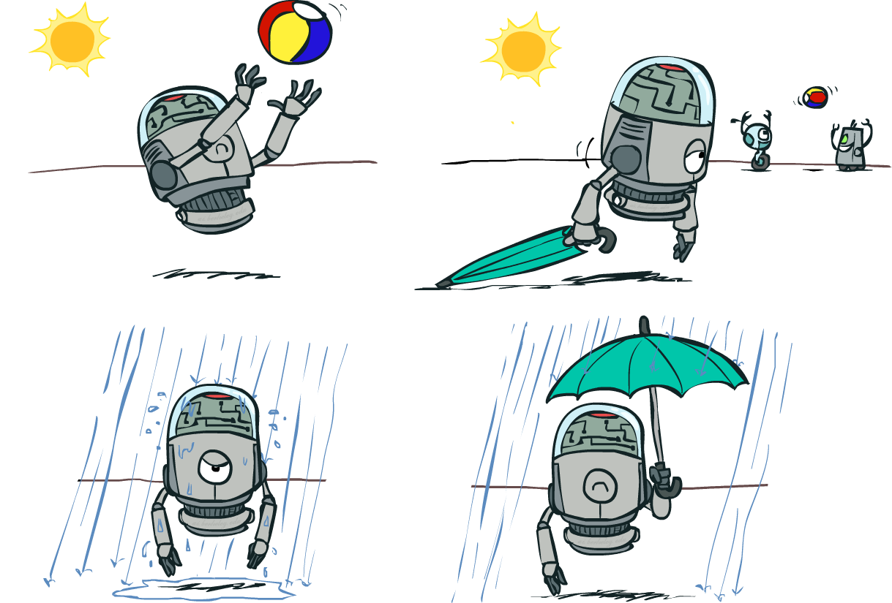

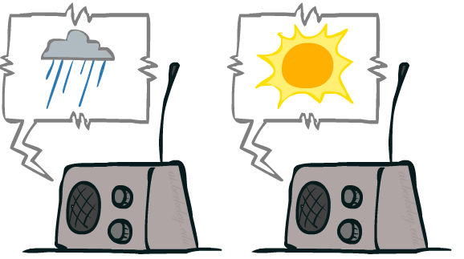
Decision Networks
Umbrella
U
Weather
Forecast
Notes:
There exists a ghostbusters demo

Slide 5
Decision Networks
MEU: choose the action which maximizes the expected utility given the evidence
Can directly operationalize this with decision networks
Bayes nets with nodes for utility and actions
Lets us calculate the expected utility for each action
New node types:
Chance nodes (just like BNs)
Actions (rectangles, cannot have parents, act as observed evidence)
Utility node (diamond, depends on action and chance nodes)
Umbrella
U
Weather
Forecast
Notes:
There exists a ghostbusters demo

Slide 6
Decision Networks
Action selection
Instantiate all evidence
Set action node(s) each possible way
Calculate posterior for all parents of utility node, given the evidence
Calculate expected utility for each action
Choose maximizing action
Umbrella
U
Weather
Forecast
Notes:
There exists a ghostbusters demo

Slide 7
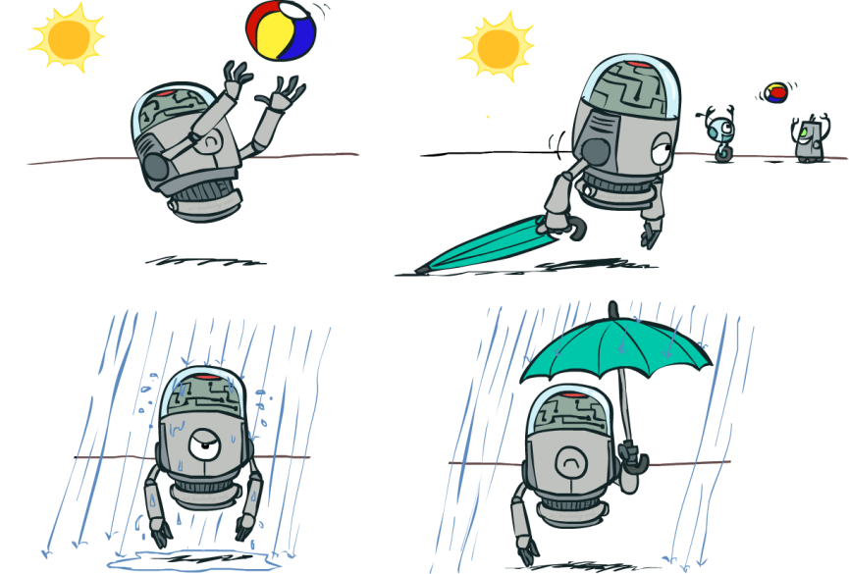
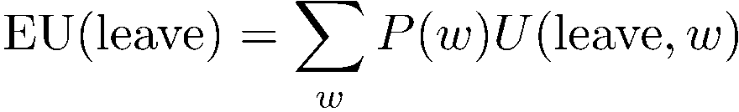
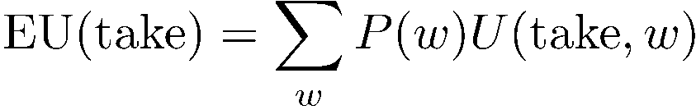

Decision Networks
Umbrella = leave
Umbrella
U
Umbrella = take
Weather
A | W | U(A,W)
leave | sun | 100
leave | rain | 0
take | sun | 20
take | rain | 70
W | P(W)
sun | 0.7
rain | 0.3
Optimal decision = leave
Notes:
There exists a ghostbusters demo

Slide 8
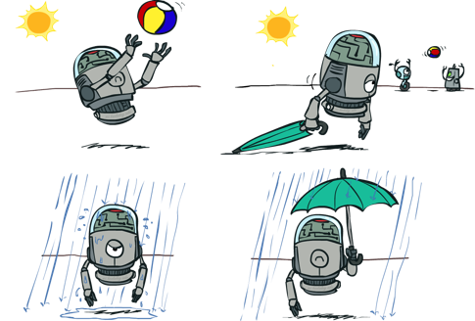

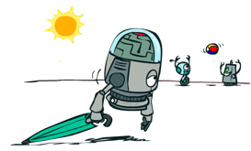

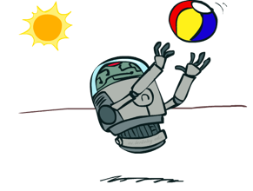
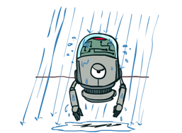
Decisions as Outcome Trees
{}
take
leave
Umbrella
Weather | {}
Weather | {}
U
sun
sun
Weather
rain
rain
U(t,s)
U(t,r)
U(l,s)
U(l,r)
Almost exactly like expectimax / MDPs
What’s changed?

Slide 9
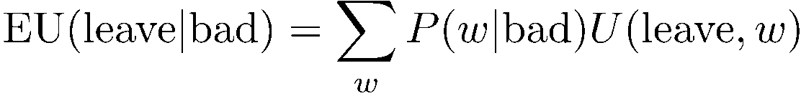


Example: Decision Networks
Umbrella = leave
A | W | U(A,W)
leave | sun | 100
leave | rain | 0
take | sun | 20
take | rain | 70
Umbrella
U
Umbrella = take
Weather
W | P(W|F=bad)
sun | 0.34
rain | 0.66
Optimal decision = take
Forecast
=bad

Slide 10
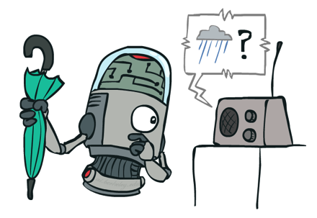
Decisions as Outcome Trees
Umbrella
{b}
take
leave
U
W | {b}
W | {b}
Weather
sun
sun
rain
rain
U(t,s)
U(t,r)
U(l,s)
U(l,r)
Forecast
=bad

Slide 11
Ghostbusters Decision Network
Demo: Ghostbusters with probability
Bust
U
Ghost Location
…
Sensor (1,1)
Sensor (1,2)
Sensor (1,3)
Sensor (1,n)
Sensor (2,1)
…
…
…
Sensor (m,1)
Sensor (m,n)

Slide 12

Video of Demo Ghostbusters with Probability

Slide 13
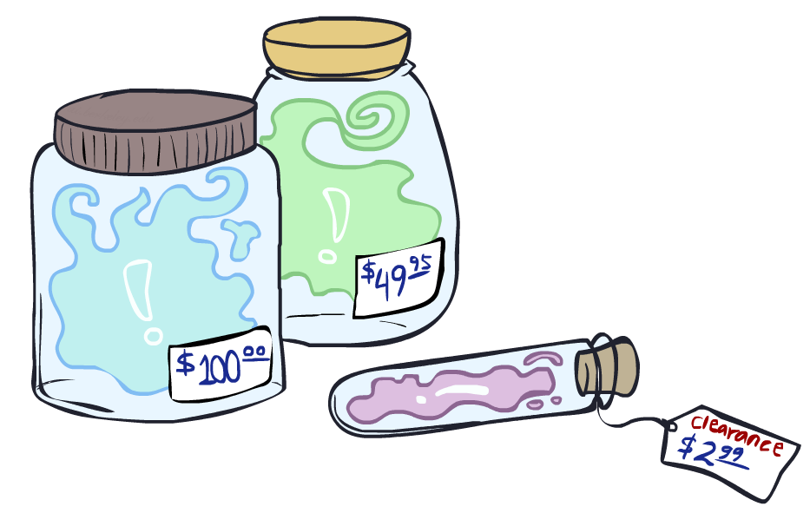
Value of Information

Slide 14
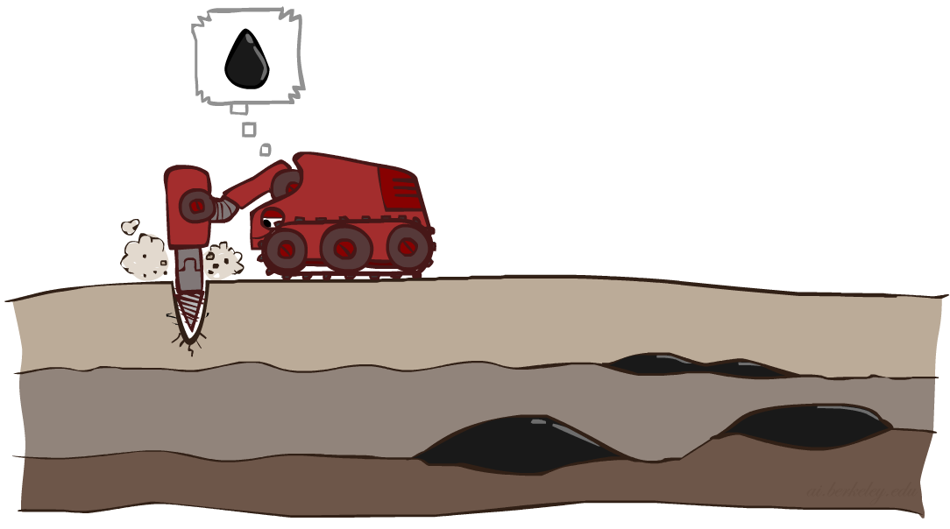
Value of Information
Idea: compute value of acquiring evidence
Can be done directly from decision network
Example: buying oil drilling rights
Two blocks A and B, exactly one has oil, worth k
You can drill in one location
Prior probabilities 0.5 each, & mutually exclusive
Drilling in either A or B has EU = k/2, MEU = k/2
Question: what’s the value of information of O?
Value of knowing which of A or B has oil
Value is expected gain in MEU from new info
Survey may say “oil in a” or “oil in b”, prob 0.5 each
If we know OilLoc, MEU is k (either way)
Gain in MEU from knowing OilLoc?
VPI(OilLoc) = k/2
Fair price of information: k/2
D | O | U
a | a | k
a | b | 0
b | a | 0
b | b | k
DrillLoc
U
O | P
a | 1/2
b | 1/2
OilLoc

Slide 15

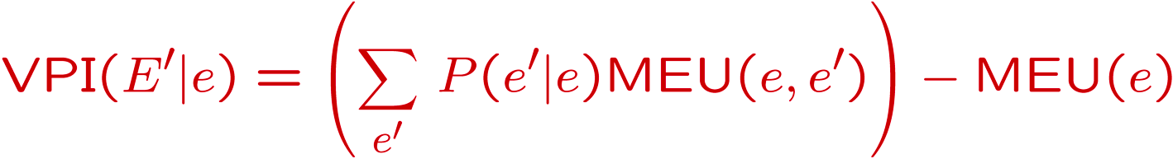
VPI Example: Weather
MEU with no evidence
Umbrella
A | W | U
leave | sun | 100
leave | rain | 0
take | sun | 20
take | rain | 70
U
MEU if forecast is bad
Weather
MEU if forecast is good
Forecast
Forecast distribution
F | P(F)
good | 0.59
bad | 0.41

Slide 16
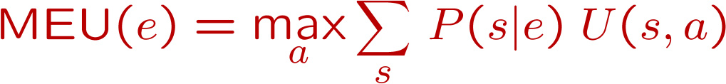
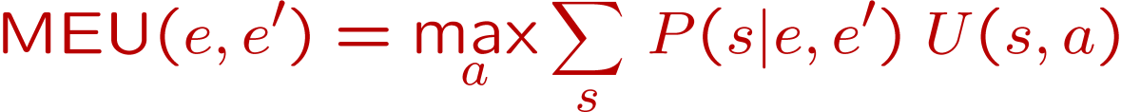
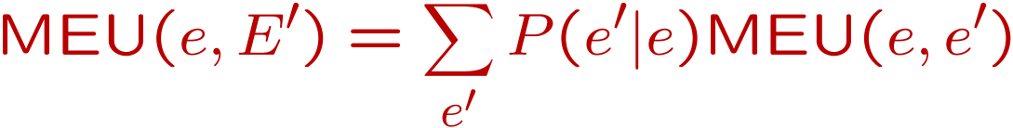
Value of Information
{+e}
Assume we have evidence E=e. Value if we act now:
Assume we see that E’ = e’. Value if we act then:
BUT E’ is a random variable whose value is
unknown, so we don’t know what e’ will be
Expected value if E’ is revealed and then we act:
Value of information: how much MEU goes up
by revealing E’ first then acting, over acting now:
a
P(s | +e)
U
{+e, +e’}
a
P(s | +e, +e’)
U
{+e}
P(+e’ | +e)
P(-e’ | +e)
{+e, +e’}
{+e, -e’}
a

Slide 17
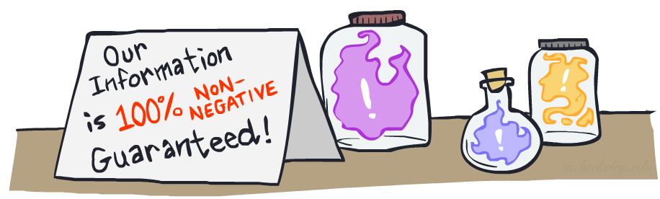

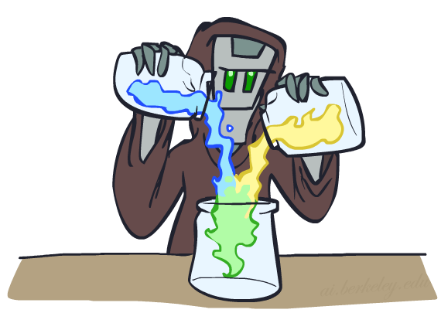
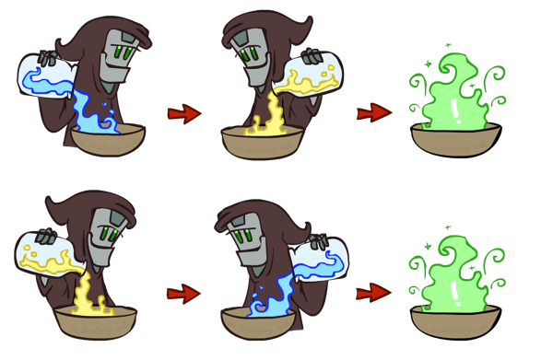
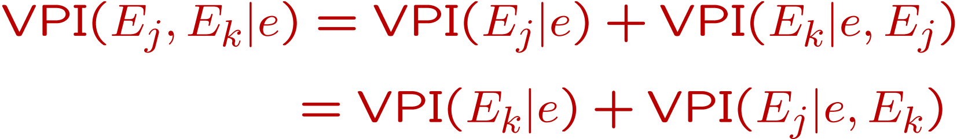
VPI Properties
Nonnegative
Nonadditive
(think of observing E_{j} twice)
Order-independent

Slide 18
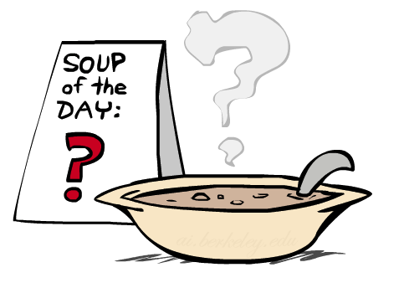
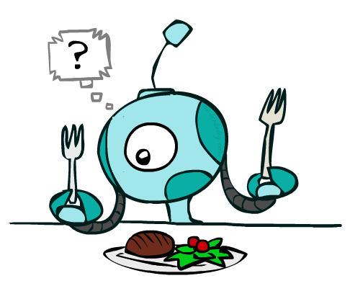
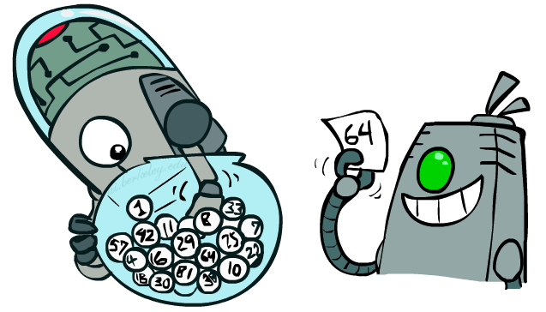
Quick VPI Questions
The soup of the day is either clam chowder or split pea, but you wouldn’t order either one. What’s the value of knowing which it is?
There are two kinds of plastic forks at a picnic. One kind is slightly sturdier. What’s the value of knowing which?
You’re playing the lottery. The prize will be $0 or $100. You can play any number between 1 and 100 (chance of winning is 1%). What is the value of knowing the winning number?

Slide 19
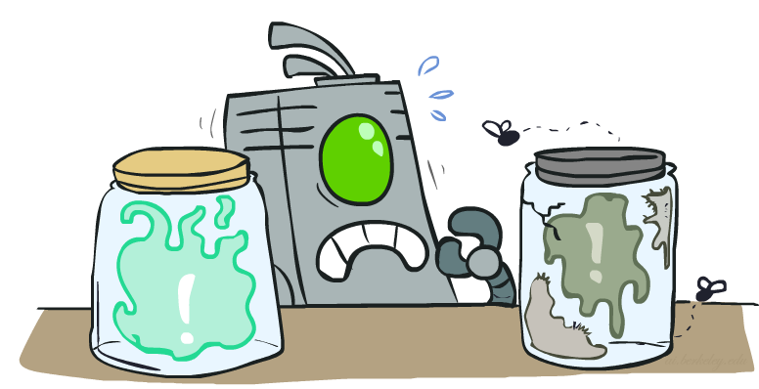
Value of Imperfect Information?
No such thing (as we formulate it)
Information corresponds to the observation of a node in the decision network
If data is “noisy” that just means we don’t observe the original variable, but another variable which is a noisy version of the original one

Slide 20
VPI Question
VPI(OilLoc) ?
VPI(ScoutingReport) ?
VPI(Scout) ?
VPI(Scout | ScoutingReport) ?
Generally:
If Parents(U) Z | CurrentEvidence
Then VPI( Z | CurrentEvidence) = 0
DrillLoc
U
Scout
OilLoc
Scouting
Report

Slide 21
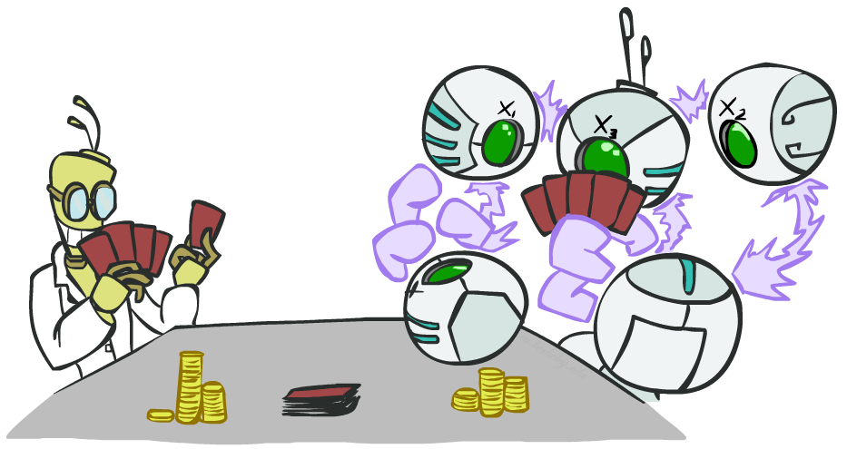
POMDPs

Slide 22
POMDPs
MDPs have:
States S
Actions A
Transition function P(s’|s,a) (or T(s,a,s’))
Rewards R(s,a,s’)
POMDPs add:
Observations O
Observation function P(o|s) (or O(s,o))
POMDPs are MDPs over belief
states b (distributions over S)
We’ll be able to say more in a few lectures
s
a
s, a
s,a,s’
s'
b
a
b, a
o
b'

Slide 23
Example: Ghostbusters
Demo: Ghostbusters with VPI
In (static) Ghostbusters:
Belief state determined by evidence to date {e}
Tree really over evidence sets
Probabilistic reasoning needed to predict new evidence given past evidence
Solving POMDPs
One way: use truncated expectimax to compute approximate value of actions
What if you only considered busting or one sense followed by a bust?
You get a VPI-based agent!
b
{e}
a
a
b, a
e, a
e’
e’
b’
{e, e’}
{e}
a_{bust}
a_{sense}
{e}, a_{sense}
U(a_{bust}, {e})
e’
{e, e’}
a_{bust}
U(a_{bust}, {e, e’})

Slide 24
Video of Demo Ghostbusters with VPI

Slide 25
More Generally*
General solutions map belief functions to actions
Can divide regions of belief space (set of belief functions) into policy regions (gets complex quickly)
Can build approximate policies using discretization methods
Can factor belief functions in various ways
Overall, POMDPs are very (actually PSPACE-) hard
Most real problems are POMDPs, and we can rarely solve then in their full generality

Slide 26
Next Time: Dynamic Models

