Slide 1
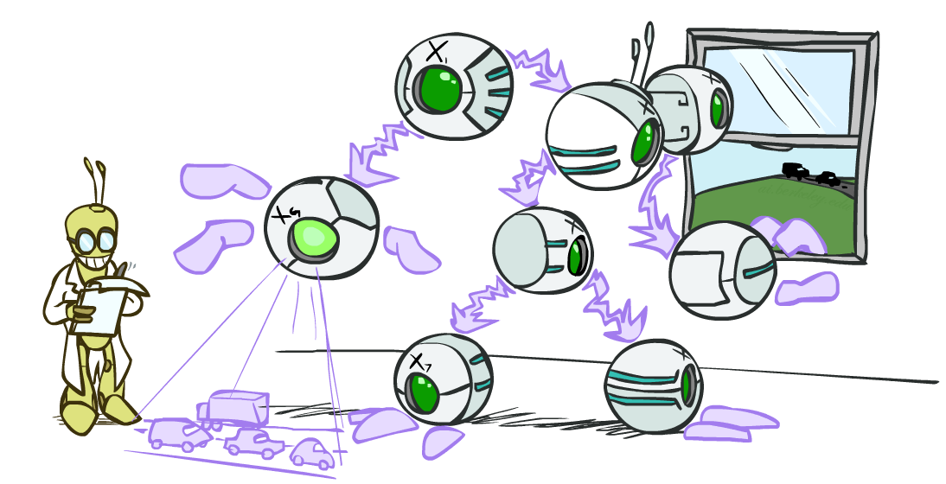
CS 370: Artificial Intelligence
Bayes’ Nets: Inference
Instructor: William DeMeo --- NJIT
[slides created by Dan Klein and Pieter Abbeel for CS188 at UC Berkeley; provided courtesy of ai.berkeley.edu.]
Notes:
Please retain proper attribution, including the reference to ai.berkeley.edu. Thanks!

Slide 2
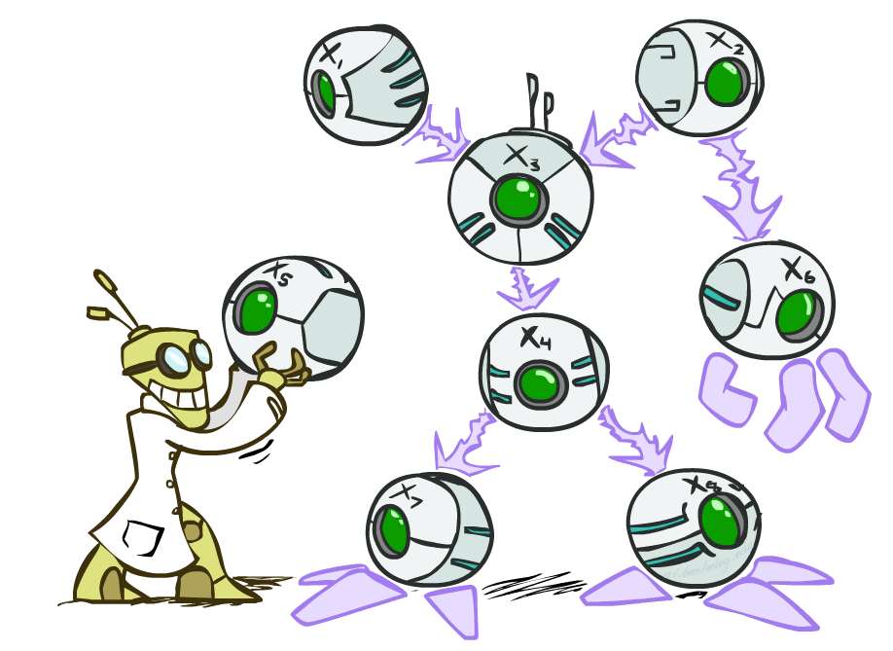

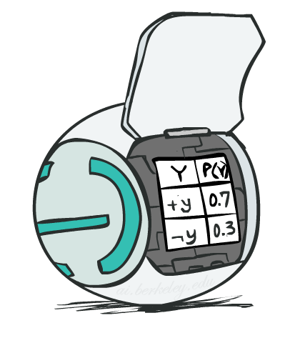
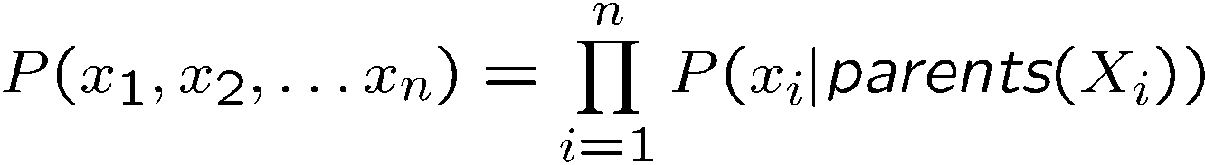
Bayes’ Net Representation
A directed, acyclic graph, one node per random variable
A conditional probability table (CPT) for each node
A collection of distributions over X, one for each combination of parents’ values
Bayes’ nets implicitly encode joint distributions
As a product of local conditional distributions
To see what probability a BN gives to a full assignment, multiply all the relevant conditionals together:

Slide 3
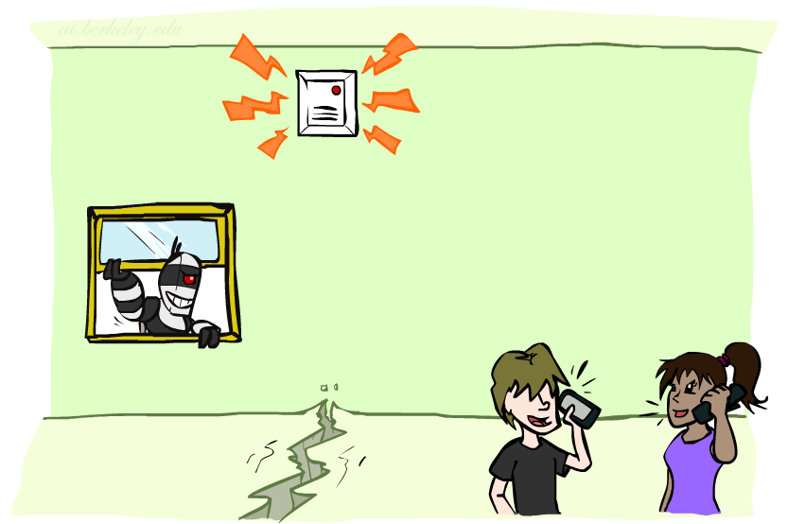
Example: Alarm Network
B | P(B)
+b | 0.001
-b | 0.999
E | P(E)
+e | 0.002
-e | 0.998
Burglary
Earthqk
Alarm
B | E | A | P(A|B,E)
+b | +e | +a | 0.95
+b | +e | -a | 0.05
+b | -e | +a | 0.94
+b | -e | -a | 0.06
-b | +e | +a | 0.29
-b | +e | -a | 0.71
-b | -e | +a | 0.001
-b | -e | -a | 0.999
John calls
Mary calls
A | J | P(J|A)
+a | +j | 0.9
+a | -j | 0.1
-a | +j | 0.05
-a | -j | 0.95
A | M | P(M|A)
+a | +m | 0.7
+a | -m | 0.3
-a | +m | 0.01
-a | -m | 0.99
[Demo: BN Applet]
Notes:
Demo:
Draw network
Specify the CPTs
Then query, e.g., Mary Calls --- not something we specified, inference computed this for us
P(B) = ?
P(B | +e) = ?
Independence
P(B) = ?
P(B | +m) = ?
Show explaining away

Slide 4

Video of Demo BN Applet

Slide 5
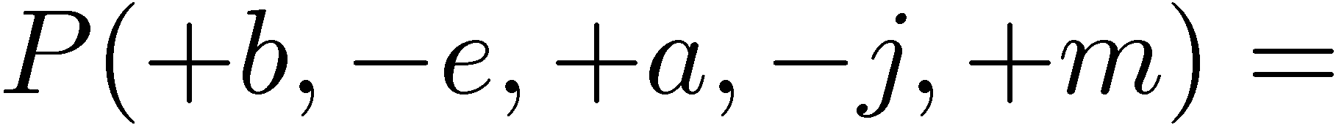
Example: Alarm Network
B | P(B)
+b | 0.001
-b | 0.999
E | P(E)
+e | 0.002
-e | 0.998
B
E
A
A | J | P(J|A)
+a | +j | 0.9
+a | -j | 0.1
-a | +j | 0.05
-a | -j | 0.95
A | M | P(M|A)
+a | +m | 0.7
+a | -m | 0.3
-a | +m | 0.01
-a | -m | 0.99
B | E | A | P(A|B,E)
+b | +e | +a | 0.95
+b | +e | -a | 0.05
+b | -e | +a | 0.94
+b | -e | -a | 0.06
-b | +e | +a | 0.29
-b | +e | -a | 0.71
-b | -e | +a | 0.001
-b | -e | -a | 0.999
J
M
Notes:
demo

Slide 6

Example: Alarm Network
B | P(B)
+b | 0.001
-b | 0.999
E | P(E)
+e | 0.002
-e | 0.998
B
E
A
A | J | P(J|A)
+a | +j | 0.9
+a | -j | 0.1
-a | +j | 0.05
-a | -j | 0.95
A | M | P(M|A)
+a | +m | 0.7
+a | -m | 0.3
-a | +m | 0.01
-a | -m | 0.99
B | E | A | P(A|B,E)
+b | +e | +a | 0.95
+b | +e | -a | 0.05
+b | -e | +a | 0.94
+b | -e | -a | 0.06
-b | +e | +a | 0.29
-b | +e | -a | 0.71
-b | -e | +a | 0.001
-b | -e | -a | 0.999
J
M
Notes:
demo

Slide 7

Bayes’ Nets
Representation
Conditional Independences
Probabilistic Inference
Enumeration (exact, exponential complexity)
Variable elimination (exact, worst-case exponential complexity, often better)
Inference is NP-complete
Sampling (approximate)
Learning Bayes’ Nets from Data

Slide 8

Inference
Inference: calculating some useful quantity from a joint probability distribution
Examples:
Posterior probability
Most likely explanation:

Slide 9





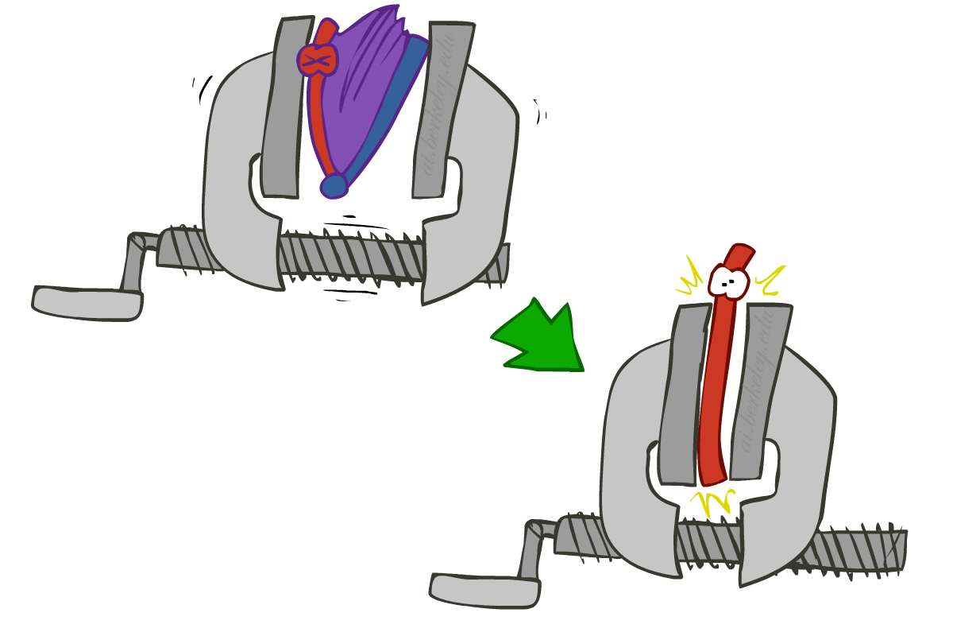
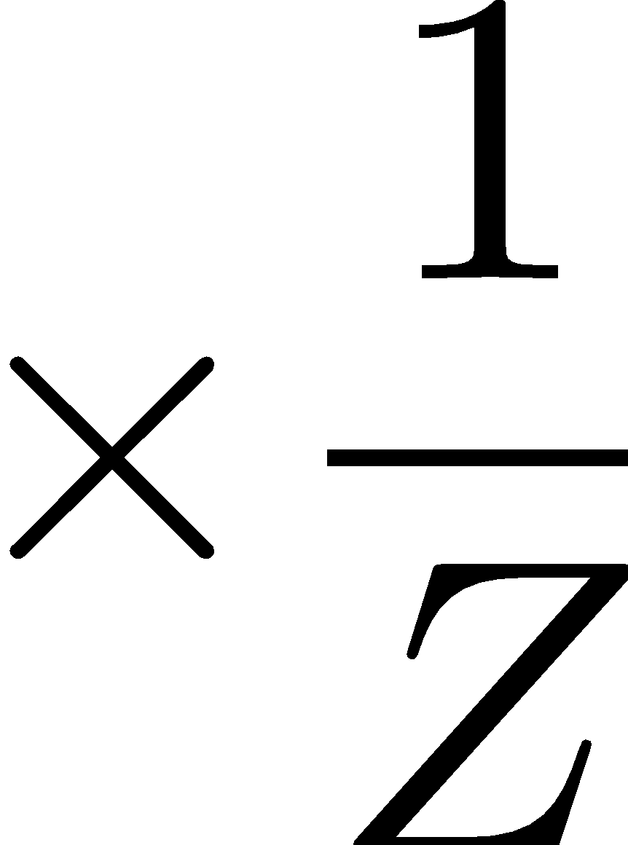
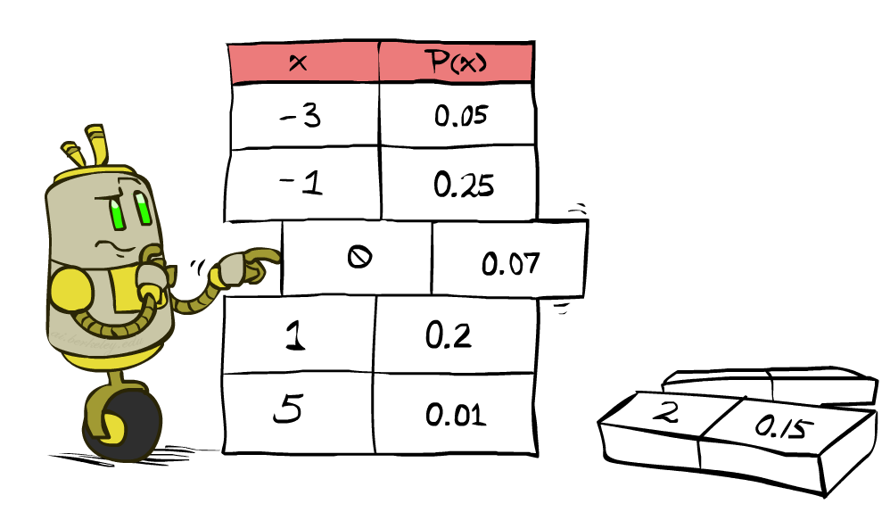


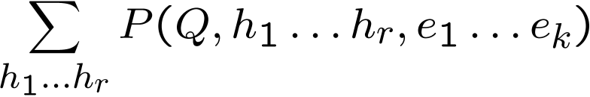
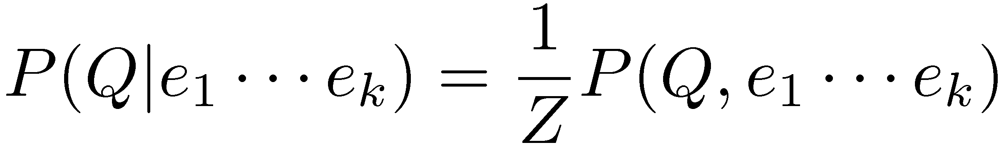
Inference by Enumeration
* Works fine with multiple query variables, too
General case:
Evidence variables:
Query* variable:
Hidden variables:
We want:
All variables
Step 1: Select the entries consistent with the evidence
Step 2: Sum out H to get joint of Query and evidence
Step 3: Normalize

Slide 10
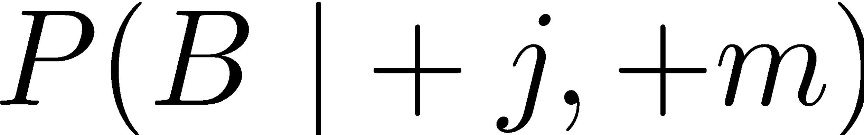
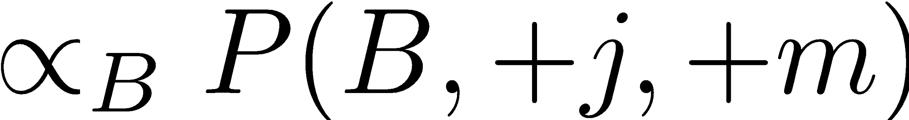
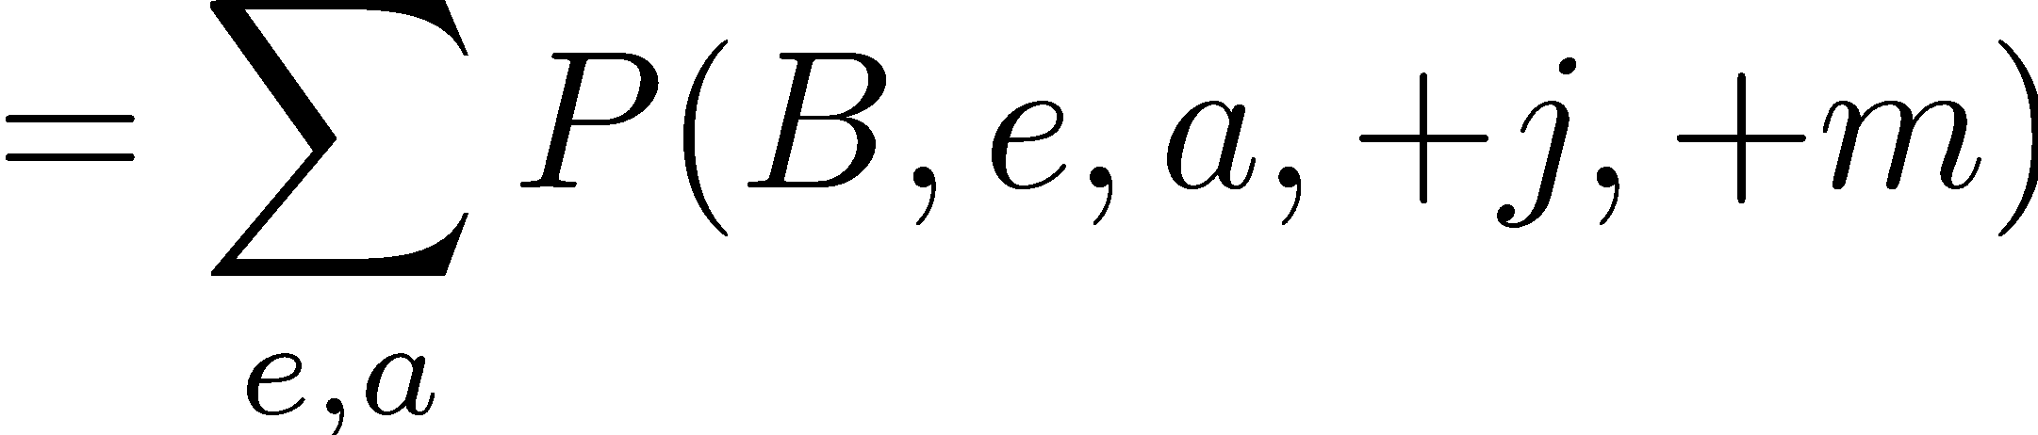
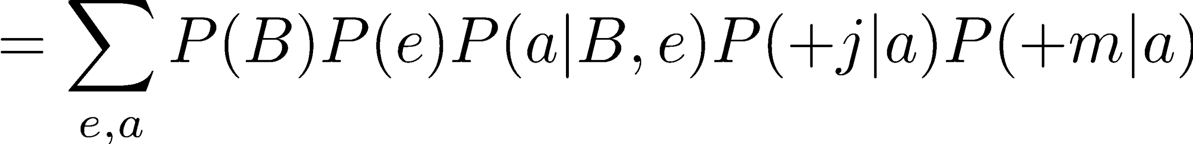
Inference by Enumeration in Bayes’ Net
Given unlimited time, inference in BNs is easy
Reminder of inference by enumeration by example:
B
E
A
J
M

Slide 11
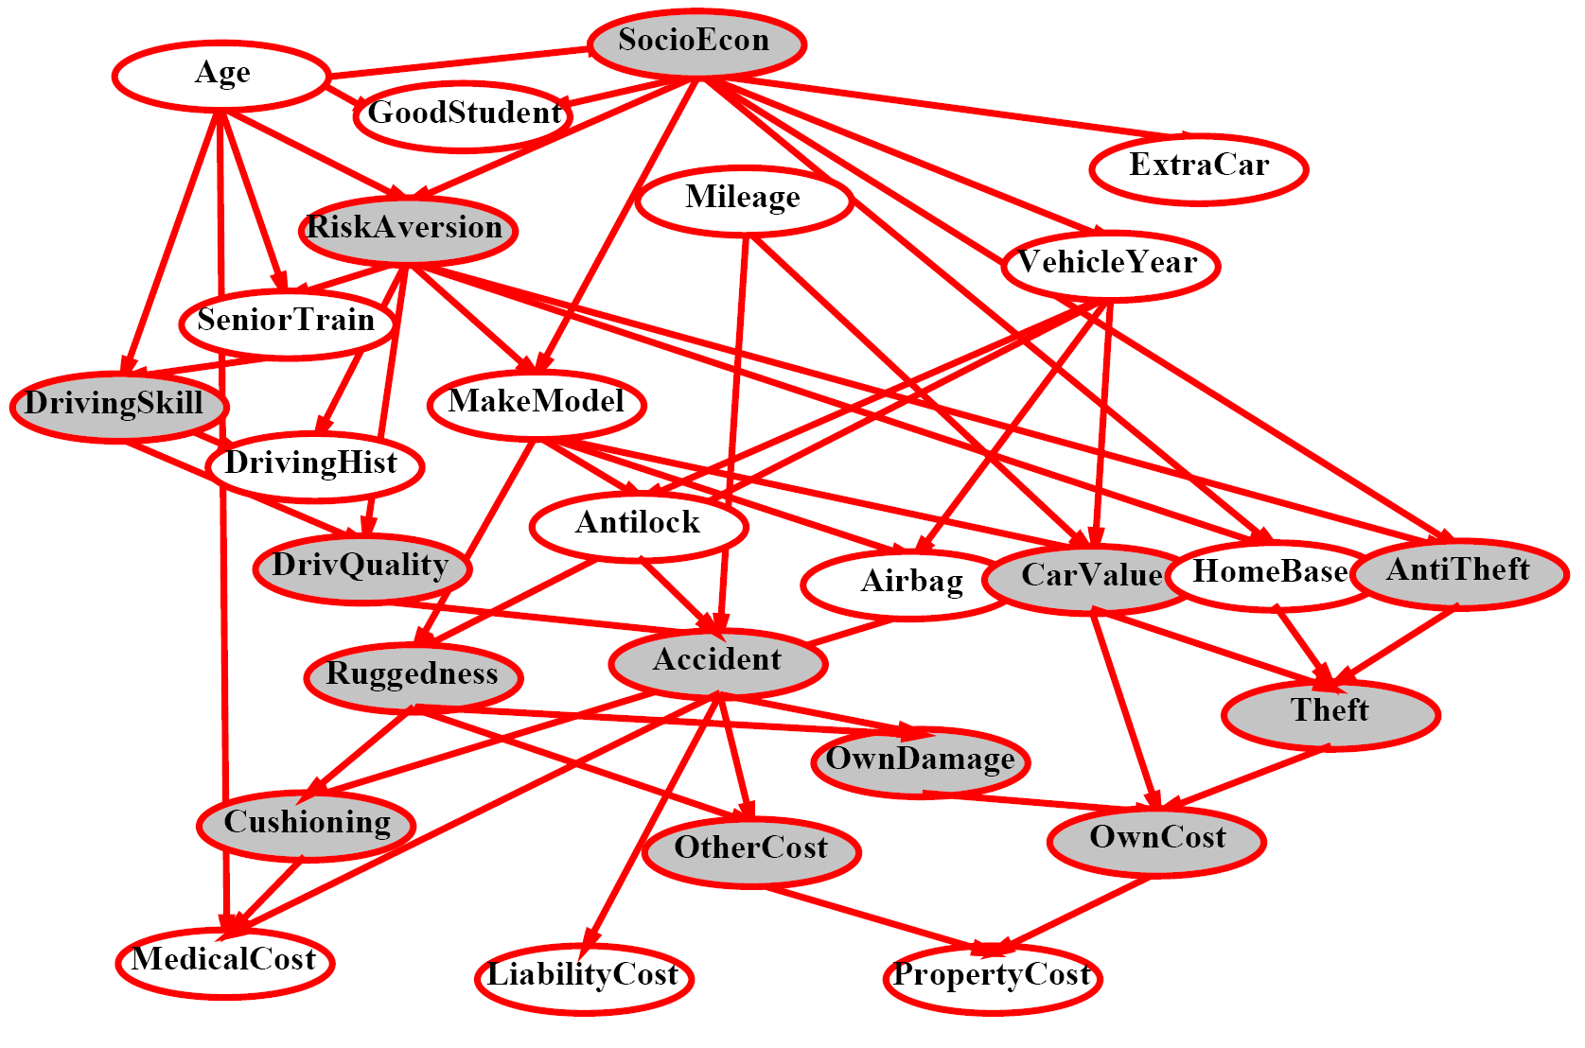
Inference by Enumeration?

Slide 12
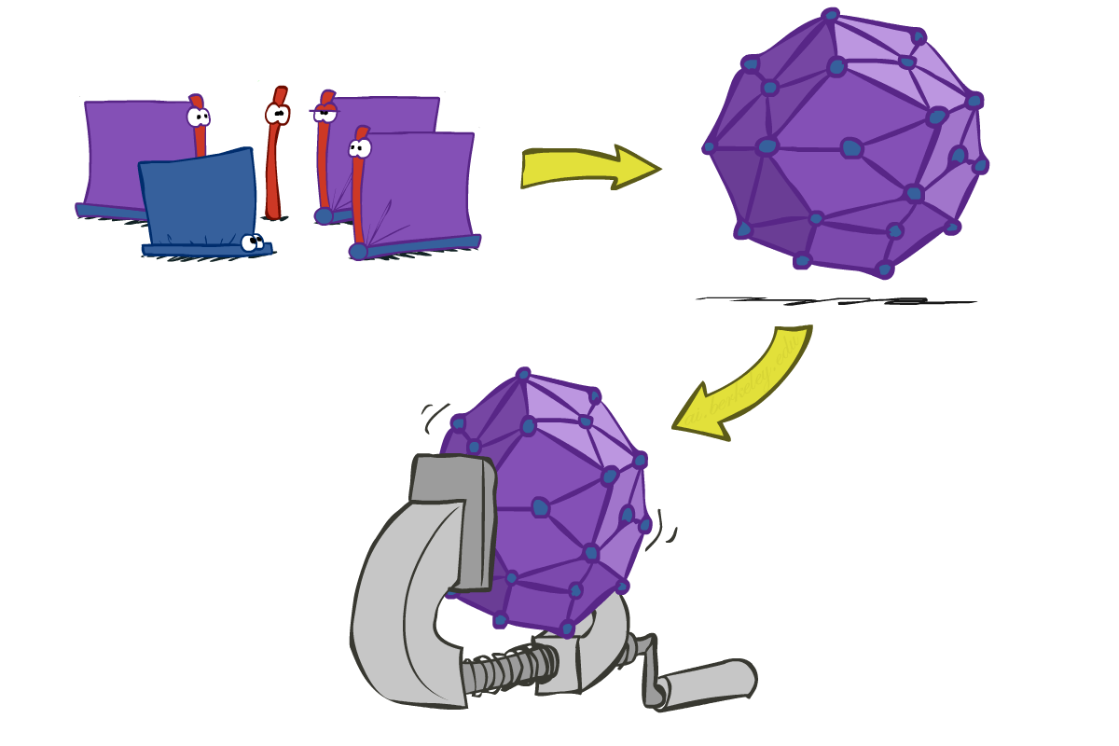
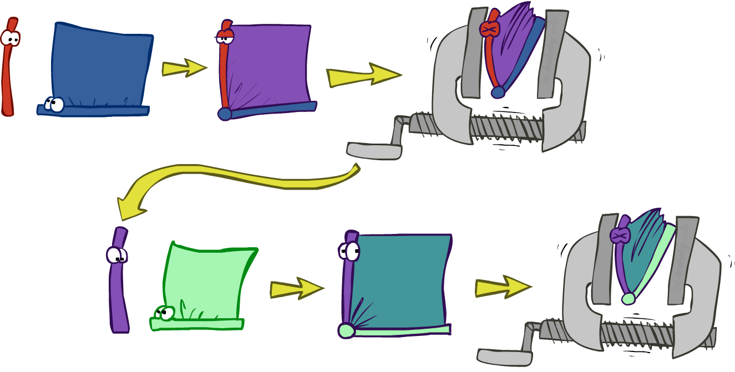
Inference by Enumeration vs. Variable Elimination
Why is inference by enumeration so slow?
You join up the whole joint distribution before you sum out the hidden variables
Idea: interleave joining and marginalizing!
Called “Variable Elimination”
Still NP-hard, but usually much faster than inference by enumeration
First we’ll need some new notation: factors

Slide 13
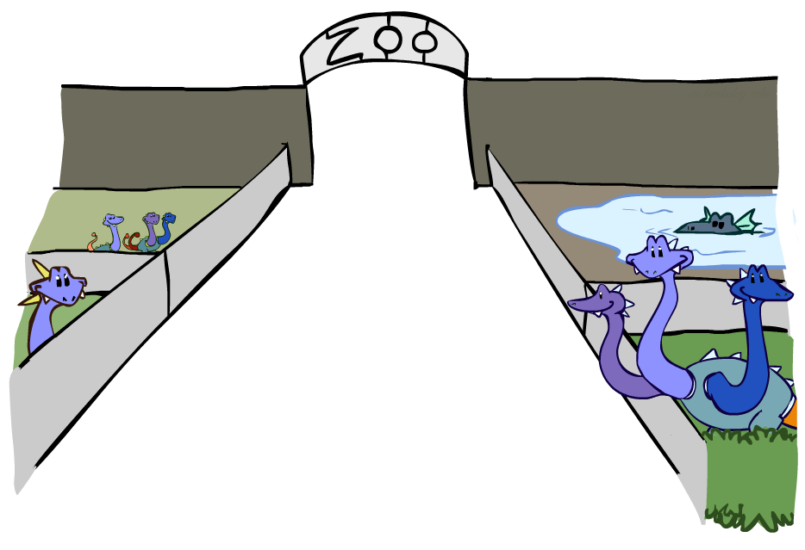
Factor Zoo

Slide 14



Factor Zoo I
Joint distribution: P(X,Y)
Entries P(x,y) for all x, y
Sums to 1
Selected joint: P(x,Y)
A slice of the joint distribution
Entries P(x,y) for fixed x, all y
Sums to P(x)
Number of capitals = dimensionality of the table
T | W | P
hot | sun | 0.4
hot | rain | 0.1
cold | sun | 0.2
cold | rain | 0.3
T | W | P
cold | sun | 0.2
cold | rain | 0.3

Slide 15
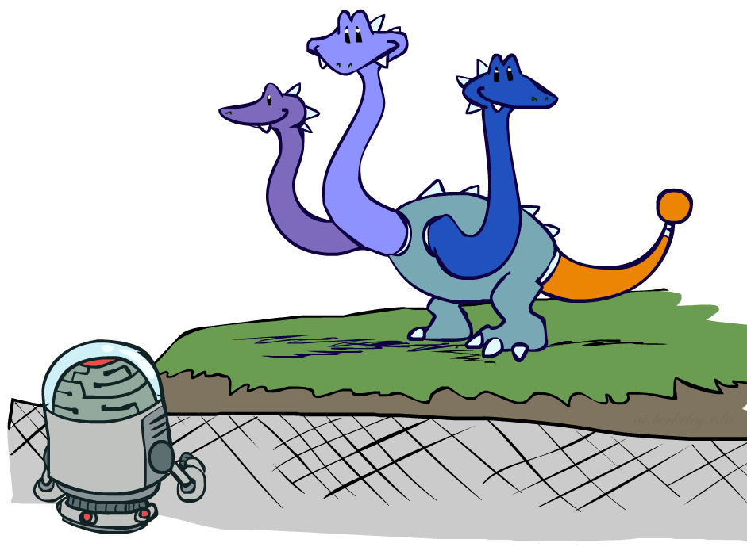

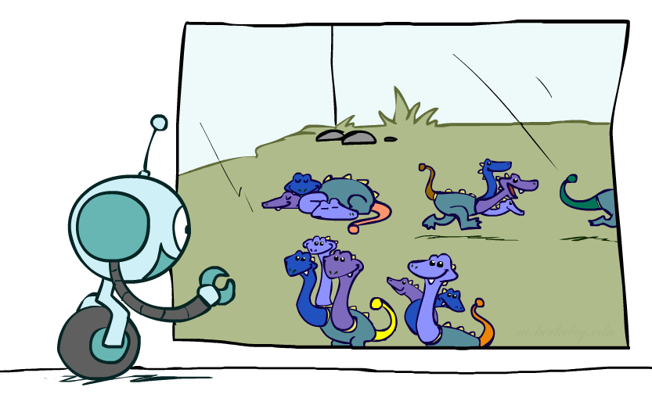



Factor Zoo II
Single conditional: P(Y | x)
Entries P(y | x) for fixed x, all y
Sums to 1
Family of conditionals:
P(X |Y)
Multiple conditionals
Entries P(x | y) for all x, y
Sums to |Y|
T | W | P
cold | sun | 0.4
cold | rain | 0.6
T | W | P
hot | sun | 0.8
hot | rain | 0.2
cold | sun | 0.4
cold | rain | 0.6

Slide 16
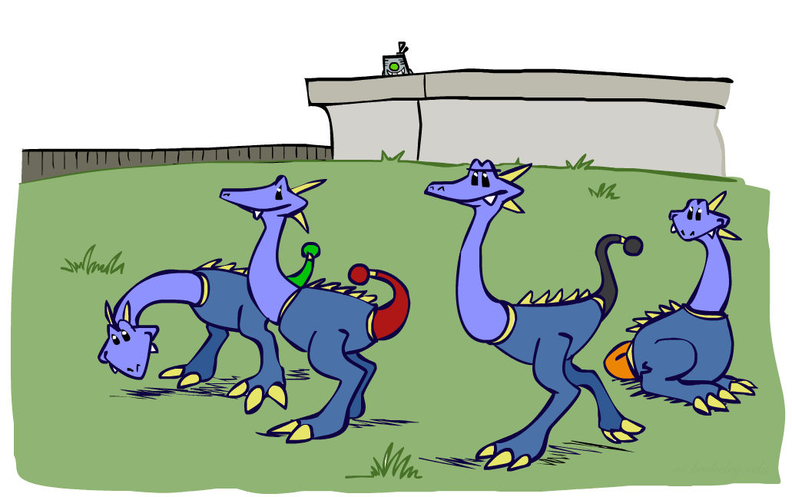



Factor Zoo III
Specified family: P( y | X )
Entries P(y | x) for fixed y,
but for all x
Sums to … who knows!
T | W | P
hot | rain | 0.2
cold | rain | 0.6

Slide 17




Factor Zoo Summary
In general, when we write P(Y₁ … Y_{N} | X₁ … X_{M})
It is a “factor,” a multi-dimensional array
Its values are P(y₁ … y_{N} | x₁ … x_{M})
Any assigned (=lower-case) X or Y is a dimension missing (selected) from the array

Slide 18


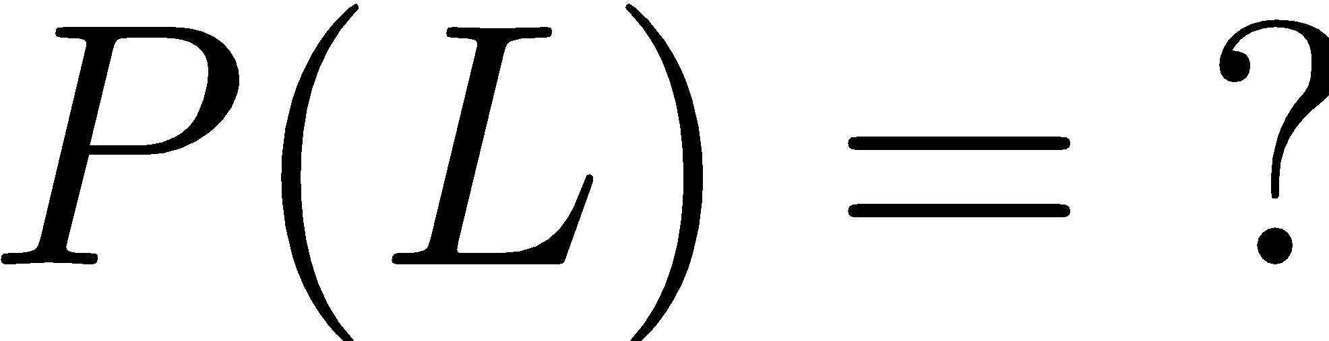
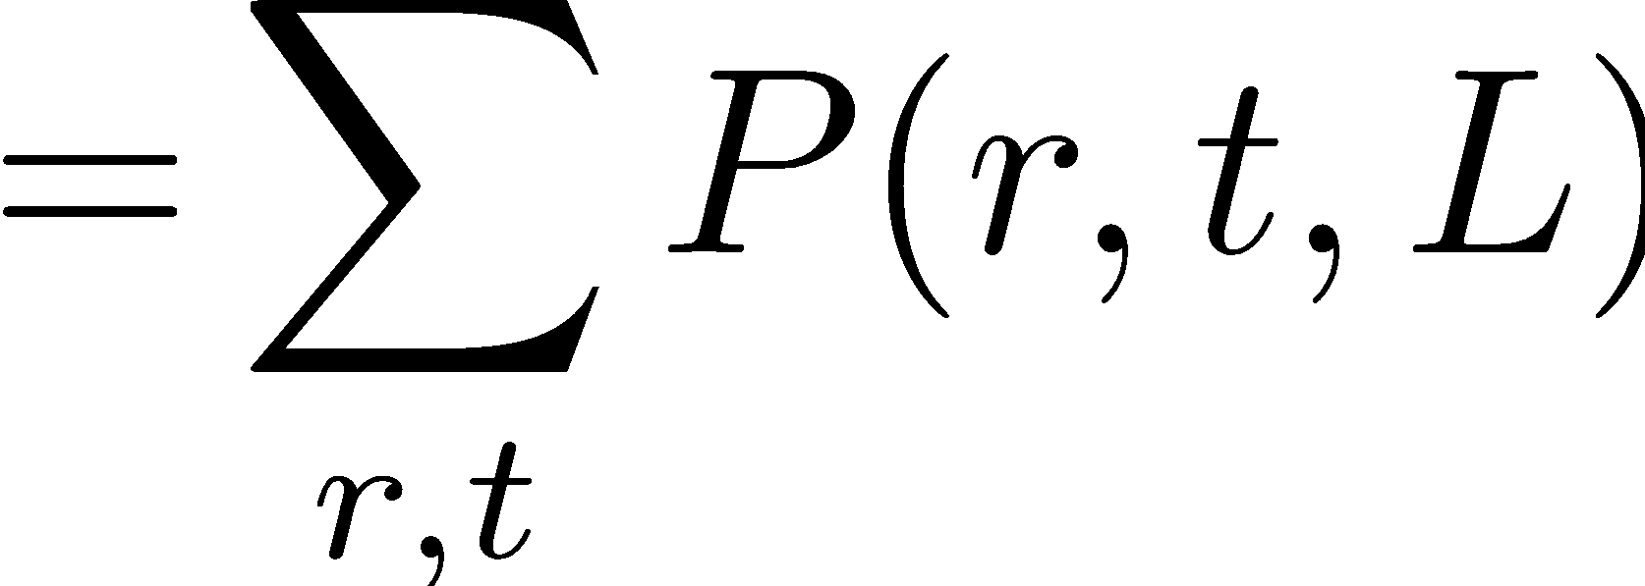

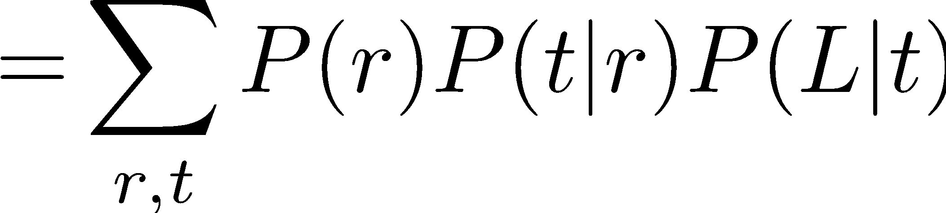
Example: Traffic Domain
Random Variables
R: Raining
T: Traffic
L: Late for class!
+r | 0.1
-r | 0.9
R
T
+r | +t | 0.8
+r | -t | 0.2
-r | +t | 0.1
-r | -t | 0.9
L
+t | +l | 0.3
+t | -l | 0.7
-t | +l | 0.1
-t | -l | 0.9

Slide 19

Variable Elimination (VE)

Slide 20







Inference by Enumeration: Procedural Outline
Track objects called factors
Initial factors are local CPTs (one per node)
Any known values are selected
E.g. if we know , the initial factors are
Procedure: Join all factors, then eliminate all hidden variables
+r | 0.1
-r | 0.9
+r | +t | 0.8
+r | -t | 0.2
-r | +t | 0.1
-r | -t | 0.9
+t | +l | 0.3
+t | -l | 0.7
-t | +l | 0.1
-t | -l | 0.9
+r | 0.1
-r | 0.9
+r | +t | 0.8
+r | -t | 0.2
-r | +t | 0.1
-r | -t | 0.9
+t | +l | 0.3
-t | +l | 0.1

Slide 21





Operation 1: Join Factors
First basic operation: joining factors
Combining factors:
Just like a database join
Get all factors over the joining variable
Build a new factor over the union of the variables involved
Example: Join on R
Computation for each entry: pointwise products
R
+r | 0.1
-r | 0.9
+r | +t | 0.8
+r | -t | 0.2
-r | +t | 0.1
-r | -t | 0.9
+r | +t | 0.08
+r | -t | 0.02
-r | +t | 0.09
-r | -t | 0.81
R,T
T

Slide 22
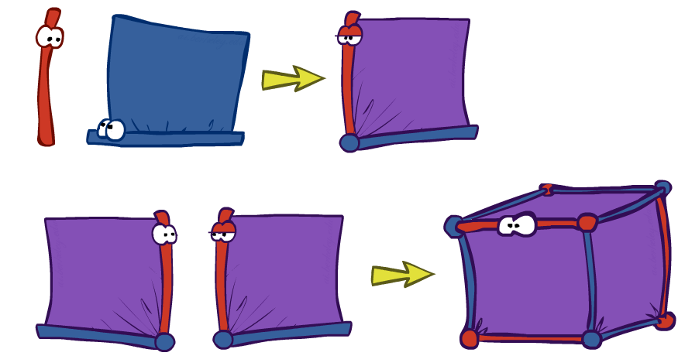
Example: Multiple Joins

Slide 23



Example: Multiple Joins
+r | 0.1
-r | 0.9
R
Join R
Join T
+r | +t | 0.08
+r | -t | 0.02
-r | +t | 0.09
-r | -t | 0.81
R, T, L
T
+r | +t | 0.8
+r | -t | 0.2
-r | +t | 0.1
-r | -t | 0.9
R, T
+r | +t | +l | 0.024
+r | +t | -l | 0.056
+r | -t | +l | 0.002
+r | -t | -l | 0.018
-r | +t | +l | 0.027
-r | +t | -l | 0.063
-r | -t | +l | 0.081
-r | -t | -l | 0.729
L
L
+t | +l | 0.3
+t | -l | 0.7
-t | +l | 0.1
-t | -l | 0.9
+t | +l | 0.3
+t | -l | 0.7
-t | +l | 0.1
-t | -l | 0.9

Slide 24
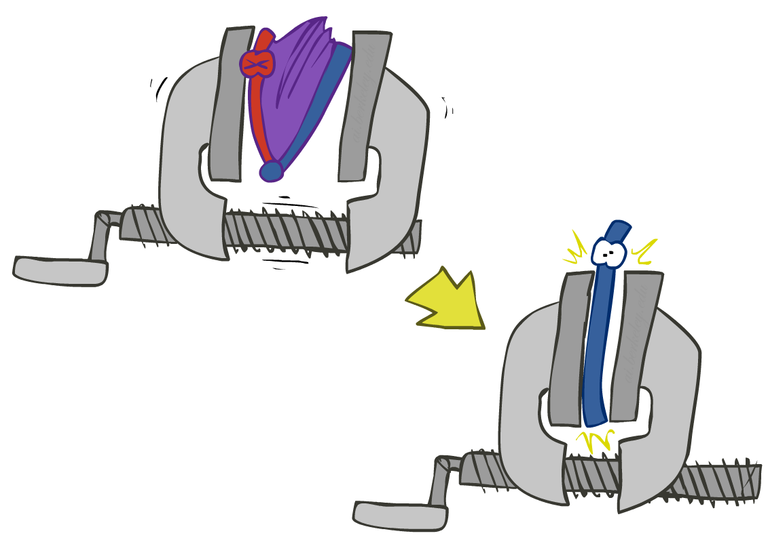


Operation 2: Eliminate
Second basic operation: marginalization
Take a factor and sum out a variable
Shrinks a factor to a smaller one
A projection operation
Example:
+r | +t | 0.08
+r | -t | 0.02
-r | +t | 0.09
-r | -t | 0.81
+t | 0.17
-t | 0.83

Slide 25



Multiple Elimination
R, T, L
T, L
L
+r | +t | +l | 0.024
+r | +t | -l | 0.056
+r | -t | +l | 0.002
+r | -t | -l | 0.018
-r | +t | +l | 0.027
-r | +t | -l | 0.063
-r | -t | +l | 0.081
-r | -t | -l | 0.729
Sum
out R
Sum
out T
+t | +l | 0.051
+t | -l | 0.119
-t | +l | 0.083
-t | -l | 0.747
+l | 0.134
-l | 0.886

Slide 26
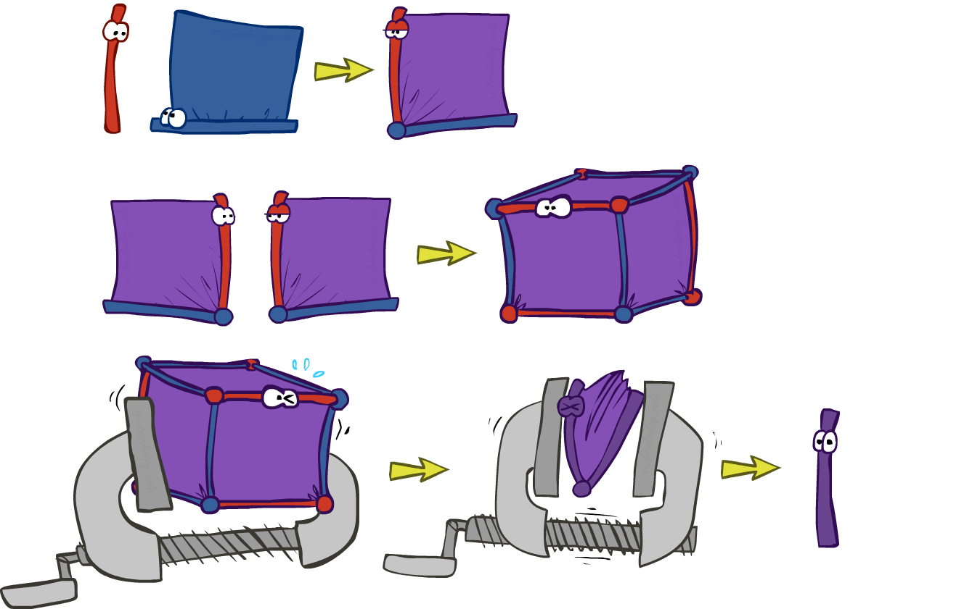
Thus Far: Multiple Join, Multiple Eliminate (= Inference by Enumeration)

Slide 27

Marginalizing Early (= Variable Elimination)

Slide 28
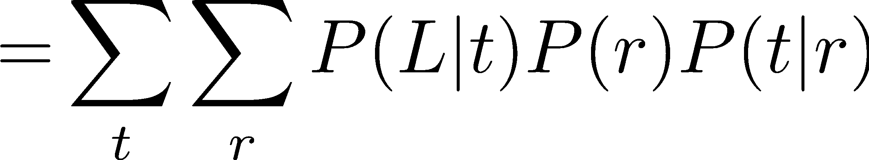
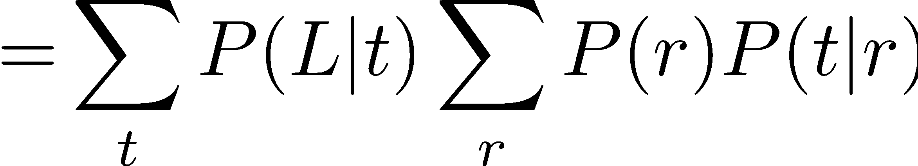
Traffic Domain
R
Inference by Enumeration
Variable Elimination
T
L
Join on r
Join on r
Join on t
Eliminate r
Eliminate r
Join on t
Eliminate t
Eliminate t

Slide 29


Marginalizing Early! (aka VE)
Join R
Sum out R
Join T
Sum out T
+r | +t | 0.08
+r | -t | 0.02
-r | +t | 0.09
-r | -t | 0.81
+r | 0.1
-r | 0.9
+t | 0.17
-t | 0.83
R
T
T, L
R, T
L
+r | +t | 0.8
+r | -t | 0.2
-r | +t | 0.1
-r | -t | 0.9
T
L
L
+t | +l | 0.051
+t | -l | 0.119
-t | +l | 0.083
-t | -l | 0.747
+l | 0.134
-l | 0.866
L
+t | +l | 0.3
+t | -l | 0.7
-t | +l | 0.1
-t | -l | 0.9
+t | +l | 0.3
+t | -l | 0.7
-t | +l | 0.1
-t | -l | 0.9
+t | +l | 0.3
+t | -l | 0.7
-t | +l | 0.1
-t | -l | 0.9

Slide 30
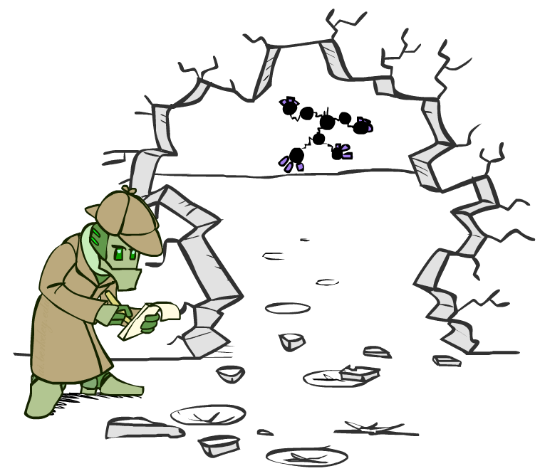



Evidence
If evidence, start with factors that select that evidence
No evidence uses these initial factors:
Computing , the initial factors become:
We eliminate all vars other than query + evidence
+r | 0.1
-r | 0.9
+r | +t | 0.8
+r | -t | 0.2
-r | +t | 0.1
-r | -t | 0.9
+t | +l | 0.3
+t | -l | 0.7
-t | +l | 0.1
-t | -l | 0.9
+r | 0.1
+r | +t | 0.8
+r | -t | 0.2
+t | +l | 0.3
+t | -l | 0.7
-t | +l | 0.1
-t | -l | 0.9

Slide 31

Evidence II
Result will be a selected joint of query and evidence
E.g. for P(L | +r), we would end up with:
To get our answer, just normalize this!
That ’s it!
Normalize
+r | +l | 0.026
+r | -l | 0.074
+l | 0.26
-l | 0.74

Slide 32

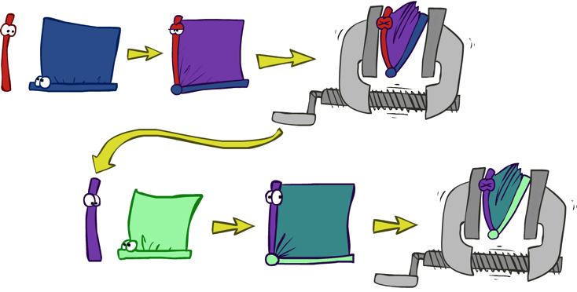


General Variable Elimination
Query:
Start with initial factors:
Local CPTs (but instantiated by evidence)
While there are still hidden variables (not Q or evidence):
Pick a hidden variable H
Join all factors mentioning H
Eliminate (sum out) H
Join all remaining factors and normalize

Slide 33
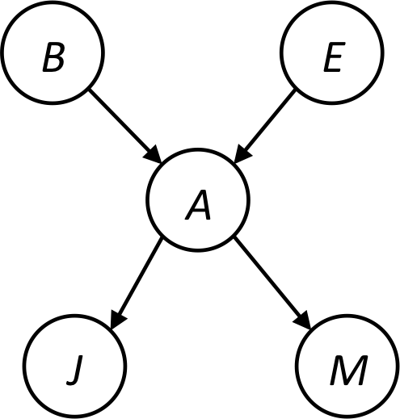









Example
Choose A

Slide 34




Example
Choose E
Finish with B
Normalize

Slide 35





Example 2: P(B|a)
Start / Select
Join on B
Normalize
B
a, B
B | P
+b | 0.1
¬b | 0.9
a
A | B | P
+a | +b | 0.08
+a | ¬b | 0.09
A | B | P
+a | +b | 8/17
+a | ¬b | 9/17
B | A | P
+b | +a | 0.8
b | ¬a | 0.2
¬b | +a | 0.1
¬b | ¬a | 0.9

Slide 36
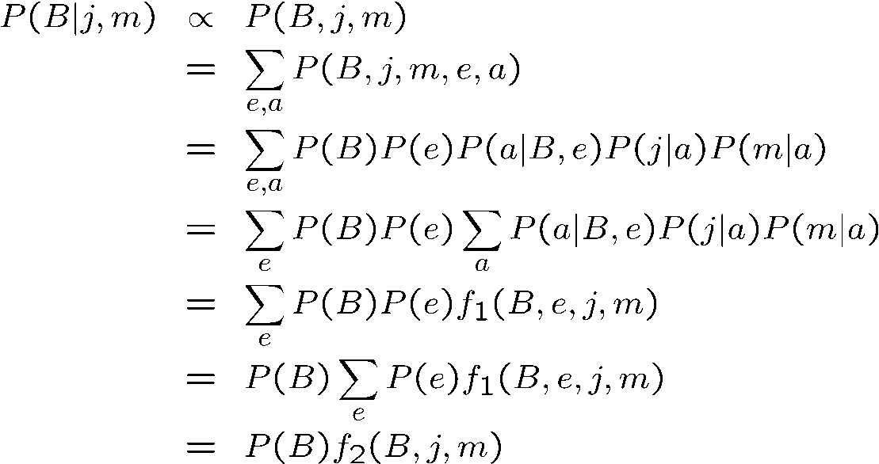
Same Example in Equations
marginal can be obtained from joint by summing out
use Bayes’ net joint distribution expression
use x*(y+z) = xy + xz
joining on a, and then summing out gives f₁
use x*(y+z) = xy + xz
joining on e, and then summing out gives f₂
All we are doing is exploiting uwy + uwz + uxy + uxz + vwy + vwz + vxy +vxz = (u+v)(w+x)(y+z) to improve computational efficiency!

Slide 37

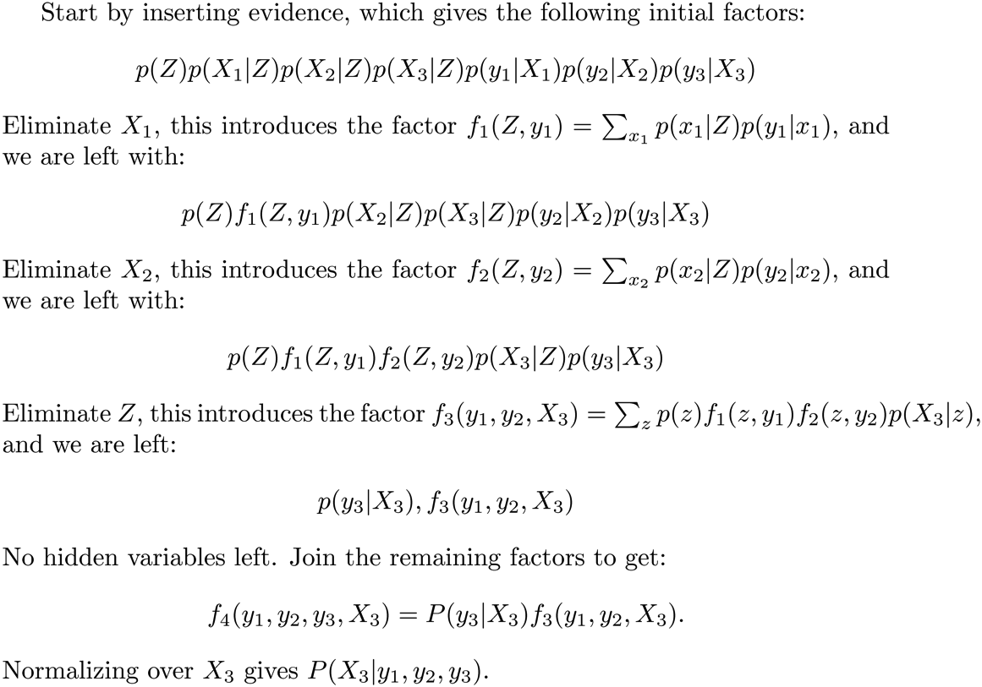






Another Variable Elimination Example
Computational complexity critically depends on the largest factor being generated in this process. Size of factor = number of entries in table. In example above (assuming binary) all factors generated are of size 2 --- as they all only have one variable (Z, Z, and X₃ respectively).

Slide 38




Variable Elimination Ordering
For the query P(X_{n}|y₁,…,y_{n}) work through the following two different orderings as done in previous slide: Z, X₁, …, X_{n-1} and X₁, …, X_{n-1}, Z. What is the size of the maximum factor generated for each of the orderings?
Answer: 2^{n+1} versus 2² (assuming binary)
In general: the ordering can greatly affect efficiency.
…
…

Slide 39
VE: Computational and Space Complexity
The computational and space complexity of variable elimination is determined by the largest factor
The elimination ordering can greatly affect the size of the largest factor.
E.g., previous slide’s example 2^{n} vs. 2
Does there always exist an ordering that only results in small factors?
No!

Slide 40















Worst Case Complexity?
CSP:
If we can answer P(z) equal to zero or not, we answered whether the 3-SAT problem has a solution.
Hence inference in Bayes’ nets is NP-hard. No known efficient probabilistic inference in general.
…
…

Slide 41
Polytrees
A polytree is a directed graph with no undirected cycles
For poly-trees you can always find an ordering that is efficient
Try it!!
Cut-set conditioning for Bayes’ net inference
Choose set of variables such that if removed only a polytree remains
Exercise: Think about how the specifics would work out!

Slide 42

Bayes’ Nets
Representation
Conditional Independences
Probabilistic Inference
Enumeration (exact, exponential complexity)
Variable elimination (exact, worst-case exponential complexity, often better)
Inference is NP-complete
Sampling (approximate)
Learning Bayes’ Nets from Data

