Slide 1
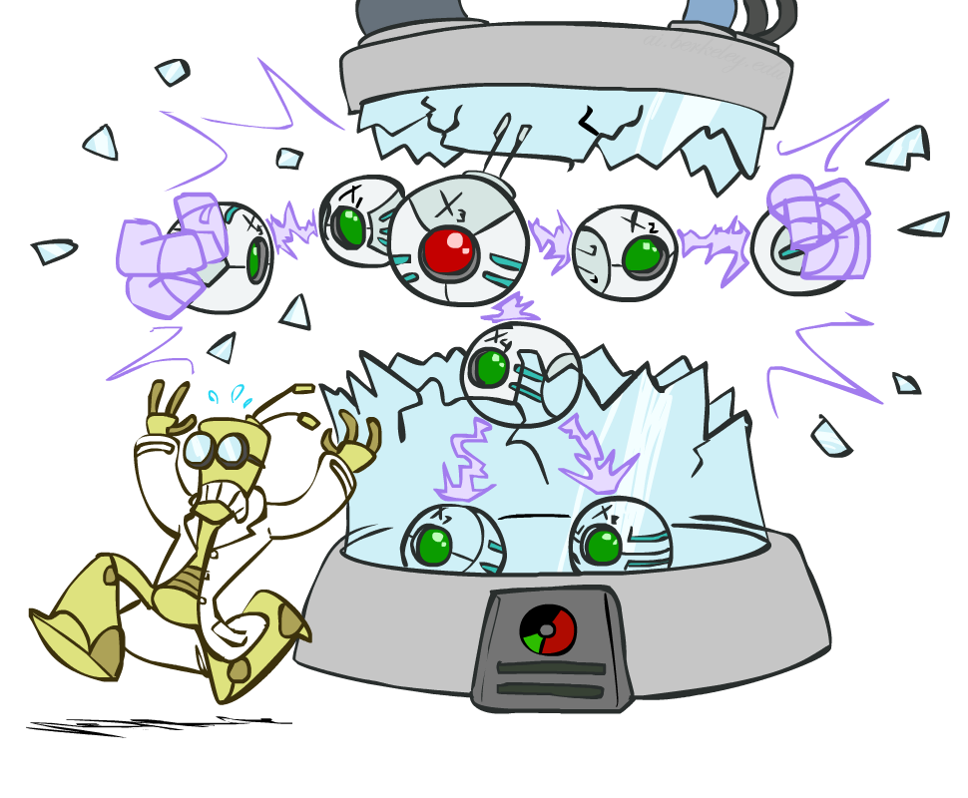
CS 370: Artificial Intelligence
Bayes’ Nets: Independence
Instructor: William DeMeo --- NJIT
[slides created by Dan Klein and Pieter Abbeel for CS188 at UC Berkeley; provided courtesy of ai.berkeley.edu.]
Notes:
Please retain proper attribution, including the reference to ai.berkeley.edu. Thanks!

Slide 2
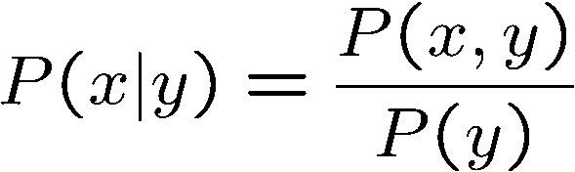

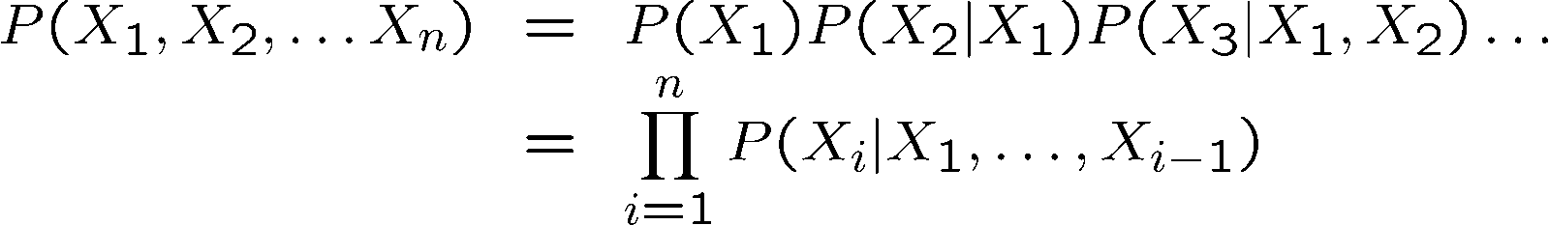

Probability Recap
Conditional probability
Product rule
Chain rule
X, Y independent if and only if:
X and Y are conditionally independent given Z if and only if:

Slide 3
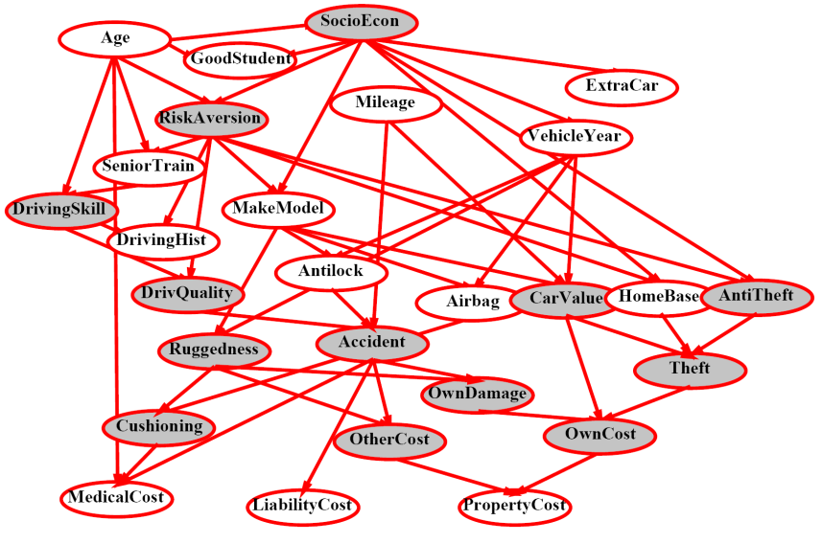
Bayes’ Nets
A Bayes’ net is an
efficient encoding
of a probabilistic
model of a domain
Questions we can ask:
Inference: given a fixed BN, what is P(X | e)?
Representation: given a BN graph, what kinds of distributions can it encode?
Modeling: what BN is most appropriate for a given domain?

Slide 4
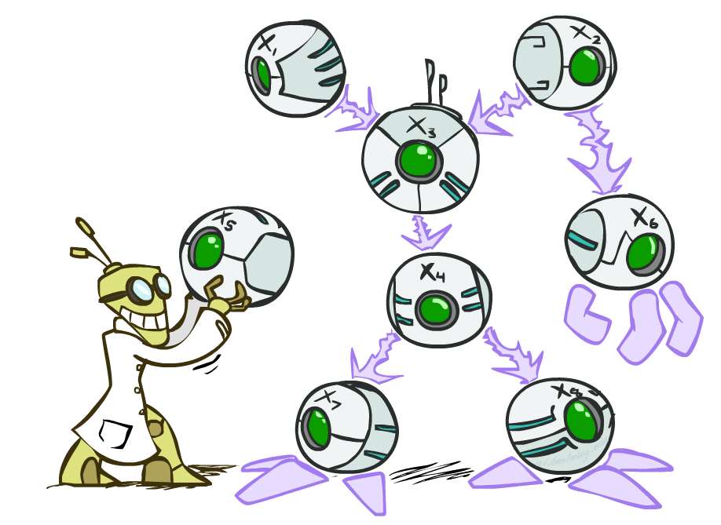

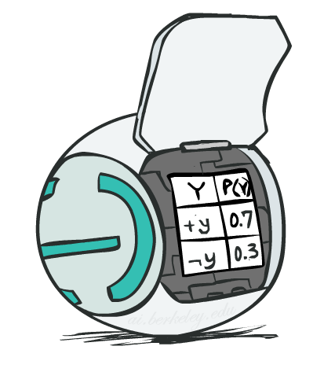
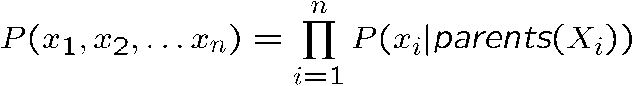
Bayes’ Net Semantics
A directed, acyclic graph, one node per random variable
A conditional probability table (CPT) for each node
A collection of distributions over X, one for each combination of parents’ values
Bayes’ nets implicitly encode joint distributions
As a product of local conditional distributions
To see what probability a BN gives to a full assignment, multiply all the relevant conditionals together:

Slide 5
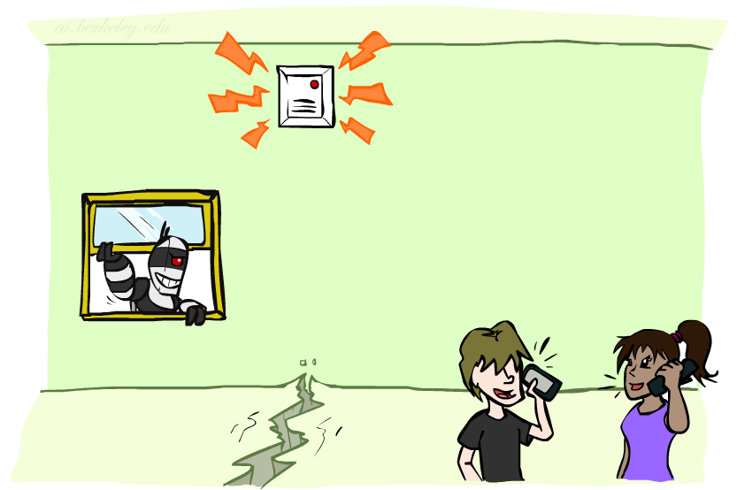
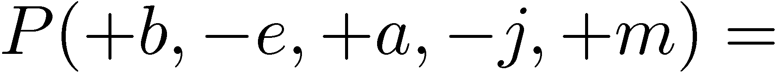
Example: Alarm Network
B | P(B)
+b | 0.001
-b | 0.999
E | P(E)
+e | 0.002
-e | 0.998
B
E
A
A | J | P(J|A)
+a | +j | 0.9
+a | -j | 0.1
-a | +j | 0.05
-a | -j | 0.95
A | M | P(M|A)
+a | +m | 0.7
+a | -m | 0.3
-a | +m | 0.01
-a | -m | 0.99
B | E | A | P(A|B,E)
+b | +e | +a | 0.95
+b | +e | -a | 0.05
+b | -e | +a | 0.94
+b | -e | -a | 0.06
-b | +e | +a | 0.29
-b | +e | -a | 0.71
-b | -e | +a | 0.001
-b | -e | -a | 0.999
J
M
Notes:
demo

Slide 6

Example: Alarm Network
B | P(B)
+b | 0.001
-b | 0.999
E | P(E)
+e | 0.002
-e | 0.998
B
E
A
A | J | P(J|A)
+a | +j | 0.9
+a | -j | 0.1
-a | +j | 0.05
-a | -j | 0.95
A | M | P(M|A)
+a | +m | 0.7
+a | -m | 0.3
-a | +m | 0.01
-a | -m | 0.99
B | E | A | P(A|B,E)
+b | +e | +a | 0.95
+b | +e | -a | 0.05
+b | -e | +a | 0.94
+b | -e | -a | 0.06
-b | +e | +a | 0.29
-b | +e | -a | 0.71
-b | -e | +a | 0.001
-b | -e | -a | 0.999
J
M
Notes:
demo

Slide 7

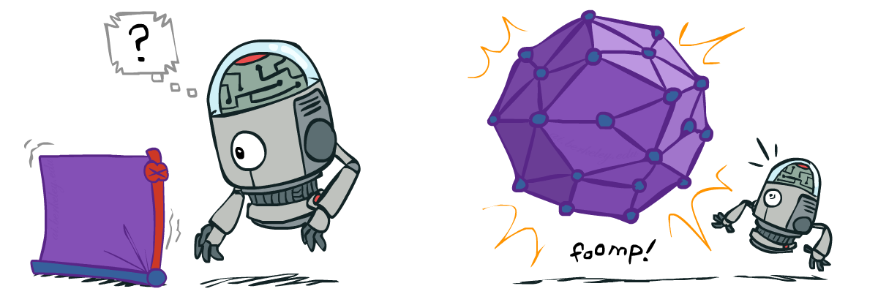
Size of a Bayes’ Net
How big is a joint distribution over N Boolean variables?
2^{N}
How big is an N-node net if nodes have up to k parents?
O(N * 2^{k+1})
Both give you the power to calculate
BNs: Huge space savings!
Also easier to elicit local CPTs
Also faster to answer queries (coming)

Slide 8

Bayes’ Nets
Representation
Conditional Independences
Probabilistic Inference
Learning Bayes’ Nets from Data

Slide 9

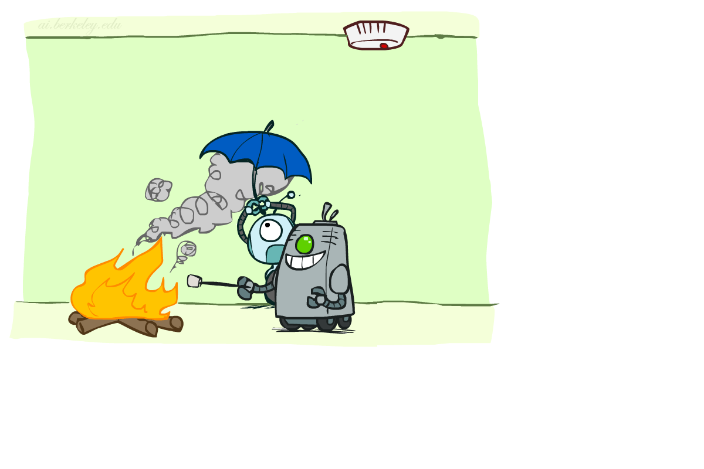

Conditional Independence
X and Y are independent if
X and Y are conditionally independent given Z
(Conditional) independence is a property of a distribution
Example:

Slide 10
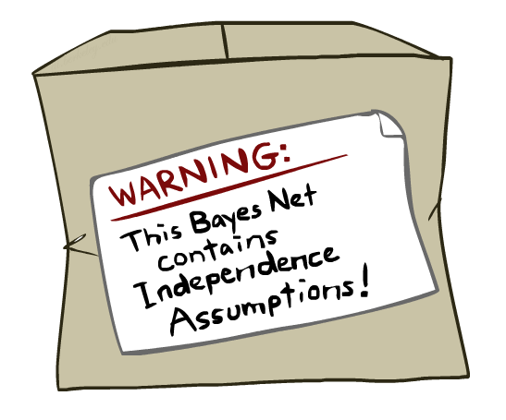
Bayes Nets: Assumptions
Assumptions we are required to make to define the Bayes net when given the graph:
Beyond above “chain rule 🡪 Bayes net” conditional independence assumptions
Often additional conditional independences
They can be read off the graph
Important for modeling: understand assumptions made when choosing a Bayes net graph
Notes:
Important for modeling: understanding which assumptions you are making!

Slide 11
Example
X
Y
Z
W
Conditional independence assumptions directly from simplifications in chain rule:
Additional implied conditional independence assumptions?

Slide 12
Independence in a BN
Important question about a BN:
Are two nodes independent given certain evidence?
If yes, can prove using algebra (tedious in general)
If no, can prove with a counter example
Example:
Question: are X and Z necessarily independent?
Answer: no. Example: low pressure causes rain, which causes traffic.
X can influence Z, Z can influence X (via Y)
Addendum: they could be independent: how?
X
Y
Z

Slide 13
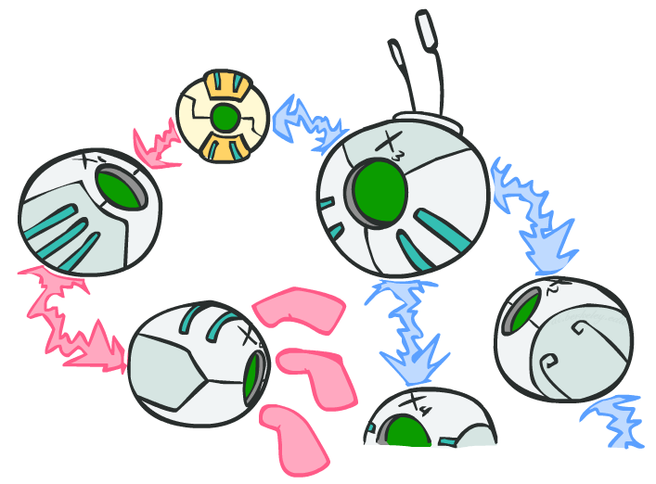
D-separation: Outline

Slide 14
D-separation: Outline
Study independence properties for triples
Analyze complex cases in terms of member triples
D-separation: a condition / algorithm for answering such queries

Slide 15
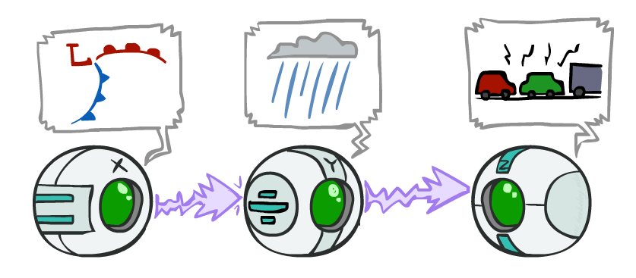
Causal Chains
This configuration is a “causal chain”
Guaranteed X independent of Z ? No!
One example set of CPTs for which X is not independent of Z is sufficient to show this independence is not guaranteed.
Example:
Low pressure causes rain causes traffic,
high pressure causes no rain causes no
traffic
In numbers:
P( +y | +x ) = 1, P( -y | - x ) = 1,
P( +z | +y ) = 1, P( -z | -y ) = 1
X: Low pressure Y: Rain Z: Traffic

Slide 16
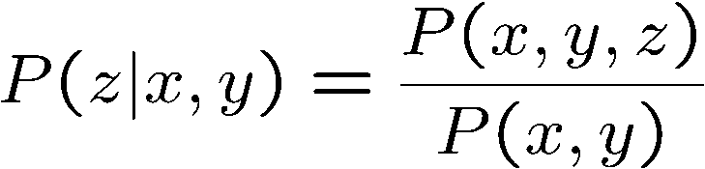
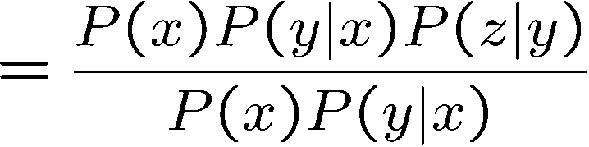

Causal Chains
This configuration is a “causal chain”
Guaranteed X independent of Z given Y?
Evidence along the chain “blocks” the influence
X: Low pressure Y: Rain Z: Traffic
Yes!

Slide 17
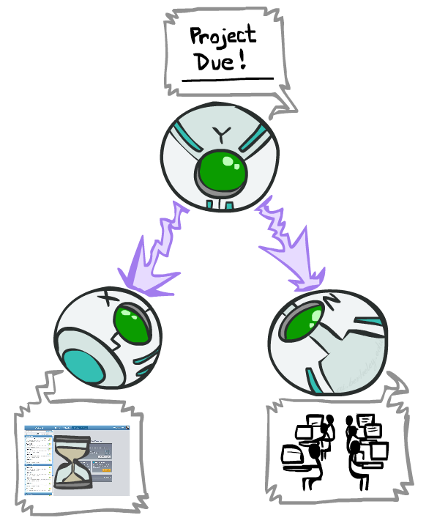
Common Cause
This configuration is a “common cause”
Guaranteed X independent of Z ? No!
One example set of CPTs for which X is not independent of Z is sufficient to show this independence is not guaranteed.
Example:
Project due causes both forums busy
and lab full
In numbers:
P( +x | +y ) = 1, P( -x | -y ) = 1,
P( +z | +y ) = 1, P( -z | -y ) = 1
Y: Project due
X: Forums busy
Z: Lab full

Slide 18
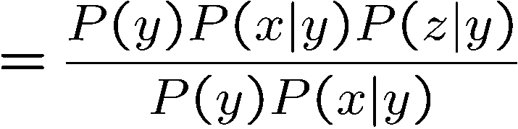
Common Cause
This configuration is a “common cause”
Guaranteed X and Z independent given Y?
Observing the cause blocks influence between effects.
Y: Project due
X: Forums busy
Z: Lab full
Yes!

Slide 19
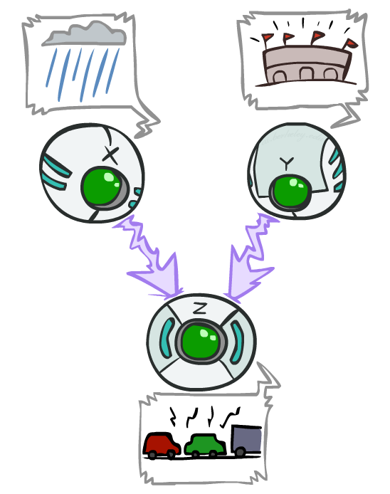
Common Effect
Last configuration: two causes of one effect (v-structures)
Are X and Y independent?
Yes: the ballgame and the rain cause traffic, but they are not correlated
Still need to prove they must be (try it!)
Are X and Y independent given Z?
No: seeing traffic puts the rain and the ballgame in competition as explanation.
This is backwards from the other cases
Observing an effect activates influence between possible causes.
X: Raining
Y: Ballgame
Z: Traffic

Slide 20
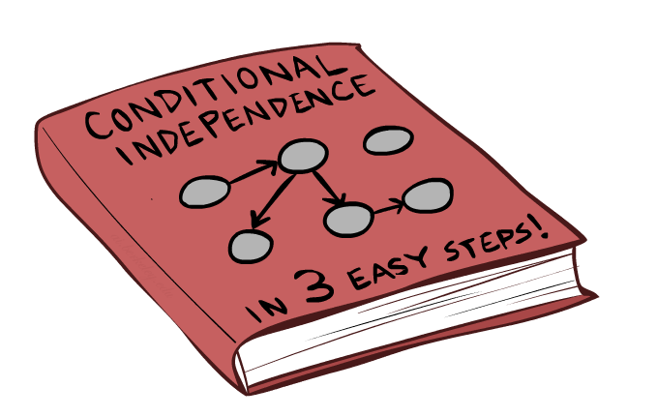
The General Case

Slide 21
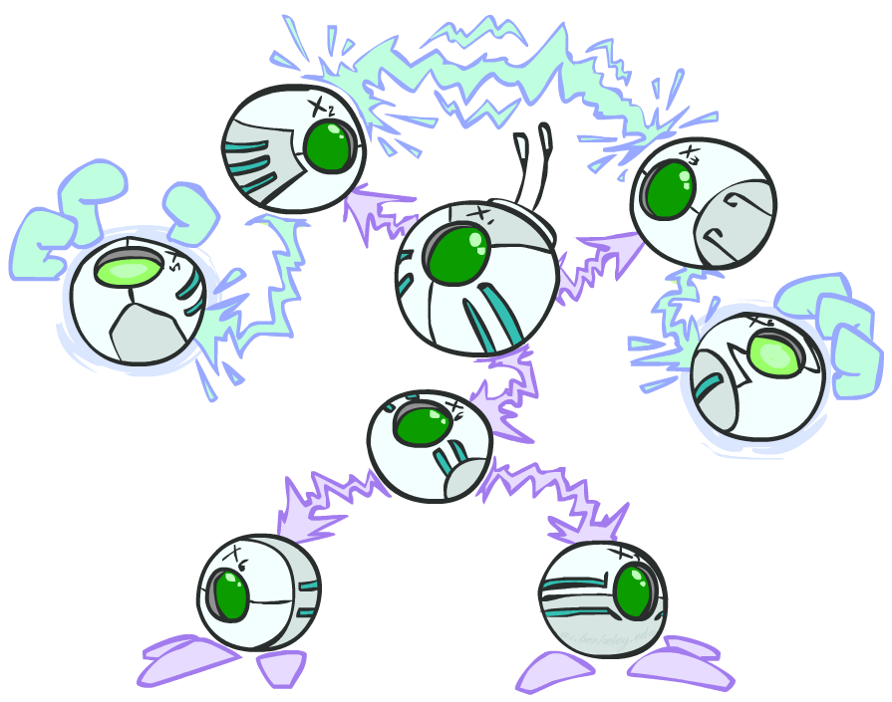
The General Case
General question: in a given BN, are two variables independent (given evidence)?
Solution: analyze the graph
Any complex example can be broken
into repetitions of the three canonical cases

Slide 22

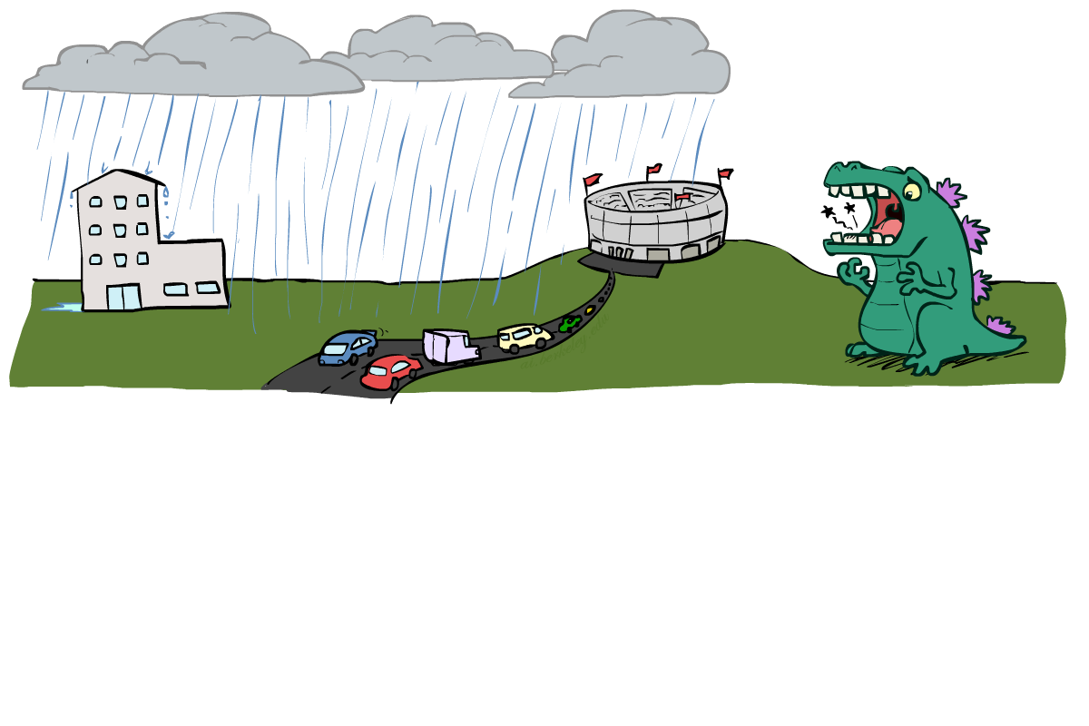
Reachability
L
Recipe: shade evidence nodes, look for paths in the resulting graph
Attempt 1: if two nodes are connected by an undirected path not blocked by a shaded node, they are conditionally independent
Almost works, but not quite
Where does it break?
Answer: the v-structure at T doesn’t count as a link in a path unless “active”
R
B
D
T

Slide 23
Active / Inactive Paths
Question: Are X and Y conditionally independent given evidence variables {Z}?
Yes, if X and Y “d-separated” by Z
Consider all (undirected) paths from X to Y
No active paths = independence!
A path is active if each triple is active:
Causal chain A → B → C where B is unobserved (either direction)
Common cause A ← B → C where B is unobserved
Common effect (aka v-structure)
A → B ← C where B or one of its descendents is observed
All it takes to block a path is a single inactive segment
Active Triples
Inactive Triples

Slide 24
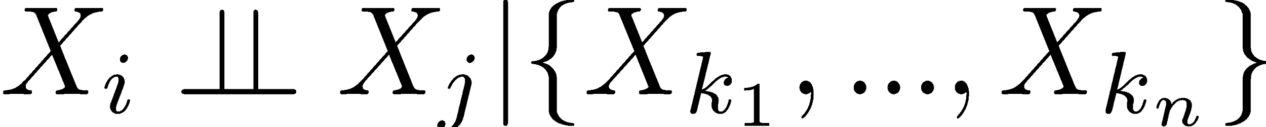
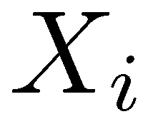
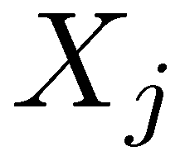

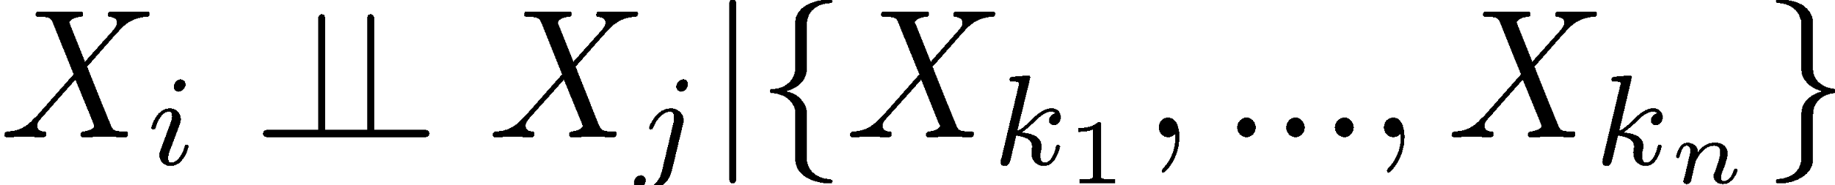
D-Separation
?
Query:
Check all (undirected!) paths between and
If one or more active, then independence not guaranteed
Otherwise (i.e. if all paths are inactive),
then independence is guaranteed

Slide 25


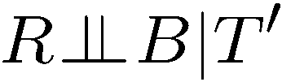
Example
Yes
R
B
T
T’
Notes:
T’: traffic report

Slide 26
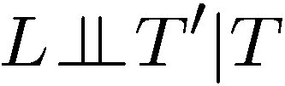


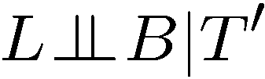

Example
L
Yes
R
B
Yes
D
T
Yes
T’

Slide 27



Example
Variables:
R: Raining
T: Traffic
D: Roof drips
S: I’m sad
Questions:
R
T
D
S
Yes

Slide 28

Structure Implications
Given a Bayes net structure, can run d-separation algorithm to build a complete list of conditional independences that are necessarily true of the form
This list determines the set of probability distributions that can be represented

Slide 29

Computing All Independences
Y
X
Z
Y
X
Z
X
Z
Y
Y
X
Z

Slide 30
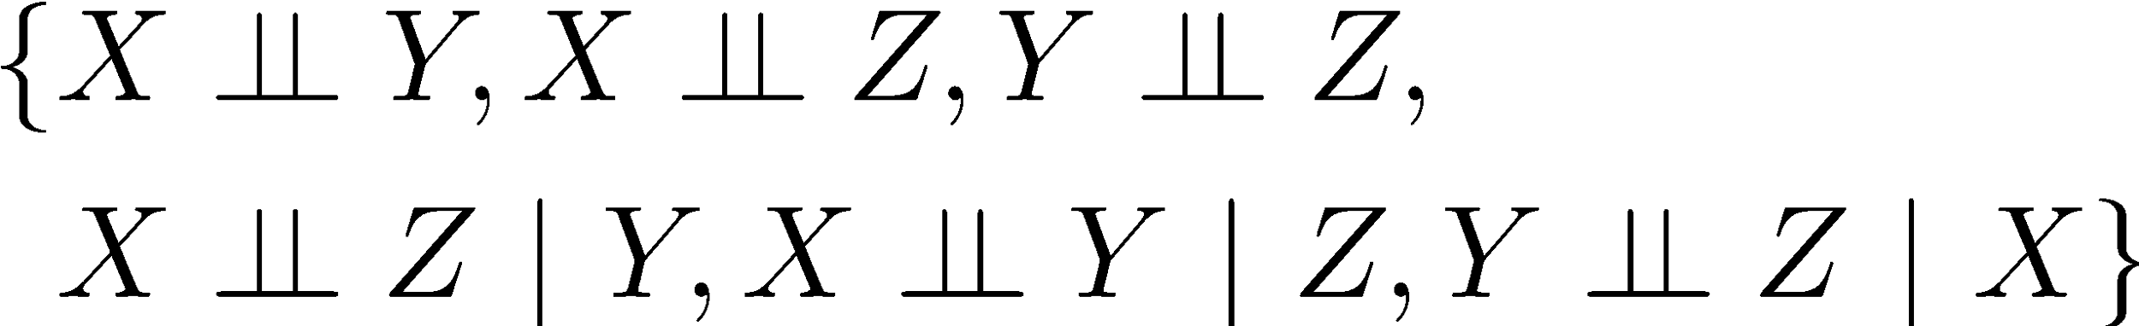
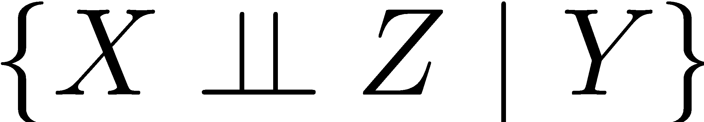

Topology Limits Distributions
Given some graph topology G, only certain joint distributions can be encoded
The graph structure guarantees certain (conditional) independences
(There might be more independence)
Adding arcs increases the set of distributions, but has several costs
Full conditioning can encode any distribution
Y
Y
X
Z
X
Z
Y
X
Z
Y
X
Z
Y
Y
Y
X
Z
X
Z
X
Z
Y
Y
Y
X
Z
X
Z
X
Z

Slide 31
Bayes Nets Representation Summary
Bayes nets compactly encode joint distributions
Guaranteed independencies of distributions can be deduced from BN graph structure
D-separation gives precise conditional independence guarantees from graph alone
A Bayes’ net’s joint distribution may have further (conditional) independence that is not detectable until you inspect its specific distribution

Slide 32
Bayes’ Nets
Representation
Conditional Independences
Probabilistic Inference
Enumeration (exact, exponential complexity)
Variable elimination (exact, worst-case
exponential complexity, often better)
Probabilistic inference is NP-complete
Sampling (approximate)
Learning Bayes’ Nets from Data

Slide 33

Have a great Spring Break!

