Slide 1
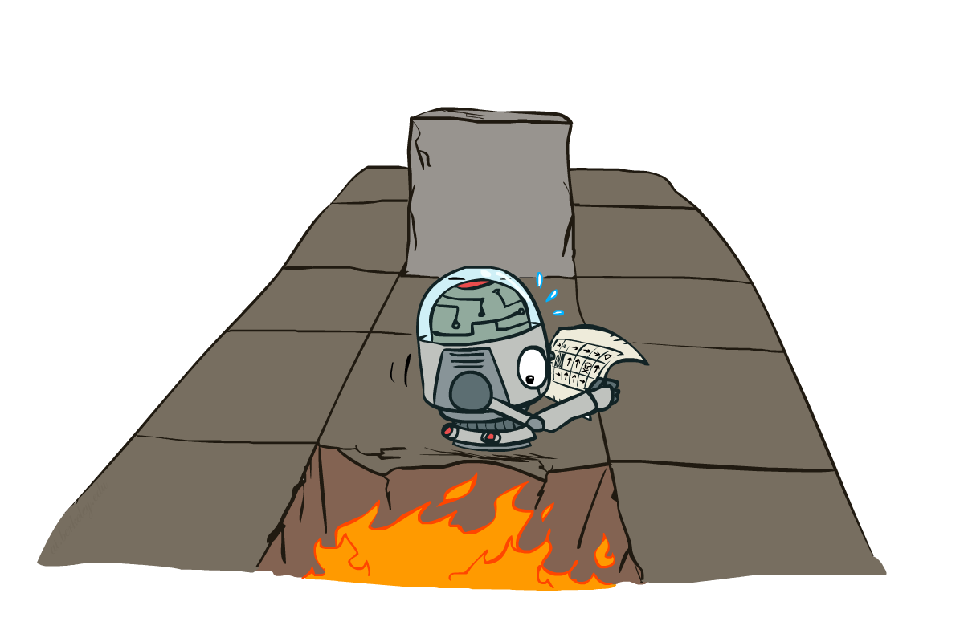
CS 370: Artificial Intelligence
Markov Decision Processes II
Instructor: William DeMeo, New Jersey Institute of Technology
[slides created by Dan Klein and Pieter Abbeel for CS188 at UC Berkeley; provided courtesy of http://ai.berkeley.edu.]
Notes:
Please retain proper attribution, including the reference to ai.berkeley.edu. Thanks!

Slide 2
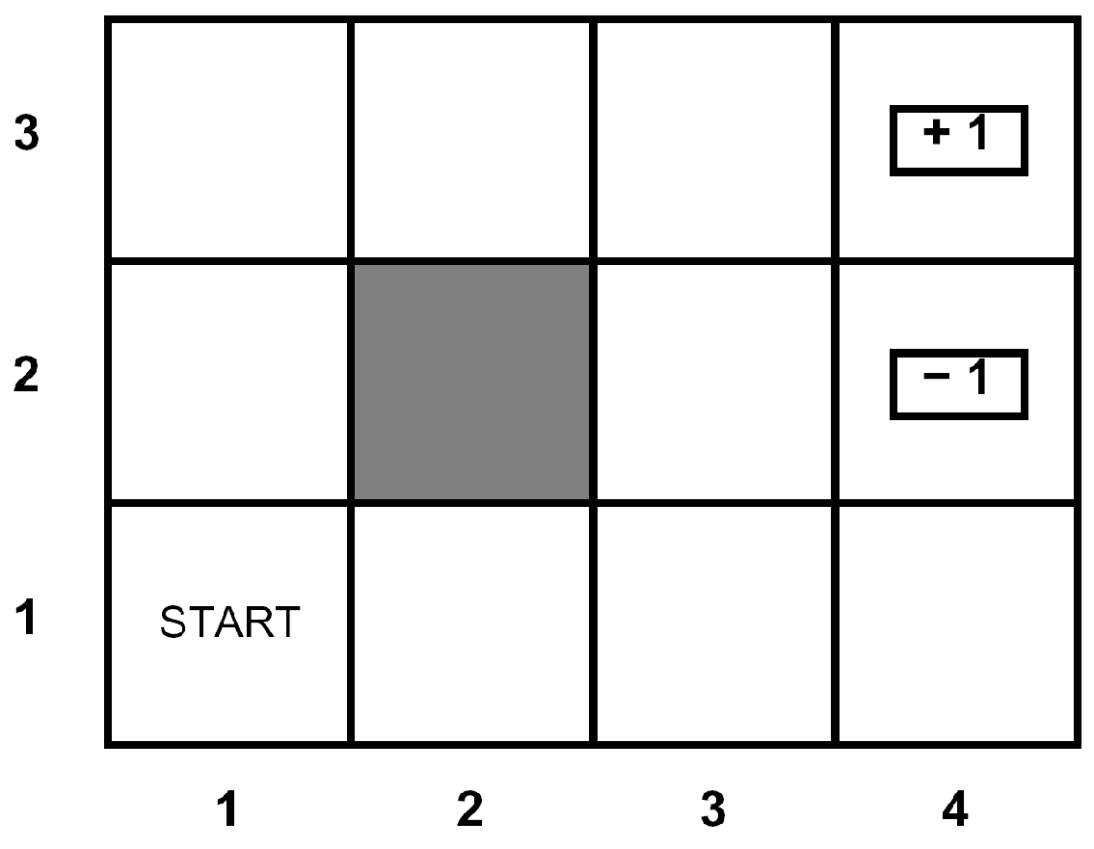
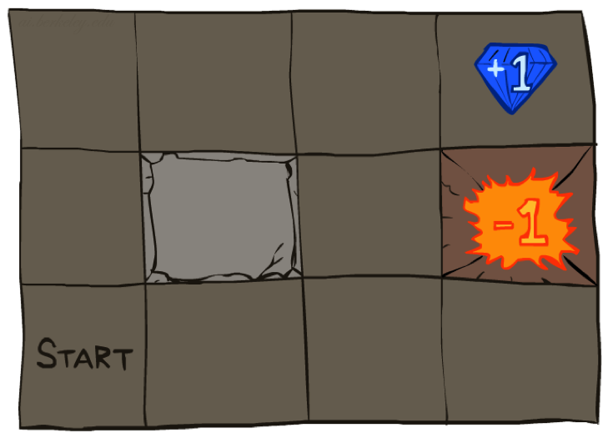




Example: Grid World
A maze-like problem
The agent lives in a grid
Walls block the agent’s path
Noisy movement: actions do not always go as planned
80% of the time, the action North takes the agent North
10% of the time, North takes the agent West; 10% East
If there is a wall in the direction the agent would have been taken, the agent stays put
The agent receives rewards each time step
Small “living” reward each step (can be negative)
Big rewards come at the end (good or bad)
Goal: maximize sum of (discounted) rewards
Notes:
[cut demo of moving around in grid world program]

Slide 3
Recap: MDPs
Markov decision processes:
States S
Actions A
Transitions P(s’|s,a) (or T(s,a,s’))
Rewards R(s,a,s’) (and discount γ)
Start state s₀
Quantities:
Policy = map of states to actions
Utility = sum of discounted rewards
Values = expected future utility from a state (max node)
Q-Values = expected future utility from a q-state (chance node)
s
a
s, a
s,a,s’
s’

Slide 4
Optimal Quantities
The value (utility) of a state s:
V*(s) = expected utility starting in s and acting optimally
The value (utility) of a q-state (s,a):
Q*(s,a) = expected utility starting out having taken action a from state s and (thereafter) acting optimally
The optimal policy:
π*(s) = optimal action from state s
s
s is a state
a
(s, a) is a q-state
s, a
s,a,s’
(s,a,s’) is a transition
s’
[Demo: gridworld values (L9D1)]
Notes:
Demo just shows V and Q values, snapshots on next slides.

Slide 5
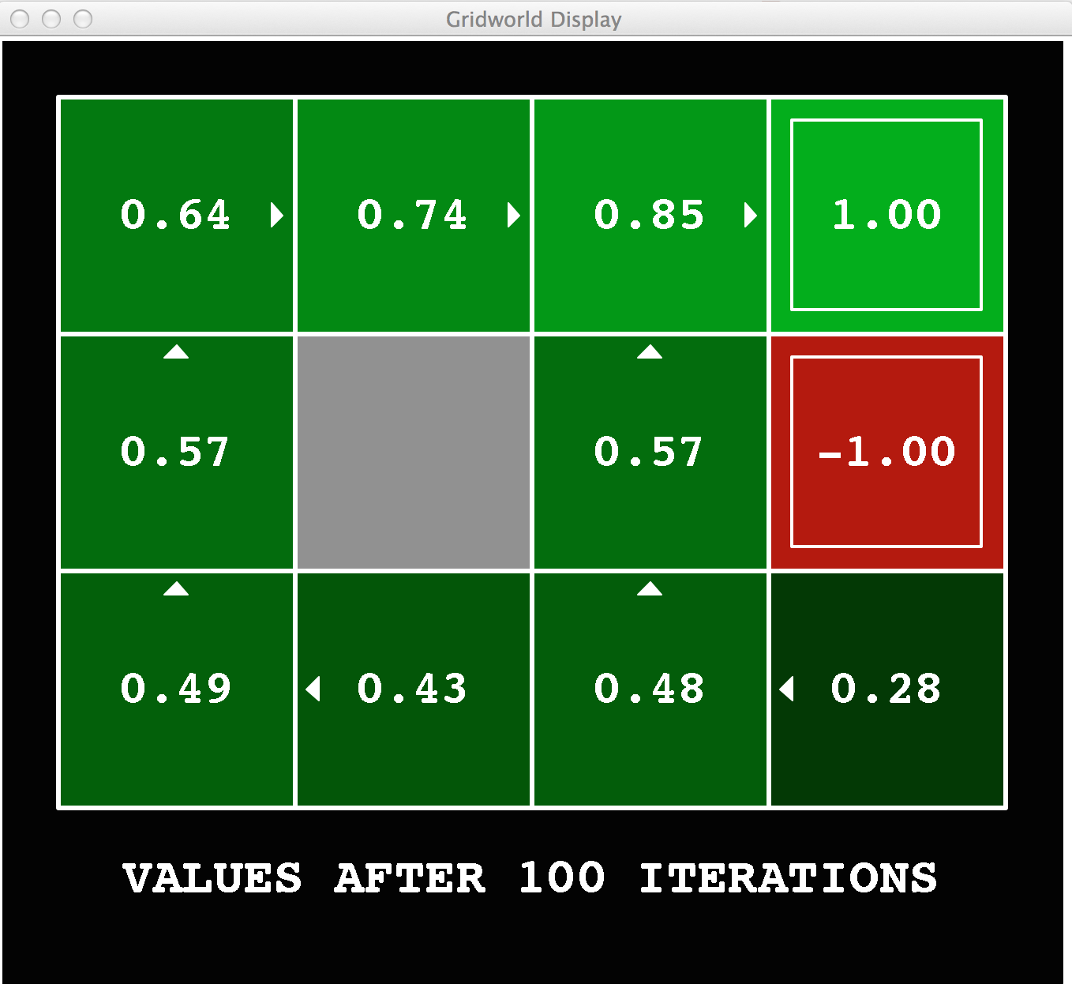
Gridworld Values V*

Slide 6
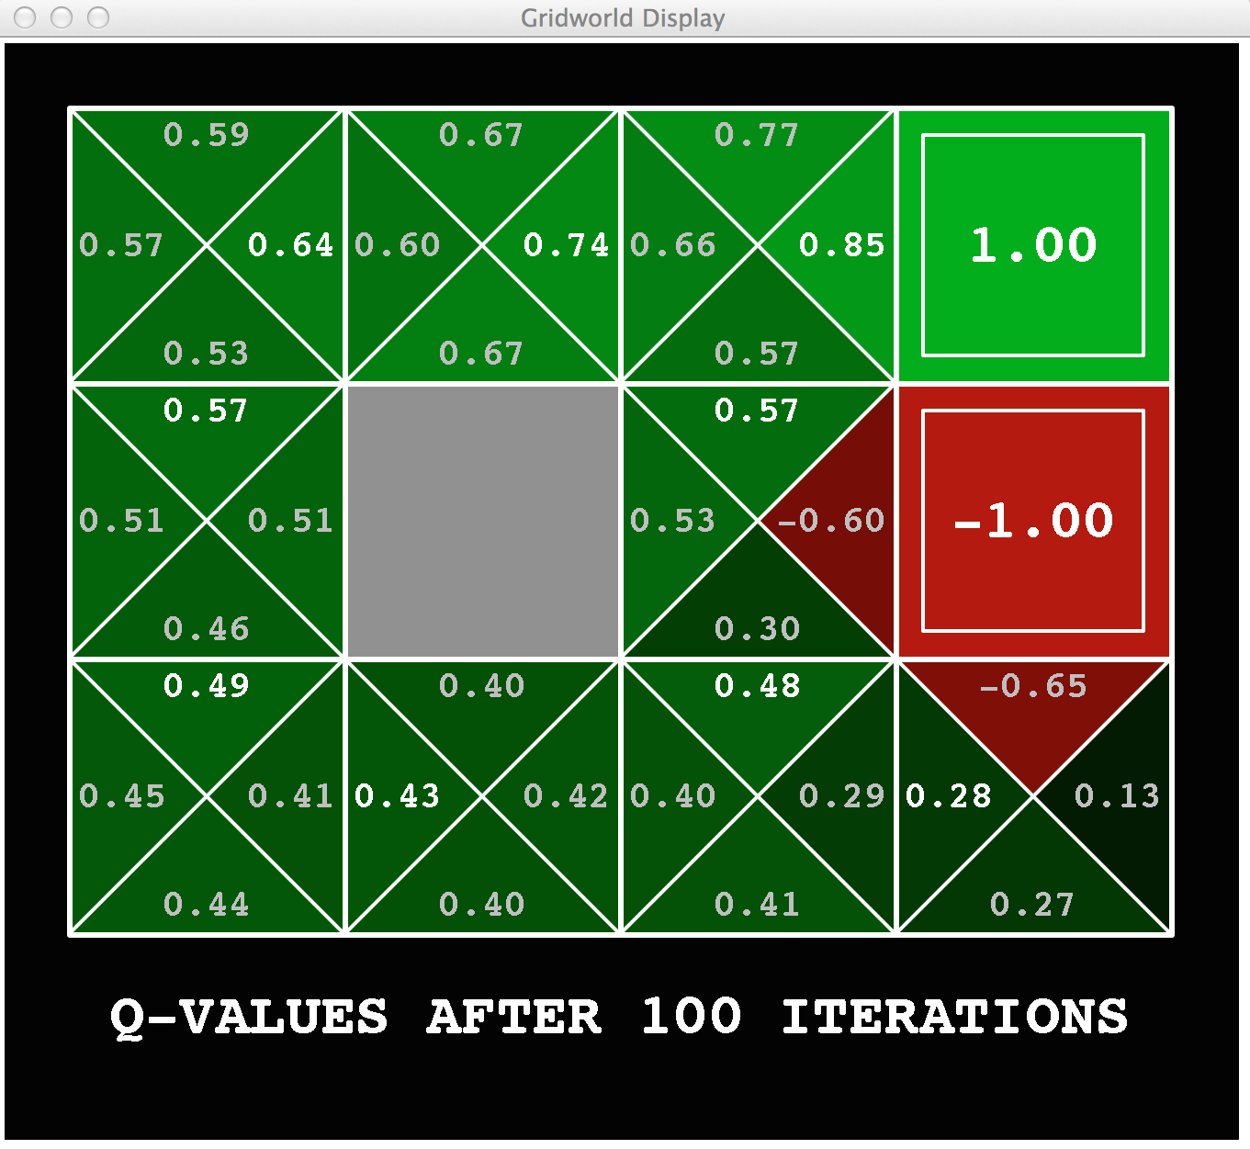
Gridworld: Q*

Slide 7

The Bellman Equations
How to be optimal:
Step 1: Take correct first action
Step 2: Keep being optimal

Slide 8

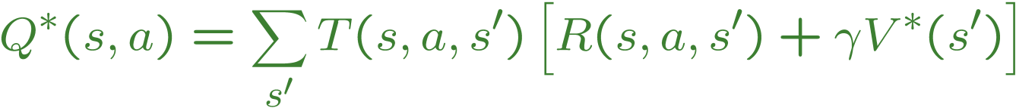
The Bellman Equations
Definition of “optimal utility” via expectimax recurrence gives a simple one-step lookahead relationship amongst optimal utility values
These are the Bellman equations, and they characterize optimal values in a way we’ll use over and over
s
a
s, a
s,a,s’
s’
Notes:
Let’s start by equations that characterize these quantities through mutual recursions. [step through this by writing on slide, one step at a time]
Recursive characterization of V* in terms of V*; not necessarily helpful; but it is a characterization.
Note: this is a set of equations that needs to be satisfied; but it could have multiple solutions (it does not, but at this stage of our knowledge it could).

Slide 9
Value Iteration
Bellman equations characterize the optimal values:
Value iteration computes them:
Value iteration is just a fixed point solution method
… though the V_{k} vectors are also interpretable as time-limited values
V(s)
a
s, a
s,a,s’
V(s’)
Notes:
Discuss computational complexity: S * A * S times number of iterations
Note: updates not in place [if in place, it means something else and not even clear what it means]

Slide 10
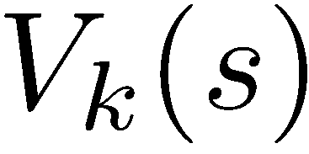
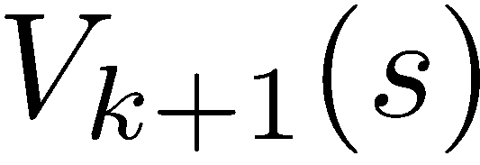
Convergence*
How do we know the V_{k} vectors are going to converge?
Case 1: If the tree has maximum depth M, then V_{M} holds the actual untruncated values
Case 2: If the discount is less than 1
Sketch: For any state V_{k} and V_{k+1} can be viewed as depth k+1 expectimax results in nearly identical search trees
The difference is that on the bottom layer, V_{k+1} has actual rewards while V_{k} has zeros
That last layer is at best all R_{MAX}
It is at worst R_{MIN}
But everything is discounted by γ^{k} that far out
So V_{k} and V_{k+1} are at most γ^{k} max|R| different
So as k increases, the values converge

Slide 11
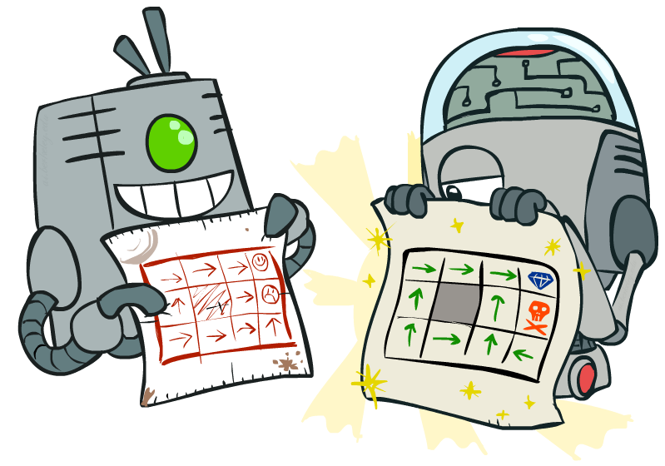
Policy Methods

Slide 12
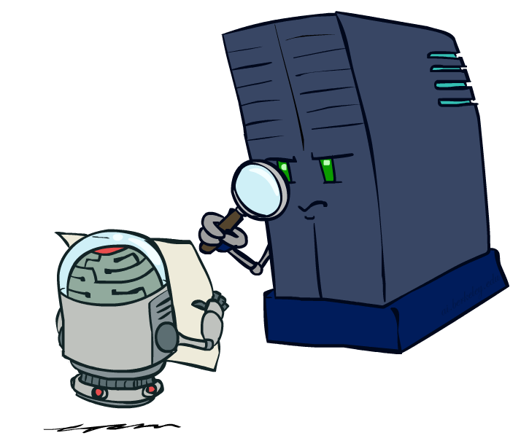
Policy Evaluation

Slide 13
Fixed Policies
Do the optimal action
Do what π says to do
s
s
a
π(s)
s, a
s, π(s)
s,a,s’
s, π(s),s’
s’
s’
Expectimax trees max over all actions to compute the optimal values
If we fixed some policy π(s), then the tree would be simpler – only one action per state
… though the tree’s value would depend on which policy we fixed

Slide 14
Utilities for a Fixed Policy
Another basic operation: compute the utility of a state s under a fixed (generally non-optimal) policy
Define the utility of a state s, under a fixed policy π:
V^{π}(s) = expected total discounted rewards starting in s and following π
Recursive relation (one-step look-ahead / Bellman equation):
s
π(s)
s, π(s)
s, π(s),s’
s’

Slide 15
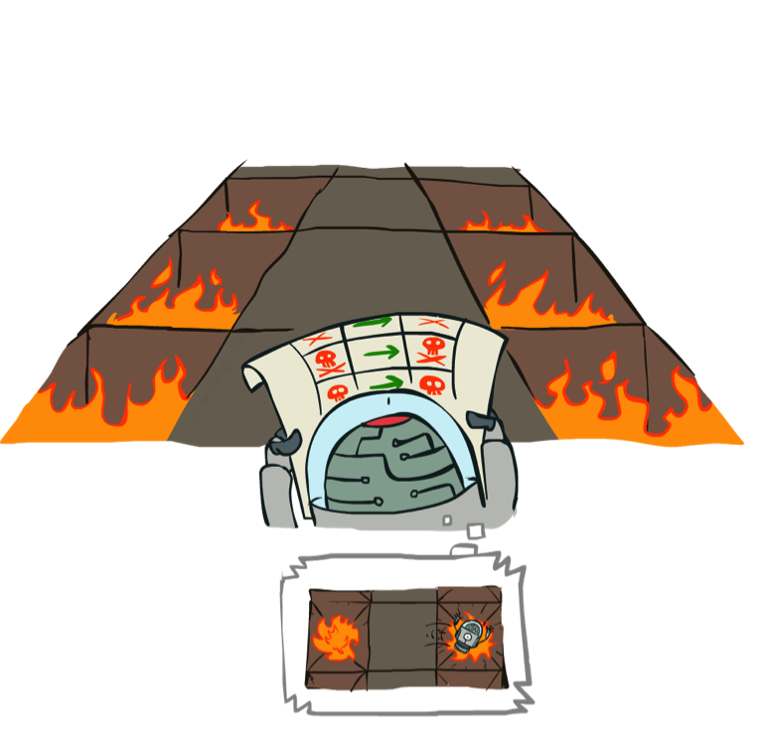
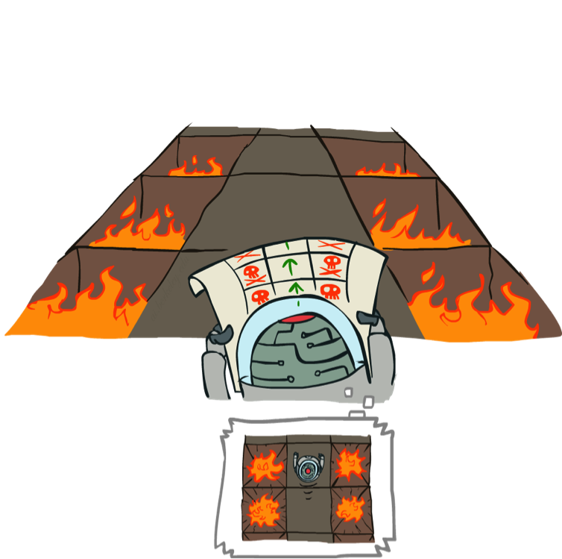
Example: Policy Evaluation
Always Go Right
Always Go Forward

Slide 16
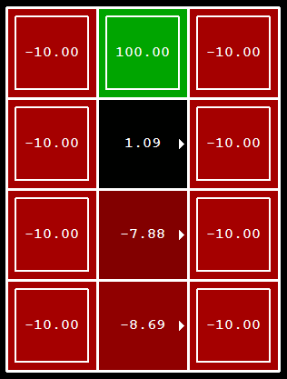
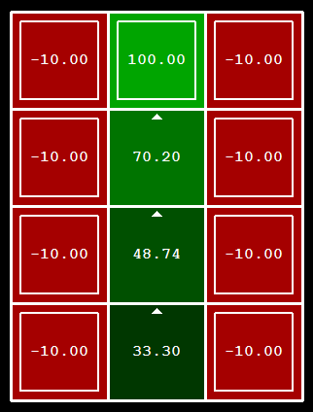
Example: Policy Evaluation
Always Go Right
Always Go Forward

Slide 17

Policy Evaluation
s
How do we calculate the V’s for a fixed policy π?
Idea 1: Turn recursive Bellman equations into updates
(like value iteration)
Efficiency: O(S²) per iteration
Idea 2: Without the maxes, the Bellman equations are just a linear system
Solve with Matlab (or your favorite linear system solver)
π(s)
s, π(s)
s, π(s),s’
s’

Slide 18
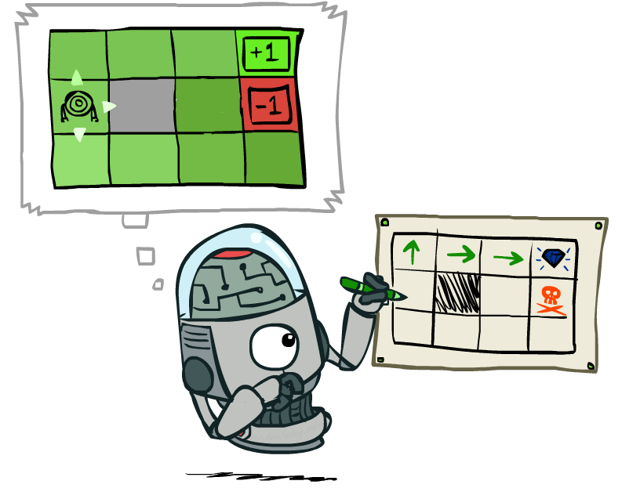
Policy Extraction

Slide 19
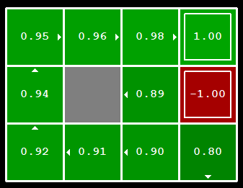

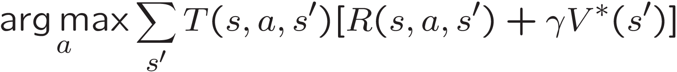
Computing Actions from Values
Let’s imagine we have the optimal values V*(s)
How should we act?
It’s not obvious!
We need to do a mini-expectimax (one step)
This is called policy extraction, since it gets the policy implied by the values

Slide 20
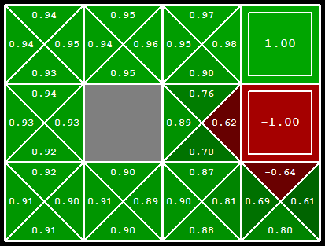
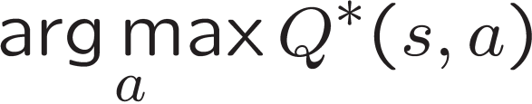
Computing Actions from Q-Values
Let’s imagine we have the optimal q-values:
How should we act?
Completely trivial to decide!
Important lesson: actions are easier to select from q-values than values!

Slide 21

Policy Iteration

Slide 22
Problems with Value Iteration
Value iteration repeats the Bellman updates:
Problem 1: It’s slow – O(S²A) per iteration
Problem 2: The “max” at each state rarely changes
Problem 3: The policy often converges long before the values
s
a
s, a
s,a,s’
s’
[Demo: value iteration (L9D2)]
Notes:
Demo steps through value iteration; snapshots of values shown on next slides.

Slide 23
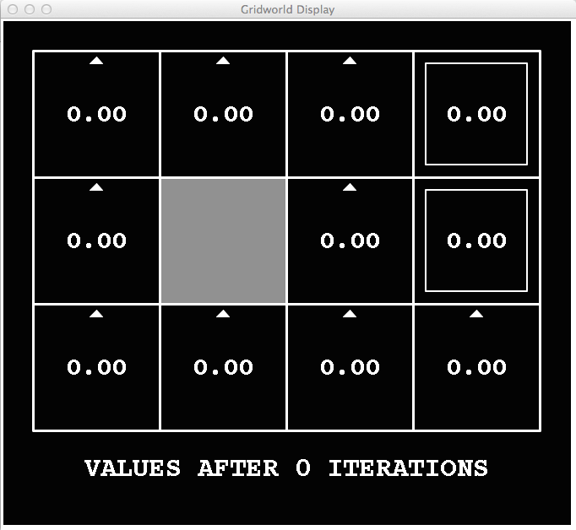
k=0
Noise = 0.2
Discount = 0.9
Living reward = 0
Notes:
Assuming zero living reward

Slide 24
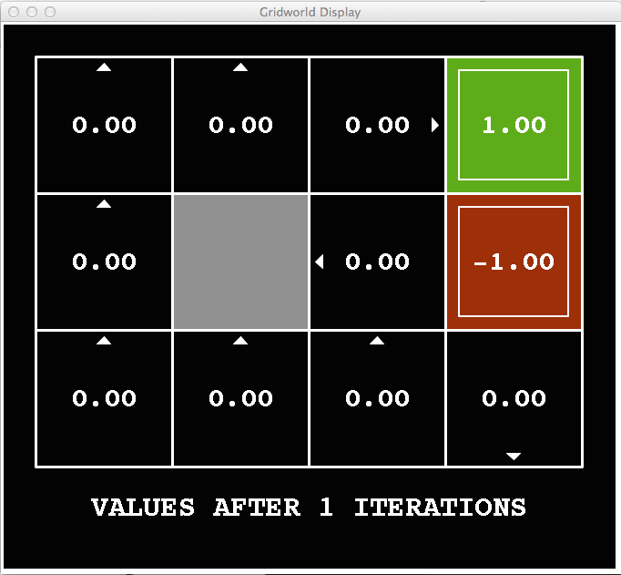
k=1
Noise = 0.2
Discount = 0.9
Living reward = 0
Notes:
Assuming zero living reward

Slide 25
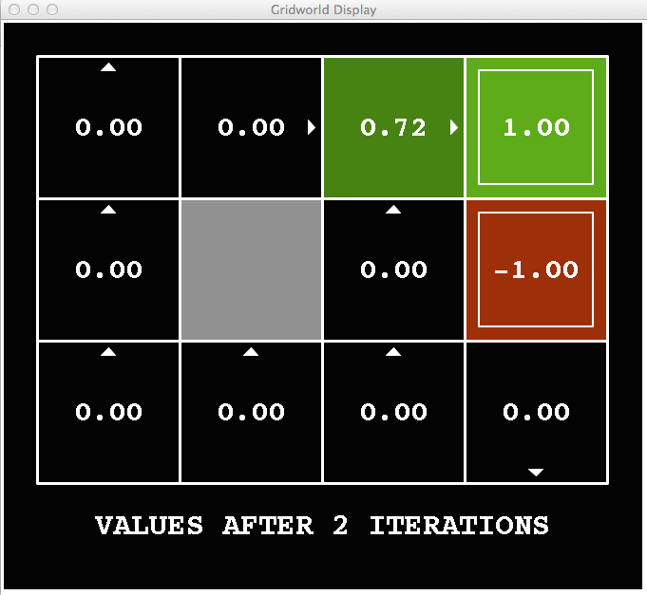
k=2
Noise = 0.2
Discount = 0.9
Living reward = 0
Notes:
Assuming zero living reward

Slide 26
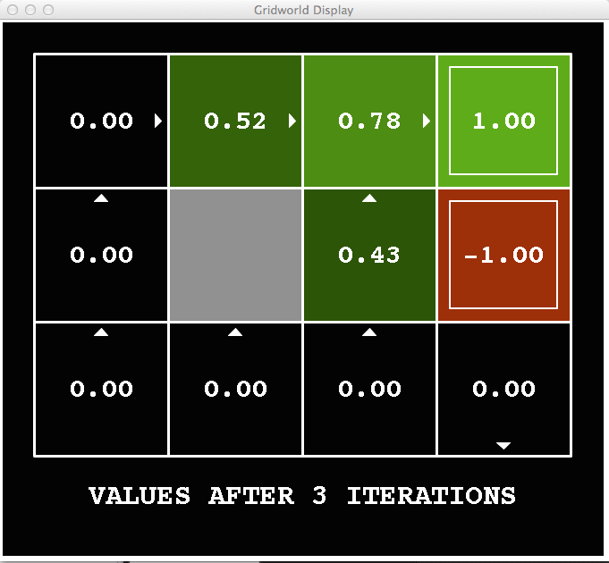
k=3
Noise = 0.2
Discount = 0.9
Living reward = 0
Notes:
Assuming zero living reward

Slide 27
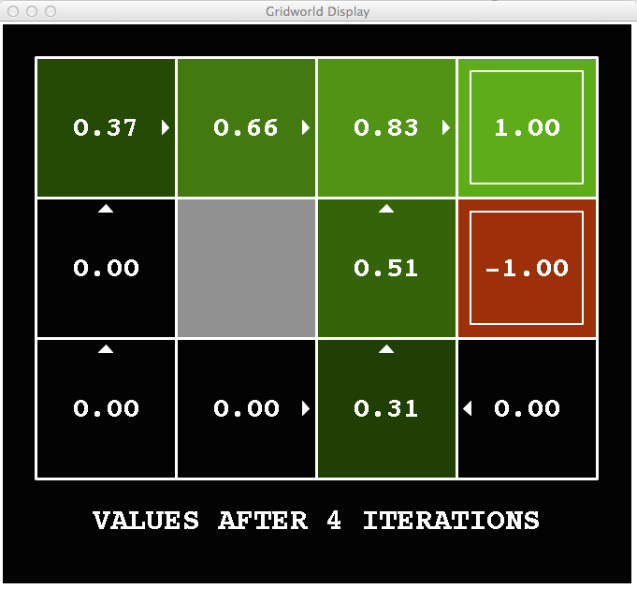
k=4
Noise = 0.2
Discount = 0.9
Living reward = 0
Notes:
Assuming zero living reward

Slide 28
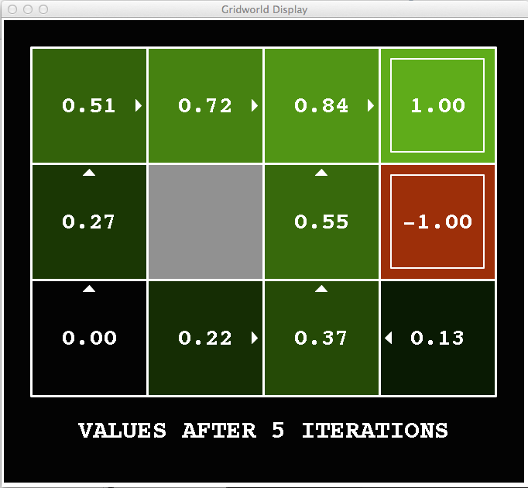
k=5
Noise = 0.2
Discount = 0.9
Living reward = 0
Notes:
Assuming zero living reward

Slide 29
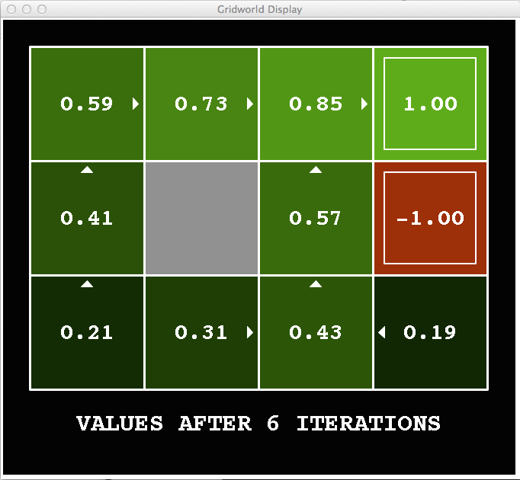
k=6
Noise = 0.2
Discount = 0.9
Living reward = 0
Notes:
Assuming zero living reward

Slide 30
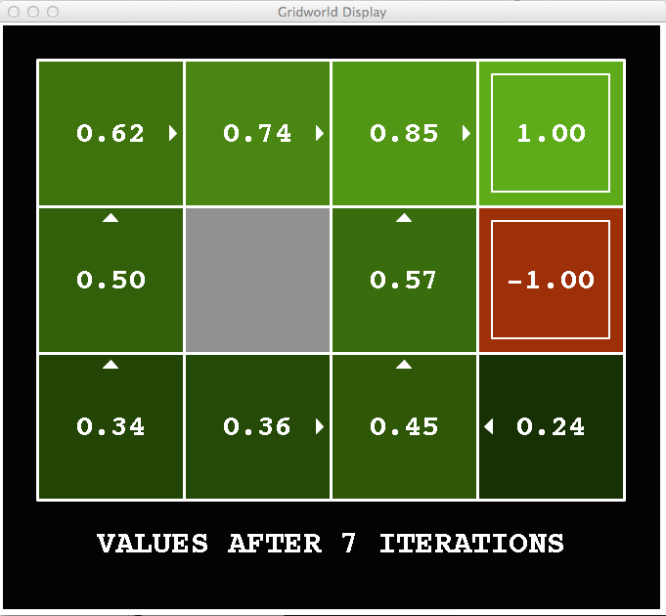
k=7
Noise = 0.2
Discount = 0.9
Living reward = 0
Notes:
Assuming zero living reward

Slide 31
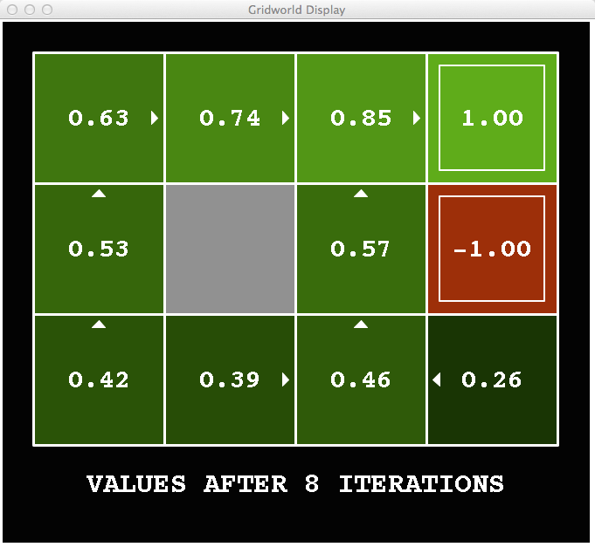
k=8
Noise = 0.2
Discount = 0.9
Living reward = 0
Notes:
Assuming zero living reward

Slide 32
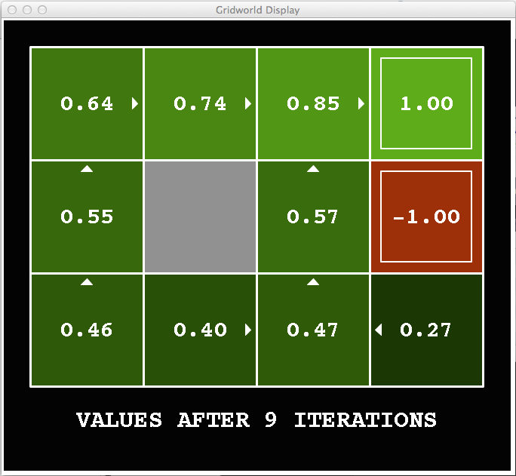
k=9
Noise = 0.2
Discount = 0.9
Living reward = 0
Notes:
Assuming zero living reward

Slide 33

k=10
Noise = 0.2
Discount = 0.9
Living reward = 0
Notes:
Assuming zero living reward

Slide 34

k=11
Noise = 0.2
Discount = 0.9
Living reward = 0
Notes:
Assuming zero living reward

Slide 35
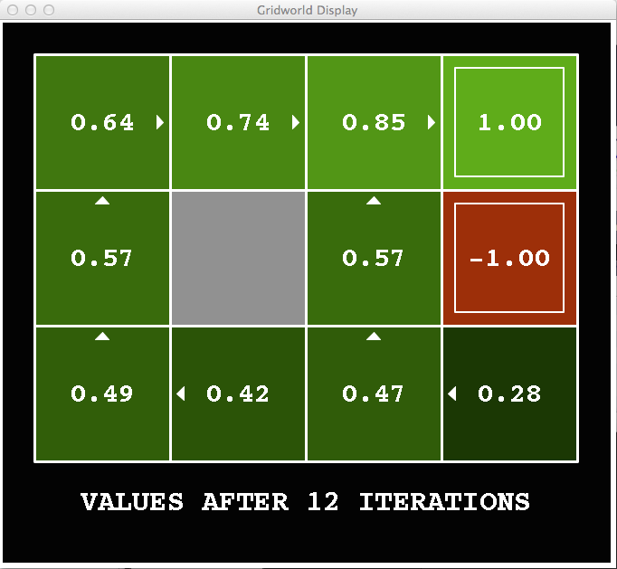
k=12
Noise = 0.2
Discount = 0.9
Living reward = 0
Notes:
Assuming zero living reward

Slide 36

k=100
Noise = 0.2
Discount = 0.9
Living reward = 0
Notes:
Assuming zero living reward

Slide 37
Policy Iteration
Alternative approach for optimal values:
Step 1: Policy evaluation: calculate utilities for some fixed policy (not optimal utilities!) until convergence
Step 2: Policy improvement: update policy using one-step look-ahead with resulting converged (but not optimal!) utilities as future values
Repeat steps until policy converges
This is policy iteration
It’s still optimal!
Can converge (much) faster under some conditions

Slide 38
Policy Iteration
Evaluation: For fixed current policy π, find values with policy evaluation:
Iterate until values converge:
Improvement: For fixed values, get a better policy using policy extraction
One-step look-ahead:

Slide 39
Comparison
Both value iteration and policy iteration compute the same thing (all optimal values)
In value iteration:
Every iteration updates both the values and (implicitly) the policy
We don’t track the policy, but taking the max over actions implicitly recomputes it
In policy iteration:
We do several passes that update utilities with fixed policy (each pass is fast because we consider only one action, not all of them)
After the policy is evaluated, a new policy is chosen (slow like a value iteration pass)
The new policy will be better (or we’re done)
Both are dynamic programs for solving MDPs

Slide 40
Summary: MDP Algorithms
So you want to….
Compute optimal values: use value iteration or policy iteration
Compute values for a particular policy: use policy evaluation
Turn your values into a policy: use policy extraction (one-step lookahead)
These all look the same!
They basically are – they are all variations of Bellman updates
They all use one-step lookahead expectimax fragments
They differ only in whether we plug in a fixed policy or max over actions

Slide 41
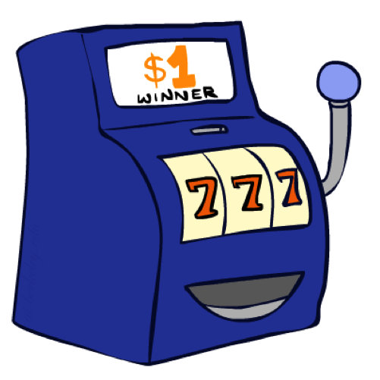
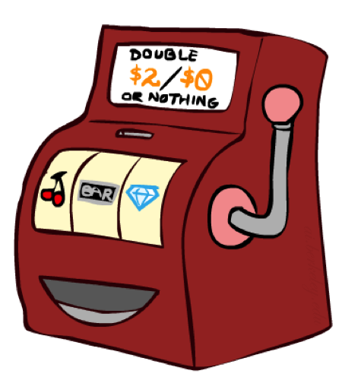

Double Bandits

Slide 42
Double-Bandit MDP
Actions: Blue, Red
States: Win, Lose
No discount
100 time steps
Both states have the same value
0.25 $0
0.75
$2
W
L
0.25
$0
$1
1.0
$1
1.0
0.75 $2

Slide 43
Offline Planning
Solving MDPs is offline planning
You determine all quantities through computation
You need to know the details of the MDP
You do not actually play the game!
No discount
100 time steps
Both states have the same value
0.25 $0
Value
0.75
$2
W
0.25
$0
Play Red
150
L
$1
1.0
$1
1.0
0.75 $2
Play Blue
100

Slide 44
Let’s Play!
$2
$2
$0
$2
$2
$2
$2
$0
$0
$0

Slide 45
Online Planning
Rules changed! Red’s win chance is different.
?? $0
??
$2
W
L
??
$0
$1
1.0
$1
1.0
?? $2

Slide 46
Let’s Play!
$0
$0
$0
$2
$0
$2
$0
$0
$0
$0

Slide 47
What Just Happened?
That wasn’t planning, it was learning!
Specifically, reinforcement learning
There was an MDP, but you couldn’t solve it with just computation
You needed to actually act to figure it out
Important ideas in reinforcement learning that came up
Exploration: you have to try unknown actions to get information
Exploitation: eventually, you have to use what you know
Regret: even if you learn intelligently, you make mistakes
Sampling: because of chance, you have to try things repeatedly
Difficulty: learning can be much harder than solving a known MDP

Slide 48
Next Time: Reinforcement Learning!

Slide 49

Asynchronous Value Iteration*
In value iteration, we update every state in each iteration
Actually, any sequences of Bellman updates will converge if every state is visited infinitely often
In fact, we can update the policy as seldom or often as we like, and we will still converge
Idea: Update states whose value we expect to change:
If is large then update predecessors of s

Slide 50
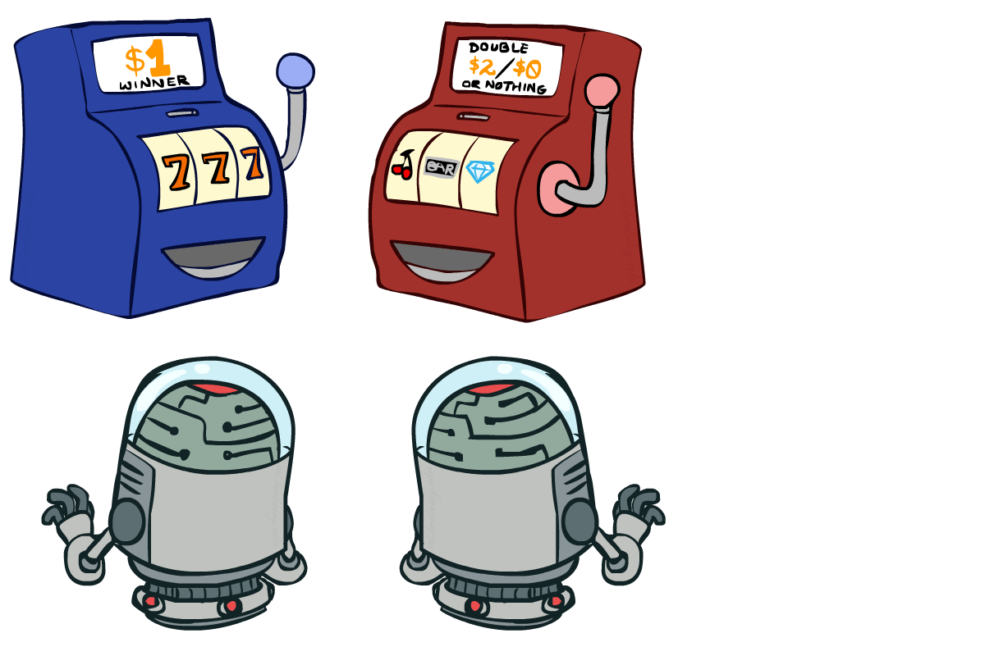
Interlude

