Slide 1
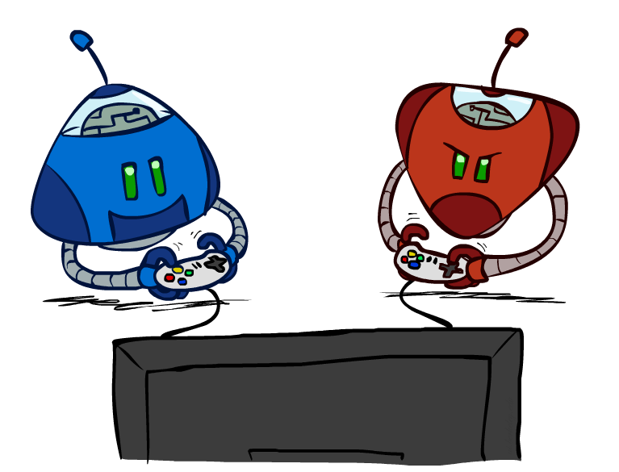
CS 188: Artificial Intelligence
Adversarial Search
Instructor: William DeMeo
New Jersey Institute of Technology
[slides created by Dan Klein and Pieter Abbeel for CS188 Intro to AI at UC Berkeley (ai.berkeley.edu).]
Notes:
Please retain proper attribution, including the reference to ai.berkeley.edu. Thanks!

Slide 2
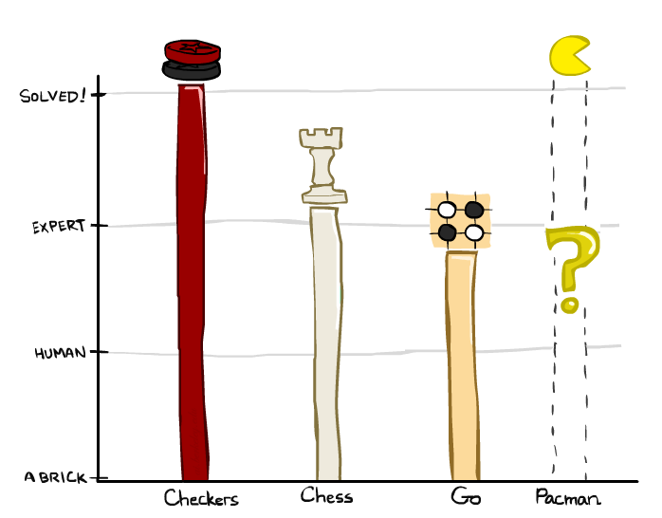
Game Playing State-of-the-Art
Checkers: 1950: First computer player. 1994: First computer champion: Chinook ended 40-year-reign of human champion Marion Tinsley using complete 8-piece endgame. 2007: Checkers solved!
Chess: 1997: Deep Blue defeats human champion Gary Kasparov in a six-game match. Deep Blue examined 200M positions per second, used very sophisticated evaluation and undisclosed methods for extending some lines of search up to 40 ply. Current programs are even better, if less historic.
Go: Human champions are now starting to be challenged by machines. In go, b > 300! Classic programs use pattern knowledge bases, but big recent advances use Monte Carlo (randomized) expansion methods.

Slide 3

Game Playing State-of-the-Art
Checkers: 1950: First computer player. 1994: First computer champion: Chinook ended 40-year-reign of human champion Marion Tinsley using complete 8-piece endgame. 2007: Checkers solved!
Chess: 1997: Deep Blue defeats human champion Gary Kasparov in a six-game match. Deep Blue examined 200M positions per second, used very sophisticated evaluation and undisclosed methods for extending some lines of search up to 40 ply. Current programs are even better, if less historic.
Go: 2016: Alpha GO defeats human champion. Uses Monte Carlo Tree Search, learned evaluation function.
Pacman

Slide 4
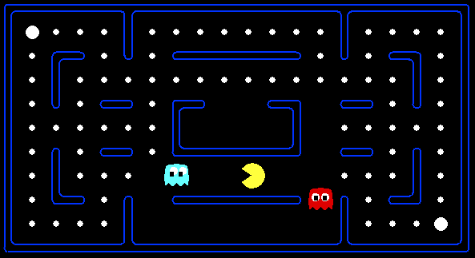
Behavior from Computation
[Demo: mystery pacman (L6D1)]

Slide 5

Video of Demo Mystery Pacman

Slide 6
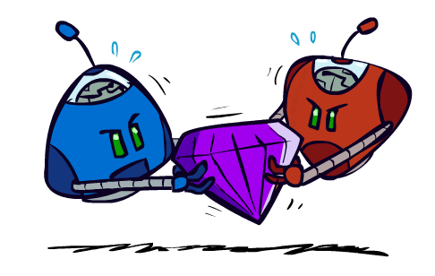
Adversarial Games

Slide 7
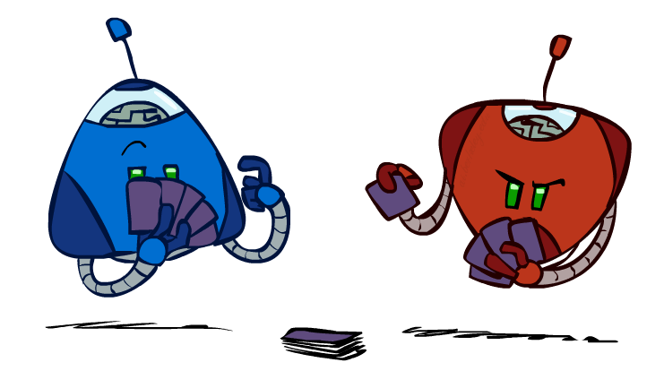
Types of Games
Many different kinds of games!
Axes:
Deterministic or stochastic?
One, two, or more players?
Zero sum?
Perfect information (can you see the state)?
Want algorithms for calculating a strategy (policy) which recommends a move from each state

Slide 8
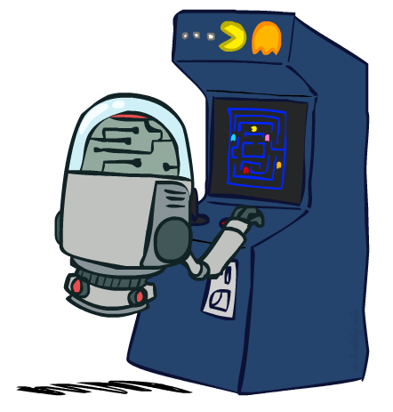
Deterministic Games
Many possible formalizations, one is:
States: S (start at s₀)
Players: P={1...N} (usually take turns)
Actions: A (may depend on player / state)
Transition Function: SxA → S
Terminal Test: S → {t,f}
Terminal Utilities: SxP → R
Solution for a player is a policy: S → A

Slide 9
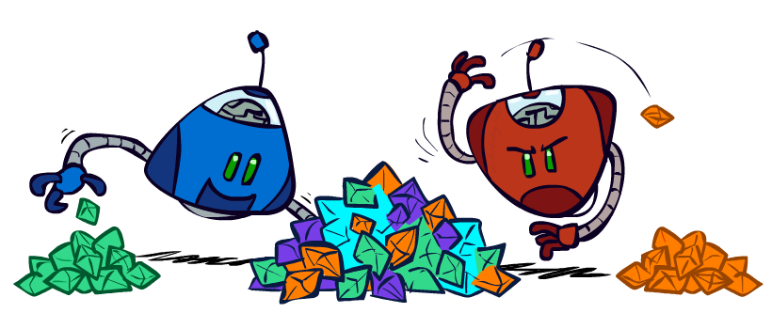
Zero-Sum Games
Zero-Sum Games
Agents have opposite utilities (values on outcomes)
Lets us think of a single value that one maximizes and the other minimizes
Adversarial, pure competition
General Games
Agents have independent utilities (values on outcomes)
Cooperation, indifference, competition, and more are all possible
More later on non-zero-sum games

Slide 10
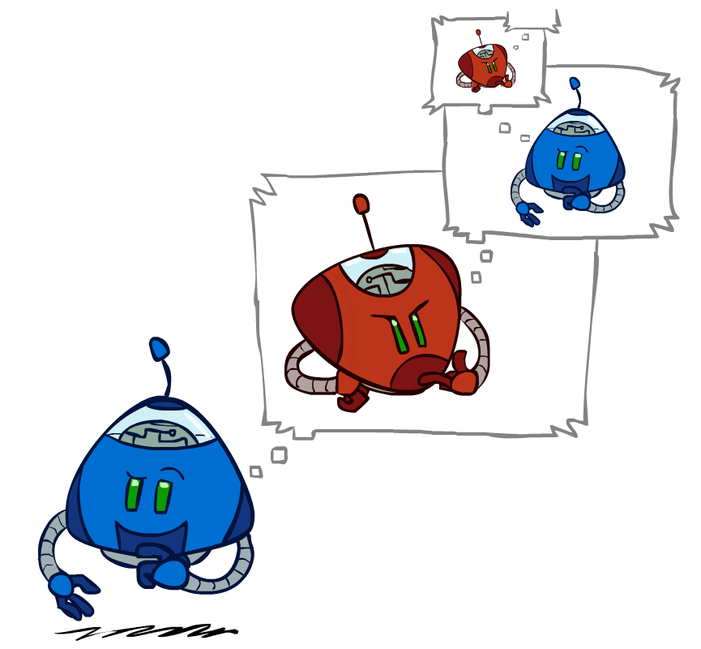
Adversarial Search

Slide 11
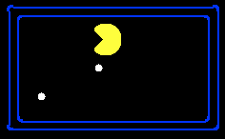
Single-Agent Trees
8
2
0
…
2
6
…
4
6

Slide 12
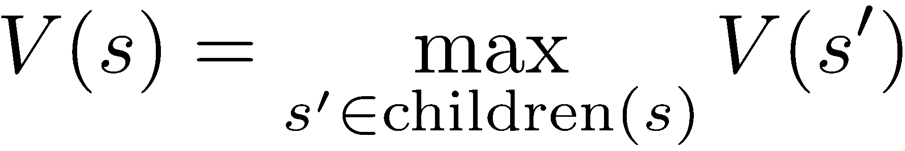
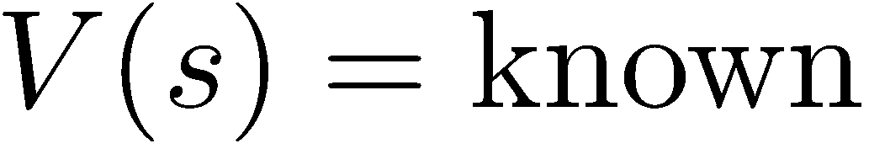
Value of a State
Value of a state: The best achievable outcome (utility) from that state
Non-Terminal States:
8
2
0
…
2
6
…
4
6
Terminal States:

Slide 13

Adversarial Game Trees
-20
-8
…
-18
-5
…
-10
+4
-20
+8

Slide 14
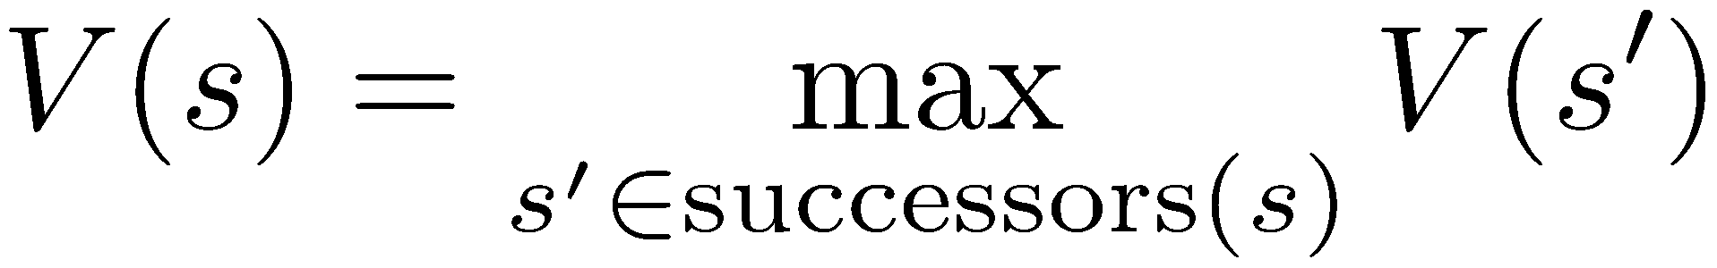
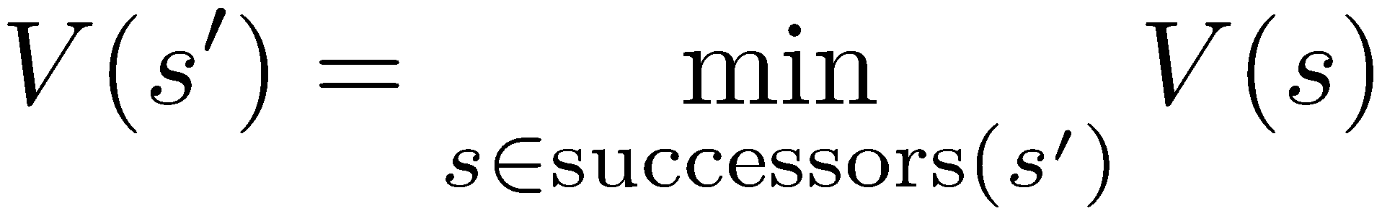
Minimax Values
States Under Agent’s Control:
States Under Opponent’s Control:
-8
-5
-10
+8
Terminal States:

Slide 15

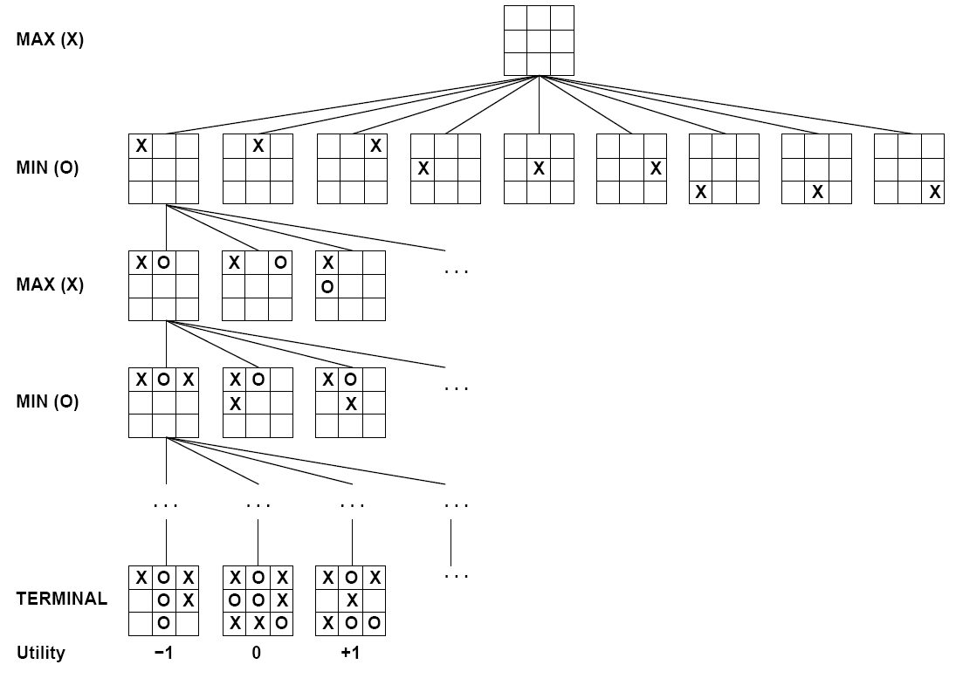

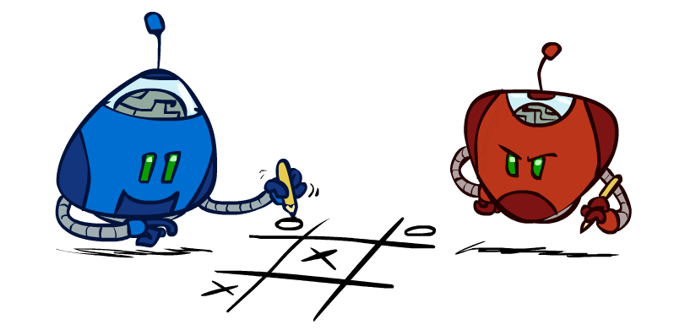
Tic-Tac-Toe Game Tree

Slide 16
Adversarial Search (Minimax)
Deterministic, zero-sum games:
Tic-tac-toe, chess, checkers
One player maximizes result
The other minimizes result
Minimax search:
A state-space search tree
Players alternate turns
Compute each node’s minimax value: the best achievable utility against a rational (optimal) adversary
Minimax values: computed recursively
5
max
2
5
min
8
2
5
6
Terminal values: part of the game

Slide 17
Minimax Implementation
def max-value(state):
initialize v = -∞
for each successor of state:
v = max(v, min-value(successor))
return v
def min-value(state):
initialize v = +∞
for each successor of state:
v = min(v, max-value(successor))
return v

Slide 18
Minimax Implementation (Dispatch)
def value(state):
if the state is a terminal state: return the state’s utility
if the next agent is MAX: return max-value(state)
if the next agent is MIN: return min-value(state)
def max-value(state):
initialize v = -∞
for each successor of state:
v = max(v, value(successor))
return v
def min-value(state):
initialize v = +∞
for each successor of state:
v = min(v, value(successor))
return v
Notes:
Pick an order for two reasons: sequential processor and pruning

Slide 19
Minimax Example
3
12
8
2
4
6
14
5
2

Slide 20
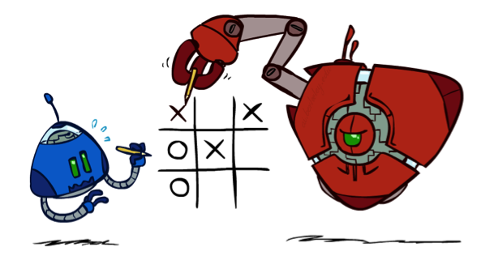
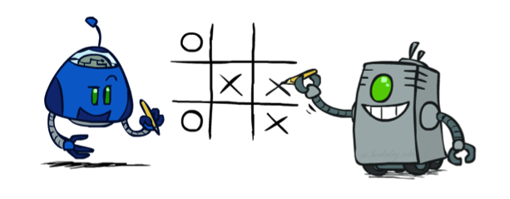
Minimax Properties
max
min
10
10
9
100
Optimal against a perfect player. Otherwise?
[Demo: min vs exp (L6D2, L6D3)]

Slide 21

Video of Demo Min vs. Exp (Min)

Slide 22
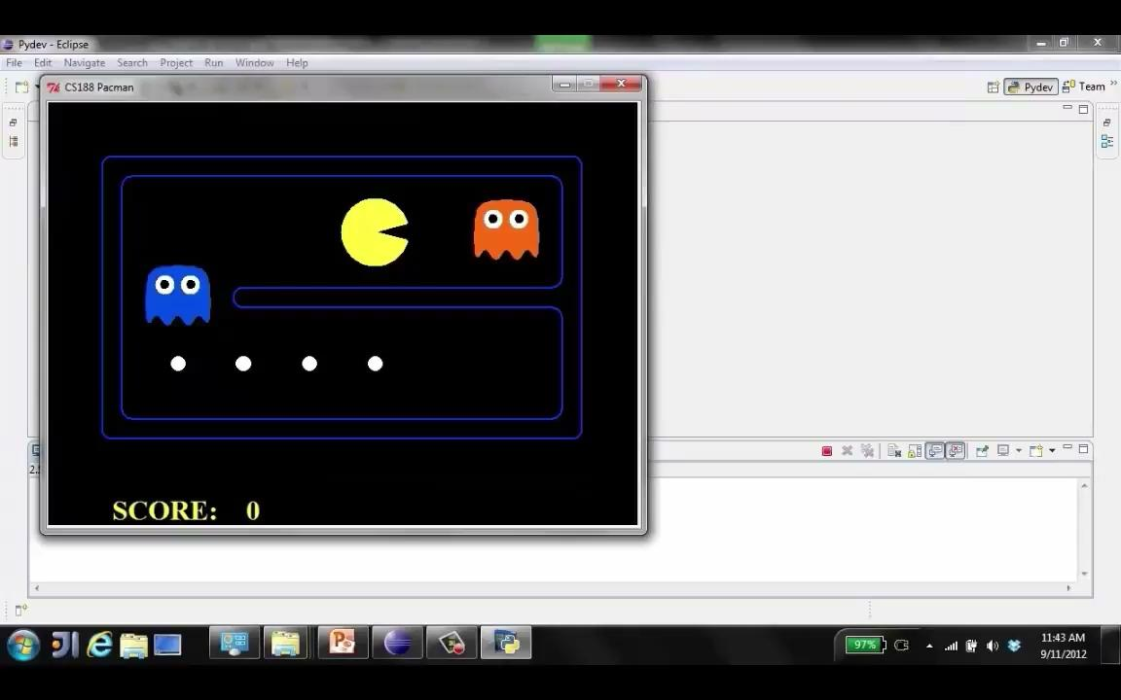
Video of Demo Min vs. Exp (Exp)

Slide 23
Minimax Efficiency
How efficient is minimax?
Just like (exhaustive) DFS
Time: O(b^{m})
Space: O(bm)
Example: For chess, b ≈ 35, m ≈ 100
Exact solution is completely infeasible
But, do we need to explore the whole tree?

Slide 24

Resource Limits

Slide 25
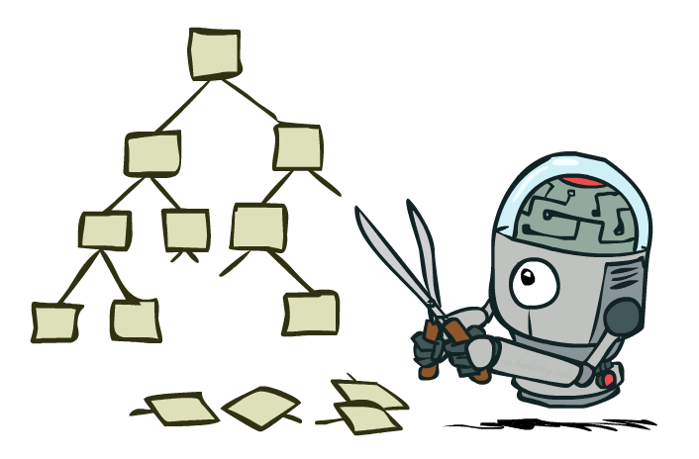
Game Tree Pruning

Slide 26
Minimax Example
3
12
8
2
4
6
14
5
2

Slide 27
Minimax Pruning
3
12
8
2
14
5
2

Slide 28
Alpha-Beta Pruning
General configuration (MIN version)
We’re computing the MIN-VALUE at some node n
We’re looping over n’s children
n’s estimate of the childrens’ min is dropping
Who cares about n’s value? MAX
Let a be the best value that MAX can get at any choice point along the current path from the root
If n becomes worse than a, MAX will avoid it, so we can stop considering n’s other children (it’s already bad enough that it won’t be played)
MAX version is symmetric
MAX
MIN
a
MAX
MIN
n

Slide 29
Alpha-Beta Implementation
α: MAX’s best option on path to root
β: MIN’s best option on path to root
def max-value(state, α, β):
initialize v = -∞
for each successor of state:
v = max(v, value(successor, α, β))
if v ≥ β return v
α = max(α, v)
return v
def min-value(state , α, β):
initialize v = +∞
for each successor of state:
v = min(v, value(successor, α, β))
if v ≤ α return v
β = min(β, v)
return v
Notes:
Pick an order for two reasons: sequential processor and pruning

Slide 30
Alpha-Beta Pruning Properties
This pruning has no effect on minimax value computed for the root!
Values of intermediate nodes might be wrong
Important: children of the root may have the wrong value
So the most naïve version won’t let you do action selection
Good child ordering improves effectiveness of pruning
With “perfect ordering”:
Time complexity drops to O(b^{m/2})
Doubles solvable depth!
Full search of, e.g. chess, is still hopeless…
This is a simple example of metareasoning (computing about what to compute)
max
min
10
10
0

Slide 31
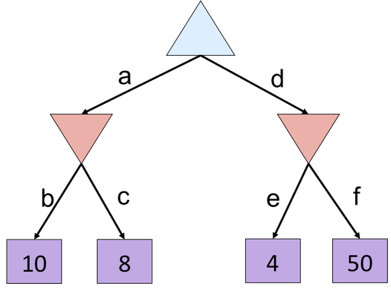
Alpha-Beta Quiz

Slide 32
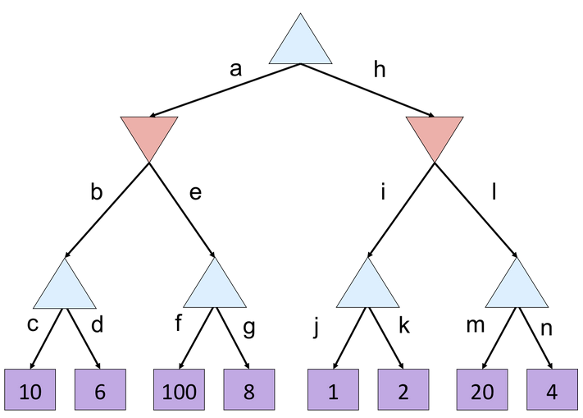
Alpha-Beta Quiz 2

Slide 33
Resource Limits

Slide 34
Resource Limits
Problem: In realistic games, cannot search to leaves!
Solution: Depth-limited search
Instead, search only to a limited depth in the tree
Replace terminal utilities with an evaluation function for non-terminal positions
Example:
Suppose we have 100 seconds, can explore 10K nodes / sec
So can check 1M nodes per move
α-β reaches about depth 8 – decent chess program
Guarantee of optimal play is gone
More plies makes a BIG difference
Use iterative deepening for an anytime algorithm
max
4
-2
4
min
-1
-2
4
9
?
?
?
?

Slide 35
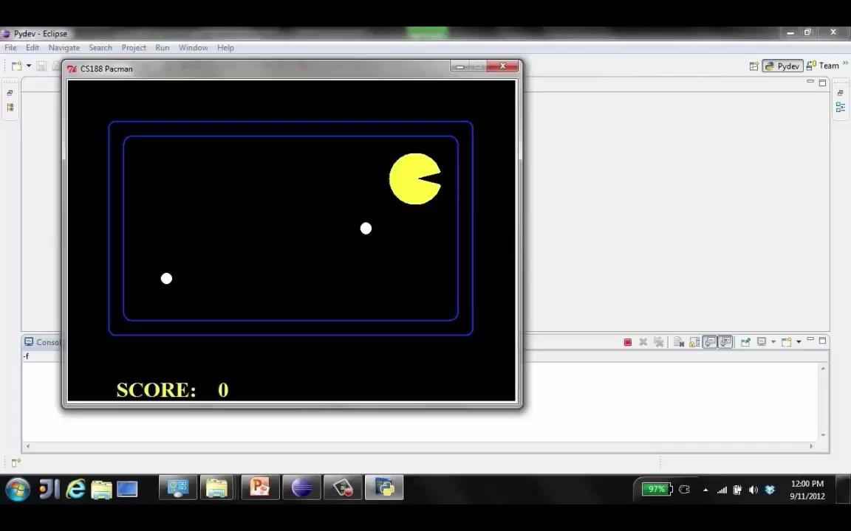
Video of Demo Thrashing (d=2)
[Demo: thrashing d=2, thrashing d=2 (fixed evaluation function) (L6D6)]

Slide 36
Why Pacman Starves
A danger of replanning agents!
He knows his score will go up by eating the dot now (west, east)
He knows his score will go up just as much by eating the dot later (east, west)
There are no point-scoring opportunities after eating the dot (within the horizon, two here)
Therefore, waiting seems just as good as eating: he may go east, then back west in the next round of replanning!

Slide 37
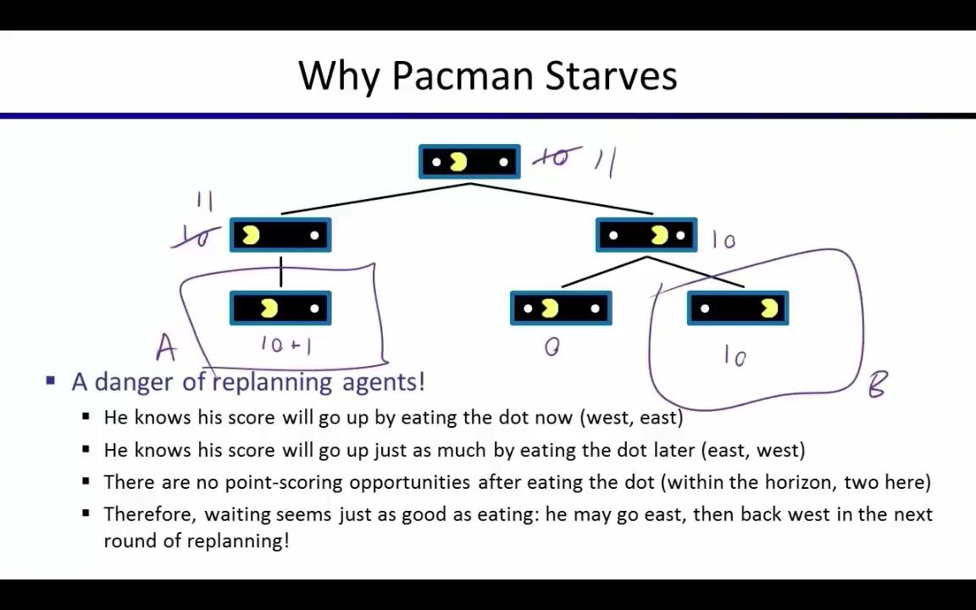
Video of Demo Thrashing -- Fixed (d=2)
[Demo: thrashing d=2, thrashing d=2 (fixed evaluation function) (L6D7)]

Slide 38
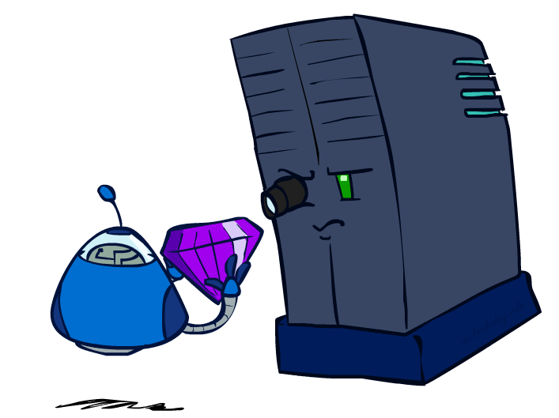
Evaluation Functions

Slide 39
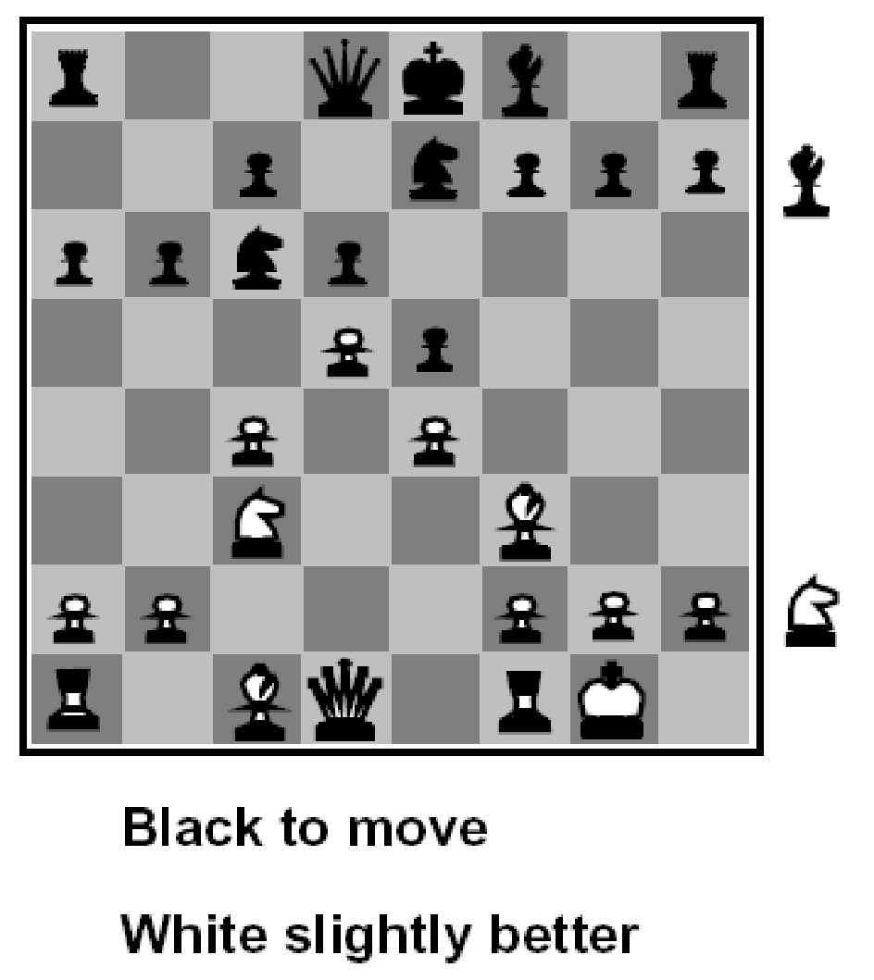
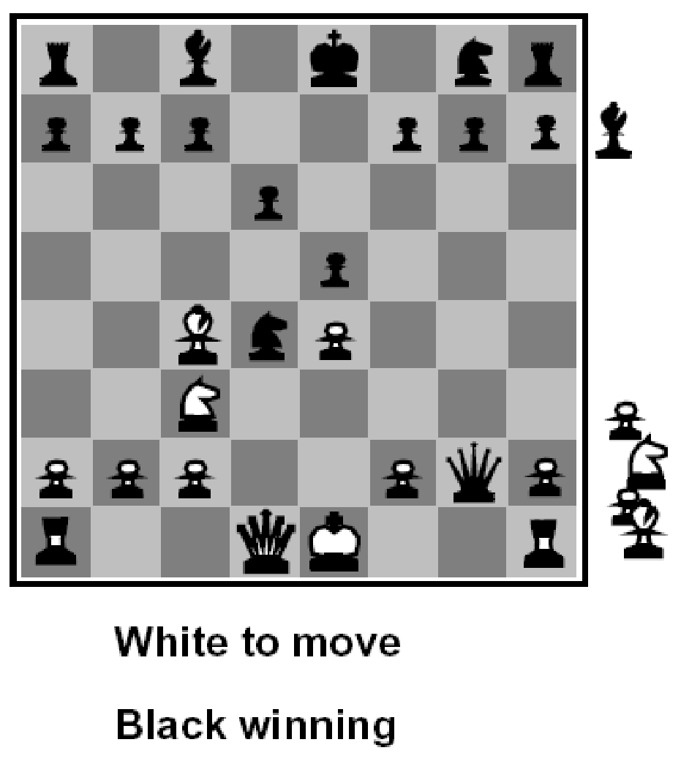
Evaluation Functions
Evaluation functions score non-terminals in depth-limited search
Ideal function: returns the actual minimax value of the position
In practice: typically weighted linear sum of features:
e.g. f₁(s) = (num white queens – num black queens), etc.

Slide 40





Evaluation for Pacman
[Demo: thrashing d=2, thrashing d=2 (fixed evaluation function), smart ghosts coordinate (L6D6,7,8,10)]

Slide 41
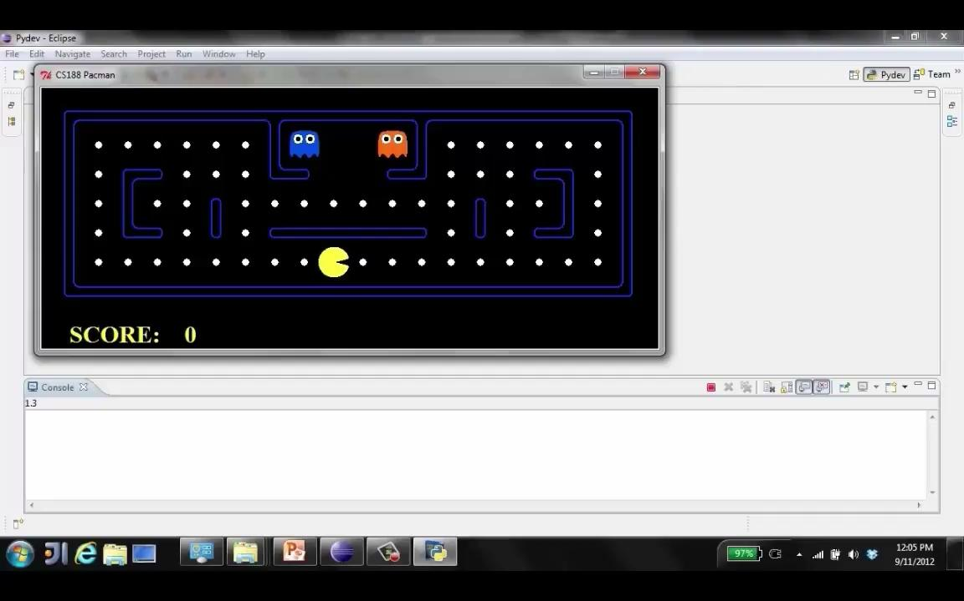
Video of Demo Smart Ghosts (Coordination)

Slide 42
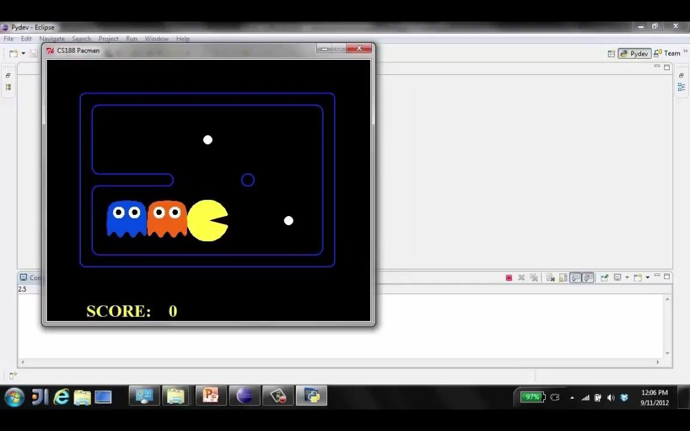
Video of Demo Smart Ghosts (Coordination) – Zoomed In

Slide 43


Depth Matters
Evaluation functions are always imperfect
The deeper in the tree the evaluation function is buried, the less the quality of the evaluation function matters
An important example of the tradeoff between complexity of features and complexity of computation
[Demo: depth limited (L6D4, L6D5)]

Slide 44
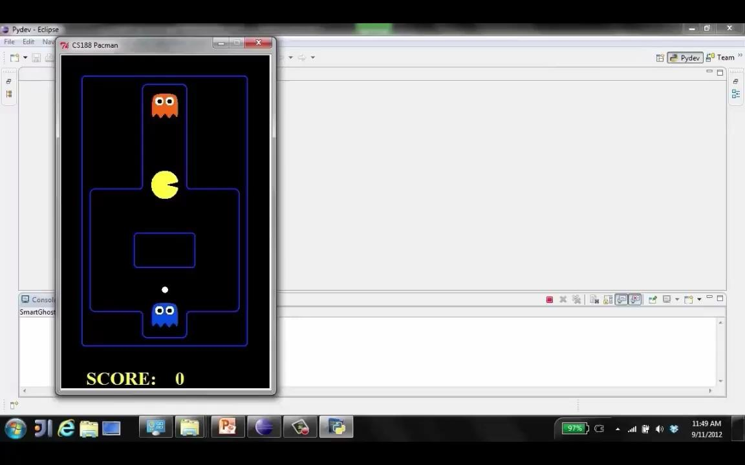
Video of Demo Limited Depth (2)

Slide 45
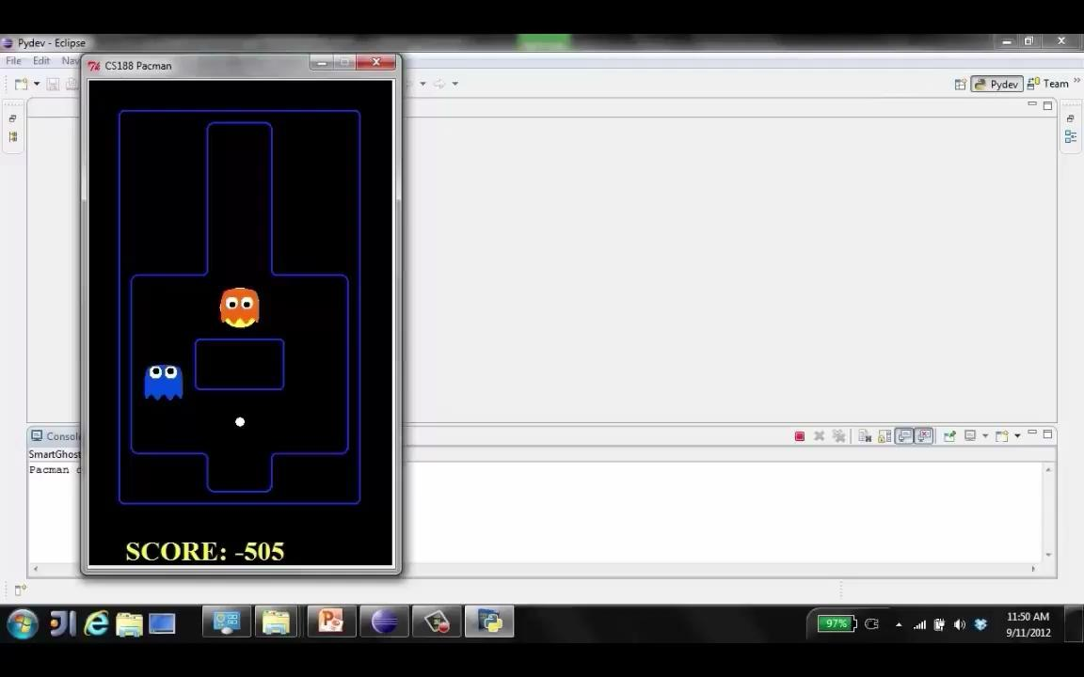
Video of Demo Limited Depth (10)

Slide 46
Synergies between Evaluation Function and Alpha-Beta?
Alpha-Beta: amount of pruning depends on expansion ordering
Evaluation function can provide guidance to expand most promising nodes first (which later makes it more likely there is already a good alternative on the path to the root)
(somewhat similar to role of A* heuristic, CSPs filtering)
Alpha-Beta: (similar for roles of min-max swapped)
Value at a min-node will only keep going down
Once value of min-node lower than better option for max along path to root, can prune
Hence: IF evaluation function provides upper-bound on value at min-node, and upper-bound already lower than better option for max along path to root THEN can prune

Slide 47
Next Time: Uncertainty!

