Slide 1
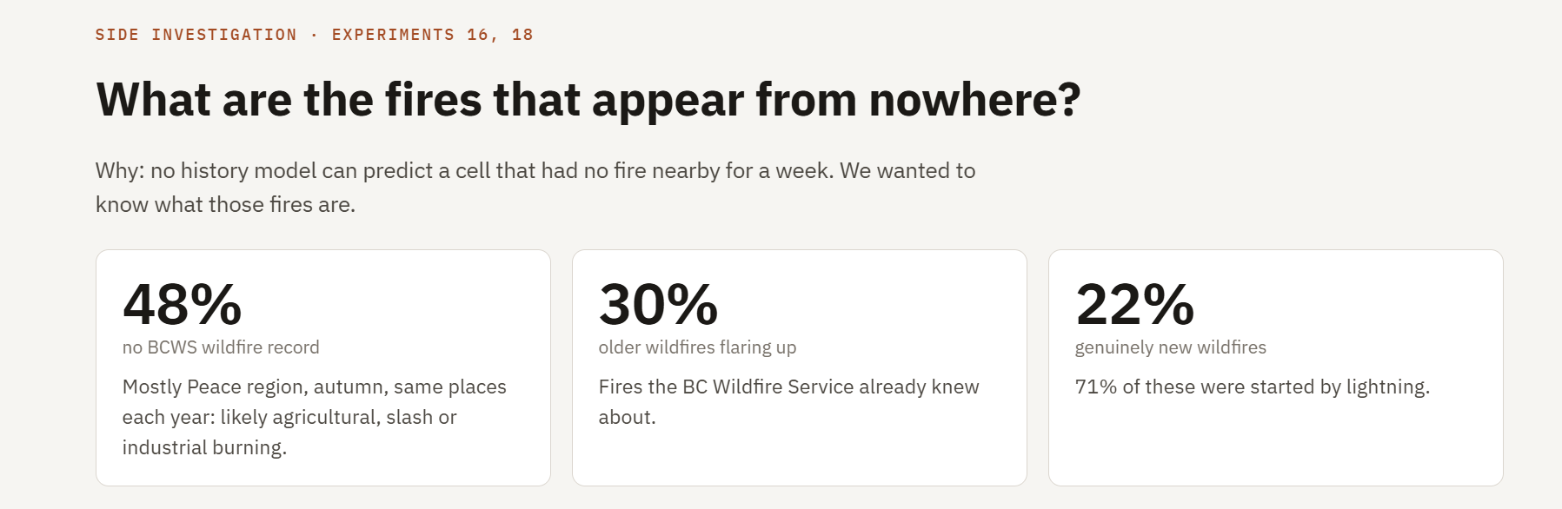
Investigation on last week results
F1 score was not budging from 0.49-0.54
Reason was noisy labels

Slide 2
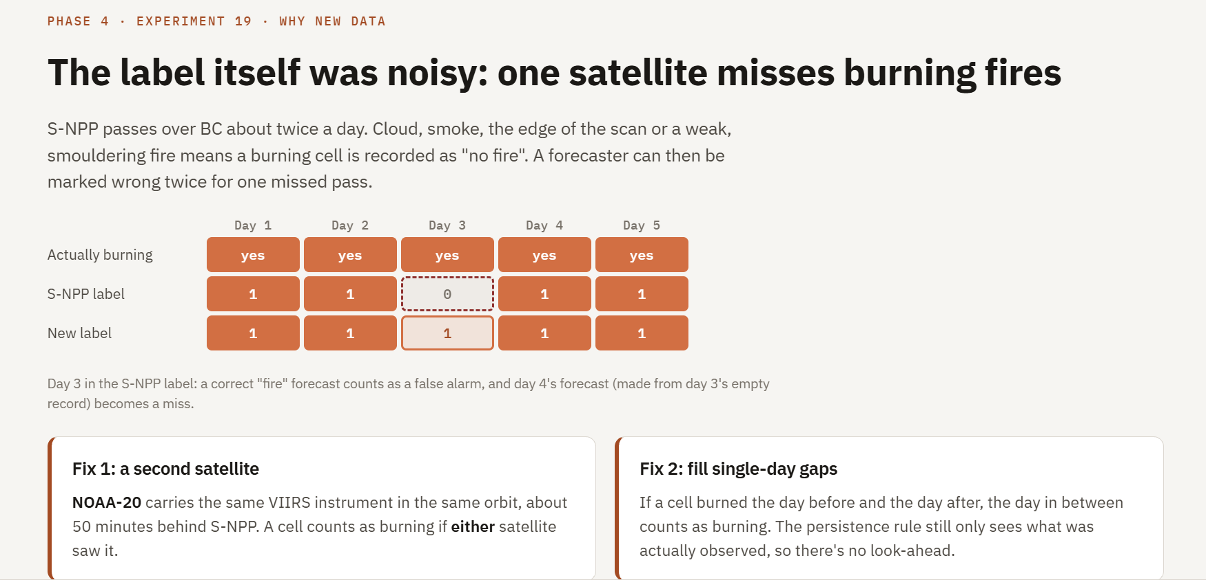
Added Second Satellite data to remove noisy labels

Slide 3
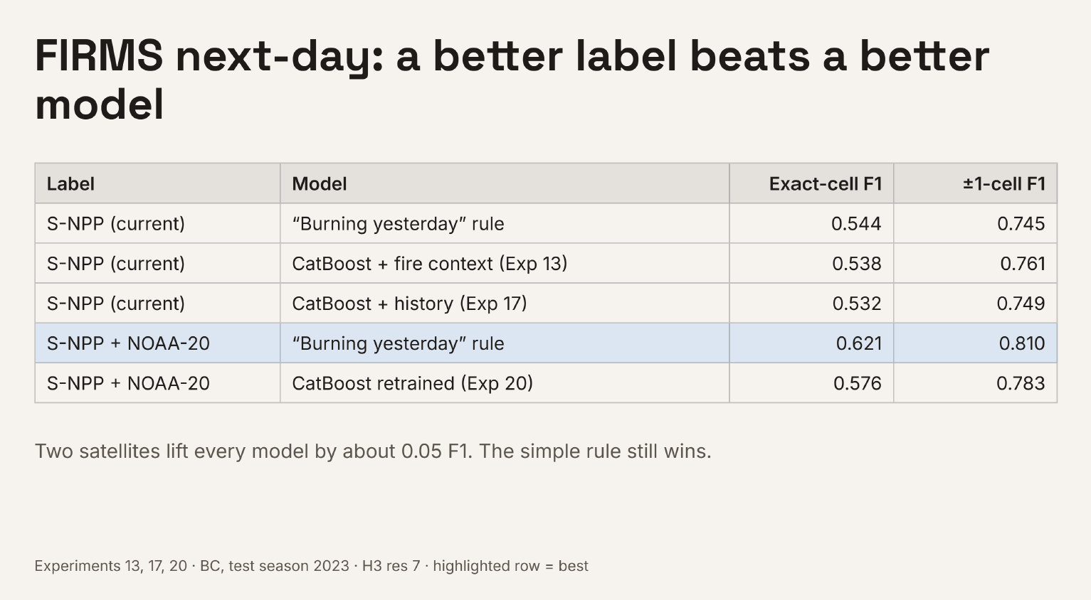
Improvements by adding New Data Source NOAA Satellite
F1 Score increased from 0.54 to 0.62 with new labels on rule based (No model learning yet)

Slide 4
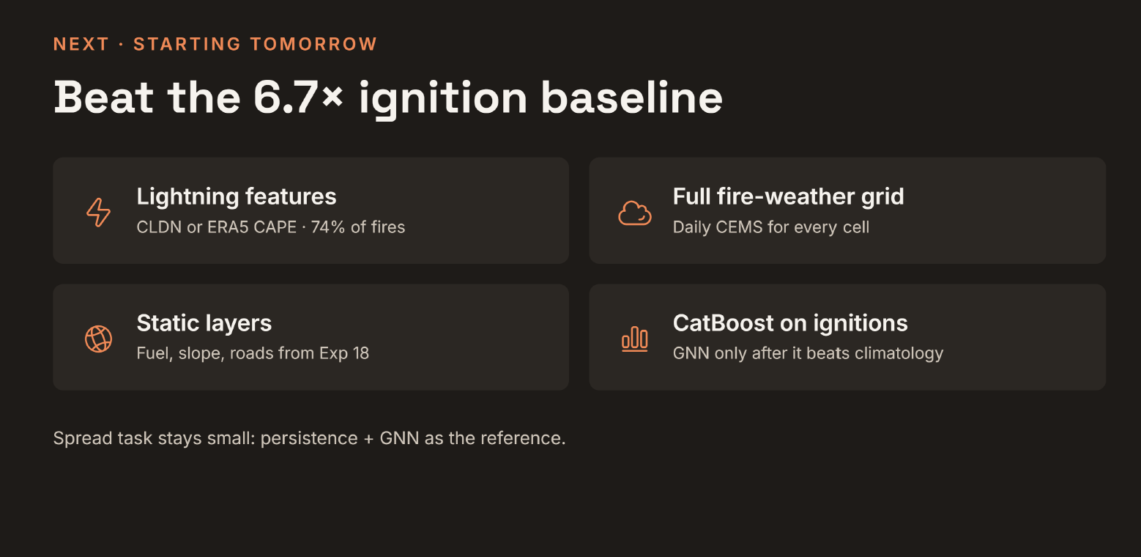
After fixing labels, adding more features this week

