Slide 1
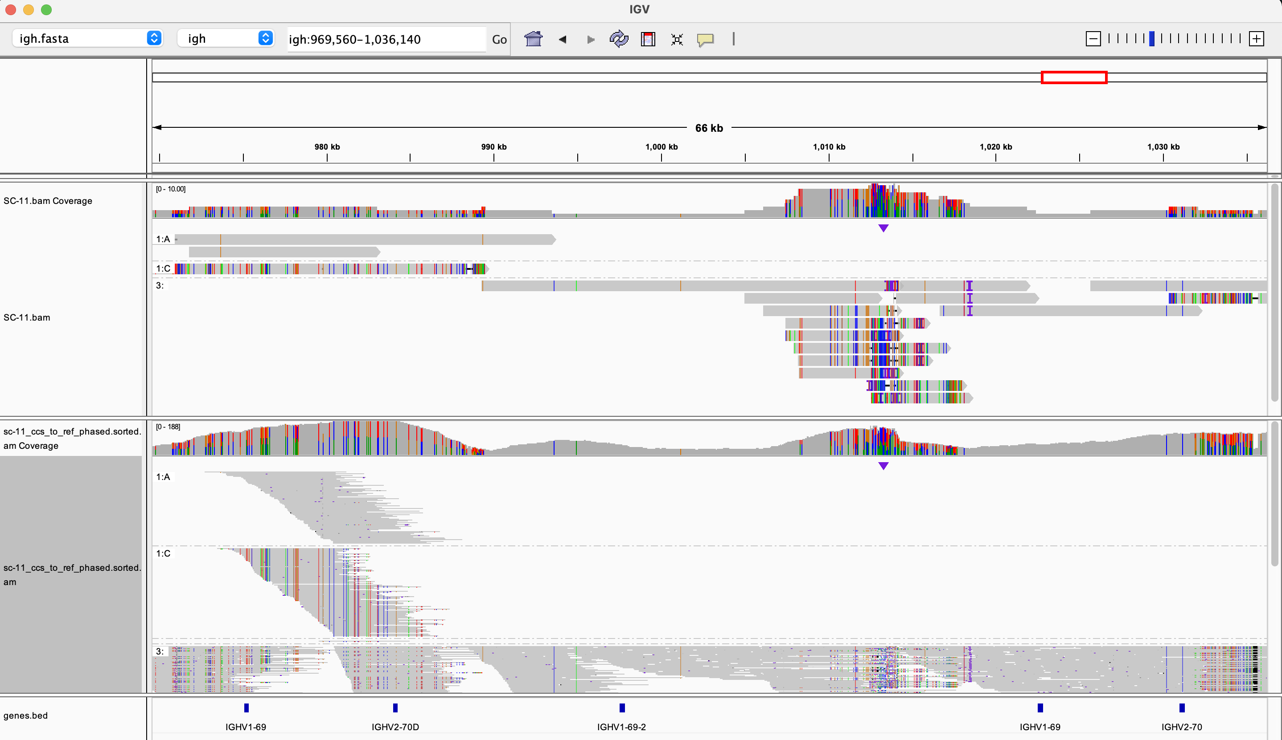
Haplotype 1 (deletion)
Those contigs join to make “WL.region.hap2_joinedContigs” – they align with 100% ID
These contigs also represent “WL.region.hap2_joinedContigs”
but mismapped here
Potentially misassembled contigs

Slide 2
Haplotype 2 (duplication)

Slide 3
BLAT of “WL.region.hap2_joinedContigs” against hg38
Deletion breakpoints based on BLAT alignment along are ambiguous
You can also see (red ticks) that the haplotype is quite divergent from from hg38
As a result, BLAT suggests that deletion could either remove 2-70D or 2-70, but it is favoring loss of IGHV2-70
Where “IGHV2-70*04_t116c” sits is difficult to delineate based on this

Slide 4
BLAT of “WL.region.hap2_joinedContigs” against hg19 (Matsuda)
Can see that the haplotype is consistent with hg19/Matsuda in terms of “gene” content
Can also see haplotype is quite divergent from hg19.
*** I DON”T LOVE WHAT GENCODE IS NOW DOING WITH ANNOTATIONS

