Slide 1
Sample SC-11 (SEQUEL II) has the same SNP *04_t116c in 2-70 and 2-70D
This is not found by IgDiscover in the repertoire, but cluster sizes are low.
20 genomic subjects in VDJbase have 2-70*04_t116c. All 20 also have 2-70D*04_t116c.
8 subjects have 2-70D*04_t116c but not 2-70*04_t116c
Is there a strong association between these two SNPs, or is it possible that reads are incorrectly mapped?
(See results/IGH/read assemblies/SC-11 for details)

Slide 2
Co-ordinates in the assembly:
2-70 exon-2 1030987-1031299 snp is 1031182 A->G (assembly is rc wrt to the genes)
2-70D exon-2 983984-984296 snp is 984179 A->G
The reference is based on 2-70*01 and 2-70D*04
Read counts in SC-11 at 2-70 and 2-70D (both primary and secondary alignments):
2-70 2-70D
RG | primary | secondary | allele
0 | 19 | 130 | *15 (prim) *04 (sec)
1 | 14 | 92 | *04_t116c
2 | 85 | 1 | *15
RG | primary | secondary | allele
0 | 3 | 124 | *15 (sec)
1 | 89 | 19 | *04
2 | 98 | 14 | *04_t116c

Slide 3
A large majority of secondary reads seen in 2-70 and 2-70D have their primary read in the corresponding duplicate:
Secondary reads at 2-70: Secondary reads at 2-70D:
RG | n | Primary location | Gene
0 | 5 | 172188-176492 | 2-5
 | 8 | 449701-451716 | 2-25
 | 23 | 1175151-1179000 | 3-9
 | 91 | 976916-983976 | 2-70D
1 | 92 | 977142-984169 | 2-70D
2 | 1 | n.d.
RG | n | Primary location | Gene
0 | 1 | 172188 | 2-5
 | 18 | 1175151-1177425 | 3-9
 | 104 | 1023446-1031166 | 2-70
1 | 2 | 1029758-1030600 | 2-70
 | 4 | 173249-176492 | 2-5
 | 12 | 445230-451716 | 2-25
2 | 14 | 1029740-1031216 | 2-70

Slide 4
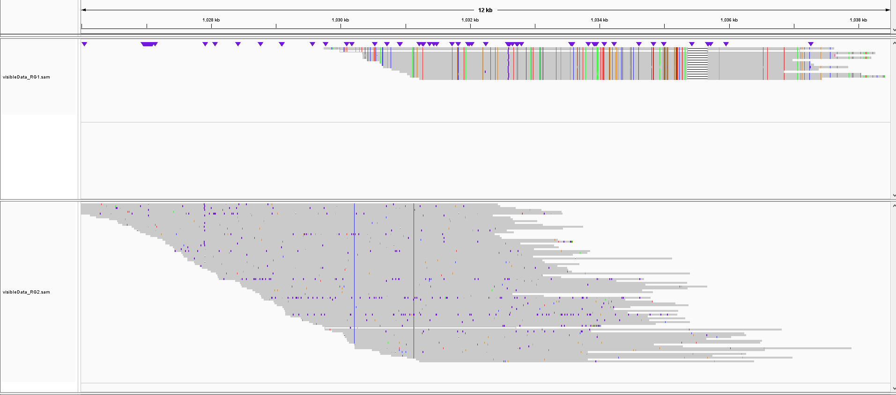
At 2-70, RG1 (*04_t116c) aligns with a gap that is not seen in RG2

Slide 5
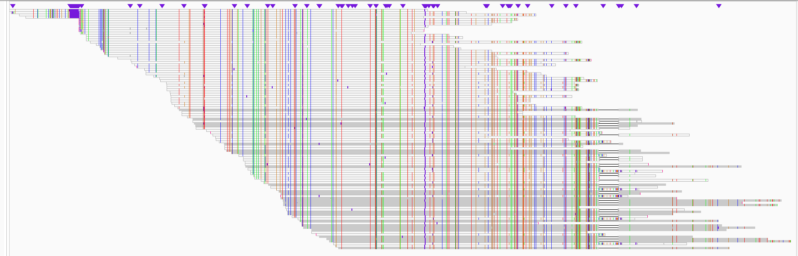
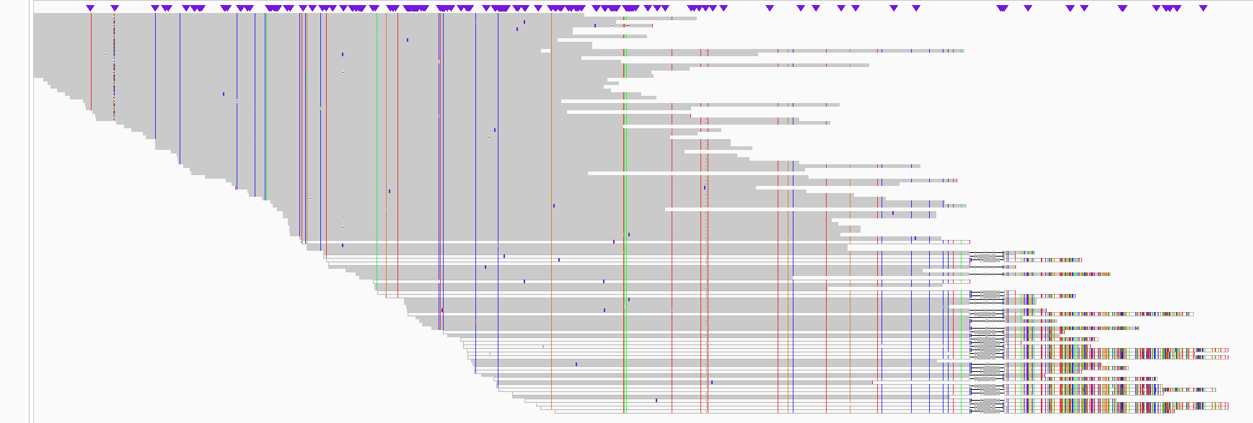
t116c–containing reads covering the 3’ side of the
gene align better with 2-70D, while those covering the 5’ side and extending beyond the ‘gap’ align better with 2-70
2-70 RG1
t116c
exon-2
Better alignment to 2-70
2-70D RG2
Better alignment to 2-70D

