Slide 1
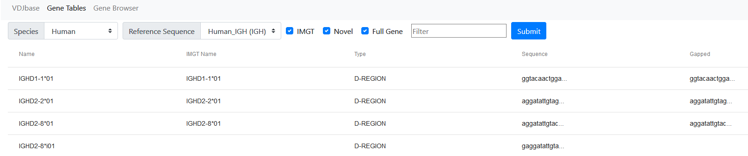
Sequences found in study
Filter by partial name, e.g. IGHV, UTR, 4-34
Click for full sequence

Slide 2
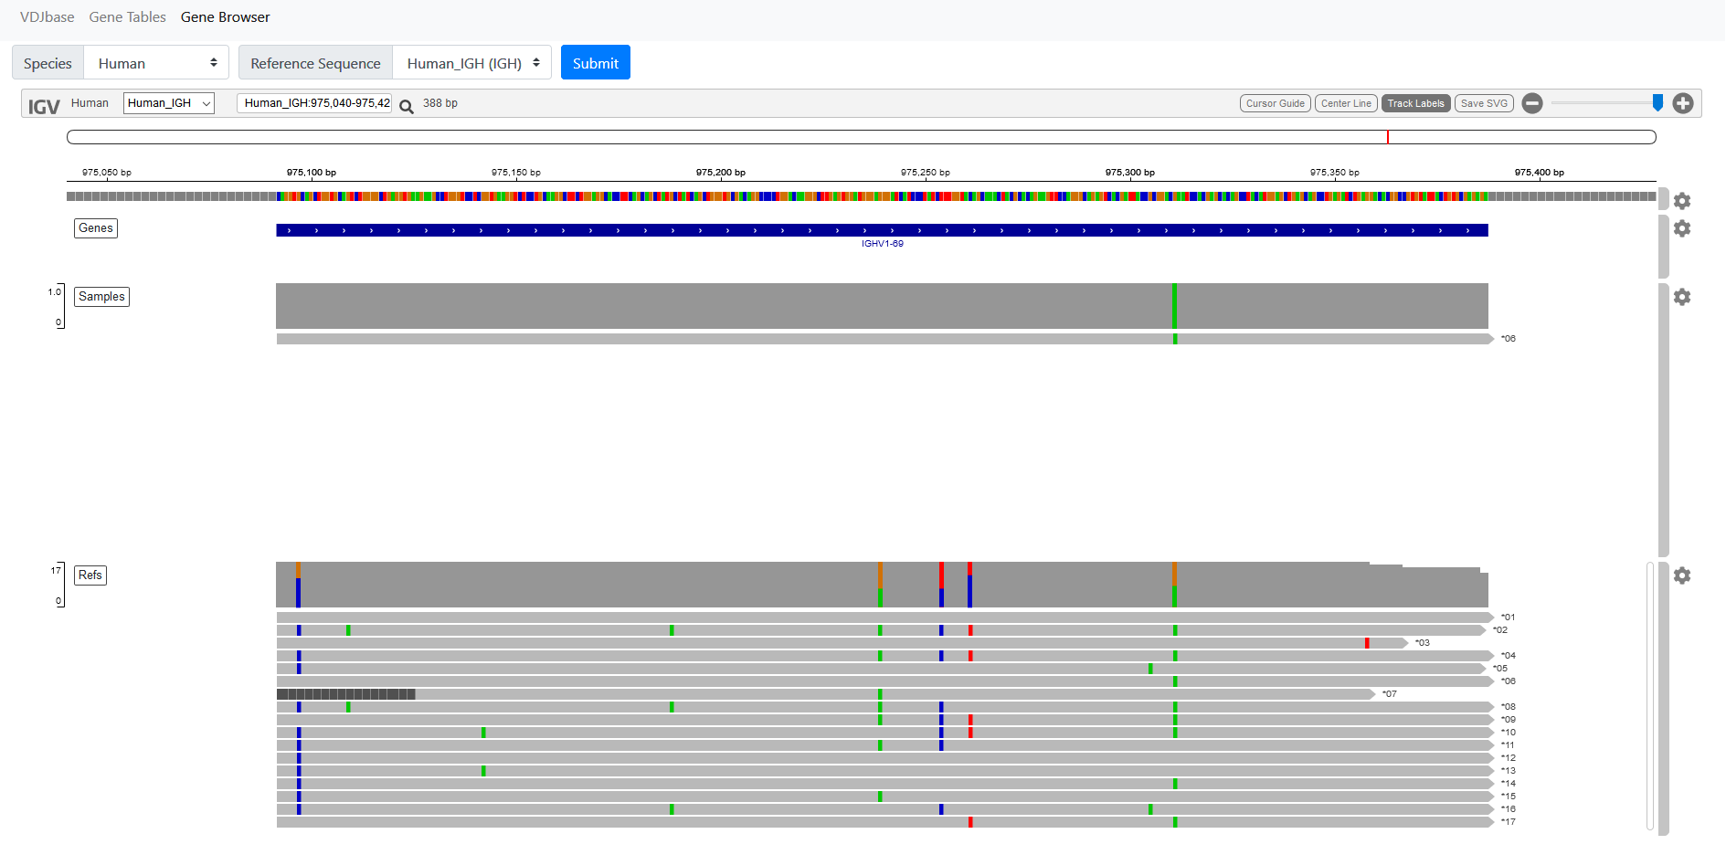
Search by partial allele name, e.g. 4-34
double click to zoom
Reference Sequence
Sequences found within samples
Sequences in IMGT reference set, + novel sequences from samples
Click on track or SNP for info

