Slide 1
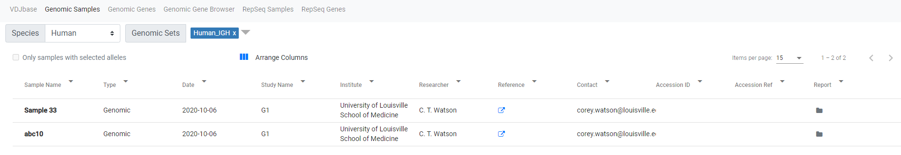
Samples in this set. Click on a sample name for details
Select columns to show. Drag to change order
Filter or sort by any field
Click for reports from underlying tools
Select a subset of genes on the Genes tab, then check this box for corresponding samples

Slide 2
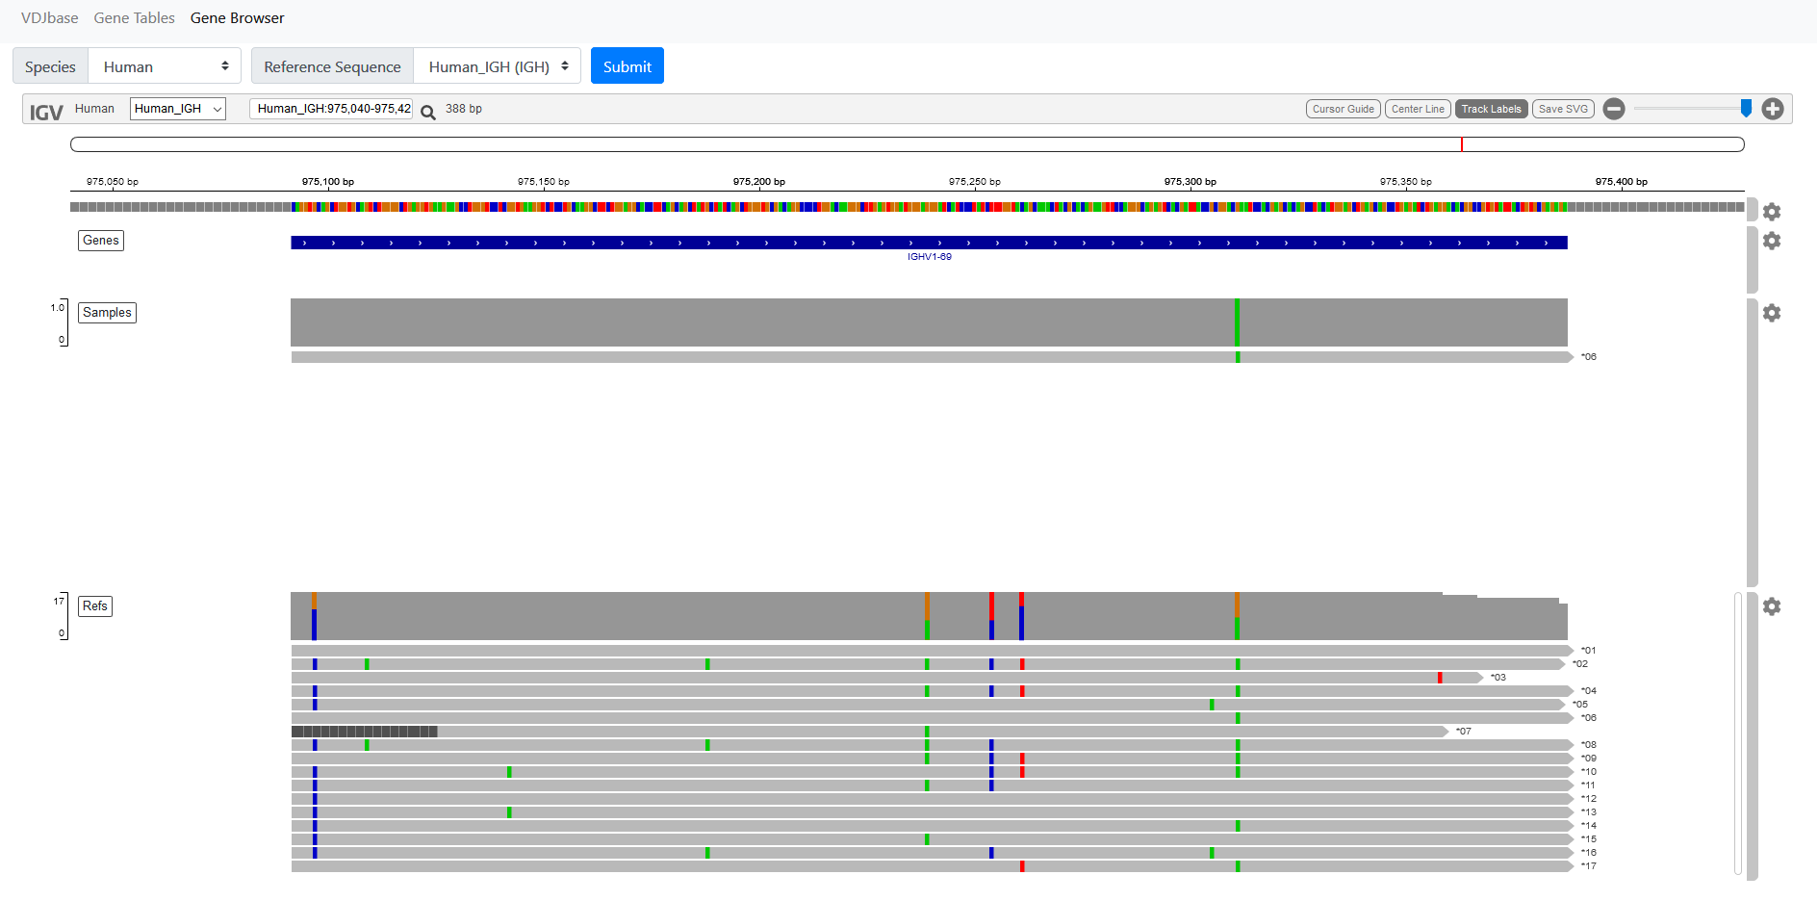
Search by partial allele name, e.g. 4-34
double click to zoom
Reference Sequence
Sequences found within samples
Sequences in IMGT reference set, + novel sequences from samples
Click on track or SNP for info

