Slide 1
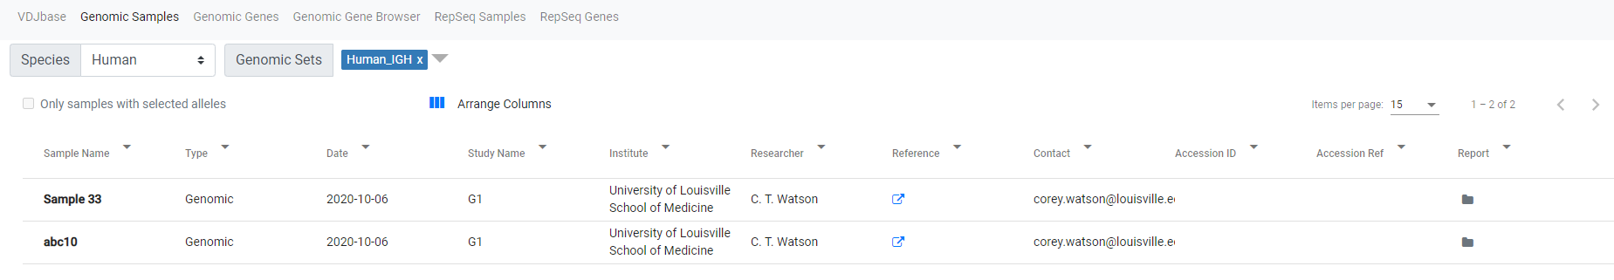
Samples in this set. Click on a sample name for details
Select columns to show. Drag to change order
Change column width by dragging divider
Filter or sort by any field
Click for reports from underlying tools
Select a subset of genes on the Genes tab, then check this box for corresponding samples

Slide 2
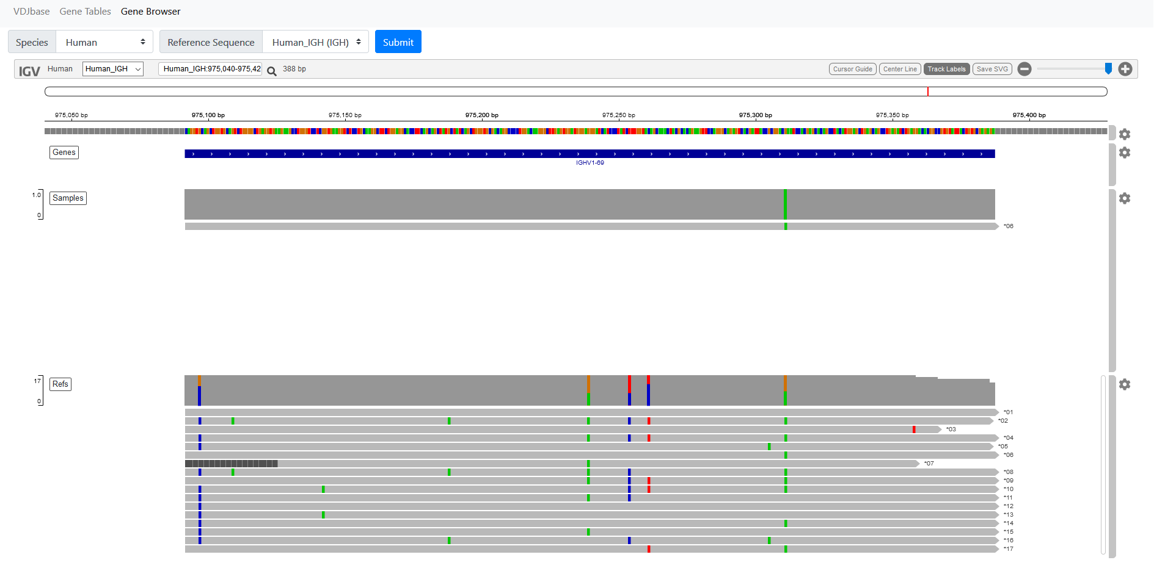
Search by partial allele name, e.g. 4-34
double click to zoom
Reference Sequence
Sequences found within samples
Sequences in IMGT reference set, + novel sequences from samples
Click on track or SNP for info

