Slide 1
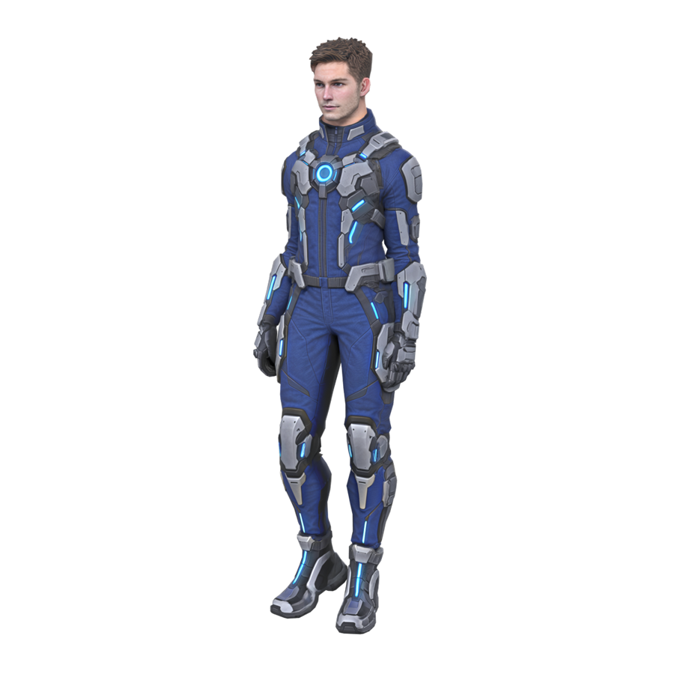
MISSION:
APEX STRIKE
AME 294 · PG3: UNREAL OR UNITY MCP GAME
A magnetic-boots puzzle game in Unity 6, and how it was built with AI
William Edwards
Notes:
Hi, I’m William. This is Mission: Apex Strike, a 3D puzzle obstacle course built in Unity 6, where magnetic boots let you walk up walls and across ceilings. I’ll cover what the game is, how it was built, the pipeline I used to go from a text prompt to a playable 3D model, the problems playtesting caught, and how the work split between me and the AI tools. (About 20 seconds.)

Slide 2
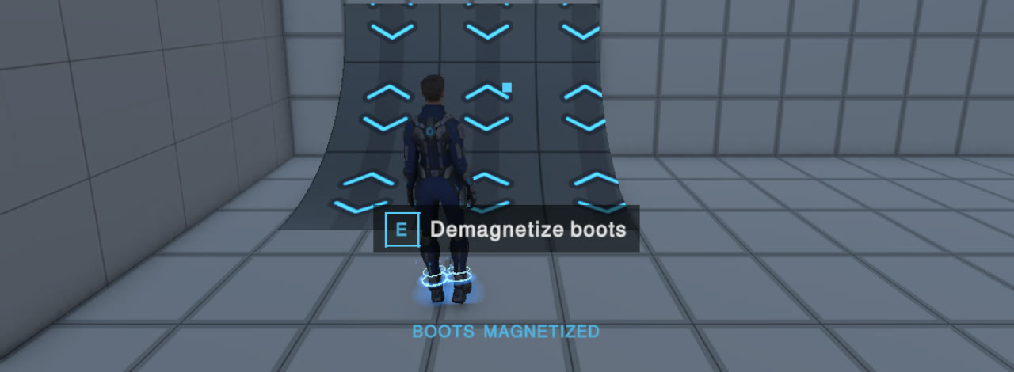
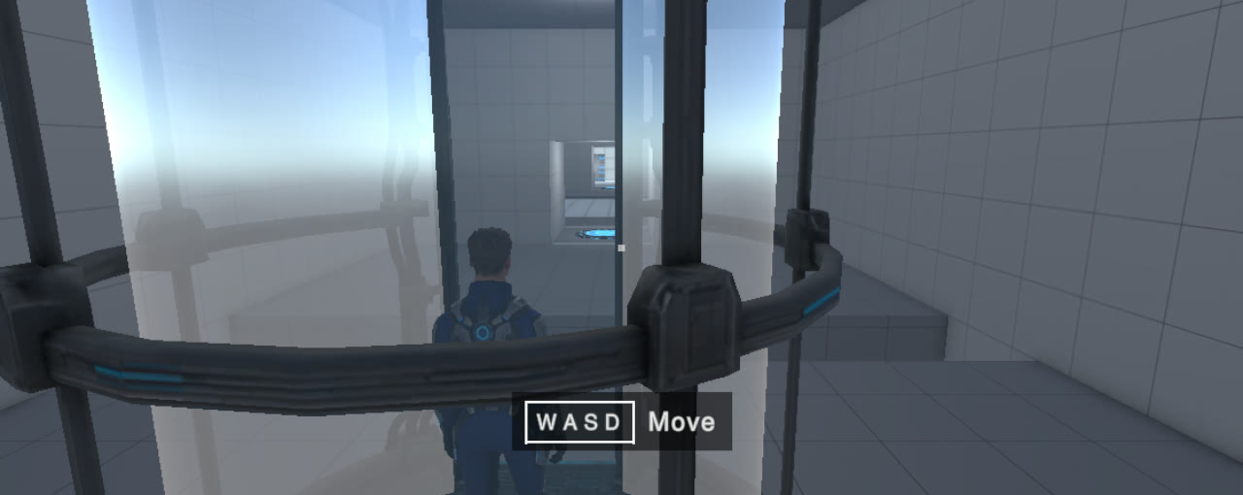
WALK ON WALLS.
DROP ON PURPOSE.
THE GAME
A 3D puzzle obstacle course. Magnetic boots stick to bright panels, curves carry you onto walls and ceilings, and switching the boots off drops you back to the floor.
The original brief: “an obstacle course with gravity effects enabled by Magnetic Boots… sci-fi/Portal style.”
Notes:
The pitch in one line: walk on walls, drop on purpose. You switch the magnetic boots on while standing on a bright magnetic panel, and curved ramps carry you up onto walls and across ceilings. Switch them off and you fall back to the floor, landing upright. That drop is the main puzzle tool: most rooms are about getting somewhere high, then letting go at exactly the right spot. The look was meant to echo Portal’s clean test chambers. (About 30 seconds.)

Slide 3
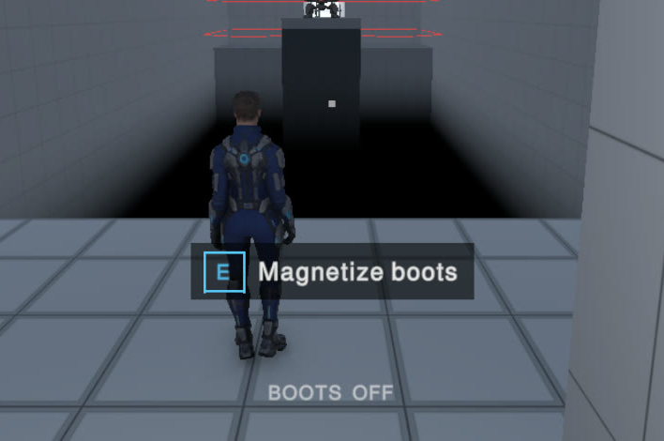
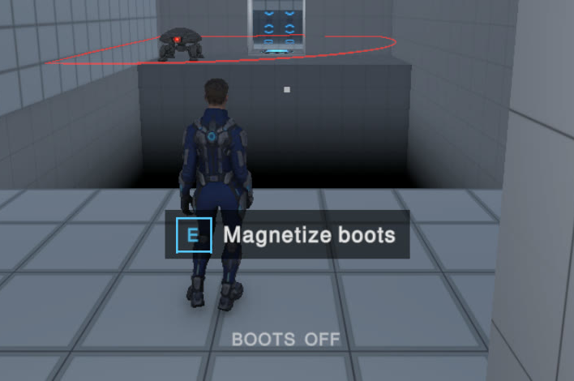
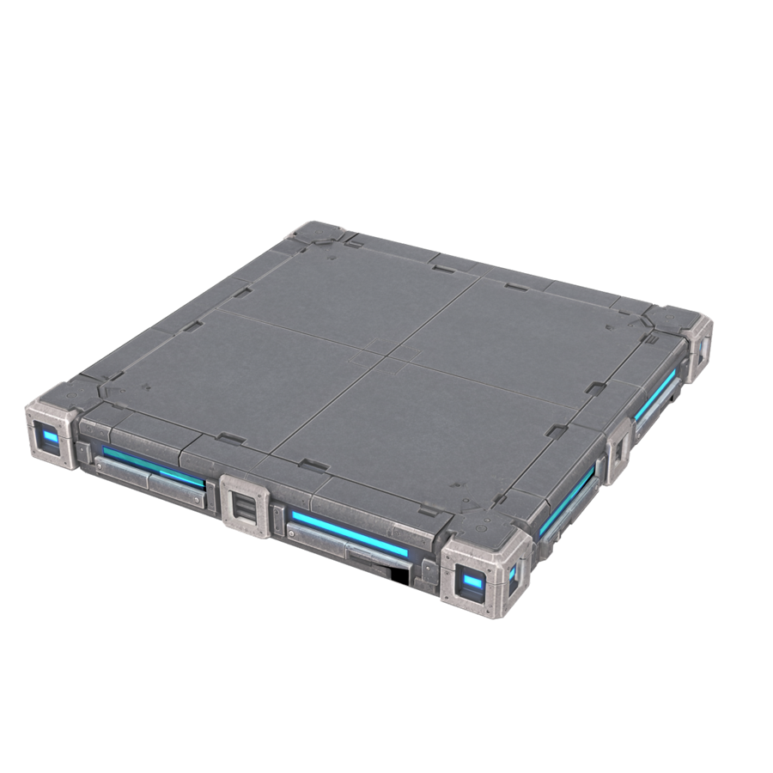
FOUR RULES, COMBINED ROOM BY ROOM
MECHANICS
Curves turn you
Drops are the puzzle
Sentries see a plane
Timing is exact
Quarter-pipes carry you onto walls and ceilings. A sharp corner is a dead end.
Boots off: fall and land upright. A marker shows where: blue safe, red void, gold sentry.
One hit kills and speed won’t save you. Drop on the dome to destroy one.
Platforms and shuttles run on a clock that rewinds on respawn, so every try is identical.
Notes:
Four rules carry the whole game. First, orientation only changes along curves: walk up a quarter-pipe and you’re on the wall; a sharp corner stops you, on purpose, so routes are readable. Second, drops: with the boots off you fall toward the world floor, and a landing marker turns blue, red or gold depending on what’s below. Third, sentries see and shoot only in a flat plane about a metre above their floor; the only way to kill one is to drop on its dome. Fourth, every moving platform runs off one clock that rewinds when you respawn, so timing puzzles behave the same every attempt. (About 40 seconds.)

Slide 4
FOURTEEN ROOMS, ONE IDEA AT A TIME
THE CHAMBER
Learn · rooms 1–10
Combine · rooms 11–13
Challenge · room 14
Walk · Boots · First Curve · Ceiling · Over the Edge · Island · Platforms · Shuttle · Sentry · Stomp
Finale · Corkscrew · Diving Board
Gauntlet
Floor → wall → ceiling → wall, then a drop from a wall onto a sentry; a jump onto a ferry.
Two ceiling shuttles meet for 2 s; drop onto an island sentry; a running jump onto a second sentry.
Each room introduces one idea, with a checkpoint after it.
Every room is proved solvable: a scripted run finishes the whole chamber with zero deaths, in about 225 s.
Notes:
The level is one long chamber of fourteen rooms. The first ten each teach a single idea, from walking and jumping up to stomping a sentry. Then three rooms combine them: the Corkscrew takes you floor to wall to ceiling to wall and ends with a drop from a wall onto a sentry; the Diving Board has you walk off a ledge onto a ferry. The Gauntlet is the deliberate challenge: two upside-down shuttles that only meet for two seconds, then a drop onto a sentry on an island, and a running jump onto another one. The AI also wrote a frame-stepped script that plays the whole chamber, so every room is proved solvable. (About 40 seconds.)

Slide 5
BY THE NUMBERS
HOW IT WAS BUILT
170
344
17 → 6
prompts to the coding agent, all logged
automated tests (62 EditMode, 282 PlayMode)
concept images, turned into six Tripo models
≈750
31 → 13
14
Tripo credits, including drafts and retries
sound generations, narrowed to the 13 in the game
rooms, proved solvable by a scripted run
Notes:
Some numbers for scale. The game took about 170 prompts to the coding agent, every one logged in the repository. The agent wrote 344 automated tests along the way, which mattered: the player motor has to work on floors, walls and ceilings, so movement is tested in all six orientations. Art went from 17 concept images to six Tripo models for roughly 750 credits, and sound from 31 generations down to the 13 effects that shipped. (About 30 seconds.)

Slide 6





ONE AGENT DRIVING THE ENGINE
TOOLCHAIN
Claude Code
Unity 6
Codex CLI
Tripo Studio
ElevenLabs
Claude Opus 5.5
URP · CLI · Pipeline
GPT image tool
Pro plan
Creator plan
All code and tests, level building, shader, audio wiring, UI, builds
The agent ran C# in the open Editor, Play mode, tests and captures
17 concept images, called by Claude Code
Six models, auto-rig, eight animation clips
13 sound effects through the API; two music tracks
The agent didn’t just write files: it controlled the running Editor, so it could build levels, play them and check the result itself.
Notes:
Here’s the toolchain. Claude Code, on Claude Opus 5.5, wrote all of the code. The key for this assignment is that it drove Unity directly: through the Unity command line and the Pipeline package it could run C# inside the open Editor, enter Play mode, run tests and take screenshots, so it could build a room, play through it and see whether it worked. For art, Claude Code called the Codex CLI to generate concept images, and I turned those into models in Tripo. Sound effects came from the ElevenLabs API, and I made the music in ElevenLabs myself. (About 35 seconds.)

Slide 7






THE LOOP BEHIND EVERY FEATURE
PROCESS
Plan
Build
Describe
Playtest
Commit
The agent proposes; I question and decide
Code and tests, then it plays the result in the Editor
I set the goal and the constraints
I play it and say what feels wrong
Only on my go-ahead
Playtest notes loop back to Build until it feels right. White steps are mine; blue steps are the agent’s.
Grey boxes first. Art and sound went onto a game that already played well.
Measure, then fix. Logs, captures and sampled animation before any change.
Test every orientation. Each movement rule checked on floors, walls and ceilings.
Notes:
Every feature went through the same loop. I describe what I want and the constraints. The agent proposes a plan, and I question it; sometimes that changes the design. For example, it first built transitions at wall corners, and I said orientation should only change along curves, which became the rule the whole game is built on. Then the agent builds: code, tests, and then it actually plays the result inside the running Editor. I playtest and say what feels wrong, and that loops back until it’s right. Nothing is committed without my go-ahead. Three habits made it work: mechanics in grey boxes before any art, measuring before fixing, and testing every movement rule on floors, walls and ceilings. (About 45 seconds.)

Slide 8
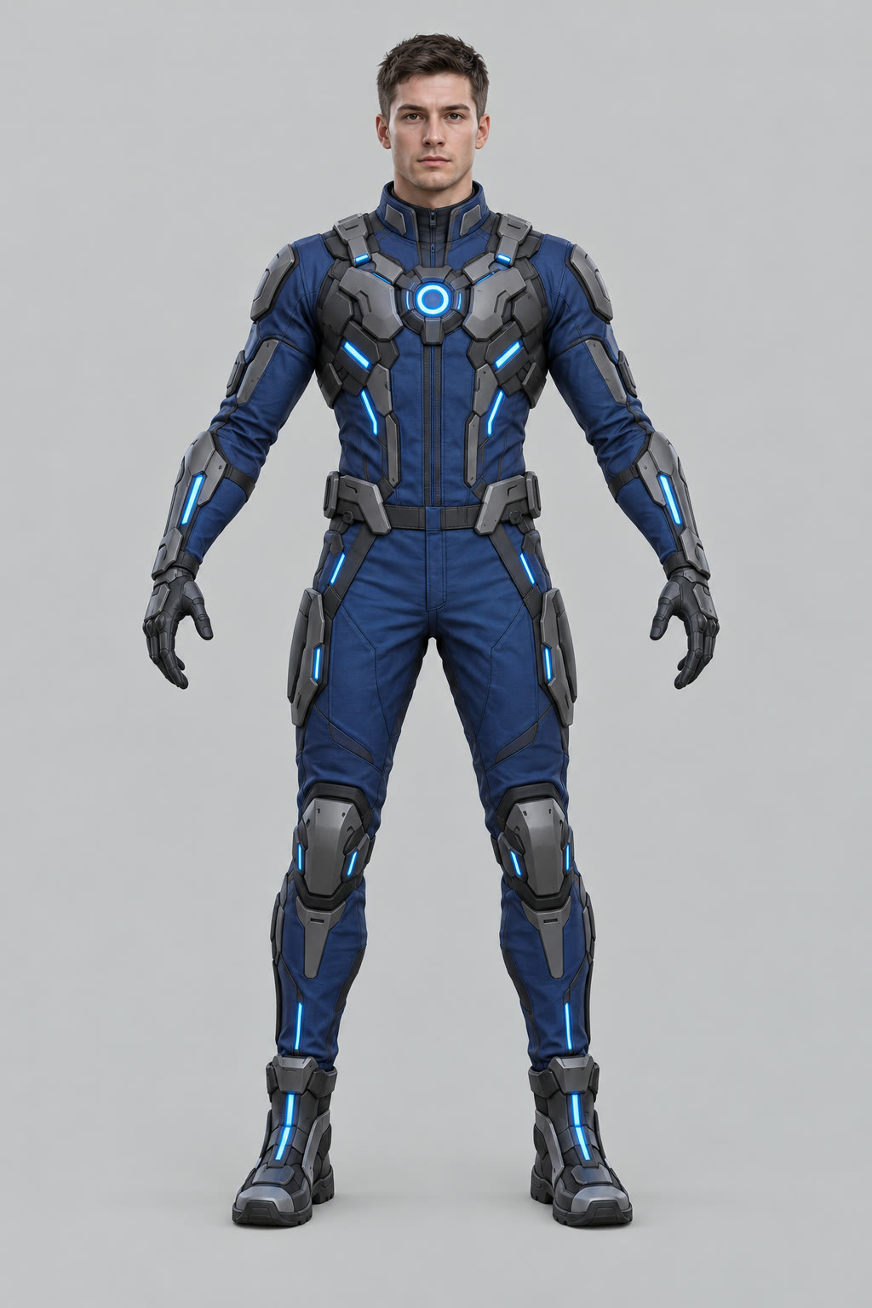
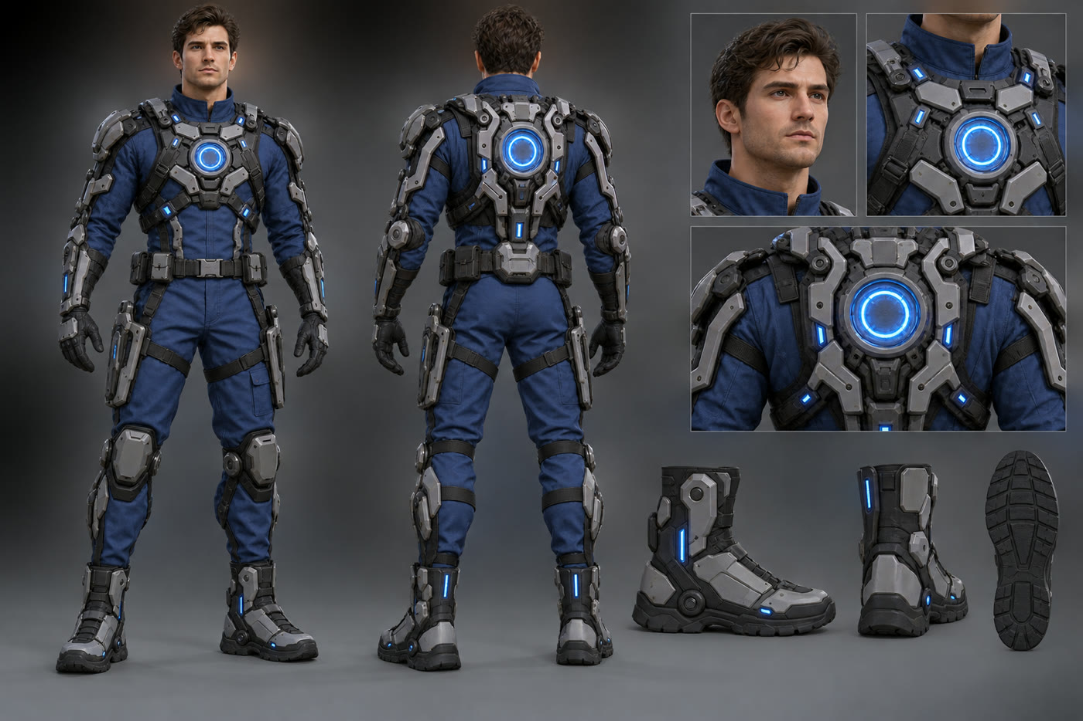

FROM A SENTENCE TO A PLAYABLE MODEL
3D ASSET WORKFLOW
1 · Prompt
2 · Codex image
3 · Refined
4 · Clean image
5 · Tripo 3D
6 · In Unity
“Athletic man in blue jumpsuit with sci-fi exoskeleton, glowing blue circle on chest…”
One view · A-pose · whole body · plain background · no panels or props
I describe the asset
Good design, busy sheet
AI rewrites it for Tripo; I approve
Front, then back from it
Model, rig, animations
AI fits and wires it
The second pass is the trick: image-to-3D wants one clean view, not a pretty concept sheet.
Notes:
This is the 3D pipeline, the same for every model. One: I describe the asset in a sentence. Two: Claude Code sends that to the Codex CLI, which generates a concept image. The first results looked great but were concept sheets: several views, close-ups, dramatic lighting. Image-to-3D tools get confused by that. Three: the agent rewrites the prompt for Tripo: one view, a neutral A-pose, the whole body in frame, a plain background, no extra panels. I approve it before it runs. Four: we get a clean front view, then generate the back view from it, so the two match. Five: I build the model in Tripo, rig it and add animations. Six: the agent imports it, fixes scale and orientation, and wires it into the game. (About 45 seconds.)

Slide 9
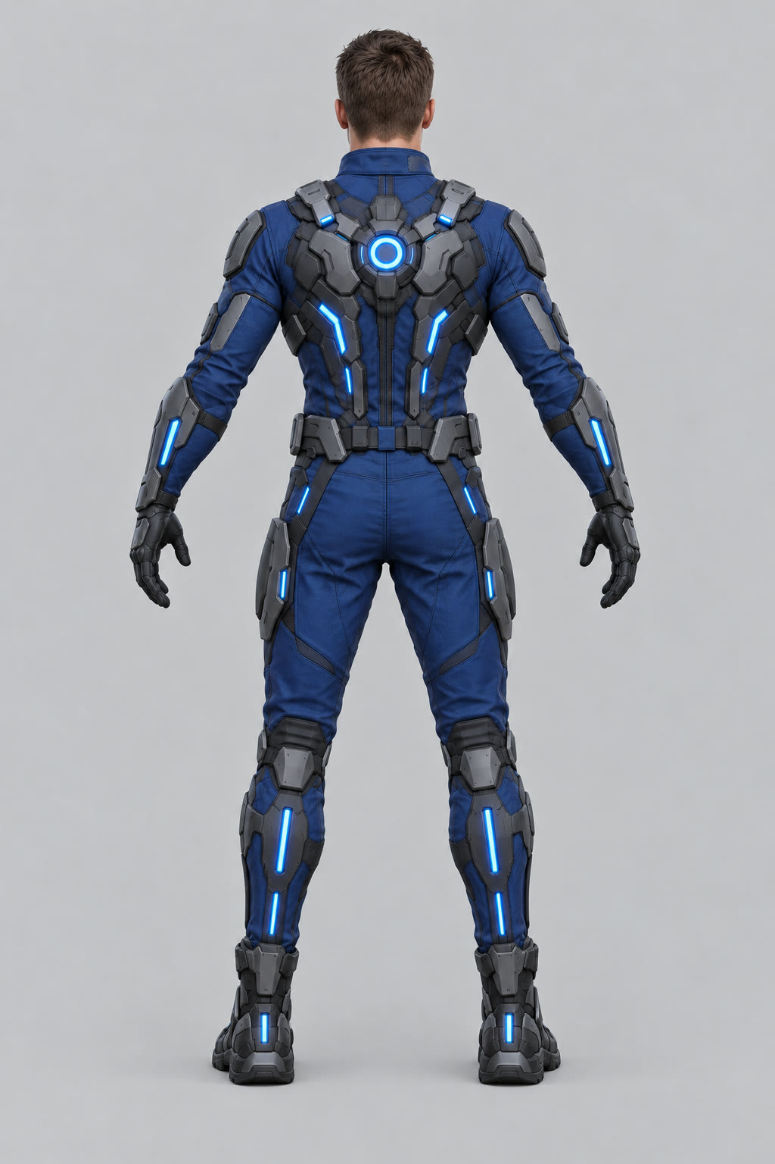

A CONCEPT SHEET BECOMES A RIGGED HERO
EXAMPLE 1 · THE PLAYER
FIRST TRY · MY PROMPT
TRIPO MODEL
“Athletic man in blue jumpsuit with sci-fi exoskeleton, glowing blue circle on chest and back plate. Front and back views. Sci-fi cyberpunk boots with flat gray panels.”
REFINED FOR TRIPO
Front view only, back view made from it · A-pose, arms 45° out · plain grey background, no shadows · slim silhouette, nothing loose
Humanoid rig; Idle, Walk, Run, Jump, plus four text-to-animation clips
Notes:
Here’s the player in detail. On the left is my original prompt and what came back: a lovely character sheet, with front and back views, a face close-up, chest and boot details. As concept art it’s great, but it’s a bad input for 3D. The agent rewrote it with Tripo in mind: front view only, an A-pose with the arms out so the auto-rigger can separate them, a plain background, nothing loose like capes or straps. Then it generated a back view using the front as the reference, so they match. Those two images went into Tripo, and on the right is the model it produced, rigged as a humanoid with walk, run, idle and jump, plus four more clips I generated from text. (About 40 seconds.)

Slide 10
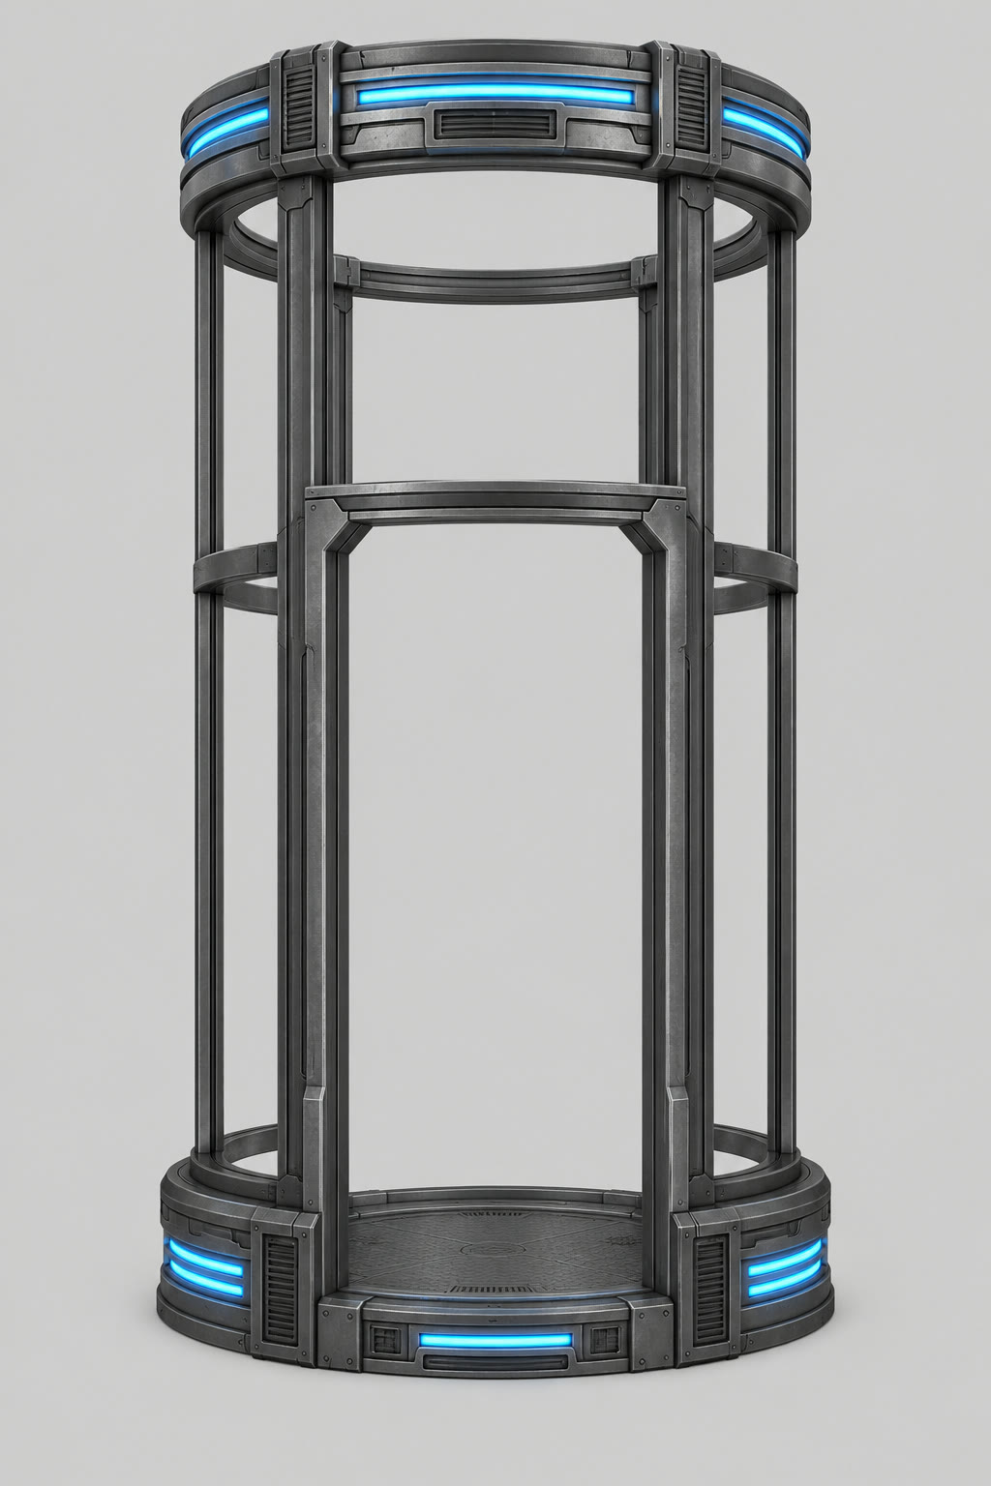
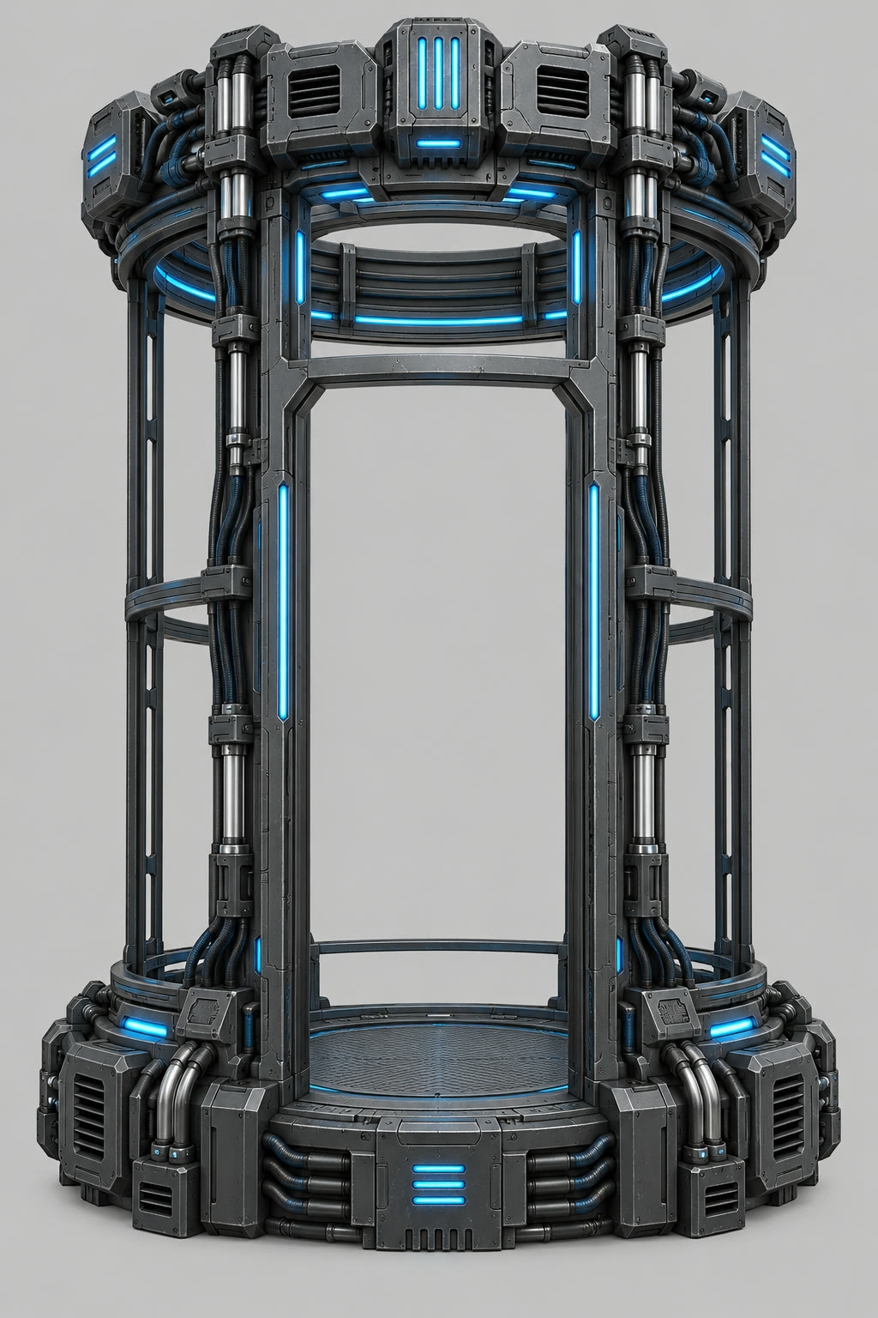
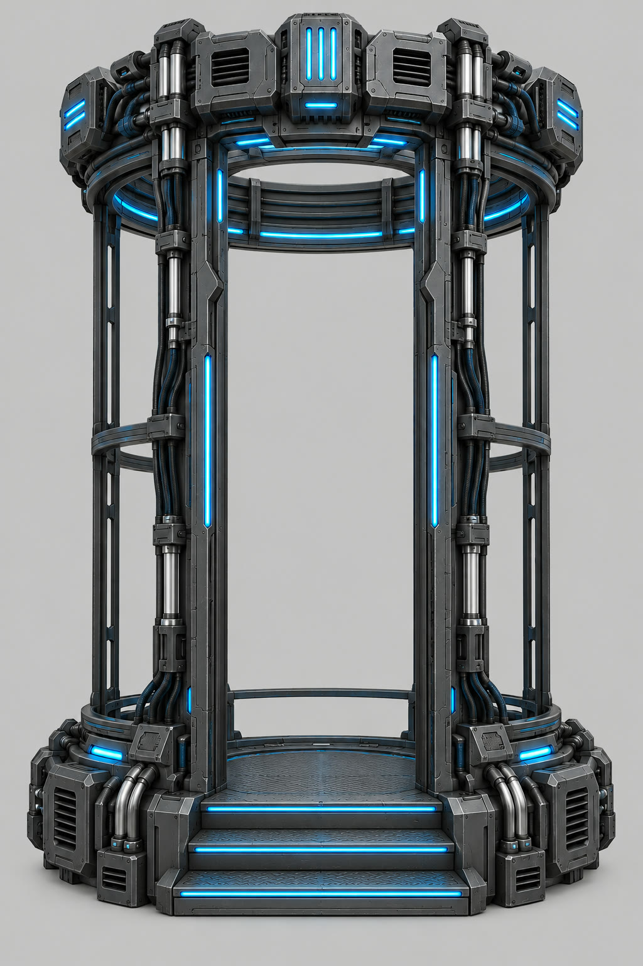
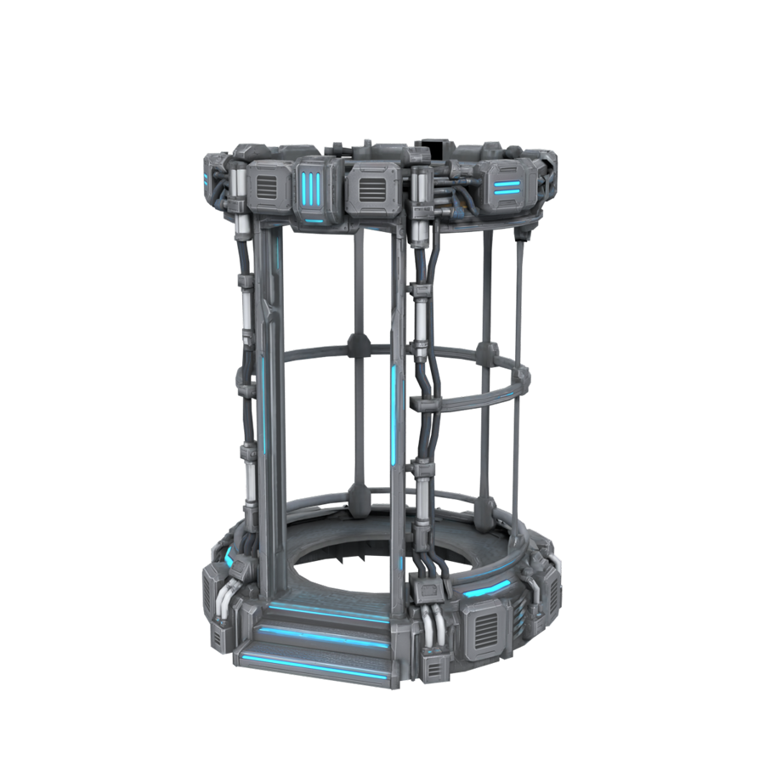
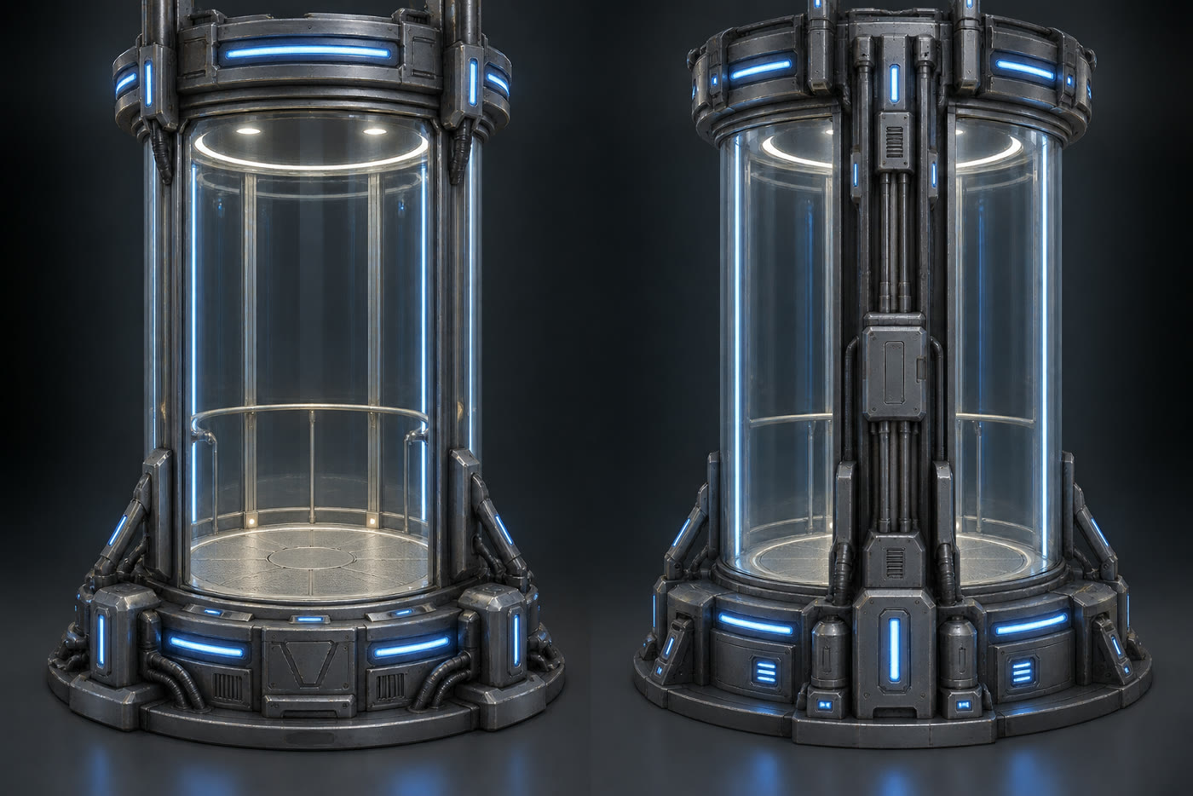

FOUR IMAGES, STEERED BY EYE
EXAMPLE 2 · THE TUBE ELEVATOR
1 · My prompt. Glass tube, machinery at base and top.
2 · Tripo-ready. One view, open frame. “Too plain.”
3 · Heavier. Collar and crown, pipes, protrusions.
4 · Steps added. Then a matching back view.
5 · Tripo model. Its empty floor ring holds our moving platform.
Notes:
The elevator shows the back-and-forth. My first prompt gave a pair of glass tubes, which is the look I wanted but, again, two views on a dark background. The Tripo-ready rewrite was clean but, in my words, too plain. So we asked for a substantial collar and crown with pipes and protrusions, then added steps up into the doorway, and generated the back view from that. When Tripo built it, the floor came out as a ring with a hole in the middle. I asked if that was a problem, and it turned out to be perfect: the moving platform that lifts you sits right in that gap. (About 40 seconds.)

Slide 11
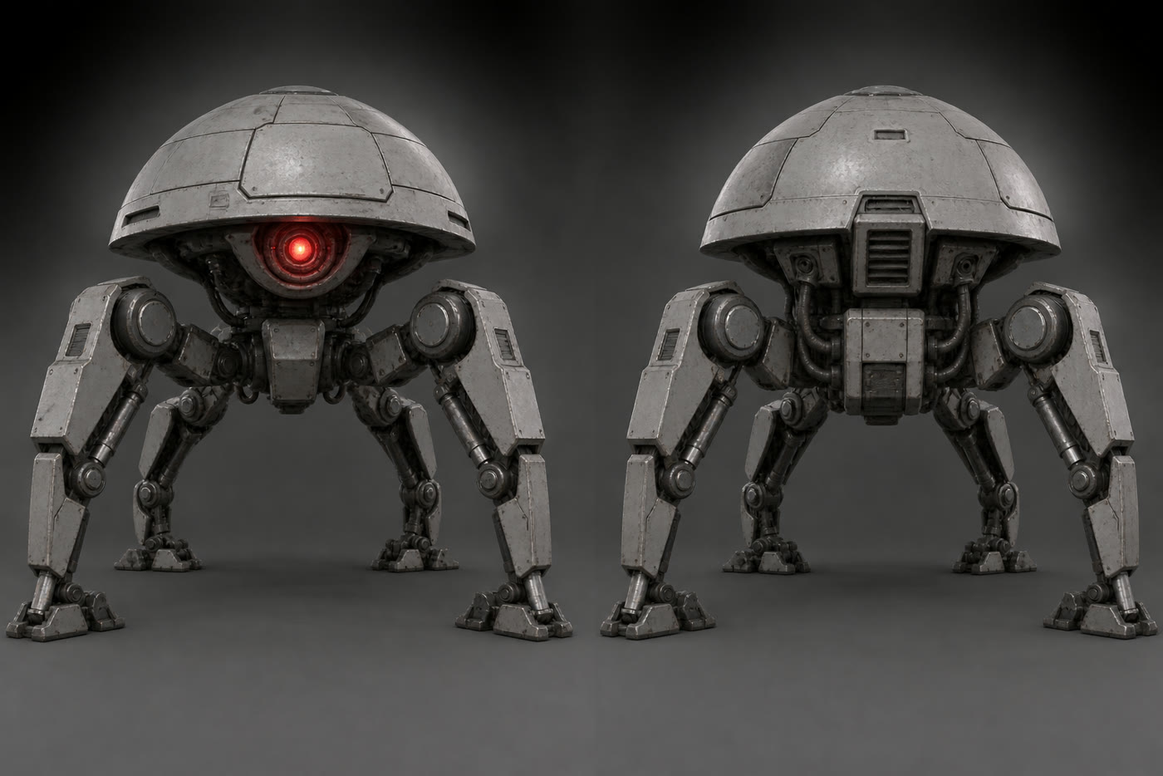
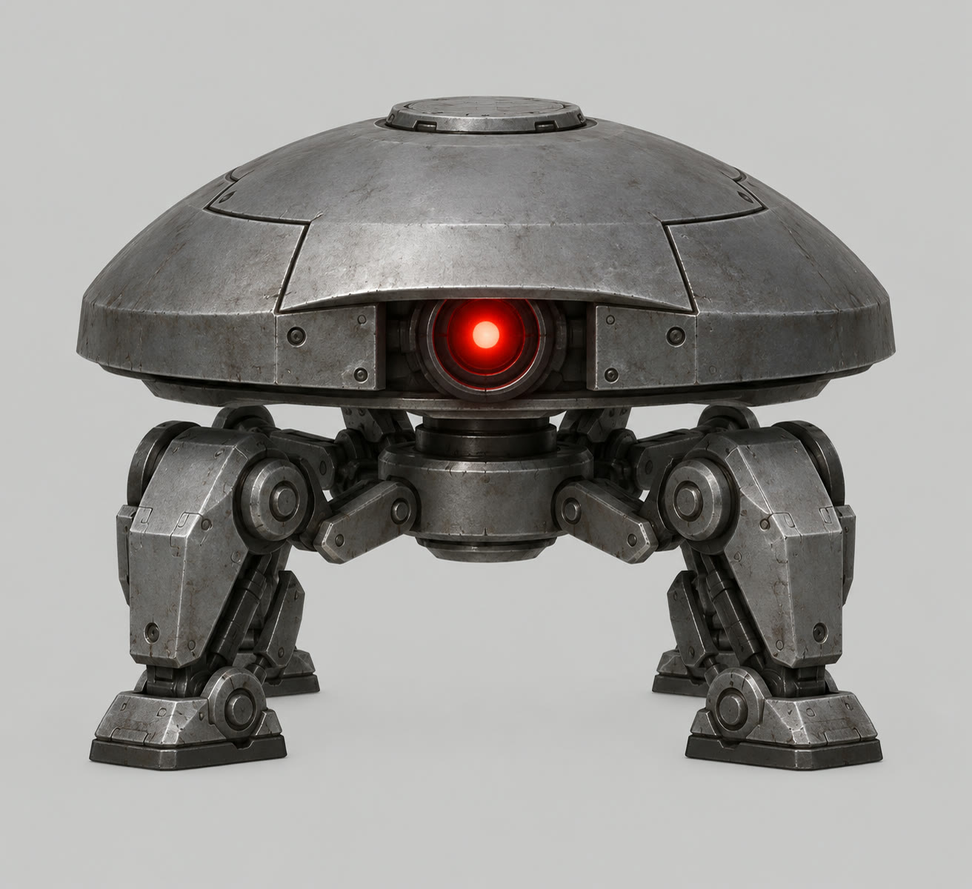
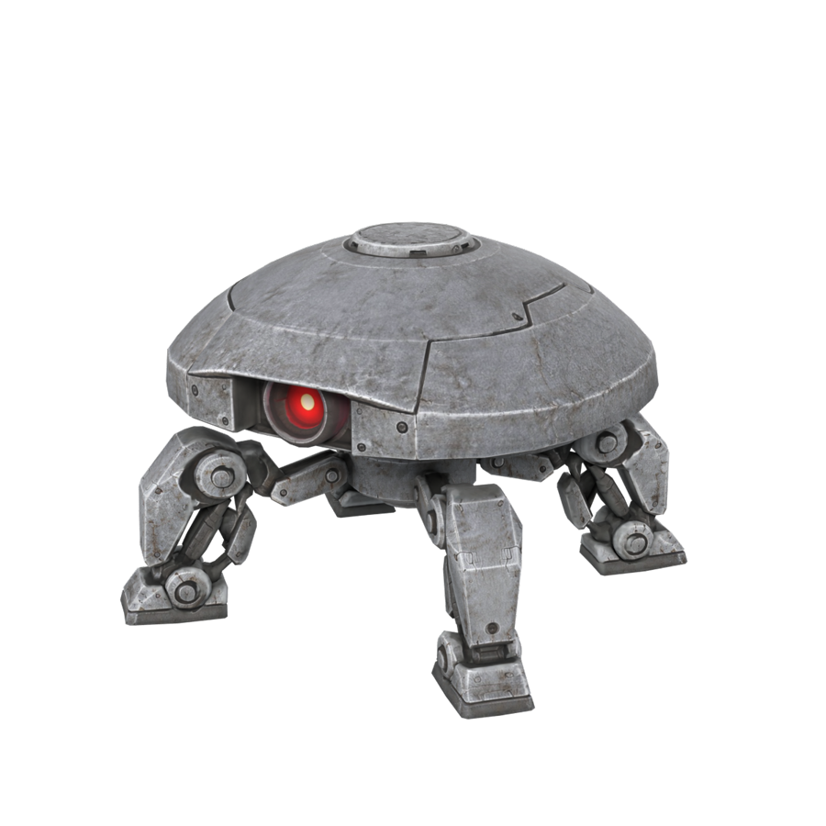
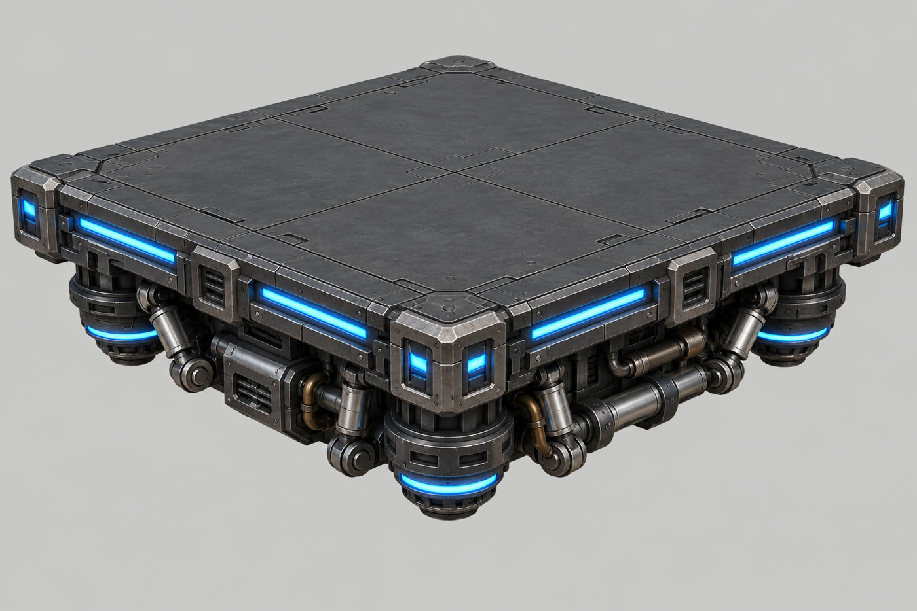
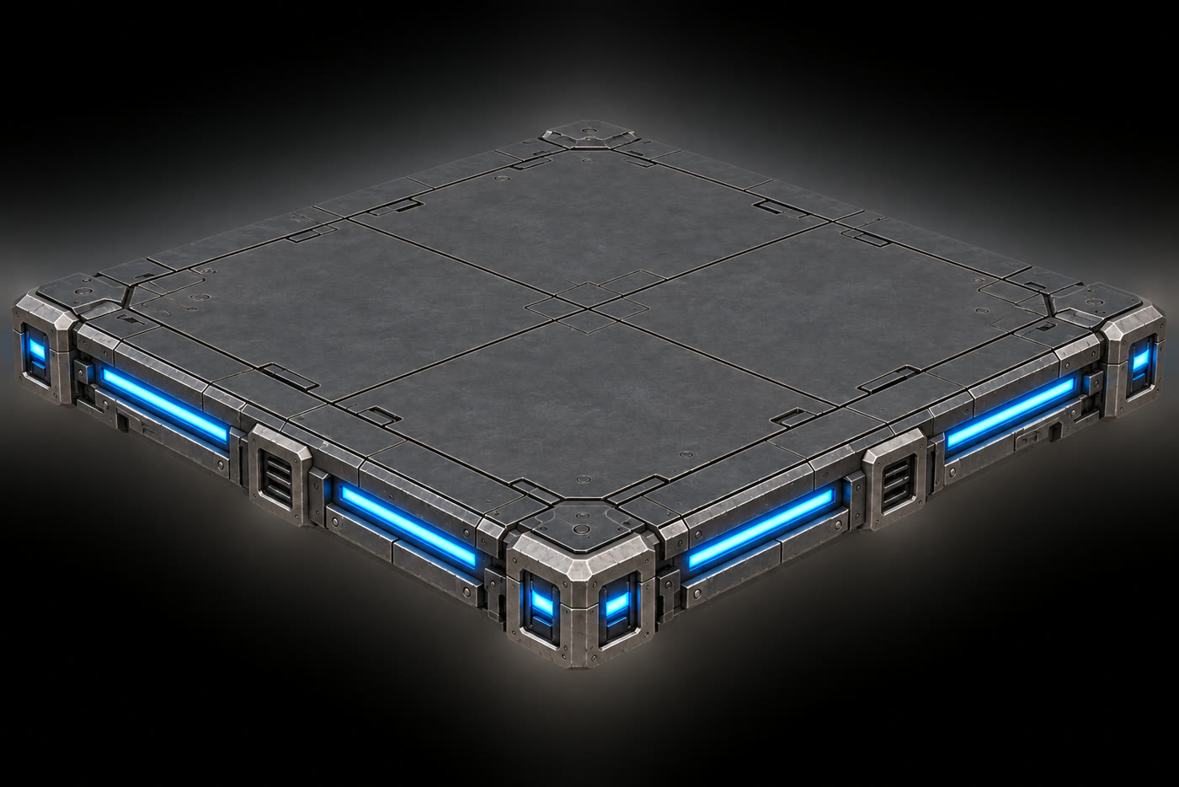
PROMPTING FOR HOW IT WILL BE USED
EXAMPLES 3 AND 4
Sentry
Asked for a domed head that reads as a separate part, so it could turn to aim on its own.
Moving platform
I spotted the thrusters underneath would hit the level, so: a flat slab, detail on the edges only.
Notes:
Two more examples, both about designing for how the model will be used, not just how it looks. For the sentry, I knew only its head should turn to aim, and Tripo can’t rig a robot that way. So the refined prompt asked for a clear gap between the dome and the legs, so the head reads as a separate part. Tripo split the model into 40 pieces, and the agent grouped them into a body and a head that turns in code. For the moving platforms, the first concept had thrusters and pistons underneath. I noticed those would collide with the level, so we asked for a thin, flat slab with all the detail on the edges. (About 35 seconds.)

Slide 12
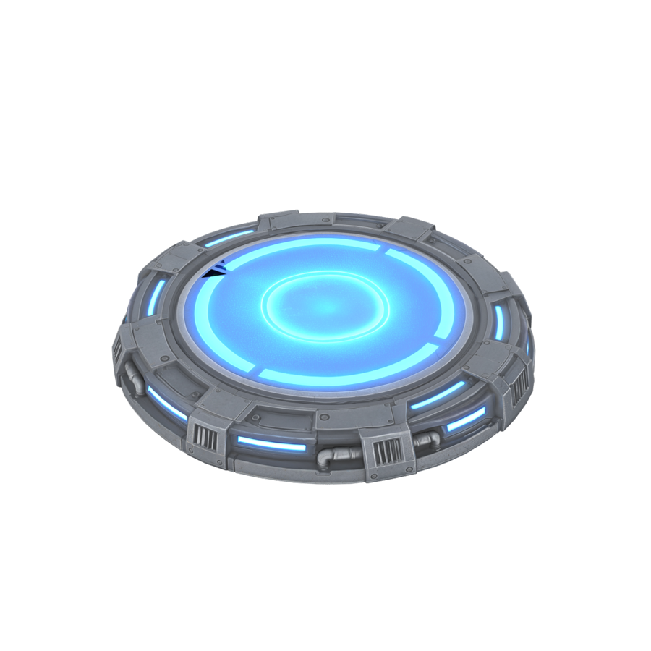
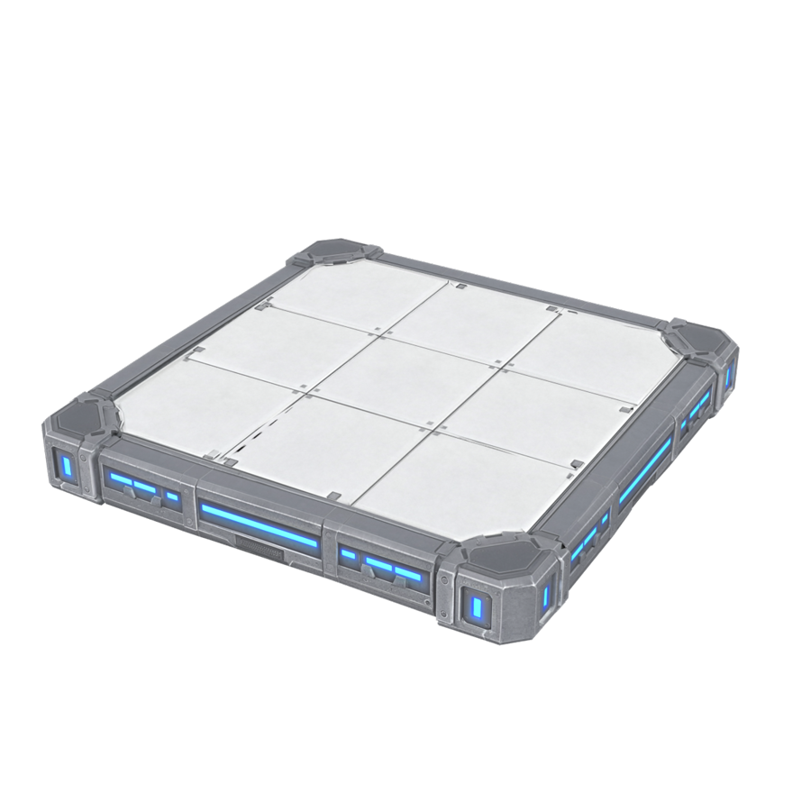
FROM TRIPO EXPORT TO PLAYABLE
INTO THE ENGINE
Scale and axes
Split to animate
Clips by playing
Skins on boxes
Exports arrive about 1 m tall and Z-up. The sentry first came in lying on its back.
40 auto-segmented parts grouped into a body and a head that aims.
Three text-to-animation walks tried in game; the third, at 3 m/s, stayed.
Models stretch over simple collider boxes, so the physics never changed.
Notes:
Getting a model into the game was its own step. Tripo exports come in about a metre tall with the Z axis up; the sentry first appeared lying on its back until the agent fixed the axes. The sentry’s 40 parts became two prefabs. For the character’s magnetized walk I generated three walk animations from text in Tripo; the first was too slow to be fun, the second over-reached, and the third, at 3 metres a second, is the one in the game. And every model is a skin over a simple box collider, so swapping art never changed how the physics plays. These are all six models. (About 35 seconds.)

Slide 13
GENERATED IN ROUNDS, CHOSEN BY EAR
SOUND
1. The agent writes prompts and calls the ElevenLabs API.
CHOSEN FOOTSTEPS, OPTION D OF 4
2. Options go on a listening page, matched in loudness.
“…Tactical boots with hard composite soles on a smooth spaceship floor panel, crisp heel and toe”
3. I pick, then we hear it in the game.
4. My playtest notes set the next round.
3 rounds · 31 generations · 13 sounds in the game · 723 credits
CHOSEN SENTRY LOCK-ON, OPTION A OF 4
“Menacing robot sentry waking and locking on: a deep low mechanical growl rising slightly, ending in a heavy low targeting thrum”
Notes:
Sound worked in rounds. The agent wrote prompts and generated effects through the ElevenLabs API, then put the options on a listening page, matched in loudness so I was comparing character, not volume. I picked, we heard it in the game, and my notes set the next round: footsteps too quiet, the hum inaudible, the sentry not menacing enough. Three rounds, 31 generations, 13 sounds in the final game. The music I made myself in ElevenLabs. (About 30 seconds.)

Slide 14
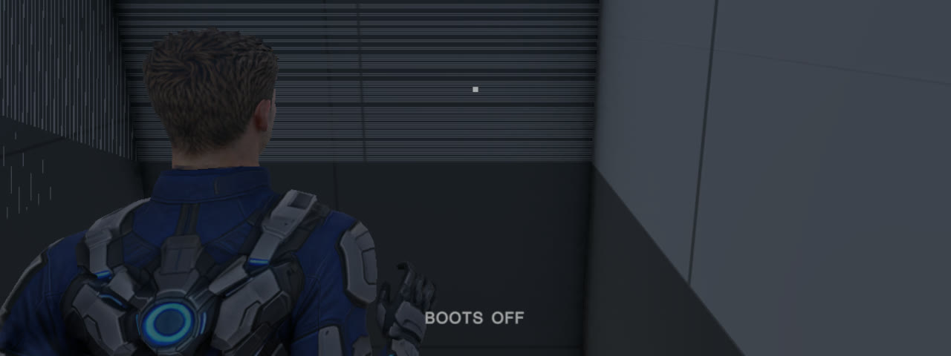

WHAT THE TESTS COULDN’T SEE
FOUND BY PLAYTESTING
Before: the start shaft flickered on the ride up
After: walls inset 5 mm from the floor’s cut edges
Jitter while riding platforms
Flickering corridor floors, twice
The player was drawn smoothly between physics steps; platforms weren’t. Now both are, and the gap holds at 2.0 cm.
Floors ran into the doorways. Fixed, then reintroduced by the script that built the new rooms.
Notes:
Automated tests check that things work; they can’t tell you something looks wrong. All of these came from me playing. When the start elevator rose, the shaft walls flickered in stripes: the floor’s opening was exactly as wide as the shaft, so two surfaces shared a plane and fought. Insetting the walls five millimetres fixed it. Riding a platform jittered, because the player was drawn smoothly between physics steps but the platforms weren’t. And the corridor floors flickered: they ran into the doorways. That one came back when the agent generated new rooms with the same mistake, which is a good reminder that AI-generated content needs re-checking too. (About 40 seconds.)

Slide 15
WHAT FELT WRONG, AND WHY
FOUND BY PLAYTESTING
What I noticed | The cause | The fix
Sentries beaten by jumping or speed | Reacted only once you were in its plane | Charges early; fires the instant you enter
A descending platform pushed me through the floor | Push-out took the shortest way: down | Step the player aside instead
Footsteps and boot hum barely audible | Two clips silent; hum all below 60 Hz | Recut; new prompts asking for midrange
Footsteps slightly out of time | Fired 0.05–0.1 s before the heel landed | Trigger when the foot stops moving
Never saw the first “magnetize” hint | Hint only looked for curves | Show it on the first magnetic floor
Magnetized walk “too slow to be fun” | 1.5 m/s with a heavy walk clip | New Tripo clip at 3 m/s
Notes:
And these are things that felt wrong. Sentries could be beaten by jumping in and out of their line of fire, which broke the design, so now they charge as you approach and fire the instant you enter. A platform coming down on me pushed me through the floor; now you’re stepped aside. Sound had two good examples of the AI investigating my vague notes: “footsteps barely audible” turned out to be two of the four clips being completely silent, and “the hum is inaudible” turned out to be a sound entirely below 60 hertz, which laptop speakers can’t play. When I said the footsteps felt slightly off, it measured the animation and found they fired a tenth of a second early. Each problem started as a playtest note from me. (About 50 seconds.)

Slide 16
HUMAN FIRST, AI IN THE MIDDLE, HUMAN LAST
THE WORKFLOW
Human first
AI in the middle
Human last
The concept and its rules: curves only, drops as puzzles
Code, tests and levels, in the live Editor
Playtest every change
Choose between options: clips, sounds, images
Every asset idea and first prompt
Prompts rewritten for Tripo and ElevenLabs
Which rooms, which hazards, how hard
Say what feels wrong
Diagnosis by measuring, not guessing
Approve anything risky, then commit
The models themselves, in Tripo
Scripted runs proving every room solvable
The AI did most of the typing. The decisions about what the game is, and whether it’s good, stayed with me.
Notes:
To sum up the workflow: human first, AI in the middle, human last. I started every piece: the concept and its core rules, like curves being the only way to change orientation, every asset idea and first prompt, which rooms to build and how hard to make them, and the Tripo modelling itself. The AI did the heavy middle: all the code and tests, building levels inside the running Editor, rewriting my prompts for each tool, and diagnosing problems by measuring rather than guessing. And I closed every loop: I played each change, chose between options, said what felt wrong, approved anything risky like deleting files, and only then committed. The AI did most of the typing; the decisions about what the game is, and whether it’s any good, stayed with me. (About 45 seconds.)

Slide 17
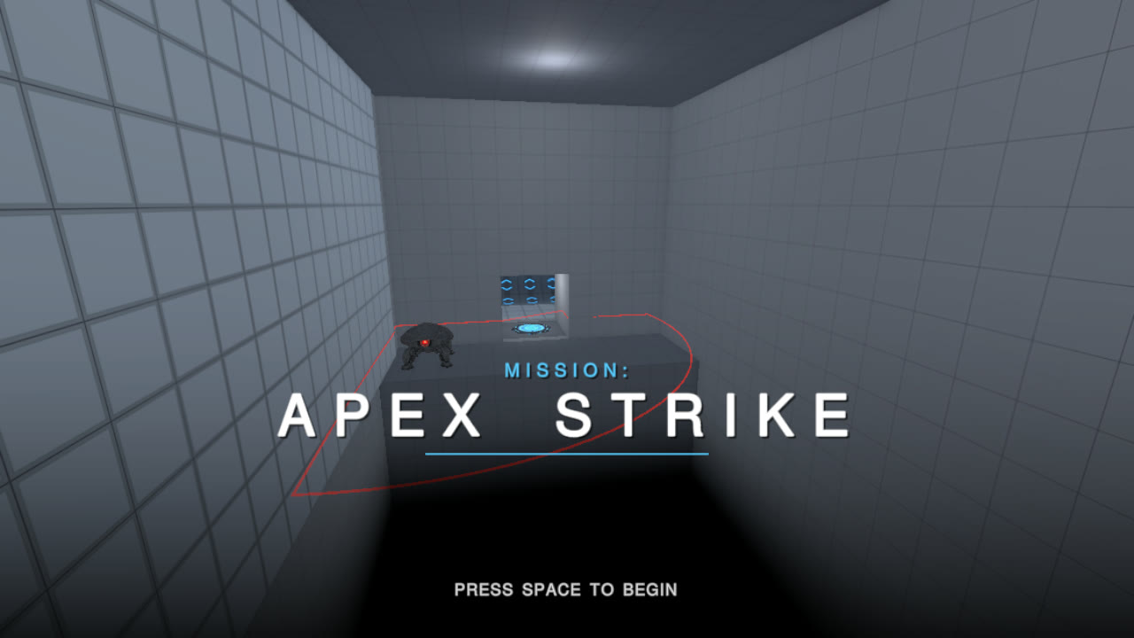
Play: aembear.itch.io/mission-apex-strike
Code and prompt log: github.com/williamedwards/mission-apex-strike
THANK YOU
Notes:
That’s Mission: Apex Strike. You can play it in the browser on itch.io, and the repository has the full project, the complete prompt log and every asset’s source prompt. Thank you, and I’m happy to take questions. (About 15 seconds.)

