Slide 1
GlaSSDOOR.COM WEB SCRAPING AND DATA ANALYSIS
BILLY FALLON
NYC DATA SCIENCE ACADEMY
02/14/2018

Slide 2
INTRODUCTION
Glassdoor.com is a leading source for company reviews, jobs listings and interview information, and salary data.
Employees and job candidates share work and interview experiences
Companies and recruiters engage with current and prospective employees while promoting available positions
In this project we will consider a large number of user generated company reviews

Slide 3
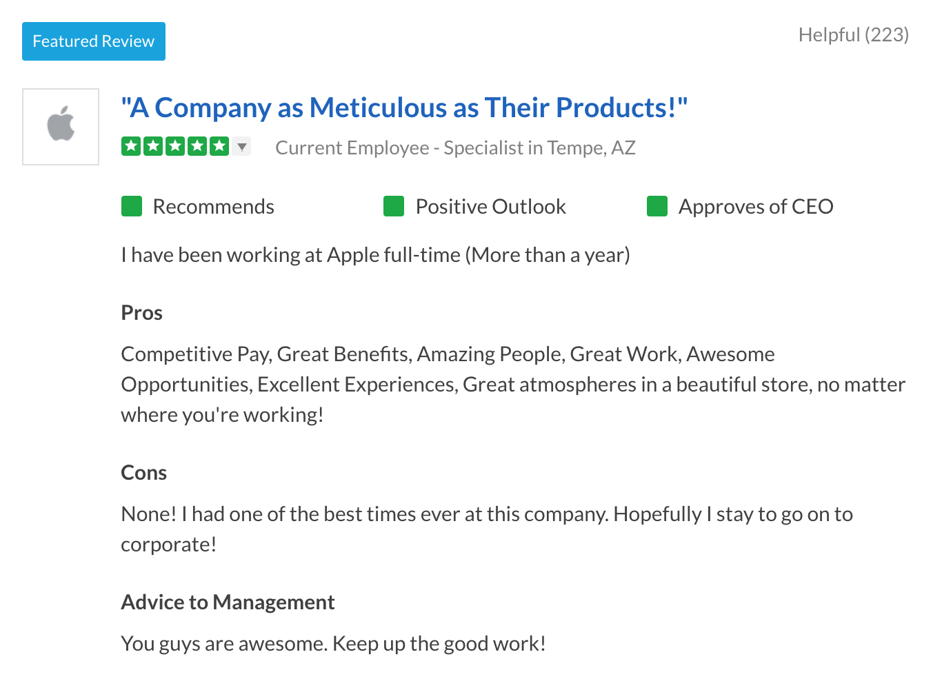
GLASSDOOR REVIEWS
Employee info:
Current vs. Former Employee
Position
Location
Review:
Overall Rating
Sub-Ratings: Work-Life Balance, Senior Management, Career Opportunities, Culture/Values, Compensation and Benefits
Outlook
CEO Recommendation
Overall Recommendation
Qualitative Feedback
Pros, Cons, Overall Advice

Slide 4
MOTIVATIONS AND QUESTIONS
Can we validate or expand upon past studies promoted by Glassdoor?
https://www.glassdoor.com/blog/company-culture-pay/
Are there interesting insights to be gained by comparing company data?
Can we identify predictive relationships between reviews and stock performance?
Can we compare Glassdoor reviews from similar companies to identify important trends?

Slide 5
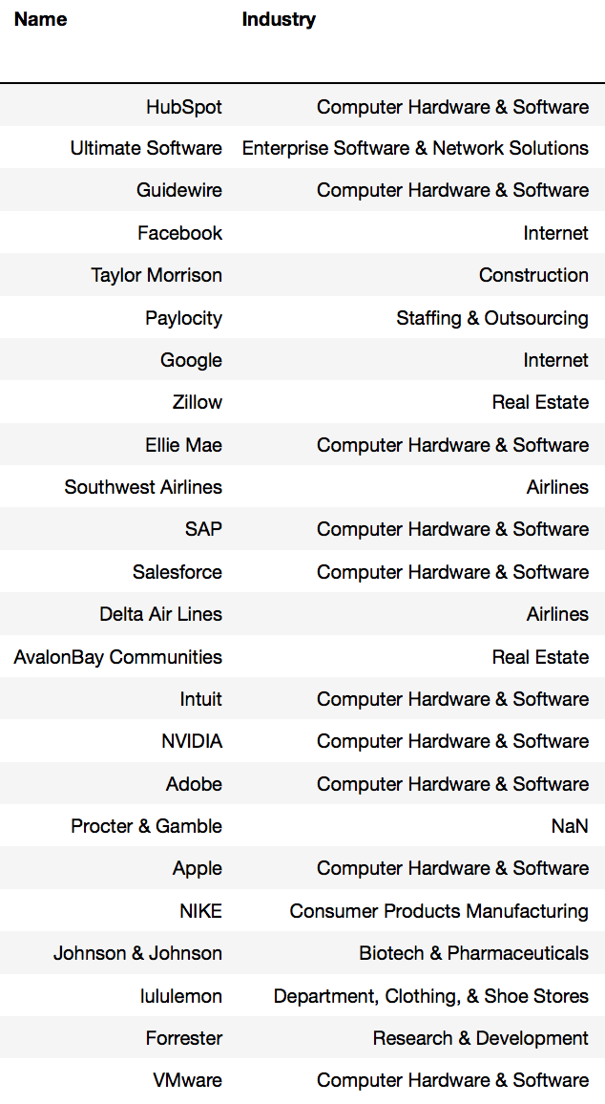
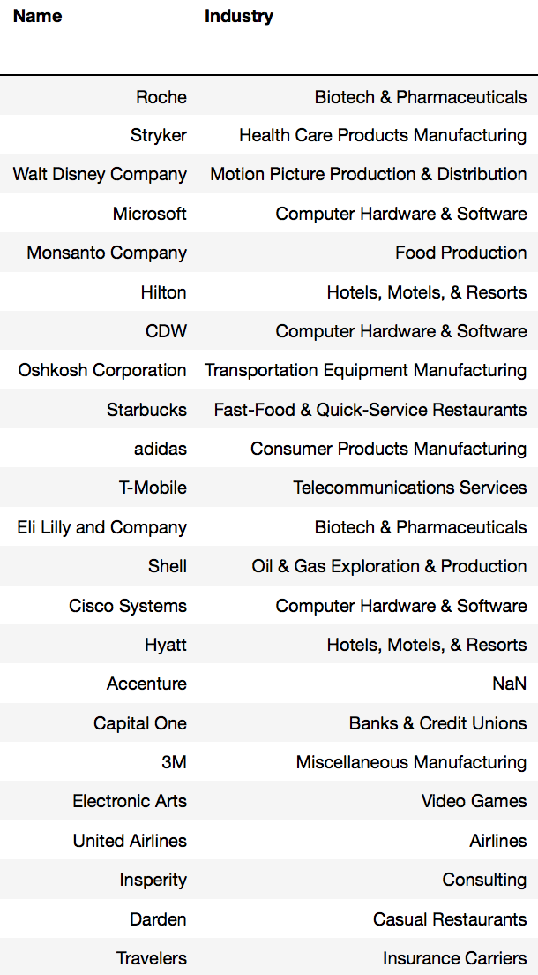
DATA GATHERING
Glassdoor ‘Top 100’ companies to work for
Filtered to 47 publicly listed companies
Scrapy crawler
93111 reviews
Daily stock prices from Yahoo! + Quandl

Slide 6
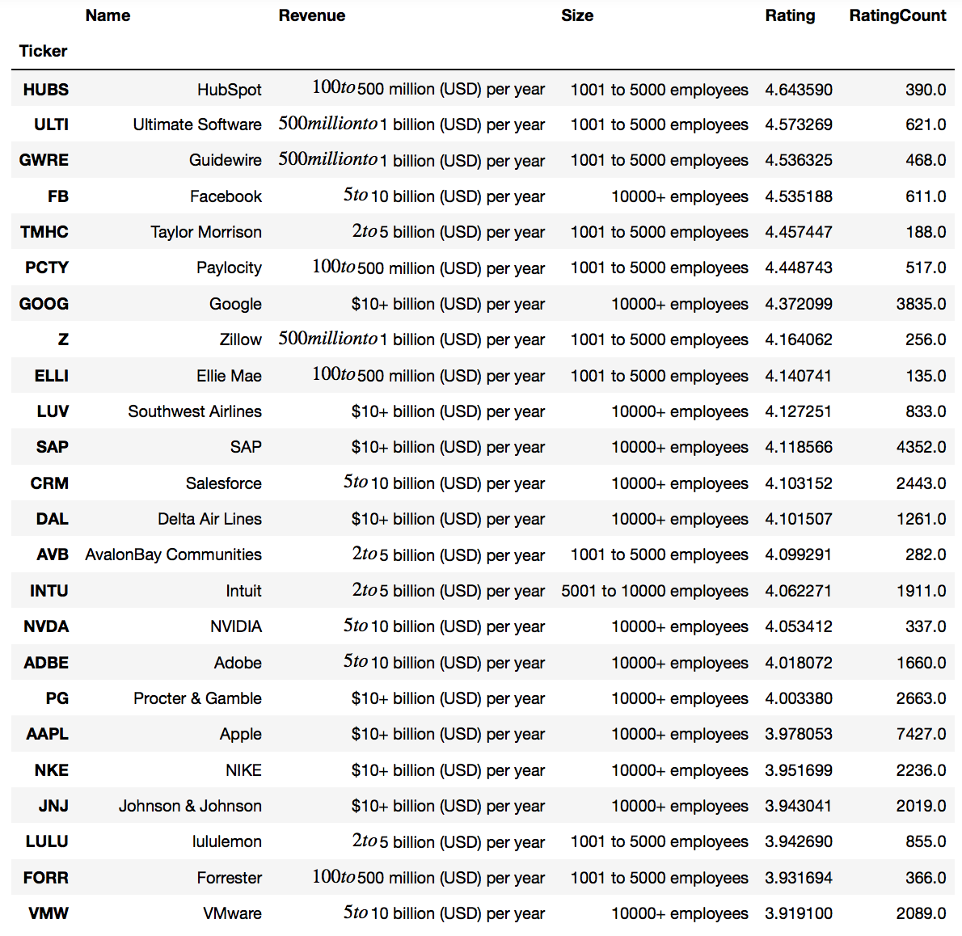
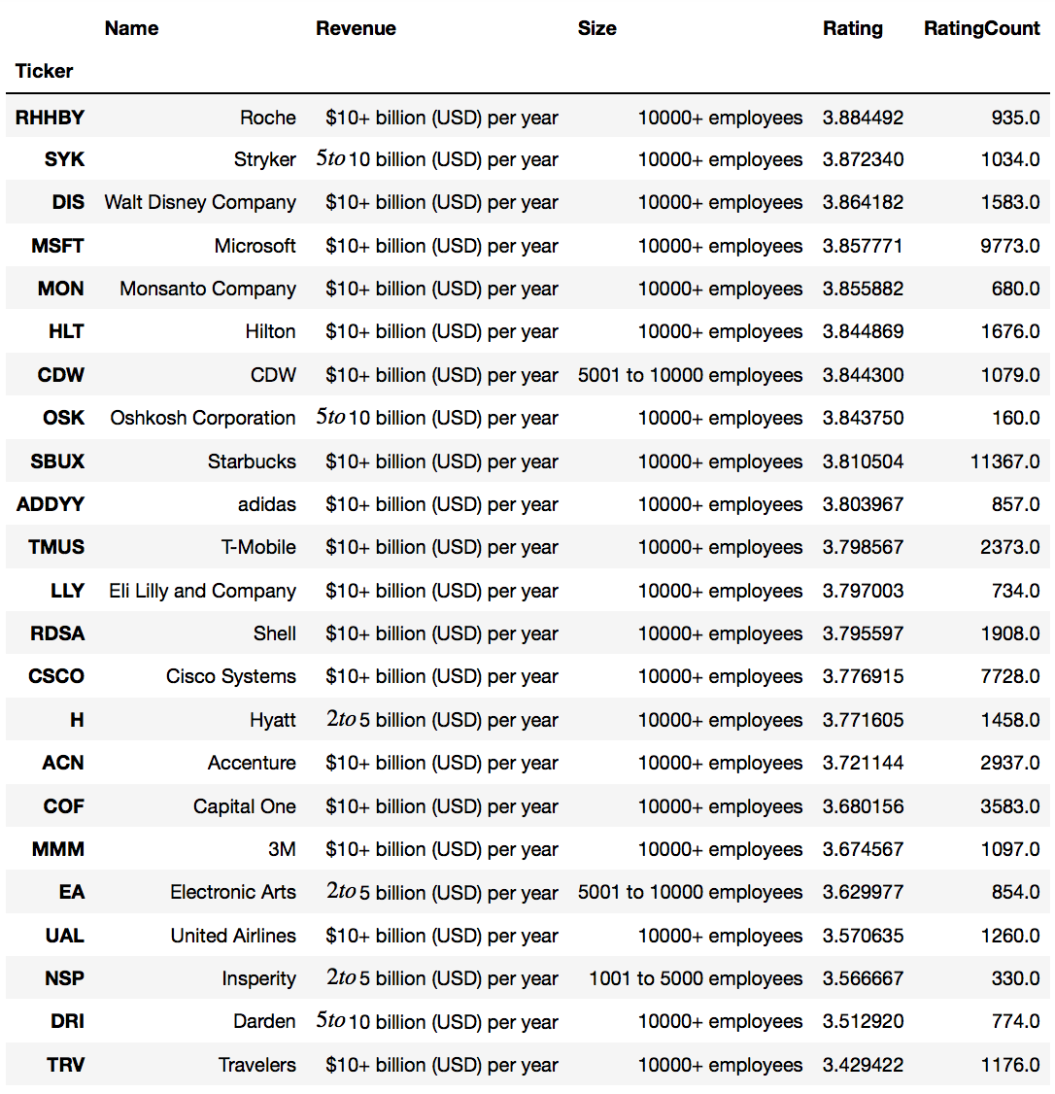

Slide 7
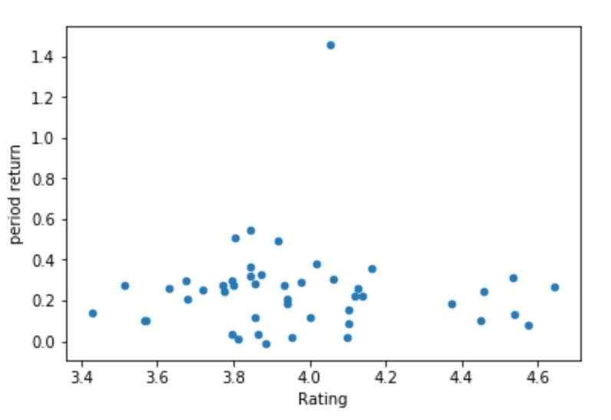
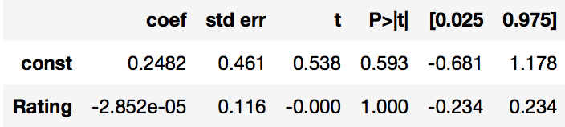
Reviews vs. stock Performance
No clear correlation over this dataset between Rating and sample period return (2 years)
Regression analysis confirms the visual
Can we identify any more nuanced relationships by looking deeper at the review data?

Slide 8
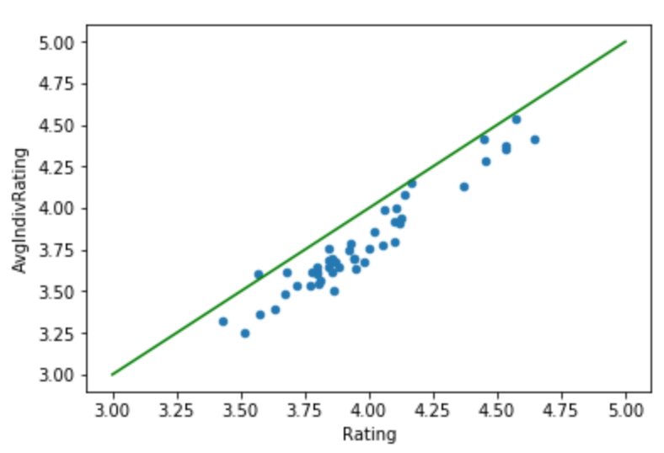
Reviewers Inflate overall ratings vs. sub-categories
Reviewers must rate overall on 1-5 scale
Each reviewer has the option to rate 5 subcategories on a 1-5 scale:
Career Opportunities
Work/Life Balance*
Senior Management*
Culture + Values
Compensation and Benefits*
On average these tend to be lower by .2 stars
Significant effect
Why might this be?

Slide 9
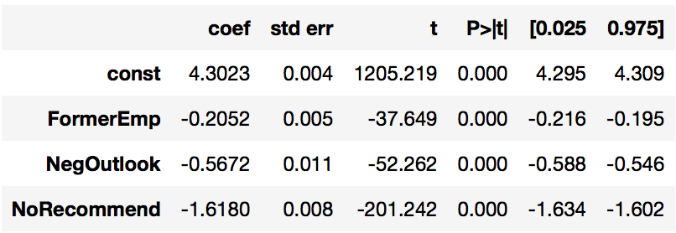
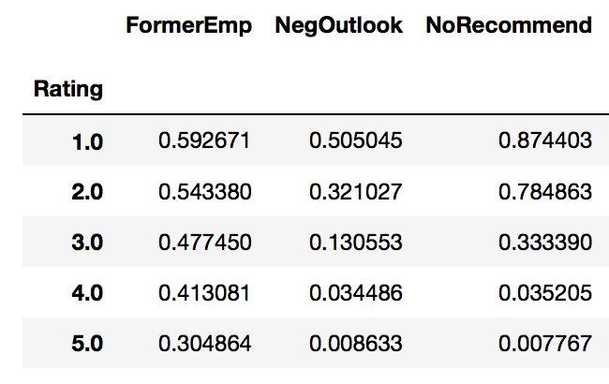
QUANTIFYING NEGATIVE REVIEWS
What impact do some review components have on overall scores?
Unsurprisingly…
Employees who choose to “Not Recommend” their employer leave significantly lower average ratings
Negative Employee outlook has further, significant impact on overall ratings
Former employees tend to rate companies lower
But does this have any predictive impact on company performance, or vice-versa…
Observe intuitive relationships in the data as a function of rating

Slide 10
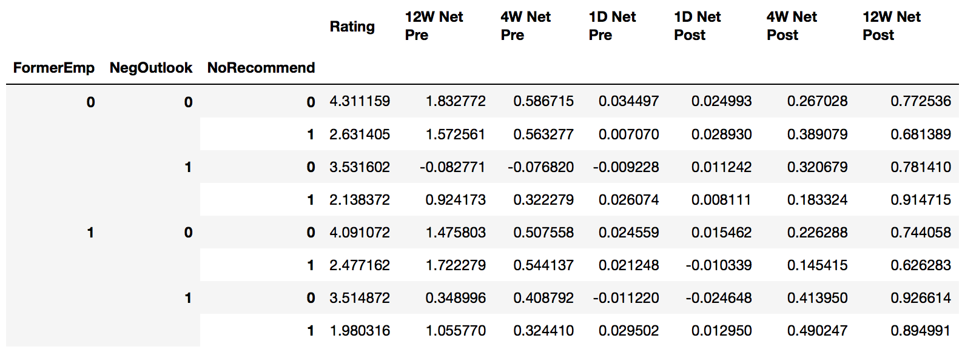
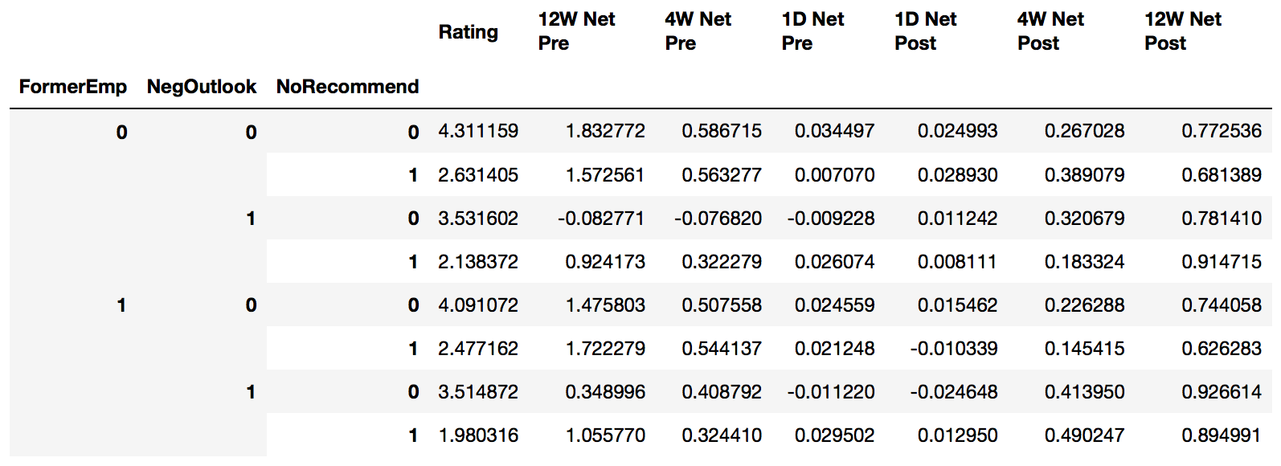
Stock performance by overall reviewer sentiment
Hypothesis: negative reviews have predictive value on future stock performance
Or, could strong/poor stock performance itself drive positive or negative reviews?
Overall, the data does not seem to support either intuition

Slide 11
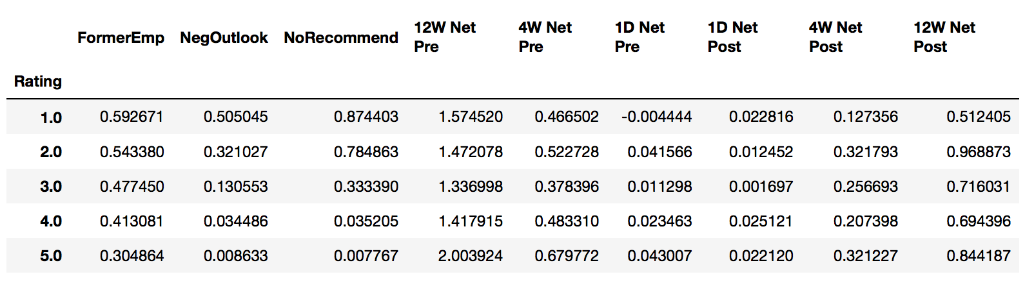
Alternative Look
This indicates some potential that the poor reviews could indicate upcoming poor performance, with a lot of caveats:
Only 47 Companies
Could be driven by larger companies with more reviews
Further statistical testing needed to determine any significance

Slide 12
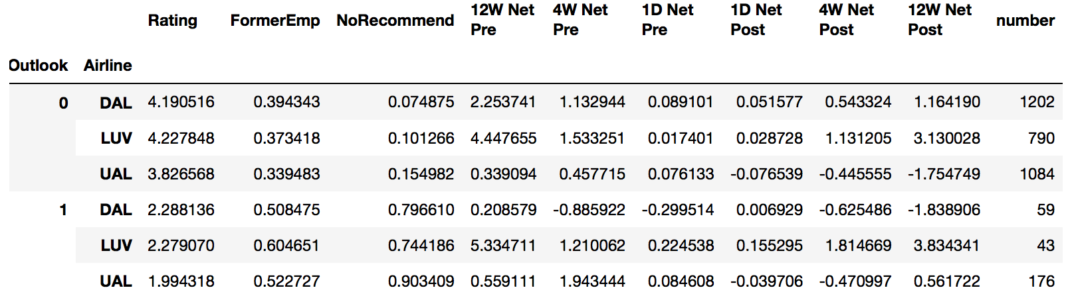
A brief industry Analysis: Airlines
We may be able to gain deeper insight by restricting the data to a smaller group of companies
Allows for better potential control for market and sector performance over the relevant period
Observe the notably lower ratings for UAL/United relative to peers
Table shows the relationship between Employee Outlook and stock performance

Slide 13
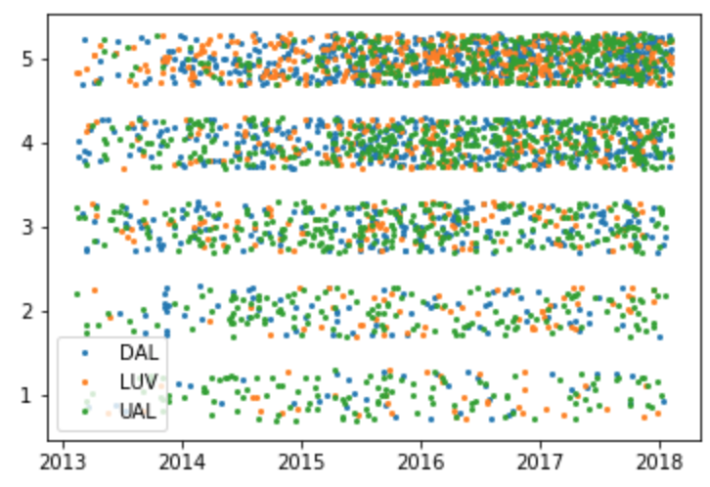
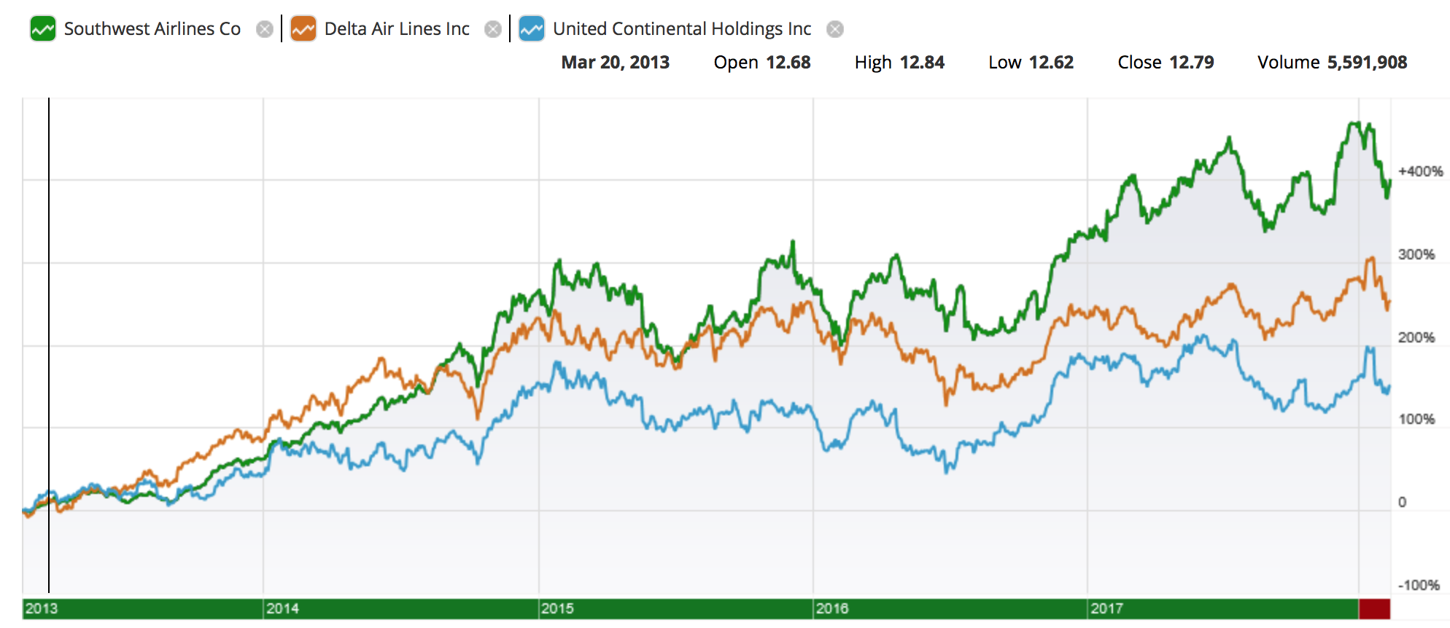
Seek to visualize the review distribution over time
Notable differences in stock performance within the same industry
Observe United Airlines underperforming its peers over the past 5 years
Seek to test the hypotheses that Glassdoor reviews could reflect this performance or could predict future performance
Further statistical analysis needed

Slide 14
SUMMARY and conclusions
TAKEAWAYS
CAVEATS AND FUTURE ANALYSIS
Successful acquisition of Glassdoor review data for a subset of companies
Stock/Rating relationship not clearly significant, both backward and forward looking
Users tend to ’round-up’ their overall view of their employers
Significant potential to compare companies reviews to each other
Expand universe of data: more companies, lower rated employers
Language processing – significant opportunity unexplored in text data
More robust statistical analysis:
More interaction variables – (Do only certain Former employees have a predictive impact? What about long tenured employees?)
Controlling more for company specific trends
Abstract from stock prices to look at sales, revenue, profit, etc.

