Slide 1
Predicting Economic Freedom using electricity generation & water sanitation
William Flynt
10 April 2024

Slide 2
Me and My Hypothesis
Software developer
Big Data™ and web stuff
Can we predict changes in economic freedom for a country based on trends in sanitation and electricity generation?

Slide 3
Why ask this question
Allocate international aid
Identify political trends
...
Complete a required MS course

Slide 4
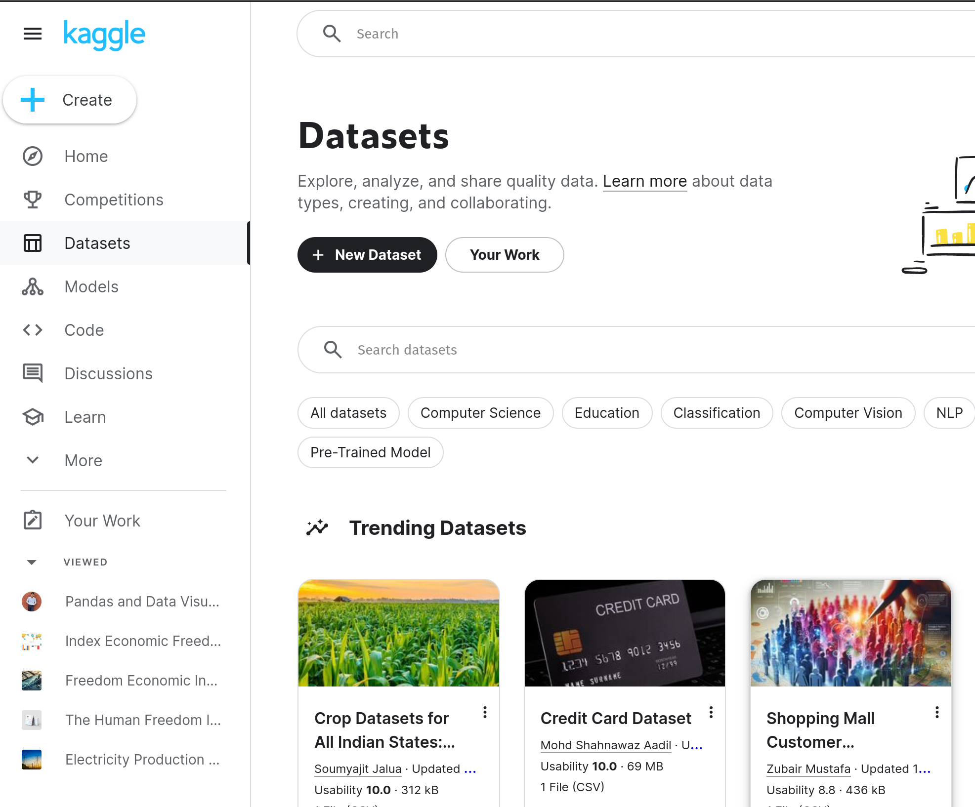
The Data
Kaggle
WS_PPL_W-SM
Net Electricity Production_Electricity_Gwh
Change from 2022
Govt Integrity

Slide 5
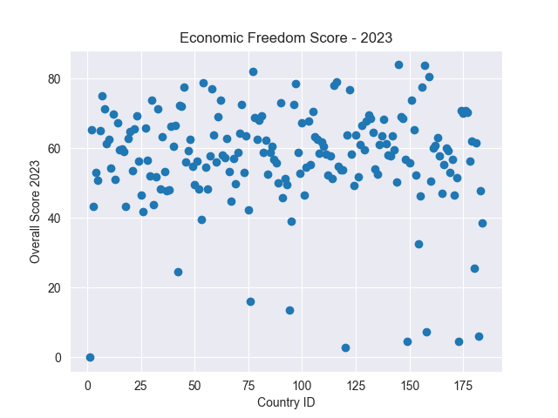
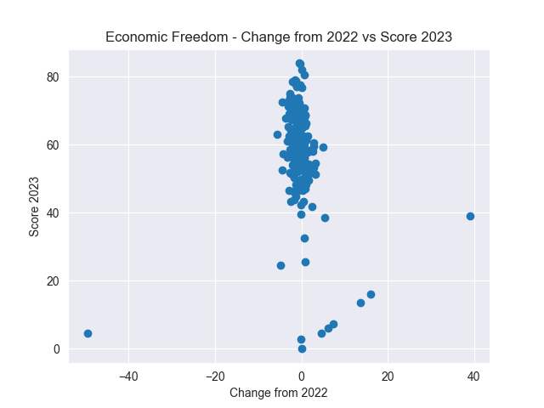
EDA
Decent variance in target
No real correlation between change and score

Slide 6
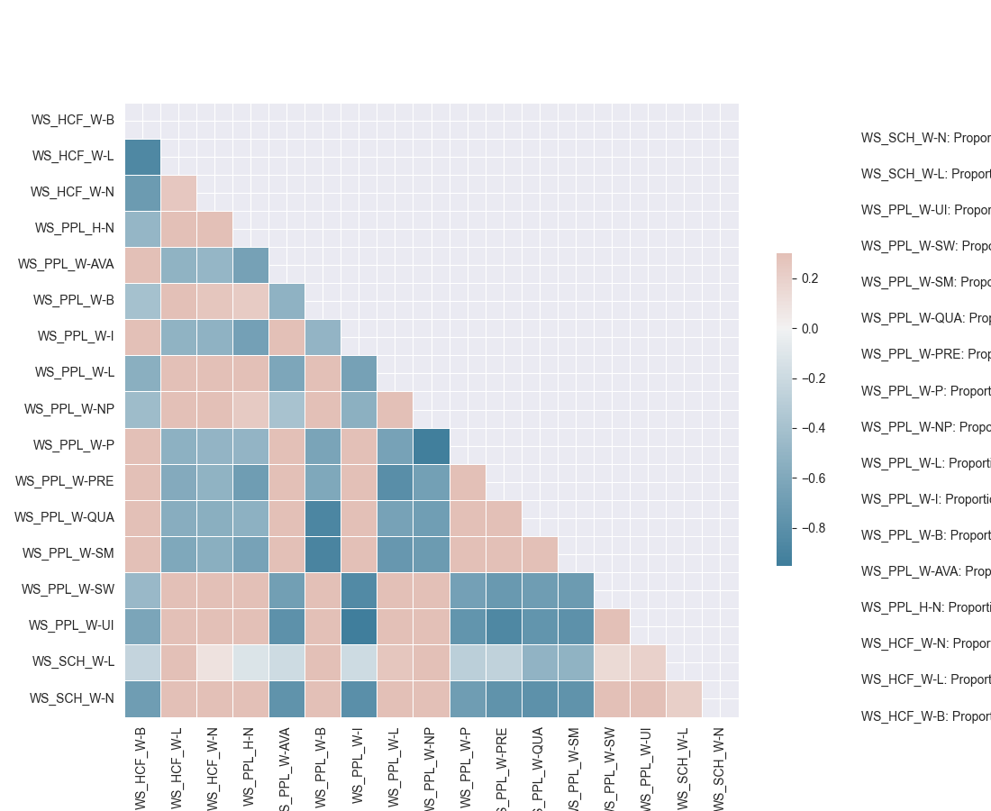
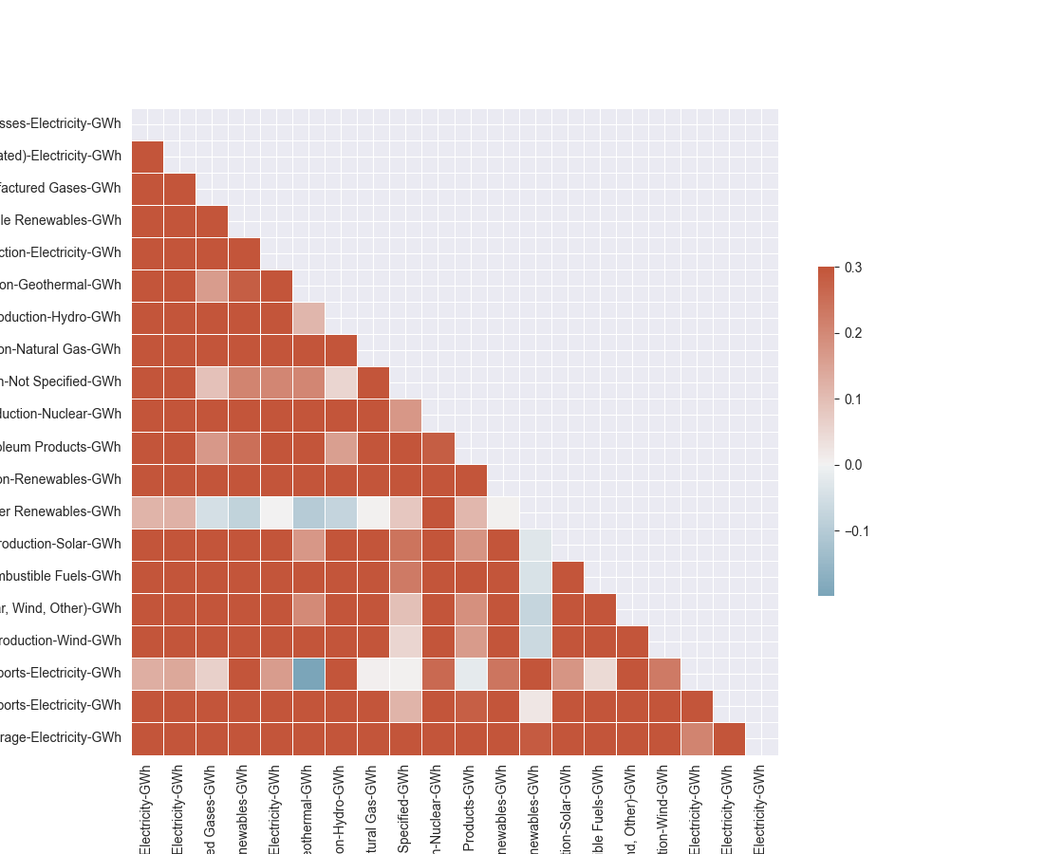
EDA
Some variables with water data were highly correlated
Less so with electricity generation

Slide 7
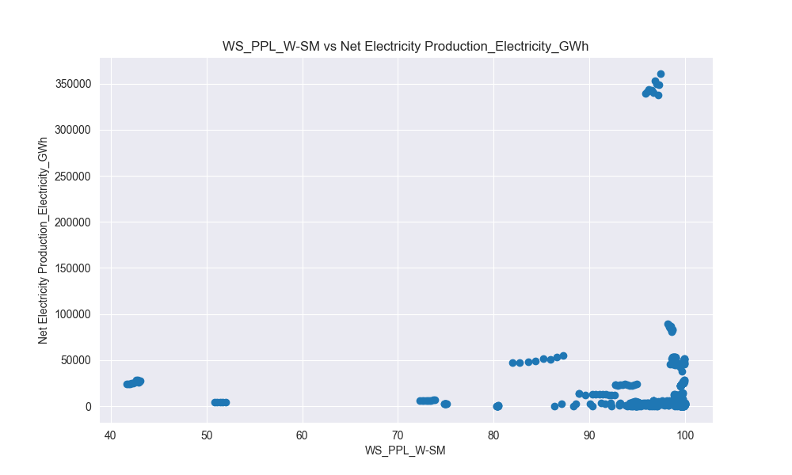
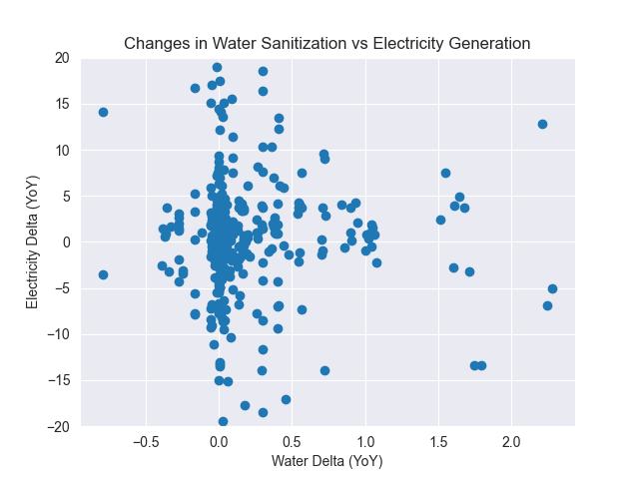
EDA
Raw scores are clustered by country
Take YoY percent change

Slide 8
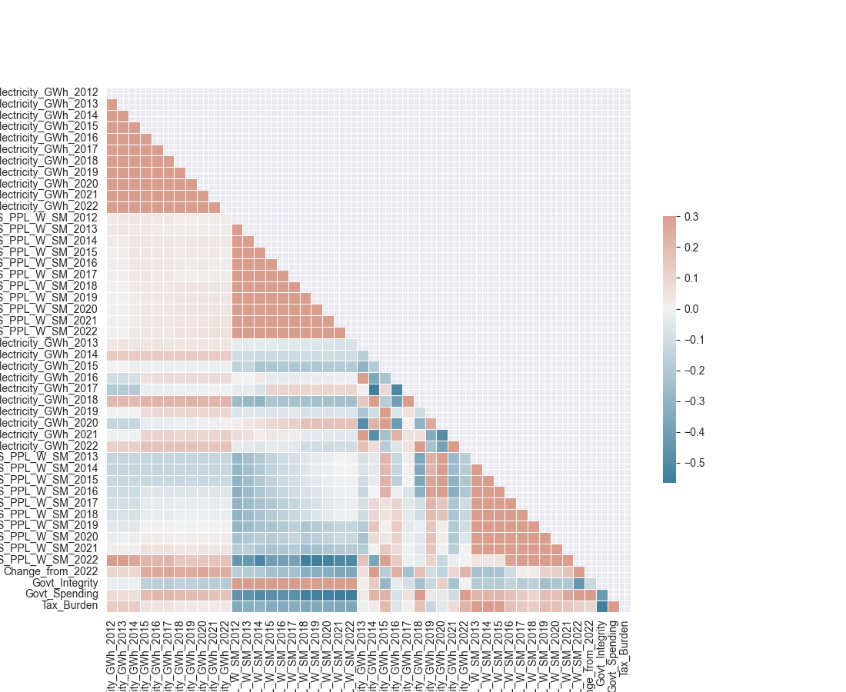
EDA

Slide 9
Models
Linear regression
Change from 2022
Government Integrity
Decision Tree Classifier
Is a country “economically free”?

Slide 10
Models
Linear regression
Change from 2022
Government Integrity
Decision Tree Classifier
Is a country “economically free”?
Because regression wasn’t going so hot...

Slide 11
Models
Linear regression
Continuous prediction of a numerical variable
Directly uses available numerical data
Easy to understand

Slide 12
Models
Decision Tree Classifier
Fast to train and use
Conceptually simple
Explainable with images
Isn’t another regression

Slide 13
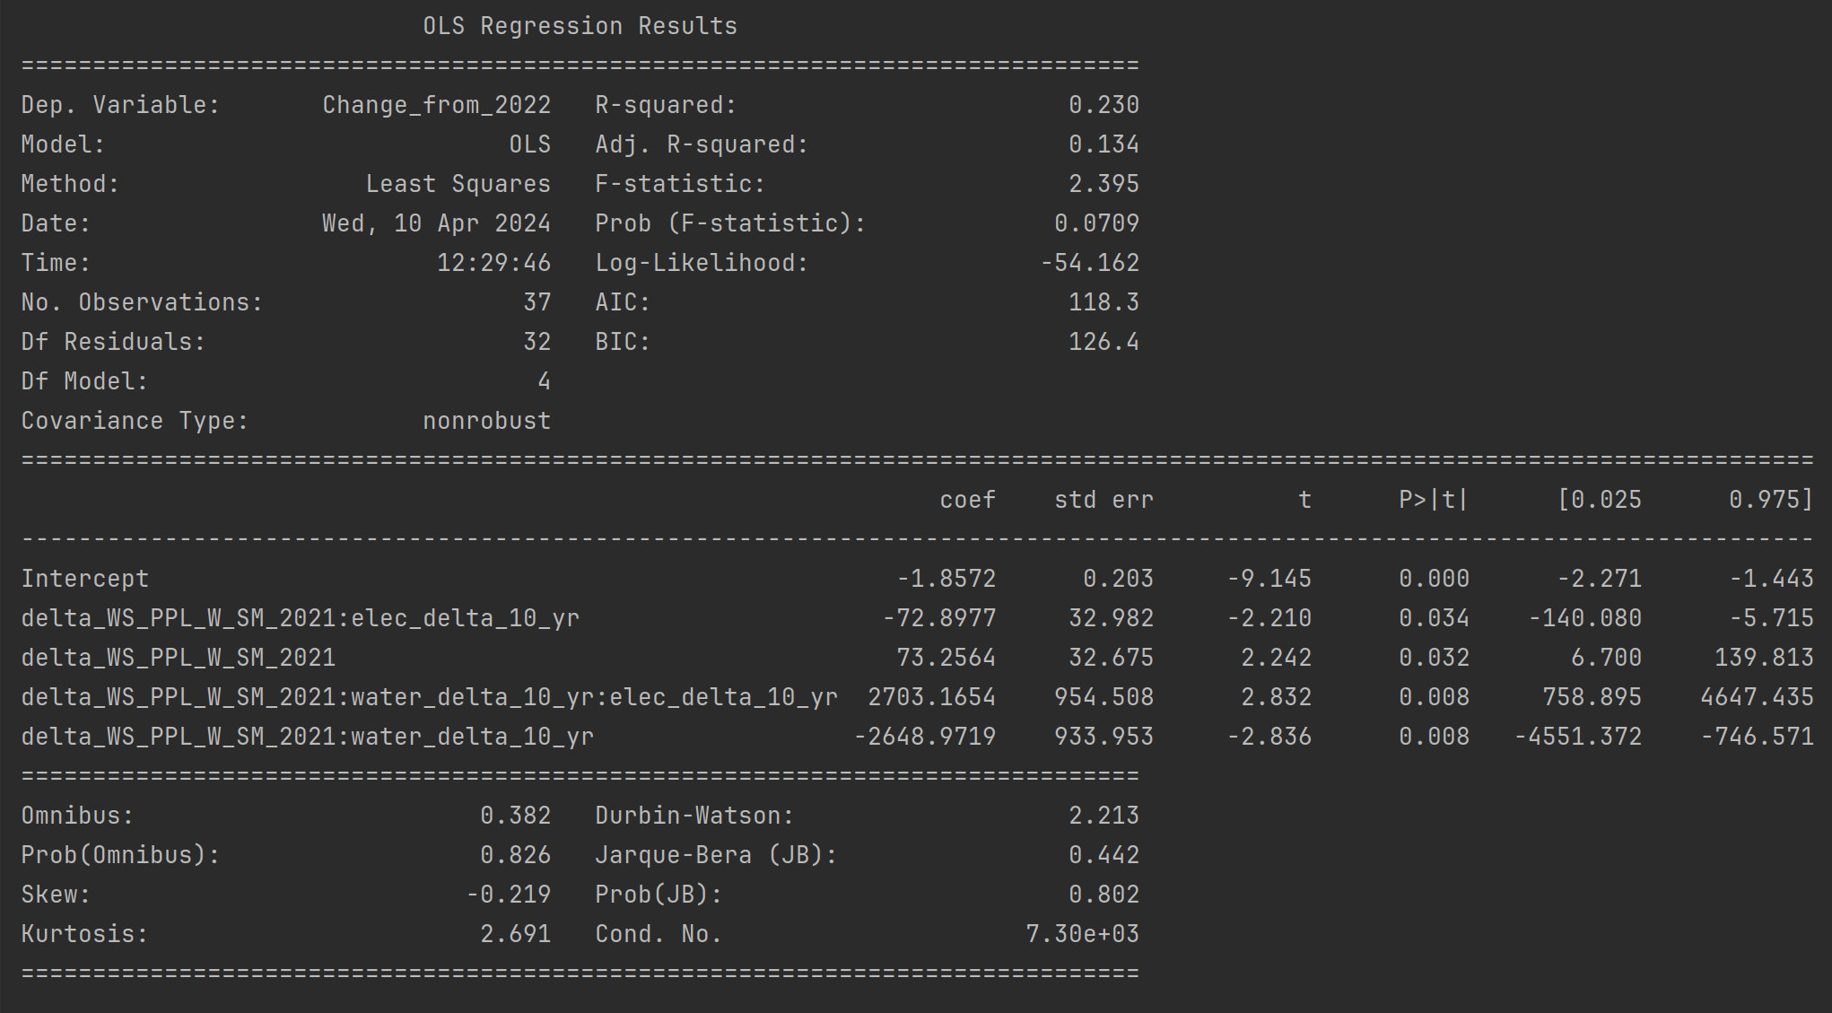
Results

Slide 14
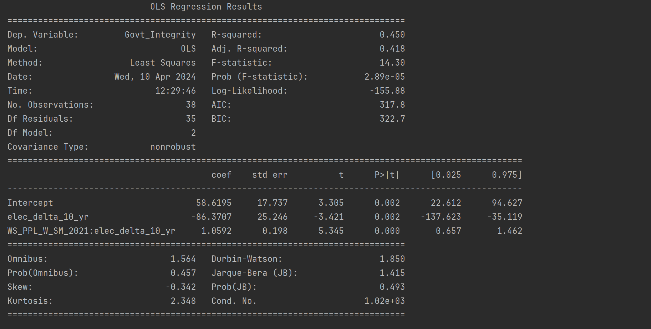
Results

Slide 15
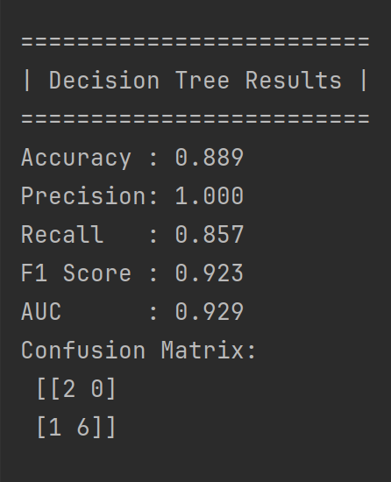
Results
Is this country economically free?
delta_WS_PPL_W_SM_2022
Change in sanitation from 2021-2022
water_delta_10_yr
Change in sanitation from 2012-2022
elec_delta_5_yr
Change in electricity generation from 2017-2022

Slide 16
It Worked!!
Right?

Slide 17
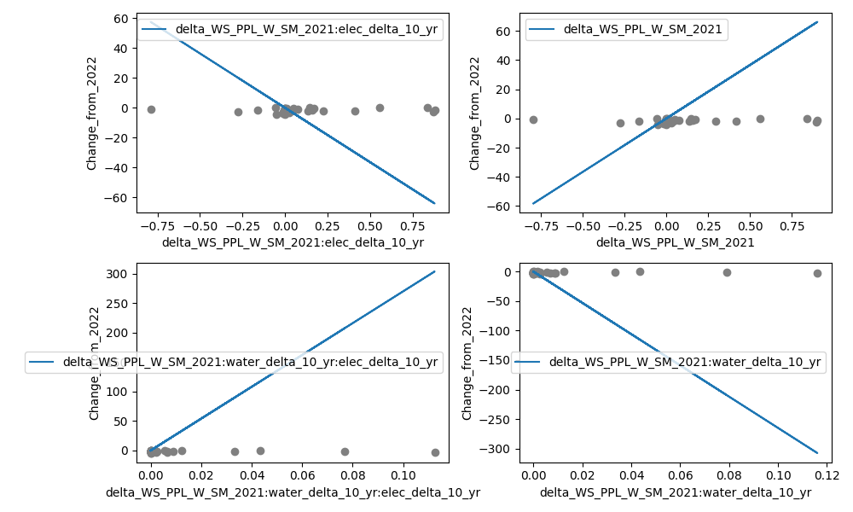
It Worked!!
Not really...

Slide 18
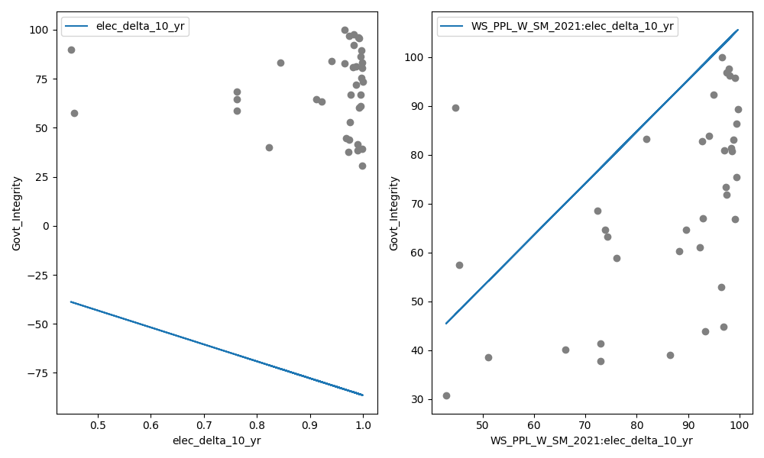
It Worked!!
Not really...

Slide 19
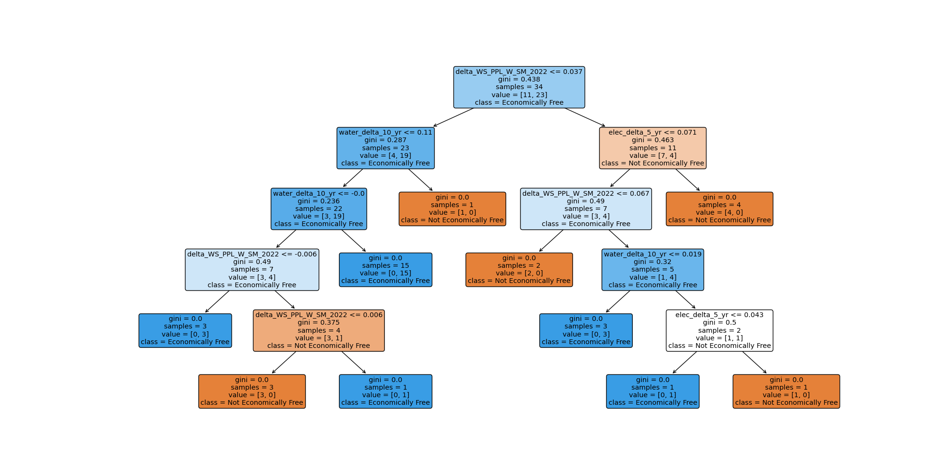
It Worked!!
Not really...

Slide 20
Future Work?
Fin
Need more data – previous econ scores
Use information on regions

