Slide 1
Software Engineering CSC4350/6450 Database Fundamentals
Fall 2019
William Gregory Johnson
PhD Candidate in Computer Science
https://williamgregoryjohnson.github.io
http://www.dsoergel.com/690/index_690.htm

Slide 2
A Database Schema
Schema Owner
[1]
Tables
Indexes
Procedures
Views
Constraints
schema objects
1) Stephens, R.K. and Plew. R.R., 2001. Database Design. SAMS, Indianapolis ,
IN. (with slight changes by V.G.D.)

Slide 3
Caution about Schema Objects
The meaning of “object” here is different than that in UML.

Slide 4
Table
“A table is the primary unit of physical storage for data in a database.”¹
Usually a database contains more than one table.
1) Stephens, R.K. and Plew. R.R., 2001. Database Design. SAMS, Indianapolis , IN.

Slide 5
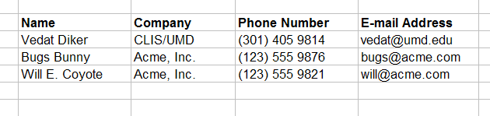
Table

Slide 6
A Database with Multiple Tables
[1]
Publishers
Books
Customers
Authors
Inventory
Orders
1) Stephens, R.K. and Plew. R.R., 2001. Database Design. SAMS, Indianapolis ,
IN. (with slight changes by V.G.D.)

Slide 7
Table
Customers

Slide 8
Field (Column)
Customers
a field

Slide 9
Record (Row)
Customers
a record

Slide 10
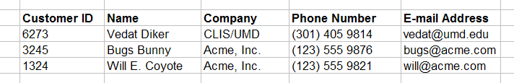
Primary Key
Customers
primary key field
Primary key is a unique identifier of records in a table.
Primary key values may be generated manually or automatically.

Slide 11
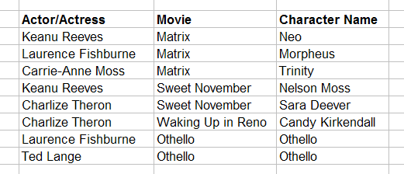
Primary Key
Roles (Performances)
primary key fields
A primary key can consist of more than one field.

Slide 12
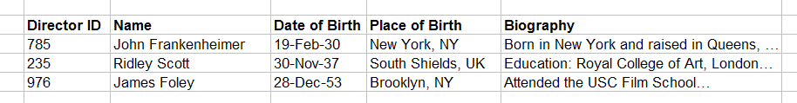
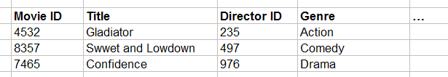
Foreign Key
primary key field
parent table
Directors
relationship
child table
Movies
foreign key field

Slide 13
Relationship Types
One-to-one
One-to-many
Many-to-many

Slide 14
Data Types
Alphanumeric (Text, Memo)
Numeric (Number, Currency, etc.)
Date/Time
Boolean (Yes/No)

Slide 15
Entity
“An entity is a business object that represents a group, or category of data.”¹
Do we know a similar concept?
1) Stephens, R.K. and Plew. R.R., 2001. Database Design, pp. 21. SAMS, Indianapolis , IN.

Slide 16
Instance (Record, Tuple)
“A single, specific occurrence of an entity is an instance. Other terms for an instance are record and tuple.”¹
Do we know a similar concept?
1) Stephens, R.K. and Plew. R.R., 2001. Database Design, pp. 210. SAMS, Indianapolis , IN.

Slide 17
Attribute
“An attribute is a sub-group of information within an entity.”¹
Do we know a similar concept?
1) Stephens, R.K. and Plew. R.R., 2001. Database Design, pp. 21. SAMS, Indianapolis , IN.

Slide 18
Relationship
A relationship is a link that relates two entities that share one or more attributes.
Do we know a similar concept?

Slide 19
OO Design → DB Design
Class → Entity (Table)
Object → Record
Attribute → Attribute (Field)
Association → Relationship
…

Slide 20
Database Environments
Mainframe
Client/Server
Internet-based

Slide 21
Database Types
Flat-file
Hierarchical
Network
Relational
Object-oriented
Object-relational

Slide 22
Normalization
A method for organizing data elements into tables.
Done in order to avoid
Duplication of data
Insert anomaly
Delete anomaly
Update anomaly

Slide 23
We will look at
First Normal Form
Second Normal Form
Third Normal Form

Slide 24
Example (Unnormalized)
Table: SalesOrders (Un-normalized)
SalesOrderNo
Date
CustomerNo
CustomerName
CutomerAddress
ClerkNo
ClerkName
Item1Description
Item1Quantity
Item1UnitPrice
Item2Description
Item2Quantity
Item2UnitPrice
Item3Description
Item3Quantity
Item3UnitPrice
Total

Slide 25
Normalize into 1NF
Separate repeating groups into new tables.
Start a new table for the repeating data.
The primary key for the repeating group is usually a composite key.

Slide 26
Example (1NF)
Table: SalesOrders
SalesOrderNo
Date
CustomerNo
CustomerName
CustomerAddress
ClerkNo
ClerkName
Total
Table: OrderItems
SalesOrderNo
ItemNo
ItemDescription
ItemQuantity
ItemUnitPrice

Slide 27
Normalize into 2NF
Remove partial dependencies.
Start a new table for the partially dependent data and the part of the key it depends on.
Tables started at this step usually contain descriptions of resources.

Slide 28
Dependencies
Functional dependency: The value of one attribute depends entirely on the value of another.
Partial dependency: An attribute depends on only part of the primary key. (The primary key must be a composite key.)
Transitive dependency: An attribute depends on an attribute other than the primary key.

Slide 29
Example (2NF)
Table: OrderItems
SalesOrderNo
ItemNo
ItemQuantity
ItemUnitPrice
Table: InventoryItems
ItemNo
ItemDescription

Slide 30
What if we did not do 2NF
Duplication of data: ItemDescription would appear for every order.
Insert anomaly: To insert an inventory item, you must insert a sales order.
Delete anomaly: Information about the items stay with sales order records. Delete a sales order record, delete the item description.
Update anomaly: To change an item description, you must change all the sales order records that have the item.

Slide 31
Normalize into 3NF
Remove transitive dependencies.
Start a new table for the transitively dependent attribute and the attribute it depends on.
Keep a copy of the key attribute in the original table.
Notes:
Start here on Tuesday

Slide 32
Example (3NF)
Table: SalesOrders
SalesOrderNo
Date
CustomerNo
ClerkNo
Total
Table: Customers
CustomerNo
CustomerName
CustomerAddress
Table: Clerks
ClerkNo
ClerkName

Slide 33
What if we did not do 3NF
Duplication of data: Customer and Clerk details would appear for every order.
Insert anomaly: To insert a customer or clerk, you must insert a sales order.
Delete anomaly: Information about the customers and clerks stay with sales order records. Delete a sales order record, delete the customer or clerk.
Update anomaly: To change the details of a customer or clerk, you must change all the sales order records that involve that customer or clerk.

Slide 34
Example (Final Tables)
Table: SalesOrders
SalesOrderNo
Date
CustomerNo
ClerkNo
Total
Table: OrderItems
SalesOrderNo
ItemNo
ItemQuantity
ItemUnitPrice
Table: InventoryItems
ItemNo
ItemDescription
Table: Customers
CustomerNo
CustomerName
CustomerAddress
Table: Clerks
ClerkNo
ClerkName

Slide 35
Entity
“An entity is a business object that represents a group, or category of data.”¹
Do we know a similar concept?
1) Stephens, R.K. and Plew. R.R., 2001. Database Design. SAMS, Indianapolis , IN.

Slide 36
Attribute
“An attribute is a sub-group of information within an entity.”¹
Do we know a similar concept?
1) Stephens, R.K. and Plew. R.R., 2001. Database Design. SAMS, Indianapolis , IN.

Slide 37
Entity Relationship Models
Mandatory Relationships
Optional Relationships
Many-to-Many Relationships
One-to-Many Relationships
One-to-One Relationships
Recursive Relationships

Slide 38
Mandatory, One-to-One
AUTOMOBILE
ENGINE
AUTOMOBILE
ENGINE

Slide 39
Mandatory, Many-to-Many
INSTRUCTOR
STUDENT
INSTRUCTOR
STUDENT

Slide 40
Optional, Many-to-Many
DEPARTMENT
STUDENT
DEPARTMENT
STUDENT

Slide 41
Recursive
EMPLOYEE
supervises
is supervised by

Slide 42
Resolving Many-to-Many Relationships
Many-to-many relationships should be avoided. We can resolve a many-to-many relationship by dividing it into two, one-to-many relationships.

Slide 43
Resolving Many-to-Many Relationships
SALES ORDERS
INV. ITEMS
SALES ORDERS
ORDER ITEMS
INV. ITEMS

Slide 44
Example (ER Diagram)
CUSTOMERS
CLERKS
SALES ORDERS
ORDER ITEMS
INV. ITEMS

Slide 45
Questions?
Thank You.

