Slide 1
OpenMC is cool
Week 3 – Basics

Slide 2
Review From Week 2
Theory
CSG (Constructive Solid Geometry)
Particle Transport (surface tracking, random numbers, etc.)
Cycles (active/inactive)
Shannon Entropy
keff calculations
Skills
Materials
Surfaces
Cells
Boundary Conditions
Sources

Slide 3
Goals today
Theory
Continuous Energy & Multigroup Cross Sections
Thermal Scattering Laws
Skills (The bulk of today)
Universes
Settings
Starting a Run
Pincell Creation

Slide 4
Theory
Please stop and ask question along the way

Slide 5
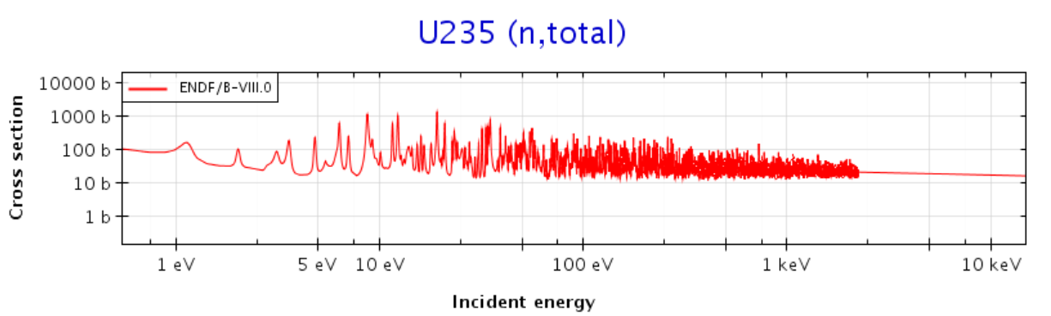
Cross Sections
Likelihood of an interaction between an incident neutron and a nucleus
Dependent on the energy of the incident neutron
“Messy” looking functions

Slide 6
Cross Section data
Cross section data is measured and recorded (a large, ongoing process, new values for cross sections are released periodically)
ENDF (US & Canada) / JEFF (Europe) / JENDL (Japan), etc. are compilations of cross section data
https://www.oecd-nea.org/janisweb/ is a great tool for visualizing cross section data of isotopes

Slide 7
Two formats for cross section data
Cross section data used in computation is either used as:
“continuous energy”
“multigroup”

Slide 8
Continuous Energy Cross Sections
Doing calculations with cross sections as a continuous function of energy
Interpolation still between points
  Hundreds of isotopes included
  Hundreds/thousands of energy data points. Linear interpolation between
Computationally extremely burdensome
Require tons of data

Slide 9
Multigroup Cross Sections
Do calculations for a certain energy range with cross section approximated as constant
Can be any number of “bins” from hundreds to a small handful
Makes the computation much faster
Slight tradeoff of computation and accuracy, however, they can be constructed very well as to not lose much in terms of accuracy
Allows us to use deterministic codes for neutron transport

Slide 10
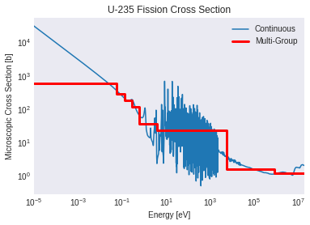
Multigroup Cross sections
Constant cross sections across energy bins
Most neutronic codes run with multigroup cross section data
Monte Carlo can run with either MG (multi group) or CE (continuous energy) cross section data
Monte Carlo can also be used to generate MG cross section data
https://github.com/openmc-dev/openmc/wiki/Example-Jupyter-Notebooks
>>Multigroup Cross Section Generation Part II: Advanced Features

Slide 11
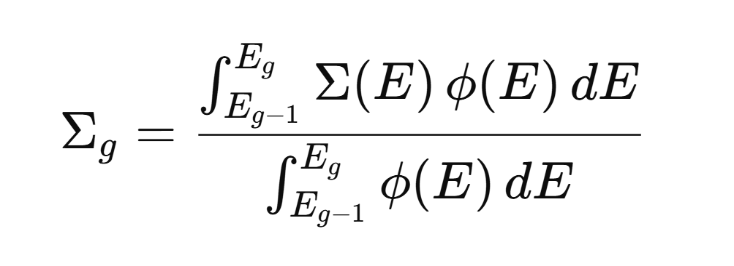
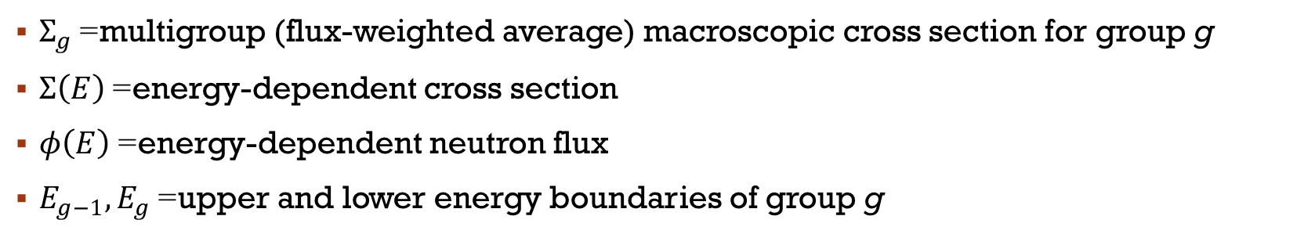
Multigroup Cross section Definition
$Σ_{g}$= multigroup (flux-weighted average) macroscopic cross section for group g
$Σ\left(E\right)$= energy-dependent cross section
$φ\left(E\right)$= energy-dependent neutron flux
$E_{g−1},E_{g}$= upper and lower energy boundaries of group g

Slide 12
Thermal Scattering Laws (TSLs)
Thermal (low energy end of spectrum) interacts with a bond or a lattice instead of an individual atom (ie an H-O bond in water)
(Also called S(α, β) tables)
ie. In order to simulate water in our code, we need to not only specify how many H atoms and how many O atoms are present, but we need to also specify that the O and H atoms are bonded.
Examples of TSLs that can be applied in OpenMC
  ‘c_H_in_H2O” (continuous energy, H in H2O)
  “c_D_in_D2O” (deuterium in heavy water)
  “c_C_in_graphite” (carbon in graphite)
  “c_Be_in_BeO” (Beryllium in Beryllium Oxide)
  "c_O_in_BeO“ (Oxygen in Beryllium Oxide)
  etc.

Slide 13
Skills
Brief overview here, and then transition to the Jupyter Notebook

Slide 14
Universes
All cells (to be run) must be put in a universe for the code to run
A sub-universe can be created with parameters, and that universe could be applied as a fill to a cell (we will not be doing this for now)

Slide 15
Settings
Required components of settings
  run_mode ( “eigenvalue” calculates keff)
  particles
  batches (cycles)
  inactive cycles
  source

Slide 16
Export to xml
OpenMC reads your code and creates xml files
Required xml files:
  Geometry
  Materials
  Settings
Optional xml files:
  Tallies
  Plots
  (a couple others we won’t use)
You specify what gets put in the XML file with Python, then OpenMC creates those files
When OpenMC runs, it runs based on what’s in the XMLs

Slide 17
Running Openmc
In python just use the function openmc.run()
If running from the terminal, there should also be an OpenMC executable that you can call to run the xml files in your directory

Slide 18

Pincell Creation
A pincell consists of:
  Fuel in the center
  Sometimes a very small air gap
  Cladding around the fuel
  Water outside (moderator)
It’s often modeled as an infinite array (reflective boundary conditions)

Slide 19
Apply it

Slide 20
Apply it
Go to the crash course openmc directory that you cloned from the github and type run the command “git pull” to get the most up to date version of code
Navigate to the week 3 folder and open week3_workbook.ipynb
We’ll briefly walk through the notebook as a class
After that open pincell_empty.ipynb and follow the instructions to create a pincell
Some guidelines:
  Do your best to not use the code in the pincell_completed.ipynb
  Avoid using AI at least while you’re learning how it works
  Try to use week2_workbook.ipynb and week3_workbook.ipynb for code help
  Also for syntax and code help refer to OpenMC documentation under users guide (https://docs.openmc.org/en/stable/usersguide/index.html) it’s very well done

