Slide 1
OpenMC is cool
Week 2 – Background

Slide 2
Goals today (this is a lot to cover)
Theory
CSG (Constructive Solid Geometry)
Particle Transport (surface tracking, random numbers, etc.)
Cycles (active/inactive)
Shannon Entropy
keff calculations
Skills
Materials
Surfaces
Cells
Boundary Conditions
Sources

Slide 3
Theory
Please stop and ask question along the way

Slide 4
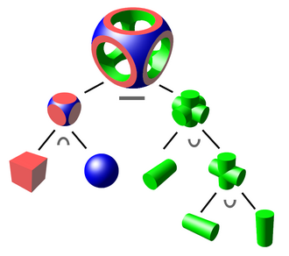
CSG (Constructive Solid Geometry)
The creation of complex shapes using the intersection of simple shapes
We use second order surfaces
This gives Monte Carlo Calculations a “general geometry”
https://en.wikipedia.org/wiki/Constructive_solid_geometry

Slide 5
Particle Transport
We are simulation neutron particles
A particle is simulated traveling through the space you set up (ie. a reactor)
Every isotope has a “cross section” which relates to the likelihood of certain interactions occurring
Our neutron interactions include things such as elastic scattering, inelastic scattering, absorption, fission, etc
Each interaction has a cross section, and the total cross section is the sum of all the individual cross sections
Microscopic cross sections are in units of area (cm^2)
Macroscopic cross section is the microscopic cross section times the amount of atoms / volume and it has units of 1 / cm

Slide 6
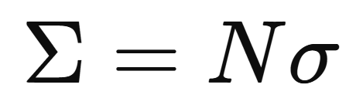
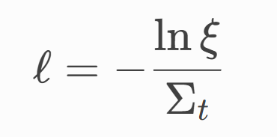
Particle Transport
Macroscopic cross section is the microscopic cross section times the amount of atoms / volume and it has units of 1 / cm. Note cross sections are a function of the neutron’s energy (velocity)
When we know the macroscopic cross section, we can figure out how far a particle will travel on average before an interaction.
Using the cross section data, we can create a relationship between the distance to collision (l) and the cross section where ξ is a random number between 0 and 1

Slide 7
Particle Transport
To begin, particles are set with initial location, directions, and energy.
Based on the material the particle is in, a path length is calculated.
At the end of the path length, if the particle has not crossed a surface, then an interaction occurs. Which particular interaction depends on how big the cross sections are for each particular interaction (ie. fission, cross section, absorption, scattering, etc.). The data for cross section magnitude for each isotope is in the fundamental nuclear cross section data that we downloaded in week 1
After an interaction occurs, a tally is made to record what happened. If the particle wasn’t destroyed (ie. an absorption interaction occurred), then a new direction, energy, and path length are calculated, and the particle travels again. This is done until the particle is destroyed
Millions of particles will be simulated, and the tallies will give information needed to calculate what is happening in the system.

Slide 8
Active Cycles
Each “cycle” is the simulation of the lifetime of a number of particles. Batch and generation are also terms used for cycle
When you set up the simulation, you will specify a number of cycles, and a number of particles per cycle.
Cycles exist because this is a “generational” process. When fissions occur, the location of fission sites is noted in the code, and the fission neutron is recorded (along with its energy, direction, and now a weight ) which contributes to the next generation/cycle
For example, when you run a simulation, you might use 100 active cycles and 1 million particles per cycle

Slide 9
keff calculations
The keff value is essentially, how many neutrons per fission cause another fission.
  keff of 1 means a steady state chain reaction
  keff above 1 means an increase in the amount of neutrons over time
  keff below 1 means a decrease in neutrons until the chain reaction ends and no fissions occur
keff is calculated using the Method of Successive Generations
It can be thought of as the number of particles in the a new generation / the number of particles in the previous generation
We run a number of generations, and the keff values converge to a value at some point, and we can take an average of the “good” keff values for our solution of what keff is

Slide 10
Shannon Entropy & Inactive Cycles
I say “good” keff calculations, because as noted before, you have to have an initial position, energy, and direction for the particles, and whatever we guess for the initial conditions, we will be wrong.
Fortunately, we know that with each generation, the particles will spread out to reflect an accurate distribution, or in other words, the distribution of the particles will converge to the correct answer.
The way that we measure if our solution is “converged” is with Shannon Entropy which is really just a measure of how much the distribution of sites is changing
Once Shannon Entropy converges, we can be pretty confident that our keff values have converged
Inactive cycles are cycles that we run where the particles are simulated like norma, but the data doesn’t contribute to our final answer.
When running a simulation, you want to set enough inactive cycles for Shannon Entropy to converge. For example, you might run 50 inactive cycles, 100 active cycles, and 1 million particles per cycle.

Slide 11
Skills
Brief overview here, and then transition to the Jupyter Notebook

Slide 12
Materials
Creating a material that is a combination of isotopes that can be applied to regions we specify in the code.

Slide 13

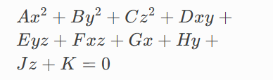
Surfaces/Boundary Conditions
The way that we create regions in space in the code
Surfaces are 2nd order 3D surfaces. Functions of x, y, and z
  Spherical Surface Equation:
  General Surface Equation:
A boundary condition instructs a particle what to do when it reaches the edge of a surface
  Most surface boundary conditions are simply “transmission” which allows the particle through
  Outside boundary conditions my be “vacuum” or “reflective” depending on what behavior you want to simulate

Slide 14
Half Spaces
Each surface creates 2 half spaces
  Ie. Spheres create a half space “inside” and “outside”
  The + half space is where the surface equation evaluates to a + number (and the opposite is true for a – half space)

Slide 15
Cells
An region defined in space (either a half space or a combination of half spaces) that also has a defined material fill

Slide 16
Sources
As explained before, we must set a starting location, energy, direction, etc. for the particles in the simulation
Fortunately, for now, we can just make a really rough guess and be confident that after enough inactive cycles the distribution of particles through the space will be accurate
In this crash course openmc we’ll just be setting the source as a single point, usually in the center of the fissionable material

Slide 17
Apply it
Now go to the crash course openmc directory that you cloned from the github and type run the command “git pull” to get the updated code I put there this week
Navigate to the week 2 folder and open week2_workbook.ipynb
We’ll walk through the notebook as a class

