Slide 1
Helpful links / search queries / things to do before meeting
https://ubuntu.com/tutorials/command-line-for-beginners#1-overview
Search for a crash course in Python (not to learn it all of course, but to get a basic idea of how python generally works)

Slide 2
OpenMC is cool
Week 1 – Installation

Slide 3
Install openmc onto your machine
What is OpenMC?
We’ll get to that later
What is our end goal for this crash course?
Everyone understands the basics of using openmc
Everyone understands the basics of how openmc works
What is our end goal for this week?
Getting all the things we need on everyone’s computer
It’ll be step by step, (largely taken from this link):
https://docs.openmc.org/en/stable/usersguide/install.html
My github repository can be found at this link (contains this powerpoint):
https://github.com/williamhm412/crash_course_openmc

Slide 4
Download WSL (Windows 11)
Find the settings “Turn Windows features on or off”
Make Sure “Windows Subsystem for Linux” is enabled
Open windows Powershell
wsl --install
→ should by default install wsl 2 on your computer with ubuntu (default)

Slide 5
Clone the git repository
mkdir ~/openmc
→ creates a directory in your home directory called openmc
cd ~/openmc
→ moves you to be in that directory
git clone https://github.com/williamhm412/crash_course_openmc.git
→ creates a repo with the class ppts and code called crash_course_openmc
From here on out when you want to get updated files type (from the repository):
git pull

Slide 6
Download Miniconda in WSL https://www.anaconda.com/docs/getting-started/miniconda/install#linux-2
mkdir -p ~/miniconda3
→ Makes directory in the home dir called miniconda3
wget https://repo.anaconda.com/miniconda/Miniconda3-latest-Linux-x86_64.sh -O ~/miniconda3/miniconda.sh
→ Goes to the minconda website and downloads the installer (bash file)
bash ~/miniconda3/miniconda.sh -b -u -p ~/miniconda3
→ Runs the bash script to install conda
rm ~/miniconda3/miniconda.sh
→ Removes the used install bash script
source ~/miniconda3/bin/activate
→ makes it so that your conda is active
conda init –all
→ Make it active in all instances

Slide 7
Conda-forge
conda config --add channels conda-forge
conda config --set channel_priority strict
→ Makes it so that you can download packages from non-default locations (conda-forge, and changes conflicting package version resolution to favor conda-forge packages)

Slide 8
Create openmc environment with openmc package installed in it
conda create --name openmc-env openmc
→ Creates virtual env called openmc-env that has the package openmc installed in it
conda activate openmc-env
→ Switches you to the openmc-env environment
This will take a second because it will create the env, and then install openmc package and all dependent packages

Slide 9
Download fundamental nuclear data
mkdir –p ~/openmc/fundamental_nuclear_data/depletion_chains
mkdir –p ~/openmc/fundamental_nuclear_data/x_section_data
→ make directories to put the data in
https://openmc.org/data/
→ download official release of ENDF VII.1 and the Fast spectrum depletion chains for VII.1
→ put the x-sections in x_section_data directory, and depletion chains in depletion_chains directory
cd ~/openmc/fundamental_nuclear_data/x_section_data
→ moves you to the directory where your data is
tar –xf endfb71.tar.xz
→ unpacks the data from the tar.xz files

Slide 10
…Continued
rm endfb71.tar.xz
→ delete the used compressed file
Add the x-sections and chains to your .bashrc file (set as environment variables)
nano ~/.bashrc
→ you’re now editing the .bashrc file located in the home directory (using the nano editor)
Scroll to the very bottom and add these lines:
export OPENMC_CROSS_SECTIONS="~/openmc/fundamental_nuclear_data/x_section_data/endfb-vii.1-hdf5/cross_sections.xml“
export OPENMC_CHAIN_FILE="~/openmc/fundamental_nuclear_data/depletion_chains/chain_endfb71_sfr.xml“
→ These make environment variables so that when you run openmc it can find the data
Exit the nano editor:
[ctrl-x] [y] [enter]

Slide 11
… continued
source ~/.bashrc
→ rerun the .bashrc file to set the environment variables
echo $OPENMC_CROSS_SECTIONS
echo $OPENMC_CHAIN_FILE
→ check to see if the variables were set correctly (it should display the path that we set in the .bashrc file)
cd ~/openmc
→ navigate to openmc dir (if not already there)
mkdir test
→ create a directory called test (a surprise tool for later)

Slide 12
Make it work with jupyter notebook
Ensure you are in openmc-env (not base)
conda install jupyter ipykernel
→ Install jupyter inside your Conda environment
Ensure you are in openmc-env (not base)
cd ~/openmc
→ navigate to the openmc directory
jupyter-notebook
→ run jupyter
Open jupyter in a browser
If you have a jupyter instance running on your windows side it sometimes gets mixed up. If needed close the windows instance and and linux case and rerun the linux case

Slide 13
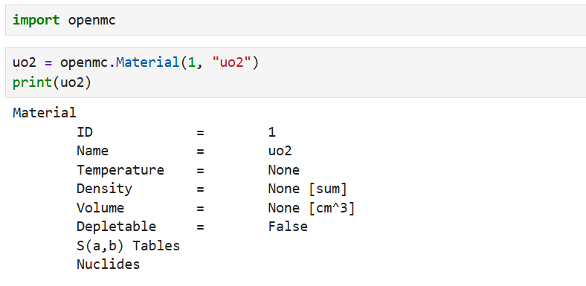
Test that it all works
Open the test director
Create a notebook called “test1.ipynb”
Write and run these lines (if you get the same result, you have succeeded)

Slide 14
A last couple notes:
You don’t need a notebook to run openmc. I prefer to code it as a .py file and to run periodically to debug, but notebooks are really helpful for learning how it all works
The openmc documentation website is a great resource, refer to that often

Slide 15
You’ve made it!
Things to remember :
How to open WSL
How to pull files from github
Be in the repository (crash_course_openmc)
git pull
How to activate the openmc environment
How to access files from the WSL filesystem
How to open jupyter notebook from WSL
cd ~/openmc
jupyter-notebook
How to import openmc into a notebook and make sure it is working

