Slide 1
OpenMC is awesome
Week 0 - Introduction

Slide 2
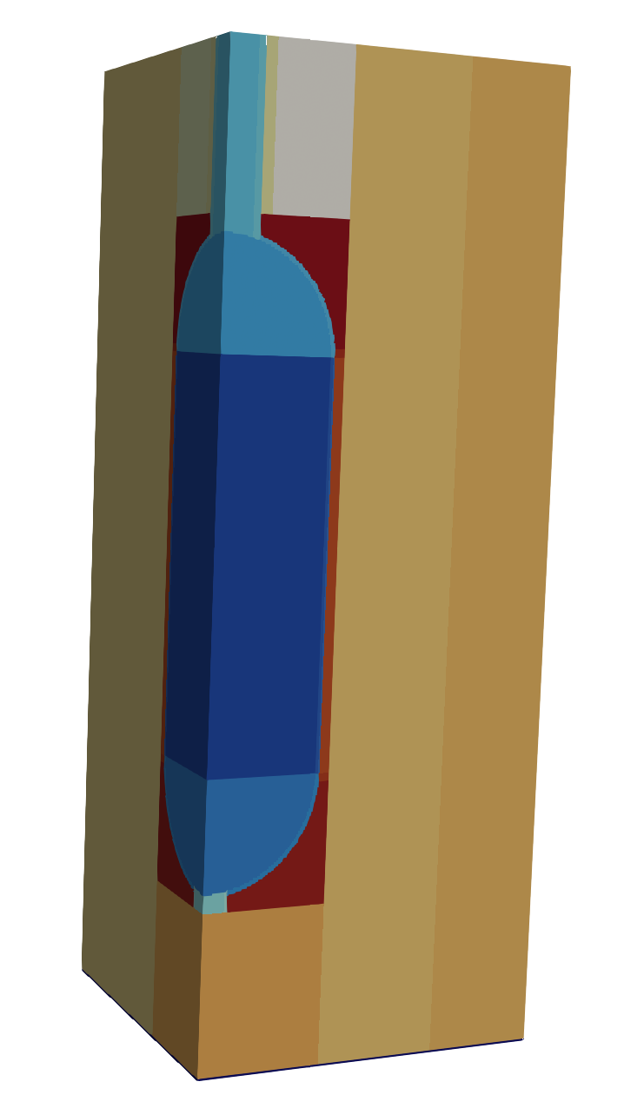
What can we do with openmc?
Model advanced reactors and fuel
Calculate reactivity (sub to supercritical)
Perform fuel lifetime composition calculations
Calculate cross sections
Measure radiation exposure
etc.

Slide 3
What is openmc?
OpenMC (Open Monte Carlo) is a method for simulating neutrons in a system
We define the system (ie. a reactor)
Statistical (Monte Carlo) vs deterministic
Track “lifetime” of a particle (neutron)
Keep track of distance traveled, energy, angle
(Measured Fundamental Data is used)
Count interactions
Repeat for millions of particles to obtain average behavior of entire system
We can calculate reactivity, fission rates, radiation, etc.
We avoid solving the transport equation:

Slide 4
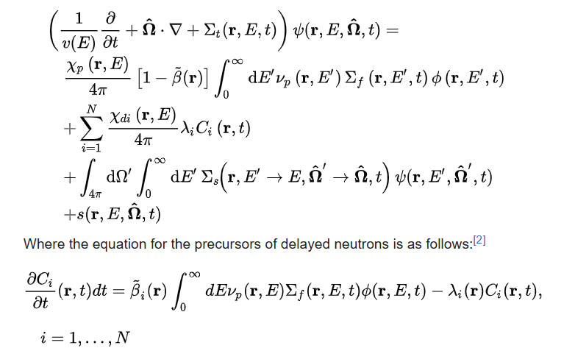
why do we want to avoid solving the transport equation?
Because it looks like this:

Slide 5
OpenMC crash course Info
Location: EB 100 (Club Commons)
Time: 7:00 – 8:30 Tuesdays (Oct 28 – Nov 25)
Contact: willm412@byu.edu

Slide 6
Structure
5 week – Once a Week Crash Course in OpenMC
Each week is a mix of:
Explanation of Theory
Explanation of Application/Syntax
Skills Practice
Everything is hosted on GitHub: https://github.com/williamhm412/crash_course_openmc
After 5 weeks anyone who would like to will collaborate on a group project where we will use our skills to create something to present at a student conference or something similar.

Slide 7
What is Covered:
Skills
Materials
Surfaces
Cells
Boundary Conditions
Sources
Universes (very basic)
Pincell Creation
Settings
Visualization
Molten Salt Reactor Creation
Tallies
Depletion
Theory
Materials
Surfaces
Cells
Boundary Conditions
Sources
Universes (very basic)
Pincell Creation
Settings
Visualization
Molten Salt Reactor Creation
Tallies
Depletion

Slide 8
Roadmap
Week 1 - Intro / Install
Week 2 – Elements of a model / Monte Carlo Background
Week 3 – Basic Model / Cross Sections
Week 4 – Visualization & Start Advanced Reactor / Monte Carlo Calculations
Week 5 – Finish Advanced Reactor / Monte Carlo Advantages and Disadvantages

