Slide 1
OpenMC is cool
Week 4 – Advanced

Slide 2
Review From Week 3
Theory
Continuous Energy & Multigroup Cross Sections
Thermal Scattering Laws
Skills (The bulk of today)
Universes
Settings
Starting a Run
Pincell Creation

Slide 3
Goals today
Theory
P tables (unresolved resonance range)
Flux and other tallies
Depletion
Skills
Visualization
Start Molten Salt Reactor Creation

Slide 4
Theory
Please stop and ask question along the way

Slide 5

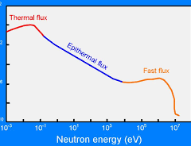

P tables (unresolved resonance range)
Unresolved Resonance Region (URR)
We understand the x-section data at low energies (characteristic, distinct peaks)
We also understand x-section data at high energies (peaks often blend into a smoothed average value)
We have a hard time characterizing x-section data at the intermediate range of neutron energies (peaks are very closely spaced and hard to characterize)
URR is from neutron energies of about 100 keV to 2 MeV (for things such as U238)

Slide 6
P tables (unresolved resonance range)
We can not resolve the resonances with our measurement techniques in this region because they are so close together
Instead we use probability tables to get statistical descriptions of this range (ie. mean level spacing, or mean resonance width)
(note: as users we aren’t going to be doing anything with ptables, but you should know that this is how Monte Carlo methods deal with those particular neutron energies)

Slide 7
Flux Tally (and other tallies)
A tally is pretty much a count of how many times something happened
The most basic tally is flux (number of neutrons passing through a unit area)
We can also tally reaction rates for any particular reaction
Common tallies to keep track of:
  Reaction Rate
  Absorption Rate
  Fission Rate
  kappa-fission (recoverable energy production rate due to fission)

Slide 8
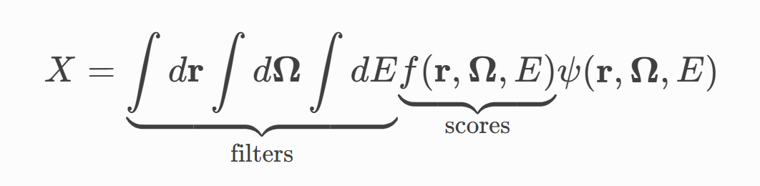

Flux Tally (and other tallies)
r | Position in space — typically a point in 3D coordinates (x, y, z) or a volume region.
Ω | Neutron direction — unit vector representing the neutron’s travel direction (angle in 3D space).
E | Neutron energy.
dr | Differential spatial volume element.
dΩ | Differential solid angle element (direction space).
dE | Differential energy element.
ψ(r,Ω,E) | Neutron angular flux — neutron flow rate through space, direction, and energy. It represents how many neutrons exist at that position, going in that direction, with that energy.
f(r,Ω,E) | Score function — describes what quantity you want to measure (e.g., flux, reaction rate, absorption, fission).
X | Final tally result — the quantity being measured (like total flux, absorption rate, dose, etc.).

Slide 9
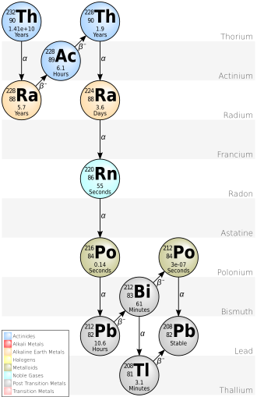
Depletion
k-eigenvalue calculations calculate the data at a given point
A depletion calculation (also called burnup calculation) will calculate nuclide densities within a material over time (ie. what is going to be in my reactor in 6 months? a year? etc.?)
A depletion is a repetition of calculating your transport equation and the transmutation equations. There are different methods for optimizing these calculations
The concentration of nuclides is calculated using data from decay chains (our OPENMC_CHAIN_FILE data that we installed in week 1 along with cross section data)
Bateman/Transmutation equations are used to solve for the change in the amount of each nuclide present over time

Slide 10
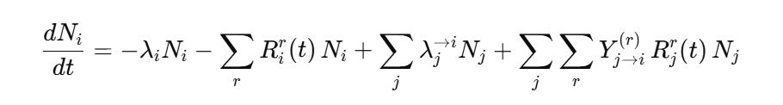
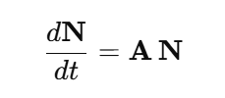
Depletion (Bateman Equations)
It’s an isotope balance
  First term = radioactive decay loss of 𝑖
  Second term = loss of 𝑖 by all neutron reactions 𝑟 (absorption, (n,2n), fission, etc.)
  Third term = production from decay of other nuclides 𝑗 into 𝑖
  Fourth term = production from neutron reactions on parent nuclides 𝑗 (including fission yields).
  You then set it up as a system of ODEs where N is a column vector containing all nuclide number densities and A is a square matrix containing info on production and losses

Slide 11
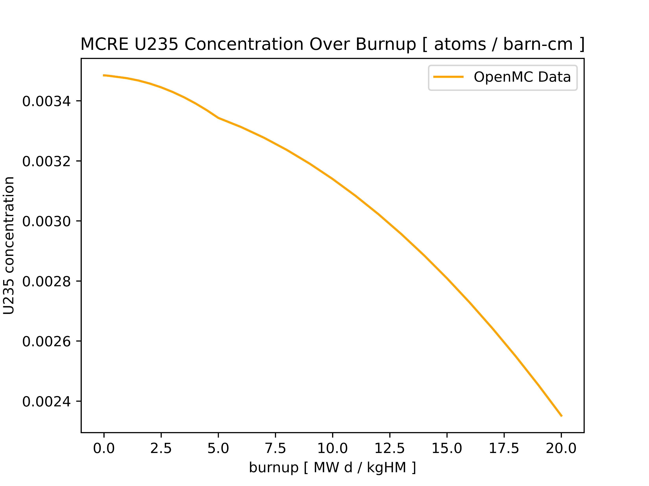
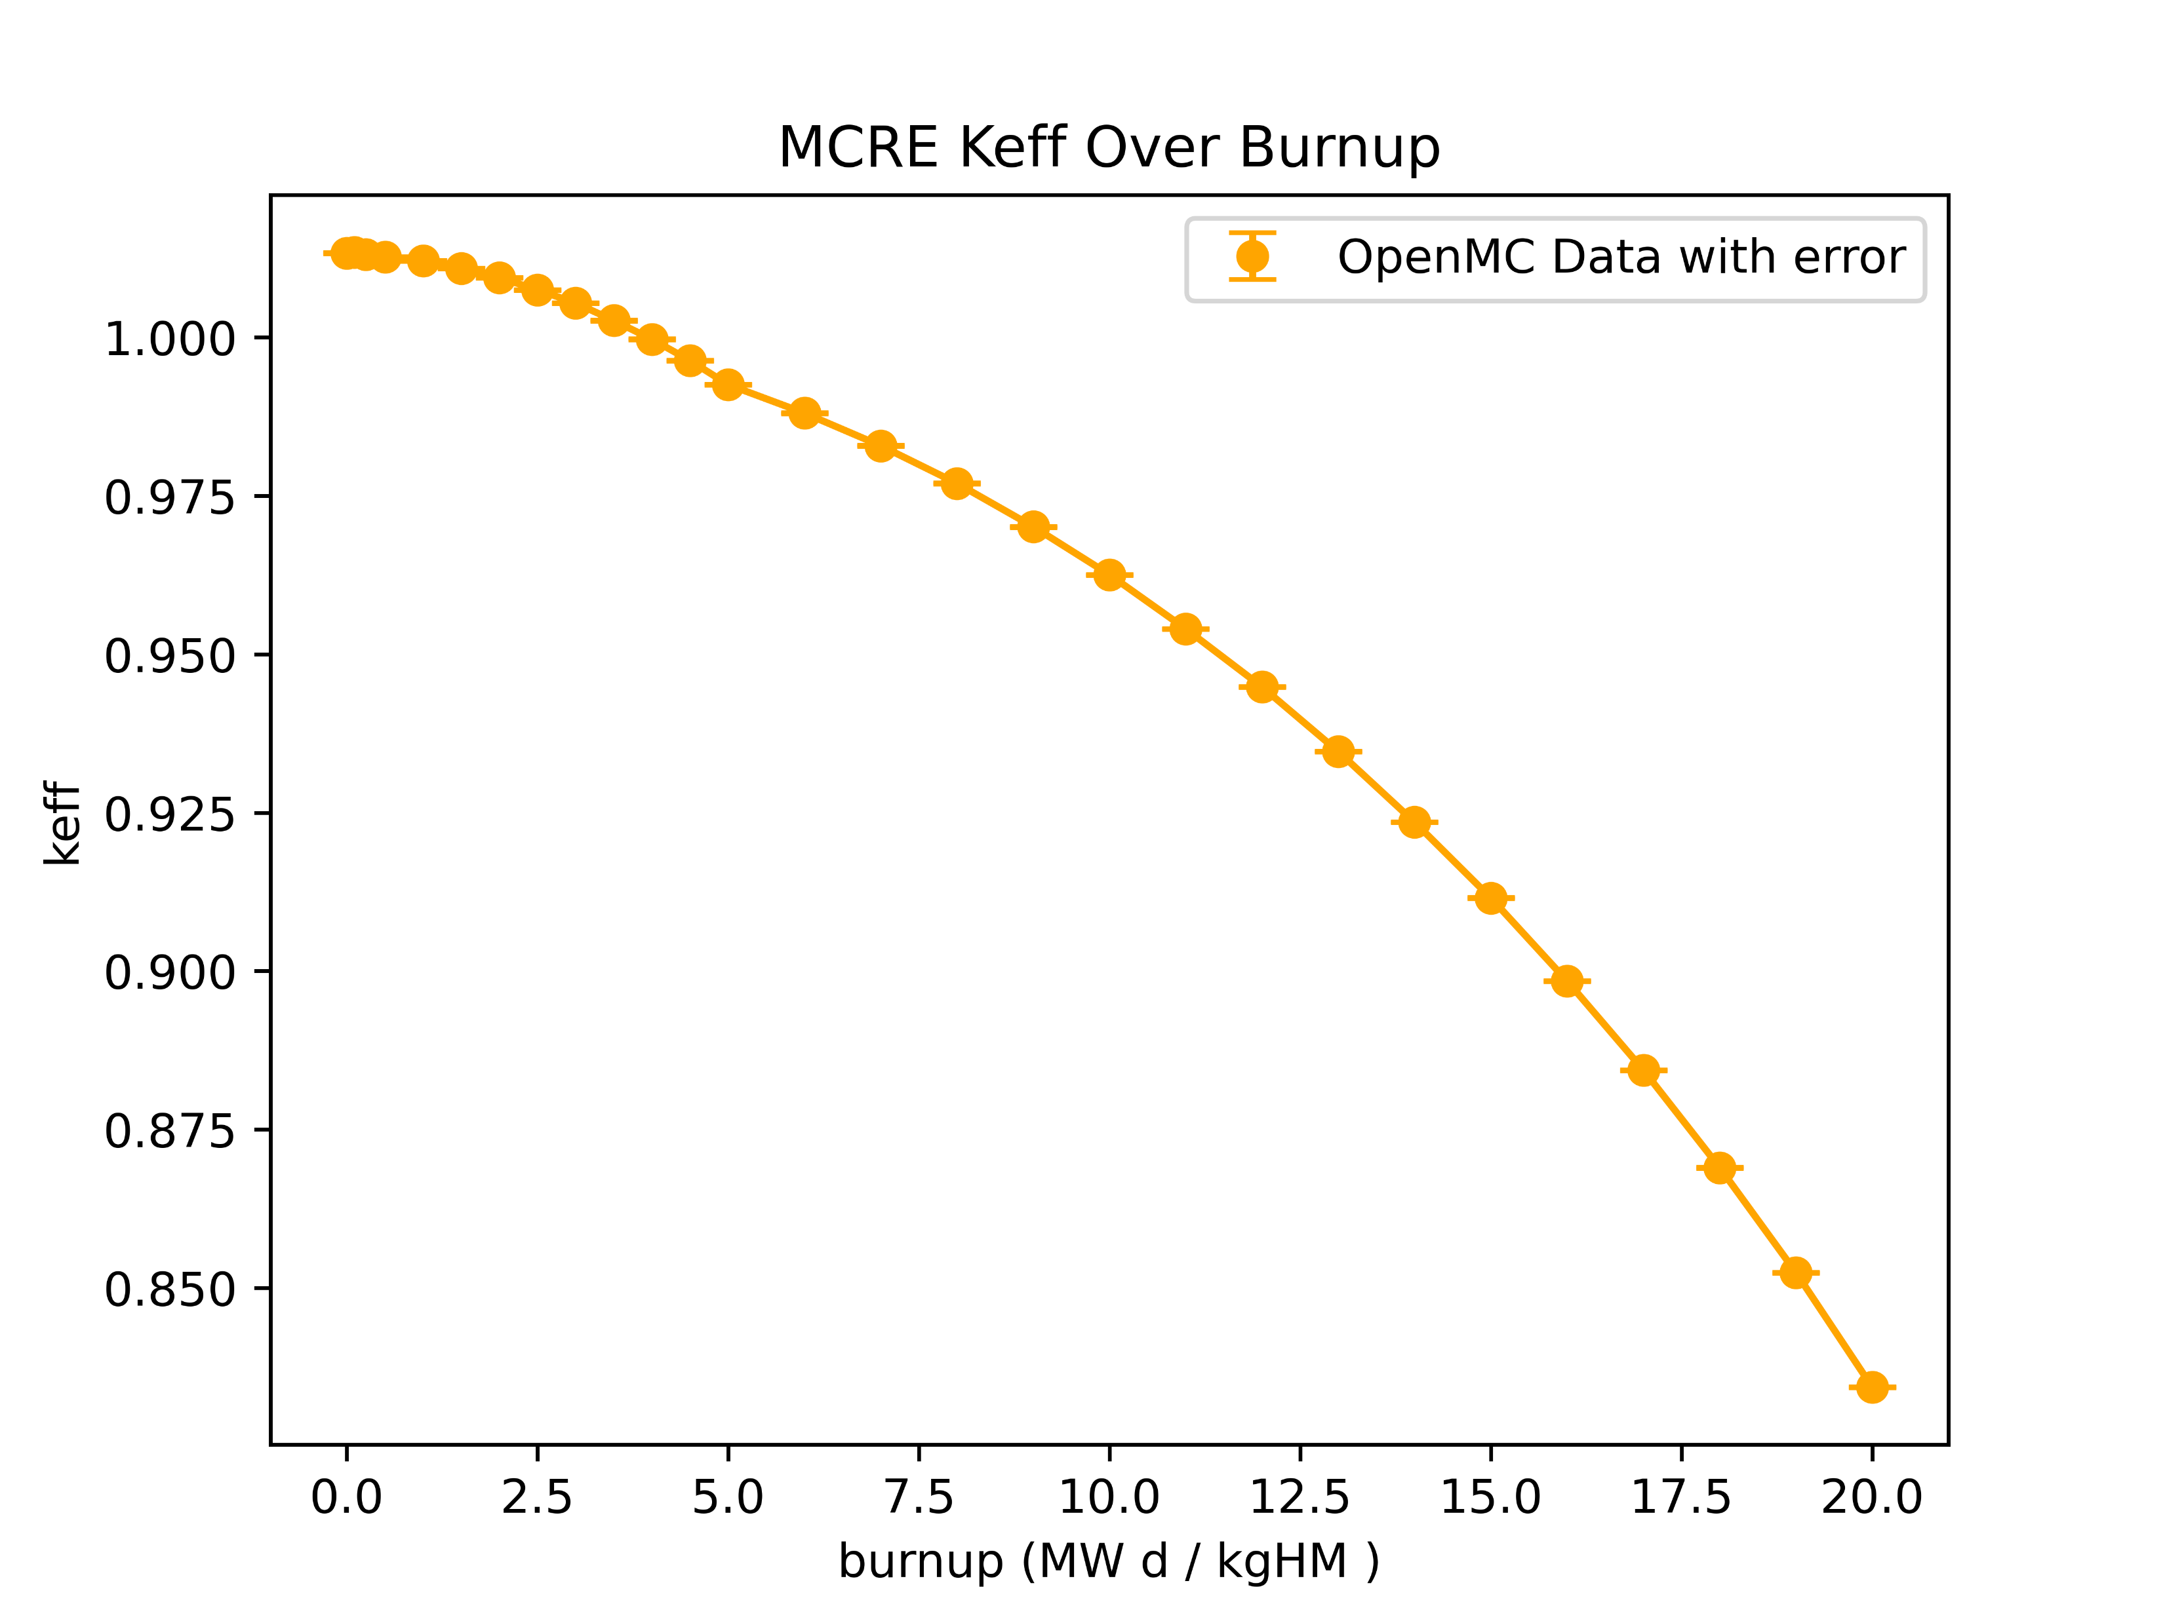
Depletion (some example data output)

Slide 12
Skills
Brief overview here, and then transition to the Jupyter Notebook

Slide 13
Visualization – Creating 2d plots
Create a plot and set the following parameters:
  basis = what plane (xy, zy, yz)
  Origin
  width
  pixels = resolution of image
  color_by = color by ‘cell’ or ‘material’ (or a couple others)
  filename

Slide 14
Visualization – creating 3d plots
A Voxel plot is a way to visualize your project in 3D
You will create a voxel plot and specify
  type = 'voxel'
  Origin → (x, y, z)
  width → (x_width, y_width, z_width)
  pixels → (x_resolution, y_resolution, z_resolution)
  Filename
Note: You will need to download ParaView (or something similar) in order to view these

Slide 15
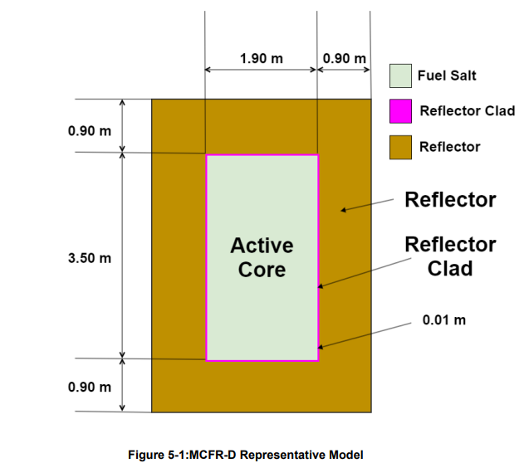
Molten Salt Reactor
MSRE-D
Image and Data From TerraPower Report

Slide 16

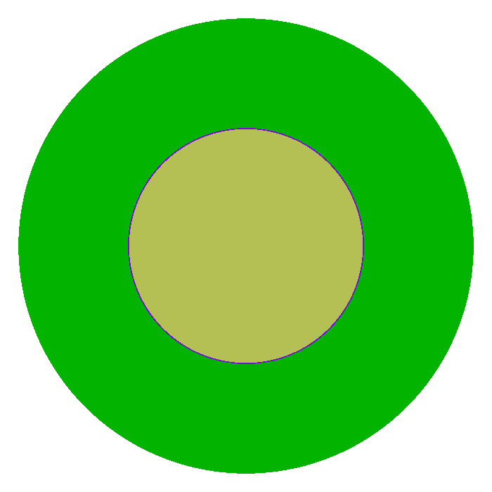

Molten Salt Reactor
MSRE-D
Image and Data From TerraPower Report

Slide 17
Apply it

Slide 18
Apply it
Go to the crash course openmc directory that you cloned from the github and type run the command “git pull” to get the most up to date version of code
Navigate to the week 4 folder >> mcfr_D >> mcfr_D.ipynb
We will walk through creation of mcfr_D all together
You will then create mcfr_C on your own
Some guidelines:
  All needed data for mcfr_C is in the TerraPower document “MCFR-ENG-PRSNT-0021Rev0-1”
  mcfr.xsls has that data systematically documented for creation of both mcfr_C and mcfr_D
  While all you need is in the excel, I recommend that you try to create the geometry on your own, and then use the excel document to check
  Avoid using AI at least while you’re learning how it works
  Also for syntax and code help refer to OpenMC documentation under users guide (https://docs.openmc.org/en/stable/usersguide/index.html) it’s very well done

