Slide 1
OPENMC IS COOL
Week 5 – Final

Slide 2
REVIEW FROM WEEK 4
Theory
P tables (unresolved resonance range)
Flux and other tallies
Depletion
Skills
Visualization
Start Molten Salt Reactor Creation

Slide 3
GOALS TODAY
Theory
Parallelization
Applications of Monte Carlo Methods
Skills
Finish Molten Salt Reactor
Tallies
Depletion

Slide 4
THEORY
Please stop and ask question along the way

Slide 5

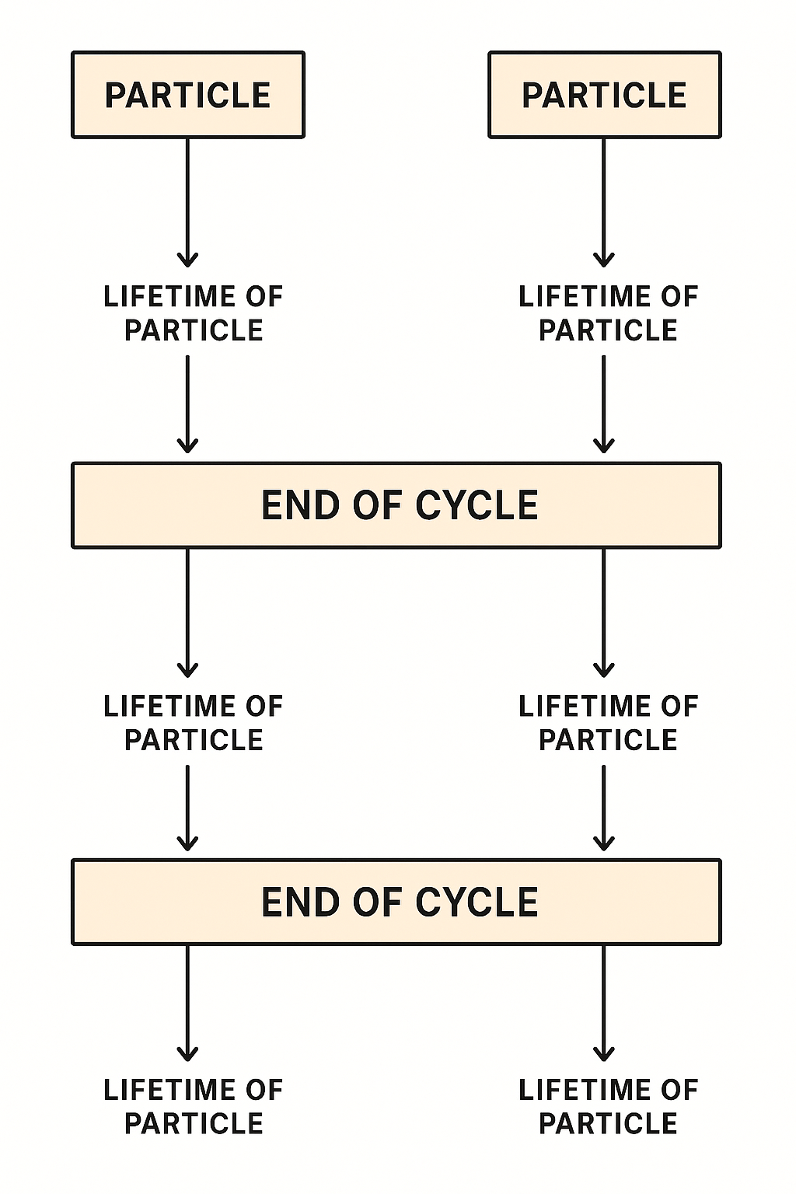

Parallelization
In each generation, the lifetime of every particle is independent of every other particle
This is good for parallel computing because a significant amount of computation is used in particle tracking and x-section look up
In order to calculate the tallies at the end of each generation, however, the data from each particle lifetime is required
Thus parallelization is done as follows:
  Geometry and nuclear data are loaded once and replicated on each process/thread
  The first cycle begins
  Particles lives/histories are tracked on separate threads
  At the end of the cycle, the threads communicate and tally data is computed
  The next cycle begins

Slide 6
Applications of Monte Carlo Methods - High Level
Nuclear Engineering (Neutron & Photon Transport)
Detector design and calibration
Cosmic ray and astrophysics simulations
Modeling of electron/photon transport in materials
Computational Chemistry
Fusion reactor design
Radiation therapy dose calculations
Imaging physics (PET/SPECT)
(Not all can be done with OpenMC, just Monte Carlo Methods)

Slide 7
Applications of Monte Carlo Methods - Neutronic Modeling
Common Monte Carlo Codes
  MCNP (Oak Ridge National Lab)
  Serpent (National Lab in Finland)
  OpenMC (Open source, Originated at MIT, contributions from labs)
  SCALE (Oak Ridge National Lab)

Slide 8
Applications of Monte Carlo Methods - OpenMC
Reactor Core Physics - model a reactor core and compute:
    multiplication factor (k-eff)
    Power distribution (axial, radial)
    Fission rate or reaction rate maps
    Flux distribution
    Component reactivity comparisons
    Fuel depletion over burnup
Fuel Assembly or Pin-Cell Calculations
    Infinite multiplication factor (k-inf)
    Doppler temperature coefficients
    Moderator temperature/void coefficients
    Effects of fuel enrichment or burnable absorbers

Slide 9
Applications of Monte Carlo Methods - OpenMC
Criticality Safety Evaluations - keff + uncertainty, sensitivity to material/geometry variations
    Fresh fuel storage racks
    Spent fuel pools
    Transport containers (dry casks, railcar transports)
    Chemical processing tanks with fissile solutions
Radiation Shielding and Dose Calculation
    Dose rate
    Shutdown dose calculations
Depletion / Burnup Studies
    Fuel isotopic evolution
    Burnup-dependent reactivity changes
    Actinide buildup and fission product poisoning
    Decay heat estimation

Slide 10
Applications of Monte Carlo Methods - OpenMC
Coupling with Thermal-Hydraulics or Fuel Performance Codes
Experiment Benchmarking
Waste classification studies
Detector design
Neutron scattering experiments
Neutron imaging and shielding problems

Slide 11
Applications of Monte Carlo Methods - OpenMC
Examples of actual things you could/would run in OpenMC
Compute keff for a 17×17 PWR assembly with various enrichments
Find radial power peaking factors in a full-core SMR model
Simulate void coefficient for a BWR at different power/flow states
Calculate dose rate behind a shielding wall
Perform burnup calculation for a pin to 60 GWd/MTU and examine isotopic buildup
Determine if a spent fuel cask is safely subcritical under flooding conditions
Run a mesh tally to compute neutron flux along a reactor vessel wall
Evaluate the reactivity worth of a control rod movement.
Run an accident scenario, like cold-water reactivity insertion, by varying moderator temperature
Generate multi-group cross section data for a deterministic core simulator

Slide 12
SKILLS
Brief overview here, and then transition to the Jupyter Notebook

Slide 13
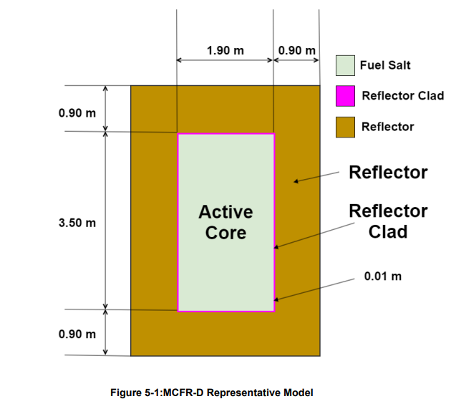

Finish Molten Salt Reactor
Last week we created a model of a Molten Chloride Reactor (MCFR-D, MCFR-C) (Image and Data From TerraPower Report)
Last week we created:
  Materials
  Geometry
  Visualization
  Settings
This week we will create:
  Tallies
  A Depletion Run

Slide 14
Tallies
Specify Filters
  Energy Filter
  Material Filter
Specify Score
  Flux
  Total Reaction Rate
  Fission Rate
  Absorption Rate
  etc. (many more)
Create tallies object and export to .xml
Post Process Tallies

Slide 15
Depletion
Specify
  Reactor power
  Timestep units (MWd/kg = MegaWatt Day / kg of Heavy Metal)
  Timesteps
  The volume of all depletable material
Pass your model into a model object
Specify your model object and depletion data in the operator object
Chose an integrator
  The integrator is pretty much which numerical method should be used. CECM is often the best operator. The simplest/fastest is usually Predictor Integrator.
Specify the operator and other settings in the integrator object and then run the depletion calculation

Slide 16
APPLY IT

Slide 17
APPLY IT
Go to the crash course openmc directory that you cloned from the github and type run the command “git pull” to get the most up to date version of code
Navigate to the week 5 folder >> mcfr_D >> mcfr_D.ipynb
We will walk through mcfr_D tallies and depletion together
You will then add tallies and depletion to your mcfr_C model from last week on your own
Some guidelines:
  Copy your last week’s MCFR_C model to the week5/MCFR_C directory and add to it
  Avoid using AI at least while you’re learning how it works
  Also for syntax and code help refer to OpenMC documentation under users guide (https://docs.openmc.org/en/stable/usersguide/index.html) it’s very well done

